Slide 1
Chapter 15 Recursion

Slide 2
Motivations
Suppose you want to find all the files under a directory that contains a particular word. How do you solve this problem? There are several ways to solve this problem. An intuitive solution is to use recursion by searching the files in the subdirectories recursively.

Slide 3
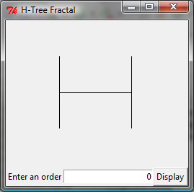
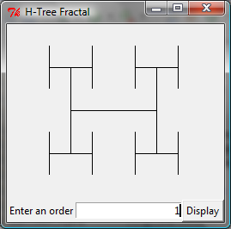
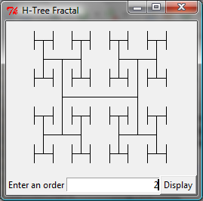
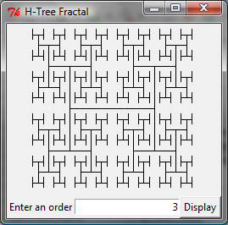
Motivations
The H-tree is used in VLSI design as a clock distribution network for routing timing signals to all parts of a chip with equal propagation delays. How do you write a program to display the H-tree? A good approach to solve this problem is to use recursion.

Slide 4
Objectives
To describe what a recursive function is and the benefits of using recursion (§15.1).
To develop recursive functions for recursive mathematical functions (§§15.2–15.3).
To explain how recursive function calls are handled in a call stack (§§15.2–15.3).
To use a helper function to derive a recursive function (§15.5).
To solve selection sort using recursion (§15.5.1).
To solve binary search using recursion (§15.5.2).
To get the directory size using recursion (§15.6).
To solve the Towers of Hanoi problem using recursion (§15.7).
To draw fractals using recursion (§15.8).
To solve the Eight Queens problem using recursion (§15.9).
To discover the relationship and difference between recursion and iteration (§15.10).
To know tail-recursive functions and why they are desirable (§15.11).

Slide 5
Computing Factorial
factorial(0) = 1;
factorial(n) = n*factorial(n-1);
n! = n * (n-1)!
ComputeFactorial

Slide 6
Computing Factorial
animation
factorial(0) = 1;
factorial(n) = n*factorial(n-1);
factorial(4)

Slide 7
Computing Factorial
animation
factorial(0) = 1;
factorial(n) = n*factorial(n-1);
factorial(4) = 4 * factorial(3)

Slide 8
Computing Factorial
animation
factorial(0) = 1;
factorial(n) = n*factorial(n-1);
factorial(4) = 4 * factorial(3)
= 4 * 3 * factorial(2)

Slide 9
Computing Factorial
animation
factorial(0) = 1;
factorial(n) = n*factorial(n-1);
factorial(4) = 4 * factorial(3)
= 4 * 3 * factorial(2)
= 4 * 3 * (2 * factorial(1))

Slide 10
Computing Factorial
animation
factorial(0) = 1;
factorial(n) = n*factorial(n-1);
factorial(4) = 4 * factorial(3)
= 4 * 3 * factorial(2)
= 4 * 3 * (2 * factorial(1))
= 4 * 3 * ( 2 * (1 * factorial(0)))

Slide 11
Computing Factorial
animation
factorial(0) = 1;
factorial(n) = n*factorial(n-1);
factorial(4) = 4 * factorial(3)
= 4 * 3 * factorial(2)
= 4 * 3 * (2 * factorial(1))
= 4 * 3 * ( 2 * (1 * factorial(0)))
= 4 * 3 * ( 2 * ( 1 * 1)))

Slide 12
Computing Factorial
animation
factorial(0) = 1;
factorial(n) = n*factorial(n-1);
factorial(4) = 4 * factorial(3)
= 4 * 3 * factorial(2)
= 4 * 3 * (2 * factorial(1))
= 4 * 3 * ( 2 * (1 * factorial(0)))
= 4 * 3 * ( 2 * ( 1 * 1)))
= 4 * 3 * ( 2 * 1)

Slide 13
Computing Factorial
animation
factorial(0) = 1;
factorial(n) = n*factorial(n-1);
factorial(4) = 4 * factorial(3)
= 4 * 3 * factorial(2)
= 4 * 3 * (2 * factorial(1))
= 4 * 3 * ( 2 * (1 * factorial(0)))
= 4 * 3 * ( 2 * ( 1 * 1)))
= 4 * 3 * ( 2 * 1)
= 4 * 3 * 2

Slide 14
Computing Factorial
animation
factorial(0) = 1;
factorial(n) = n*factorial(n-1);
factorial(4) = 4 * factorial(3)
= 4 * 3 * factorial(2)
= 4 * 3 * (2 * factorial(1))
= 4 * 3 * ( 2 * (1 * factorial(0)))
= 4 * 3 * ( 2 * ( 1 * 1)))
= 4 * 3 * ( 2 * 1)
= 4 * 3 * 2
= 4 * 6

Slide 15
Computing Factorial
animation
factorial(0) = 1;
factorial(n) = n*factorial(n-1);
factorial(4) = 4 * factorial(3)
= 4 * 3 * factorial(2)
= 4 * 3 * (2 * factorial(1))
= 4 * 3 * ( 2 * (1 * factorial(0)))
= 4 * 3 * ( 2 * ( 1 * 1)))
= 4 * 3 * ( 2 * 1)
= 4 * 3 * 2
= 4 * 6
= 24

Slide 16



Trace Recursive factorial
animation
Executes factorial(4)

Slide 17
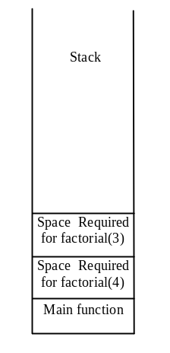
Trace Recursive factorial
animation
Executes factorial(3)

Slide 18
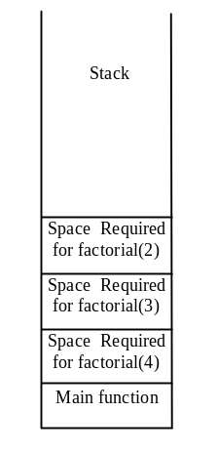
Trace Recursive factorial
animation
Executes factorial(2)

Slide 19
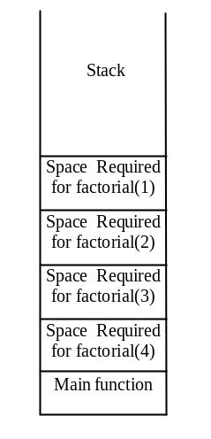
Trace Recursive factorial
animation
Executes factorial(1)

Slide 20
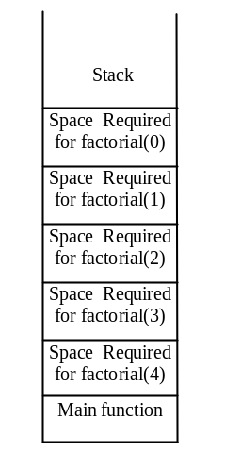
Trace Recursive factorial
animation
Executes factorial(0)

Slide 21
Trace Recursive factorial
animation
returns 1

Slide 22
Trace Recursive factorial
animation
returns factorial(0)

Slide 23
Trace Recursive factorial
animation
returns factorial(1)

Slide 24

Trace Recursive factorial
animation
returns factorial(2)

Slide 25
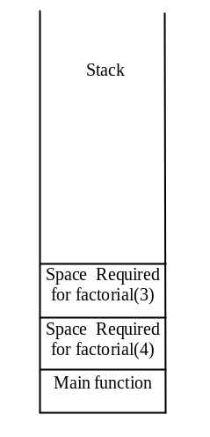
Trace Recursive factorial
animation
returns factorial(3)

Slide 26
Trace Recursive factorial
animation
returns factorial(4)

Slide 27

factorial(4) Stack Trace

Slide 28
Other Examples
f(0) = 0;
f(n) = n + f(n-1);

Slide 29
Fibonacci Numbers
Fibonacci series: 0 1 1 2 3 5 8 13 21 34 55 89…
indices: 0 1 2 3 4 5 6 7 8 9 10 11
fib(0) = 0;
fib(1) = 1;
fib(index) = fib(index -1) + fib(index -2); index >=2
fib(3) = fib(2) + fib(1) = (fib(1) + fib(0)) + fib(1) = (1 + 0) +fib(1) = 1 + fib(1) = 1 + 1 = 2
ComputeFabonacci

Slide 30

Fibonnaci Numbers, cont.

Slide 31
Characteristics of Recursion
All recursive functions have the following characteristics:
  One or more base cases (the simplest case) are used to stop recursion.
  Every recursive call reduces the original problem, bringing it increasingly closer to a base case until it becomes that case.
In general, to solve a problem using recursion, you break it into subproblems. If a subproblem resembles the original problem, you can apply the same approach to solve the subproblem recursively. This subproblem is almost the same as the original problem in nature with a smaller size.

Slide 32
Problem Solving Using Recursion
Let us consider a simple problem of printing a message for n times. You can break the problem into two subproblems: one is to print the message one time and the other is to print the message for n-1 times. The second problem is the same as the original problem with a smaller size. The base case for the problem is n==0. You can solve this problem using recursion as follows:
def nPrintln(message, times):
if times >= 1:
print(message)
nPrintln(message, times - 1)
# The base case is times == 0

Slide 33
Think Recursively
Many of the problems presented in the early chapters can be solved using recursion if you think recursively. For example, the palindrome problem in Listing 8.1 can be solved recursively as follows:
def isPalindrome(s):
if len(s) <= 1: # Base case
return True
elif s[0] != s[len(s) - 1]: # Base case
return False
else:
return isPalindrome(s[1 : len(s) – 1])

Slide 34
Recursive Helper Functions
The preceding recursive isPalindrome function is not efficient, because it creates a new string for every recursive call. To avoid creating new strings, use a helper function:
def isPalindrome(s):
return isPalindromeHelper(s, 0, len(s) - 1)
def isPalindromeHelper(s, low, high):
if high <= low: # Base case
return True
elif s[low] != s[high]: # Base case
return False
else:
return isPalindromeHelper(s, low + 1, high - 1)

Slide 35
Recursive Selection Sort
Find the smallest number in the list and swaps it with the first number.
Ignore the first number and sort the remaining smaller list recursively.
RecursiveSelectionSort

Slide 36
Recursive Binary Search
Case 1: If the key is less than the middle element, recursively search the key in the first half of the array.
Case 2: If the key is equal to the middle element, the search ends with a match.
Case 3: If the key is greater than the middle element, recursively search the key in the second half of the array.
RecursiveBinarySearch

Slide 37
Recursive Implementation
def recursiveBinarySearch(list, key):
low = 0
high = len(list) - 1
return recursiveBinarySearchHelper(list, key, low, high)
def recursiveBinarySearchHelper(list, key, low, high):
if low > high: # The list has been exhausted without a match
return -low - 1
mid = (low + high) // 2
if key < list[mid]:
return recursiveBinarySearchHelper(list, key, low, mid - 1)
elif key == list[mid]:
return mid
else:
return recursiveBinarySearchHelper(list, key, mid + 1, high)
def main():
list = [3, 5, 6, 8, 9, 12, 34, 36]
print(recursiveBinarySearch(list, 3))
print(recursiveBinarySearch(list, 4))
main()

Slide 38
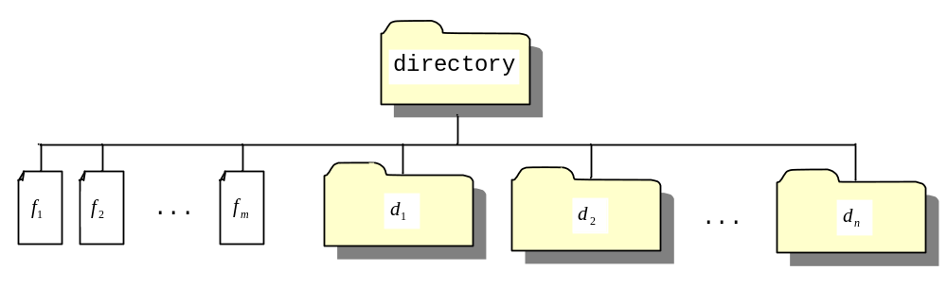
Directory Size
The preceding examples can easily be solved without using recursion. This section presents a problem that is difficult to solve without using recursion. The problem is to find the size of a directory. The size of a directory is the sum of the sizes of all files in the directory. A directory may contain subdirectories. Suppose a directory contains files , , ..., , and subdirectories , , ..., , as shown below.

Slide 39
Directory Size
The size of the directory can be defined recursively as follows:
DirectorySize

Slide 40
Towers of Hanoi
There are n disks labeled 1, 2, 3, . . ., n, and three towers labeled A, B, and C.
No disk can be on top of a smaller disk at any time.
All the disks are initially placed on tower A.
Only one disk can be moved at a time, and it must be the top disk on the tower.

Slide 41
Tower of Hanoi Animation
animation
https://liveexample.pearsoncmg.com/dsanimation/TowerOfHanoi.html

Slide 42
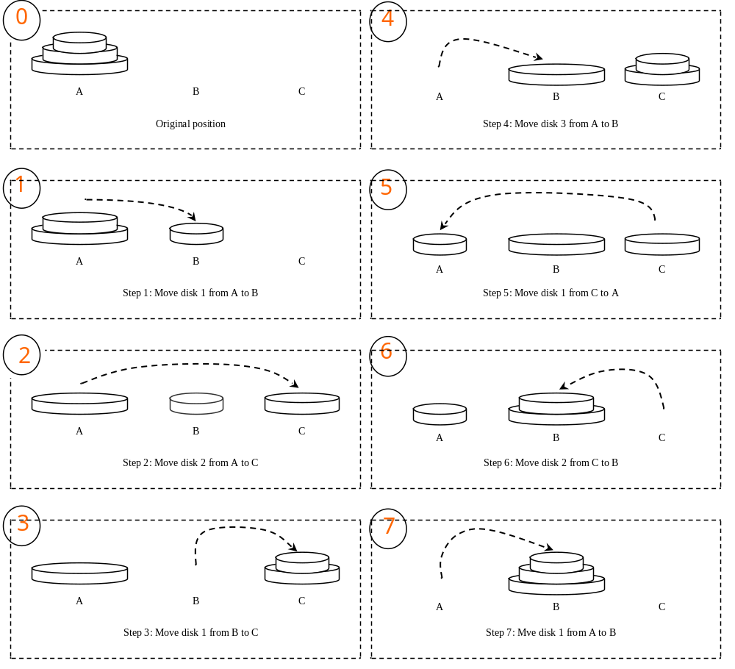
Towers of Hanoi, cont.

Slide 43
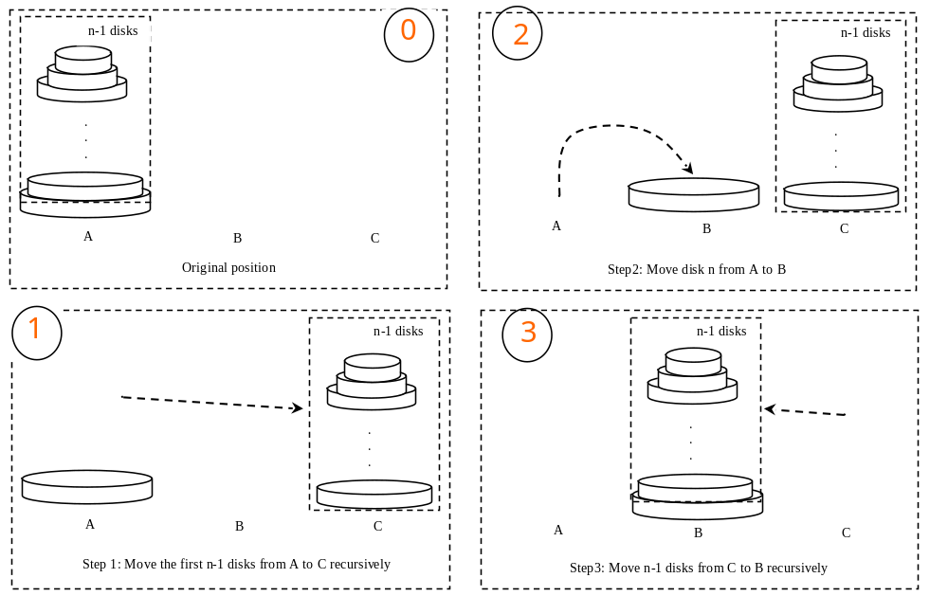
Solution to Towers of Hanoi
The Towers of Hanoi problem can be decomposed into three subproblems.

Slide 44
Solution to Towers of Hanoi
Move the first n - 1 disks from A to C with the assistance of tower B.
Move disk n from A to B.
Move n - 1 disks from C to B with the assistance of tower A.
TowersOfHanoi

Slide 45
Fractals?
A fractal is a geometrical figure just like triangles, circles, and rectangles, but fractals can be divided into parts, each of which is a reduced-size copy of the whole. There are many interesting examples of fractals. This section introduces a simple fractal, called Sierpinski triangle, named after a famous Polish mathematician.

Slide 46
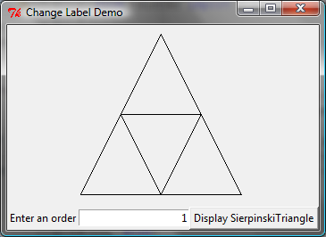
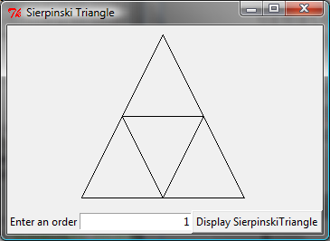
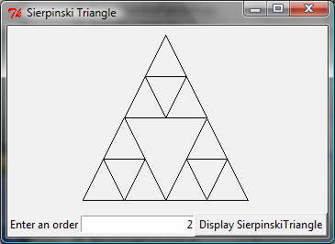
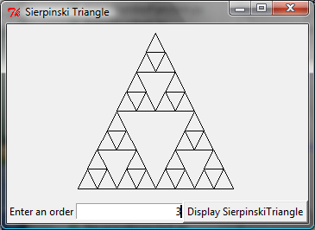
Sierpinski Triangle
It begins with an equilateral triangle, which is considered to be the Sierpinski fractal of order (or level) 0, as shown in Figure (a).
Connect the midpoints of the sides of the triangle of order 0 to create a Sierpinski triangle of order 1, as shown in Figure (b).
Leave the center triangle intact. Connect the midpoints of the sides of the three other triangles to create a Sierpinski of order 2, as shown in Figure (c).
You can repeat the same process recursively to create a Sierpinski triangle of order 3, 4, ..., and so on, as shown in Figure (d).

Slide 47
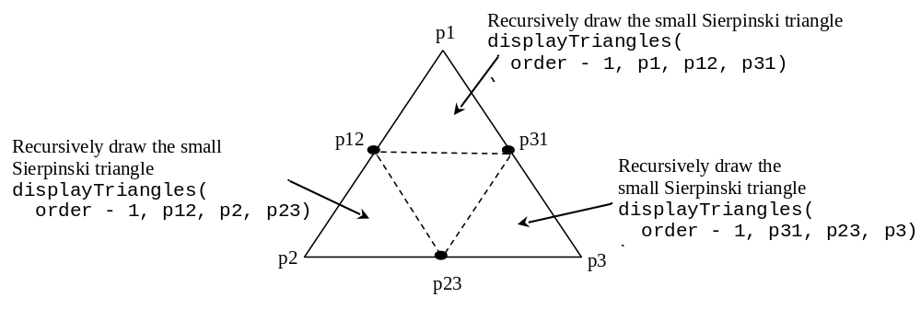
Sierpinski Triangle Solution
SierpinskiTriangle

Slide 48
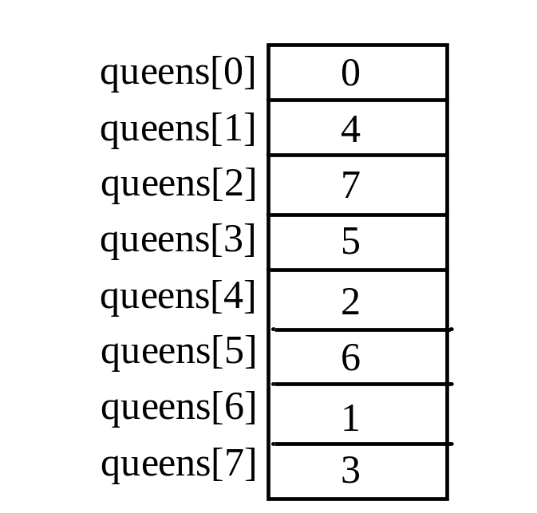
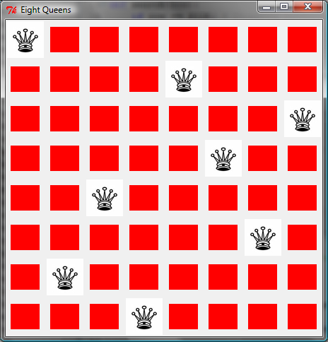
Eight Queens
EightQueens

Slide 49
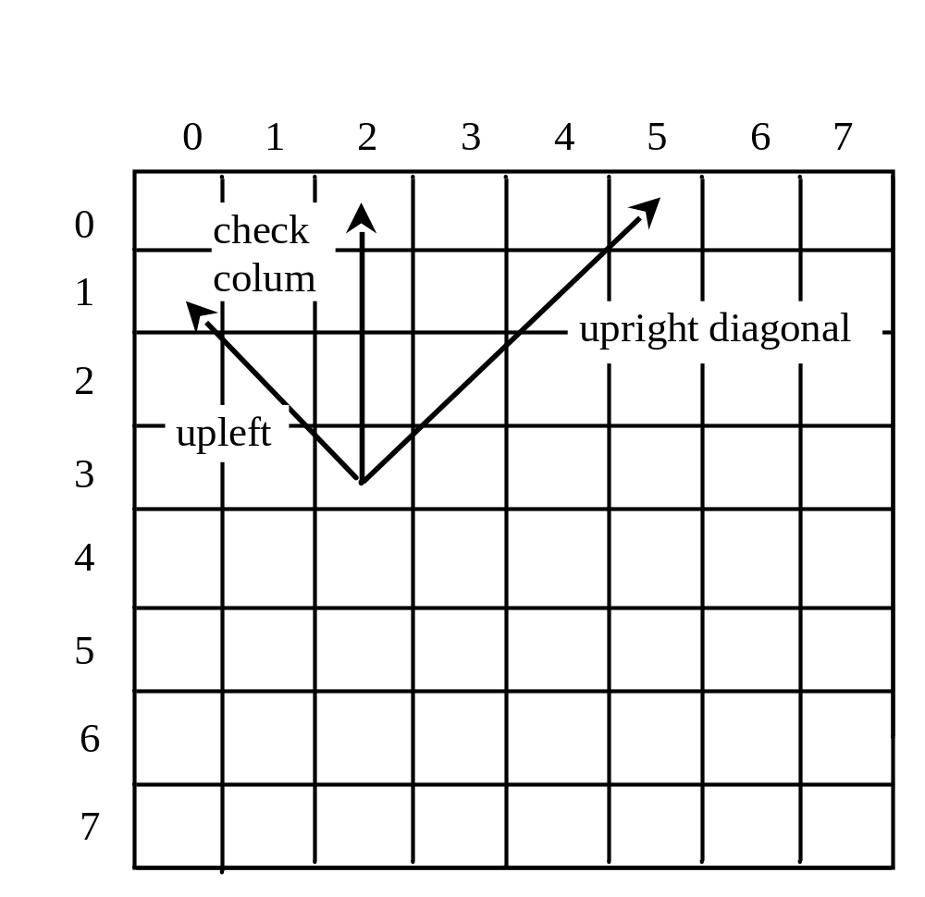
Eight Queens

Slide 50
Recursion vs. Iteration
Recursion is an alternative form of program control. It is essentially repetition without a loop.
Recursion bears substantial overhead. Each time the program calls a function, the system must assign space for all of the function’s local variables and parameters. This can consume considerable memory and requires extra time to manage the additional space.

Slide 51
Advantages of Using Recursion
Recursion is good for solving the problems that are inherently recursive.

Slide 52
Tail Recursion
A recursive function is said to be tail recursive if there are no pending operations to be performed on return from a recursive call.
Non-tail recursive
ComputeFactorial
Tail recursive
ComputeFactorialTailRecursion

