Slide 1
Simulation, Pricing and Validation of an Atlas Option
Completed by :
Robert Cook
Georgios Kepertis
Bhavin Shah

Slide 2
What is an Atlas Option?
The Atlas option is a call on the mean of a basket of stocks, a basket that has some of the best and worst performers removed.
The number of stocks at the top and bottom of the basket to be removed can be varied.
It is one of many exotic options that come under Mountain Range options
An important feature of this option is that the payoff is expressed as a percent of a reference, usually taken as an index.

Slide 3
Pros
Cons
Less transaction costs : One transaction instead of having to take individual trades on every position in the basket
Eliminate the risk associated with entry and exit timing
Offer flexibility and customization, hence can be tweaked as per risk-preference
Less liquidity available as compared to vanilla options
Price of the option might not correlate or trade in the same manner as the individual components would to price fluctuations or the time remaining until expiration
Higher premium than vanilla options

Slide 4
Assumptions
The risk-free rate is constant
Volatility used in the Black-Scholes model is annualized realized volatility
There are no transaction costs
Returns are normally distributed
Covariance matrix is created so that it is full-rank by construction

Slide 5
Methodology
Gather price data for the basket of stocks
Compute the returns, correlation matrix, covariance matrix
Simulate prices for the basket of stocks
Using these simulated paths, we price the Atlas option based on how many best-performing and worst-performing stocks we want to remove
Obtain plots that help explain the behavior of the price of the option under various scenarios

Slide 6
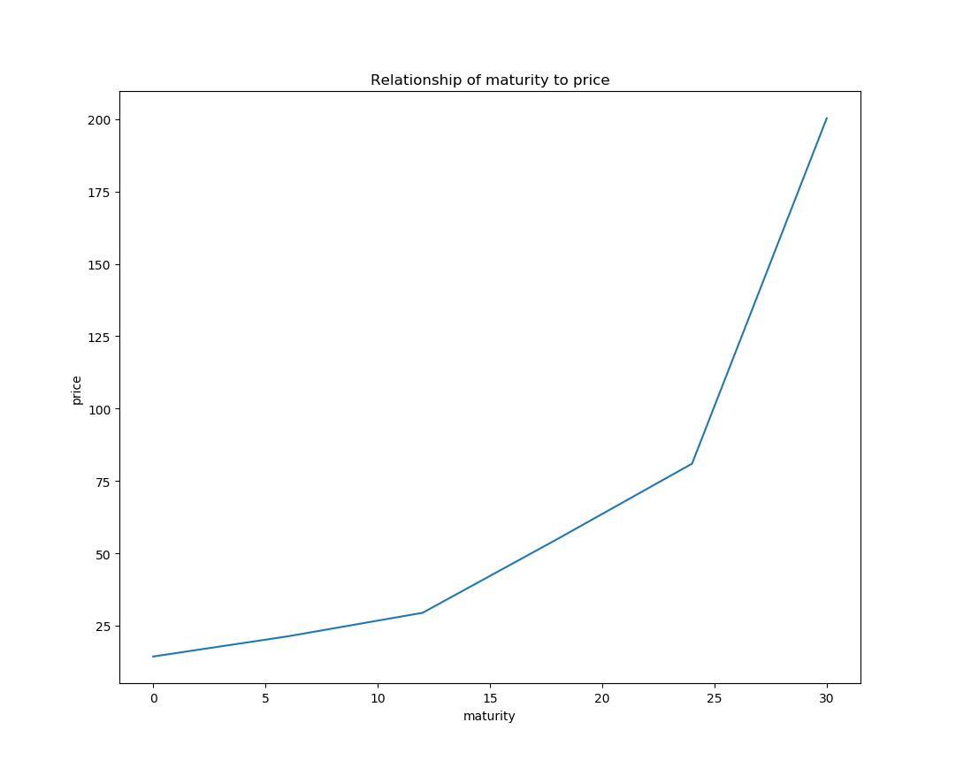
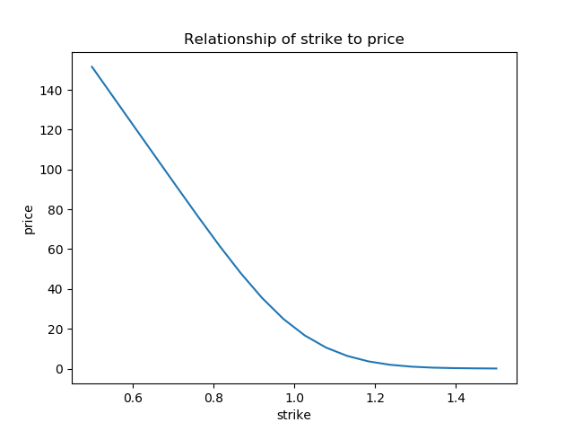
Examples

Slide 7
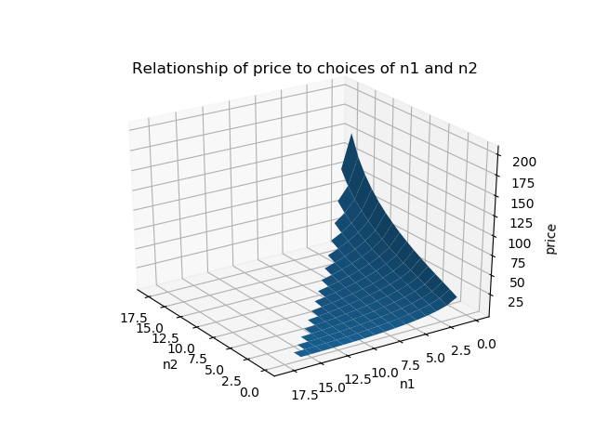
Examples

