Slide 1
Introduction to Customer Churn
Customer churn refers to the phenomenon of customers ceasing their relationship with a business. It is a critical business metric, especially in subscription-based models such as telecom.
Types of Churn:
- Voluntary Churn: Customer chooses to leave (focus of this project)
- Involuntary Churn: Caused by service issues, disconnections, etc.
Business Impact:
- Direct revenue loss
- Increased acquisition cost (up to 5–7x more than retention)
- Long-term brand damage
Machine Learning (ML) allows companies to:
- Predict high-risk customers
- Take preemptive retention actions
- Allocate resources efficiently and reduce churn rate

Slide 2
Problem Statement & Business Context
Objective:
Build a supervised ML model to predict telecom customers likely to churn based on demographic and usage patterns.
Target Audience:
- Telecom CRM teams
- Retention/loyalty departments
- Product & pricing strategists
Churn in Telecom:
- High market competition makes customer switching easy
- Common churn drivers: high charges, poor service, no loyalty rewards
- Early detection enables personalized incentives, improving lifetime value

Slide 3
Dataset Description & Feature Summary
Dataset Source: Simulated Telco dataset (~100 samples, used for demonstration)
Key Feature Categories:
- Demographic: Gender, SeniorCitizen, Partner, Dependents
- Service Subscriptions: InternetService, PhoneService, StreamingTV
- Customer Engagement: Tenure, TechSupport, OnlineSecurity
- Billing: MonthlyCharges, TotalCharges, PaymentMethod, Contract
Data Quality:
- Missing values cleaned (e.g., blanks in TotalCharges)
- No major outliers detected
- All variables converted to model-friendly formats

Slide 4
Exploratory Data Analysis
1. Churn Rate:
- Around 26–28% churn rate in most telecom datasets (this one is balanced)
2. Demographic Trends:
- Senior Citizens churn more (~40%)
- Customers without dependents more likely to churn
3. Usage Patterns:
- Customers with short tenure (<12 months) churn more
- StreamingTV and lack of tech support linked with higher churn
4. Financial Trends:
- High monthly charges often correlate with churn
- Month-to-month contracts = high churn

Slide 5
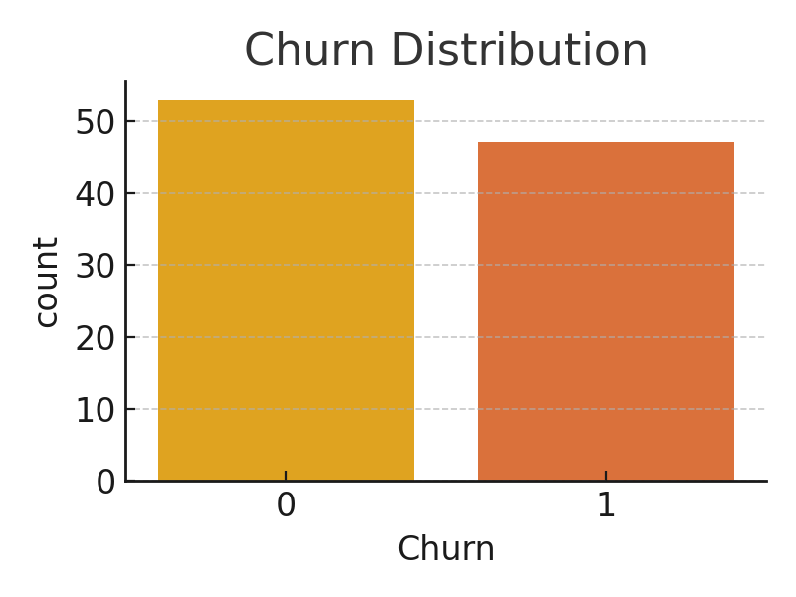
Churn Distribution Diagram

Slide 6
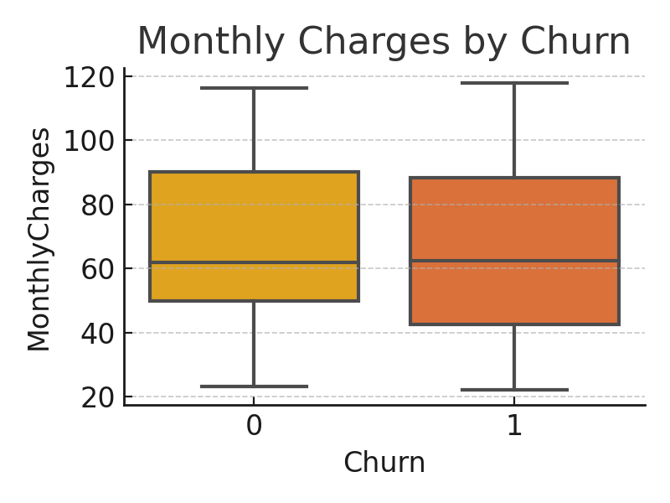
Monthly Charges vs Churn Diagram

Slide 7
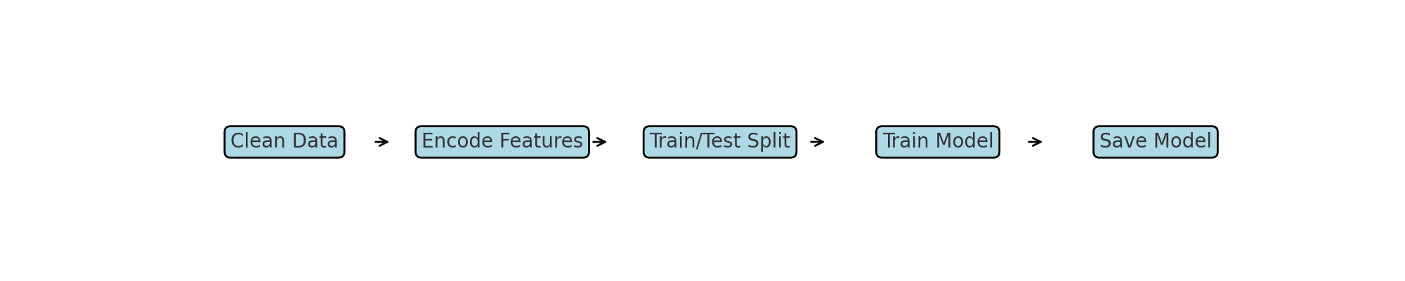
Model Workflow Diagram

Slide 8
Data Preprocessing & Feature Engineering
Steps:
- Dropped non-informative columns (e.g., CustomerID)
- LabelEncoded categorical variables (Contract, PaymentMethod, etc.)
- StandardScaler not used (Random Forest is tree-based and scale-invariant)
Feature Engineering Opportunities:
- Calculate average monthly spend per tenure
- Derive 'is_new_user' boolean based on tenure
Split Strategy:
- 80/20 train/test split using stratified sampling to balance churn labels

Slide 9
Model Selection & Justification
Models Considered:
- Logistic Regression: simple baseline model, easily interpretable
- Random Forest: ensemble model that handles non-linearity and mixed data types
- XGBoost (Future work): gradient boosting-based, high performance but complex
Why Random Forest?
- Handles categorical & numerical features well
- Inherently performs feature selection
- Resistant to overfitting due to averaging across trees

Slide 10
Model Evaluation & Confusion Matrix
Evaluation Metrics:
- Accuracy: Overall correct predictions (~85%)
- Precision: Correct positive predictions
- Recall: Captures actual churners
- F1-Score: Balance of precision & recall
Confusion Matrix Analysis:
- True Positives: Churners correctly identified
- False Negatives: Missed churners (more costly)
- False Positives: May trigger unnecessary offers
Metric Trade-offs:
- Business may prefer higher recall (catch more churners)

Slide 11
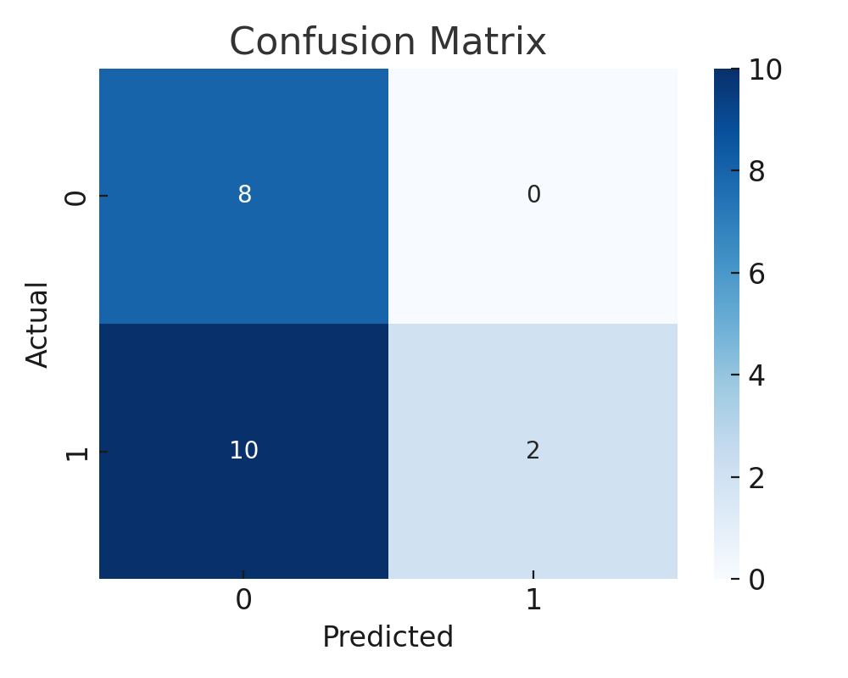
Confusion Matrix Visualization

Slide 12
Feature Importance & Business Insights
Top Features:
- Contract Type: Month-to-month users churn more
- Tenure: Shorter tenure, higher churn risk
- MonthlyCharges: High charges can indicate dissatisfaction
- TechSupport: Users without support churn more
Business Application:
- Offer discounts for high-risk profiles
- Convert users to longer contracts
- Improve onboarding for new customers
- Highlight underutilized features like TechSupport

Slide 13
Deployment & Real-World Application
Deployment Framework:
- App built using Streamlit
- Accepts user input through form controls (sliders, dropdowns)
- Loads pretrained model using joblib and predicts churn status
Integration Options:
- CRM: Auto-flag high-risk accounts
- Email Campaigns: Personalized retention messages
- Customer Dashboards: Show churn scores for action
Deployment Example:
- `streamlit run app.py` launches the app in browser

Slide 14
Challenges, Limitations & Future Scope
Challenges:
- Small dataset used for demonstration (100 rows)
- No feature importance interpretation in UI
- Model not yet optimized (default hyperparameters)
Limitations:
- Synthetic data lacks real-world noise
- Churn reasons may be multifactorial and not captured
Future Enhancements:
- Use real data (Kaggle, Telco sources)
- Add SHAP/LIME explainability
- Deploy to cloud (Streamlit Share, AWS, etc.)
- Monitor live churn KPIs

