Slide 1
Movie Box-office Success Forecaster
Praveen Singh Samota - 2020104
Bhavishi Bansal - SP22001
Vardhana Sharma - SP22003
Pragya Singh - 2017305

Slide 2
Abstract : Motivation
The silver screen industry is a billion-dollar industry with the extensive involvement of various stakeholders. In 2019, the global box office was worth $42.2 Billion. The movie industry is a massive sector for investment but larger business sectors have more complexity, and it is hard to choose how to invest. Furthermore, significant investments come with more significant risks. Through this project, we want to explore ML models that help us successfully predict the box office performance of movies.

Slide 3
Introduction
Predicting the success of a movie is a complicated process. We can consider a lot of variables based on which we can say it was successful, for example, good critic reviews and reaction from the audience. Here, we’ll examine the box office revenue to conclude whether the movie was successful or not.

Slide 4
Literature Survey
Paper 1: N. Quader, M. O. Gani, D. Chaki and M. H. Ali, "A machine learning approach to predict movie box-office success," 2017 20th International Conference of Computer and Information Technology (ICCIT), 2017
(https://ieeexplore.ieee.org/document/8281839)
The paper proposes a decision support system for movie investment sector using machine learning techniques such as ​​Support Vector Machine (SVM), Neural Networks and Natural Language Processing; the system predicts a movie box office profit based on some pre-released features and post-released features. The target class is divided into five categories based on the revenue the movie generates.

Slide 5
Paper 2:- Jatale, Sanyam & Moze, Rohan & Khandekar, Varsha & Jain, Shubham & Mokate, Sanket. (2021). Analyzing and Predicting The Success of Box Office Collection of a Movie Using Machine Learning. International Journal of Advanced Research in Science, Communication and Technology.
http://ijarsct.co.in/A1392.pdf
This paper, builds a prediction model using machine learning techniques such as random forest classifiers, decision trees, and regression models. The authors examined a lot of previous work on this problem and arrived at a point to include new features to increase efficiency. Social media likes are one of the highlights of this paper; facebook numbers of directors, actors and movie pages are considered as features. Instead of focusing on the gross income of the movie as a target value only, the authors considered the IMDb score as well

Slide 6
Dataset Description
The dataset contains 5043 movies retrieved from the IMDb dataset present on Kaggle. The features are:- color, movie title, director name, critic numbers for reviews, duration, director’s facebook likes, actor 1/2/3 facebook likes and names, gross revenue generated,number of voted users, facenumber in poster, plot keywords, movie imdb link, number of user reviews, language, country, content rating budget, year of release, aspect ratio, movie’s facebook page likes, and IMDb score.

Slide 7
Preprocessing
Duplicate entries were deleted, and numerical and categorical columns were identified to treat them separately. In categorical features, null values were recognized, first of all, several color values were null, and they were replaced with the mode value of the feature. Rows with empty actor names were identified with their titles and replaced with the appropriate names we found using the internet. In the same way, we filled up the values of empty language and country rows. After that, the rows still left with null values in categorical columns were dropped. Similarly, the null values were checked for numerical features. Duration got only one row with empty value, we replaced it with the duration time available on the IMDb page of the movie.

Slide 8
Data visualization and methodology
Our Goal is to build a machine-learning model to predict the success/revenue of a new movie given such features as budget, release dates, and genres. A conclusive note based on model training and testing process with some detailed insights on the tested data.

Slide 9
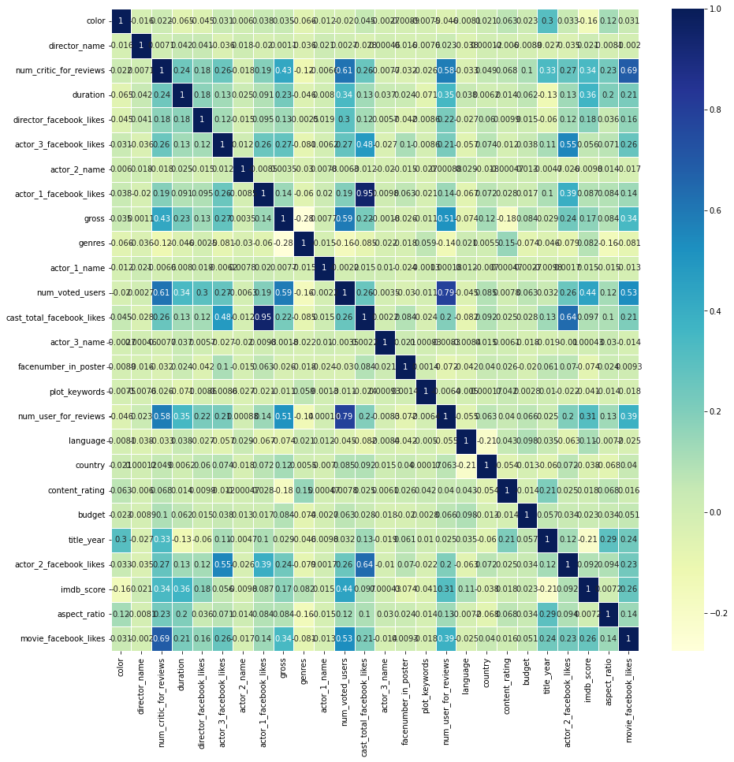
Seaborn correlation matrix

Slide 10
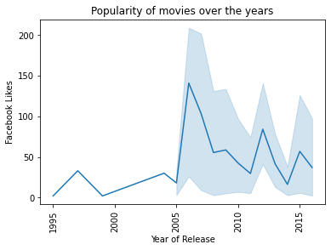
Popularity of movies over the years

Slide 11
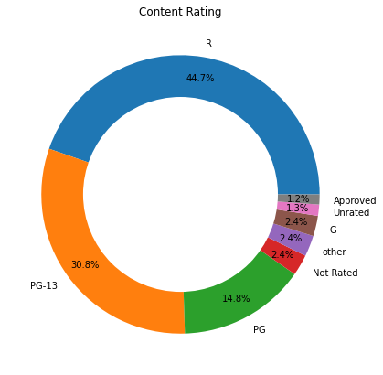
Content Rating Pie Chart

Slide 12
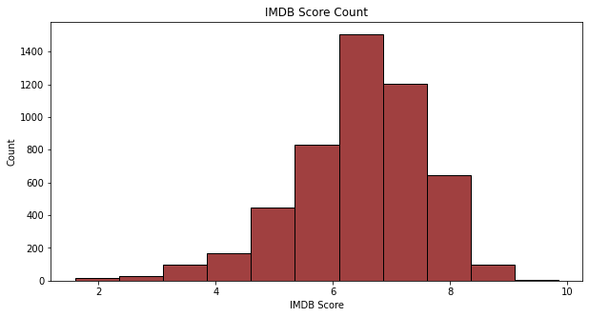
IMDb score count

Slide 13
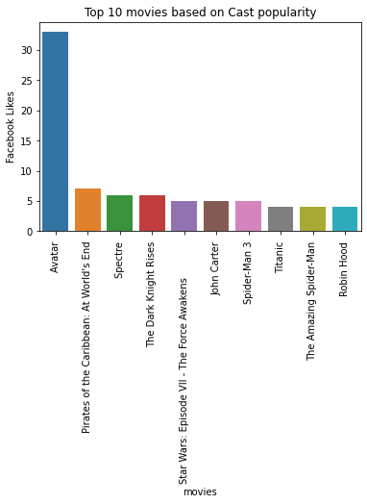
Top 10 movies based on Cast Popularity

Slide 14
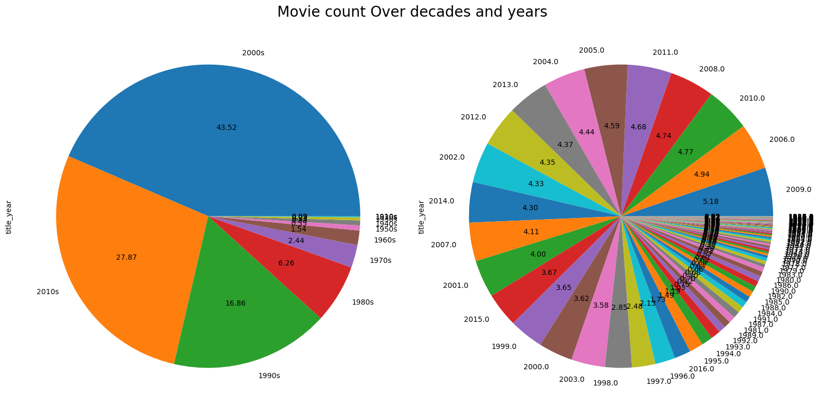

Slide 15
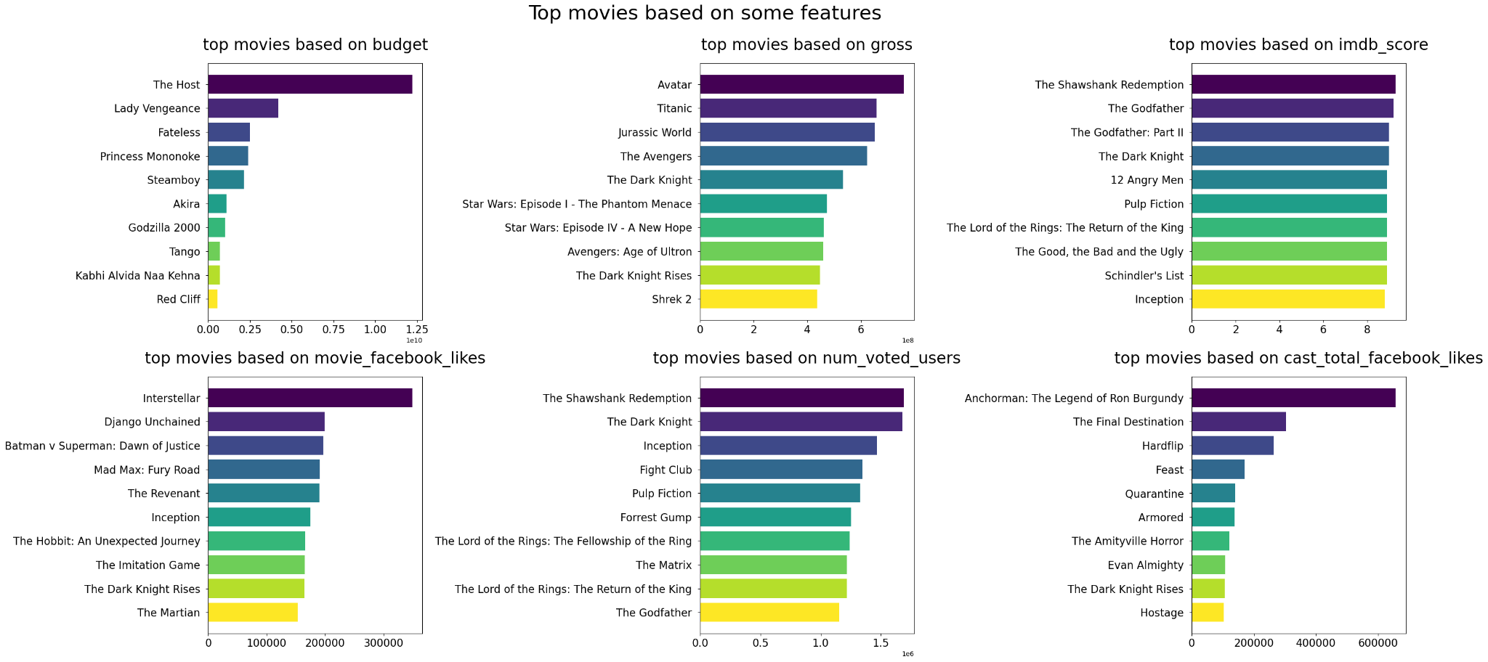
Top movies based on some features

Slide 16
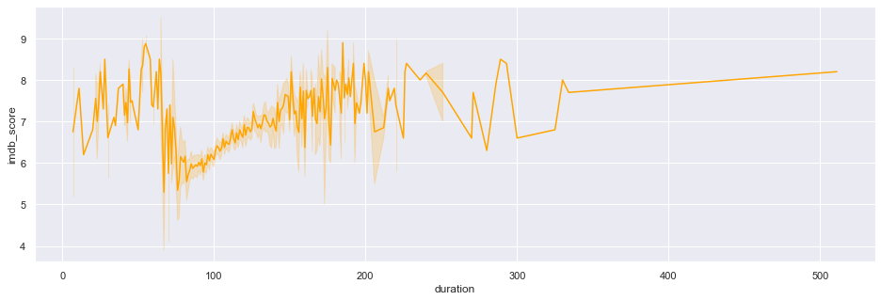
IMDb Score vs Duration

Slide 17
Results and Analysis
We decided to create models based on two different features, i.e. IMDb score and gross revenue generated. The reason is, a movie can be successful in one of two terms, it doesn’t need to be financially successful to get a good audience rating.
Implemented various models - logistic regression, random forest, gradient boosting, ada boosting, decision tree (gini and entropy), Naive Bayes, Support Vector Machine, and KNeighbors Classification.

Slide 18
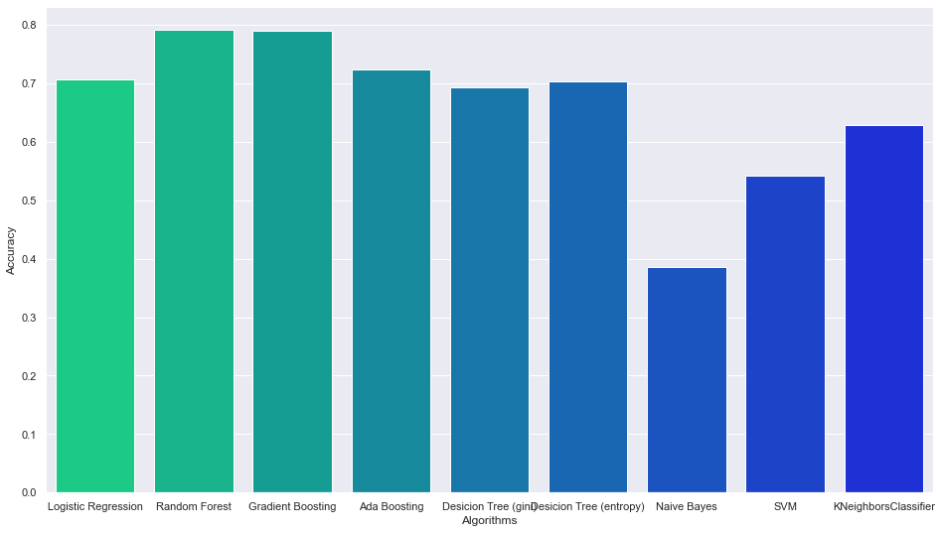
IMDb Score as Target Variable

Slide 19
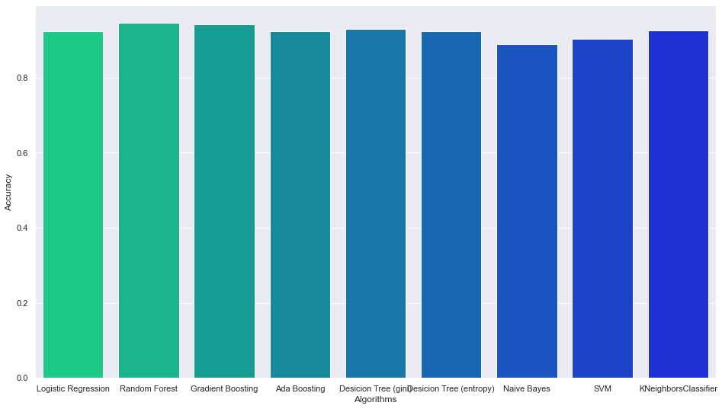
Gross Revenue Generated as Target Variable

Slide 20
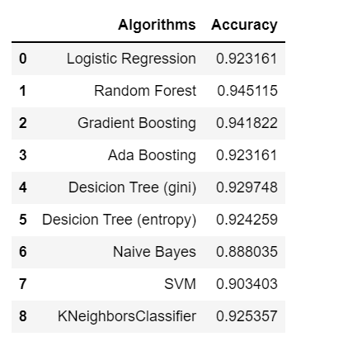
Gross Revenue Generated as Target Variable

Slide 21
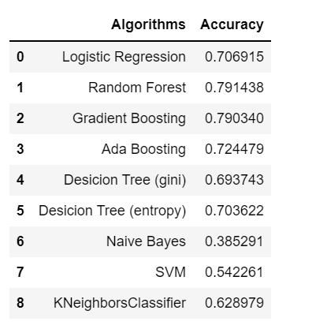
IMDB Score Generated as Target Variable

Slide 22
Conclusion
Accuracy was an issue for the IMDb score models, which depict an entirely different picture than the assumption we made during the implementation phase. There’s a vast difference between the average accuracy of models using gross as the target variable and models using IMDb score as the target variable. Overall, we can say that Random Forest can be a good model for box office success prediction

