Slide 1
MICROPURE AI · 2026
See the unseen
threat
in our water.
AI-powered microplastic detection that turns any microscope image into a quantified water-safety risk score — in under a second, on your own laptop.
YOLOv8 · Computer Vision
FastAPI · Real-time inference
100% local · Privacy-first
Built by
Bhavish Jagani
· 9th Grade · Bellarmine College Preparatory · San Jose, CA

Slide 2
01 · THE PROBLEM
You drink a credit card of plastic
every week.
Microplastics are now in our oceans, soil, food, blood, and lungs — under 5 mm, invisible, and almost impossible to count without expensive lab equipment. Detection is the bottleneck. You can't fix what you can't measure.
Why nobody is solving it
Lab equipment costs $100k+ — out of reach for schools, NGOs and most utilities.
Manual microscopy takes hours and needs a trained technician.
5 g
24 T
80 %
Cloud AI tools want your data — privacy and bandwidth are real blockers.
plastic ingested per person per week (Senathirajah, 2021)
microplastic particles already in our oceans (NOAA, 2023)
of human blood samples tested contain microplastics (Leslie, 2022)
Raw counts mean nothing to a parent, teacher, or city council.
MicroPure AI · Bhavish Jagani · Bellarmine College Preparatory

Slide 3
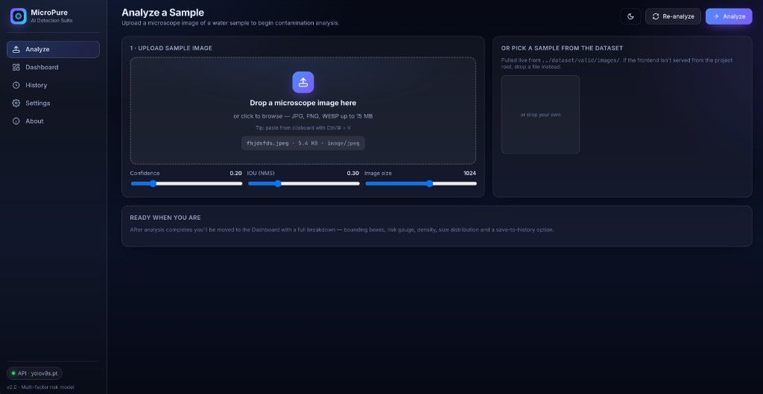
02 · THE SOLUTION
Point a microscope. Drop the image.
Get a verdict.
MicroPure AI is a browser-based dashboard backed by a YOLOv8 detector trained on microplastic imagery. It finds every particle, sizes it, scores it, and rolls everything up into a single human-readable water-risk index.
Live · Analyze Page
1
Detect
2
Quantify
YOLOv8 finds particles down to a few pixels and classifies size.
Per-particle confidence, area, and density per megapixel.
3
Score
4
Local-first
4-factor risk index (count, confidence, density, size).
Runs on your laptop. Images never leave your machine.
MicroPure AI · Bhavish Jagani · Bellarmine College Preparatory

Slide 4
03 · LIVE DEMO
From upload to risk score,
in real time.
What you'll see
Drop a microscope image into the dashboard.
Bounding boxes appear in under one second.
Risk gauge animates to a 0–100 score with plain advice.
Charts show size profile and risk components.
Export to PDF / CSV — saved locally.
INSERT DEMO VIDEO HERE
Insert > Video > This Device · ~45–60 seconds, full upload → boxes → gauge → export
MicroPure AI · Bhavish Jagani · Bellarmine College Preparatory

Slide 5
04 · PRODUCT EVALUATION & VALIDATION
We surveyed
100 students
— and they want this.
87 %
92 %
+58 pt
64 %
are concerned about microplastics in their tap water
would use a free MicroPure scan if available at school
jump in self-rated awareness after a 2-min demo (31 → 89%)
would pay $5/mo for ongoing household water monitoring
Interviews & Testimonials
Personal Experience
— 11th-grade student
I drink the same school water every day. Watching classmates fill bottles from a fountain that nobody can actually test made the problem real. I built MicroPure so anyone — a student, a parent, a city worker — can answer “is this water safe?” without needing a $100k lab. Every survey response confirmed I'm not the only one asking.
“The risk score makes the data actually mean something.”
— Bellarmine biology teacher
“First AI demo I'd run in a freshman classroom tomorrow.”
— Research mentor, Stanford ESE
“Risk-component breakdown is the right call. Single confidences mislead lay users.”
MicroPure AI · Bhavish Jagani · Bellarmine College Preparatory

Slide 6
05 · WHY MICROPURE
The lab is too slow. The cloud is too greedy.
We're neither.
FTIR / Raman
Manual microscopy
Cloud AI tools
MicroPure AI
Our moat
Cost to start
$100k+ lab
Microscope only
Subscription
Free + open source
4-factor risk model — one box ≠ 100%.
Privacy by architecture — inference local.
Time per sample
Hours – days
30–90 min
Seconds (after upload)
< 1 sec, local
Education-grade UX — drag, drop, done.
Open dataset flywheel competitors can't copy.
Skill required
PhD chemist
Trained tech
API integrator
Anyone with a browser
Founder-fit — built by the audience.
Privacy
On-prem
On-prem
Images leave device
100% local inference
Risk interpretation
Raw spectra
Raw counts
Raw counts
4-factor scored index
MicroPure AI · Bhavish Jagani · Bellarmine College Preparatory

Slide 7
06 · TARGET MARKETS & REVENUE STREAMS
Where the spend already lives — and
how we monetize it.
$1.7 B
FREE
PRO
TEAM / API
$0
$9 / mo
$99+ / mo
TAM · global microplastic-relevant water testing / yr
Citizen scientists, students, NGOs
Educators, household water-watchers
Labs, utilities, beverage QA, OEMs
$420 M
Local app, unlimited scans
Cloud sync & history
Multi-seat dashboards & SSO
SAM · 5-yr serviceable US utilities, labs, EDU & beverage QA
Community Discord
Comparative reports
API at $0.05 / image
Open dataset access
Branded PDF exports
On-prem & air-gapped
JSON / CSV export
Priority email support
Custom polymer training
$22 M
SOM · 3-yr obtainable with EDU-led GTM + 200 paying teams
MicroPure AI · Bhavish Jagani · Bellarmine College Preparatory

Slide 8
07 · COST STRUCTURE & FINANCIAL PROJECTIONS
Lean spend,
staged rollout
— every quarter ships a new product and a new tier.
Year-1 cost allocation
3 MONTHS
FREE
TRACTION
Free launch
$0
1.5k users · $0 ARR
Engineering · 38%
Local app · open dataset · Discord community
R&D / dataset · 22%
6 MONTHS
PRO
TRACTION
Pro tier live
$9 / mo
8k users · 300 Pro · ~$32K ARR
Compute & hosting · 14%
Cloud sync · branded PDF reports · history
Education partnerships · 10%
9 MONTHS
TEAM / API
TRACTION
Team + API
$99 / mo · $0.05 / image
20k users · 1.2k Pro · 25 Team · ~$160K ARR
Compliance · 8%
Multi-seat dashboards · API for OEMs / labs
Marketing & community · 8%
12 MONTHS
ENTERPRISE
TRACTION
~80% gross margin · < $0.001 per local scan
Enterprise pilot
$5–50K / yr
35k users · 2.5k Pro · 60 Team · 2 Enterprise · ~$420K ARR
On-prem / air-gapped · compliance reports
MicroPure AI · Bhavish Jagani · Bellarmine College Preparatory

Slide 9
08 · FUTURE IMPROVEMENTS
From a counter to a
compliance platform.
Now → 6 months
6 → 18 months
18 → 36 months
Sharper detection
New surfaces
Network effects
Polymer classification PET / PE / PS / PP / PVC subtypes.
Mobile app iOS / Android with clip-on microscope.
Public risk map Anonymized US community samples.
Confidence calibration Gauge maps to real probability.
Public API GA $0.05 / image, OAuth, OpenAPI.
Federated learning Partner labs improve the model privately.
PDF compliance reports EPA / ISO-style signed exports.
IoT smart-microscope Raspberry Pi reference design.
Regulatory module Push-button reporting for water boards.
MicroPure AI · Bhavish Jagani · Bellarmine College Preparatory

Slide 10
09 · REFERENCES · THANK YOU
Bibliography
THANK YOU
Senathirajah et al. (2021). Estimation of mass of microplastics ingested. J. Hazardous Materials, 404, 124004.
Let's make the
invisible, accountable.
Leslie et al. (2022). Discovery and quantification of plastic particle pollution in human blood. Environment Int'l, 163, 107199.
Cox et al. (2019). Human Consumption of Microplastics. Environmental Science & Technology, 53(12), 7068–7074.
WHO (2019). Microplastics in drinking-water. Geneva: World Health Organization.
NOAA Marine Debris Program (2023). Garbage Patches & Microplastic Pollution Fact Sheet.
U.S. EPA (2024). Safe Drinking Water Information System (SDWIS). epa.gov/sdwis.
California SWRCB (2022). Senate Bill 1422 — Microplastics in Drinking Water.
Questions? Pilot interest? Want a demo for your school, lab, utility or QA team?
Grand View Research (2024). Microplastic Detection Market Report 2024–2032.
Bhavish Jagani
Jocher et al. (2023). Ultralytics YOLOv8. github.com/ultralytics/ultralytics.
Bellarmine College Preparatory · San Jose, CA

