Slide 1




relay
relay
Deadline-Aware Food Rescue Dispatch
Restaurant
Driver
Shelter
Team ____ | AmiHacks · Track A · PS-1 Surplus-to-Shelter
Notes:
Relay turns a restaurant's unsold food into a shelter's next meal before the food-safety clock runs out. It's a working, deployed product: Google sign-in, a section for every role, real ML and RL, MongoDB storage and email notifications.

Slide 2






relay
Why Surplus Food Still Gets Wasted
Key challenges in real-time food rescue
2–6 Hour Window
WhatsApp & Phone Calls
Volunteers Can Say No
Food spoils before a match is found
Manual coordination breaks at scale
16.4% of rescues unclaimed or last-hour
No Capacity View
Trust Gap
No Impact Trail
Can the shelter take 40 kg tonight?
Was it picked up safely and used?
No records for CSR, tax or audits
Notes:
The problem statement gives a 2–6 hour usable window. Coordination today is phone, spreadsheets and WhatsApp. The best public data (412 Food Rescue, 4,574 rescues) shows 16.4% were never claimed or only claimed in the final hour. Shelters have no way to publish capacity, donors don't know if food was used, and nothing is recorded for impact or tax.

Slide 3
relay
The Real Problem
Matching is easy. Getting a human to commit in time is hard.
99%
Food-safety clock
4 h for cooked food
Donor's window
they close & leave
match rate: finding a shelter is solved
Copia
Rescue window
16.4%
of rescues never claimed or only in the final hour
412 Food Rescue, 4,574 rescues
Ask ≠ Dispatch
Shelter hours + space
open? room for it?
volunteers can say no, not reply, or cancel
our key insight
Notes:
We reframed the problem. A commercial platform (Copia) reports a 99% match rate, so finding a recipient is solved. What fails is fulfilment under a hard deadline using volunteers you can't command. Three windows must overlap: the food-safety clock (FDA Food Code: 4 hours for cooked food), the donor's closing time, and the shelter's receiving hours and space.

Slide 4




relay
What Relay Solves
One co-pilot for donors, drivers, shelters and coordinators
Serve-Time Safety
Right Drivers, Right Number
Early Human Alert
Safe when eaten, not just when delivered
ML odds · RL wave size · no spam
Escalate before the last safe moment
Verified Handover
Every Role Informed
4-digit code · pickup checklist · receipt
In-app 🔔 + email at every moment
Notes:
Five things Relay does that manual coordination can't: it checks food will be safe at serving time; it asks the drivers most likely to say yes, and only as many as needed; it alerts a coordinator before it's too late; it proves delivery with a handover code; and it keeps every person informed in the app and by email.

Slide 5









relay
Relay in One Flow
From a WhatsApp-style message to a delivered, receipted meal
re-plan every 8 min, or instantly on any change (cancel · shelter full · new food)
Post
Rules
ML
RL
Offers
Pickup
Handover
Impact
30 s, plain text
safe shelter
who says yes
how many to ask
sized wave
safety checklist
4-digit code
kg · meals · receipt
odds too low?
Human alerted before the last safe moment
one-click backup courier
Matched in ~60 ms · planner p95 ~15 ms · 0 safety violations in simulation
Notes:
A donor pastes a message; it becomes a structured card. Rules choose a shelter that can serve it safely. The acceptance model scores each driver, the RL agent decides how many to ask and when, and offers go out. Pickup has a safety checklist; the shelter's 4-digit code confirms delivery; impact and a receipt are recorded. If claim odds are too low, a human is alerted before the last safe moment.

Slide 6










relay
Overall Architecture
Users
FastAPI server
Auth · roles · HttpOnly sessions
MongoDB Atlas
or SQLite
Web App
role-based SPA
Leaflet + CARTO maps
live board
AI explainer
bell 🔔 · receipts
Donor
Planner brain
Google
sign-in
REST
Rules
ML
RL
Email · Brevo / SMTP
outbox + retries
Driver
safety
p(yes)
wave size
Shelter
Living-city simulator
+ offline training
Event log
(append-only)
Notifier
(who gets what)
Admin
ordered write-behind → database
Replay the event log → rebuild the whole city after any restart
Notes:
Every role uses one web app and signs in with Google; the server checks role and ownership on every route. The planner brain has three tiers: rules for safety, an ML acceptance model, and an RL wave policy. Every change is an immutable event, written in order by a background writer to MongoDB Atlas (or SQLite), so state can be rebuilt by replaying the log. The notifier turns events into in-app notes and emails (Brevo API or SMTP) with an outbox and retries. A living-city simulator replays real dataset behaviour for demos.

Slide 7




relay
Decision Pipeline
Donation
Offers sent
(area only until accept)
1 · Rules
safe at serving time?
space · hours · veg?
shelter
2 · ML
p(yes) per driver
logistic + driver effect
3 · RL (Q-function)
ask k ∈ {0,1,2,3,5,8}
Q = meals − 0.02·pings
Shelters
P(claim) = 1 − Π(1 − pᵢ)
location · history
Deadline L near →
escalate to human
+ backup courier
No reply in 8 min, a cancellation or a full shelter → re-plan with fresh odds
Drivers
Safety is always a rule, never a model. ML predicts people. RL only sizes the wave.
Notes:
Stage 1 tests every shelter with hard rules, including whether food will still be safe when the shelter serves it (use-lead). Stage 2: a calibrated logistic model with per-volunteer effects predicts each driver's chance of accepting within 8 minutes. Stage 3: a fitted-Q-iteration agent scores asking 0, 1, 2, 3, 5 or 8 drivers; the reward is meals rescued minus 0.02 per ping. The claim probability of a wave is 1 minus the product of (1 − p). If the latest safe escalation time L approaches, a coordinator is alerted.

Slide 8


relay
Learning Pipeline (Offline RL)
147,444 offers →
Acceptance model
AUC 0.786 (ceiling 0.787)
Deploy
models/
Data audit
5 critical bugs fixed
(time base, rewards, labels)
Simulator
30 held-out nights
relay_data
300 nights of logs
31,502 decisions →
Fitted Q-Iteration, 20 rounds
reward = meals − 0.02·pings
live event log becomes new training data · python ml.py all
Trained offline: nobody wants a policy changing itself mid-shift.
Notes:
We audited the provided dataset first and found 5 critical issues: offer times were relative to posting, RL rewards were on the wrong steps, behaviour-cloning labels were empty, one feature was a leaked oracle, and the late-night flag used relative time. We rebuilt everything from raw logs. The acceptance model reaches AUC 0.786 against an oracle ceiling of 0.787. Offline RL (fitted Q-iteration on gradient-boosted trees) learns from 31,502 logged decisions. Every policy is then evaluated on 30 held-out nights that no model saw.

Slide 9
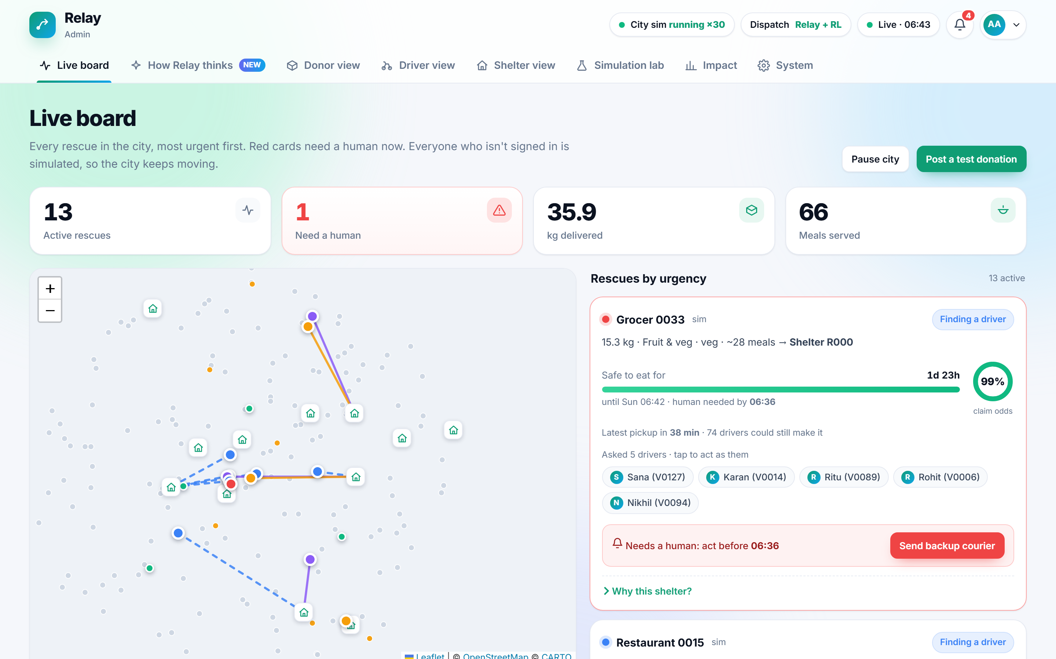
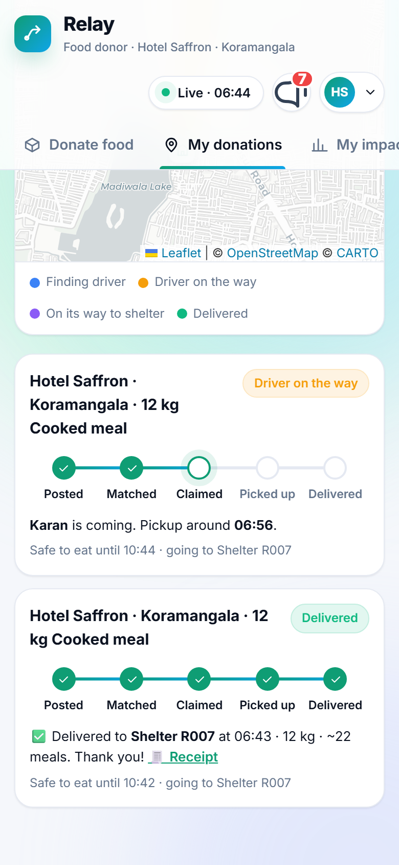
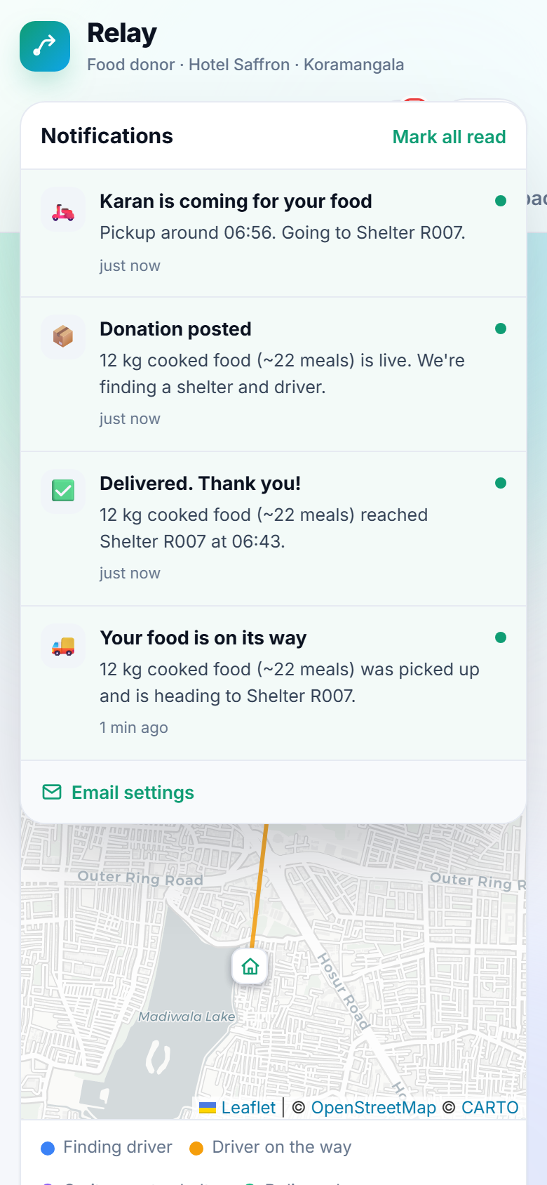
relay
The Product
Live, role-based and running on real Bengaluru data
Donor tracker
5-step live status
Notifications
in-app + email
Coordinator live board
urgency · claim odds · one-click backup
Notes:
Real screens from the running app. Left: the admin live board, with every rescue sorted by urgency, the claim odds ring, the drivers asked, and a one-click backup courier when a human is needed. Right: the donor's phone, showing the 5-step tracker and the notification bell.

Slide 10
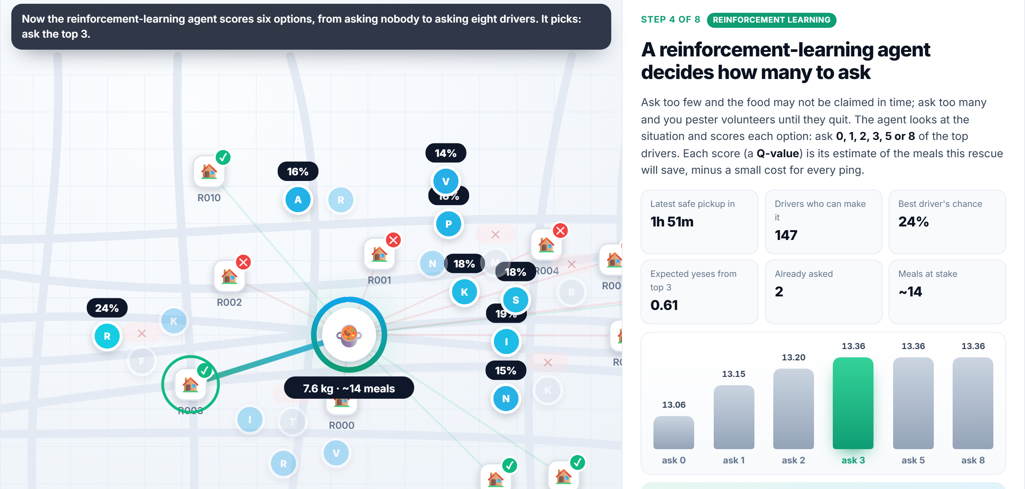
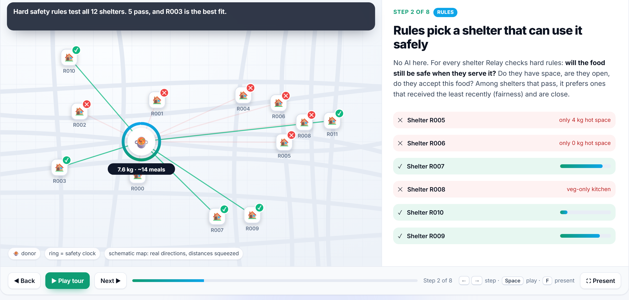
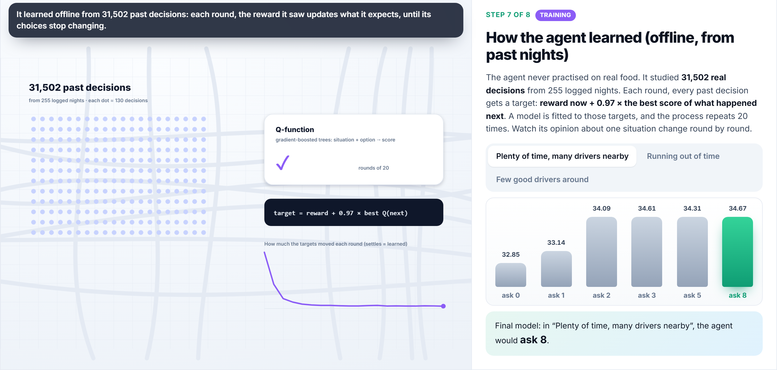
relay
Explainable AI, Built In
An animated walkthrough of every real decision, for non-experts
Step 2 · rules
Rules ✓/✕ with reasons
ML odds per driver
RL Q-values → choice
Camera zoom · typed narration · presenter mode (F, ←, →)
Step 7 · how it learned
Notes:
'How Relay thinks' replays one live decision in 8 animated steps: the safety rules test every shelter, the ML model scores each driver, the RL agent's Q-values for each wave size, the offers, the reward, how the agent learned over 20 rounds, and the results. It has a presenter mode with camera zoom and narration, so anyone can follow why Relay decided what it did.

Slide 11

relay
Features for Every Role
Donor
Driver
Shelter
Admin
30-second post from plain text
Live tracker & map
Printable receipt (CSR / tax)
Only offers that fit
Address after accepting
Pickup safety checklist
Space per food type
“Full” switch, veg-only, confidential
Handover code
Live board, urgency first
One-click backup courier
AI explainer · lab · system health
Sign in with Google → each role sees only its part. Checked on every API call.
Notes:
Every person signs in with Google and sees only their part. Donors post in seconds and follow their food live. Drivers get offers only when they're a good fit, see the exact address only after accepting, and confirm food condition at pickup. Shelters control what they can take and give a code at handover. Coordinators see the whole city, can send a backup courier, and can inspect every decision.

Slide 12
relay
Right Message, Right Moment
In-app 🔔 + email for every role
Posted
Driver accepts
Picked up
Delivered
Posted ✓ safe until 10:44
“Karan is coming, ~06:56”
“On its way”
Delivered + receipt
Donor
Offer (area only)
Addresses + Maps links
Thank-you + meals
Driver
Food coming · code 4821
On its way · code 4821
Handover confirmed
Shelter
The handover code goes only to the shelter · confidential shelters are never revealed · each person chooses their email settings
Notes:
Every moment produces an in-app notification and an email: HTML plus plain text, sent through Brevo's HTTPS API or SMTP, with an outbox and retries. The donor never receives the handover code, since the code proves delivery. A confidential shelter's address is never emailed to a driver. Admins get escalation emails only for real donors, and each person can turn emails off.

Slide 13
relay
Results
30 held-out nights of real Bengaluru data (simulated)
−91%
pings vs
broadcast
+13 pts
food rescued
vs broadcast
0
food-safety
violations
RL halved pings vs our rules-only planner (25.0 → 12.7). The static rule rescues 3.9 pts more food but pings 5× as much: a burnout trade-off you can tune.
Simulated, not a field result. The simulator replays the dataset's real donations, drivers and shelters.
Notes:
Same 30 held-out nights for every policy. Against a WhatsApp-style broadcast, Relay + RL rescues 13 points more food (76.6% → 89.6%) with 91% fewer pings (145 → 12.7 per rescue). Against the 412 Food Rescue static rule, it pings 5× less for 3.9 points less food; that's a burnout setting, not a hidden flaw. Zero food-safety violations for every policy (the original logs had 17). Be clear these are simulated.

Slide 14
relay
Model Quality
Small, calibrated models that run on a free server
0.786
0.005
AUC acceptance model
calibration error (ECE)
oracle ceiling 0.787
says 30% → ~30% say yes
70%
~15 ms
behaviour-cloning accuracy
planner p95 latency
vs 43% majority baseline
match in ~60 ms
settles after ~6 rounds = learned
Notes:
The acceptance model's AUC is 0.786, within 0.001 of the oracle ceiling (the true probabilities in the data), and it's well calibrated (ECE 0.005). Behaviour cloning of the dispatcher reaches 70% accuracy vs 43% for the majority class. Fitted Q-iteration's Bellman change falls from 5.0 to about 0.2 and stabilises after about 6 rounds. The planner runs in about 15 ms at p95, so matching feels instant.

Slide 15

relay
Novelties of Our System
A shelter is chosen only if food is still safe when it's served, not just delivered.
Calibrated p(yes) per volunteer; P(claim) = 1 − Π(1 − p). Just enough offers.
Serve-Time
Safety
Ask, Don't
Dispatch
relay
Computes the last safe moment to act, and alerts a human before it.
Offline RL decides how many to ask and when: halved pings vs rules.
Early
Escalation
RL Wave
Sizing
Notes:
Four things we believe are new together: serve-time safety (use-lead, not just delivery time); probabilistic offer waves instead of dispatch; an explicit escalation deadline so humans act in time; and an offline-RL policy that sizes each wave, which halved notifications compared with our rules-only planner.

Slide 16










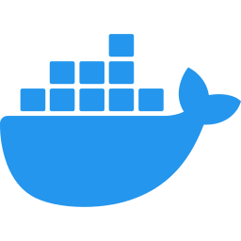

relay
Tech Stack Used
Python
FastAPI
scikit-learn
pandas
MongoDB Atlas
SQLite
Google OAuth
Leaflet + CARTO
JS · SVG animations
Brevo email API
Docker
Render (free)
Notes:
Python, FastAPI and Uvicorn on the server. scikit-learn for the logistic acceptance model, gradient-boosted fitted Q-iteration and behaviour cloning; pandas and PyArrow for the data. MongoDB Atlas (or SQLite) for storage, Google Identity Services for sign-in, Leaflet with CARTO tiles for maps, vanilla JS with SVG and Web Animations for the UI, Brevo's HTTPS email API (or SMTP), and Docker on Render's free tier. No GPU, no paid AI required.

Slide 17

relay
Feasibility
Viability
Built, tested and deployable today
Sustainable and ready to scale
40 automated checks pass
end-to-end, storage, email, safety
Free for NGOs & volunteers
no cost to people doing good
Runs free: ~215 MB, no GPU
Render + Atlas + Brevo free tiers
Paid ESG / CSR reports
for food chains and hotels
Fallbacks built in
SQLite · email previews · backup courier
City by city
new city = new config, not new code
Safety by rules
conservative FDA/FSSAI-based clock
Pilot: 6 weeks, shadow mode
campus dining + 1 NGO chapter
Notes:
Feasibility: the product is built and deployable. 25 end-to-end checks, 8 storage and email tests and 7 property tests pass. It runs in about 215 MB with no GPU, on free tiers. If MongoDB is off it uses SQLite; if email isn't configured, emails are kept as previews; if drivers don't respond, a backup courier is one click away. Viability (proposed): free for NGOs and volunteers, paid verified ESG/CSR reports for food chains, and expansion city by city. The first step is a 6-week shadow-mode pilot.

Slide 18



relay
Impact & Benefits
Who gains, and by how much (simulated vs WhatsApp broadcast)
+16%
−78%
−59%
meals reaching people
pings to the busiest volunteers
food lost
30 s
0
100%
for a restaurant to donate
food-safety violations
rescues on an audit-ready log
SDG 2 Zero Hunger
SDG 12.3 Halve food waste
SDG 13 Climate action
Notes:
Compared with a WhatsApp-style broadcast on the same simulated nights: about 16% more meals, 59% less food lost, and 78% fewer pings to the most-asked volunteers, which means less burnout. Restaurants donate in 30 seconds and get receipts; shelters get food they can serve safely; governments and ESG teams get an audit-ready log. Aligned with SDG 2, SDG 12.3 and SDG 13. Don't quote a CO2 figure unless you cite its source.

Slide 19







relay
Methodology & Roadmap
Research
Rules
RL
Product
Scale
PS + 412FR, UNEP, FDA, FSSAI
safety clock, feasibility
offline FQI
roles, email, Mongo, deploy
city by city
Data audit
ML
Simulate
Pilot
5 bugs fixed
acceptance model
30 held-out nights
6-week shadow mode
Built during the hackathon
Next: field pilot → scale
Notes:
We researched the problem and real food-rescue data, audited the dataset, built safety rules first, then the acceptance model, then offline RL, evaluated everything on 30 held-out simulated nights, and built the full product with roles, email, MongoDB and a free deployment. Next: a 6-week shadow-mode pilot with our campus dining hall and one NGO chapter (Relay recommends, humans decide), then scale city by city.

Slide 20
relay
relay
Surplus food, on a plate, while it's still safe to eat.
Live demo
Safety by rules
Efficiency by AI
Deployable at ₹0
Thank you · Team ____
Notes:
Demo, about 3 minutes: 1) sign in as a restaurant, post '30 plates veg biryani…' and watch it match in under a second; 2) watch the tracker, the bell and the emails, then the receipt on delivery; 3) admin → How Relay thinks in presenter mode (press F, then Space); 4) Simulation lab: the same night side by side. Close with: Relay makes sure surplus food reaches a plate while it's still safe to eat.

