Slide 1

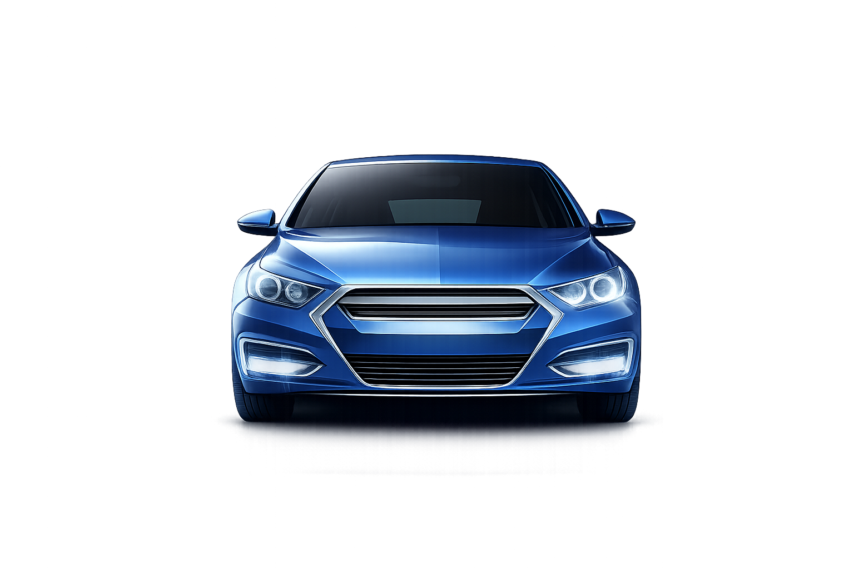
Introduction
The Indian used car market has witnessed significant growth in recent years, driven by rising disposable incomes, increasing digital adoption , and evolving consumer buying behaviour.
Research Objectives
Analysed growth pattern, regional demand, customer personas and Key Trend.
Prepared By – Bhavishya Bisht

Slide 2
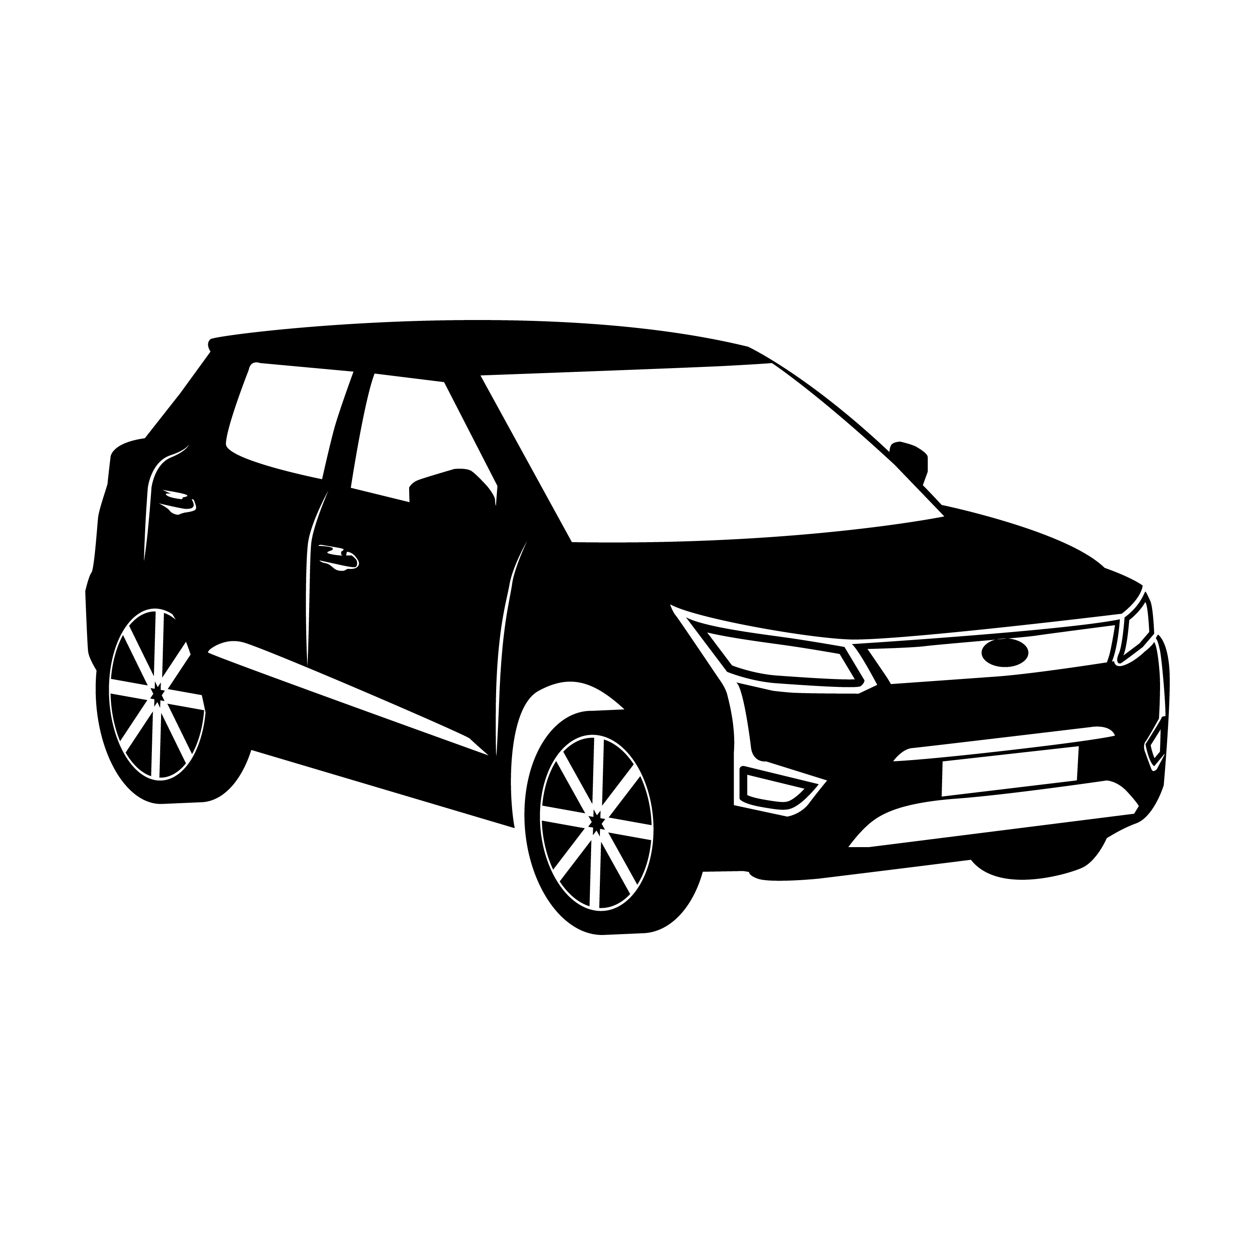
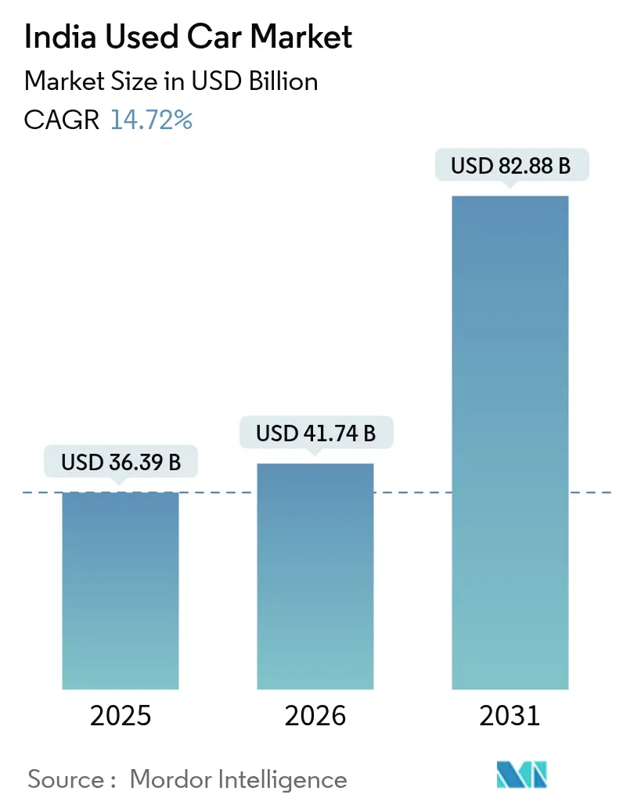
India Used Car Market
The India used car market is valued at USD71.74 BILLION IN 2026. The market is experiencing a significant shift from a fragmented, unorganised sector to a more structured ecosystem, with sales volumes projected to surpass 6 million units in FY2026.
The growth of the used car market in India is being driven by increasing digital adoption rising new car prices, and growing consumer preference for value-for-money mobility solutions .
Online platforms such as CARS24 and other organized players have improved price transparency, vehicle inspection standards, and financing availability, making used car purchases more trustworthy and convenient for buyers across tier-1 and tier-2 cities.

Slide 3
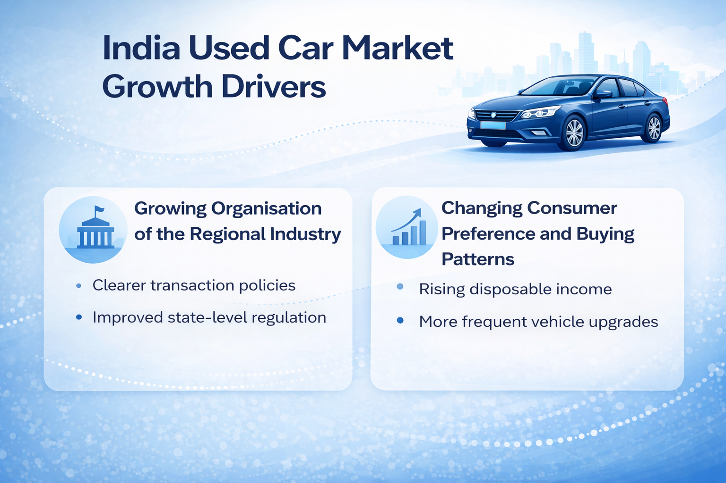
India Used Car Market Growth Drivers:
Growing Organisational of the regional industry will generate more confidence among new used cars buyers
The Indian used car market was historically unorganized, with unclear transaction policies and low consumer awareness. To improve transparency, the Ministry of Road Transport and Highways introduced the central Motor Vehicles Rules, 2022, Under the new Framework, dealers must obtain state authorization and are considered the vehicle owners until the final sale to the consumer
Changing consumer preference and buying patterns to positively impact the growth market rate
The Indian use car market is growing due to rising disposable income and changing consumer buying behaviour. Consumers are increasingly upgrading vehicles more frequently, making more pre-owned cars a cost-effective option . The new-to-used car ratio has shifted from 1:1.21 to 1:1.12, while the average vehicle holding period has reduced to about 3.1 years , highlighting the increasing popularity of used cars.

Slide 4
India Used Car Market :Opportunities
A key untapped opportunity in India’s second-hand car market lies in rural and non-metro area. Demand for personal mobility is constantly rising in these areas, backed by limited availability of public transport, improving rural incomes, and the development of road infrastructure, The supply of good-quality second-hand cars, however, remains heavily concentrated in tier-1 and metro cities, creating a geographic mismatch.
It is further creating a compelling case for organized companies to extend their logistics networks and physical presence into non-metro areas. It will likely provide easy access to after-sales support financing options, and certified vehicles. Companies such as Spinny have already initiated pilot operations in small towns across Madhya Pradesh and Uttar Pradesh. Such strategies not only deliver a high-growth frontier for companies seeking to scale in a largely underserved market but also promise to bridge the supply-demand gap.

Slide 5
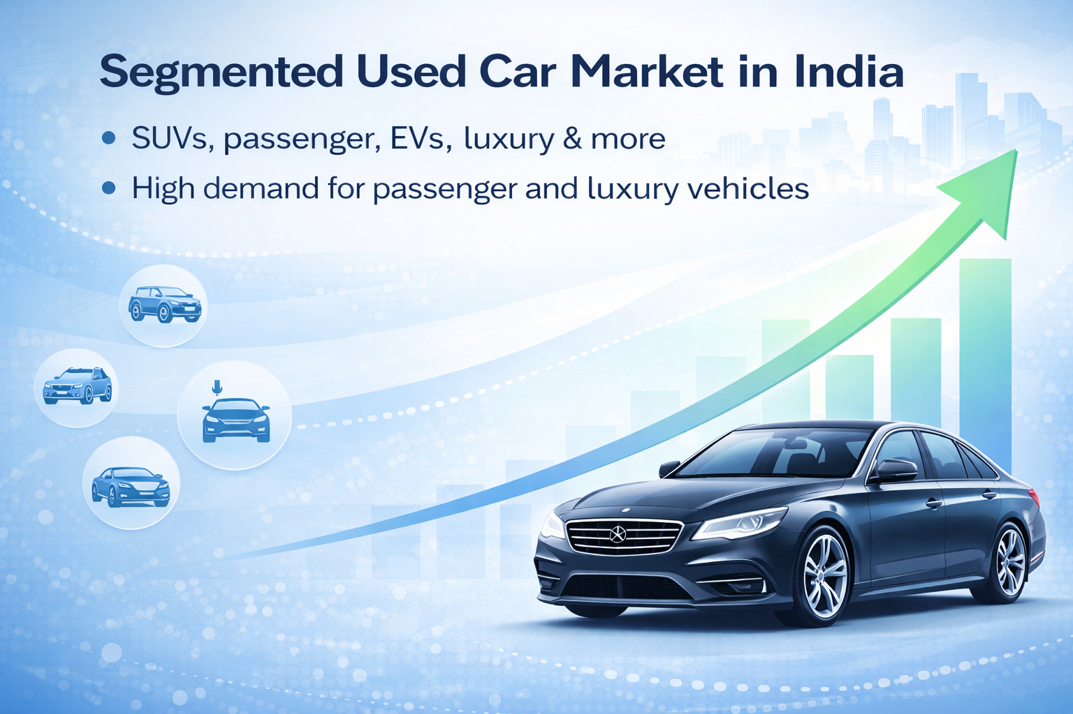
India Used Car market : Segmentation
The India used Car market is segmented based on type of vehicle mode of service , and region .
Based on the type of vehicle, the regional market segments are sports utility vehicles(SUV), passenger vehicles, Electric Vehicles(EV), luxury vehicles, and others.
In 2023, the highest demand was observed In the passenger vehicle segment. The growth rate is a result of higher demand for vehicles in urban areas for small families . As of 2024, more than 45 lakh people in the city of Mumbai owned a private vehicle. The luxury vehicle sector has been growing at a rapid pace. The surge In buyers wanting to experience driving luxury vehicles at affordable prices is fuelling the segmental demand.

Slide 6
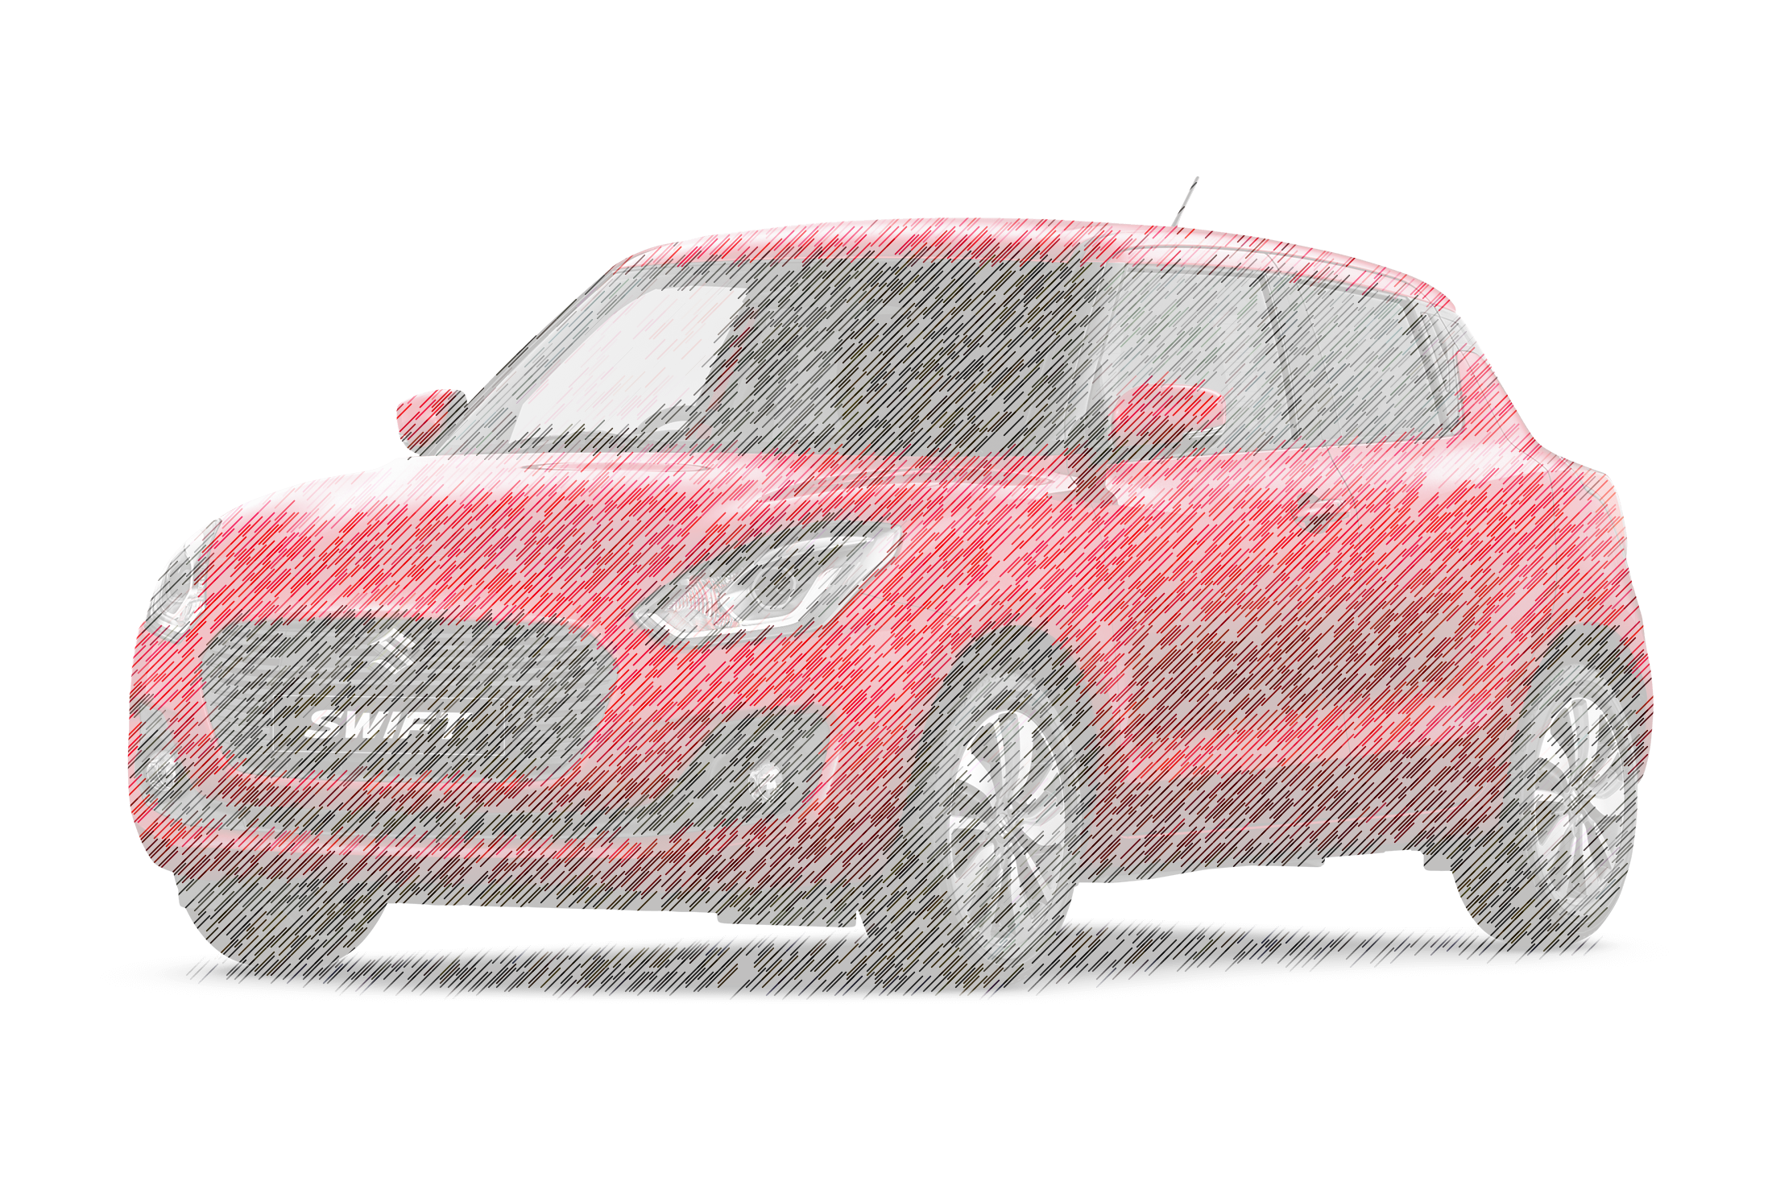
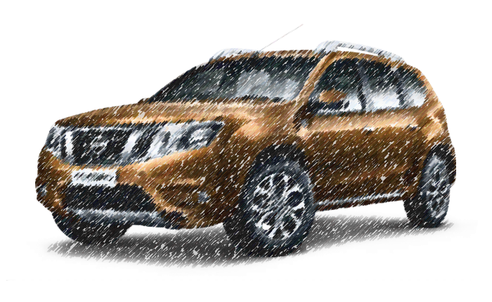
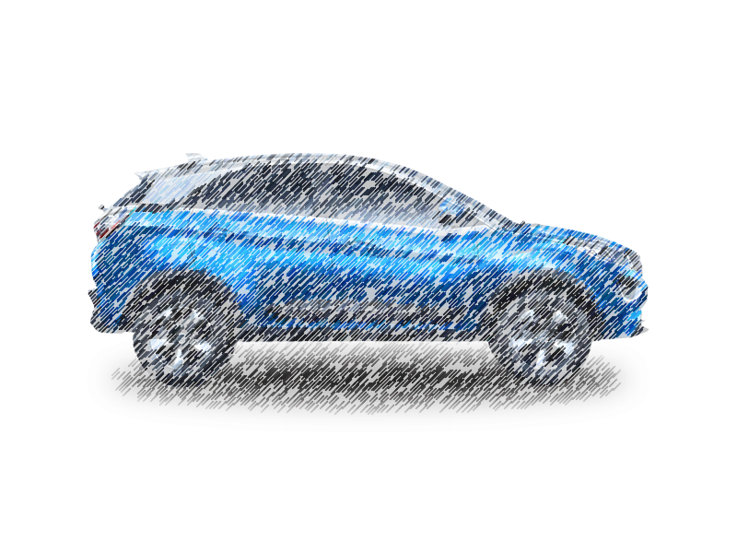
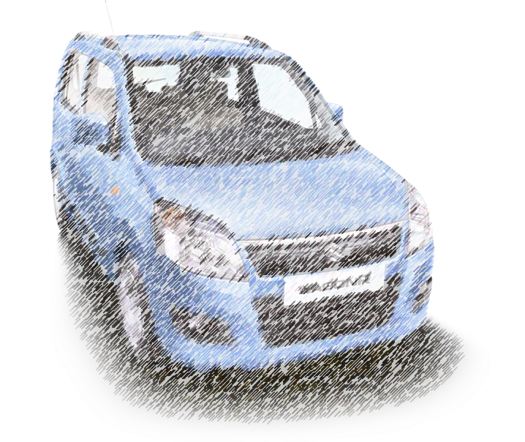
Used Car Market : Customer Personas
The First-time Aspirant
Motivation: Ownership
-64% of buyers are first-timers.
Typically young professionals or families in tier-2/3 cities.
Prefer budget hatchbacks(e.g. Maruti Swift).
Price sensitive (usually under ₹5 Lakh).
The Smart Upgrader
Value for Money
Urban middle-class buyers
Prefer used SUV or Sedan over new hatchback
Focus on better features within same budget
The Skill Builder
Utility
New drivers learning and gaining confidence
Buy low-cost pre-owned vehicles first
Prefer manual transmission
The Second-Car Seeker
convenience
Affluent metro households (Delhi, Mumbai)
Looking for an additional family vehicle
Used for short commutes or school runs
Prefer compact automatic petrol cars

Slide 7
India Used Car Market : Regional Analysis
Maharashtra is the leading state in India for used car sales, holding a 20.7% share of the national market in 2025. It is followed by Karnataka(16.5%) and Gujarat (13.5%), with the overall market heavily driven by demand in Western India, which accounted for over one-third of all used car transactions.
Key details regarding the used car market:
• Top States: Maharashtra (20.7%), Karnataka (16.5%), Gujarat (13.5%), and UttarPradesh (13%) are the top states for used car demand.
• Top Models: The Maruti Suzuki Baleno is the most sold used car, followed by the Grand i10 and Kwid.
• Regional Trend : South India accounts for over 40% of used car sales, with West India closely following.

Slide 8

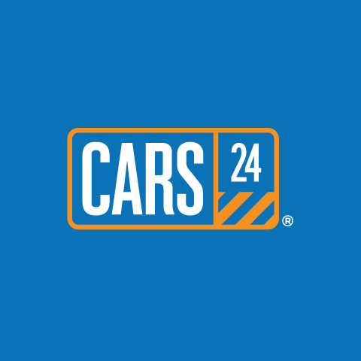

India Used Car Market : Competitive Landscape
India used car market is showcasing a dynamic shift, with both unorganized and organized players vying for consumer attention. Unorganized dealers are currently leading in terms of volume owing to their informal credit options and hyperlocal reach. Organized players, including OLX Autos, Spinny , and Cars24, are rapidly gaining ground by providing hassle-free car insurance and warranty, financing, and quality assurance.
The consumer-to-consumer (C2C) segment is , however, shrinking, mainly because of increasing concerns over trust and transparency . To gain a competitive advantage these dealers are aiming to embrace differentiating strategies, including subscription models, digital retailing, and home test drives. A few value-added benefits such as loyalty programs, return policies, and extended warranties are also helping them to transform buyers experience in this rapidly evolving market.

Slide 9
India Used Car Market : Digital Transformation
Digital transformation is creating unprecedented transparency in a traditionally opaque market, with organized retail expected to grow from 30% to 50% market share by 2030. Cars24's INR 5 billion technology investment and hiring of 100+ tech experts demonstrate the capital intensity required to build real-time valuation algorithms and maintenance tracking systems.
CarTrade Tech’s achievement of 150 million yearly unique users with 90% organic traffic validates the asset-light digital platform model’s scalability. The shift toward digital-first transactions id particularly pronounced among women buyers, who now represent 46% of purchase compared to 35% in Q3 FY2024, with Delhi-NCR leading at 48% female participation .
Platform consolidation accelerates as financing integration becomes critical, with 60% of Cars24 transactions now including embedded lending solutions. Technology adoption in tier-2 and tier-3 cities reduces information asymmetry that historically favoured local dealers, creating market democratization effects that benefit buyers and sellers through improved price discovery mechanisms.

Slide 10
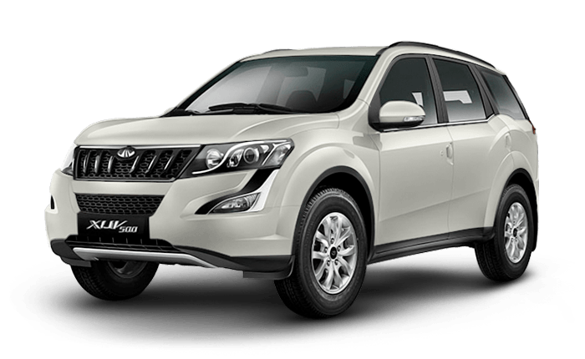
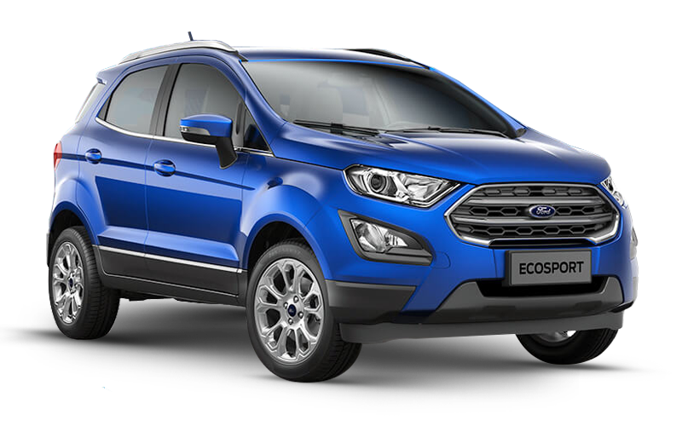
India Used Car Market : Key Trends
Rise of SUVs and Premiumization: SUVs and compact SUVs have captured over 50% of the market. Consumers are upgrading from hatchbacks to SUVs and sedans, with a strong preference for better, more modern, feature-rich, and safer vehicles.
Digital Transformation: Online marketplaces (like Cars24, Spinny) are rapidly gaining share by increasing transparency and providing access to a wider selection of vehicles.
Younger Car Age: The market is dominated by vehicles aged 3-5 years (45.94% share) due to shorter ownership cycles.
Regional Demand Concentration: South and West India dominate, with Maharashtra and Karnataka being key hubs for used car sales.

