Slide 1
Document Intelligence Platform
AI Engineer Internship — Technical Case Study
End-to-end document upload, OCR, structured extraction, financial validation and persistence.
Four supported types: invoice, balance sheet, profit & loss, cash flow statement.
Designed as a practical 3-day assessment project: modular, testable and deployable.

Slide 2
Dataset analysis
What the supplied files revealed
20 invoice JPGs: thermal receipts, photographed/rotated receipts, low-contrast scans and clean business invoices.
30 financial PDFs covering 2017–2026 across three statement types.
Financial statements commonly contain comparative periods; cash-flow files range from 1 to 2 pages.
Most financial PDFs are image-based and require OCR; at least one supplied cash-flow PDF exposes selectable text.
Layouts, units and tax presentation vary, so extraction cannot be filename- or template-hardcoded.

Slide 3
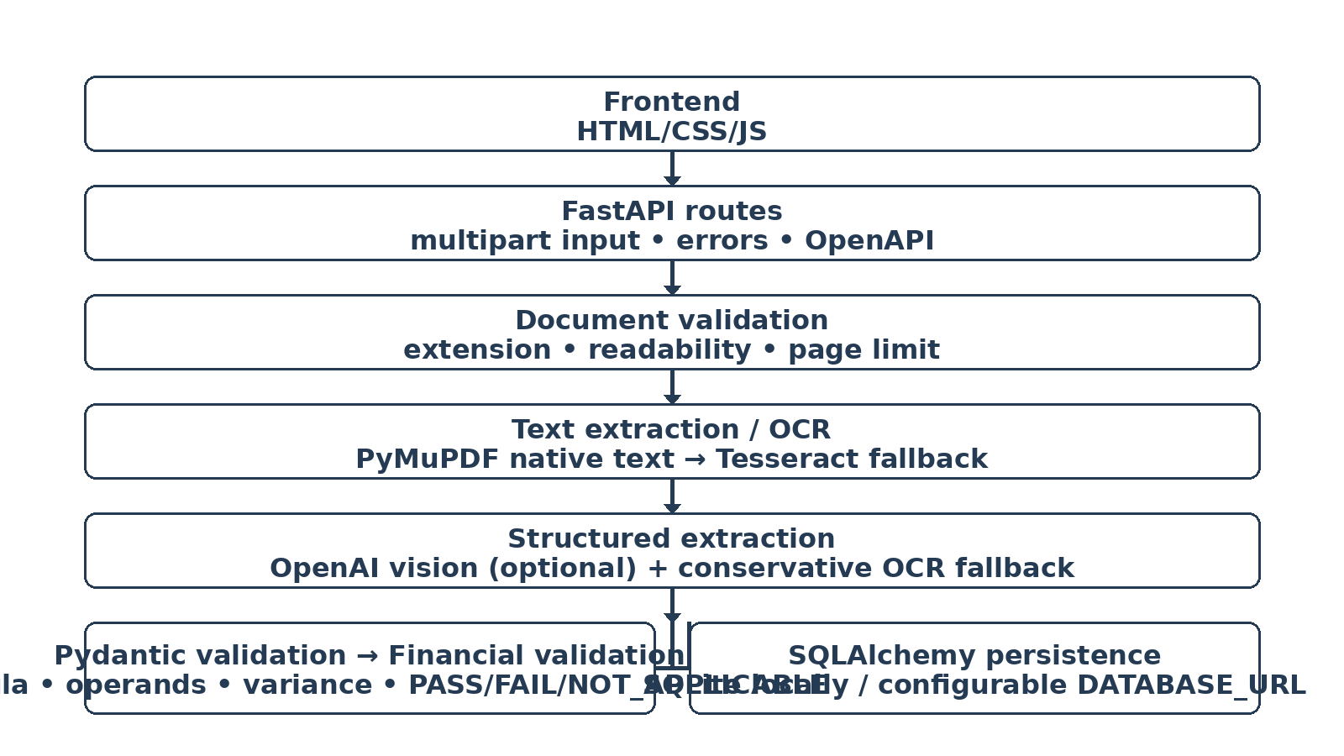
Architecture
Separation of extraction, validation and persistence

Slide 4
Extraction strategy
1. Validate file type, integrity, readability and the 3-page limit.
2. Prefer native PDF text when sufficient; otherwise render pages and run Tesseract OCR.
3. Attempt orientation correction for difficult images.
4. With OPENAI_API_KEY configured, send OCR text plus page images to a vision-capable model for structured extraction.
5. Validate the returned structure with Pydantic; use a conservative OCR parser only as a fallback.
6. Missing or unreadable values are null rather than invented.

Slide 5
Financial validation
Invoice: quantity × unit price, line-item subtotal, subtotal + tax − discount, cash paid − total = change where inputs exist.
Balance Sheet: capital & liabilities ≈ assets, independently by period.
Profit & Loss: income, expenditure and minority-interest relationships from the case study.
Cash Flow: operating + investing + financing + FX ≈ net change; opening + net change ≈ closing.
Every check reports formula, operands, calculated value, reported value, variance and PASS/FAIL/NOT_APPLICABLE.
Parenthesized values are parsed as negative; missing inputs are never assumed.

Slide 6
API & persistence
POST /api/v1/documents/process — multipart file + document_type.
GET /api/v1/documents/{document_name} — latest stored result.
GET /api/v1/documents — dashboard list.
GET /api/v1/health — deployment health check.
FastAPI provides Swagger/OpenAPI automatically at /docs.
SQLAlchemy repository persists validation, extraction and processing metadata; document name is upserted to return the latest result.

Slide 7
Testing & engineering discipline
Automated tests cover upload validation, empty/unsupported files, financial calculations, negative values, NOT_APPLICABLE, extraction schema and API health/upload flow.
Local verification completed: 8 automated tests passed.
Live local smoke test verified health, frontend HTML, static CSS, POST processing, GET-by-name and dashboard list endpoints.
Dataset samples were actually OCR-processed; the difficult rotated receipt demonstrates the limitation of a Tesseract-only fallback.
No secrets, fabricated metrics, hardcoded dataset answers or fake deployment URLs are included.

Slide 8
Deployment & interview story
Containerized deployment includes Tesseract and a production Uvicorn startup command.
OPENAI_API_KEY and DATABASE_URL are environment-configured; no secrets are committed.
Use a durable managed PostgreSQL database for a deployment where the filesystem is ephemeral.
Demo flow: choose document type → upload → process → inspect evidence and tables → inspect validation → open raw JSON.
Be ready to explain why OCR is needed, why the LLM receives both OCR text and images, how missing values are handled, and why financial validation is independent from extraction.

Slide 9
Current limitations & next steps
Severely degraded or rotated receipts can exceed Tesseract fallback accuracy.
High-accuracy multimodal extraction requires a configured compatible LLM API.
Production version should add durable object storage, managed PostgreSQL, queues, rate limits, authentication, OCR bounding boxes and human review.
Deployment URLs are intentionally placeholders until a real deployment is created and verified.
AI coding assistants were used for drafting, debugging, test review and documentation, consistent with the assessment's permitted-use policy.

