Slide 1

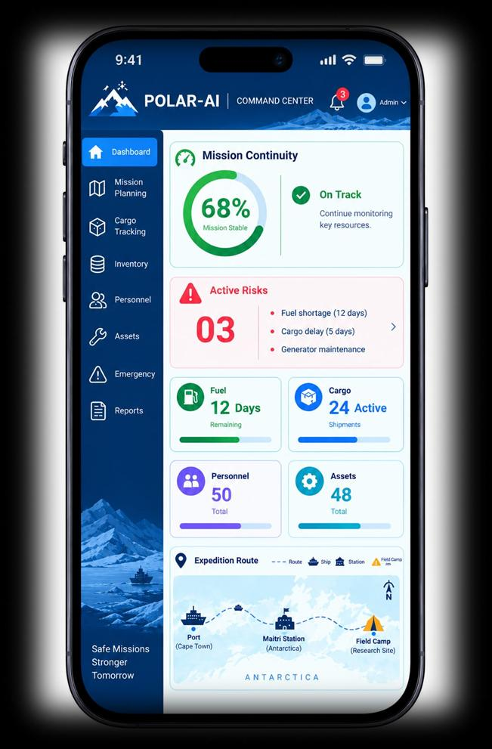
CompileX
POLAR-AI
Mission Continuity Intelligence for Extreme Environments
⚠ THE CHALLENGE
📊 Continuity Score
0–100% live mission health index
🚢 Cargo Tracking
Tracks Goa → Cape Town → Bases
🛡️ OUR SOLUTION
📄 Data Silos
Manifests & stock trapped in disconnected spreadsheets.
FROM REACTIVE TO PREDICTIVE
CONVENTIONAL POLAR-AI
📦 Resupply Delays
8-month winter isolation with zero resupply windows.
Static spreadsheets → 0–100% Live health index
🔄 What-If Simulator
Tests delays & rationing in real-time
🧠 Mission Memory
Recalls past expedition incident logs
Alerts after failure → Predicts 7–14 days ahead
⛽ Cascading Failures
Fuel shortage → Generator trip → Station heat loss.
Isolated cargo delays → Cascading life-support trace
📡 Total Blackout
Polar blizzards cut all cloud & satellite links.
Manual guesswork → What-If scenario simulation
🔗 Dependency Graph
Links Fuel → Power → Heat → Labs
🛡️ Offline Triage
Instant SOS dispatch & emergency logs
"Reactive tools report shortages.
Extreme missions need cascading foresight."
Fails when offline → 100% Offline-first PWA
⭐ CORE USP: MISSION CONTINUITY INTELLIGENCE FOR EXTREME ENVIRONMENTS
“POLAR-AI connects cargo, stock, assets, and weather to predict cascading failures and simulate mitigation options before shortages become life-critical.”
1. CASCADING FAILURE TRACE
Fuel Shortage → Generator Trip → Station Heat Loss
2. INTERACTIVE WHAT-IF ENGINE
Tests resupply delays & rationing deltas before field action
3. 100% OFFLINE PWA & HUMAN GATE
Zero-internet field autonomy; Commander retains final approval

