Slide 1
What is programming?
ESC101
August 2

Slide 2
Announcements
Students without emails entered
Screening exam
Location, New Core Labs, same room as regular labs
5th August, 9 am
Not necessary to join project track if selected, can also take to self-diagnose
Websites will be available using IITK login by tonight

Slide 3
Websites
Canvas:
canvas.cse.iitk.ac.in
Your iitk email will be the login
Click forgot password to reset password via email
Prutor:
esc101.cse.iitk.ac.in
Your iitk email will be the login
Same password as iitk email.
System introduction in the labs this week

Slide 4
Today’s class
What is programming?
What is the programming workflow?
What do simple C programs look like?
Related reading: Gottfried, Chapter 1

Slide 5
What is a computer?
Device which can be instructed to carry out arithmetic and logical operations automatically
Must take inputs
Must store inputs
Must give outputs
Must process information
We input using programs
A computer without programming is like a music casette
We will learn programming in this course.

Slide 6
Why am I doing this course?
Every discipline uses computing: All branches of engineering, sciences, design and arts.
Understand how computers work
Write your own programs
Automate boring repetitive stuff!
Welcome
Esc101, Programming

Slide 7
Process of Programming: Modelling
Define and model the problem. In real-life this is important and complicated.
Modelling the section assignment process
Explicit Input →list of people with attributes
Roll number
Name
Section preference
Implicit inputs → modelling
an equality constraint
a comprehensiveness constraint
Number of sections
Output
12 equal* lists, no student left without a section
Welcome
Esc101, Programming

Slide 8
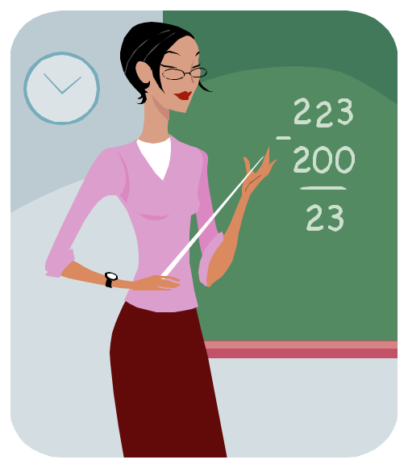
Learning to model
In this course, all problems will be defined precisely and will be simple
You will learn how to model problems on your own outside this course
If you are having trouble modelling, ask for help
Welcome
Esc101, Programming

Slide 9
Process of Programming: Algorithm
Obtain a logical solution to your problem.
A logical solution is a finite and clear step-by-step procedure to solve your problem.
Also called an Algorithm (or recipe).
We can visualize this using a Flowchart.
Very important step in the programming process.
Welcome
Esc101, Programming

Slide 10
Algorithms in Ordinary Life? (Recipes!)
An algorithm is a familiar concept: cooking recipes are almost algorithms! (not quite precise enough for a computer!)
Ingredients
1 liter (33 oz) ice cream (any flavor).
Crushed cereal, such as corn flakes, frosted flakes, cinnamon squares, or puffed rice.
Flour (a small bowl of it, approx 1/2 cup).
Oil (use an unflavoured oil that has a high heat point).
2 eggs (beaten in a bowl large enough for dipping).
Cinnamon and/or sugar (optional).
Instructions
Prepare the two baking sheets by lining with a silicon liner or parchment paper. Then place the sheets in the freezer for half an hour prior to making the ice cream balls.
Scoop symmetrical balls of ice cream. Try to make each scoop about as large as your fist. Make as many scoops as will fit on the baking sheets.
Harden the scooped ice cream balls in the freezer.
Set out the bowls for dipping. Place a bowl of flour, a bowl of beaten egg and a bowl of crushed cereal or fine cookie/cracker crumbs in the workspace, in a formation that makes it easy to dip in order.
Coat the ice cream.
Place the ice cream balls back on the baking sheets, then back in the freezer.
Fry the coated ice cream balls. Heat up the oil until it shimmers - approx 185C.
Serve the ice cream balls.
Source: Wikihow: Fried Ice-cream

Slide 11
Flowchart to depict algorithm
Start
For calculating 0+1+2+…+N
Input N
Sum = 0
Yes
I = 1
Sum = Sum + I
I <= N ?
I = I + 1
No
Print Sum
End
Too Detailed? Computers need precise instructions

Slide 12
Flowchart to depict algorithm
Start
For calculating 0+1+2+…+N
Input N
Sum = 0
Yes
No
N < 1?
I = 1
Sum = Sum + I
I = I + 1
I <= N ?
Yes
No
One needs to consider all cases, such as N could be wrongly input
Print Sum
End

Slide 13
Algorithms
Obtain a logical solution to your problem.
A logical solution is a finite and clear step-by-step procedure to solve your problem.
Also called an Algorithm (or recipe).
We can visualize this using a Flowchart.
Very important step in the programming process.

Slide 14
Flowchart to depict algorithm
Start
For calculating 1+2+…+N
Input N
Sum = 0
Yes
No
N < 1?
I = 1
Sum = Sum + I
I = I + 1
I <= N ?
Yes
No
Print Sum
End
Too Detailed? Computers need precise instructions

Slide 15
GCD
An algorithm to find the greatest common divisor of two positive integers m and n, m ≥ n.
The ugly way
Take the smaller number p.
For each number k, p ≥k≥1, in descending order, do the following.
If k divides m and n, then k is the gcd of m and n

Slide 16
GCD
This will compute gcd correctly, but is VERY slow (think about large numbers m and n=m-1).
There is a faster way…

Slide 17
GCD – the beautiful way
Remainder
8
6
2
Gcd(8, 6) = 2.

Slide 18
The Euclidean algorithm
102
102 mod 21 = 18
21
21 mod 18 = 3
18
3
Gcd (102, 21) = 3

Slide 19
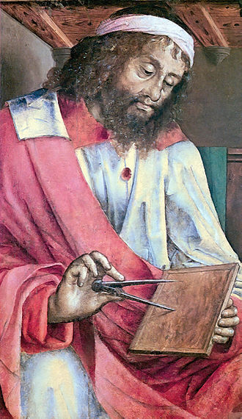
Euclidean algorithm
Suppose a > b. Then the gcd of a and b is the same as the gcd of b and the remainder of a when divided by b.
gcd(a,b) = gcd (b, a % b)
Notes:
Why is this faster?

Slide 20
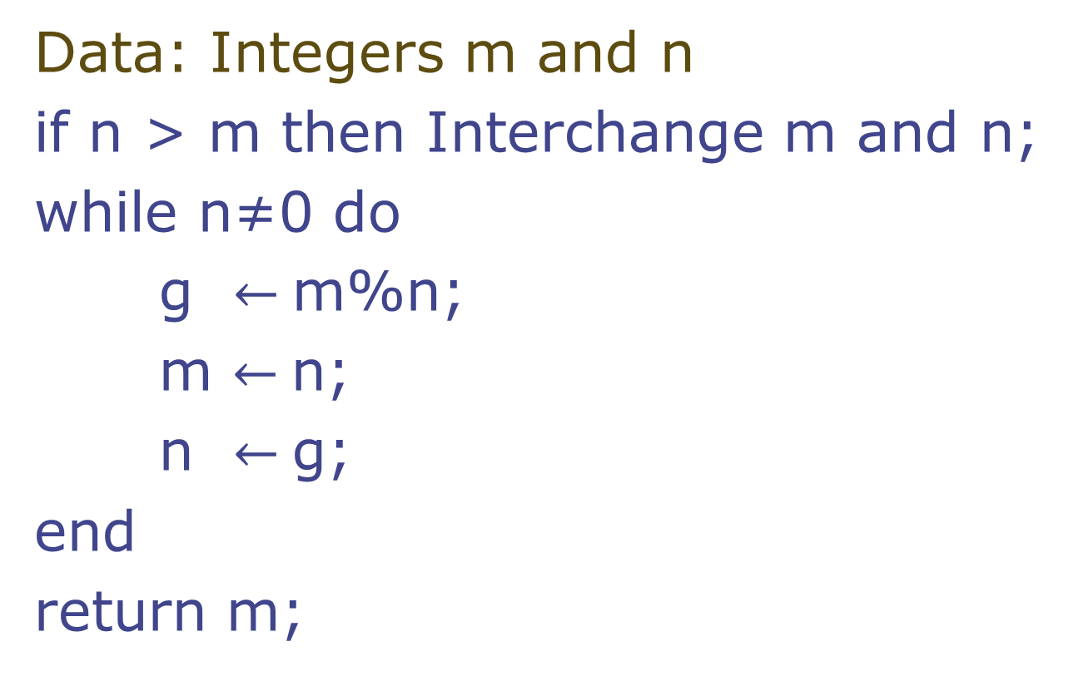
GCD Algorithm
Notes:
At this point, read them as english statements

Slide 21
Programming in C
Notes:
After designing algorithm, we will write code for it. Why two steps?

Slide 22
The Programming Cycle
Write your program or edit (i.e., change or modify) your program.
Compile your program. If compilation fails, return to editing step.
Run your program on an input. If output is not correct, return to editing step.
Repeat step 3 for other inputs, if any.
Compilation Errors ?
Write/Edit
NO
Compile
Run
YES
YES
More
Inputs
OK?
NO
YES!!
Inputs
Exhausted
DONE
Notes:
What is the use of compilation?

Slide 23
Why program in high level languages like C
Writing programs in machine language is long, tedious and error-prone.
They are also not portable—meaning program written for one machine may not work on another machine.
Compilers work as a bridge.
Take as input a C program and produce an equivalent machine program.
Compiler for C for a given target machine
Equivalent
Machine Program
on target machine
C program

Slide 24
IDE for Edit-Compile-Run cycle
In this course, you will be using an Integrated Development Environment (IDE). IDE will be available through your browser.
First login to the system.
Type in your program in the editor of the IDE.
Use the compile button to compile.
Run button to run.
The labs in the first week will introduce you to the system in more detail.
Notes:
Prutor, will be shown in this week’s lab.

Slide 25
Simple! Program
In the first week, we practice the simplest C programs.
# include <stdio.h>
int main () {
printf(“Welcome to ESC101”);
return 0;
}
The program prints the message “Welcome to ESC101”
Notes:
Some standard stuff and then the main output.

Slide 26
Program components
# include <stdio.h>
int main ()
{
printf(“Welcome to ESC101”);
return 0;
}
This tells the C compiler
to include the standard input
output library.
2. Include this line routinely
as the first line of your C file.
printf is the function called to output from a C program. To print a string, enclose it in “ ” and it gets printed. For now, do not try to print “ itself.
“return” returns the control to the caller (program finishes in this case.)
main() is a function.
All C programs start by executing from the first statement of the main function.
printf(“Welcome to ESC101”);
is a statement in C. Statements in C end in semicolon ;

Slide 27
printf
printf is the “voice” of the C program
Used to interact with the users
printf prints its arguments in a certain format
Format provided by user

Slide 28
Another Simple Program
Program to add two integers (17 and 23).
# include <stdio.h>
int main () {
int a = 17;
int b = 23;
int c;
c = a + b;
printf(“Result is %d”, c);
return 0;
}
The program prints the message: Result is 40

Slide 29
# include <stdio.h>
int main () {
int a = 17;
int b = 23;
int c;
c = a + b;
printf(“Result is %d”,c);
return 0;
}
This tells the compiler to reserve a “box” large enough to hold an integer value. The box is named “a” for use in the rest of the program.
“= 17” stores value 17 in the box that we have named “a”.
It is OK to skip this part and store value later as we do for box named “c”.
+ is an operator used to add two numbers. The numbers come from the values stored in the boxes named “a” and “b”
%d tells printf to expect one integer argument whose value is to be printed. We call it placeholder.
We will see more placeholders soon.

Slide 30
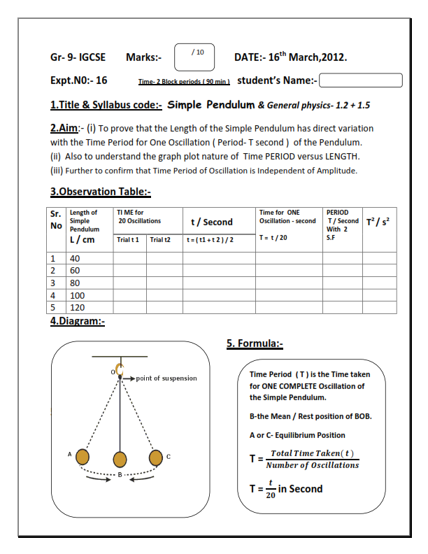
printf (% format)
% format specifiers allow C program to print things whose values are yet not computed
will be known while running the program
%... is similar to the blanks in a lab sheets used for phy/chem labs

Slide 31
Do you now understand this program?
Program to add two integers (17 and 23).
# include <stdio.h>
int main () {
int a = 17;
int b = 23;
int c;
c = a + b;
printf(“Result is %d”, c);
return 0;
}
The program prints the message: Result is 40

Slide 32
Next class
The alphabet of C
Like int
The grammar of C
Like using “ ” to delimit strings
The keywords of C
Like printf
Related reading: Chapter 2.1-2.3

