Slide 1
C Syntax and primitives
ESC101
4th August

Slide 2
Announcements
Screening exam for advanced track
Tomorrow, 9 – 11 am
New Core Labs, CC-02
Can bring reference books, open-book exam
Have to write programs in C
Will involve using pointers, recursion, arrays etc.
Canvas website
Email adarshaj@cse.iitk.ac.in
Prutor login
Email hrishirt@cse.iitk.ac.in
CC me

Slide 3
Announcements
15th August lab makeup on August 19th 2pm-5pm
Tutorial makeup on August 19th 12pm-1pm
We are collecting names for extra orientation classes
For students from Hindi backgrounds
For students who haven’t used computers before
Please give your name to your tutor in next tutorial
We will announce dates and times for extra orientation classes next week

Slide 4
Remember this program?
Program to add two integers (17 and 23).
# include <stdio.h>
int main () {
int a = 17;
int b = 23;
int c;
c = a + b;
printf(“Result is %d”, c);
return 0;
}
The program prints the message: Result is 40

Slide 5
This class
The alphabet of C
Like int
The grammar of C
Like using “ ” to delimit strings
The keywords of C
Like printf
Related reading: Chapter 2

Slide 6
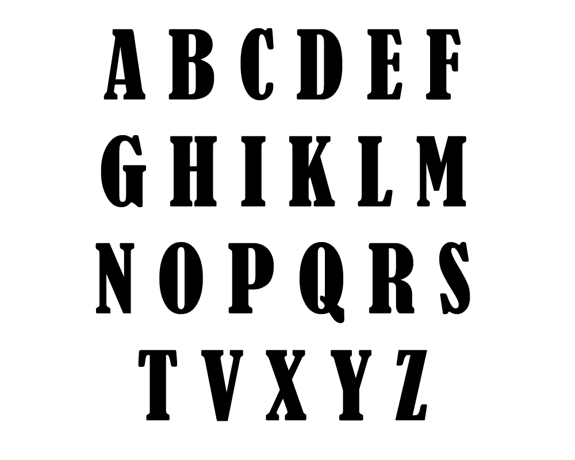
Language building blocks
“Bring me tea”

Slide 7
C alphabet
A B .... Z
a b .... z
0 1 .... 9
Space . , : ; ‘ $ “
# % & ! _ { } [ ] ( ) |
+ - * / =
Have to say mathematical things, logical things, pragmatic things, and explanatory things
Dictionary
Subjects
Objects
Operations
Locations
“Perform operation _xC1 on object t001 with subject NiS from location ViZ321”

Slide 8
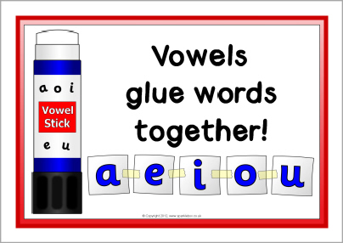
Context-sensitive rules
Some letters are special in every language, and placement and positioning of letters also affects their use
crayon
rain
rabbit
agora
Learn as you use

Slide 9
Context-sensitive rules
; ends statements
What happens if I write printf(“Hi;”) ?
How about if I want to print out “Hi” with the quotation marks?

Slide 10
Context-sensitive rules
Printf prints things to console
// printf will do nothing
/* printf */ will do nothing
These are special character combinations indicating programmer comments
Best way to learn the rules
Play the game
Don’t be afraid

Slide 11
Words
Made of alphabets
Used to convey meaning
English words have fixed meanings
C keywords have fixed meanings
All other C words (identifiers) have variable meanings
They take the meaning you want to give them

Slide 12
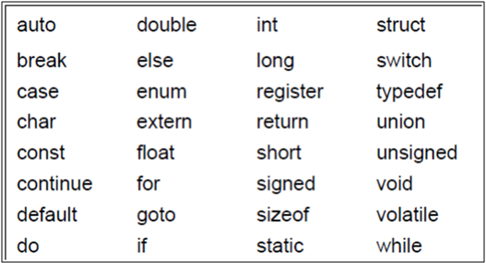
C keywords
Seen already
Later in the course
These 32 key words mean the same across every C compiler.
Some compilers reserve a few extra keywords, but those are less important.

Slide 13
Keyword usage
#include <stdio.h>
int main(void){
int main = 3;
printf("%d", main);
return 0;
}
#include <stdio.h>
int main(void){
int else = 3;
printf("%d", else);
return 0;
}
This will work
Not recommended
This won’t work

Slide 14
int
Computers store data in binary code
A 0 or 1 is a bit
8 bits make a byte
2/4/8 bytes make a word (depending on architecture)
The keyword int asks the computer to assign one word of memory to store an integer value
int a = 34;
How many integers can you store using N bits?
Can only use int to store integers in a limited range
If you exceed the range, you will get a compilation error
0000 0000 | 0010 0010

Slide 15
return
You will understand this better if/when you learn about OS
For this course, return is what you use to end execution of the current set of instructions
It returns the value 0 to indicate successful execution of instructions
Unsuccessful execution returns non-zero value
In C, using void main and no return statement terminates the program abnormally
Best avoided in this course

Slide 16
Do you now understand this program?
Program to add two integers (17 and 23).
# include <stdio.h>
int main () {
int a = 17;
int b = 23;
int c;
c = a + b;
printf(“Result is %d”, c);
return 0;
}
The program prints the message: Result is 40

Slide 17
C identifier syntax
Can use
A – Z
a – z
0 – 9
The underscore character
Cannot begin with a number
A_3, abcDS2, this_variable are fine
321, 5_r, dfd@dhr, this variable, no-entry are not

Slide 18
C identifier conventions
Prefer to use short names
Use capital letters to identify program constants
Use small letters to identify program variables

Slide 19
C character constants
#include <stdio.h>
int main(void){
int a = 'B';
printf("%d\n", a);
return 0;
}
What do you think the output will be?

Slide 20
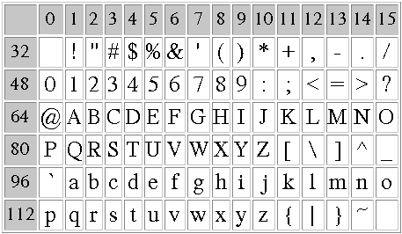
ASCII character set
Translates letters to numbers for the computer to understand

Slide 21
Character constant operations
#include <stdio.h>
int main(void){
int a = ‘C‘ – ‘3’;
printf("%d\n", a);
return 0;
}
#include <stdio.h>
int main(void){
int a = ‘c‘ – ‘3’;
printf("%d\n", a);
return 0;
}

Slide 22
Next class
C program structure
Variables
Expressions
Statements
Declarations
Problem → Pseudocode → Program
Extra examples
Related reading: Chapter 2

