Slide 1
Data types in C
ESC101
9th August

Slide 2
Last class
Four types of C statements
Declaration
Input
Output
Expressions

Slide 3
This class
C data types
Type conversions
Implicit
Explicit
Consequences
Related reading: Chapter 2.7-2.13

Slide 4
Data Types in C
char
Single character, e.g. a or C or 6 or $
int
Bounded integers, e.g. 732 or -5
float
Real numbers, e.g. 3.14 or 2.0
double
Real numbers with more precision

Slide 5
Type modifiers in C
Signed
Range [-2^{N-1} , 2^{N-1}-1]
Unsigned
Range [0,2^{N}-1]
Short
Can use half the size of the normal data type
Long
Can use double the size of the normal data type

Slide 6
Composite data types
unsigned char (%c)
signed short int = signed short = short (%hi)
unsigned int (%u)
signed long int = signed long = long (%li)
long long (%ll)
float (%f)
double (%f or %lf)
long double (%Lf)

Slide 7

Rocket science
First launch of the Ariane 5 rocket on 4th June 1996
Rocket lost its flight path and disintegrated 40 seconds into launch
Cost → $370 million
Fundamental cause of disaster
Float to int data type casting

Slide 8
Floating point representation
Have to represent three things
sign
Number
Exponent
Assign some bits of memory for each
1 bit for sign
m for exponent
n for mantissa

Slide 9
Conceptual example
Consider a 4 bit memory
What can you assign with unsigned int?
0,1,.....15
What can you assign with signed int?
Use twos complement notation
-8,-7,.... ,7
What can you assign with float?
s
e
m
m
1.0, 1.1, 1.2, 1.3
2.0, 2.2, 2.4, 2.6
-1.0, -1.1, -1.2, -1.3
-2.0, -2.2, -2.4, -2.6
(-1)^{s} * 1.m* 2^{e-0}

Slide 10
Edge cases in float representations
Has upper bound
Has lower bound
Needs special handling for special numbers
Zero (when e and m are all zeros)
Infinity
Exact matches can be problematic
Is x = 0.902323?

Slide 11
temp_conversion.c
Microprocessors represent real numbers using finite precision, i.e., using limited number of digits after decimal point.
Typically uses scientific notation:
12.3456789 represented as 1.23456789E+1.
Compile and Run
# include <stdio.h>
int main() {
float C;
float F;
C=50;
F = ((9*C)/5) + 32;
printf(“The temperature”);
printf( “ %f ”, C);
printf(“Celsius equals”);
printf(“ %f ”, F);
printf(“Fahrenheit”);
return 0;
}
“%f” signifies that the corresponding variable is to be printed as a real number in decimal notation.
C
50.000
F
??
??
??
122.0000
The temperature
50.000000
Celsius equals
122.000000
Fahrenheit

Slide 12
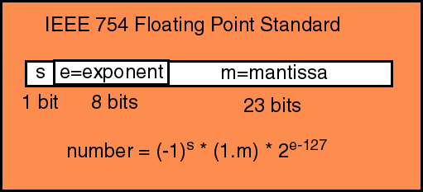
IEEE 754 floating point representation

Slide 13
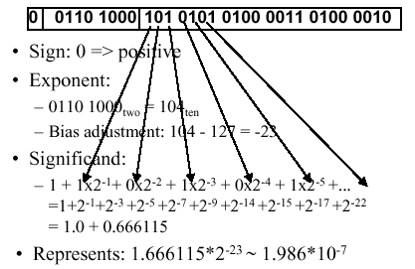
Single-precision floating point representation
This is what you’re using when you are invoking float

Slide 14
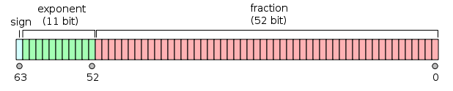
Double precision
Same logic as single precision, but with 64 bits of memory

Slide 15
Type Conversion (Type casting)
Converting values of one type to other.
Example: int to float and float to int (also applies to other types)
Can be implicit or explicit
int k =5;
float x = k; // good implicit conversion, x gets 5.0
float y = k/10; // poor implicit conversion
float z = ((float) k)/10; // Explicit conversion, z gets 0.5

Slide 16
Typecasting application
int main(){
int total=100, number=50;
float percentage=0.0;
percentage=(number/total)*100;
printf("%.2f",percentage);
}
Output: 0.0
int main(){
int total=100, number=50;
float percentage=0.0;
percentage= (float) number/total *100;
printf("%.2f",percentage);
}
Output: 50.0

Slide 17
Loss of Information!
Type conversion may result in lost information.
Larger sized type (e.g. float ) converted to smaller sized type (e.g. int) is undefined/ unpredictable.
Smaller sized type (e.g. int) converted to larger type (e.g. float) may also result in loss. Take care!

Slide 18
float to int: type conversion (result ok)
float x;
…
(int) x;
converts the real value stored in x into an integer. Can be used anywhere an int can.
#include<stdio.h>
int main() {
float x; int y; /* define two variables */
x = 5.67;
y = (int) x; /* convert float to int */
printf(“%d”, y);
return 0;
}
Output : 5

Slide 19

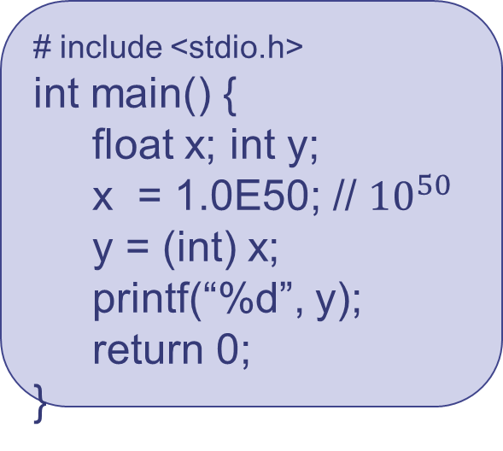
float to int type conversion (not ok!)
float is a larger box, int is a smaller box. Assigning a float to an int may lead to loss of information and unexpected values.
The floating point number 1E50 is too large to fit in an integer box.
# include <stdio.h>
int main() {
float x; int y;
x = 1.0E50; // ${10}^{50}$
y = (int) x;
printf(“%d”, y);
return 0;
}
Output:
2147483647
Careful when converting from a ‘larger’ type to ‘smaller’ type. Undefined.

Slide 20
Rocket science
Rocket’s horizontal velocity was greater than older rocket’s (Ariane 4)
Inertial navigation system
A single calculation required conversion from double to int
Worked fine with the smaller value in Ariane 4
Gave a garbage result for the large value in Ariane 5
Commanded engine to make an impossibly large course correction
Veered off course
Auto-destruct sequence initialized

Slide 21
int to float (can go wrong)
# include <stdio.h>
int main() {
int y;
y = 1000001;
printf(“%f”, (float) y);
return 0; }
Output:
1000001.000000
Result is correct
# include <stdio.h>
int main() {
int y;
y = 10000009;
printf(“%f\n”, (float) y);
printf(“ %d”, y);
return 0; }
Output:
10000008.000000
10000009
Result is not correct.
Information is lost
16 bit float vs 32 bit int

Slide 22
char to int
Range: 0 to 255
You should NOT try to remember ASCII values
Encoding/programming languages provide alternatives to use them
C treats characters as integers corresponding to their ASCII value.
While displaying with %c placeholder, the ASCII value is converted to its corresponding character.

Slide 23
char ←→ int
Interconversion between character and integer datatypes can be exploited to write programs.
printf("%d\n", 'A');
printf("%d\n", '7');
printf("%c\n", 70);
printf("%c\n", 321);
Output:
65
55
F
321 is outside range! What do you think will be the output of
printf("%c\n",321);
Try it out

Slide 24
char-int operations
Interconversion between character and integer datatypes can be exploited to write programs.
printf("%c\n", ‘C’+5);
printf("%c\n", ‘D’ - ‘A’ + ‘a’ );
printf("%d\n", ‘3’ + 2);
Output:
H
d
53
Placeholder determines the output.
Use with caution.
Avoid arithmetic operation such as * and / on characters.
Common Mistake: Incorrect data type of placeholder.

Slide 25
Next class
I/O
Escape sequences etc.
Operators
Related reading : Chapter 3

