Slide 1
Conditional statements
ESC101
18th August

Slide 2
This class
Control statements (Ch 6.1-6.2, 6.11)
Branching – if-else, goto

Slide 3
Announcement
Tuesday labs tomorrow 2pm-5pm
Tutorial tomorrow 12pm-1pm
NCC cadets, come ASAP
Perspective taking test
Participation is voluntary, not part of course grade
Will take 5 minutes
Conducted in next tutorial class (Tuesday, 22nd)

Slide 4

Perspective taking test
Standing at flower, facing tree
Point to cat
Tree
Flower

Slide 5
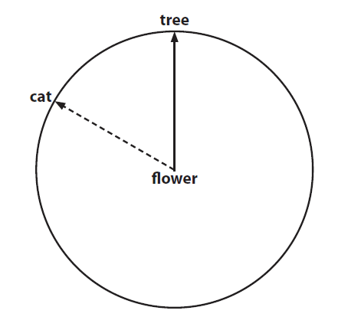
Perspective taking test
Standing at flower, facing tree
Point to cat

Slide 6
Control statements
Flow of control so far
Top to bottom
#include <stdio.h>
#include <stdlib.h>
int main() {
int n;
double m;
m = log(n); // natural log
printf("%f\n", m);
return 0;
}

Slide 7
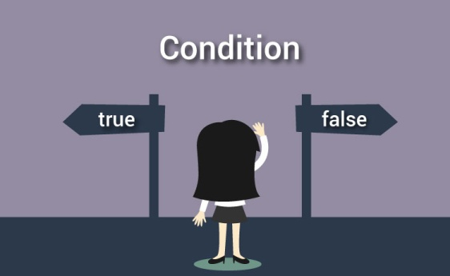
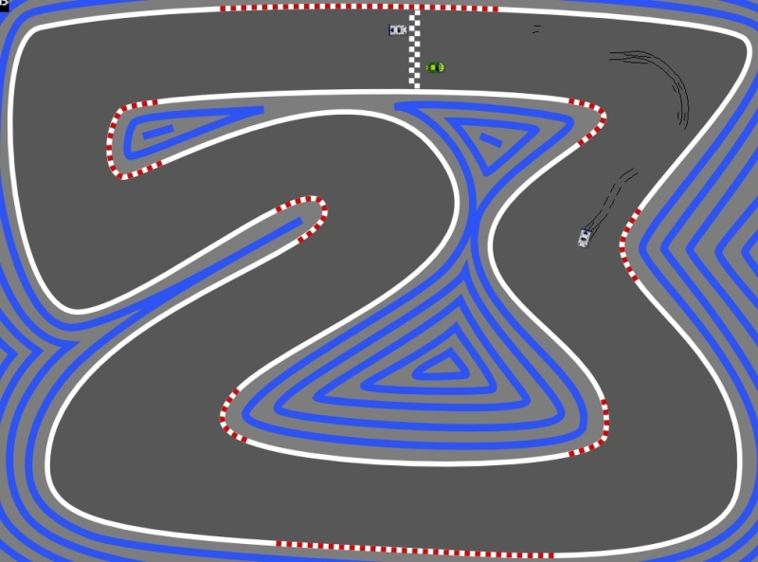

Control statements
Branching
Looping

Slide 8
Branching: use case
What happens when n is negative?
#include <stdio.h>
#include <stdlib.h>
int main() {
int n;
double m;
scanf(“%d”,&n);
m = log(n); // natural log
printf("%f\n", m);
return 0;
}

Slide 9
if statement
General form of the if statement
Execution of if statement
First the expression is evaluated.
If it evaluates to a non-zero value, then S1 is executed and then control (program counter) moves to the statement S2.
If expression evaluates to 0, then S2 is executed.
if (expression)
statement S1
statement S2
true
false
S1
S2

Slide 10
goto statement
Can ask program to skip to a particular arbitrary location in your code
Syntax –
goto label;
label: expression;
Program control goes to the statement beginning with the label in the goto statement

Slide 11
Solving the use case
#include <stdio.h>
#include <stdlib.h>
int main() {
int n;
double m;
printf(“Please enter a positive number: ”);
scanf(“%d”,&n);
if (n<0)
goto error;
m = log(n); // natural log
printf("%f\n", m);
error: printf(“Why can’t you follow instructions?");
return 0;
}

Slide 12
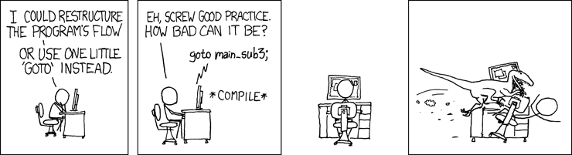
goto statement
A computer programmer is someone who, when asked to go to hell, objects to the use of the word ‘goto’ - Rajat, ESC101 instructor
(Almost) never use goto
Too arbitrary, makes code hard to understand

Slide 13
Branching statements in C
3 types of conditional statements in C
if (cond) action
if (cond) action
else some-other-action
switch-case
Each action is a sequence of one or more statements!

Slide 14
if-else statement
General form of the if-else statement
Execution of if-else statement
First the expression is evaluated.
If it evaluates to a non-zero value, then S1 is executed and then control (program counter) moves to S3.
If expression evaluates to 0, then S2 is executed and then control moves to S3.
S1/S2 can be block of statements!
if (expression)
statement S1
else
statement S2
statement S3
true
false
S1
S2
S3

Slide 15
Solving the use case with if-else
#include <stdio.h>
#include <stdlib.h>
int main() {
int n;
double m;
printf(“Please enter a positive number: ”);
scanf(“%d”,&n);
if (n>0)
m = log(n); // natural log
printf("%f\n", m);
else
printf(“Why can’t you follow instructions?");
return 0;
}
Something’s not quite right in this code

Slide 16
Compound Statements
A block of code containing zero or more statements
Contained between { and }
Format:
{
Local Declarations
Statements
}

Slide 17
Getting it right
#include <stdio.h>
#include <stdlib.h>
int main() {
int n;
double m;
printf(“Please enter a positive number: ”);
scanf(“%d”,&n);
if (n>0){
m = log(n); // natural log
printf("%f\n", m);
}
else
printf(“Why can’t you follow instructions?");
return 0;
}

Slide 18
Good indentation practice
This is a main statement
This is a dependent statement
Main statements are statements in the main control flow of your program
Dependent statements branch off from the main flow
Indent them, for easier understanding of code
Matters more in some languages, like python
Pro-tip: use 4 spaces instead of tab to indent

Slide 19
Example
Problem: Input a, b, c are real positive numbers such that c is the largest of these numbers. Print ACUTE if the triangle formed by a, b, c is an acute angled triangle and print NOT ACUTE otherwise.
int main() {
float a; float b; float c;
scanf(“%f%f%f”, &a,&b,&c); /* input a,b,c */
if ( (a*a + b*b) > (c*c) ) { /* expression*/
printf(“ACUTE”);
}
else {
printf(“NOT ACUTE”);
}
return 0;
}

Slide 20
if-else statement
Read two integers and print the min.
# include <stdio.h>
int main() {
int x, y;
scanf(“%d%d”, &x,&y);
if (x < y) {
printf(“%d”, x);
} else {
printf(“%d”, y);
}
return 0;
}
Check if x is less than y.
If so, print x
Otherwise, print y.

Slide 21
Tracing Execution of if-else
Run the program
# include <stdio.h>
int main() {
int x; int y;
scanf(“%d%d”, &x,&y);
if (x < y) {
printf(“%d\n”,x);
}
else { printf(“%d\n”,y);}
return 0;
}
Input
6 10
x
y
6
10
6 < 10 so the if-branch is taken
Output
6

Slide 22
Nested if-else
#include <stdio.h>
#include <stdlib.h>
int main() {
int c,d;
printf(“Do you like C? (0/1) ”);
scanf(“%d”,&c);
if(c){
printf(“Do you really like C? (0/1) ”);
scanf(“%d”,&d);
if(d)
printf(“I really like C!”);
else
printf(“Not really”);
}
else{
printf(“No, I hate it”);
}
return 0;
}

Slide 23
Nested if-else
If e1 s1 else if e2 s2
If e1 s1 else if e2 s2 else s3
If e1 if e2 s1 else s2 else s3
If e1 if e2 s1 else s2
Rule of thumb: else clause looks for the closest previous if without an else

Slide 24




Finding min of 3 numbers
Input a,b,c
TRUE
a<=b
FALSE
TRUE
a<=c
FALSE
TRUE
b<=c
FALSE
Print
a
Print c
Print b
Print
c

Slide 25




Input a,b,c
int a,b,c;
scanf(“%d%d%d”,&a,&b,&c);
if (a <= b) {
if (a <= c) {
printf(“min = %d”,a);
}
else {
printf(“min = %d”, c);
}
}
else {
if (b <= c) {
printf(“min = %d”, b);
}
else {
printf(“min =%d”, c);
}
}
a<=b
TRUE
FALSE
a<=c
b<=c
TRUE
FALSE
TRUE
FALSE
Print
a
Print c
Print b
Print
c
Each branch translates to an if-else statement
Hierarchical branches result in nested if-s

Slide 26
More Conditionals
Sorting a sequence of numbers (i.e., arranging the numbers in ascending or descending order) is a basic primitive.
Problem: read three numbers into a, b and c and print them in ascending order.
Start with the flowchart for finding minimum of three numbers and add one more level of conditional check.
Then translate the flowchart into C program.

Slide 27
Finding min of 3 numbers
Input a,b,c
Replace print by more comparisons and then print.
TRUE
a<=b
FALSE
TRUE
a<=c
FALSE
TRUE
b<=c
FALSE
Print
a
Print c
Print b
Print
c

Slide 28




Ascending order of 3 numbers
Input a,b,c
TRUE
a<=b
FALSE
TRUE
a<=c
FALSE
TRUE
b<=c
FALSE
Print
a
Print c
Print b
Print
c
TRUE
b<=c
FALSE
print
TRUE
a<=c
FALSE
print
c a b
c b a
print
print
print
print
a b c
a c b
b a c
b c a

Slide 29
if (a <= b) {
if (a <= c) { /* a <= b and a <= c */
if (b <= c) { /* a <= b, a <= c, b <= c */
printf(“%d %d %d \n”, a, b, c);
} else { /* a <= b, a <= c, c < b */
printf(“%d %d %d \n”, a, c, b);
}
} else { /* a <= b, c < a*/
printf(“%d %d %d \n”, c, a, b) ;
}
} else { /* b < a */
if (b <= c) { /* b < a and b <= c */
if (a <= c) { /* b < a, b <= c, a <= c */
printf(“%d %d %d\n”, b, a, c);
} else { /* b < a, b <= c, c < a */
printf(“%d %d %d\n”, b, c, a); }
}
} else { /* b < a, c < b */
printf(“%d %d %d\n”, c, b, a); }
}
}
Notes:
29

Slide 30
Nested if, if-else
Earlier examples showed us nested if-else statements
Because if and if-else are also statements, they can be used anywhere a statement or block can be used.
if (a <= b) {
if (a <= c) { … } else {…}
} else {
if (b <= c) { … } else { … }
}

Slide 31
Else if
A special kind of nesting is the chain of if-else-if-else-… statements
if (cond1) {
stmt1
} else {
if (cond2) {
stmt2
} else {
if (cond3) {
….
}
}
}
if (cond1)
stmt-block1
else if (cond2)
stmt-block2
else if (cond3)
stmt-block3
else if (cond4)
stmt-block4
else if …
else
last-block-of-stmt
if (cond1) {
stmt1
} else {
if (cond2) {
stmt2
} else {
if (cond3) {
….
}
}
}
} else
if (cond2) {
stmt2
} else {
if (cond3) {
….
}
}
} else if (cond2) {
stmt2
} else {
if (cond3) {
….
}
}
} else if (cond2) {
stmt2
} else if (cond3) {
…
}
if (cond2) {
stmt2
} else {
if (cond3) {
….
}
}
General form of if-else-if-else…

Slide 32
Else if
A special kind of nesting is the chain of if-else-if-else-… statements
if (cond1) {
stmt1
} else {
if (cond2) {
stmt2
} else {
if (cond3) {
….
}
}
}
if (cond1)
stmt-block1
else if (cond2)
stmt-block2
else if (cond3)
stmt-block3
else if (cond4)
stmt-block4
else if …
else
last-block-of-stmt
General form of if-else-if-else…

Slide 33
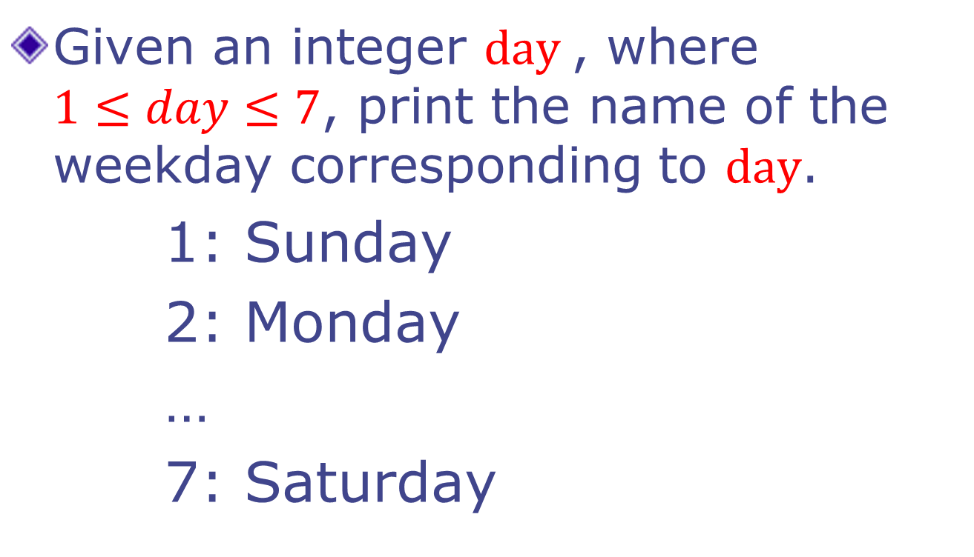
Example
Given an integer $day$, where $1≤day≤7$, print the name of the weekday corresponding to $day$.
1: Sunday
2: Monday
…
7: Saturday

Slide 34
Printing the day
int day;
scanf (“%d”, &day);
if (day == 1) { printf(“Sunday”); }
else if (day == 2) { printf (“Monday”); }
else if (day == 3) { printf (“Tuesday”); }
else if (day == 4) { printf (“Wednesday”); }
else if (day == 5) { printf (“Thursday”); }
else if (day == 6) { printf (“Friday”); }
else if (day == 7) { printf (“Saturday”); }
else { printf (“ Illegal day %d”, day); }

Slide 35
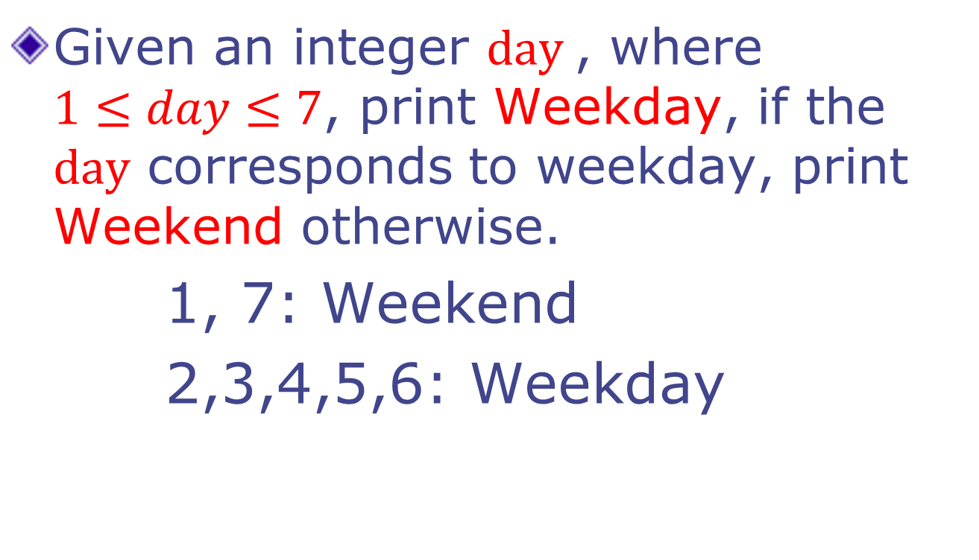
Example 2
Given an integer $day$, where $1≤day≤7$, print Weekday, if the $day$ corresponds to weekday, print Weekend otherwise.
1, 7: Weekend
2,3,4,5,6: Weekday

Slide 36
Weekday - version 1
int day;
scanf (“%d”, &day);
if (day == 1) { printf(“Weekend”); }
else if (day == 2) { printf (“Weekday”); }
else if (day == 3) { printf (“Weekday”); }
else if (day == 4) { printf (“Weekday”); }
else if (day == 5) { printf (“Weekday”); }
else if (day == 6) { printf (“Weekday”); }
else if (day == 7) { printf (“Weekend”); }
else { printf (“ Illegal day %d”, day); }

Slide 37
Weekday - version 2
int day;
scanf (“%d”, &day);
if ((day == 1) || (day == 7)) {
printf(“Weekend”);
} else if ( (day == 2) || (day == 3)
|| (day == 4) || (day == 5)
|| (day == 6)) {
printf (“Weekday”);
} else {
printf (“ Illegal day %d”, day);
}

Slide 38
Weekday - version 3
int day;
scanf (“%d”, &day);
if ((day == 1) || (day == 7)) {
printf(“Weekend”);
} else if ( (day >= 2) && (day <= 6) ) {
printf (“Weekday”);
} else {
printf (“ Illegal day %d”, day);
}

Slide 39
Summary of if, if-else
if-else, nested if's, else if.
Braces {…} can be omitted if a block has only one statement.
Multiple ways to solve a problem
issues of better readability
and efficiency.

Slide 40
Next class
More if-else
Switch-case
Examples of conditional statement usage

