Slide 1
More about conditionals
ESC101
August 21st

Slide 2
Announcements
Should have received minor quiz 1 sheets
Should have received lab 2 scores
Major quiz 1 on August 28th
In class, during class hours
Syllabus
Everything up to the coming Friday’s lecture
Tomorrow’s tutorial
Spatial orientation test
Not graded for course
Voluntary. Don’t have to do it if you don’t want to.

Slide 3
Copying
Copy at your own risk
in any component (lab/quiz/exams/lab exams).
If you are caught, you get penalized on grade (most likely F).
Will not be allowed to drop the course
Case reported to DoAA/SSAC
No warning or second chance
All parties involved in copying will be held equally responsible. Copying from internet is penalized equally.
Policy may change on need basis
Esc101, Programming

Slide 4
This class
More about if-else statements
Switch-case
Break

Slide 5
If-else review
#include<stdio.h>
int main() {
int i = 5, j = 6, k = 7;
if(i > j == k)
printf("%d %d %d", i++, ++j, --k);
else
printf("%d %d %d", i, j, k);
return 0;
}
5 6 7
#include<stdio.h>
int main() {
int i = 5;
if(i = i - 5 > 4)
printf("inside if block");
else
printf("inside else block");
return 0;
}
Inside else block

Slide 6
If-else review
#include<stdio.h>
int main() {
if(sizeof(0))
printf(“Yes");
else
printf(“No");
return 0;
}
Yes
#include <stdio.h>
int main()
{
char val=1;
if(val--==0)
printf("TRUE");
else
printf("FALSE");
return 0;
}
FALSE

Slide 7
Trick questions
Choice of compiler affects output
Will not be on exam
If in doubt, give your answer
With justification
Will mark with from now on

Slide 8
Unmatched if and else
X
if ((a != 0) && (b != 0))
if (a * b >= 0)
printf (“positive”);
else
printf(“zero”);
OUTPUT for a = 5, b = 0
NO OUTPUT!!
OUTPUT for a = 5, b = -5
zero
if ((a != 0) && (b != 0))
if (a * b >= 0)
printf (“positive”);
else
printf(“negative”);
OUTPUT for a = 5, b = 0
NO OUTPUT!!
OUTPUT for a = 5, b = -5
negative

Slide 9
Unmatched if and else
An else always matches closest unmatched if
Unless forced otherwise using { … }
if (cond1)
if (cond2)
…
else
…
if (cond1) {
if (cond2)
…
else
…
}

Slide 10
Unmatched if and else
An else always matches closest unmatched if
Unless forced otherwise using { … }
if (cond1)
if (cond2)
…
else
…
if (cond1) {
if (cond2)
…
}
else
…
IS NOT SAME AS

Slide 11
Else if
A special kind of nesting is the chain of if-else-if-else-… statements
if (cond1) {
stmt1
} else {
if (cond2) {
stmt2
} else {
if (cond3) {
….
}
}
}
if (cond1)
stmt-block1
else if (cond2)
stmt-block2
else if (cond3)
stmt-block3
else if (cond4)
stmt-block4
else if …
else
last-block-of-stmt
if (cond1) {
stmt1
} else {
if (cond2) {
stmt2
} else {
if (cond3) {
….
}
}
}
} else
if (cond2) {
stmt2
} else {
if (cond3) {
….
}
}
} else if (cond2) {
stmt2
} else {
if (cond3) {
….
}
}
} else if (cond2) {
stmt2
} else if (cond3) {
…
}
if (cond2) {
stmt2
} else {
if (cond3) {
….
}
}
General form of if-else-if-else…

Slide 12
Else if
A special kind of nesting is the chain of if-else-if-else-… statements
if (cond1) {
stmt1
} else {
if (cond2) {
stmt2
} else {
if (cond3) {
….
}
}
}
if (cond1)
stmt-block1
else if (cond2)
stmt-block2
else if (cond3)
stmt-block3
else if (cond4)
stmt-block4
else if …
else
last-block-of-stmt
General form of if-else-if-else…

Slide 13
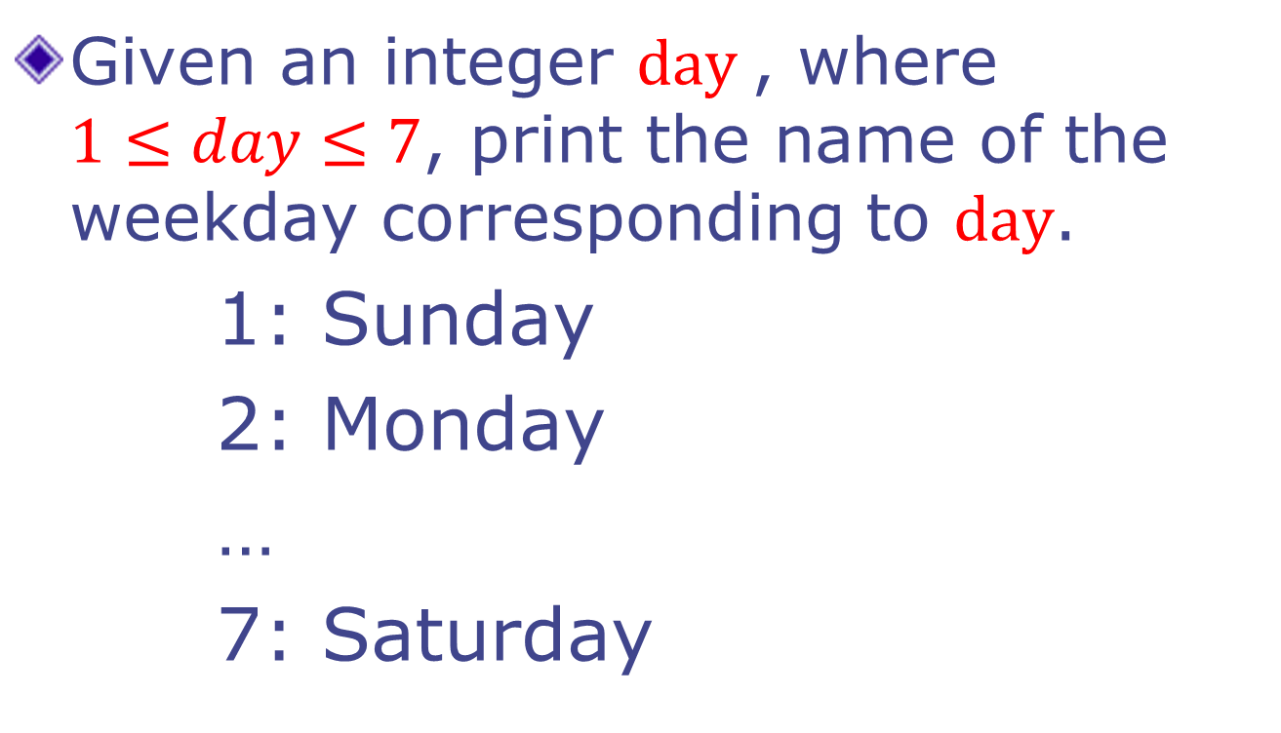
Example
Given an integer $day$, where $1≤day≤7$, print the name of the weekday corresponding to $day$.
1: Sunday
2: Monday
…
7: Saturday

Slide 14
Printing the day
int day;
scanf (“%d”, &day);
if (day == 1) { printf(“Sunday”); }
else if (day == 2) { printf (“Monday”); }
else if (day == 3) { printf (“Tuesday”); }
else if (day == 4) { printf (“Wednesday”); }
else if (day == 5) { printf (“Thursday”); }
else if (day == 6) { printf (“Friday”); }
else if (day == 7) { printf (“Saturday”); }
else { printf (“ Illegal day %d”, day); }

Slide 15
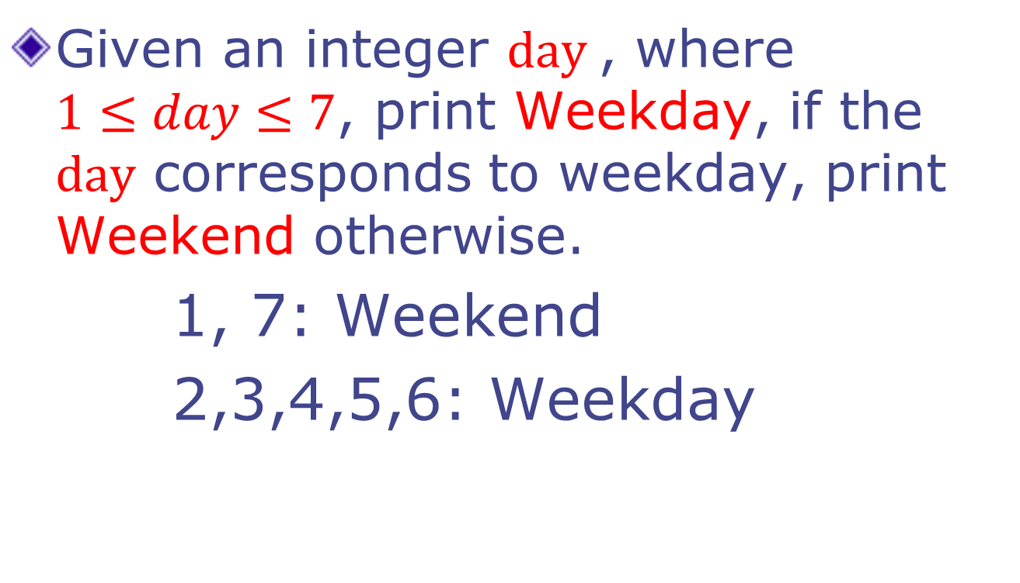
Example 2
Given an integer $day$, where $1≤day≤7$, print Weekday, if the $day$ corresponds to weekday, print Weekend otherwise.
1, 7: Weekend
2,3,4,5,6: Weekday

Slide 16
Weekday - version 1
int day;
scanf (“%d”, &day);
if (day == 1) { printf(“Weekend”); }
else if (day == 2) { printf (“Weekday”); }
else if (day == 3) { printf (“Weekday”); }
else if (day == 4) { printf (“Weekday”); }
else if (day == 5) { printf (“Weekday”); }
else if (day == 6) { printf (“Weekday”); }
else if (day == 7) { printf (“Weekend”); }
else { printf (“ Illegal day %d”, day); }

Slide 17
Weekday - version 2
int day;
scanf (“%d”, &day);
if ((day == 1) || (day == 7)) {
printf(“Weekend”);
} else if ( (day == 2) || (day == 3)
|| (day == 4) || (day == 5)
|| (day == 6)) {
printf (“Weekday”);
} else {
printf (“ Illegal day %d”, day);
}

Slide 18
Weekday - version 3
int day;
scanf (“%d”, &day);
if ((day == 1) || (day == 7)) {
printf(“Weekend”);
} else if ( (day >= 2) && (day <= 6) ) {
printf (“Weekday”);
} else {
printf (“ Illegal day %d”, day);
}

Slide 19
Switch-case statement
Multi-way decision
Checks whether an expression matches one out of a number of constant integer values
Execution branches based on the match found
Oh man! Missed Esc101 major quiz!
Today is Friday

Slide 20
Printing the day, version 2
switch (day) {
case 1: printf(“Sunday”); break;
case 2: printf (“Monday”); break;
case 3: printf (“Tuesday”); break;
case 4: printf (“Wednesday”); break;
case 5: printf (“Thursday”); break;
case 6: printf (“Friday”); break;
case 7: printf (“Saturday”); break;
default: printf (“ Illegal day %d”, day);
}

Slide 21
Weekday, version 4
switch (day) {
case 1:
case 7: printf (“Weekend”); break;
case 2:
case 3:
case 4:
case 5:
case 6: printf (“Weekday”); break;
default: printf (“ Illegal day %d”, day);
}

Slide 22
The break statement
Syntax –
break;
Used to break out of current code branch
Not to end the program

Slide 23
General Form of switch-case
switch (selector-expr) {
case label1: s1; break;
case label2: s2; break;
...
case labelN: sN; break;
default : sD;
}
Expr only of type INT
Execution starts at the matching case.
default is optional. (= remaining cases)
The location of default does not matter.
The statements following a case label are executed one after other until a break is encountered (Fall Through)
Notes:
Expr can be int, char, conditional. NOT float.
Once the execution begins the subsequent case-conditions get executed too!

Slide 24
Example
Switch expressions can only be of type int
#include<stdio.h>
int main() {
char ch = 65;
switch(ch) {
case 'A': printf("Apple");
break;
case 'B': printf("Bing");
break;
default: printf("Bye");
break;
}
return 0;
}
Apple

Slide 25
General Form of switch-case
switch (selector-expr) {
case label1: s1; break;
case label2: s2; break;
...
case labelN: sN; break;
default : sD;
}
Expr only of type INT
Execution starts at the matching case.
default is optional. (= remaining cases)
The location of default does not matter.
The statements following a case label are executed one after other until a break is encountered (Fall Through)
Notes:
Expr can be int, char, conditional. NOT float.
Once the execution begins the subsequent case-conditions get executed too!

Slide 26
Fall Through…
int n = 100;
int digit = n%10; // last digit
switch (digit) {
default : printf(“Not divisible by 5\n”);
break;
case 0: printf(“Even\n”);
case 5: printf(“Divisible by 5\n”);
break;
}
What is printed by the program fragment?
Answer:
Even
Divisible by 5;

Slide 27
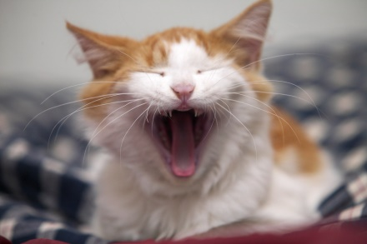

Class Quiz
What is the value of expression:
Compile time error
Run time crash
I don’t know / I don’t care
0
1
(5<2) && (3/0)
The correct answer is

Slide 28
Short-circuit evaluation
Do not evaluate the second operand of binary logical operator if result can be deduced from first operand
Arguments of && and || are evaluated from left to right (in sequence)
Also applies to nested logical operators
!( (2>5) && (3/0) ) || (4/0)
Evaluates to 1
1
0
0
1

Slide 29
3 Factors for Expr Evaluation
Precedence
Applied to two different class of operators
+ and *, - and *, && and ||, + and &&, …
Associativity
Applied to operators of same class
* and *, + and -, * and /, …
Order of evaluation
Precedence and associativity identify the operands for each operator (Parenthesization)
Not which operand/expr is evaluated first
In C, order of evaluation of operands is defined only for && and ||

Slide 30
Next class
Loops (6.3-6.5)
While statement
Do-while statement
For statement

