Slide 1
Looping
ESC101
August 23rd

Slide 2
This class
Introduction to looping
While statement
Do-while statement

Slide 3

The computer’s BIG advantage
Once you’ve told a computer how to do something once, it can reproduce the exact same process a trillion times.

Slide 4
Printing Multiplication Table
5 | X | 1 | = | 5
5 | X | 2 | = | 10
5 | X | 3 | = | 15
5 | X | 4 | = | 20
5 | X | 5 | = | 25
5 | X | 6 | = | 30
5 | X | 7 | = | 35
5 | X | 8 | = | 40
5 | X | 9 | = | 45
5 | X | 10 | = | 50

Slide 5
Program…
int n;
scanf(“%d”, &n);
printf(“%d X %d = %d”, n, 1, n*1);
printf(“%d X %d = %d”, n, 2, n*2);
printf(“%d X %d = %d”, n, 3, n*3);
printf(“%d X %d = %d”, n, 4, n*4);
….
Too much
repetition!
Can I avoid
it?

Slide 6
Printing Multiplication Table
Loop Entry
Input n
i = 1
Loop Exit
i <=10
TRUE
FALSE
Print n x i = ni
i = i+1
Stop
Loop

Slide 7
Printing Multiplication Table
Input n
i = 1
scanf(“%d”, &n);
int i = 1;
while (i <= 10) {
printf(“%d X %d = %d”,
n, i, n*i);
i = i + 1;
}
// loop exited!
TRUE
i <=10
FALSE
Print n x i = ni
i = i+1
Stop

Slide 8
While Statement
while (expression)
statement1;
statement2;
FALSE
expression
TRUE
statement1
statement2
Read in English as:
As long as expression is TRUE execute statement1.
when expression becomes FALSE execute statement 2.

Slide 9
While Statement
while (expression)
statement1;
statement2;
FALSE
expression
TRUE
statement1
statement2
Evaluate expression
If TRUE then
execute statement1
goto step 1.
If FALSE then execute statement2.

Slide 10
Example 1
Read a sequence of integers from the terminal until -1 is read.
Output sum of numbers read, not including the -1..
First, let us write the loop, then add code for sum.
int a;
scanf(“%d”, &a); /* read into a */
while ( a != -1) {
scanf(“%d”, &a); /* read into a inside loop*/
}

Slide 11
Tracing the loop
int a;
scanf(“%d”, &a); /* read into a */
while ( a != -1) {
scanf(“%d”, &a); /*read into a inside loop*/
}
INPUT
4
15
-5
-1
??
4
15
-5
-1
Trace of memory
location a
One scanf is executed every time body of the loop is executed.
Every scanf execution reads one integer.

Slide 12
Add numbers until -1
Keep an integer variable s.
s is the sum of the numbers seen so far (except the -1).
int a;
int s;
s = 0; // not seen any a yet
scanf(“%d”, &a); // read into a
while (a != -1) {
s = s + a; // last a is not -1
scanf(“%d”, &a); // read into a inside loop
}
// one could print s here etc.

Slide 13
Terminology
Iteration: Each run of the loop is called an iteration.
In example, the loop runs for 3 iterations, corresponding to inputs 4, 15 and -5.
For input -1, the loop is exited, so there is no iteration for input -1.
3 components of a while loop
Initialization
first reading of a in example
Condition (evaluates to a Boolean value)
a != -1
Update
another reading of a
scanf(“%d”, &a); /* read into a */
while (a != -1) {
s = s + a;
scanf(“%d”, &a); /*read into a inside loop*/
}
// INPUTS: 4 15 -5 -1

Slide 14
Common Mistakes
Initialization is not done
Incorrect results. Might give error.
Update step is skipped
Infinite loop: The loop goes on forever. Never terminates.
Our IDE will exit with “TLE” error (Time Limit Exceeded)
The update step must take the program towards the condition evaluating to false.
Incorrect termination condition
Early or Late exit (even infinite loop).

Slide 15
Practice Problem
Given a positive integer n, print all the integers less than or equal to n that are divisible by 3 or divisible by 5
Hint: Two conditions will be used:
x <= n
(x%3 == 0) || (x%5 == 0)

Slide 16
int n; int x;
scanf(“%d”, &n); // input n
x = 1; // [while] initialization
while ( x <= n) { // [while] cond
if ((x%3 == 0) || (x%5 == 0)) { // [if] cond
printf(“%d\n”, x);
}
x = x+1; // [while] update
}

Slide 17
do-while loops
do-while statement is a variant of while.
General form:
Execution:
First execute statement.
Then evaluate expr.
If expr is TRUE then go to step 1.
If expr is FALSE then break from loop
Continuation of loop is tested after the statement.
do
statement
while (expr);
statement
expr
TRUE
FALSE

Slide 18
Comparing while and do-while
In a while loop the body of the loop may not get executed even once, whereas, in a do-while loop the body of the loop gets executed at least once.
In the do-while loop structure, there is a semicolon after the condition of the loop.
Rest is similar to a while loop.

Slide 19
Comparative Example
Problem: Read integers and output each integer until -1 is seen (include -1 in output).
The program fragments using while and do-while.
Using while
int a;/*current int*/
scanf(“%d”,&a);
while (a != -1) {
printf(“%d\n”, a);
scanf(“%d”, &a);
}
printf(“%d\n”, a);
Using do-while
int a; /*current int*/
do {
scanf(“%d”, &a);
printf(“%d\n”, a);
} while (a != -1);

Slide 20
For Loop
Print the sum of the reciprocals of the first 100 natural numbers.
int i; // counter from 1..100
float rsum = 0.0;// the sum
// the for loop
for ( i=1; i<=100; i=i+1 ) {
rsum = rsum + (1.0/i);
}
printf(“sum is %f “, rsum);

Slide 21
For loop in C
General form
init_expr is the initialization expression.
update_expr is the update expression.
test_expr is the expression that evaluates to either TRUE (non-zero) or FALSE (zero).
statement is the work to repeat (can be multiple statements in {…} )
for (init_expr; test_expr; update_expr)
statement;

Slide 22
For loop in C
init_expr
for (init_expr; test_expr; update_expr)
statement;
First evaluate init_expr;
Evaluate test_expr;
If test_expr is TRUE then
execute statement;
execute update_expr;
go to Step 2.
if test_expr is FALSE then break from the loop
test_expr
TRUE
FALSE
statement
update_expr

Slide 23
int i;
float rsum = 0.0;
for (i=1; i<=4; i=i+1) {
rsum = rsum + (1.0/i);
}
printf(“sum is %f”, rsum);
i
rsum
1
0.0
2
3
4
5
2.0833333..
1.833333..
1.0
1.5
Evaluate init_expr; i.e., i=1;
Evaluate test_expr i.e., i<=4 TRUE
Enter body of loop and execute.
Execute update_expr; i=i+1; i is 2
Evaluate test_expr i<=4: TRUE
Enter body of loop and execute.
Execute i=i+1; i is 3
Evaluate test_expr i<=4: TRUE
Enter body of loop and execute.
Execute i=i+1; i is 4
Evaluate test_expr i<=4: TRUE
Enter body of loop and execute.
Execute i=i+1; i is 5
Evaluate test_expr i<=4: FALSE
Exit loop & jump to printf
sum is 2.083333
sum of reciprocals of 1 to 4 is 2.083333 $

Slide 24
For loop in terms of while loop
for (init_expr; test_expr; update_expr)
statement;
Execution is (almost) equivalent to
Almost? Exception if there is a continue; inside statement– this will be covered later.
Both are equivalent in power.
Which loop structure to use, depends on the convenience of the programmer.
init_expr;
while (test_expr) {
statement;
update_expr;
}

Slide 25
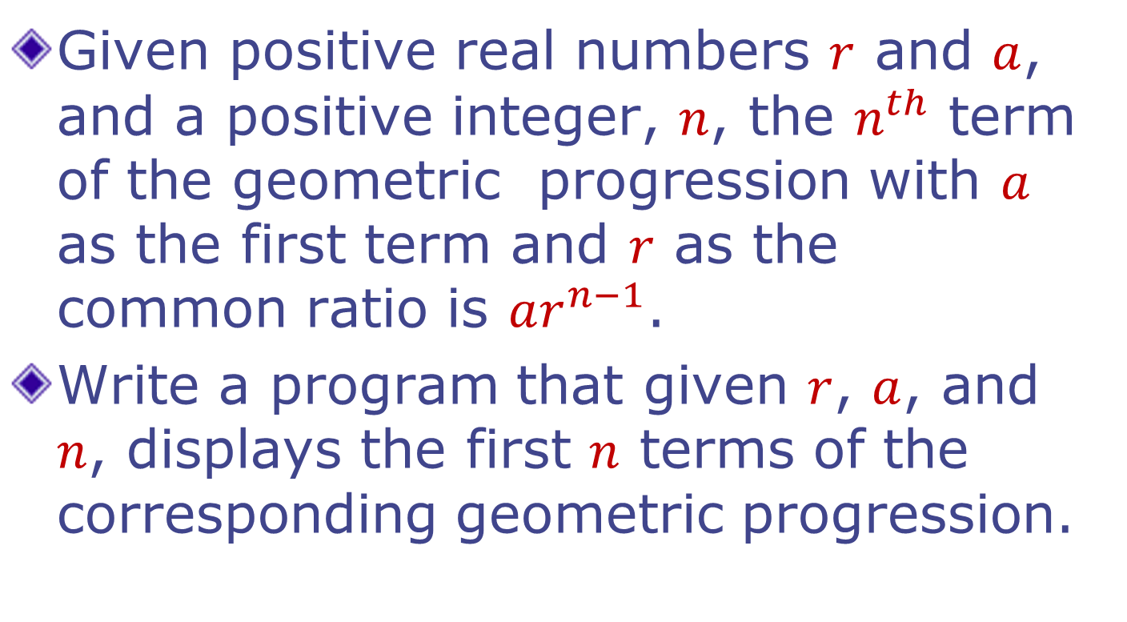
Example: Geometric Progression

Slide 26
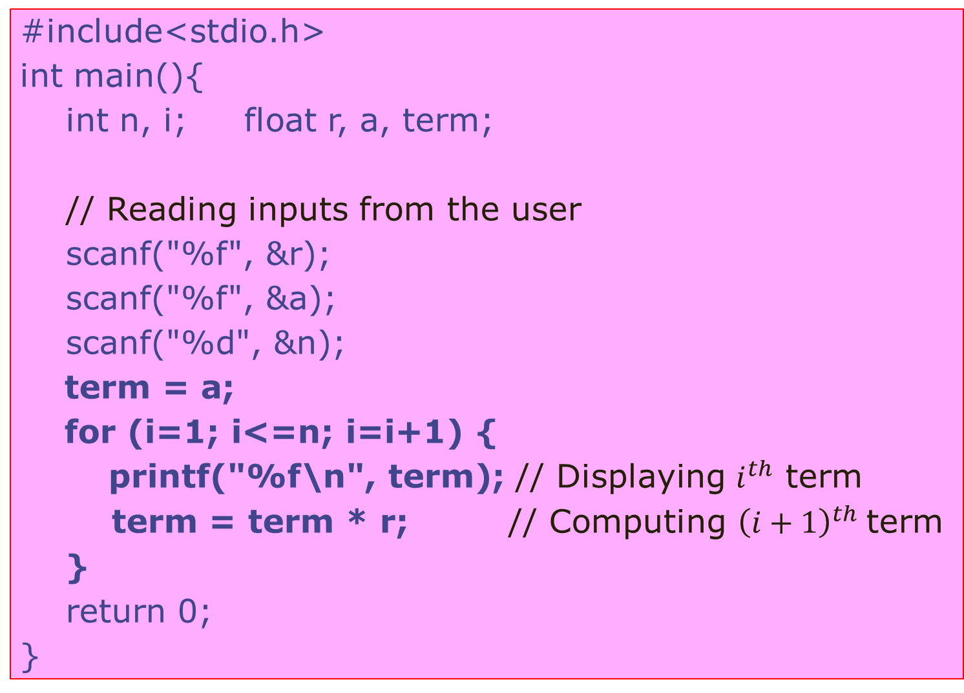
#include<stdio.h>
intmain(){
intn, i; float r, a, term;
// Reading inputs from the user
scanf("%f", &r);
scanf("%f", &a);
scanf("%d", &n);
term = a;
for (i=1; i<=n; i=i+1) {
printf("%f\n", term); // Displaying $i^{th}$term
term = term * r; // Computing ${\left(i+1\right)}^{th}$term
}
return 0;
}

Slide 27

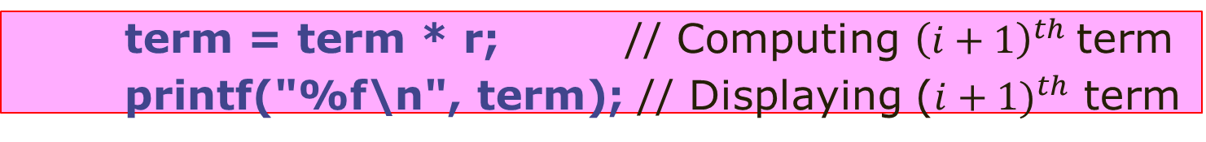
#include<stdio.h>
intmain(){
intn, i; float r, a, term;
// Reading inputs from the user
scanf("%f", &r);
scanf("%f", &a);
scanf("%d", &n);
term = a;
for (i=1; i<=n; i=i+1) {
printf("%f\n", term); // Displaying $i^{th}$term
term = term * r; // Computing ${\left(i+1\right)}^{th}$term
}
return 0;
}
Careful: Changing the order of statements changes the meaning of the program. Computation of
$a, ar, …,ar^{n−1}$ vs.
$ar, ar^{2},…,ar^{n}$
term = term * r; // Computing ${\left(i+1\right)}^{th}$term
printf("%f\n", term); // Displaying (${i+1)}^{th}$ term

Slide 28
Next class
Using loops
Use cases
Warnings and exception handling
Major quiz 1 on Monday, August 28th 12pm in L20
Please don’t be late
Please don’t be absent
One A4 sized sheet in your own handwriting permitted
Other reference material not allowed
Mobile phones not allowed

