Slide 1
More looping
ESC101
August 25th

Slide 2
This class
Loops
For statement syntax, use and precautions
Continue statement
Using loops

Slide 3
For loop in C
General form
init_expr is the initialization expression.
update_expr is the update expression.
test_expr is the expression that evaluates to either TRUE (non-zero) or FALSE (zero).
statement is the work to repeat (can be multiple statements in {…} )
for (init_expr; test_expr; update_expr)
statement;

Slide 4
For loop in C
init_expr
for (init_expr; test_expr; update_expr)
statement;
First evaluate init_expr;
Evaluate test_expr;
If test_expr is TRUE then
execute statement;
execute update_expr;
go to Step 2.
if test_expr is FALSE then break from the loop
test_expr
TRUE
FALSE
statement
update_expr

Slide 5
For loop in action
#include <stdio.h>
int main(){
int i;
for (i=1;i<=3; i++){
printf("%d\t",i);
}
printf("\n%d\t",i);
return 0;
}
1 2 3
4
#include <stdio.h>
int main(){
int i;
for (i=1;i<=3;++i){
printf("%d\t",i);
}
printf("\n%d\t",i);
return 0;
}
1 2 3
4

Slide 6
For loop in terms of while loop
for (init_expr; test_expr; update_expr)
statement;
Execution is (almost) equivalent to
Almost? Exception if there is a continue; inside statement
Both are equivalent in power.
Which loop structure to use?
init_expr;
while (test_expr) {
statement;
update_expr;
}

Slide 7
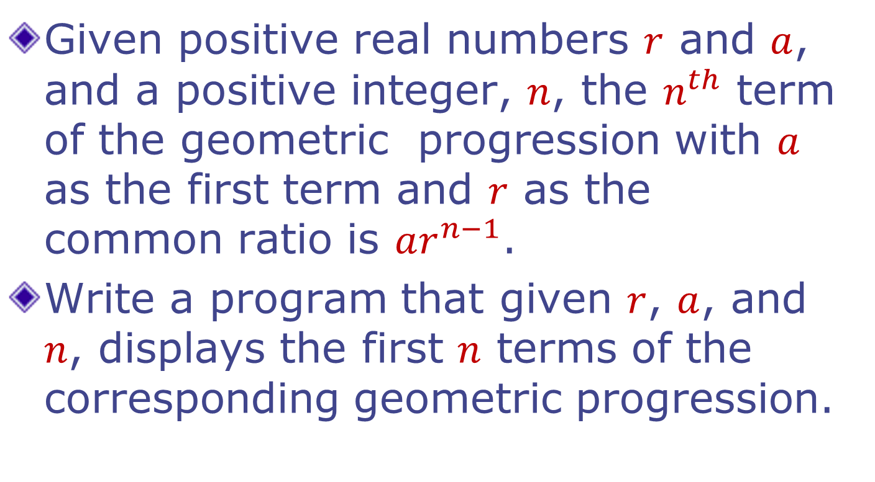
Example: Geometric Progression

Slide 8
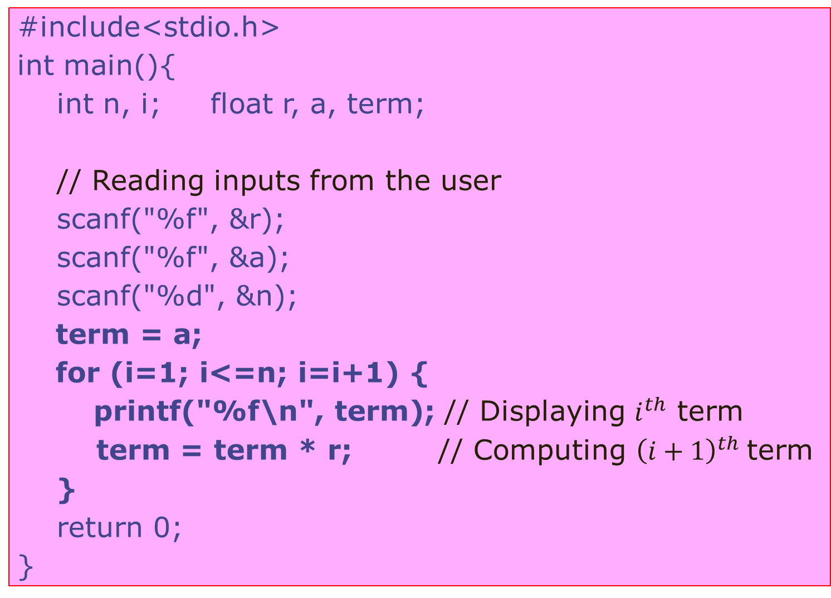
#include<stdio.h>
intmain(){
intn, i; float r, a, term;
// Reading inputs from the user
scanf("%f", &r);
scanf("%f", &a);
scanf("%d", &n);
term = a;
for (i=1; i<=n; i=i+1) {
printf("%f\n", term); // Displaying $i^{th}$term
term = term * r; // Computing ${\left(i+1\right)}^{th}$term
}
return 0;
}

Slide 9

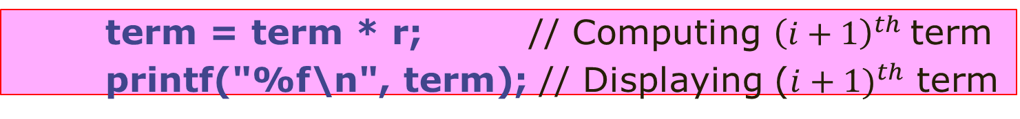
#include<stdio.h>
intmain(){
intn, i; float r, a, term;
// Reading inputs from the user
scanf("%f", &r);
scanf("%f", &a);
scanf("%d", &n);
term = a;
for (i=1; i<=n; i=i+1) {
printf("%f\n", term); // Displaying $i^{th}$term
term = term * r; // Computing ${\left(i+1\right)}^{th}$term
}
return 0;
}
Careful: Changing the order of statements changes the meaning of the program. Computation of
$a, ar, …,ar^{n−1}$ vs.
$ar, ar^{2},…,ar^{n}$
term = term * r; // Computing ${\left(i+1\right)}^{th}$term
printf("%f\n", term); // Displaying (${i+1)}^{th}$ term

Slide 10
Important consideration: scope
#include <stdio.h>
int main(){
for (int i=1;i<=2;i++)
printf("%d\n",i);
return 0;
}
Output?
1
2
AVOID

Slide 11
Important consideration: scope
#include <stdio.h>
int main(){
for (int i=1;i<=2;i++)
printf("%d\n",i);
printf(“%d\n”,i);
return 0;
}
Output?
AVOID
AVOID

Slide 12
Block scope of a variable
#include <stdio.h>
int main(){
{ //start block
int i;
for (i=1;i<=2;i++)
printf("%d\n",i);
} //end block
return 0;
}
Output?
1
2
AVOID

Slide 13
Block scope of a variable
#include <stdio.h>
int main(){
{
int i;
for (i=1;i<=2;i++)
printf("%d\n",i);
}
printf("outside %d\n",i);
return 0;
}
Output?
Compiler error: 'i' undeclared

Slide 14
Block scope of a variable
#include <stdio.h>
int main(){
int i;
for (i=1;i<=2;i++){
printf("%d\n",i);
int j=0;
printf(“j=%d\n",j+1);
}
return 0;
}
Output?
1
j=1
2
j=1

Slide 15
Flexibility in expression checking
#include <stdio.h>
int main(){
int i, j = -1;
for (i=1;j<=2; i++){
printf("%d\t",i);
j = i;
}
printf("\n%d\t",i);
printf("\n%d\t",j);
return 0;
}
1 2 3
4 3
#include <stdio.h>
int main(){
int i,j;
for (i=1;j<=2;++i){
printf("%d\t",i);
j = i;
}
printf("\n%d\t",i);
printf("\n%d\t",j);
return 0;
}
1 gbg

Slide 16
Undesirable flexibility
#include <stdio.h>
int main(){
int j,i=1;
for (;j<=2;i++){
printf("%d\t",i);
j = i;
}
printf("\n%d\t",i);
printf("%d\n",j);
return 0;
}
1 4200288
#include <stdio.h>
int main(){
int i=1,j;
for (;j<=2;i++){
printf("%d\t",i);
j = i;
}
printf("\n%d\t",i);
printf("%d\n",j);
return 0;
}
2 3
4 3

Slide 17
For loop best practices
I want to do something a times
for(i = 0; i < a; i++)
I want to do something an indeterminate number of times until a condition is true
while (condition)
Always remember to initialize values in for expressions to some value
Then don’t need to worry about scope
But have to, for larger programs

Slide 18
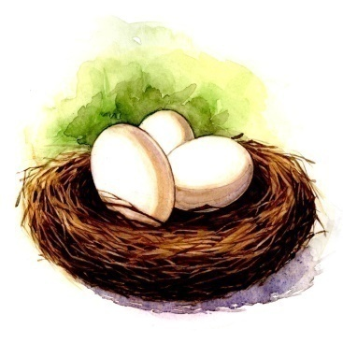

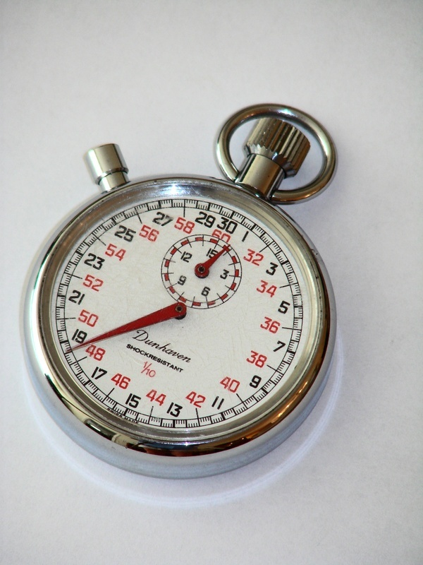

Nested Loops
Loop with in a loop
Many iterations of inner loop $⇒$ One iteration of outer loop

Slide 19
Example
Write a program that displays the following pattern
1 | 2 | 3 | 4 | 5
2 | 4 | 6 | 8 | 10
3 | 6 | 9 | 12 | 15
4 | 8 | 12 | 16 | 20
5 | 10 | 15 | 20 | 25
6 | 12 | 18 | 24 | 30
7 | 14 | 21 | 28 | 35
8 | 16 | 24 | 32 | 40
integers are printed in 5 columns each

Slide 20
#include<stdio.h>
int main(){
int i, j;
for (i=1; i<=8; i=i+1) {
for (j=1; j<=5; j=j+1) {
printf("%4d", i*j); // Displaying i, 2i, …, 5i
}
printf(“\n”); // Move to the next line
}
return 0;
}

Slide 21
Displaying a pattern
#include <stdio.h>
int main(){
int i,j;
for (i=1; i<=5; i=i+1){
for (j=i; j<2*i; j=j+1){
printf("%d ",j);
}
printf("\n");
}
return 0;
}
Output?
1
2 3
3 4 5
4 5 6 7
5 6 7 8 9

Slide 22

Back to Break
Used for exiting a loop forcefully
Example Program:
Read 100 integer inputs from a user. Print the sum of inputs until a negative input is found (Excluding the negative number) or all 100 inputs are exhausted.

Slide 23
int value;
int sum = 0;
int i;
for (i = 0; i < 100; i++) {
scanf(“%d”, &value);
if (value < 0) {
//-ve number: no need to go
// around the loop any more!!
break;
}
sum = sum + value;
}
printf(“%d”, sum);

Slide 24
When to break?
Use of break sometimes can simplify exit condition from loop.
However, it can make the code a bit harder to read and understand.
Tip: if the loop terminates in at least two ways which are sufficiently different and requires substantially different processing then consider the use of termination via break for one of them.

Slide 25

Continue
Used for skipping an iteration of a loop
The loop is NOT exited.
Example Program:
Read 100 integer inputs from a user. Print the sum of only positive inputs.

Slide 26
int sum = 0;
int i, value;
for (i = 0; i < 100; i++) {
scanf(“%d”, &value);
if (value < 0) {
//-ve number: no need to add it
// to the sum. Go ahead and
// check the next input.
continue;
}
sum = sum + value;
}
printf(“%d”, sum);

Slide 27
Break and Continue
if there are nested loop: break and continue apply to the nearest enclosing loop only.
for (i = 0; i < 100; i++) {
for (j = 0; j < 100; j++) {
if (…) break;
}
…
}

Slide 28
Continue and Update Expr
Make sure continue does not bypass update-expression for loops
Specially for while and do-while loops
i = 0;
while (i < 100) {
scanf(“%d”, &value);
if (value < 0) continue;
sum = sum + value;
i++;
}
i is never incremented
potentially infinite loop!!

Slide 29
Continue and Update Expr
Correct Code:
i = 0;
while (i < 100) {
i++;
scanf(“%d”, &value);
if (value < 0) continue;
sum = sum + value;
}

Slide 30
Continue and Update Expr
Correct Code:
i = 0;
while (i < 100) {
scanf(“%d”, &value);
if (value < 0) {
i++;
continue;
}
sum = sum + value;
i++;
}

Slide 31
Big difference between for and while
#include <stdio.h>
int main(){
int i = 0;
while(i < 10) {
if(i == 5) continue;
printf("%d\t", i);
i++;
}
return 0;
}
#include <stdio.h>
int main(){
int i = 0;
for(i = 0; i < 10; i++) {
if(i == 5) continue;
printf("%d\n", i);
}
return 0;
}
0 1 2 3 4 6 7 8 9
0 1 2 3 4 .....................

Slide 32
Important elements of major quiz
Types
Basics, type-casting
Operators
Precedence, associativity
Pay particular attention to the assignment operator
Conditionals
If-else
Switch-case
Loops
While
For
Lots of combinations

Slide 33

How many times is the loop executed?
Probable intention:
int a = 10 - 6;
while (a < 10) {
if (a = 5) {
printf(“%d\n“, a);
}
a=a+1;
}
int a =10 - 6;
while (a < 10) {
if (a == 5) {
printf(“%d“, a);
}
a=a+1;
}
Output5
5
5
…
Output
5
A common bug

Slide 34
Announcements
Major quiz 1 on Monday, August 28th 12pm in L20
Please don’t be late
Please don’t be absent
One A4 sized sheet in your own handwriting permitted
Cheat sheet
Can write whatever you want on it
Other reference material not allowed
Mobile phones not allowed.
Instant zero in the exam if we find a mobile phone on you
Bring ID
Remedial lab session today 2pm-5pm

