Slide 1
Functions
ESC101
August 30th

Slide 2
Announcements
Major quiz marks by Tuesday
Next exams
Lab mid-sem exam on 16th September at 0900
More details closer to the date
Theory mid-sem exam on 22nd September 1300-1500
Venue information closer to the date

Slide 3
Quick overview
We’ve already learned
C data types
Operations and expressions
Conditional statements
Loops
Mid-sem additional material
Functions
Arrays

Slide 4
This class
Introduction to functions (Ch 7)
Basic syntax
Basic use cases

Slide 5
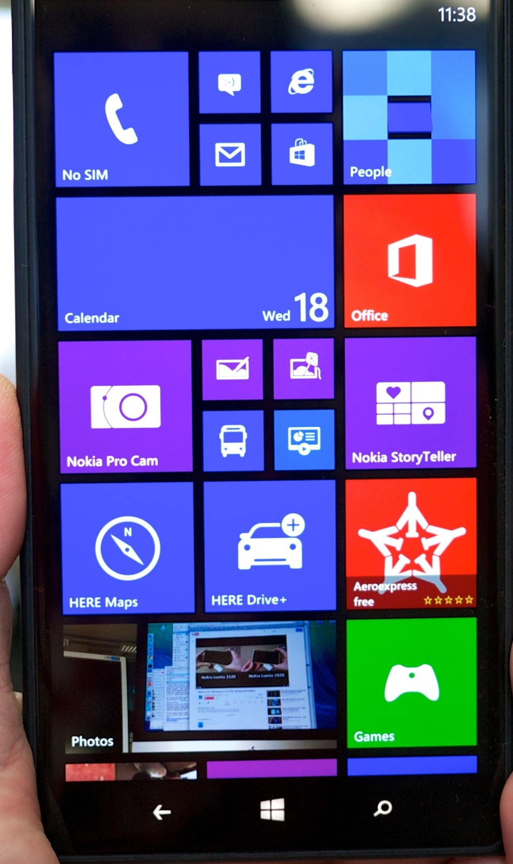
A Modern Smartphone
Surf the net
Input: Web address
Output: Desired page
Book tickets
Input: userid, password, booking info, bank info
Output: Ticket
Send email
Input: email address of receiver, mail text
Output: --
Take photos
Input: --
Output: Picture
Talk (we can do that too!!)
Input: Phone number
Output: Conversation (if lucky)
…

Slide 6
Lots of related/unrelated task to perform
Divide and Conquer
Create well defined sub tasks
Work on each task independently
Development, Enhancements, Debugging
Reuse of tasks.
Email and Chat apps can share spell checker.
Phone and SMS apps can share dialer
C facilitates this using Functions

Slide 7
Function
An independent, self-contained entity of a C program that performs a well-defined task.
It has
Name: for identification
Arguments: to pass information from outside world (rest of the program)
Body: processes the arguments do something useful
Return value: To communicate back to outside world
Sometimes not required

Slide 8
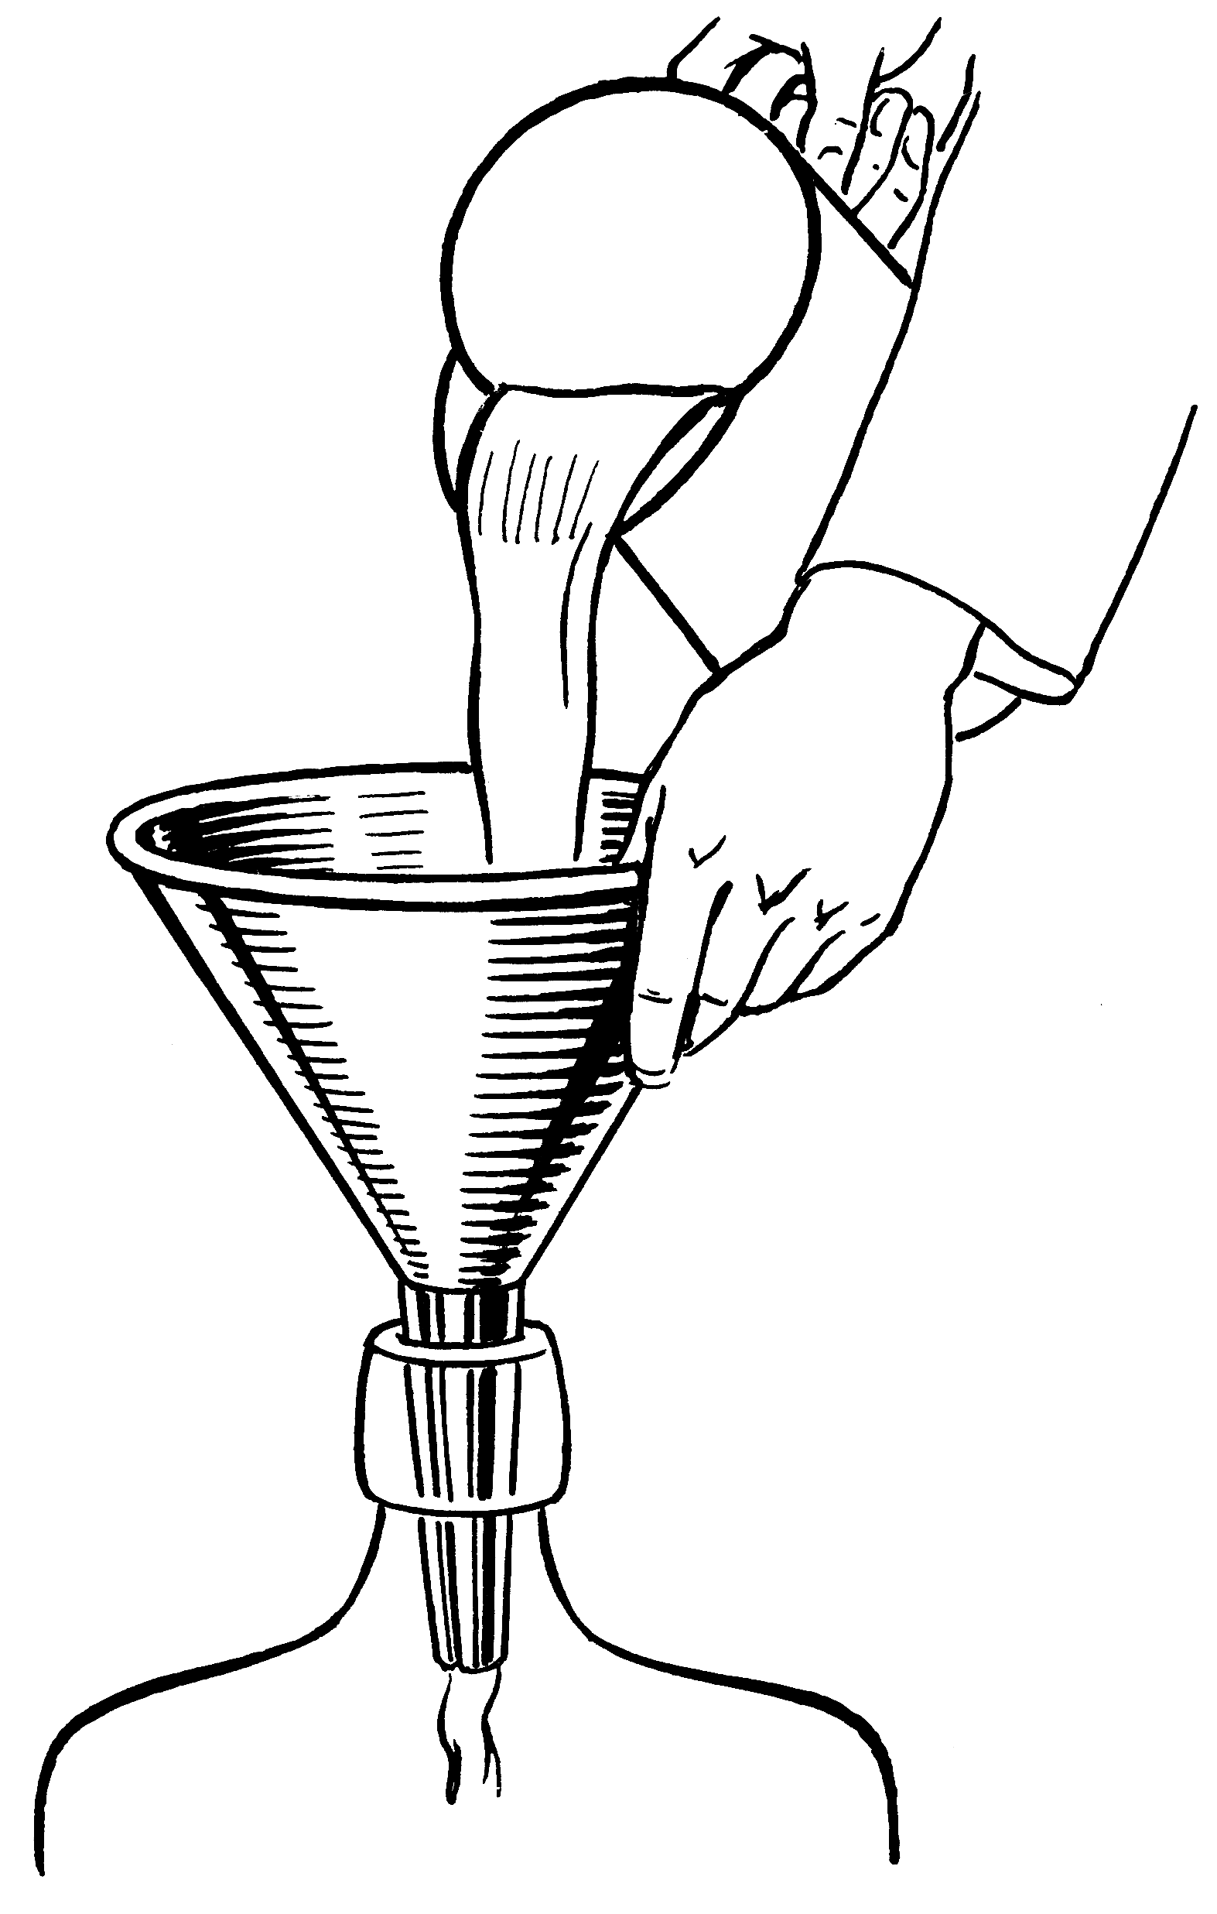
Parts of a function
Input
f
Output

Slide 9
int max (int a, int b) {
if (a > b)
return a;
else
return b;
}
2 arguments
a and b,
both of type int.
(formal args)
Return Type
Function Name
int main () {
int x;
x = max(6, 4);
printf(“%d”,x);
return 0;
}
Body of the
function, enclosed
inside { and }
(mandatory)
returns an int.
Call to the function.
Actual args are 6 and 4.

Slide 10
Arguments
Input to the function
Should have matching type
Type should be declared
A new copy of these arguments is made
Function works on these new copies

Slide 11
Why use functions?
Example : Maximum of 3 numbers
int main(){
int a, b, c, m;
/* code to read
* a, b, c */
if (a>b){
if (a>c) m = a;
else m = c;
}
else{
if (b>c) m = b;
else m = c;
}
/* print or use m */
return 0;
}
int max(int a, int b){
if (a>b)
return a;
else
return b;
}
int main() {
int a, b, c, m;
/* code to read
* a, b, c */
m = max(a, b);
m = max(m, c);
/* print or use m */
return 0;
}
This code
can scale
easily to
handle
large
number
of inputs
(e.g.: max
of 100
numbers!)

Slide 12
Why use functions?
Break up complex problem into small sub-problems.
Solve each of the sub-problems separately as a function, and combine them together in another function.
The main tool in C for modular programming.

Slide 13
Advantages of using functions
Code Reuse: Allows us to reuse a piece of code as many times as we want, without having to write it.
Think of the printf function!
Procedural Abstraction: Different pieces of your algorithm can be implemented using different functions.
Distribution of Tasks: A large project can be broken into components and distributed to multiple people.
Easier to debug: If your task is divided into smaller subtasks, it is easier to find errors.
Easier to understand: Code is better organized and hence easier for an outsider to understand it.

Slide 14
We have seen functions before
main() is a special function. Execution of program starts from the beginning of main().
scanf(…), printf(…) are standard input-output library functions.
sqrt(…), pow(…) are math functions in math.h

Slide 15
Function Call
A function call is an expression
feeds the necessary values to the function arguments,
directs a function to perform its task, and
receives the return value of the function.
Similar to operator application
5 + 3 is an expression of type integer that evaluates to 8
max(5, 3) is an expression of type integer that evaluates to 5

Slide 16
Function Call
Since a function call is an expression
it can be used anywhere an expression can be used
subject to type restrictions
printf(“%d”, max(5,3));
max(5,3) – min(5,3)
max(x, max(y, z)) == z
if (max(a, b)) printf(“Y”);
prints 5
evaluates to 2
checks if z is max of x, y, z
prints Y if max of a and b is not 0.

Slide 17
Returning from a function: Type
Return type of a function tells the type of the result of function call
Any valid C type
int, char, float, double, …
void
Return type is void if the function is not supposed to return any value
void print_one_int(int n) {
printf(“%d”, n);
}

Slide 18
Returning from a function: return statement
If return type is not void, then the function should return a value:
return return_expr;
If return type is void, the function may fall through at the end of the body or use a return without return_expr:
return;
void print_positive(int n) {
if (n <= 0) return;
printf(“%d”, n);
}
Returning through return
Fall through
Notes:
- There is no compiler error if a function of return-type int returns nothing.

Slide 19
Returning from a function: return statement
When a return statement is encountered in a function definition
control is immediately transferred back to the statement making the function call in the parent function.
A function in C can return only ONE value or NONE.
Only one return type (including void)

Slide 20
Function Declaration- Prototype
A function declaration is a statement that tells the compiler about the different properties of that function
name, argument types and return type of the function
Structure:
Looks very similar to the first line of a function definition, but NOT the same
has semicolon at the end instead of BODY
return_type function_name (list_of_args);

Slide 21
Function Declaration
return_type function_name (list_of_args);
Examples:
int max(int a, int b);
int max(int x, int y);
int max(int , int);
Position in program: Before the call to the function
allows compiler to detect inconsistencies
Header files (stdio.h, math.h,…) contain declarations of frequently used functions
#include <…> just copies the declarations
All 3 declarations are equivalent! Since there is no BODY here, argument names do not matter, and are optional.

Slide 22
Example program
Problem description: write a program to accept two positive integers and return all the prime numbers lying between them
Solution approach
Use main function for I/O
Use a loop to run through all numbers in the range
Use a custom function to check for primality of each number
Primality test:
Run a loop over possible divisors
Assign a flag value to 1 if the number is divisible by a smaller number
Return ‘prime’ if flag stays zero at the end of the loop

Slide 23
#include <stdio.h>
int checkPrimeNumber(int n);
int main() {
int n1, n2, i, flag;
printf("Enter two positive integers: ");
scanf("%d %d", &n1, &n2);
printf("Prime numbers between %d and %d are: ", n1, n2);
for(i=n1+1; i<n2; ++i) {
// i is a prime number, flag will be equal to 1
flag = checkPrimeNumber(i);
if(flag == 1)
printf("%d ",i);
}
return 0;
}
// user-defined function to check prime number
int checkPrimeNumber(int n) {
int j, flag = 1;
for(j=2; j <= n/2; ++j) {
if (n%j == 0) {
flag =0;
break;
}
}
return flag;
}
Prototype
Function call
Definition

Slide 24
Avoiding Common Errors
Declare functions before use.
Argument list of a function:
Provide the required number of arguments,
Check that each function argument has the correct type (or that conversion to the correct type will lose no information).

Slide 25
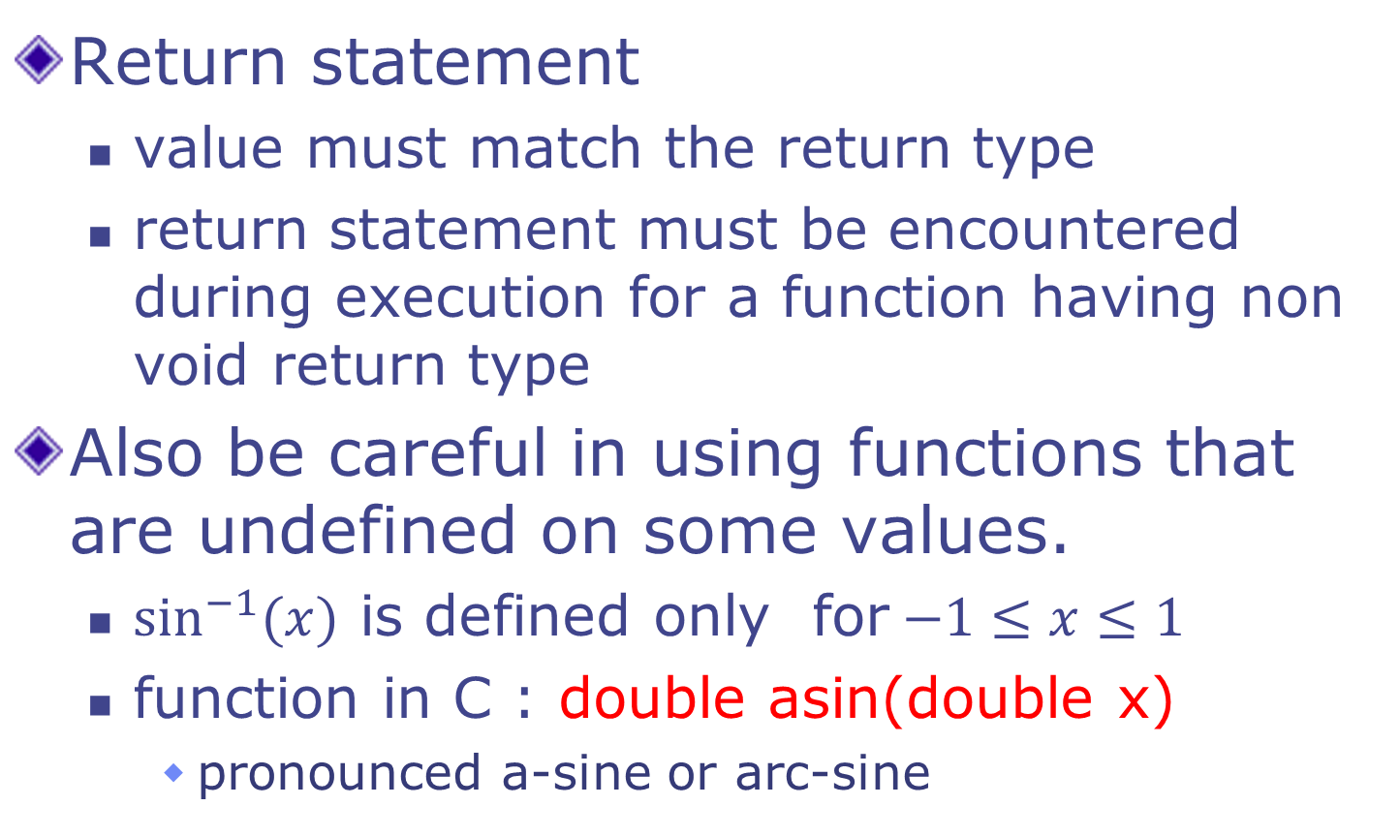
Avoiding Common Errors
Return statement
value must match the return type
return statement must be encountered during execution for a function having non void return type
Also be careful in using functions that are undefined on some values.
$\sin^{−1}{(x)}$ is defined only for$−1≤x≤1$
function in C : double asin(double x)
pronounced a-sine or arc-sine

Slide 26
Scope of a Name
Functions allow us to divide a program into smaller parts
each part does a well defined task
There are other ways to partition a program
Statement blocks, Files
Scope of a name is the part of the program in which the name can be used

Slide 27
Scope of a Name
Two variables can have the same name only if they are declared in separate scopes.
A variable can not be used outside its scope.
C program has
function/block scope
file scope
global/external scope

Slide 28
Scope Rules: Functions
The scope of the variables present in the argument list of a function's definition is the body of that function.
The scope of any variable declared within a function is the body of the function.
int max(int a, int b) {
int m = 0;
if (a > b) m = a;
else m = b;
return m;
}
int min(int a, int b) {
int m = 0;
if (a < b) m = a;
else m = b;
return m;
}
int main() { … }
int max(int a1, int b1) {
int m1 = 0;
if (a1 > b1) m1 = a1;
else m1 = b1;
return m1;
}
int min(int a2, int b2) {
int m2 = 0;
if (a2 < b2) m2 = a2;
else m2 = b2;
return m2;
}
int main() { … }
scope of
m1, a1, b1
scope of
m2, a2, b2

Slide 29
Scope Rules : Blocks
For an identifier declared at the head of a block
Scope begins at the end of declaration
Scope ends at the end of the block
int main() {
int m = 5;
{
float m = 6.5; // shadows
printf(“%f”, m); // prints 6.5
}
printf(“%d” , m); // prints 5
}

Slide 30
Scope of a Name
Scopes can be nested
A name in inner scope “shadows” the same name, if present in outer scope
int main() {
int m = 5;
{
float m = 6.5; // shadows
printf(“%f”, m); // prints 6.5
}
printf(“%d” , m); // prints 5
}

Slide 31
Next class
Functions
Execution trace
Parameter passing
More examples

