Slide 1
More about functions
ESC101
September 1st

Slide 2
This class
Functions
Execution trace
Parameter passing
More examples

Slide 3
Announcements
MQ1 has been graded
Many have not done well
Extra class to solve MQ1 questions?
Remedial labs from 2pm-5pm today
int i; int j = 2;
for(i=2; i<=20; i = i+7){
for(; j< 7; j= j*2){
printf("%d\t%d\n", i, j+1);
j++;
}
}

Slide 4
int max (int a, int b) {
if (a > b)
return a;
else
return b;
}
2 arguments
a and b,
both of type int.
(formal args)
Return Type
Function Name
int main () {
int x;
x = max(6, 4);
printf(“%d”,x);
return 0;
}
Body of the
function, enclosed
inside { and }
(mandatory)
returns an int.
Call to the function.
Actual args are 6 and 4.

Slide 5
Example program
Problem description: write a program to accept two positive integers and return all the prime numbers lying between them
Solution approach
Use main function for I/O
Use a loop to run through all numbers in the range
Use a custom function to check for primality of each number
Primality test:
Run a loop over possible divisors
Assign a flag value to 1 if the number is divisible by a smaller number
Return ‘prime’ if flag stays zero at the end of the loop

Slide 6
#include <stdio.h>
int checkPrimeNumber(int n);
int main() {
int n1, n2, i, flag;
printf("Enter two positive integers: ");
scanf("%d %d", &n1, &n2);
printf("Prime numbers between %d and %d are: ", n1, n2);
for(i=n1+1; i<n2; ++i) {
// i is a prime number, flag will be equal to 1
flag = checkPrimeNumber(i);
if(flag == 1)
printf("%d ",i);
}
return 0;
}
// user-defined function to check prime number
int checkPrimeNumber(int n) {
int j, flag = 1;
for(j=2; j <= n/2; ++j) {
if (n%j == 0) {
flag =0;
break;
}
}
return flag;
}
Prototype
Function call
Definition

Slide 7
Avoiding Common Errors
Declare functions before use.
Argument list of a function:
Provide the required number of arguments,
Check that each function argument has the correct type (or that conversion to the correct type will lose no information).

Slide 8
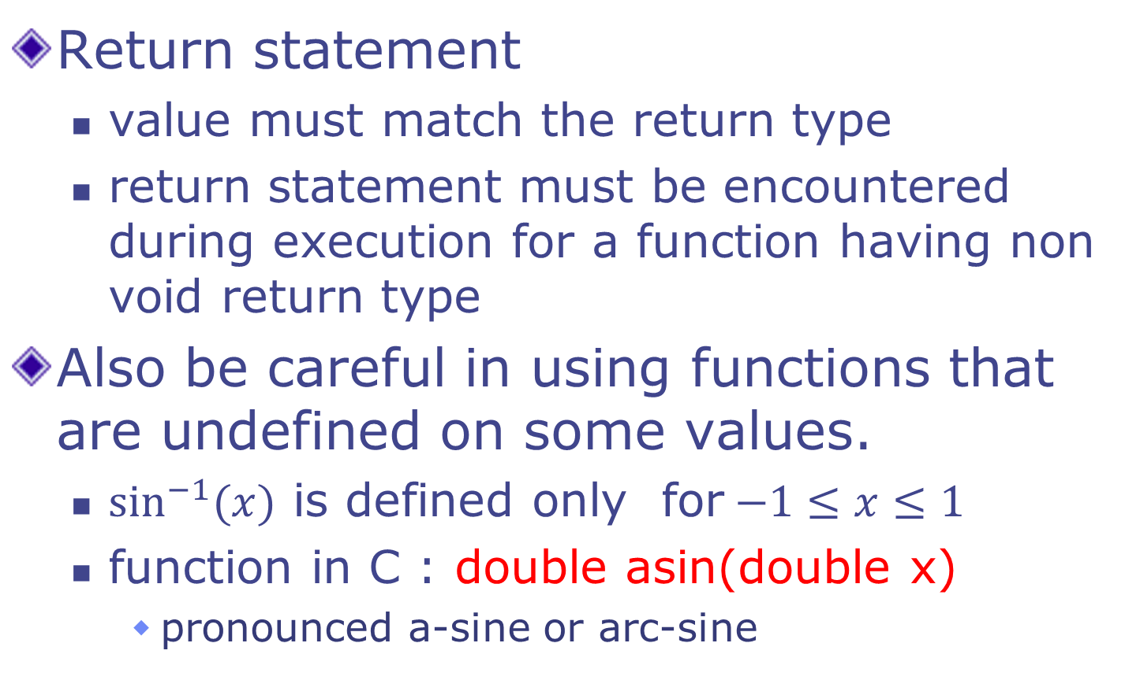
Avoiding Common Errors
Return statement
value must match the return type
return statement must be encountered during execution for a function having non void return type
Also be careful in using functions that are undefined on some values.
$\sin^{−1}{(x)}$ is defined only for$−1≤x≤1$
function in C : double asin(double x)
pronounced a-sine or arc-sine

Slide 9
Scope of a Name
Functions allow us to divide a program into smaller parts
each part does a well defined task
There are other ways to partition a program
Statement blocks, Files
Scope of a name is the part of the program in which the name can be used

Slide 10
Scope of a Name
Two variables can have the same name only if they are declared in separate scopes.
A variable can not be used outside its scope.
C program has
function/block scope
file scope
global/external scope

Slide 11
Scope Rules: Functions
The scope of the variables present in the argument list of a function's definition is the body of that function.
The scope of any variable declared within a function is the body of the function.
int max(int a, int b) {
int m = 0;
if (a > b) m = a;
else m = b;
return m;
}
int min(int a, int b) {
int m = 0;
if (a < b) m = a;
else m = b;
return m;
}
int main() { … }
int max(int a1, int b1) {
int m1 = 0;
if (a1 > b1) m1 = a1;
else m1 = b1;
return m1;
}
int min(int a2, int b2) {
int m2 = 0;
if (a2 < b2) m2 = a2;
else m2 = b2;
return m2;
}
int main() { … }
scope of
m1, a1, b1
scope of
m2, a2, b2

Slide 12
Scope Rules : Blocks
For an identifier declared at the head of a block
Scope begins at the end of declaration
Scope ends at the end of the block
int main() {
int m = 5;
{
float m = 6.5; // shadows
printf(“%f”, m); // prints 6.5
}
printf(“%d” , m); // prints 5
}

Slide 13
Scope of a Name
Scopes can be nested
A name in inner scope “shadows” the same name, if present in outer scope
int main() {
int m = 5;
{
float m = 6.5; // shadows
printf(“%f”, m); // prints 6.5
}
printf(“%d” , m); // prints 5
}

Slide 14

Execution of a Function: Steps
All functions in
this route are
busy

Slide 15
Steps when a function is called: max(6,4) in step 10a.
Allocate space for (i) return value, (ii) store return address and (iii) pass parameters.
Create a box informally called ``Return value’’ of same type as the return type of function.
Create a box and store the location of the next instruction in the calling function (main)—return address. Here it is 10 (why not 11?). Execution resumes from here once function terminates.
Parameter Passing- Create boxes for each formal parameter: a, b here. Initialize them using actual parameters, 6 and 4.
1
2
3
4
5
6
7
8
9
10
11
12
13
#include <stdio.h>
int max(int a, int b) {
if (a > b)
return a;
else
return b;
}
int main () {
int x;
x = max(6, 4);
printf(“%d”,x);
return 0;
}
10a

Slide 16
Calling max(6,4):
Allocate space for return value.
Store return address (10).
Pass parameters.
1
2
3
4
5
6
7
8
9
10
11
12
13
#include <stdio.h>
int max(int a, int b) {
if (a > b)
return a;
else
return b;
}
x
6
-1
main
Return
value
6
S
T
A C K
int main () {
int x = -1;
x = max(6, 4);
printf(“%d”,x);
return 0;
}
Return
Address
10
max
a
6
b
4
(Memory)
After completing max(), execution in main() will re-start from address 10.

Slide 17

Stack
We referred to stack.
A stack is just a part of the memory of the program that grows in one direction only.
The memory (boxes) of all variables defined as actual parameters or local variables reside on the stack.
The stack grows as functions call functions and shrinks as functions terminate.

Slide 18
Evaluating expressions
Associativity and Precedence precisely define what an expression means, e.g.,
a * b – c / d
is same as:
(a * b) – (c / d)
But how exactly are expressions evaluated?

Slide 19
Evaluating expression (a*b) – (c/d)
Computers evaluate one operator at a time.
Above expr may be evaluated as
t1 = c/d;
t2 = a*b;
t3 = t2 – t1;
t1, t2, t3 are temporary variables, created by the compiler (not by programmer). They are temporary, meaning, their lifetime is only until use.

Slide 20
Evaluating expression (a*b) – (c/d)
The order of evaluation of arguments for most C operators is not defined
Exceptions are && and ||
Remember: short circuit evaluation
Above expr may also be evaluated as
t1 = a*b;
t2 = c/d;
t3 = t1 – t2;
Do not depend on order of evaluation of args, except for && and ||
Same holds true for function arguments

Slide 21
int main () {
int a =4, b = 2, c = 5, d = 6;
a = a + b *c-d/a;
b = b-(c-d)*a;
printf(“%d %d”,a,b);
return 0; }
State of the program
just prior to printf
a
13
b
15
c
5
d
6
Output
13 15
Since each function call is also an expression, statements having mix of function calls and operators are also evaluated in a similar fashion.

Slide 22
Define a factorial function.
Use to calculate ^{n}C_{k}
Let us trace the execution of main().
Add temporary variables for expressions and intermediate expressions in main for clarity.
# include <stdio.h>
int fact(int r) { /* calc. r! */
int i;
int ans=1;
for (i=0; i < r; i=i+1) {
ans = ans *(i+1);
}
return ans;
}
int main () {
int n, k;
int res;
scanf(“%d%d”,&n,&k);
res = (fact(n)/ fact(k))/fact(n-k);
printf(“%d choose %d is”,n,k);
printf(“%d\n”,res);
return 0;
}

Slide 23
int fact(int r) { /* calc. r! */
int i; int ans =1 ;
/* code here */
}
Input
4 2
S
T
A
C
K
n
4
Actual
Parameter n
t1
1
2
3
4
5
6
7
8
9
int main () {
int n, k;
int res;
scanf(“%d%d”,&n,&k);
printf(“%d choose %d is”);
printf(“%d\n”, res);
return 0;
}
k
2
t2
res
t3
main()
/* Adding temporary vars and Intermediate exprs. */
int t1, t2, t3;
t1 = fact(n);
t2 = fact(k):
t3 = fact(n-k);
res = (t1/t2)/t3;
fact()
Set up return
value and return
address
Return
value
Return
address
5
Formal parameter
gets value of
actual parameter
r
4
i
JUMP to fact ()
ans
1
Create local variables & initialize

Slide 24
# include <stdio.h>
int fact(int r) { /* calc. r! */
int i;
int ans =1 ;
for ( i=0; i < r; i=i+1) {
ans = ans *(i+1);
}
return ans;
}
We have jumped to fact() and prepared the stack for the call. Parameters are passed, return addr is stored and local variables are initialized. Now we are ready to execute.
Return
value
24
Assign to return value
S
T
A
C
K
Return
address
Now jump to return address
5
r
4
i
4
3
0
1
2
fact()
ans
1
1
2
6
24

Slide 25
1
2
3
4
5
6
7
8
9
int main () {
int n, k;
int res;
scanf(“%d%d”,&n,&k);
printf(“%d choose %d is”);
printf(“%d\n”,res);
return 0;
}
n
4
24
t1
k
2
t2
/* Adding temporary vars
and Intermediate exprs. */
int t1, t2, t3;
t1 = fact(n);
t2 = fact(k):
t3 = fact(n-k);
res = (t1/t2)/t3;
res
t3
main()
Return
value
24
We are back
in main. Local variables/formal parameters of fact() are not accessible here.
Stack is shown.
S
T
A
C
K
Return
address
5
r
4
i
4
fact()
ans
24
Only return value
is copied into t1.
Control jumps to statement 5,
since that was the return address.
After copying return value,
assume that the stack for
fact() is wiped clean.

Slide 26
1
2
3
4
5
6
7
8
9
int main () {
int n, k;
int res;
scanf(“%d%d”,&n,&k);
printf(“%d choose %d is”);
printf(“%d\n”,res);
return 0;
}
n
4
24
t1
S
T
A
C
K
k
2
t2
res
main()
t3
/* Adding temporary vars
and Intermediate exprs. */
int t1, t2, t3;
t1 = fact(n);
t2 = fact(k):
t3 = fact(n-k);
res = (t1/t2)/t3;
The next statement is another function call: fact(k). Prepare stack for new call.
Save return address.
Create box for return value.
Pass Parameters: Create boxes corresponding to formal parameters. Copy values from actual parameters.
Jump to called function.
Create/initialize local variables.
After copying return value,
assume that the stack for
fact() is wiped clean.

Slide 27
int fact(int r) { /* calc. r! */
int i; int ans =1 ;
/* code here */
}
S
T
A
C
K
n
4
24
t1
k
2
t2
1
2
3
4
5
6
7
8
9
int main () {
int n, k;
int res;
scanf(“%d%d”,&n,&k);
printf(“%d choose %d is”);
printf(“%d\n”,res);
return 0;
}
res
t3
main()
fact()
/* Adding temporary vars and Intermediate exprs. */
int t1, t2, t3;
t1 = fact(n);
t2 = fact(k):
t3 = fact(n-k);
res = (t1/t2)/t3;
Return
value
Save return address.
Create box for return value.
Pass Parameters.
Jump to fact
Return
address
6
r
2

Slide 28
S
T
A
C
K
n
4
24
t1
# include <stdio.h>
int fact(int r) { /* calc. r! */
int i;
int ans=1;
for (i=0; i < r; i=i+1) {
ans = ans *(i+1);
}
return ans;
}
k
2
t2
res
t3
main()
fact()
Return
value
2
Return
address
6
r
2
i
0
1
2
Assign value of ans to box for
return value.
Create local variables and
initialize them
ans
1
1
2
Now jump to return address

Slide 29
S
T
A
C
K
n
4
24
t1
1
2
3
4
5
6
7
8
9
int main () {
int n, k;
int res;
scanf(“%d%d”,&n,&k);
printf(“%d choose %d is”);
printf(“%d\n”,res);
return 0;
}
k
2
2
t2
res
t3
main()
/* Adding temporary vars
and Intermediate exprs. */
int t1, t2, t3;
t1 = fact(n);
t2 = fact(k):
t3 = fact(n-k);
res = (t1/t2)/t3;
fact()
Return
value
2
Return
address
6
r
2
i
2
ans
2
This is another function call. So we
prepare stack. Earlier entries for fact() is erased.

Slide 30
S
T
A
C
K
int fact(int r) { /* calc. r! */
int i; int ans =1 ;
/* code here */
}
n
4
24
t1
k
2
2
t2
1
2
3
4
5
6
7
8
9
int main () {
int n, k;
int res;
scanf(“%d%d”,&n,&k);
printf(“%d choose %d is”);
printf(“%d\n”,res);
return 0; }
res
t3
main()
fact()
Return
value
Save return address.
Create box for return value.
Pass Parameters.
Jump to fact
/* Adding temporary vars
and Intermediate exprs. */
int t1, t2, t3;
t1 = fact(n);
t2 = fact(k):
t3 = fact(n-k);
res = (t1/t2)/t3;
Return
address
7
r
2
Previous stack for fact() has
been erased.

Slide 31
S
T
A
C
K
n
4
24
t1
# include <stdio.h>
int fact(int r) { /* calc. r! */
int i;
int ans=1;
for (i=0; i < r; i=i+1) {
ans = ans *(i+1);
}
return ans;
}
k
2
t2
res
t3
main()
fact()
Return
value
2
Return
address
7
r
2
i
0
1
2
Assign value of ans to box for
return value.
Create local variables and
initialize them
ans
1
1
2
Now jump to return address

Slide 32
S
T
A
C
K
main()
n
4
24
t1
1
2
3
4
5
6
7
8
9
int main () {
int n, k;
int res;
scanf(“%d%d”,&n,&k);
printf(“%d choose %d is ”);
printf(“%d\n”,res);
return 0; }
k
2
2
t2
res
6
2
t3
/* Adding temporary vars
and Intermediate exprs. */
int t1, t2, t3;
t1 = fact(n);
t2 = fact(k):
t3 = fact(n-k);
res = (t1/t2)/t3;
fact()
Return
value
2
Return
address
7
r
2
i
2
ans
2
Stack for fact() is erased after return value is copied.
4 choose 2 is 6

Slide 33
Next class
Functions
More examples
Macros

