Slide 1
Finishing up with functions
ESC101
September 4th

Slide 2
This class
Nested function calls
Predefined functions

Slide 3
Nested Function Calls
Functions can call each other
A declaration or definition (or both) must be visible before the call
Help compiler detect any inconsistencies in function use
Compiler warning, if both (decl & def) are missing
#include<stdio.h>
int min(int, int); //declaration
int max(int, int); //of max, min
int max(int a, int b) {
return (a > b) ? a : b;
}
// a “cryptic” min, uses max
int min(int a, int b) {
return a + b – max (a, b);
}
int main() {
printf(“%d”, min(6, 4));
}

Slide 4
Predefined Functions
C has many predefined functions. We have seen scanf, printf.
To use a predefined function, the corresponding header file must be included.
Mathematical functions defined in the library math.h.
Input/Output functions in stdio.h
String functions in string.h

Slide 5
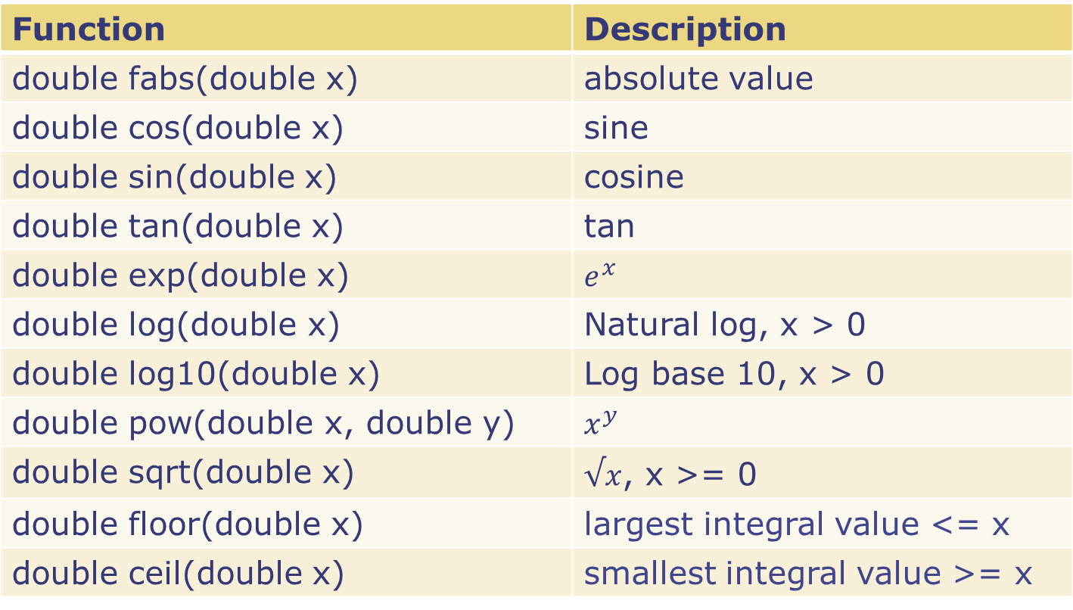
Some predefined math functions
Function | Description
double fabs(double x) | absolute value
double cos(double x) | cosine
double sin(double x) | sine
double tan(double x) | tan
double exp(double x)
double log(double x) | Natural log, x > 0
double log10(double x) | Log base 10, x > 0
double pow(double x, double y)
double sqrt(double x)
double floor(double x) | largest integral value <= x
double ceil(doublex) | smallest integral value >= x

Slide 6
Avoiding Common Errors
Declare functions before use.
Argument list of a function:
Provide the required number of arguments,
Check that each function argument has the correct type (or that conversion to the correct type will lose no information).

Slide 7
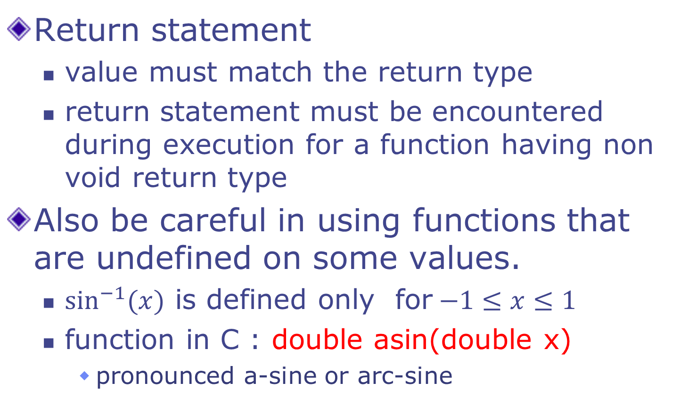
Avoiding Common Errors
Return statement
value must match the return type
return statement must be encountered during execution for a function having non void return type
Also be careful in using functions that are undefined on some values.
$\sin^{−1}{(x)}$ is defined only for$−1≤x≤1$
function in C : double asin(double x)
pronounced a-sine or arc-sine

Slide 8
Scope of a Name
Two variables can have the same name only if they are declared in separate scopes.
A variable can not be used outside its scope.
C program has
function/block scope
file scope
global/external scope

Slide 9
Global Variable
Variable declared outside every function definition
Can be accessed by all functions in the program that follow the declaration
Also called External variable
What if a variable is declared inside a function that has the same name as a global variable?
The global variable is “shadowed” inside that particular function only.

Slide 10
Global Variables
#include<stdio.h>
int g=10, h=20;
int add(){
return g+h;
}
void fun1(){
int g=200;
printf("%d\n",g);
}
int main(){
fun1();
printf("%d %d %d\n",
g, h, add());
return 0;
}
The variable g and h have been defined as global variables.
The use of global variables is normally discouraged. Use local variables of functions as much as possible.
Global variables are useful for defining constants that are used by different functions in the program.
200
10 20 30

Slide 11
Global Variables: example
const double PI = 3.14159;
double circum_of_circle(double r) {
return 2 * PI * r; }
double area_of_circle (double r) {
return PI * r * r;
}
defines PI to be of type double with value 3.14159. Qualified by const, which means that PI is a constant. The value inside the box associated with PI cannot be changed anywhere.

Slide 12
Constants via #define
#define PI 3.14159
double circum_of_circle(double r) {
return 2 * PI * r; }
double area_of_circle (double r) {
return PI * r * r;
}
replaces PI by the constant 3.14159 everywhere.
#define name replacement-text

Slide 13
Static Variables
We have seen two kinds of variables: local variables and global variables.
There are static variables too.
int f () {
int ncalls = 0;
ncalls = ncalls + 1;
/* track the number of
times f() is called */
… body of f() …
}
GOAL: count number of calls to f()
SOLUTION: define ncalls as a static variable inside f().
It is created as an integer box the first time f() is called.
Once created, it never gets destroyed, and retains its value across invocations of f().
It is like a global variable, but visible only within f().
Static variables are not allocated on stack. So they are not destroyed when f() returns.
int f () {
static int ncalls = 0;
ncalls = ncalls + 1;
/* track the number of
times f() is called */
… body of f() …
}
int ncalls = 0;
int f () {
ncalls = ncalls + 1;
/* track the number of
times f() is called */
… body of f() …
}
Use a local variable?
gets destroyed every time f returns
Use a global variable?
other functions can change it! (dangerous)

Slide 14
Summary
Global Variable
Visible everywhere
Lives everywhere (never destroyed)
Local Variable
Visible in scope
Lives in scope (destroyed at the point where we leave the scope)
Static Variable
Visible in Scope
Lives everywhere! (but can not be accessed outside scope)

Slide 15
Macros
Everything you write outside functions is a command to the C pre-processor
All directives to pre-processor begin with #
All other pre-processor statements involve using #define
To define macros and constants
A C macro is a rule that maps an input sequence to an output sequence
Before the program has compiled

Slide 16
Macros
Object-like macros
#define BUFFER_SIZE 1024
Pre-defined macros in C, e.g. _DATE_ , _TIME_ etc.
Function-like macros
#define min(X, Y) ((X) < (Y) ? (X) : (Y))
x = min(a,b) will be expanded to
x = ((a) < (b) ? (a) : (b))
Before compilation

Slide 17
Macro pitfalls
Macro is a simple copy-paste
Without parentheses, can make operator precedence betray your code’s logic
#define SQR(x) (x*x)
int main() {
int a, b=3;
a = SQR(b+5);
printf("%d\n",a);
return 0;
}
23

Slide 18
Argument passing: some details
Formal argument
What you put in the function definition
Actual argument
What you put in the function call
int sum(int a, int b) {
int c=a + b;
return c;
}
int main() {
int var1 =10; int var2 = 20;
int var3 = sum(var1, var2);
printf("%d", var3);
return 0;
}
Formal arguments
Actual arguments

Slide 19
Passing parameters by value
Copy of variable is created in the function’s local scope
All changes are made to this local variable
Global variable retains its original value
int increment(int var) {
var = var+1;
return var;
}
int main() {
int num1=20; int num2 = increment(num1);
printf("num1 value is: %d", num1);
printf("num2 value is: %d", num2);
return 0;
}
20
21

Slide 20
Another example
What will this program output?
int main( ) {
int num1 = 35, num2 = 45 ;
printf("Before swapping: num1 value is %d and num2 value is %d", num1, num2); /*calling swap function*/
swapnum ( num1, num2 );
printf("After swapping: num1 value is %d and num2 value is %d", num1, num2);
}
swapnum ( int var1, int var2 ) {
int tempnum ;
tempnum = var1 ;
var1 = var2 ;
var2 = tempnum ;
}
Before swapping: num1 value is 35 and num2 value is 45
Before swapping: num1 value is 35 and num2 value is 45

Slide 21
Passing parameters by reference
Value of actual argument not passed to formal argument
Address of actual argument passed to formal argument
Updates value of global variable

Slide 22
An example
Remember: & means ‘address of’
New concept: * means ‘value from’
int increment(int *var) {
*var = *var+1;
return *var;
}
int main() {
int num1=20; int num2 = increment(&num1);
printf("num1 value is: %d", num1);
printf("num2 value is: %d", num2);
return 0;
}
21
21
Value from what?

Slide 23
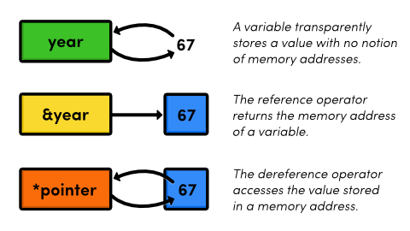
Gentle brush with pointers
Pointers are special variables that store memory addresses
We will cover pointers in much greater depth soon

Slide 24
Example program
#include<stdio.h>
int main(){
int* pc;
int c;
c=22;
printf("Address of c:%p\n",&c);
printf("Value of c:%d\n\n",c);
pc=&c;
printf("Address of pointer pc:%p\n",pc);
printf("Content of pointer pc:%d\n\n",*pc);
c=11;
printf("Address of pointer pc:%p\n",pc);
printf("Content of pointer pc:%d\n\n",*pc);
*pc=2;
printf("Address of c:%p\n",&c);
printf("Value of c:%d\n\n",c);
return 0;
}
Address of c:0x7ffcd40c7d8c
Value of c:22
Address of pointer pc:0x7ffcd40c7d8c
Content of pointer pc:22
Address of pointer pc:0x7ffcd40c7d8c
Content of pointer pc:11
Address of c:0x7ffcd40c7d8c
Value of c:2

Slide 25
Passing arguments by reference
Use pointers as formal arguments
Telling compiler you will be passing a memory address, not a value
Pass address using reference operator (&) during function call

Slide 26
Swap program corrected
int main( ) {
int num1 = 35, num2 = 45 ;
printf("Before swapping: num1 value is %d and num2 value is %d", num1, num2); /*calling swap function*/
swapnum ( &num1, &num2 );
printf("After swapping: num1 value is %d and num2 value is %d", num1, num2);
}
swapnum ( int *var1, int *var2 ) {
int tempnum ;
tempnum = *var1 ;
*var1 = *var2 ;
*var2 = tempnum ;
}
Before swapping: num1 value is 35 and num2 value is 45
Before swapping: num1 value is 45 and num2 value is 35

Slide 27
Summary
Passing arguments by value
Global variables unaffected
Passing arguments by reference
Global variables potentially affected

Slide 28
ClassQuiz: Argument Passing
// swapping a and b
void swap(int a, int b){
int temp;
temp = a;
a = b;
b = temp;
printf("a=%d b=%d\n", a, b);
}
int main(){
int a=10, b=15;
printf("a=%d b=%d\n", a, b);
swap(a, b);
printf("a=%d b=%d\n", a, b);
return 0;
}
What is the output of the program?
(fill the blanks)
OUTPUT
a=___ b=___
a=___ b=___
a=___ b=___
10
15
10
15
15
10

Slide 29
Next class
Begin with arrays

