Slide 1
Recap, Intro to recursion
ESC101
September 13th

Slide 2
Announcements
Lab mid sem on Saturday, 16th September
Lab | Sections | Time
CC-02 | B1,B2,B3 | 9 am
CC-01 | B4 | 9 am
CC-03 | B5 | 9 am
Maths Lab (NCL) | B6 | 9 am
Lab | Sections | Time
CC-02 | B7,B8,B9 | 12:30 pm
CC-01 | B10 | 12:30 pm
CC-03 | B11 | 12:30 pm
Maths Lab (NCL) | B12 | 12:30 pm

Slide 3
Tips for Lab Exam
Read all instructions and the questions carefully.
Approaching a problem:
Don't try to write the entire program in one attempt.
Write short segments of code and keep compiling whenever possible to ensure correctness.
Use functions to divide your program into smaller components.
Write functions to perform ONE task at a time. Combine the tasks in main.

Slide 4
Tips for Lab Exam
If your program is not working
insert dummy printf statements to test where it is going wrong.
Specially test input/output of the functions you write.
make a variable table (especially when using loops).
Debug ONE iteration of a loop at a time.
Important: Write comments to explain your code.
Give meaningful variable names.
Use proper indentation.
Do not rely solely on the test cases provided by us.

Slide 5
Conduct for Lab Exam
Lab exam will be conducted through esc101.cse.iitk.ac.in
The network will be ON during the exam
Closed book exam
You are not allowed to access any other site during the exam
Do not check emails (@iitk, @gmail, …)
Mobiles are not allowed on person (even if switched off)
ITS stores your keystrokes and program development steps!

Slide 6
Conduct for Lab Exam
We will monitor system usage
Tracking IP used for submission and incoming and outgoing network traffic
Manually and automatically
Please don’t cheat
It’ll make life unpleasant for all concerned

Slide 7
Theory mid-sem exam
22nd September, 1300-1500
Seating arrangement = even row even seat (ERES)
No ID = -5 marks
Cell phone = -10 marks
Cell phone use = 0 on the exam
Room | Sections
L16 | B5,B6
L17 | B9,B10
L18* | B8,B11
L19 | B7,B12
L20 | B1,B2,B3,B4

Slide 8
Tips for Midsem Exam
Read the instructions.
Read the question carefully.
In questions where you are required to give the output of a program, understand what the code is doing.
Check for tricky constructs

Slide 9
Tips for Midsem Exam
Questions where you need to complete a partially filled program:
First understand the problem.
Then try to understand the given code.
Complete the program.
Check whether the completed program is behaving as it should.
Finally check whether you have answered all questions and verify your answers.
Practice!

Slide 10
Syllabus
Types, operators and expressions
Control statements
If-else, while, do-while, for, break, continue
Loops
Functions
Arrays
Excluding multi-dimensional arrays

Slide 11
Sample Question: Euclid's Number
The n-th primorial number, pn is the product of the first n primes.
E.g. p1 = 2, p2 = 6, p3 = 30, and so on.
The n-th Euclid number, En is defined as En = pn + 1.
E.g. E1 = 3, E2 = 7, E3 = 31, and so on.
Question: Write a program that displays the first n Euclid numbers and states for each number whether it is prime or composite.

Slide 12
Solving for Euclid’s Numbers
We can use the top down approach to solve the problem.
Assume a function to display Euclid numbers (with prime/composite-ness) and use it in main.
#include <stdio.h>
void display_euclid(int n); // decl. only
int main(){
int val;
scanf("%d",&val);
display_euclid(val);
return 0;
}

Slide 13
Now fill in the details of display_euclid
May require more assumed functions!
int primorial(int n);
int is_prime(int n);
// display first n the Euclid number and whether they
// are prime or composite.
void display_euclid(int n){
int i, en;
for (i=1; i<=n; i++) {
en = primorial(i)+1;
if (is_prime(en) == 1)
printf("%d: Prime\n", en);
else
printf("%d: Composite\n", en);
}
}

Slide 14
Keep filling the details of assumed functions
Till bottom out (where no more functions are assumed)
// return the nth primorial no.
int primorial(int n)
{
int count=0, i=2, prod=1;
while (count<n){
if (is_prime(i) == 1){
prod = prod * i;
count++;
}
i++;
}
return prod;
}
// return 1 if n is prime,
// else return 0.
int is_prime(int n){
int i;
for (i=2; i*i<=n; i++){
if (n%i == 0)
return 0;
}
return 1;
}

Slide 15
#include <stdio.h>
void display_euclid(int n);
int main(){
int val;
scanf("%d",&val);
display_euclid(val);
return 0;
}
int primorial(int n);
int is_prime(int n);
// display first n the euclid number …
void display_euclid(int n){
int i, en;
for (i=1; i<=n; i++) {
en = primorial(i)+1;
if (is_prime(en) == 1)
printf("%d: Prime\n",en);
else
printf("%d: Composite\n",en);
}
}
// return the nth primorial no.
int primorial(int n)
{
int count=0, i=2, prod=1;
while (count<n){
if (is_prime(i) == 1){
prod = prod * i;
count++;
}
i++;
}
return prod;
}
// return 1 if n is prime …
int is_prime(int n){
int i;
for (i=2; i*i<=n; i++) {
if (n%i == 0)
return 0;
}
return 1;
}

Slide 16
General principle of program development
Break up your task into smaller sub-tasks, and those sub-tasks into still smaller sub-tasks and so on until each sub-task is easily solvable in a function/block.
Write a function for each of the sub-tasks.
Design your program from the top-down, big task to the small tasks.
Debug/test your program bottom-up.
Debug functions that perform
elementary tasks, and then move on to testing more complex functions.

Slide 17

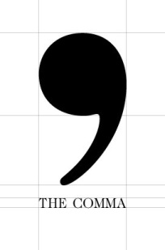


Comma– as a separator
C allows multiple variables of the same type to be defined as one statement, separated by commas.
Defines three integer
variables named a,b
and c.
a
b
Examples (independent definitions)
int a, b, c;
int a = 2, b = 5, c=15;
float x = 3.59, y = 4.5;
int x = 5, float y = 10.0;
c
Defines three integer
variables named a,b
and c. Initializes a to 2, b to 5 and c to 15.
a
b
2
5
c
15
Compilation error!
x
y
Defines two float variables named x and y. Initializes x to 3.59 and y to 10.0.
3.59
10.0

Slide 18
Comma– as an operator
Comma as an operator is a binary operator that takes two expressions as operands.
Think of just like + or – or * or / or = or == etc.. Some examples,
i+2, sum=sum-1;
scanf(“%d”,&m), sum=0, i=0;
Execution of expr1 , expr2 proceeds as follows.
Evaluate expr1, discard its result and then evaluate expr2 and return its value (and type).
expr1 , expr2
,

Slide 19
Optimization
Depending on the requirement, program can be made more efficient
use Sieve of Eratosthenes to compute primes
“Memorization” to compute primorial
p(n) = p(n-1) * N, where N is n-th prime
Use of array to store p(1) … p(n)
Use of long to increase domain
Avoid overflow longer…
Need special tricks to hold numbers bigger than long

Slide 20
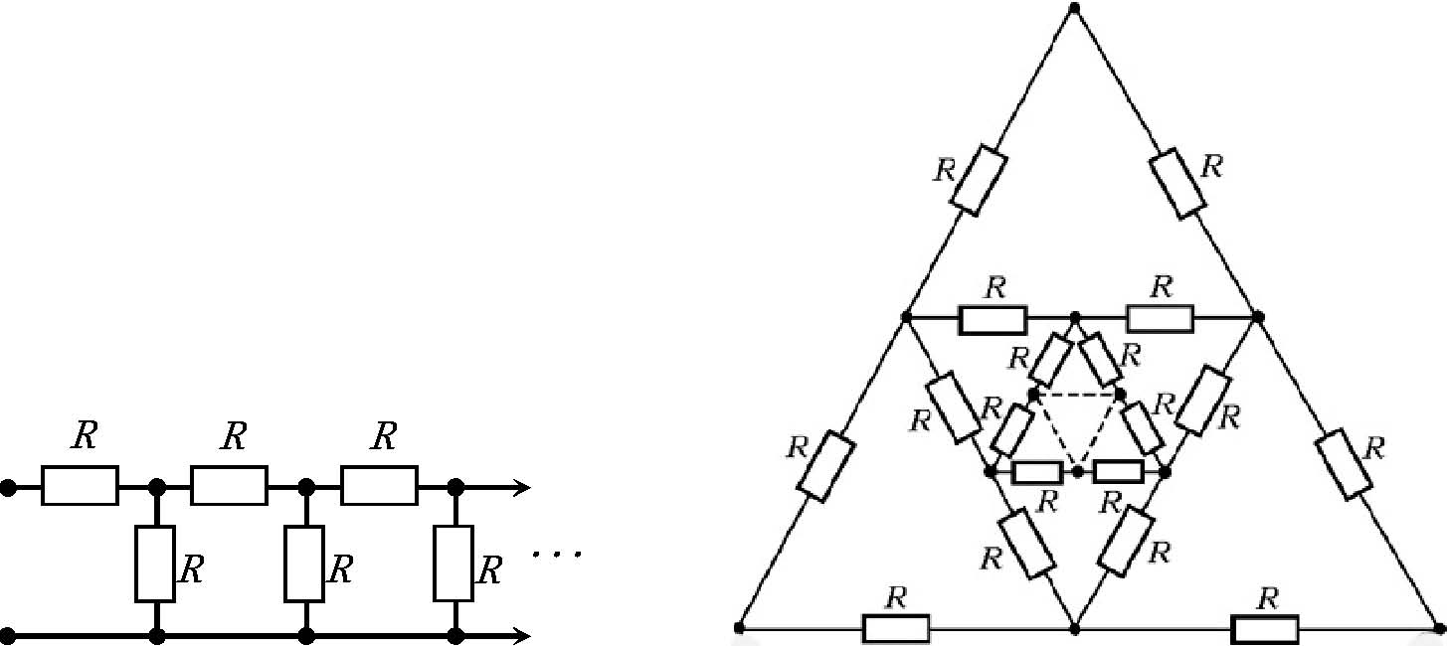
ESC101: Introduction to Computing
Recursion

Slide 21
Recursion
A function defined by calling itself, directly or indirectly, is called a recursive function.
The phenomenon itself is called recursion
Examples:
Factorial:
Even and Odd:
0! = 1
n! = n * (n-1)!
Even(n) = (n == 0) || Odd(n-1)
Odd(n) = (n != 0) && Even(n-1)

Slide 22
Recursive Functions: Properties
The arguments change between the recursive calls
5! = 5 * 4! = 5 * 4 * 3! = …
Change is towards a case for which solution is known (base case)
There must be one or more base cases
0! is 1
Odd(0) is false
Even(0) is true

Slide 23
Example: Factorial
Write a program to print the factorial of an integer n
Can do it using loops
To calculate the factorial of n, you calculate all the factorials in between
long int factorial(int n){
int i;
long int fact = 1;
for (i=1; i<(n+1); i++){
fact *= i;
}
return fact;
}

Slide 24
Example: Factorial
Write a recursive program to print the factorial of an integer n
Process
N! = N x (N-1)! (recursion)
0! = 1 (base case)
long int factorial(int n){
if(n==0)
return 1;
else
return(n*factorial(n-1));
}

Slide 25
Tracing the flow of control
long int factorial(int n){
if(n==0)
return 1;
else
return(n*factorial(n-1));
}
main()
main()
120
F(5)
F(5)
24
F(4)
F(4)
6
F(3)
F(3)
2
F(2)
1
F(2)
F(1)
1
F(1)
Values returned in reverse order off the memory stack!
F(0)

Slide 26
Recursion and Induction
When programming recursively, think inductively
Mathematical induction for the natural numbers
Structural induction for other recursively-defined types (to be covered later!)

Slide 27
Recursion and Induction
When writing a recursive function,
Write down a clear, concise specification of its behavior,
Give an inductive proof that your code satisfies the specification.

Slide 28
A more useful example
Write a function search(int a[], int n, int key) that performs a sequential search of the array a[0..n-1] of int. Returns 1 if the key is found, otherwise returns 0.
How should we start? We have to think of the function search() in terms of search applied to a smaller array. Don’t think in terms of loops…think recursion.
Here’s a possibility ….

Slide 29
search(a,n,key)
Base case: If n is 0, then, return 0.
Otherwise: /* n > 0 */
compare last item, a[n-1], with key.
if a[n-1] == key, return 1.
search in array a, up to size n-1.
return the result of this “smaller’’ search.
a
search(a,10,3)
31
4
10
35
59
31
3
25
35
11
Either 3 is a[9]; or search(a,10,3) is same as the result of search for 3 in the array starting at a and of size 9.

Slide 30

int search(int a[], int n, int key) {
if (n==0) return 0;
if (a[n-1] == key) return 1;
return search(a,n-1,key);
}
Let us do a quick trace.
a
E.g., (0) search(a,5,10)
31
4
10
35
59
a[4] is 59, not 10. call search(a,4,10)
a
(2) search(a,3,10)
31
4
10
35
59
a
(1) search(a,4,10)
a[2] is 10, return 1
31
4
10
35
59
a[3] is 35, calls search(a,3,10)

Slide 31
int search(int a[], int n, int key) {
if (n==0) return 0;
if (a[n-1] == key) return 1;
return search(a,n-1,key);
}
Let us do another quick trace.
a
(2) search(a,3,3)
a
E.g., (0) search(a,5,3)
31
4
10
35
59
31
4
10
35
59
a[2] is 10, calls search(a,2,3)
a[4] is 59, not 3. call search(a,4,3)
a
(3) search(a,2,3)
a
(1) search(a,4,3)
31
4
10
35
59
31
4
10
35
59
a[1] is 4, calls search(a,1,3)
a[3] is 35, calls search(a,3,3)
a
(4) search(a,1,3)
31
4
10
35
59
31
4
10
35
59
a
(5) search(a,0,3)
returns 0
a[0] is 31, calls search(a,0,3)

Slide 32
Stack
int search(int a[], int n, int key) {
if (n==0) return 0;
if (a[n-1] == key) return 1;
return search(a,n-1,key);
}
a
search(a,5,3)
31
4
10
35
59
function | called by | return address | return value
search(a,5,3) | main() | ---
search(a,4,3) | search(a,5,3) | search.5
search(a,3,3) | search(a,4,3) | search.4
search(a,2,3) | search(a,3,3) | search.3
search(a,1,3) | search(a,2,3) | search.2
search(a,0,3) | search(a,1,3) | search.1
recursion exits here
A state of the stack

Slide 33
Stack
int search(int a[], int n, int key) {
if (n==0) return 0;
if (a[n-1] == key) return 1;
return search(a,n-1,key);
}
a
search(a,5,3)
31
4
10
35
59
function | called by | return address | return value
search(a,5,3) | main() | ---
search(a,4,3) | search(a,5,3) | search.5
search(a,3,3) | search(a,4,3) | search.4
search(a,2,3) | search(a,3,3) | search.3
search(a,1,3) | search(a,2,3) | search.2
search(a,0,3) | search(a,1,3) | search.1 | 0
recursion exits here
A state of the stack

Slide 34
Stack
int search(int a[], int n, int key) {
if (n==0) return 0;
if (a[n-1] == key) return 1;
return search(a,n-1,key);
}
a
search(a,5,3)
31
4
10
35
59
function | called by | return address | return value
search(a,5,3) | main() | ---
search(a,4,3) | search(a,5,3) | search.5
search(a,3,3) | search(a,4,3) | search.4
search(a,2,3) | search(a,3,3) | search.3
search(a,1,3) | search(a,2,3) | search.2 | 0
state of the stack

Slide 35
Stack
int search(int a[], int n, int key) {
if (n==0) return 0;
if (a[n-1] == key) return 1;
return search(a,n-1,key);
}
a
search(a,5,3)
31
4
10
35
59
function | called by | return address | return value
search(a,5,3) | main() | ---
search(a,4,3) | search(a,5,3) | search.5
search(a,3,3) | search(a,4,3) | search.4
search(a,2,3) | search(a,3,3) | search.3 | 0
A state of the stack

Slide 36
Stack
int search(int a[], int n, int key) {
if (n==0) return 0;
if (a[n-1] == key) return 1;
return search(a,n-1,key);
}
a
search(a,5,3)
31
4
10
35
59
function | called by | return address | return value
search(a,5,3) | main() | ---
search(a,4,3) | search(a,5,3) | search.5 | 0
A state of the stack

Slide 37
Stack
int search(int a[], int n, int key) {
if (n==0) return 0;
if (a[n-1] == key) return 1;
return search(a,n-1,key);
}
a
search(a,5,3)
31
4
10
35
59
function | called by | return address | return value
search(a,5,3) | main() | --- | 0
A state of the stack

Slide 38
int search(int a[], int n, int key) {
if (n==0) return 0;
if (a[n-1] == key) return 1;
return search(a,n-1,key);
}
a
search(a,5,3)
31
4
10
35
59
search(a,5,3) returns 0. Recursion call stack terminates.

Slide 39
Next class
More about recursion

