Slide 1
Strings - basics
ESC101
October 4th

Slide 2
Welcome back
This week (4th, 6th and 9th):
Strings and n-D arrays
Basic extensions of what we’ve learned about arrays so far
Next week
Searching and sorting
Not in Major Quiz 2 syllabus
MQ2 syllabus: recursion, strings and n-D arrays

Slide 3
More announcements
Monday (2nd Oct) makeup lab on Saturday, Oct 7th
MQ2 → 18th October
At 12 pm in L20
Midsem copies either shown to you yesterday, or during the makeup tutorial this week
Check with your tutor, they have your copies
I am away till the 8th
Limited access to email
Will process all drop requests 9th onwards
There will be class on 6th in the regular time slot

Slide 4
Tentative grading scheme
Grade | Marks
A* | 95+
A | 80+
B | 65+
C | 50+
D | 35+
E | 20+
F | <20 + copying/cheating

Slide 5
Weightage (Theory)
Quizzes: 20%
Minor quizzes: total weight = 10%
Conducted in tutorial hours
2 Major Quizzes: each 5%
Conducted in lecture hours
Midterm: 15%
Final exam : 25%
Esc101, Programming

Slide 6
Weightage (Lab)
Labs: 5%
Weightage of later labs may be more. (First lab: 0 weight)
No make-up lab for absentees.
Lab exams: 35%
Mid-term lab exam: 15%
End-term lab exam: 20%
Esc101, Programming

Slide 7
Copying
Copy at your own risk
in any component (lab/quiz/exams/lab exams).
If you are caught, you get penalized on grade (most likely F).
Will not be allowed to drop the course
Case reported to DoAA/SSAC
No warning or second chance
All parties involved in copying will be held equally responsible. Copying from internet is penalized equally.
Policy may change on need basis
Esc101, Programming

Slide 8
Reminder: arrays
An array in C is defined similar to defining a variable.
int a[5];
The square parenthesis [5] indicates that a is not a single integer but an array, that is a consecutively allocated group, of 5 integers.
It creates five integer boxes or variables
Array elements are consecutively allocated in memory.
a[0] a[1] a[2] a[3] a[4]
The boxes are addressed as a[0], a[1], a[2], a[3] and a[4].
These are called the elements of the array.
Notes:
a[i] can be thought of as a variable

Slide 9
Reading into arrays
Read N numbers from user directly into an array
#include <stdio.h>
int main() {
char word[10];
for (i=0; i<10; i=i+1) {
scanf(“%c”, &word[i]);
}
return 0;
}
scanf can be used directly, treat an
array element like variable of the same data type.
1. For reading elements
of a char array s[],
use scanf(“%c”, &s[j]).
2. This is a really clunky way of reading text. No?
Notes:
Important: treat an array element like a variable.

Slide 10
Recap about arrays
Basics: Arrays are
defined as follows.
float w[100];
int num[10];
char s[10];
….
w
array of floats
w[0]
w[1]
w[2]
w[99]
float w[100] defines 100 variables of type float. Their names are indexed: w[0],w[2],…w[99]
array of ints
num
num[0]
num[1]
num[2]
num[9]
array of characters
It also defines a variable called w which stores the address of w[0].
s
s[0] s[1] s[2]
s[9]

Slide 11
How can we create an int array num[] and initialize it to:
num
-2
3
5
-7
19
103
11
Method 1
int num[] = {-2,3,5,-7,19, 103, 11};
Initial values are placed within curly braces separated by commas.
The size of the array need not be specified. It is set to the number of initial values provided.
Array elements are assigned in sequence in the index order. First constant is assigned to array element [0], second constant to [1], etc..
Method 2
int num[10] = {-2,3,5, -7, 19, 103, 11};
Specify the array size. size must be at least equal to the number of initialized values. Array elements assigned in index order. Remaining elements are set to 0.

Slide 12
Recommended method: array size determined from the number of initialization values.
int num[] = {-2,3,5,-7,19,103,11};
Is this correct?
int num[100] ={0,-1,1,-1};
YES! Creates num as an array of size 100. First 4 entries are initialized as given. num[4] … num[99] are set to 0.
num
0
-1
1
-1
0
0
0
Is this correct?
NO! it won’t compile!
int num[6] = {-2,3,5,-7,19,103,11};
num is declared to be an int array of size 6 but 7 values have been initialized.
Number of initial values must be less than equal to the size specified.
Why?

Slide 13


Initialization values could be constants or constant expressions. Constant expressions are expressions built out of constants.
int num[] = { 109, 7+3, 25*1023 };
Type of each initialization constant should be promotable/demote-able to array element type.
E.g.,
int num[] = { 1.09, ‘A’, 25.05};
Float constants 1.09 and 25.05 downgraded to int
Would
this work?
int curr = 5;
int num[] = { 2, curr*curr+5};
YES! ANSI C allows constant expressions AND
simple expressions for initialization values. “Simple” is compiler dependent.

Slide 14
Character array initialization
Character arrays may be initialized like arrays of any other type. Suppose we want the following char array.
‘I’
‘ ’
‘a’
‘m’
‘ ‘
‘D’
‘I’
s
‘O’
‘N’
‘\0’
s[0] s[1] s[2]
s[3] s[4] s[5]
s[6] s[7]
s[8]
We can write:
s[]={‘I’,’ ‘,’a’,’ m’,’ ’,’D’,’O’,’N’,’\0’ };
BUT! C allows us to define string constants. We can also write:
s[] = “I am DON”;
“I am DON” is a string constant. Strings constants in C are specified by enclosing in double quotes.
It is equivalent to a character array ending with ‘\0’.
The ‘\0’ character (also called NULL char) is automatically added to the end.

Slide 15
Printing strings
We have used string constants many times. Can you recall?
printf and scanf: the first argument is always a string.
printf(“The value is %d\n”, value);
scanf(“%d”, &value);
Strings are printed using %s option.
Output
E.g. 1
printf(“%s”, “I am DON”);
I am DON
Output
E.g. 2
char str[]=“I am GR8DON”;
printf(“%s”, str);
I am GR8DON
‘I’
‘ ’
‘a’
‘m’
‘ ’
‘G’
‘R’
‘8’
‘D’
‘O’
‘N’
‘\0’
str
str[0]
str[2]
str[4]
str[6]
str[8]
str[11]
State of memory after definition of str in E.g. 2. Note the NULL char added in the end.
This NULL char is not printed.

Slide 16
Strings
Consider the fragment.
This defines a constant string, i.e., character array terminated by, but not including, ‘\0’.
char str[]=“I am GR8DON”;
str[4] = ‘\0’;
printf(“%s”, str);
What is printed?
Let us trace the memory state of str[].
str
str[0]
str[2]
str[4]
str[6]
str[8]
str[11]
‘I’
‘ ’
‘a’
‘m’
‘ ’
‘G’
‘R’
‘8’
‘D’
‘O’
‘N’
‘\0’
‘\0’
Output
A string is a sequence of characters terminated by ‘\0’. This ‘\0’ is not part of the string.
I am
There may be non-null characters after the first occurrence of ‘\0’ in str[]. They are not part of the string str[] and don’t get printed by printf(“%s”, str);

Slide 17


So did we lose the chars after the first ‘\0’ ? Where did they go?
Of course not, they remain right where they were. They were not printed because we used %s in printf. Let’s take a look.
str
str[0]
str[2]
str[4]
str[6]
str[8]
str[11]
‘I’
‘ ’
‘a’
‘m’
‘ \0’
‘G’
‘R’
‘8’
‘D’
‘O’
‘N’
‘\0’
char str[]=“I am GR8DON”;
str[4]=‘\0’;
printf(“%s”, str);
Output
The character
‘\0’ may be printed differently on screen depending on terminal settings.
I am
int i;
for (i=0; i < 11; i++) {
putchar(str[i]);
}
Output
I amGR8DON

Slide 18
Reading a String (scanf)
Placeholder: %s
Argument: Name of character array.
No & sign before character array name. (?)
Input taken in a manner similar to numeric input.
With %s, scanf skips whitespaces.
There are three basic whitespace characters in C : space, newline ('\n') and tab ('\t').
Any combination of the three basic whitespace characters is a whitespace.

Slide 19
Reading a String (scanf)
Starts with the first non-whitespace character.
Copies the characters into successive memory cells of the character array variable.
When a whitespace character is reached, scanning stops.
scanf places the null character at the end of the string in the array variable.

Slide 20
#include <stdio.h>
int main() {
char str1[20], str2[20];
scanf("%s",str1);
scanf("%s",str2);
printf("%s + %s\n",
str1, str2);
return 0;
}
INPUT
IIT Kanpur
OUTPUT
IIT + Kanpur
INPUT
I am DON
OUTPUT
I + am

Slide 21
Why is there no & when we read character array?
Remember parameter passing?
A simple variable can not be modified from inside a function call (Recall swap() function)
However, Arrays can be modified from inside a function call (Recall read_into_array() function)
Similarly, scanf can also “modify” arrays directly. Since string is just an array of chars, & is not required.
More on this when we do pointers

Slide 22
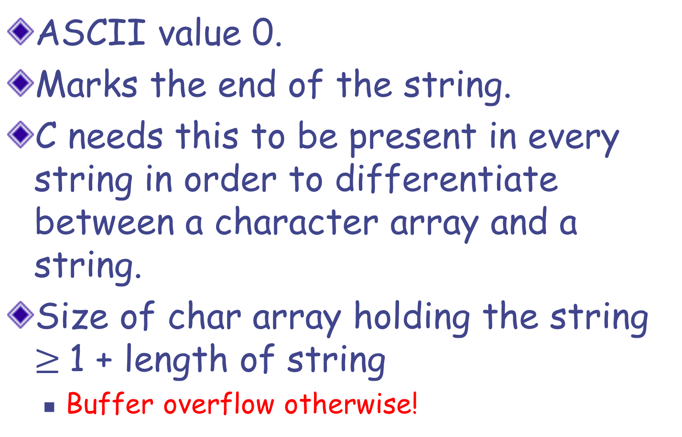
NULL character ‘\0’
ASCII value 0.
Marks the end of the string.
C needs this to be present in every string in order to differentiate between a character array and a string.
Size of char array holding the string $≥$1 + length of string
Buffer overflow otherwise!

Slide 23
NULL character ‘\0’
What happens if no '\0' is kept at the end of string?
‘\0’ is used to detect end of string, for example in printf(“%s”, str).
Without ‘\0’, such functions will keep reading array elements beyond the array bound (out of bound access).
We can get an incorrect result or a Runtime Error.

Slide 24
Reading a line as an input
scanf, when used with the %s placeholder, reads a block of non-whitespace characters as a string.
What if we want to read a line as a string?
We will define our own function to read a line.
EXERCISE: Take as input a line (that ends with the newline character) into a character array as a string.

Slide 25
#include <stdio.h>
// read a line into str, return length
int read_line(char str[]) {
int c, i=0;
c = getchar();
while (c != ‘\n’ && c != EOF) {
str[i] = c;
c = getchar();
i++;
}
str[i] = ‘\0’; // we want a string!
return i; // i is the length of the string
}
Buffer overflow possible

Slide 26
#include <stdio.h>
// read a line into str, return length.
// maximum allowed length is limit
int read_line(char str[] ) {
int c, i=0;
c = getchar();
while (c != ‘\n’ && c != EOF) {
str[i] = c;
c = getchar();
i++;
if (i == limit-1) break;
}
str[i] = ‘\0’; // we want a string!
return i; // i is the length of the string
}
, int limit
Safer version!

Slide 27
Special string I/O
C has special I/O functions for strings
Use gets() for string input
Use puts() for string output
But gets is a terrible function
Never use it!
int main(){
char line[80];
gets(line);
puts(line);
}

Slide 28
Reading with fgets
The gets() function doesn’t know the size of the buffer it is writing to
can easily overflow
Fix: use fgets() instead
Syntax
char* fgets(char *string, int length, FILE * stream);
To read from standard input, just set file stream to stdin
E.g. fgets(str, 30, stdin) will read a string of name str and size 30 from the standard input

Slide 29
Strings: recap
Character array terminated by ‘\0’ character.
Declare: char str[] = “Delhi”;
Print: printf(“this is the string: %s \n”, str);
Read: scanf(“%s”, str); \\ no & before name
Reads from first non-whitespace to next whitespace
Null character: ‘\0’
Marks the end of string. Not same as EOF
ASCII value 0.

Slide 30
Next class
String functions in C
Operations on strings

