Slide 1
Pointers: the prequel
ESC101
October 20th

Slide 2
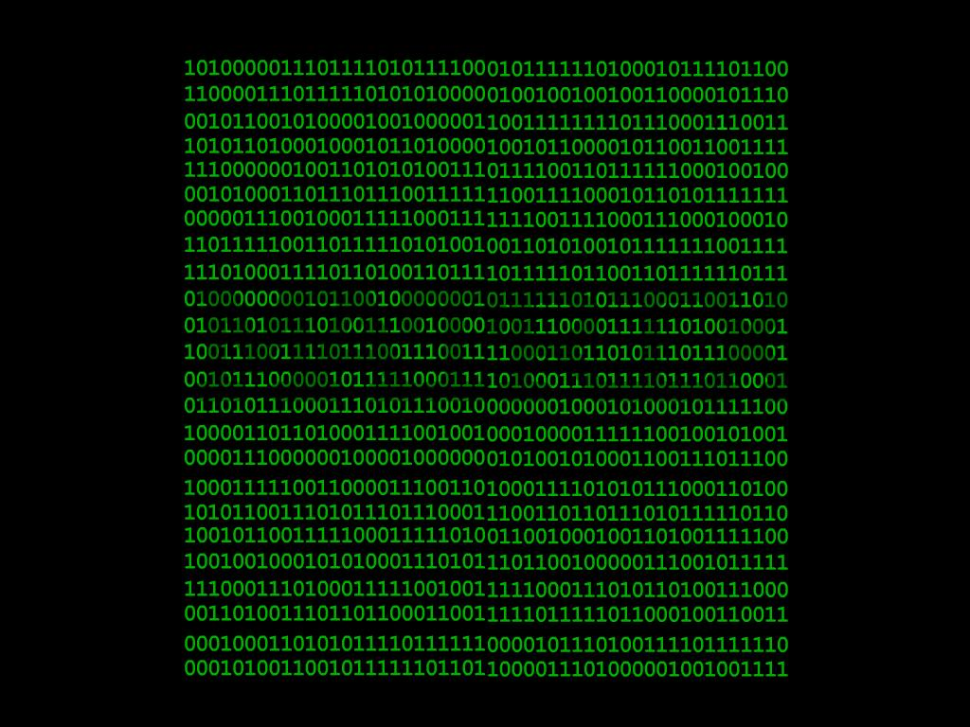
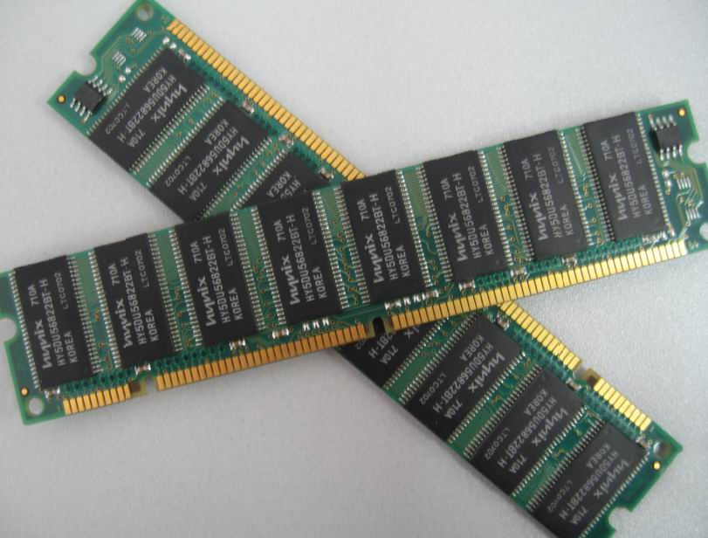

Slide 3
Simplified View of Memory
“Array” of blocks
Each block can hold a byte (8-bits)
“char” stored in 1 block
“int” (32-bit) stored in 4 consecutive blocks
Finite number of blocks
  Limited by the capacity of (Virtual) Memory
  Blocks are addressable – [0…2^{N}-1]
1004000
1004001
1004002
1004003
1004004
1004005
1004006
1004007
1004008
1004009
1004010
1004011
1004012
1004013
1004014
1004015
‘A’
‘E’
‘I’
‘O’
‘U’
1024
1004001

Slide 4
Simplified View of Memory
  Blocks are addressable.
  Address range: [0…2^{N}-1]
  N is the number of bits in address (number of digits in binary world)
  Any integer in the above range
    Can be used as an index in the MEMORY ARRAY
  Since memory array is unique, we can use this index alone
    If context is clear
1004000
1004001
1004002
1004003
1004004
1004005
1004006
1004007
1004008
1004009
1004010
1004011
1004012
1004013
1004014
1004015
‘A’
‘E’
‘I’
‘O’
‘U’
1024
1004001

Slide 5
Simplified View of Memory
1004000
1004001
1004002
1004003
1004004
1004005
1004006
1004007
1004008
1004009
1004010
1004011
1004012
1004013
1004014
1004015
‘A’
‘E’
‘I’
‘O’
‘U’
1024
1004001
Content of the 4-blocks starting at address 1004012
  1004001
Without knowing the context it is not possible to determine the significance of number 1004001
  It could be an integer value 1004001
  It could be the “location” of the block that stores ‘E’
“Type” helps us
disambiguate.
How do we decide what it is?
Notes:
Address is not very useful till we have the type.

Slide 6
What is a Pointer
Pointer: A special type of variable that contains an address of a memory location.
Think of a pointer as a new data type (a new kind of box) that holds memory addresses.
Pointers are almost always associated with the type of data that is contained in the memory location.
  For example, an integer pointer is a memory location that contains an integer.
  Character pointer, float pointer
  Even pointer to pointer (more on this later …)

Slide 7

Remember Arrays?
The memory allocated to array has two components:
A consecutively allocated segment of memory boxes of the same type, and
A box with the same name as the array. This box holds the address of the base (i.e., first ) element of the array.
int num[10];
num
num[0]
num[1]
num[2]
num[9]
This definition for num[10] gives 11 boxes, 10 of type int, and 1 of type address of an int box.
Hmm…
We represent the address of a box x by an arrow to the box x. So addresses are referred to as pointers.
Contents of an address box: pointer to the box whose address it contains. e.g., num points to num[0] above.

Slide 8

What can we do with a box? e.g., an integer box?
We can do operations supported for the data type of the box.
int num[10];
True!. But we can also take the address of a box. Like scanf for reading using the & operator.
For integers, we can do + - * / % etc. for each of num[0] through num[9].
OK. Say I want to take the address of num[1] and store it in an address variable ptr.
ptr = &num[1];
ptr would be of type address of int. In C this type is int *.
But what is the type of ptr? And how do i define ptr?
int * ptr;
ptr= &num[1];

Slide 9
ptr =&num[1]
let’s look at the memory
int num[10];
int * ptr;
ptr = &num[1];
state after num[10] gets defined.
OK, ptr is of type pointer to integer. But what does
mean?
num
num[0]
ptr = &num[1];
num[1]
num[2]
num[9]
ptr
The statement creates a new box of type “address of an int box”, more commonly referred to as, of type “pointer to integer”.
int *ptr;
The statement assigns to ptr the address of the box num[1]. Commonly referred to as: ptr now points to num[1].
ptr = &num[1];

Slide 10
OK, i see. The program fragment below results in this memory state.
int num[10];
int * ptr;
ptr = &num[1];
num
num
[0]
num[1]
num[2]
num[9]
5
ptr
question
Yes! scanf(“%d”,ptr) reads input integer into the box pointed to by the corresponding argument.
The box pointed to by ptr is num[1].
So num[1] becomes 5.
Suppose I now add the following statement after above fragment
scanf(“%d”,ptr);
Input
and input is :
5
Does num[1] become 5?

Slide 11
num
num
[0]
num[1]
num[2]
num[9]
5
Well, what else can you do
with ptr?
ptr
num is of type int [] (i.e., array of int). In C the box num stores the pointer to num[0]. Internally, C represents num and ptr in the same way. So the type int * can be used wherever int[] was used.
What’s so interesting? Please give examples.
Here are the interesting parts! You can
de-reference the pointer.
do simple arithmetic + - with pointers.
compare pointers and test for ==, <, > etc., similar to ordinary integers.

Slide 12
10
num
num
[0]
num[1]
num[2]
num[3]
num[4]
num[9]
5
ptr
De-referencing pointer ptr gives the box pointed to by ptr. The de-referencing operator in C is also *.
printf(“%d”, *ptr);
Output
5
Since ptr points to num[1], *ptr is the box num[1]. Printing it gives the output 5.
Consider statement
*ptr = *ptr + 5;
This will add 5 to the value in box pointed by ptr. So num[1] will become 5+5 = 10

Slide 13
15
22
num
num
[0]
num[1]
num[2]
num[3]
num[4]
num[9]
1
10
7
-1
61
ptr
Recall rule about pointers:
De-referencing a pointer ptr gives the box pointed to by ptr. The de-referencing operator in C is *.
Consider the statements. Execute them on above memory state.
*ptr = *ptr + 5;
num[2] = num[1]+num[2];
OK…
1st statement will add 5 to the value in box pointed by ptr. So *ptr becomes 10 + 5 = 15.
But *ptr and num[1] are the same box. So 2nd statement assigns 15 + 7 equals 22 to num[2].

Slide 14
num
num[0]
num[1]
num[2]
num[9]
15
22
Its
legal
because
1
16
Consider the
statement
ptr
num can be thought to be of type int *, and, ptr is of type int *.
So *num is of type int, which is 1 and *ptr is of type int with value 15
So num[2] is set to 16.
num[2]= *num + *ptr;
Is it a legal statement?
What would be the result?

Slide 15
Example program
#include<stdio.h>
int main(){
int* pc;
int c;
c=22;
printf("Address of c:%p\n",&c);
printf("Value of c:%d\n\n",c);
pc=&c;
printf("Address in pointer pc:%p\n",pc);
printf("Content pointed by pc:%d\n\n",*pc);
c=11;
printf("Address in pointer pc:%p\n",pc);
printf("Content pointed by pc:%d\n\n",*pc);
*pc=2;
printf("Address of c:%p\n",&c);
printf("Value of c:%d\n\n",c);
return 0;
}
Address of c:0x7ffcd40c7d8c
Value of c:22
Address in pointer pc:0x7ffcd40c7d8c
Content pointed by pc:22
Address of pointer pc:0x7ffcd40c7d8c
Content pointed by pc:11
Address of c:0x7ffcd40c7d8c
Value of c:2

Slide 16
Let’s now do some pointer arithmetic.
Let
int num[] = {1,22,16,-1,23};
num[0]
num[1]
num[2]
num[3]
num[4]
1
22
16
-1
23
num
num+1 points to integer box just next to the integer box pointed to by num. Since arrays were consecutively allocated, it points to num[1].
Okay,
What’s
cool?
So num+1 points to num[1]. Similarly, num+2 points to num[2], num + 3 points to num[3], and so on.
Can you tell me the output of this printf statement?
Hmm…
Output
would
be
printf(“%d %d %d”, *(num+1),
*(num+2),*(num+3));
22 16 -1

Slide 17

Predict the output
owlie
char str[] =“BANTI is a nice girl”;
char *ptr = str + 6; /*initialize*/
printf(“%s”,ptr);
First let us draw the state of memory.
str[0]
str[5]
str[10]
str[15]
‘B’
‘A’
‘N’
‘T’
‘I’
‘i’
‘s’
‘ ’
‘a’
‘ ’
‘n’
‘i’
‘c’
‘e’
‘ ’
str
ptr
‘g’
‘i’
‘r’
‘l’
‘\0’
str[16]
str[20]
ptr points to str[6]. printf prints
the string starting from str[6].
Output
is a nice girl

Slide 18
OK. Let me understand.The char array str[] was initialized as below.
str + 5
char str[] = “BANTI is a nice girl”;
char *ptr; ptr = str + 6;
str is of type
char *. So str + 6 points to the 6th character from the character pointed to by str. That is ptr. Correct?
str
‘B’
‘A’
‘N’
‘T’
‘I’
‘ ’
str + 10
equals ptr +4
‘i’
‘s’
‘ ’
‘a’
‘ ’
‘n’
ptr
str + 18
‘i’
‘c’
‘e’
‘ ’
‘g’
‘i’
str + 23
Here are some other pointer expressions-are they correct?
‘r’
‘l’
‘\0’
--
--
--
expressions with pointers
Yes,
that’s
correct
Yes, they’re all correct. Can you tell me the output of:
Hmm… I’m thinking
printf(“%s”,ptr-5);

Slide 19
char str[] = “BANTI is a nice girl”;
char *ptr; ptr = str + 6;
printf(“%s”,ptr-5);
ptr -5 should point to the 5th char backwards from the char pointed to by ptr. So ptr-5 points here
str
‘B’
‘A’
‘N’
‘T’
‘I’
‘ ’
‘i’
‘s’
‘ ’
‘a’
‘ ’
‘n’
ptr
The string starting from this point is “ANTI is a nice girl”. That would be the output. Correct?
‘i’
‘c’
‘e’
‘ ’
‘g’
‘i’
‘r’
‘l’
‘\0’
--
--
--
Output
ANTI is a nice girl
Yes,
that’s
correct

Slide 20
Pointers play an important role when used as parameters in function calls.
OK.
How
so?
Let’s start with the old example.
int main() {
int a = 1, b = 2;
swap(a,b);
printf(“From main”);
printf(“a = %d”,a);
printf(“b=%d\n”,b);
}
void swap(int a, int b) {
int t;
t = a; a=b; b =t;
printf(“From swap”);
printf(“a = %d”,a);
printf(“b= %d\n”,b);
}
The swap(int a, int b) function is intended to swap (exchange) the values of a and b.
Could you
explain again? i’m not so sure
But, the value of a and b do not change in main(), they are only swapped in swap().
OK, let’s first
trace the call to swap

Slide 21
int main() {
int a = 1, b = 2;
swap(a,b);
printf(“From main”);
printf(“ a = %d”,a);
printf(“b = %d”,b);
}
void swap(int a, int b) {
int t;
t = a; a=b; b =t;
printf(“From swap ”);
printf(“a= %d”,a);
printf(“b= %d\n”,b);
}
a
1
Output:
From swap a= 2 b= 1
STACK
b
2
Now swap() returns:
Return address is line 3 of main(). Program counter is set to this location.
Stack for swap() is deleted.
main()
return
address
swap()
main.3
a
2
1
1
t
b
1
2

Slide 22

int main() {
int a = 1, b = 2;
swap(a,b);
printf(“From main”);
printf(“ a = %d”,a);
printf(“b = %d”,b);
}
void swap(int a, int b) {
int t;
t = a; a=b; b =t;
printf(“From swap ”);
printf(“a = %d”,a);
printf(“b = %d\n”,b);
}
Output:
From swap a = 2 b = 1
a
1
Hmm…
STACK
b
2
Returning back to main(),we resume execution from line 3.
main()
But the variables a and b of main() are unchanged from what they were before the call to swap(). They are printed as is.
Changes made by swap() remained local to the variables of swap(). They did not propagate back to main().

Slide 23
int main() {
int a = 1, b = 2;
swap(a,b);
printf(“From main”);
printf(“ a = %d”,a);
printf(“b = %d”,b);
}
void swap(int a, int b) {
int t;
t = a; a=b; b =t;
printf(“From swap ”);
printf(“a = %d”,a);
printf(“b = %d\n”,b);
}
Output:
From swap a = 2 b = 1
OK, i
remember
now
a
1
From main a = 1 b = 2
b
2
Passing int/float/char as parameters does not allow passing “back” to calling function.
Any changes made to these variables are lost once the function returns.
Pointers will help us solve this problem!

Slide 24
Here is the changed program.
void
swap(int *ptra, int *ptrb)
{
int t;
t = *ptra;
*ptra= *ptrb;
*ptrb =t;
}
int main() {
int a = 1, b = 2;
swap(&a, &b);
printf(“a=%d, b=%d”,
a, b);
return 0;
}
The function swap() uses pointer to integer arguments, int *ptra and int *ptrb.
The main() function calls swap(&a,&b), i.e., passes the addresses of the ints it wishes to swap.

Slide 25
Tracing the swap function
int main() {
int a = 1, b = 2;
swap(&a, &b);
}
1
2
a
b
&a
&b
Address of a. (a is situated at memory location 0x1024)
0x1024
0x2000

Slide 26
void swap(int *ptra, int *ptrb) {
int t;
t = *ptra;
*ptra= *ptrb;
*ptrb =t;
}
a
b
1
2
2
1
1
2
0x1024
0x2000
&a
&b
main
2
swap
0x1024
0x2000
ptra
ptrb
t

Slide 27
Class quiz
Will the following code perform swap correctly?
a
b
void swap(int *ptra, int *ptrb) {
int *ptrt;
ptrt = ptra;
ptra= ptrb;
ptrb =ptrt;
}
1
2
0x1024
0x2000
&a
&b
0x1024
0x2000
ptra
ptrb
ptrt
Notes:
No, it will swap the pointers in the swap function.

