Slide 1
Dynamic memory allocation
ESC101
October 23rd

Slide 2
Simplified View of Memory
1004000
1004001
1004002
1004003
1004004
1004005
1004006
1004007
1004008
1004009
1004010
1004011
1004012
1004013
1004014
1004015
‘A’
‘E’
‘I’
‘O’
‘U’
1024
1004001
x
In programming, “type” helps us decide whether 1004001 is an integer or a pointer to block containing ‘E’ (or something else)
#include<stdio.h>
int main() {
char x[5] = {‘A', ‘E', ‘I', ‘O', ‘U'};
int y = 1024;
char *p = x+1;
…
}
y
#include<stdio.h>
int main() {
char x[5] = {‘A', ‘E', ‘I', ‘O', ‘U'};
int y = 1024;
int p = 1004001;
…
}
Declaration of a pointer to char box
p

Slide 3
Pointers: Visual Representation
Typically represented by box and arrow diagram
45FD
53
x is an int variable that contains the value 53.
Address of x is 45FD.
px is a pointer to int that contains address of x.
8CF2
45FD
px
x
839B
‘H’
y is an char variable that contains the character ‘H’.
Address of y is 839B.
py is a pointer to char that contains address of y.
8BF9
839B
py
y
We are showing addresses for explanation only.
Ideally, the program should not depend on actual addresses.

Slide 4
Pointer to a pointer
If we have a pointer P to some memory cell, P is also stored somewhere in the memory.
So, we can also talk about address of block that stores P.
B4F7
45FD
53
8BF9
B4F7
45FD
ppx
px
x
We are showing addresses for explanation only.
Ideally, the program should not depend on actual addresses.
int x = 53;
int *px = &x;
int **ppx = &px;
Notes:
- Note that &(&x) gives a compiler error. You should first store the address &x in px and then do &px.

Slide 5
Size of Datatypes
The smallest unit of data in your computer's memory is one bit. A bit is either 0 or 1.
8 bits make up a byte.
2¹⁰ bytes is 1 kilobyte (KB). 2¹⁰ KB is 1 megabyte (MB). 2¹⁰ MB is 1 gigabyte (GB).
2¹⁰ GB is 1 terabyte (TB)
Every data type occupies a fixed amount of space in your computer's memory.

Slide 6
Size of Datatypes
There is an operator in C that takes as argument the name of a data type and returns the number of bytes the data type takes
the sizeof operator.
For example, sizeof(int) return the number of bytes a variable of type int uses up in your computer’s memory.

Slide 7
sizeof Examples
printf("int: %d\n", sizeof(int));
printf("float: %d\n", sizeof(float));
printf("long int: %d\n", sizeof(long int));
printf("double: %d\n", sizeof(double));
printf("char: %d\n", sizeof(char));
printf("int ptr: %d\n", sizeof(int *));
printf("double ptr: %d\n", sizeof(double*));
printf("char ptr: %d\n", sizeof(char *));
int: 4
float: 4
long int: 8
double: 8
char: 1
int ptr: 8
double ptr: 8
char ptr: 8
The values can vary from computer to computer.
Note that all pointer types occupy the same number of bytes (8 bytes in this case).
Depends only on total # of memory blocks (RAM/Virtual Memory) and not on data type

Slide 8
Static Memory Allocation
When we declare an array, size has to be specified before hand.
During compilation, the C compiler knows how much space to allocate to the program
Space for each variable.
Space for an array depending on the size.
This memory is allocated in a part of the memory known as the stack.
Need to assume worst case scenario
May result in wastage of Memory

Slide 9
Automatic Memory Allocation
The compiler automatically creates boxes to hold return values and actual parameters of function calls
Memory only allocated for the duration of the function call
Destroyed after function call
Also allocated on stack
Can’t use for persistent operations
Except with ‘static’ type, which is limited to single variables

Slide 10
Middle path: dynamic Memory Allocation
There is a way of allocating memory to a program during runtime.
This is known as dynamic memory allocation.
Dynamic allocation is done in a part of the memory called the heap.
You can control the memory allocated depending on the actual input(s)
Less wastage

Slide 11
Memory allocation: malloc
The malloc function is declared in stdlib.h
Takes as argument an integer (say n, typically > 0),
Allocates n consecutive bytes of memory space, and
returns the address of the first cell of this memory space
The return type is void*
WAIT!! Doesn’t void means “nothing” in C?
What is the meaning of void*? Pointer to nothing!

Slide 12
void* is NOT pointer to nothing!
malloc knows nothing about the use of the memory blocks it has allocated
void* is used to convey this message
Does not mean pointer to nothing, but means pointer to something about which nothing is known
The blocks allocated by malloc can be used to store “anything” provided we allocate enough of them

Slide 13
malloc: Example
A pointer to float
float *f;
f= (float*) malloc(10 * sizeof(float));
Size big enough to hold 10 floats.
Explicit type casting to convey users intent
Note the use of sizeof to keep it machine independent
malloc evaluates its arguments at runtime to allocate (reserve) space. Returns a void*, pointer to first address of allocated space.

Slide 14
malloc: Example
Key Point: The size argument can be a variable or non-constant expression!
After memory is allocated, pointer variable behaves as if it is an array!
float *f; int n;
scanf(“%d”, &n);
f= (float*) malloc(n * sizeof(float));
f[0] = 0.52;
scanf(“%f”, &f[3]); //Overflow if n<=3
printf(“%f”, *f + f[0]);
This is because, in C, f[i] simply means *(f+i).

Slide 15
Exercise
Write a program that reads two integers, n and m, and stores powers of n from 0 up to m (n⁰, n¹, …, n^{m})
#include<stdio.h>
#include<stdlib.h>
int main(){
int *pow, i, n, m;
scanf("%d %d", &n, &m); // m>= 0
pow = (int *) malloc ((m+1) * sizeof(int));
pow[0] = 1;
for (i=1; i<=m; i++)
pow[i] = pow[i-1]*n;
for (i=0; i<=m; i++)
printf("%d\n",pow[i]);
return 0;
}
Note that instead of writing pow[i], we can also write
*(pow + i)

Slide 16
NULL
A special pointer value to denote “points-to-nothing”
C uses the value 0 or name NULL
In Boolean context, NULL is equivalent to false, any other pointer value is equivalent to true
A malloc call can return NULL if it is not possible to satisfy memory request
negative or ZERO size argument
TOO BIG size argument

Slide 17
Pointers and Initialization
Uninitialized pointer has GARBAGE value, NOT NULL
Memory returned by
malloc is not initialized.
Brothers of malloc
calloc(n, size): allocates memory for n-element array of size bytes each. Memory is initialized to 0.
realloc(ptr, size): changes the size of the memory block pointed to by ptr to size bytes.
Both malloc, calloc return a logically contiguous block of memory.
Calloc also clears-memory with zeros.
Notes:
- calloc for “contiguous allocation”.

Slide 18
malloc()
To allocate memory use
void *malloc(size_t size);
Takes number of bytes to allocate as argument.
Use sizeof to determine the size of a type.
Returns pointer of type void *. A void pointer may be assigned to any pointer.
If no memory available, returns NULL.
e.g.
char *line;
int linelength = 100;
line = (char*)malloc(linelength);

Slide 19
malloc() example
To allocate space for 100 integers:
int *ip;
if ((ip = (int*)malloc(100 * sizeof(int))) == NULL){
printf("out of memory\n");
exit();
}
Note we cast the return value to int*.
Note we also check if the function returns NULL.

Slide 20
free()
To release allocated memory use
free()
Deallocates memory allocated by malloc().
Takes a pointer as an argument.
e.g.
free(newPtr);
Freeing unused memory is a good idea, but it's not mandatory. When your program exits, any memory which it has allocated but not freed will be automatically released.

Slide 21
calloc()
Similar to malloc(), the main difference is that the values stored in the allocated memory space are zero by default. With malloc(), the allocated memory could have any value.
calloc() requires two arguments - the number of variables you'd like to allocate memory for and the size of each variable.
void *calloc(size_t nitem, size_t size);
Like malloc(), calloc() will return a void pointer if the memory allocation was successful, else it'll return a NULL pointer.

Slide 22
calloc() example
/* Using calloc() to initialize 100 floats to 0.0 */
#include <stdlib.h>
#include <stdio.h>
#define BUFFER_SIZE 100
int main(){
float * buffer;
int i;
if ((buffer = (float*)calloc(BUFFER_SIZE, sizeof(float))) == NULL){
printf("out of memory\n");
exit(1);
}
for (i=0; i < BUFFER_SIZE; i++)
printf(“buffer[%d] = %f\n”, i, buffer[i]);
return 0;
}

Slide 23
realloc()
If you find you did not allocate enough space use realloc().
You give realloc() a pointer (such as you received from an initial call to malloc()) and a new size, and realloc does what it can to give you a block of memory big enough to hold the new size.
int *ip;
ip = (int*)malloc(100 * sizeof(int));
...
/* need twice as much space */
ip = (int*)realloc(ip, 200 * sizeof(int));

Slide 24
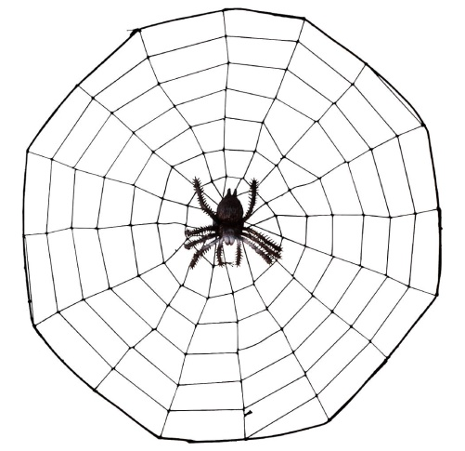
With great power comes great responsibility
Power to allocate memory when needed must be complimented by the responsibility to de-allocate memory when no longer needed!
free unused pointers
Be prepared to face rejection of demand
Check the return value of malloc (and its variants)

Slide 25
Typical dynamic allocation
int * ar;
….
ar = (int *) malloc(…); // allocate memory
if (ar == NULL) { // or if (!ar)
// take corrective measures and return failures
}
…ar[i] …
free(ar); // free after last use of ar

Slide 26

Dynamic memory management is similar to library management

Slide 27

Pointer Declaration = Registration
int *ar;
Declare your intent that you will use books from the library

Slide 28

malloc = check out
Reserve book(s) for your use
ar = (int*) malloc(…);

Slide 29
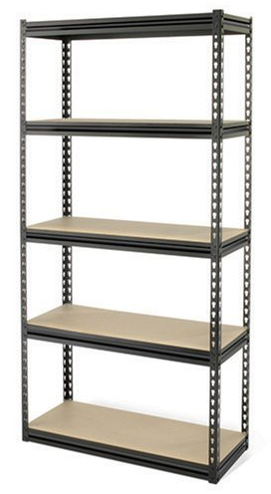
What if the book is not available?
if (ar == NULL) {
// take corrective measures
// OR return failure
}
Book not available: Purchase the book?
Share with a friend?
Not study ☹

Slide 30

If the check out is successful
…ar[i]… // use of ar
Read it.

Slide 31


If the check out is successful
br = ar; // copy the address
…
ar[i] = …; // change the content
…
br[i] = …; // change the content indirectly
…
Share it.
Use it!

Slide 32

free = return the book
free(ar); // free after last use of
// alloc’ed memory
Your job is done, return the book so that others can use it.

Slide 33
Return the book
br = ar;
…
free(br); // free after last use
free(ar); // multiple free of same loc not allowed
Your friend can also return the book for you.
But a book can be returned only once per check out!

