Slide 1
Pointers and arrays
ESC101
October 25th

Slide 2
Announcements
MQ2 copies shown in tutorial next week
Lab end sem exam on 11th November in NCL (as before)
Syllabus: everything
Logistics: same as before
Theory end sem exam on 22nd November afternoon
Details to follow
Cannot miss this exam
End sem copies shown on 27th November
Vacation begins 28th

Slide 3
Recap: dynamic memory allocation
int * ar;
….
ar = (int *) malloc(…); // allocate memory
if (ar == NULL) { // or if (!ar)
// take corrective measures and return failures
}
…ar[i] …
free(ar); // free after last use of ar

Slide 4
Question
What is the difference between the arr we get from
int arr[10]
int *arr followed by arr = malloc(sizeof(int)*10)
Both are pointers to the first block of memory assigned to the array
Static assigned pointer cannot be re-assigned
Dynamically assigned pointer can be re-assigned

Slide 5
Question: realloc and free
How do we free a pointer we passed into realloc and returned out into the same variable name?
If realloc succeeds in memory allocation, old memory is automatically freed
If realloc fails, it returns the old address as the new address

Slide 6

Arrays and Pointers
In C, array names are nothing but pointers.
Can be used interchangeably in most cases
However, array names can not be assigned, but pointer variables can be.
Array name is not a variable. It gets evaluated in C.
int ar[10], *b;
ar = ar + 2;
ar = b;
b = ar;
b = b + 1;
b = ar + 2;
b++;

Slide 7

Precedence (Unary Refined)
( ) [ ]
LR
* (deref) ++ --
! & + -
RL
* / %
LR
+ -
LR
< <= > >=
LR
== !=
LR
&&
||
LR
LR
=
RL
,
LR

Slide 8
Array of Pointers
Consider the following declaration
int *arr[10];
arr is a 10-sized array of pointers to integers
How can we have equivalent dynamic array?
int **arr;
arr = malloc ( );
(int **)
10 *
sizeof(int *)

Slide 9
Array of Pointers
int **arr;
arr = malloc ( );
(int **)
10 *
sizeof(int *)
Note that individual elements in the array arr (arr[0], … arr[9]) are NOT allocated any space. Uninitialized.
We need to do it (directly or indirectly) before using them.
int j;
for (j = 0; j < 10; j++)
arr[j] = (int*) malloc (sizeof(int));

Slide 10
Subtle difference
Array of pointers
Pointer to array
int *ptr[10];
int a[10]={0,1,2,3,4,5,6,7,8,9};
*ptr=a;
printf("%d",*ptr[1]);
int (*ptr)[10];
int a[10]={99,1,2,3,4,5,6,7,8,9};
ptr=&a;
printf("%d",(*ptr)[1]);
Output: Segfault
Output: 1

Slide 11
Exercise: All Substrings
Read a string and create an array containing all its substrings (i.e. contiguous).
Display the substrings.
Input: ESC
Output:
E
ES
ESC
S
SC
C

Slide 12
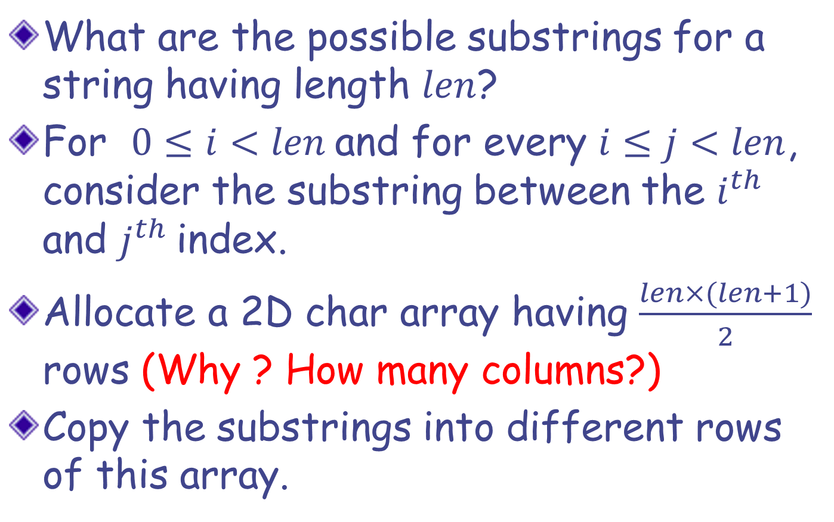
All Substrings: Solution Strategy
What are the possible substrings for a string having length $len$?
For $0≤i<len$and for every $i≤j<len$, consider the substring between the $i^{th}$and $j^{th}$index.
Allocate a 2D char array having $\frac{len×(len+1)}{2}$rows (Why ? How many columns?)
Copy the substrings into different rows of this array.

Slide 13
Solution: Version 1
int len, i, j, k=0, nsubstr;
char st[100], **substrs;
scanf("%s",st);
len = strlen(st);
nsubstr = len*(len+1)/2;
substrs = (char**)malloc(sizeof(char*) * nsubstr);
for (i=0; i<nsubstr; i++)
substrs[i] = (char*)malloc(sizeof(char) * (len+1));
for (i=0; i<len; i++){
for (j=i; j<len; j++){
strncpy(substrs[k], st+i, j-i+1);
k++;
}
}
for (i=0; i<k; i++)
printf("%s\n",substrs[i]);
for (i=0; i<k; i++)
free(substrs[i]);
free(substrs);

Slide 14
Too much wastage…
E | ‘\0’
E | S | ‘\0’
E | S | C | ‘\0’
S | ‘\0’
S | C | ‘\0’
C | ‘\0’

Slide 15
Solution: Version 2
int len, i, j, k=0,nsubstr; char st[100], **substrs;
scanf("%s",st);
len = strlen(st);
nsubstr = len*(len+1)/2;
substrs = (char**)malloc(sizeof(char*) * nsubstr);
for (i=0; i<len; i++)
for (j=i; j<len; j++){
substrs[k] = (char*)malloc(sizeof(char) * (j-i+2));
strncpy(substrs[k], st+i, j-i+1);
k++;
}
for (i=0; i<k; i++)
printf("%s\n",substrs[i]);
for (i=0; i<k; i++)
free(substrs[i]);
free(substrs);
This version uses much less memory compared to version 1

Slide 16
Solution: Version 3
int len, i, j, k=0,nsubstr;
char st[100], **substrs;
scanf("%s",st);
len = strlen(st);
nsubstr = len*(len+1)/2;
substrs = (char**)malloc(sizeof(char*) * nsubstr);
for (i=0; i<len; i++){
for (j=i; j<len; j++){
substrs[k] = strdup(st+i, j-i+1);
k++;
}
}
for (i=0; i<k; i++)
printf("%s\n",substrs[i]);
for (i=0; i<k; i++)
free(substrs[i]);
free(substrs);
Less code => more readable, fewer bugs!
possibly faster!

Slide 17
Example Function that Returns Pointer
char *strdup(const char *s);
strdup creates a copy of the string (char array) passed as arguments
copy is created in dynamically allocated memory block of sufficient size
returns a pointer to the copy created
C does not allow returning an Array of any type from a function
But we can use a pointer to simulate return of an array (or multiple values of same type)

Slide 18

Returning Pointer: Beware
#include<stdio.h>
int *fun();
int main() {
printf("%d",*fun());
}
int *fun() {
int *p, i;
p = &i;
i = 10;
return p;
}
#include<stdio.h>
int *fun();
int main() {
printf("%d",*fun());
}
int *fun() {
int *p;
p = (int*)malloc(sizeof(int));
*p = 10;
return p;
}
OUTPUT: 10
OUTPUT

Slide 19
Returning Pointer: Beware
The function stack (except for the return value) is gone once the function completes its execution.
All addresses of local variables and formal arguments become invalid
available for “reuse”
But the heap memory, once allocated, remains until it is explicitly “freed”
even beyond the function that allocated it.
addresses of static and global variables remain valid throughout the program.

Slide 20
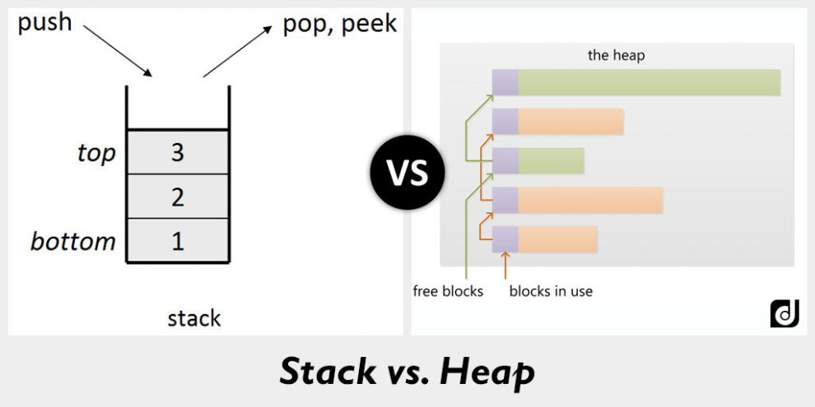
Stack vs heap
Compiler controls the stack, programmer controls the heap

Slide 21
An Intuition
Think of executing a function as writing on a classroom blackboard.
Once the function finishes execution (the class is over), everything on the blackboard is erased.
What if we want to retain a message, after class is over?
Solution could be to post essential information on a “notice board”, which is globally accessible to all classrooms.
The blackboard of a class is like the stack (possibly erased/overwritten in the next class), and the notice board is like the heap.

Slide 22
Class Quiz
The following program illustrates the value of declarations of the form int (*ptr)[2] .
#include<stdio.h>
int main() {
int a[] = {1,2,3};
int (*ptr)[2] = &a;
printf("%d\n", (*ptr)[0]); printf("%d\n", (*ptr)[1]);
(*ptr)[0] = -1;
printf("%d\n", a[0]);
return 0;
}
An equivalent assignment is:
int (*ptr)[2];
ptr = &a;
OUTPUT:
1
2
-1

