Slide 1
Winding up pointers
ESC101
October 30th

Slide 2
Solution: Version 2
int len, i, j, k=0,nsubstr; char st[100], **substrs;
scanf("%s",st);
len = strlen(st);
nsubstr = len*(len+1)/2;
substrs = (char**)malloc(sizeof(char*) * nsubstr);
for (i=0; i<len; i++)
for (j=i; j<len; j++){
substrs[k] = (char*)malloc(sizeof(char) * (j-i+2));
strncpy(substrs[k], st+i, j-i+1);
k++;
}
for (i=0; i<k; i++)
printf("%s\n",substrs[i]);
for (i=0; i<k; i++)
free(substrs[i]);
free(substrs);

Slide 3
Solution: Version 3
int len, i, j, k=0,nsubstr;
char st[100], **substrs;
scanf("%s",st);
len = strlen(st);
nsubstr = len*(len+1)/2;
substrs = (char**)malloc(sizeof(char*) * nsubstr);
for (i=0; i<len; i++){
for (j=i; j<len; j++){
substrs[k] = strdup(st+i, j-i+1);
k++;
}
}
for (i=0; i<k; i++)
printf("%s\n",substrs[i]);
for (i=0; i<k; i++)
free(substrs[i]);
free(substrs);
Less code => more readable, fewer bugs!
possibly faster!

Slide 4
Example Function that Returns Pointer
char *strdup(const char *s);
strdup creates a copy of the string (char array) passed as arguments
copy is created in dynamically allocated memory block of sufficient size
returns a pointer to the copy created
C does not allow returning an Array of any type from a function
But we can use a pointer to simulate return of an array (or multiple values of same type)

Slide 5

Returning Pointer: Beware
#include<stdio.h>
int *fun();
int main() {
printf("%d",*fun());
}
int *fun() {
int *p, i;
p = &i;
i = 10;
return p;
}
#include<stdio.h>
int *fun();
int main() {
printf("%d",*fun());
}
int *fun() {
int *p;
p = (int*)malloc(sizeof(int));
*p = 10;
return p;
}
OUTPUT: 10
OUTPUT

Slide 6
Returning Pointer: Beware
The function stack (except for the return value) is gone once the function completes its execution.
All addresses of local variables and formal arguments become invalid
available for “reuse”
But the heap memory, once allocated, remains until it is explicitly “freed”
even beyond the function that allocated it.
addresses of static and global variables remain valid throughout the program.

Slide 7
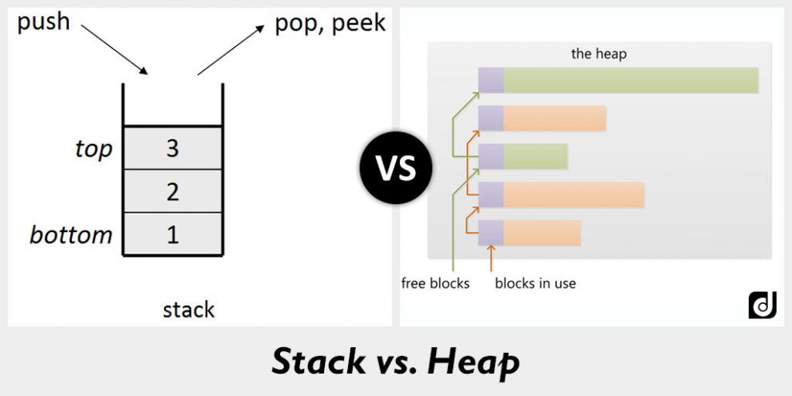
Stack vs heap
Compiler controls the stack, programmer controls the heap

Slide 8
An Intuition
Think of executing a function as writing on a classroom blackboard.
Once the function finishes execution (the class is over), everything on the blackboard is erased.
What if we want to retain a message, after class is over?
Solution could be to post essential information on a “notice board”, which is globally accessible to all classrooms.
The blackboard of a class is like the stack (possibly erased/overwritten in the next class), and the notice board is like the heap.

Slide 9
Class Quiz
The following program illustrates the value of declarations of the form int (*ptr)[2] .
#include<stdio.h>
int main() {
int a[] = {1,2,3};
int (*ptr)[2] = &a;
printf("%d\n", (*ptr)[0]); printf("%d\n", (*ptr)[1]);
(*ptr)[0] = -1;
printf("%d\n", a[0]);
return 0;
}
An equivalent assignment is:
int (*ptr)[2];
ptr = &a;
OUTPUT:
1
2
-1

Slide 10
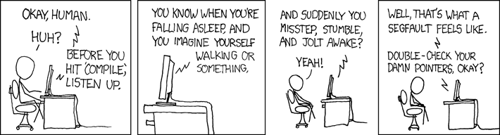
Common Issues and Errors
Source: http://www.xkcd.com/371

Slide 11
Common Issues and Errors
Forgetting to malloc, forgetting to initialize allocated memory
Not allocating enough space in malloc (e.g. Allocating 4 characters instead of 5 to store the string “IITK”.)
Returning pointers to temporaries (called dangling pointers)
Forgetting to free memory after use (called a memory leak.)
Freeing the same memory more than once (runtime error), using free-d memory

Slide 12
Memory Leaks
Consider code:
Memory is allocated to a at line 2.
However, at line 3, a is reassigned NULL
No way to refer to allocated memory!!
We can not even free it, as free-ing requires passing address of allocated block
This memory is practically lost for the program (Leaked)
Ideally, memory should be freed before losing last reference to it
1. int *a;
2. a = (int *)malloc(5*sizeof(int));
3. a = NULL;

Slide 13
Multidimensional Arrays
Declaration:
double mat[5][6];
int mat[5][6];
float mat[5][6];
mat is a 5 X 6 matrix of doubles (or ints or floats). It has 5 rows, each row has 6 columns, each entry is of type double.
2.1 | 1.0 | -0.11 | -0.87 | 31.5 | 11.4
-3.2 | -2.5 | 1.678 | 4.5 | 0.001 | 1.89
7.889 | 3.333 | 0.667 | 1.1 | 1.0 | -1.0
-4.56 | -21.5 | 1.0e7 | -1.0e-9 | 1.0e-15 | -5.78
45.7 | 26.9 | -0.001 | 1000.09 | 1.0e15 | 1.0
mat
Notes:
- int dim3[5][6][7]; is also allowed!
13

Slide 14
Multi-dimensional Array vs. Multi-level pointer
int a[2][3];
int **b;
b = (int**)malloc(2*sizeof(int*));
b[0] = (int*)malloc(3*sizeof(int));
b[1] = (int*)malloc(3*sizeof(int));
Are these two equivalent?
Both a and b can hold 6 integer in a 2x3 grid like structure.
In case of a all 6 cells are consecutively allocated. For b, we have 2 blocks of 3 consecutive cells each.

Slide 15
Memory layout
int **b;
b = (int**)malloc(2*sizeof(int*));
b[0] = (int*)malloc(3*sizeof(int));
b[1] = (int*)malloc(3*sizeof(int));
int a[2][3];
b[0]
a
b
b[1]
Logical Layout
Warning:
(*b+3) may not point to b[1][0].
(*a+3) points to a[1][0].

Slide 16
Indexing Elements
b[0][1]
How to refer to an element
of the array in the language
of pointers?
b[0][1] is *(*b+1)
b[1][0] is **(b+1)
b[1][2] is *(*(b+1)+2)
In general, b[i][j] is *(*(b+i)+j)
b[0]
b
b[1]
b[1][0]
b[1][2]
b[0]
Expression Value
**(b+1)
*(*b+1)
(**b+1)
*(*b+2)+2
*(*(b+1)+2)+2
1
4
9
20
4
2
b
20
30
40
11
b[1]
42

Slide 17
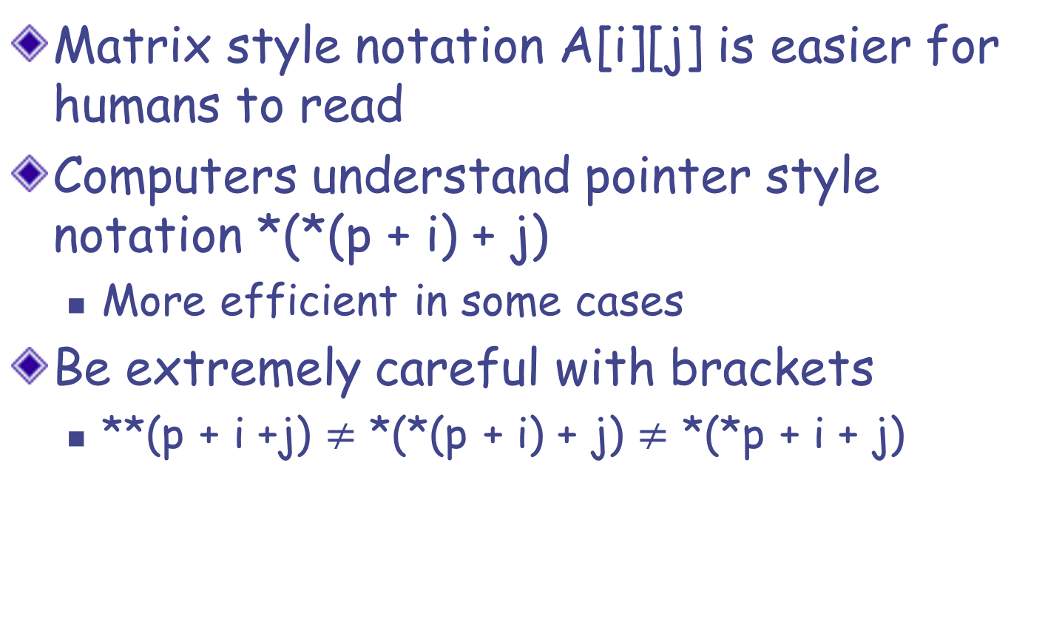
Pointers vs. Arrays: Indexing
Matrix style notation A[i][j] is easier for humans to read
Computers understand pointer style notation *(*(p + i) + j)
More efficient in some cases
Be extremely careful with brackets
**(p + i +j) $≠$ *(*(p + i) + j) $≠$*(*p + i + j)

Slide 18
int a[3][3], i, j, *b, *c;
for (i=0; i<3; i++)
for (j=0; j<3; j++)
a[i][j] = pow((i+3),(j+1));
b = *a;
c = *(a+2);
for (i=0; i<3; i++)
printf("%d ", b[i]);
printf("\n");
for (i=0; i<3; i++)
printf("%d ", *(c+i));
At this point,
array a is:
3 | 9 | 27
4 | 16 | 64
5 | 25 | 125
What do b and c point-to here?
b is a pointer to
a[0][0]?
c is a pointer to
a[2][0]?
OUTPUT
3 9 27
5 25 125

Slide 19
int a[3][3], i, j, *b, *c;
for (i=0; i<3; i++)
for (j=0; j<3; j++)
a[i][j] = pow((i+3),(j+1));
b = *a;
c = *(a+2) + 1;
for (i=0; i<3; i++)
printf("%d ", b[i]);
printf("\n");
for (i=0; i<2; i++)
printf("%d ", *(c+i));
At this point,
array a is:
3 | 9 | 27
4 | 16 | 64
5 | 25 | 125
What do b and c point-to here?
b is a pointer to
a[0][0]?
c is a pointer to
a[2][1]?
OUTPUT
3 9 27
25 125
note
the
change

Slide 20
Remember this?
Array of pointers
Pointer to array
int *ptr[10];
int a[10]={0,1,2,3,4,5,6,7,8,9};
*ptr=a;
printf("%d",*ptr[1]);
int (*ptr)[10];
int a[10]={99,1,2,3,4,5,6,7,8,9};
ptr=&a;
printf("%d",(*ptr)[1]);
Output: Segfault
Output: 1

Slide 21
Array of Pointers vs. Pointer to an Array
int arr[2][3];
(number of rows fixed,
number of columns fixed)
int (*arr)[3];
(only the number of columns fixed)
. .
.
Array of arrays
int* arr[3];
(only the number of rows fixed)
int **arr;
(general case)

Slide 22
Variants of malloc – Advanced Types
int (*arr)[3];
(only the number of columns fixed)
. .
.
arr = (int (*)[3]) malloc(n*3*sizeof(int));
or
arr = (int (*)[3]) malloc(n*sizeof(int[3]));
Array of arrays
int* arr[3];
(only the number of rows fixed)
arr = (int *[3]) malloc(n*sizeof(int[3]));
Only when you want to use n columns in each row.

Slide 23
int **a, *b[2], (*c)[3], d[2][3];
//c = d; /* Fine, matches the column size */
//c = b; /* Warning: incompatible pointer type; different sizes! */
printf("sizeof(a) = %3d, sizeof(*a) = %3d, sizeof(**a) = %3d\n",
sizeof(a), sizeof(*a), sizeof(**a) );
printf("sizeof(b) = %3d, sizeof(*b) = %3d, sizeof(**b) = %3d\n",
sizeof(b), sizeof(*b), sizeof(**b) );
printf("sizeof(c) = %3d, sizeof(*c) = %3d, sizeof(**c) = %3d\n",
sizeof(c), sizeof(*c), sizeof(**c) );
printf("sizeof(d) = %3d, sizeof(*d) = %3d, sizeof(**d) = %3d\n",
sizeof(d), sizeof(*d), sizeof(**d) );
sizeof(a) = 8, sizeof(*a) = 8, sizeof(**a) = 4
sizeof(b) = 16, sizeof(*b) = 8, sizeof(**b) = 4
sizeof(c) = 8, sizeof(*c) = 12, sizeof(**c) = 4
sizeof(d) = 24, sizeof(*d) = 12, sizeof(**d) = 4

