Slide 1
Sorting
ESC101
October 13th

Slide 2
Makeup lab announcement
Makeup lab on Oct 20th
By popular demand
Allowed to take remotely in the same time slot (2pm – 5 pm)
If outside campus, will need to use VPN
http://www.iitk.ac.in/cc/vpn_update/sslvpn.htm
https://www.iitk.ac.in/ccnew/index.php/13-network/99-how-to-use-ssl-vpn
Your responsibility to figure out how to get set up with VPN
Connectivity failure → I can’t help
Can also come to lab in person on Oct 20th between 2-5 pm

Slide 3
Sorting
Given a list of integers (in an array), arrange them in ascending order.
Or descending order
Sorting is an extremely important problem in computer science.
A common problem in everyday life.
Example:
Contact list on your phone.
Ordering marks before assignment of grades.
INPUT ARRAY
OUTPUT ARRAY
5 | 6 | 2 | 3 | 1 | 4
1 | 2 | 3 | 4 | 5 | 6

Slide 4
What’s easy to do in a Sorted Array?
Clearly, searching for a key is fast.
Rank Queries: find the k^{th} largest/smallest value.
Quantile: 90%ile—the key value in the array such that 10% of the numbers are larger than it.
40
50
55
60
70
75
80
85
90
92
90 percentile : 90
80 percentile : 85
10 percentile: 40
50 percentile: 70
(also called median)
Marks in an exam: sorted

Slide 5
Sorted array have difficulty with
inserting a new element while preserving the sorted structure.
deleting an existing element (while preserving the sorted structure.
In both cases, there may be need to shift elements to the right or left of the index corresponding to insertion or deletion.
40
50
55
60
70
75
80
85
90
92
Example: Insert 65.
1. Find index where 65 needs to be inserted
40
50
55
60
65
70
75
80
85
90
92
2. Shift right from index 5 to create space.
3. Insert 65
May have to shift n-1 elements in the worst case.

Slide 6
Sorting
Many well known sorting Algorithms
Selection sort
Merge sort
Quick sort
Bubble sort
…
Special cases also exist for specific problems/data sets
Different runtime
Different memory requirements

Slide 7
Selection Sort
Select the largest element in your array and swap it with the first element of the array.
Consider the sub-array from the second element to the last, as your current array and repeat Step 1.
Stop when the array has only one element.
Base case, trivially sorted

Slide 8
Selection Sort: Pseudo code
selection_sort(a, start, end) {
if (start == end) /* base case, one elt => sorted */
return;
idx_max = find_idx_of_max_elt(a, start, end);
swap(a, idx_max, start);
selection_sort(a, start+1, end);
}
swap(a, i, j) {
tmp = a[i];
a[i] = a[j];
a[j] = tmp;
}
main() {
arr[] = { 5, 6, 2, 3, 1, 4 };
selection_sort(arr, 0, 5);
/* print arr */
}

Slide 9
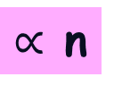
Selection Sort: Properties
Is the pseudo code iterative or recursive?
What is the estimated run time when input array has n elements
for swap
for find_idx_of_max_elt
for selection_sort
Practice: Write C code for iterative and recursive versions of selection sort.
Constant
$∝$ n
On next slide

Slide 10
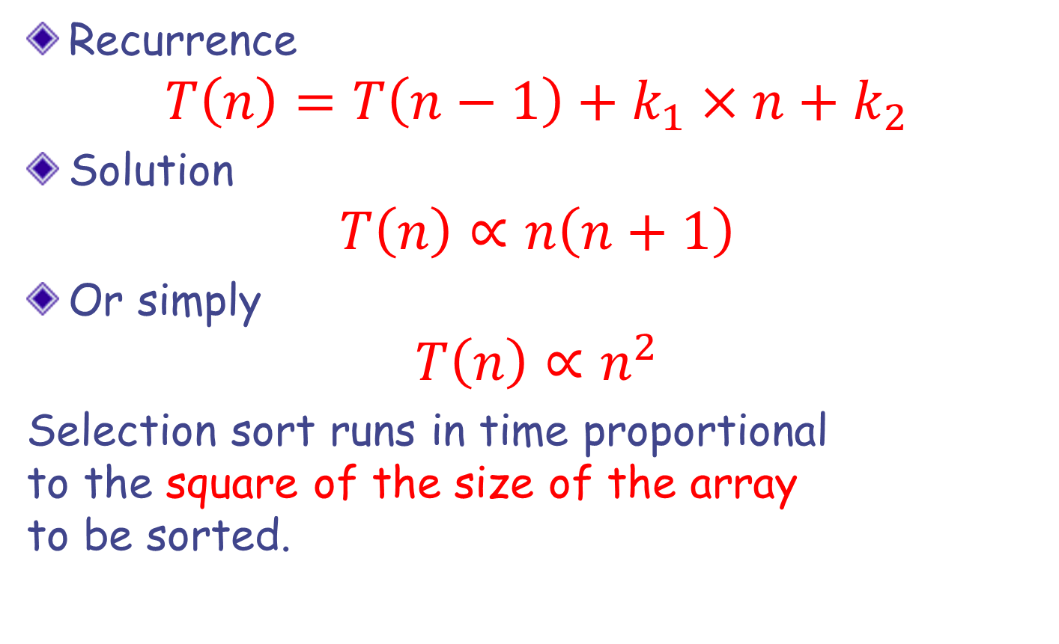
Selection Sort: Time Estimate
Recurrence
$$T\left(n\right)=T\left(n−1\right)+k_{1}×n+k_{2}$$
Solution
$$T\left(n\right)∝n\left(n+1\right)$$
Or simply
$$T\left(n\right)∝n^{2}$$
Selection sort runs in time proportional to the square of the size of the array to be sorted.
Can we do
better?
Can we do
better?
YES WE CAN

Slide 11
Merging Two Sorted Arrays
Input: Array A of size n & array B of size m.
Create an empty array C of size n + m.
Variables i , j and k
array variables for the arrays A, B and C resp.
At each iteration
compare the i^{th} element of A (say u) with the j^{th} element of B (say v)
if u is smaller, copy u to C; increment i and k,
otherwise, copy v to C; increment j and k,

Slide 12
void merge(int ar[], int start, int n) {
int temp[MAX_SZ], k, i=start, j=start+n/2;
int lim_i = start+n/2, lim_j = start+n;
for(k=0; k<n; k++) {
if ((i < lim_i) && (j < lim_j)) {// both active
if (ar[i] <= ar[j]) { temp[k] = ar[i]; i++; }
else { temp[k] = ar[j]; j++; }
} else if (i == lim_i) // 1st half done
{ temp[k] = ar[j]; j++; } // copy 2nd half
else // 2nd half done
{ temp[k] = ar[i]; i++; } // copy 1st half
}
for (k=0; k<n; k++)
ar[start+k]=temp[k]; // in-place
}

Slide 13

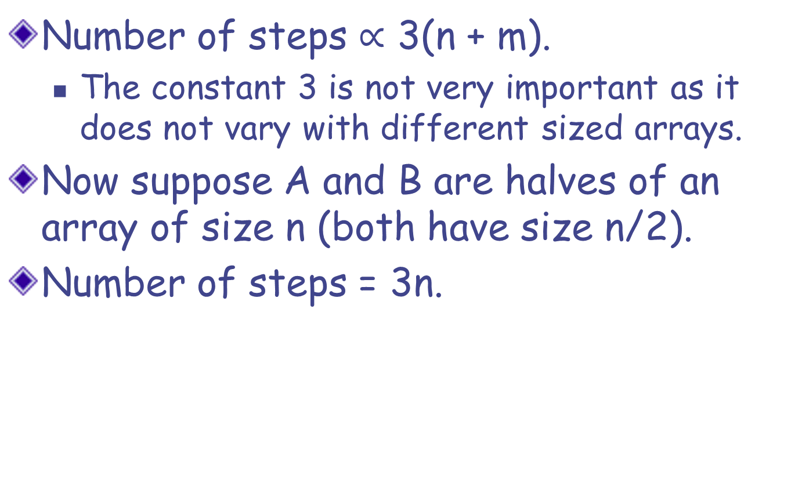
Time Estimate
Number of steps $∝$3(n + m).
The constant 3 is not very important as it does not vary with different sized arrays.
Now suppose A and B are halves of an array of size n (both have size n/2).
Number of steps = 3n.
$$T\left(n\right)∝n$$

Slide 14
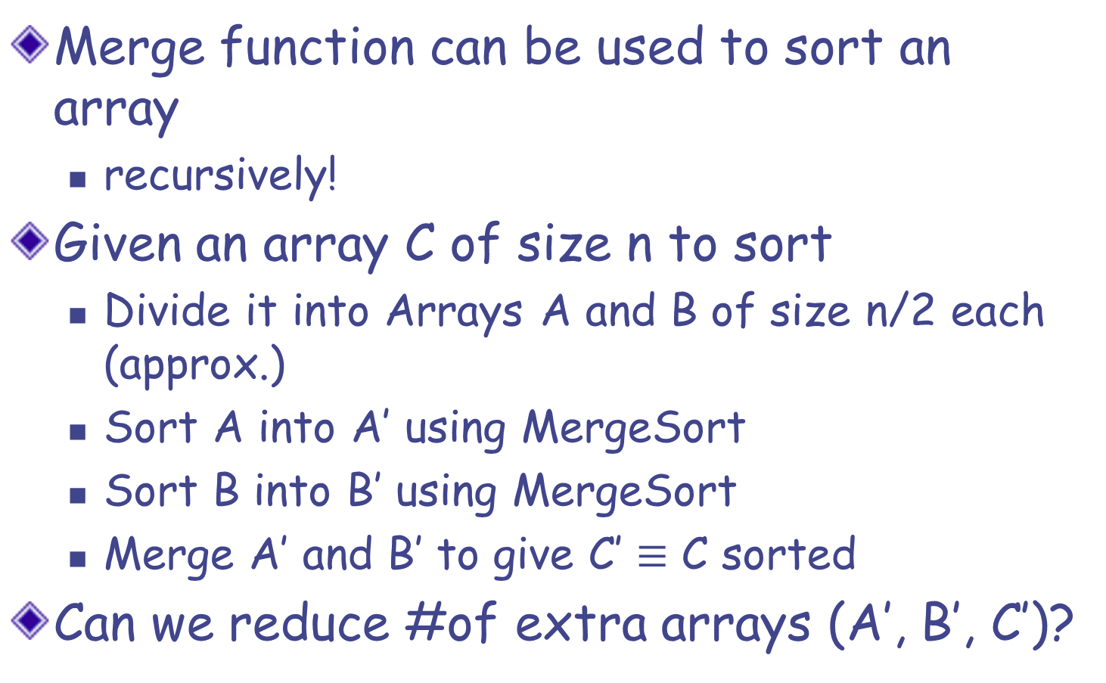
MergeSort
Merge function can be used to sort an array
recursively!
Given an array C of size n to sort
Divide it into Arrays A and B of size n/2 each (approx.)
Sort A into A’ using MergeSort
Sort B into B’ using MergeSort
Merge A’ and B’ to give C’ $≡$ C sorted
Can we reduce #of extra arrays (A’, B’, C’)?
Recursive calls.
Base case?
n <= 1

Slide 15
/*Sort ar[start, …, start+n-1] in place */
void merge_sort(int ar[], int start, int n) {
if (n>1) {
int half = n/2;
merge_sort(ar, start, half);
merge_sort(ar, start+half, n-half);
merge(ar, start, n);
}
}
int main() {
int arr[]={2,5,4,8,6,9,8,6,1,4,7};
merge_sort(arr,0,11);
/* print array */
return 0;
}

Slide 16
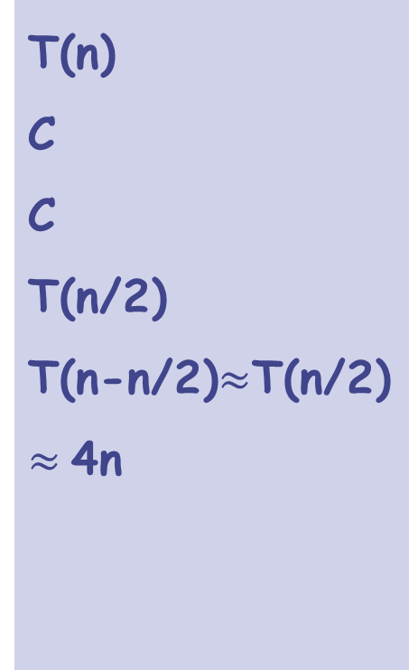
Time Estimate
T(n)
C
C
T(n/2)
T(n-n/2)$≈$T(n/2)
$≈$4n
void merge_sort(int a[], int s, int n) {
if (n>1) {
int h = n/2;
merge_sort(a, s, h);
merge_sort(a, s+h, n-h);
merge(a, s, n);
}
}

Slide 17
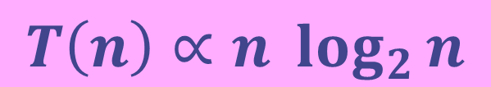
Time Estimate
T(n) = 2T(n/2) + 4n
= 2(2T(n/4) + 4n/2) + 4n = 2²T(n/4) + 8n
= 2²(2T(n/8) + 4n/4) + 4n = 2³T(n/8) + 12n
= … // keep going for k steps
= 2^{k}T(n/2^{k}) + k*4n
Assume n = 2^{k} for some k. Then,
T(n) = n*T(1) + 4n*log₂n
$$T\left(n\right)∝n \log_{2}{n}$$

Slide 18
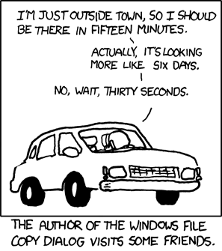
Order Notation
Why worry about O(n) vs O(n²) vs O(…) algo?
http://xkcd.com/612/

Slide 19
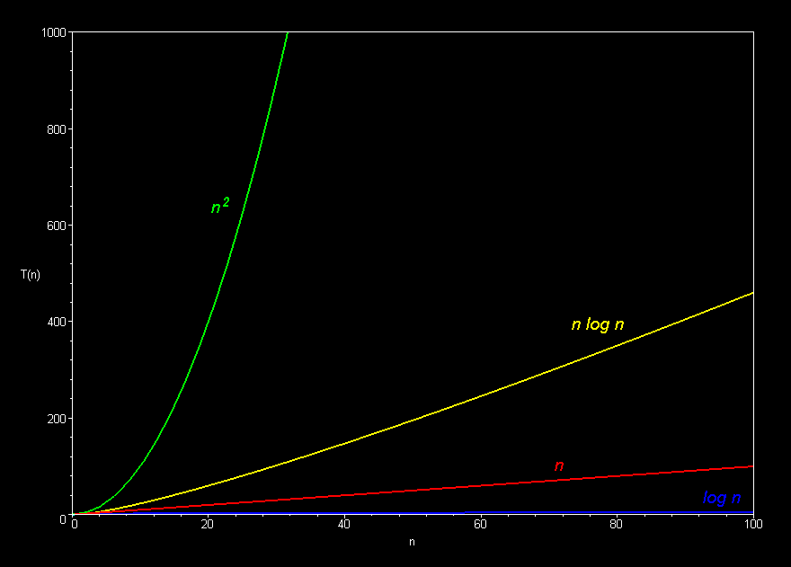
Time Estimates…
SelectionSort
Source: http://science.slc.edu/~jmarshall/courses/2002/spring/cs50/BigO/
MergeSort
Simple Search
BinSearch

Slide 20
QuickSort-- Partition Routine
A useful sub-routine (function) for many problems, including quicksort(), the most popularly used sorting method.
Partition takes an array a[] of size n and a value called the pivot.
The pivot is an element in the array is usually chosen as a[0].
Partition re-arranges the array elements into two parts:
the left part has all elements <= pivot.
the right part has all elements >= pivot.
Partition returns the index of the beginning of the right part.
Let us see an example.

Slide 21
Partition takes an array a[] of size n and a value called the pivot.
The pivot is an element in the array is usually chosen as a[0].
Partition re-arranges the array elements into two parts:
all elements in the left part are <= pivot
all elements in the right part are >= pivot
Input Array a[], size is n : 11
31
4
10
35
59
31
3
25
35
11
0
Call to partition(a,11). Pivot element is assumed to be a[0]: 31
0
4
10
11
25
3
31
31
35
35
31
left partition
right partition
return value is 6

Slide 22
COMMENTS
Multiple “partitions” of an array are possible, even for the same pivot. They all would satisfy the above specification.
Note: Partition DOES NOT sort the array. It is “weaker” than sorting. But it is useful step towards sorting (useful for other problems also).

Slide 23
partition(int a[], int n). pivot will be a[0].
Partition re-arranges the array elements into two parts:
the left part has all elements <= pivot
the right part has all elements >= pivot
Partition should return either the first index of the right part or the last index of the left part. (Both answers would be acceptable).
Designing partition: Goal is to have linear time complexity, meaning that the number of comparisons and exchanges of items must be linear in the size.
Also, we will do partition in place – that is, without using extra arrays.
Can you do it easily if you have extra arrays?

Slide 24
a
Desigining Partition
31
4
10
35
59
31
3
25
35
11
0
0
31
10
l
pivot
r
Keep two integer variables denoting indices: l starts at the left end and r starts at the right end.
pivot is a[0] which is 31.
Value of pivot will not change during partition.
Basic Step in Partition Loop:
As long as a[l] <= pivot, advance l by 1.
As long as a[r] >= pivot, decrease r by 1.
If l < r, Exchange a[l] with a[r].
advance l by 1; decrement r by 1

Slide 25
a
Desigining Partition
31
4
10
35
59
31
3
25
35
11
0
3
31
10
l
pivot
r
Let us run this step on the above array
Basic Step in Partition Loop:
As long as a[l] <= pivot, advance l by 1.
First loop terminates, with l as 3.
Second loop terminates immediately, with r as 10.
As long as a[r] >= pivot, decrease r by 1.
If l < r, Swap a[l] with a[r].
advance l by 1; decrement r by 1
Now we swap a[3] with a[10]

Slide 26
a
Desigining Partition
31
4
10
0
59
31
3
25
35
11
35
4
31
9
l
pivot
r
Let us run this step on the above array
Basic Step in Partition Loop:
As long as a[l] < pivot, advance l by 1.
Swap and Advance
As long as a[r] > pivot, decrease r by 1.
swap a[3] with a[10]
Advance l to 4
Decrement r to 9
Swap a[l] with a[r].
advance l by 1; decrement r by 1

Slide 27
a
Desigining Partition
31
4
10
0
59
31
3
25
35
11
35
4
31
9
l
pivot
r
Let us run this step on the above array
Basic Step in Partition Loop:
As long as a[l] < pivot, advance l by 1.
Invariant
As long as a[r] > pivot, decrease r by 1.
a[0]…a[l-1] are all <= pivot.
a[r+1]…a[n-1] are all >= pivot.
Swap a[l] with a[r].
advance l by 1; decrement r by 1

Slide 28
a
Desigining Partition
31
4
10
0
59
31
3
25
35
11
35
l
4
31
9
pivot
r
Basic Step in Partition Loop:
Now what should we do?
We can run the basic step again.
As long as a[l] <= pivot, advance l by 1.
As long as a[r] >= pivot, decrease r by 1.
Loop for l
The loop for l terminates immediately since 59 > 31.
If l < r, Swap a[l] with a[r].
advance l by 1; decrement r by 1

Slide 29
a
Desigining Partition
31
4
10
0
59
31
3
25
35
11
35
l
4
31
9
pivot
r
Basic Step in Partition Loop:
Now what should we do?
We can run the basic step again.
As long as a[l] <= pivot, advance l by 1.
As long as a[r] >= pivot, decrease r by 1.
Swap and advance
Swap 59 with 11
Increment l by 1
Decrement r by 1
If l < r, Swap a[l] with a[r].
advance l by 1; decrement r by 1

Slide 30
a
Desigining Partition
31
4
10
0
11
31
3
25
35
59
35
l
5
31
8
pivot
r
Basic Step in Partition Loop:
Now what should we do?
We can run the basic step again.
As long as a[l] <= pivot, advance l by 1.
As long as a[r] >= pivot, decrease r by 1.
If l < r, Swap a[l] with a[r].
advance l by 1; decrement r by 1

Slide 31
a
Desigining Partition
31
4
10
0
11
31
3
25
35
59
35
l
8
31
8
pivot
r
Basic Step in Partition Loop:
As long as a[l] <= pivot, advance l by 1.
As long as a[r] >= pivot, decrease r by 1.
Loop for l
The loop for l terminates at l=8.
If l < r, Swap a[l] with a[r].
advance l by 1; decrement r by 1

Slide 32
a
Desigining Partition
31
4
10
0
11
31
3
25
35
59
35
l
8
31
7
pivot
r
Basic Step in Partition Loop:
As long as a[l] <= pivot, advance l by 1.
As long as a[r] >= pivot, decrease r by 1.
Loop for r
The loop for r terminates at r=7.
If l < r, Swap a[l] with a[r].
advance l by 1; decrement r by 1

Slide 33
a
Desigining Partition
31
4
10
0
11
31
3
25
35
59
35
l
8
7
l
r
Basic Step in Partition Loop:
Partition is almost done!
As long as a[l] < pivot, advance l by 1.
As long as a[r] > pivot, decrease r by 1.
Why? From invariant:
What should we return?
We can return r.
Swap a[l] with a[r].
advance l by 1; decrement r by 1

Slide 34
int partition(int a[], int n) {
int l = 0, r = n-1, pivot = a[0];
while (l <=n-1 && r>=0) {
while (a[l] <= pivot && l<=n-1)
{ l=l+1; }
while (a[r] >= pivot && r>=0)
{ r=r-1; }
if(l<r) {
swap(a, l, r);
l = l+1; r = r-1;
} else {
/* move pivot to its position */
swap(a, l-1, 0);
return l-1;
}
}
}

Slide 35
Next class
Why the partition function?
Quicksort

