Slide 1

TA 101: Technical Arts
2015-16 II
Dr. Prishati Raychowdhury
Department of Civil Engineering
IIT Kanpur
Office: FB 330; Phone: 6692
E-mail: prishati@iitk.ac.in

Slide 2
AUTOCAD
Lecture 12 & 13

Slide 3
AutoCAD Schedule
AutoCAD Laboratory Session (LA#7)
SL. No. | Section | Day | Date | Time | Venue
1 | B1 | Tue | 23/02/2016 | 10 am – 1 pm | IME autoCAD lab
2 | B2 | Tue | 23/02/2016 | 10 am – 1 pm | IME autoCAD lab
3 | B3 | Tue | 23/02/2016 | 10 am – 1 pm | Northern Lab
4 | B4 | Mon | 22/02/2016 | 10 am – 1 pm | IME autoCAD lab
5 | B5 | Mon | 22/02/2016 | 10 am – 1 pm | IME autoCAD lab
6 | B6 | Mon | 22/02/2016 | 10 am – 1 pm | Northern Lab
7 | B7 | Wed | 24/02/2016 | 10 am – 1 pm | IME autoCAD lab
8 | B8 | Wed | 24/02/2016 | 10 am – 1 pm | IME autoCAD lab
9 | B9 | Wed | 24/02/2016 | 10 am – 1 pm | Northern Lab
10 | B10 | Thu | 25/02/2016 | 10 am – 1 pm | IME autoCAD lab
11 | B11 | Thu | 25/02/2016 | 10 am – 1 pm | IME autoCAD lab
12 | B12 | Thu | 25/02/2016 | 10 am – 1 pm | Northern Lab

Slide 4
Autodesk and AutoCAD
AutoCAD is a commercial software application for 2D and 3D Computer-Aided Design (CAD) and Drafting
AutoCAD was first released in 1982, developed and marketed by AutoDesk company
AutoCAD is used today across a wide range of industries, by architects, project managers, engineers, graphic designers, and other professionals

Slide 5

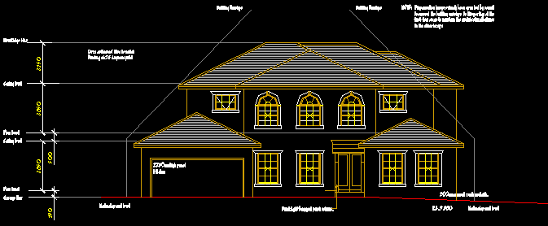
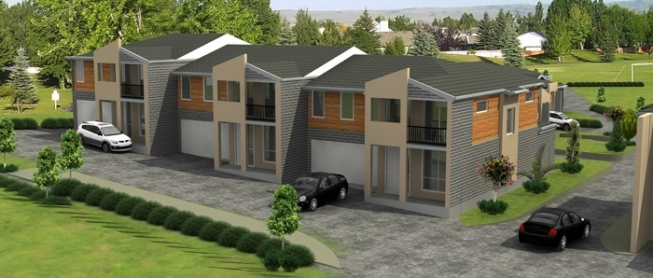
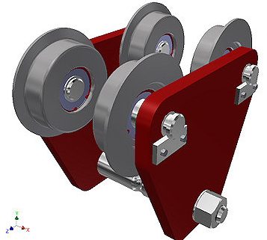
AutoCAD applications
http://applieddesignintelligence.com/2d-to-3d-cadd-conversion/
http://www.architecturalmodelingindia.com/architectural-3d-modeling/3d-modeling-services.php

Slide 6
AutoCAD for TA101
Points
Lines
Curves
Dimensions
Materials
Lighting
TA 101

Slide 7
Practice procedure
Open the correct version of AutoCAD (AutoCAD 2014 or AutoCAD 2015)
Look at the basic menus and icons
Make a basic sketch of the drawing before coming to the lab (how many views, scale, basic dimensions, coordinates etc.)
Save your drawing intermittently to avoid loosing it
Go through the AutoCAD instruction manual given to you

Slide 8
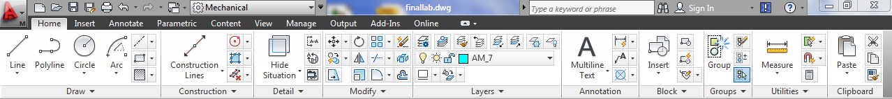
Basic Instructions
Commands can be entered into AutoCAD in two ways –
The Ribbon – Contains the graphical access to all commands and features, divided into intuitive headings and icons which are self explanatory
The Command line – Present at the bottom of the interface, it is another way of interacting and using features in AutoCAD. It is considered to be a faster method of inputting data

Slide 9
Basic Instructions
Choose your Work space: AutoCAD classics
Go to FORMAT: Set Units (mm)
Set Drawing limits (500 x 500)
Set drawing scale
Draw Boundary (A4 size: 297 mm x 210 mm)
Saving an AutoCAD file (as .dwg)
Draw
  Line, circle, arc, ellipse, tangent
  Rectangle, polygon
  Parallel lines, perpendicular lines, midpoint

Slide 10
Basic Instructions
Zoom, Undo, Pan
Modes: Snap, Tracking, Grid, Ortho
  Move, Copy, Erase
  Scale
  Offset, Trim, Extent, Mirror, Rotate
  Text and text style (choose ~3-5 mm size)
Create your drawing label (~90 mm x 50 mm)
  Dimension style & dimensioning

Slide 11
Basic Instructions
Layer
Property
  Line type: hidden lines, dashed lines, center lines, customize line type
  Line thickness, line color
Sections & Hatching
Block, Group, Explode
Export
Plot

Slide 12
Mid Semester Examination
Date: 20th Feb, Saturday, 2016
Time: 1:00 PM – 5:30 PM
Batch I (B1 to B6): 1:00 PM – 3:00 PM
Batch II (B7 to B12): 3:30 PM – 5:30 PM
Venue: Northern Lab, Drawing Hall

Slide 13
Mid Semester Syllabus
Basic constructional geometry
Orthographic projection
Dimensioning
Isometric Projection
Oblique Projection
Missing Lines and views

Slide 14
IMPORTANT NOTE
PLEASE bring ONLY your Drawing Instruments (Mini Drafter, Set Squares, Stencils, Pencils, Eraser). These can be brought in a handy FILE FOLDER
DO NOT BRING YOUR BAG and CELL PHONE
ABSOLUTELY NO SHARING of INFORMATION and EQUIPMENT
Entry STRICTLY PROHIBITED after 12:45 PM (for Batch I), and after 3:15 PM (for Batch II)

Slide 15
Exercise in AutoCAD
1. Draw the object shown below in AutoCAD
2. Draw the isometric view of the object shown below

