Slide 1
Mathematic for Computer Science - III CS203B
Lecture 12:
Variance
Chebyshev’s Inequality

Slide 2

How to compute
P[$X≥(1+ε)E[X]$]
P[$X≤(1−ε)E[X]$]

Slide 3
Tools
Markov’s Inequality
Chebyshev’s Inequality
Chernoff bound

Slide 4
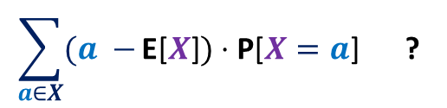


First a simple question as a Homework
$X$ : a random variable defined over a probability space ($Ω$,P).
Question:
What is
Answer:
$$\sum_{a∈X}{(a −}\text{E}\text{[}X\text{]})⋅\text{P}\text{[}X=a\text{]} \text{?}$$
$$0$$

Slide 5
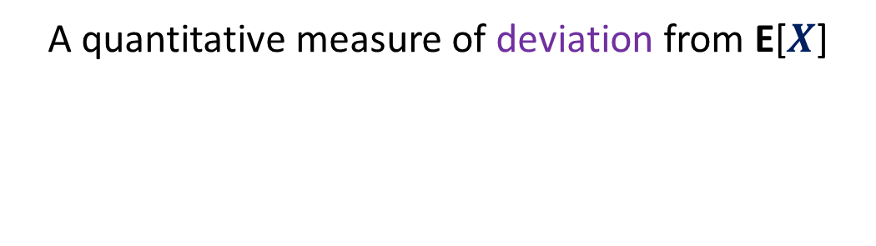
Variance
A quantitative measure of deviation from E[$X$]

Slide 6





What is P[$X>a]$
$X$ : a random variable defined over a probability space ($Ω$,P).
$$X$$
Probability
$$a$$
E[$X$]
Discrete values

Slide 7








$X$ : a random variable defined over a probability space ($Ω$,P).
$Y$ : a random variable defined over the same probability space.
E[$X$] = E[$Y$]
$$a$$
$$a$$
P[$Y>a]$
P[$X>a]$
$$Y$$
$$X$$
Probability
Probability
E[$X$]
E[$Y$]
Discrete values
Discrete values
Discrete values

Slide 8



$X$ : a random variable defined over a probability space ($Ω$,P).
$Y$ : a random variable defined over the same probability space.
E[$X$] = E[$Y$]
P[$X<a]$
P[$Y<a]$
$$a$$
$$a$$
$$Y$$
$$X$$
Probability
Probability
E[$X$]
E[$Y$]
Discrete values
Discrete values
Discrete values

Slide 9
Let us combine the deviations on both sides.

Slide 10







Which r.v. has more deviation from expected value?
$X$ : a random variable defined over a probability space ($Ω$,P).
$Y$ : a random variable defined over the same probability space.
P[$|X−E\left[X\right]|>δ]$ = ?
P[$|Y−E\left[Y\right]|>δ]$ = ?
E[$X$] = E[$Y$]
$$δ$$
$$δ$$
$$δ$$
$$δ$$
$$Y$$
$$X$$
$$Y$$
Probability
Probability
With insights from this example, try to quantify the deviation
of a random variable.
E[$X$]
E[$Y$]
Discrete values
Discrete values
Discrete values

Slide 11





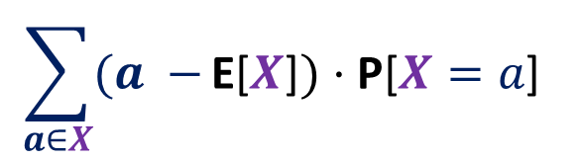

$$\sum_{a∈X}{(a −}\text{E}\text{[}X\text{]})⋅\text{P}\text{[}X=a\text{]}$$
Idea $2$:
We need to consider ‘distance’ of $a$from E[$X$].
Idea $1$:
We need to consider each value $a$taken by $X$ while calculating deviation.
E[$X$]
$$X$$
Probability
Farther the value $a$ from E[$X$],
more should be its contribution to deviation.
Discrete values taken by the random variables

Slide 12
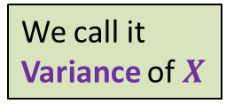



$$\sum_{a∈X}{(a −}\text{E}\text{[}X\text{]})⋅\text{P}\text{[}X=a\text{]}$$
We call it
Variance of $X$
Idea $3$:
We need to consider $\text{P}\text{[}X=a\text{]}$ as well
E[$X$]
$$X$$
Probability
Larger the probability of $X$ = $a$,
more should be its contribution to deviation.
Discrete values taken by the random variables

Slide 13
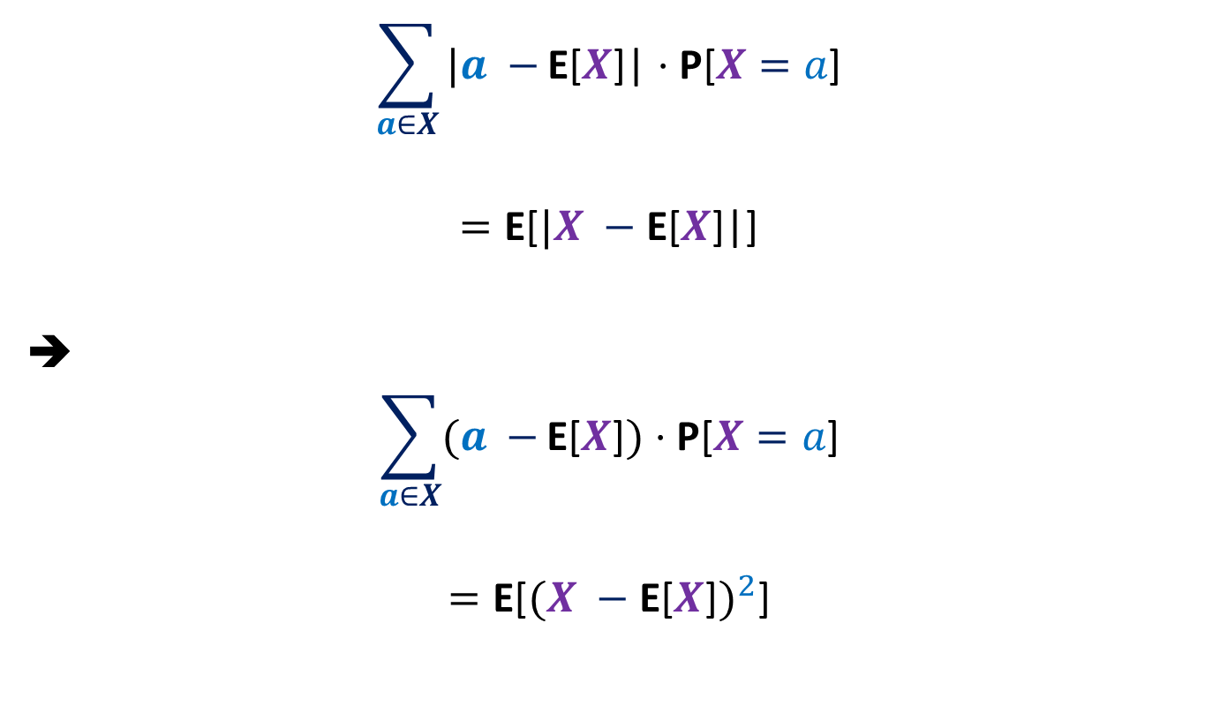


Variance of $X$
$$\sum_{a∈X}{|a −}\text{E}\text{[}X\text{]}\text{|}⋅\text{P}\text{[}X=a\text{]}$$
$$=\text{E}\text{[}|X −\text{E}\text{[}X\text{]}\text{|}\text{]}$$
➔
$$\sum_{a∈X}{(a −}\text{E}\text{[}X\text{]})⋅\text{P}\text{[}X=a\text{]}$$
$$=\text{E}\text{[}{(X −\text{E}\text{[}X\text{]})}^{2}\text{]}$$
$$2$$

Slide 14
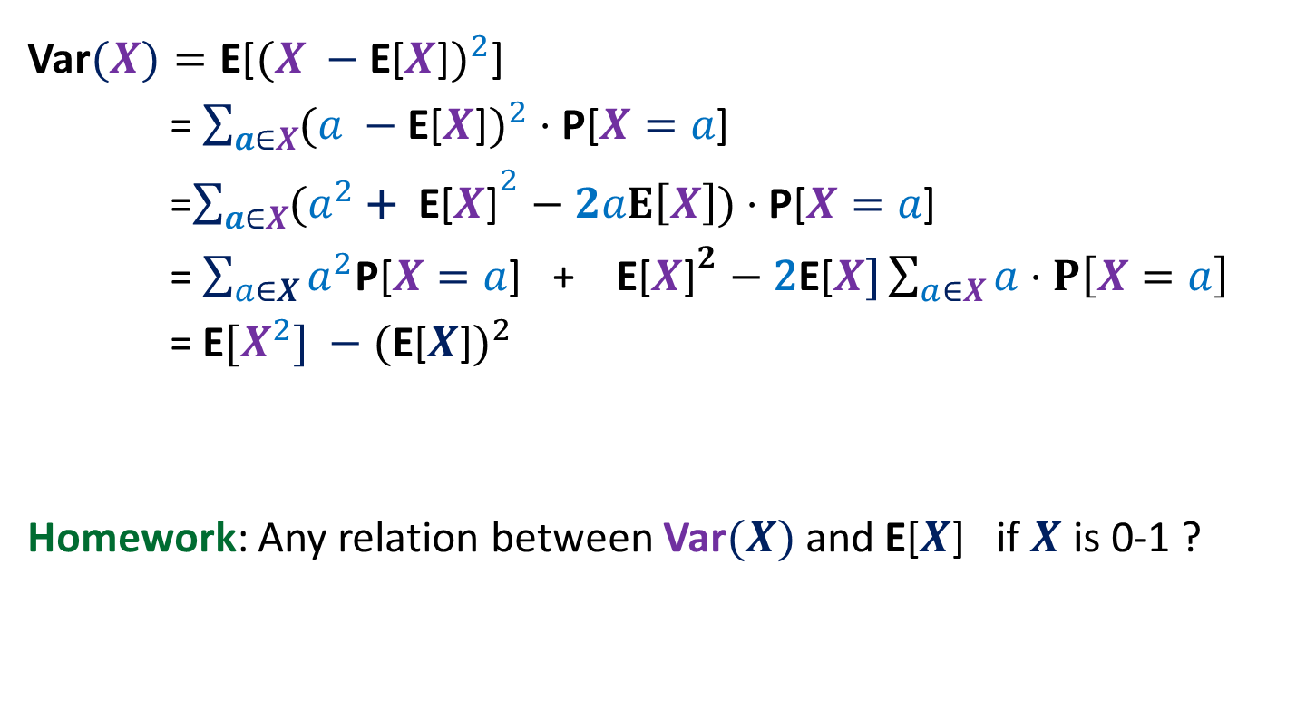

Variance of $X$
Var$(X)=\text{E}\text{[}{(X −\text{E}\text{[}X\text{]})}^{2}\text{]}$
= $\sum_{a∈X}{({a −\text{E}\text{[}X\text{]})}^{2}}⋅\text{P}\text{[}X=a\text{]}$
=$\sum_{a∈X}{({a^{2} \text{+ }\text{E}\text{[}X\text{]}}^{2}−2aE\left[X\right])}⋅\text{P}\text{[}X=a\text{]}$
= $\sum_{a∈X}{a^{2}\text{P}\text{[}X=a\text{]}\text{ + }\text{E}\text{[}X{\text{]}}^{2}−\text{2}\text{E}\text{[}X]\sum_{a∈X}{a⋅P\left[X=a\right]}}$
= $\text{E}[{X^{2}] −\text{(}\text{E}\text{[}X\text{]})}^{2}$
Homework: Any relation between Var$(X)$ and $\text{E}\text{[}X$] if $X$ is 0-1 ?

Slide 15
Examples

Slide 16





Variance of $aX$
$Y$ = $aX$
Question: What is $Variance of [Y]$ ?
$E[Y]$ = $E[aX]$
$E[Y^{2}]$ = $E[{(aX)}^{2}]$
= $\sum_{ω}{(a^{2}{\left(X\left(ω\right)\right)}^{2}}$ $⋅P(ω)$
= $a^{2}\sum_{ω}{{\left(X\left(ω\right)\right)}^{2}⋅P\left(ω\right))}$
= $a^{2}E[X^{2}]$
$Var[Y]$ = $E[Y^{2}]$ - ${\left(E\left[Y\right]\right)}^{2}$ = $a^{2}Var[X]$
= $aE[X]$
Homework
Var$(X+b)$ = ?
Var$(X)$

Slide 17

Variance of Bernoulli random variable
Suppose $X$ : Bernoulli random variable with parameter $p$.
Question: What is $Var[X]$ ?
$E[X]$ = $p$
$E[X^{2}]$ = $p$
Therefore,
$Var[X]$ = $E[X^{2}]$ - ${\left(E\left[X\right]\right)}^{2}$
= $p−p^{2}$
= $p(1−p)$

Slide 18

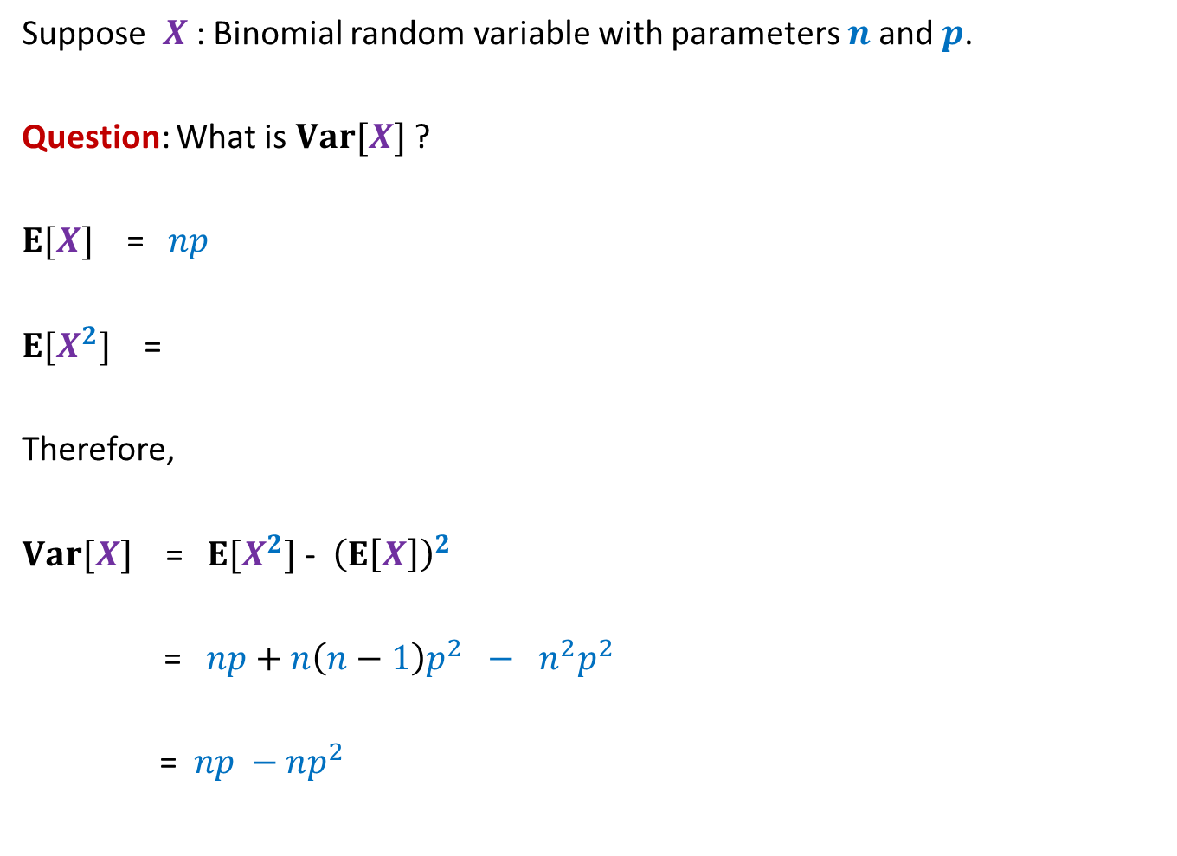

Variance of Binomial random variable
Suppose $X$ : Binomial random variable with parameters $n$and $p$.
Question: What is $Var[X]$ ?
$E[X]$ = $np$
$E[X^{2}]$ =
Therefore,
$Var[X]$ = $E[X^{2}]$ - ${\left(E\left[X\right]\right)}^{2}$
= $np+n\left(n−1\right)p^{2} − n^{2}p^{2}$
= $np −np^{2}$
$$np+n\left(n−1\right)p^{2}$$
$$= np\left(1−p\right)$$

Slide 19
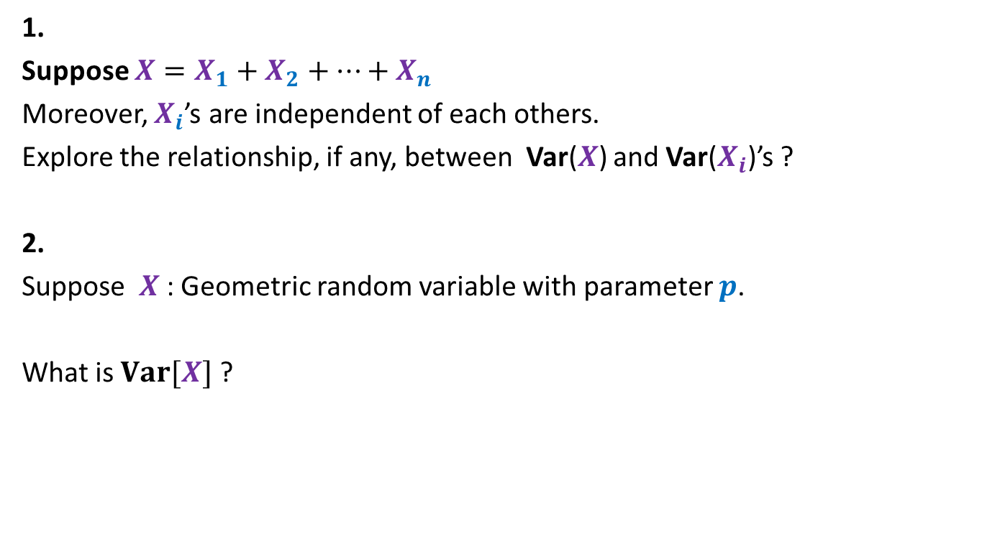
Homework
1.
Suppose $X=X_{1}+X_{2}+⋯+X_{n}$
Moreover, $X_{i}$’s are independent of each others.
Explore the relationship, if any, between Var($X$) and Var($X_{i}$)’s ?
2.
Suppose $X$ : Geometric random variable with parameter $p$.
What is $Var[X]$ ?

Slide 20

Chebyshev’s Inequality
Theorem: Suppose $X$is a random variable defined over a probability space ($Ω$,P)
Then for any positive real number $δ$,
P[$|X−$E[$X$]| $≥δ$] $≤\frac{\text{Var}\text{(}\text{X}\text{)} }{δ^{2}}$

Slide 21

Chebyshev’s Inequality
P[$|X−$E[$X$]| $≥δ$]
= P[${\left(X −\text{E}\text{[}X\text{]}\right)}^{2}≥δ^{2}$ ]
Using Markov Inequality,
$$≤\frac{\text{E}\text{[}{(X −\text{E}\text{[}X\text{]})}^{2}\text{] }}{δ^{2}}$$
$$=\frac{\text{E}{[X^{2}] −\text{(}\text{E}\text{[}X\text{]})}^{2} }{δ^{2}}$$
$$=\frac{\text{Var}\text{(}X\text{)} }{δ^{2}}$$
$$=\frac{(σ\text{(}X{\text{)}\text{)}}^{2} }{δ^{2}}$$
$σ$: standard deviation of $X$.

Slide 22

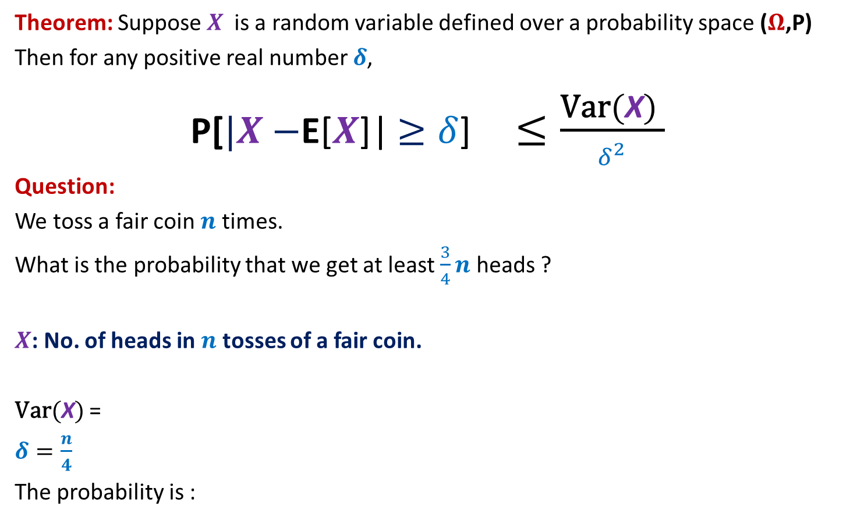
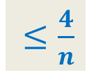
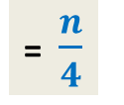
Chebyshev’s Inequality
Theorem: Suppose $X$is a random variable defined over a probability space ($Ω$,P)
Then for any positive real number $δ$,
P[$|X−$E[$X$]| $≥δ$] $≤\frac{\text{Var}\text{(}\text{X}\text{)} }{δ^{2}}$
Question:
We toss a fair coin $n$ times.
What is the probability that we get at least $\frac{3}{4}n$ heads ?
$X$: No. of heads in $n$ tosses of a fair coin.
$\text{Var}\text{(}\text{X}\text{)}$ =
$δ=\frac{n}{4}$
The probability is :
$$np\left(1−p\right)$$
= $\frac{n}{4}$
$≤\frac{4}{n}$

Slide 23
Homework
From the last class

Slide 24
Homework 1
Expectation of
a random number of random variables

Slide 25


Elevator problem
The number of people that enter an elevator at ground floor
is a Poisson random variable with mean $10$.
There are $N$ floors above the ground floor.
Each person is equally likely to get off at any one of the $N$ floors independently.
Compute the expected number of stops that the elevator will make before
discharging all of its passengers.

Slide 26
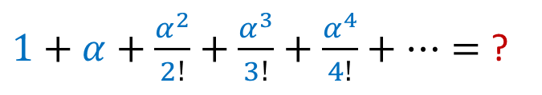
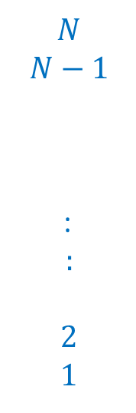


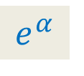
Hints
X: the number of floors at which persons leave elevator.
Y : the number of persons at ground floor.
$$N$$
$$N−1$$
:
$$:$$
$$2$$
$$1$$
Calculate E[X|Y=$m$]
No. of non-empty bins
$m$ persons
$1+α+\frac{α^{2}}{2!}+\frac{α^{3}}{3!}+\frac{α^{4}}{4!}+…=$ ?
$$e^{α}$$

Slide 27
Homework 2
Expectation of
Product of independent random variables

Slide 28






Hints
$X$ : a random variable defined over a probability space ($Ω$,P).
$Y$ : a random variable defined over the same probability space.
$X$ and $Y$ are independent.
Theorem:
$$E\left[X⋅Y\right]=E\left[X\right]⋅E[Y]$$
For all $b∈Y, a∈X$
$$P\left[X=a | Y=b\right]$$
?
$$P[X=a]$$
$$=$$
1. Partition the sample space based on all values taken by $Y$.
2. Use Partition theorem.
3. What is $E\left[X|Y=b\right]$ ?

