Slide 1
Mathematic for Computer Science - III CS203B
Lecture 14

Slide 2

Computing a random permutation of [$0,n−1$]
In an efficient manner.

Slide 3

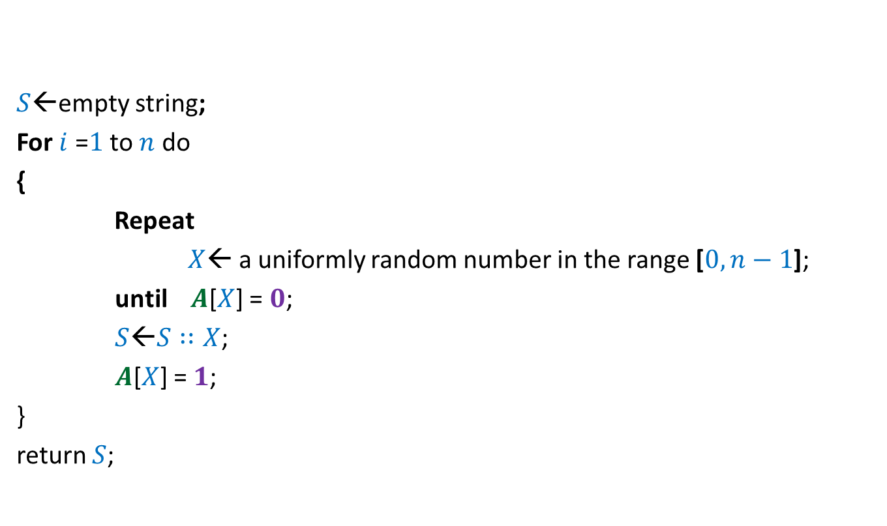


$$A$$
$$0$$ | $$0$$ | $$0$$ | $$0$$ | $$0$$ | $$0$$ | $$0$$ | $$0$$
$S$←empty string;
For $i$ =$1$ to $n$ do
{
Repeat
$X$← a uniformly random number in the range [$0,n−1$];
until $A$[$X$] = $0$;
$S$←$S∷X$;
$A$[$X$] = $1$;
}
return $S$;
$$0 1 … n−1$$
Homework: Prove that the algorithm indeed computes a uniformly random permutation.

Slide 4


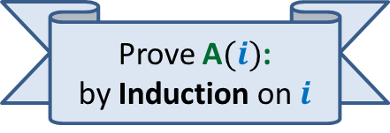
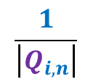


$Q_{i,n}$ :
set of all permutations of $i$ indices
from [$0,n−1$].
Let $a$ $∈$ $Q_{i,n}$
$$\frac{1}{\left|Q_{i,n}\right|}$$
A$(i)$: At the end of $i$th iteration, Probability ($S=a$) =
Prove A$(i)$:
by Induction on $i$
$$0$$ | $$0$$ | $$0$$ | $$0$$ | $$0$$ | $$0$$ | $$0$$ | $$0$$
$$A$$
$S$←empty string;
For $i$ =$1$ to $n$ do
{
Repeat
$X$← a uniformly random number in the range [$0,n−1$];
until $A$[$X$] = $0$;
$S$←$S∷X$;
$A$[$X$] = $1$;
}
return $S$;
$$0 1 … n−1$$

Slide 5






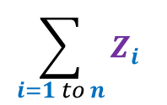



$Z$ :
The number of random number generated
to generate a permutation of [$0,n−1$].
$Z_{i}$ :
The number of random number generated
during $i$th iteration.
$$\sum_{i=1 to n}{Z_{i}}$$
$$0$$ | $$0$$ | $$0$$ | $$0$$ | $$0$$ | $$0$$ | $$0$$ | $$0$$
$Z$ =
$$A$$
$$1$$
$$1$$
$$1$$
$$1$$
$$1$$
$S$←empty string;
For $i$ =$1$ to $n$ do
{
Repeat
$X$← a uniformly random number in the range [$0,n−1$];
until $A$[$X$] = $0$;
$S$←$S∷X$;
$A$[$X$] = $1$;
}
return $S$;
$$0 1 … n−1$$
$(i−1)$ $1$’s
What is the expected no. of calls to “random number generator” this algorithm makes ?

Slide 6

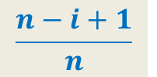

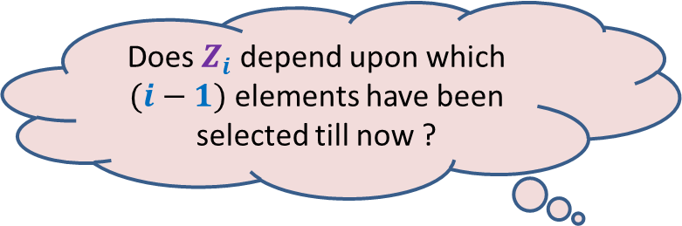
$Z_{i}$ :
Geometric random variable with parameter
$$\frac{n−i+1}{n}$$
$$Success$$
$$\sum_{i=1 to n}{Z_{i}}$$
$$0$$ | $$0$$ | $$0$$ | $$0$$ | $$0$$ | $$0$$ | $$0$$ | $$0$$
$Z$ =
$$A$$
$$1$$
$$1$$
$$1$$
$$1$$
$$1$$
$S$←empty string;
For $i$ =$1$ to $n$ do
{
Repeat
$X$← a uniformly random number in the range [$0,n−1$];
until $A$[$X$] = $0$;
$S$←$S∷X$;
$A$[$X$] = $1$;
}
return $S$;
$$0 1 … n−1$$
$$Failure$$
Does $Z_{i}$ depend upon which
$(i−1)$ elements have been
selected till now ?
No

Slide 7




$Z_{i}$ :
Geometric random variable with parameter
$$\frac{n−i+1}{n}$$
E[$Z_{i}$] =
$$\frac{n}{n−i+1}$$
$$\sum_{i=1 to n}{Z_{i}}$$
= $n\left(1+\frac{1}{2}+⋯+\frac{1}{n}\right)$
$$0$$ | $$0$$ | $$0$$ | $$0$$ | $$0$$ | $$0$$ | $$0$$ | $$0$$
E[ ]
E[ ]
$Z$ =
$$A$$
$$1$$
$$1$$
$$1$$
$$1$$
$$1$$
$S$←empty string;
For $i$ =$1$ to $n$ do
{
Repeat
$X$← a uniformly random number in the range [$0,n−1$];
until $A$[$X$] = $0$;
$S$←$S∷X$;
$A$[$X$] = $1$;
}
return $S$;
$≈$ $n$ log $n$
$$0 1 … n−1$$

Slide 8
Random walk
A glimpse of a beautiful world

Slide 9



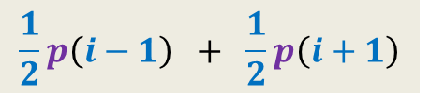
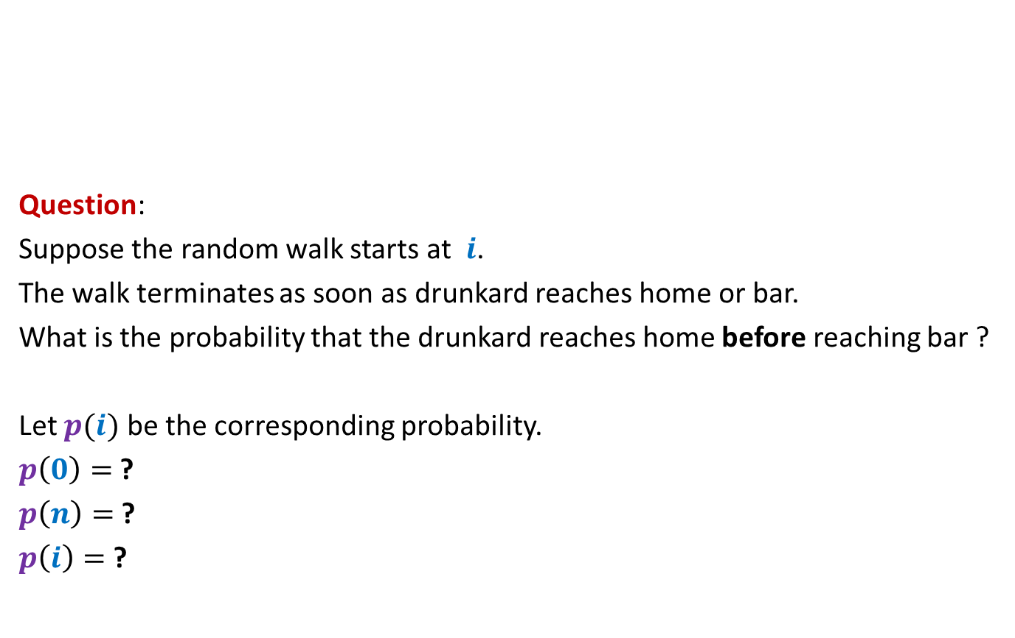






Random walk on a line
½
½
Question:
Suppose the random walk starts at $i$.
The walk terminates as soon as drunkard reaches home or bar.
What is the probability that the drunkard reaches home before reaching bar ?
Let $p(i)$ be the corresponding probability.
$p\left(0\right)=$ ?
$p\left(n\right)=$ ?
$p\left(i\right)=$ ?
bar
home
$$0$$
$$1$$
$$i−1$$
$$i$$
$$i+1$$
$$n−1$$
$$n$$
$$0$$
$$1$$
$$\frac{1}{2}p\left(i−1\right) + \frac{1}{2}p\left(i+1\right)$$

Slide 10


Random walk on a line
$V\left(i\right)$: Potential at point $i$.
$V\left(0\right)=0$, $V\left(n\right)=1$,
Current entering $i$ = Current leaving $i$.
$\frac{\left(V\left(i+1\right)−V\left(i\right)\right)}{1}$ = $\frac{\left(V\left(i\right)−V\left(i−1\right)\right)}{1}$
$V\left(i\right)=$ $\frac{1}{2}\left(V\left(i−1\right) + V\left(i+1\right)\right)$
current
$$0$$
$$1$$
$$i−1$$
$$i$$
$$i+1$$
$$n−1$$
$$n$$
$1$ Volt
Each resistance is 1 ohm.

Slide 11
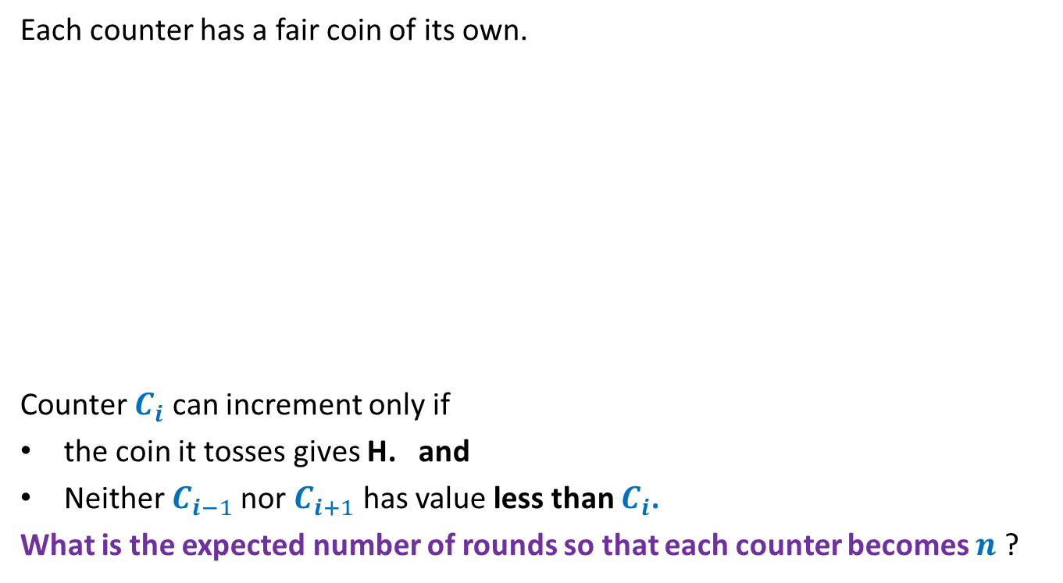
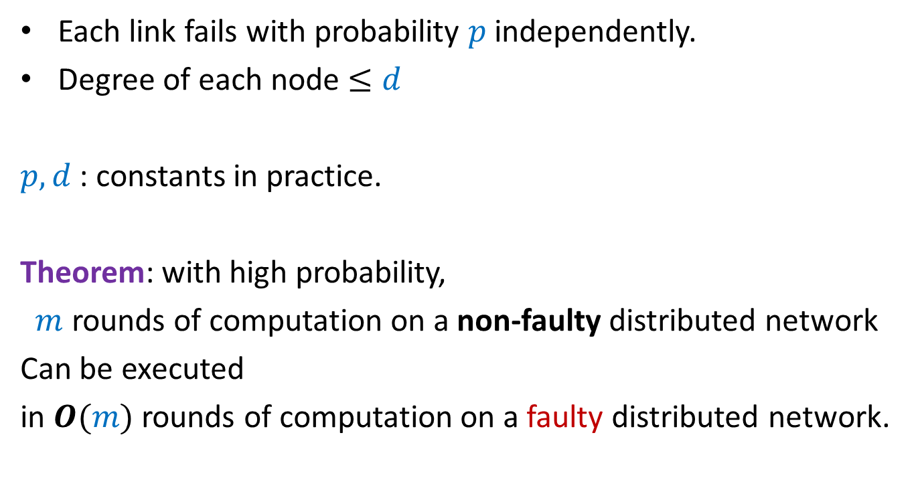






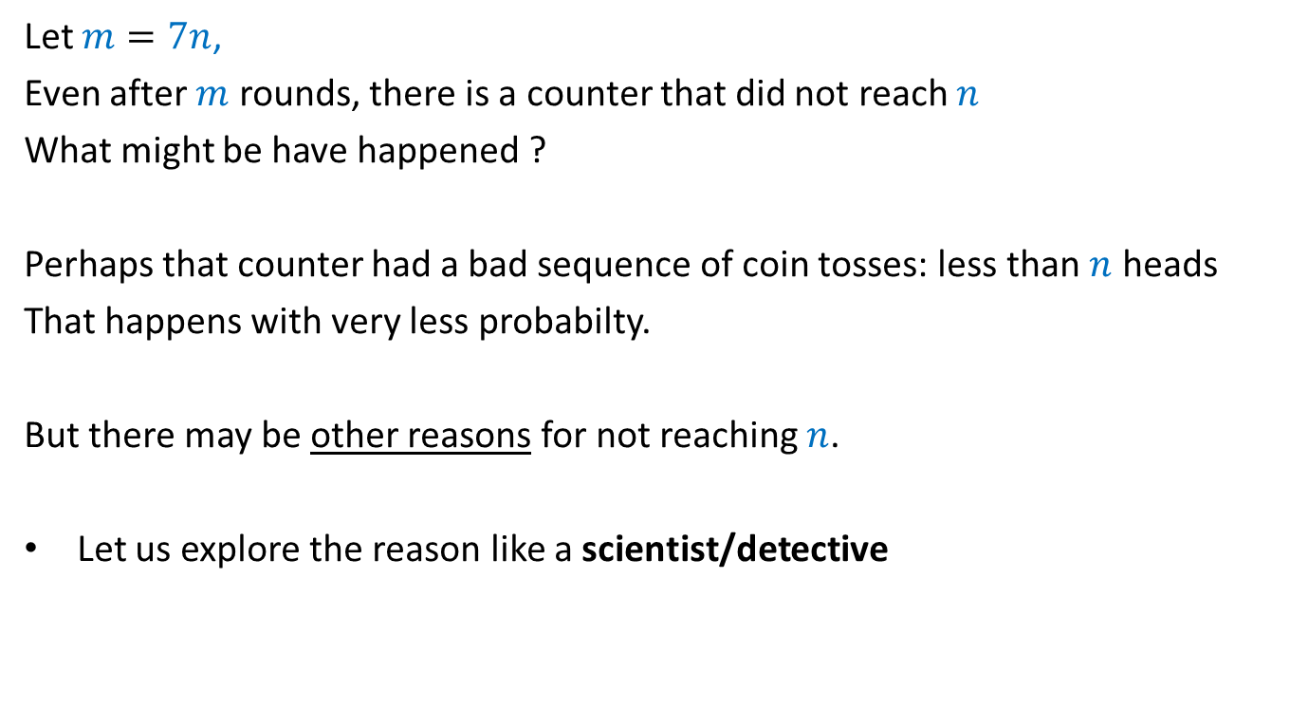
Random walk on a line
½
½
$p\left(0\right)=0$, $p\left(n\right)=1$, $p\left(i\right)=$ $\frac{1}{2}\left(p\left(i−1\right) + p\left(i+1\right)\right)$
$V\left(i\right)$: Potential at point $i$
$V\left(0\right)=0$, $V\left(n\right)=1$, $V\left(i\right)=$ $\frac{1}{2}\left(V\left(i−1\right) + V\left(i+1\right)\right)$
Hence $V\left(i\right)$ and $p\left(i\right)$ satisfy the same set of equations.
➔ If these equations have unique solution, then $V\left(i\right)=p\left(i\right)$ for all $i$.
bar
home
$$0$$
$$1$$
$$i−1$$
$$i$$
$$i+1$$
$$n−1$$
$$n$$
current
$$0$$
$$1$$
$$i−1$$
$$i$$
$$i+1$$
$$n−1$$
$$n$$
$1$ Volt

Slide 12


Harmonic function in 1-dimension
Definition: function $f$ defined on [$0,n$] is said to be harmonic function if
at each internal point $i$
Lemma: A harmonic function attains its maximum (and minimum) value at
the boundary points.
$f$($i$) = $\frac{1}{2}\left(f\text{(}i−1\text{)}\text{ +}f\text{(}i+1\text{)}\right)$
$$0$$
$$1$$
$$i−1$$
$$i$$
$$i+1$$
$$n−1$$
$$n$$
Boundary point
Boundary point
Internal points

Slide 13

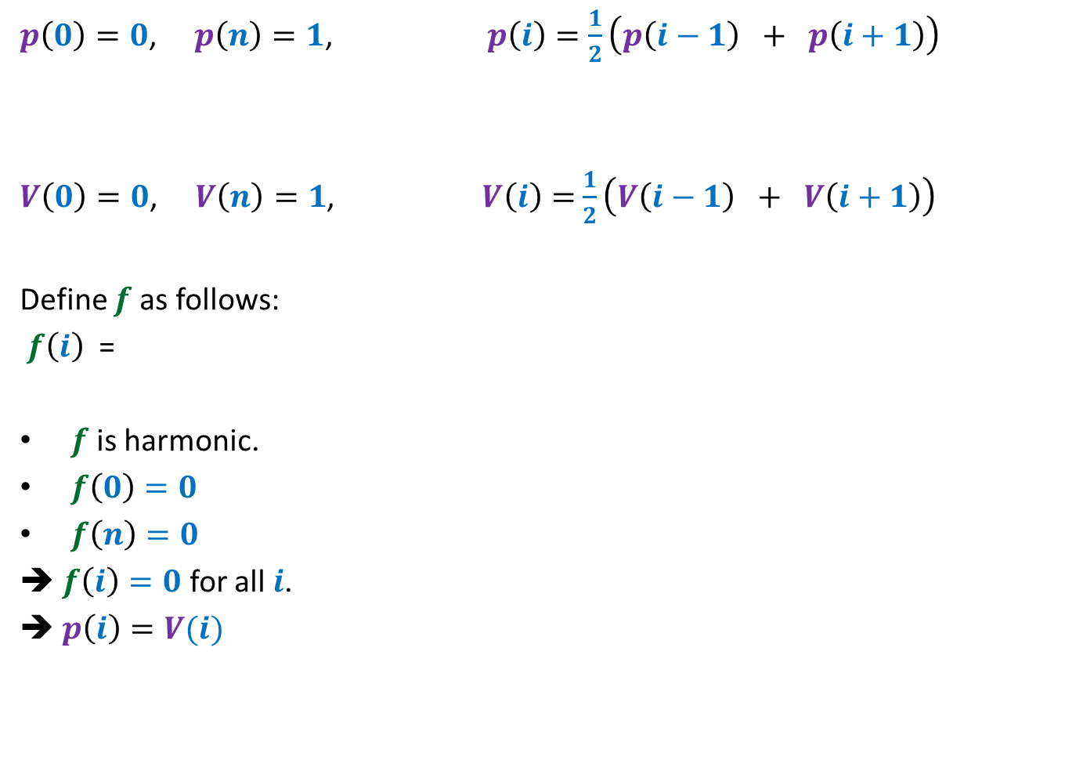
Random walk on a line
$p\left(0\right)=0$, $p\left(n\right)=1$, $p\left(i\right)=$ $\frac{1}{2}\left(p\left(i−1\right) + p\left(i+1\right)\right)$
$V\left(0\right)=0$, $V\left(n\right)=1$, $V\left(i\right)=$ $\frac{1}{2}\left(V\left(i−1\right) + V\left(i+1\right)\right)$
Define $f$ as follows:
$f\left(i\right)$ =
$f$ is harmonic.
$f\left(0\right)=0$
$f\left(n\right)=0$
➔ $f\left(i\right)=0$ for all $i$.
➔ $p\left(i\right)=V(i)$
$$p\left(i\right)−V(i)$$

Slide 14











$$y$$
$$b$$
home
Question: What is $p_{x}$, probability of reaching home before bar ?
$p_{v}=0$,
$p_{c}=1$,
$p_{x}=\frac{1}{ deg(x) }\sum_{y∈N(x)}{p_{y}}$
$$c$$
bar
$$v$$
$$x$$
$$u$$
$$g$$
$$d$$
$$a$$
$$z$$

Slide 15

1 volt
$$y$$
$$b$$
Question: What is relation between $V_{x}$ and $V_{y}$’s where $y∈N(x)$ ?
$V_{v}=0$,
$V_{c}=1$,
Net current leaving $x$is 0.
$\sum_{y∈N(x)}{{(V}_{x}−V_{y}) \text{=0}}$
➔ $V_{x}=\frac{1}{ deg(x) }\sum_{y∈N(x)}{V_{y}}$
$$c$$
$$v$$
$$x$$
$$u$$
$$g$$
$$d$$
$$a$$
$$z$$

Slide 16


$$y$$
$$b$$
Question: What is relation between $V_{x}$ and $V_{y}$’s where $y∈N(x)$ ?
$V_{v}=0$,
$V_{c}=1$,
$$V_{x}=\frac{1}{ deg(x) }\sum_{y∈N(x)}{V_{y}}$$
Hence $V_{x}$ and $p_{x}$ satisfy the same set of equations.
➔ Since these equations have unique solution, therefore $V_{x}=p_{x}$ for all $x$.
$$c$$
$$v$$
$$x$$
$$u$$
$$g$$
$$d$$
$$a$$
$$z$$
$p_{v}=0$,
$p_{c}=1$,
$$p_{x}=\frac{1}{ deg(x) }\sum_{y∈N(x)}{p_{y}}$$

Slide 17
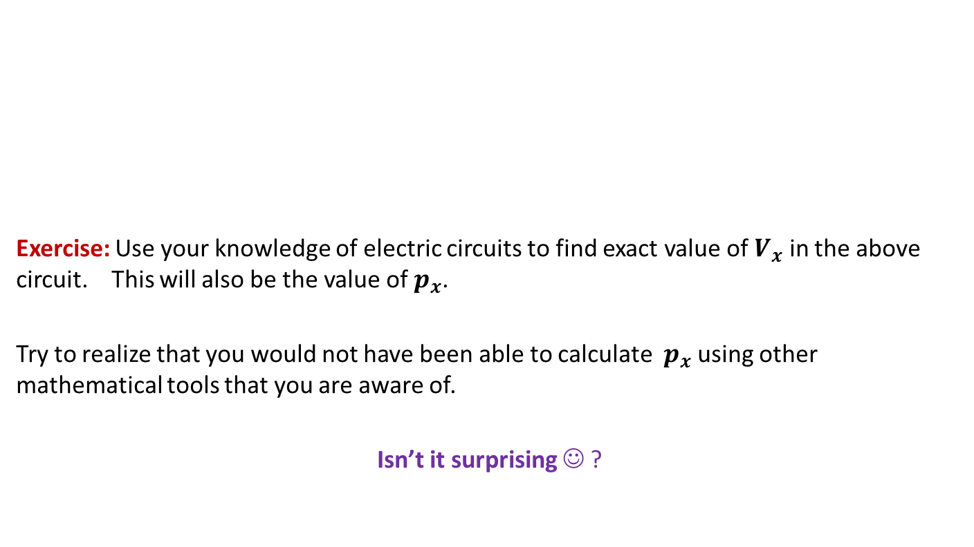
$$y$$
$$b$$
Exercise: Use your knowledge of electric circuits to find exact value of $V_{x}$ in the above circuit. This will also be the value of $p_{x}$.
Try to realize that you would not have been able to calculate $p_{x}$ using other mathematical tools that you are aware of.
Isn’t it surprising ☺ ?
$$c$$
$$v$$
$$x$$
$$u$$
$$g$$
$$d$$
$$a$$
$$z$$

Slide 18
Continuous Probability Space
Motivational problems

Slide 19
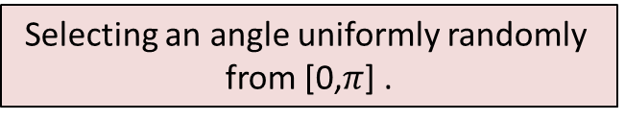
Continuous sample spaces
Selecting a point uniformly randomly from [0,1]
0
1
1-dimensional Space
time
Selecting a point uniformly randomly
from unit square.
Selecting an angle uniformly randomly
from [0,$π$] .

Slide 20
Problem 1
2 points are picked from a stick of unit length.
The stick is broken at these points
What is the probability that the 3 segments can form a triangle ?
0
1

Slide 21
Problem 2
2 points are picked from a unit square.
What is the expected distance between the two points ?

Slide 22

Problem 3
There is a stick of unit length in vertical plane.
The stick subtends an angle with x-axis
The angle is picked uniformly randomly from [0,$π$]
What is expected length of its shadow ?

Slide 23






Continuous sample spaces
$$0$$
P[$0.34512$ is picked] = ?
Selecting a point uniformly randomly from [0,1]
0
1
time
Selecting a point uniformly randomly
from unit square.
Selecting an angle uniformly randomly
from [0,$π$] .
$$0$$
$$0$$
P[($0.35,0.72$) is picked] = ?
P[($π/3$) is picked] = ?

