Slide 1
Mathematic for Computer Science - III CS203B
Lecture 15
Continuous Probability Space
I

Slide 2
Continuous Probability Space

Slide 3
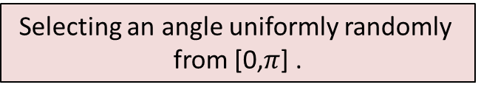
Continuous sample spaces
Selecting a point uniformly randomly from [0,1]
0
1
1-dimensional Space
time
Selecting a point uniformly randomly
from unit square.
Selecting an angle uniformly randomly
from [0,$π$] .

Slide 4






Continuous sample spaces
$$0$$
P[$0.34512$ is picked] = ?
Selecting a point uniformly randomly from [0,1]
0
1
time
Selecting a point uniformly randomly
from unit square.
Selecting an angle uniformly randomly
from [0,$π$] .
$$0$$
$$0$$
P[($0.35,0.72$) is picked] = ?
P[($π/3$) is picked] = ?

Slide 5
Uniform Probability Space

Slide 6


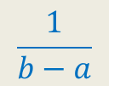
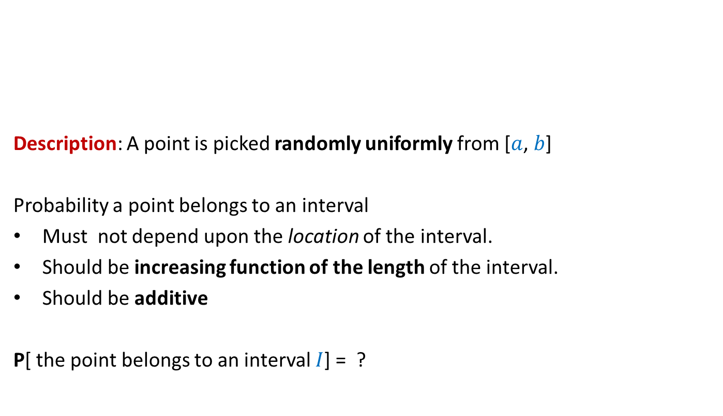





Uniform Probability Space
$$I_{1}$$
$$I_{2}$$
Description: A point is picked randomly uniformly from [$a$, $b$]
Probability a point belongs to an interval
Must not depend upon the location of the interval.
Should be increasing function of the length of the interval.
Should be additive
P[ the point belongs to an interval $I$] = ?
$$a$$
$$b$$
How can we capture these properties formally
and yet in simple words ?
P($I_{1}∪I_{2}$ ) = P($I_{1}$) + P($I_{2}$)
for any two non-overlapping $I_{1}$ and $I_{2}$
$$\frac{1}{b−a}$$
$$c⋅|I|$$

Slide 7










Uniform Probability Space
$$Δx$$
$$x$$
$$a$$
$$I$$
$$b$$
$$\frac{Δx}{b−a}$$
P[ the point is from $I ]$ =
E[$Z$|the point is from$I ]$ =
$$≈ x$$
$$±Δx$$
$Z$ :
Distance of the point from left end.
E[$Z$] =

Slide 8

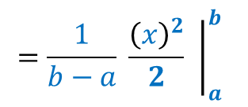

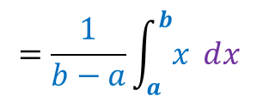


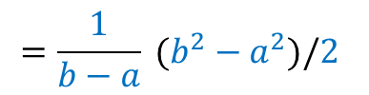

Uniform Probability Space
$$Δx$$
$$1 2 3 … n$$
$$a$$
$$b$$
$$\frac{Δx}{b−a}$$
P[ the point is from $I ]$ =
E[$Z$|the point is from$I ]$ =
$$≈ x$$
$$±Δx$$
$Z$ :
Distance of the point from left end.
$$=\frac{1}{b−a}\int_{a}^{b}{x ⅆx}$$
$$={\frac{1}{b−a} \left.\frac{{\left(x\right)}^{2}}{2} \right|}_{a}^{b}$$
=
$$\sum_{i≤n}{x_{i}⋅}$$
$$\frac{Δx}{b−a}$$
E[$Z$] =
$$\lim_{n→∞}{}$$
$$≈$$
How to get rid of approximation?
$$=\frac{1}{b−a} (b^{2}−a^{2})/2$$
$$=\frac{b+a}{2}$$

Slide 9


Problem 1
2 points are picked randomly uniformly on a stick of unit length.
The stick is broken at these points
What is the probability that the 3 segments can form a triangle ?
0
1
$ε$ :
The three segments of the stick
can be joined to form a triangle.
P[$ε$] = ?

Slide 10
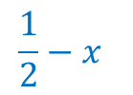









Problem 1
Idea:
Simplify the problem
What if first point is fixed deterministically,
and second point is picked randomly
The stick is marked at point $x$.
Second point is picked uniformly random from the stick and marked.
The stick is cut at the 2 marked points.
We get 3 segments.
What is the probability that the 3 segments can form a triangle ?
$$\frac{1}{2}−x$$
$$x$$
0
1
$$\frac{1}{2}$$
$$x$$
$p(x)$ = ?
$$x$$
Assume that $x<\frac{1}{2}$
$$p(x)$$
A nice observation:
If $x>\frac{1}{2}$ , $p(x)$ = $1−x$
Note: the first point is the point picked first
and not the point that is closer to $0$

Slide 11


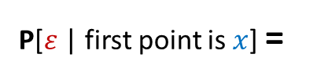
Problem 1
$$x$$
0
1
$$Δx$$
$$\frac{1}{2}$$
$p(x)$ = ?
$$x$$
P[$ε$ | first point is $x$] =
$$p(x)$$
Because probability of this event is 0 ☹
$ε$ :
The three segments of the stick
can be joined to form a triangle.
P[$ε$] = ?
What to do now ?
Work with intervals

Slide 12


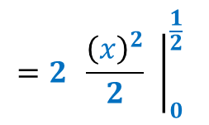

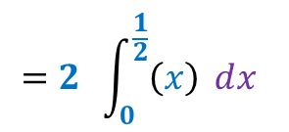
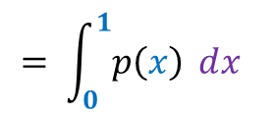






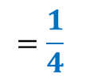
Problem 1
$$\frac{1}{2}$$
$$1 2 3 … n$$
$$x$$
0
1
$$Δx$$
P[ the first point is from $Δx]$ =
$$Δx$$
P[$ε$ |the first point is from $Δx]$ =
$$≈p\left(x\right)$$
$$±Δx$$
$$\sum_{i≤n}{p\left(x_{i}\right)⋅Δx}$$
$$= \int_{0}^{1}{p\left(x\right) ⅆx}$$
$$=2 \int_{0}^{\frac{1}{2}}{\left(x\right) ⅆx}$$
P[$ε$] $≈$
$$\lim_{n→∞}{}$$
=
How to get rid of approximation?
$$={2 \left.\frac{{\left(x\right)}^{2}}{2} \right|}_{0}^{\frac{1}{2}}$$
$$=\frac{1}{4} −0$$
$$=\frac{1}{4}$$

Slide 13







Uniform Probability Space
P[the point belongs to an interval $I$] = ?
$$0$$
$$1$$
$$\frac{1}{2}$$
$$|I|$$
Question:
What can we say about the point
given that point is not picked from [$\frac{1}{2},1$]
Uniformly distributed in [$0, \frac{1}{2}$].
Homework: Prove it using the tools you know.

Slide 14
Problem 1*
1 point is picked randomly from a stick of unit length.
The stick is broken at the point.
The larger part of the stick is picked.
We break the larger part at a uniformly random point.
What is the probability that 3 segmens can form a triangle
0
1
$ε$ :
The three segments of the stick
can be joined to form a triangle.
P[$ε$] = ?

Slide 15
Problem 1**
1 point is picked randomly from a stick of unit length.
The stick is broken at the point.
The right part of the stick is picked.
We break the right part at a uniformly random point.
What is the probability that 3 segmens can form a triangle
0
1
$ε$ :
The three segments of the stick
can be joined to form a triangle.
P[$ε$] = ?

Slide 16


Problem 2
$$(1,1)$$
2 points are picked from a unit square.
What is the expected square of distance between the two points ?
$$(0,0)$$

