Slide 1
Mathematic for Computer Science - III CS203B
Lecture 16
Continuous Probability Space
II

Slide 2
Uniform Probability Space

Slide 3



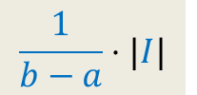

Uniform Probability Space
$$I$$
Description: A point is picked randomly uniformly from [$a$, $b$]
P[the point belongs to an interval $I$] = ?
$$a$$
$$b$$
$$\frac{1}{b−a}⋅|I|$$

Slide 4







Uniform Probability Space
P[the point belongs to an interval $I$] = ?
$$a$$
$$b$$
$$d$$
$$\frac{1}{b−a}⋅|I|$$
$$|I|$$
Question:
What can we say about the point
given that point is not picked from [$d,b$]
Uniformly distributed in [$a, d$].

Slide 5









Uniform Probability Space
$$Δx$$
$$x$$
$$a$$
$$I$$
$$b$$
$$\frac{Δx}{b−a}$$
P[ the point is from $I ]$ =
E[$Z^{2}$|the point is from $I ]$ =
$$≈ x^{2}$$
$Z$ :
Distance of the point from left end.
E[$Z^{2}$] =

Slide 6





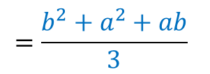

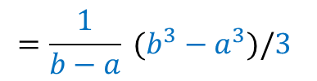
Uniform Probability Space
$$Δx$$
$$x$$
$$a$$
$$b$$
$$\frac{Δx}{b−a}$$
P[ the point is from $I ]$ =
E[$Z^{2}$|the point is from$I ]$ =
$$≈ x^{2}$$
$Z$ :
Distance of the point from left end.
$$\frac{1}{b−a}\int_{a}^{b}{x^{2} ⅆx}$$
$$={\frac{1}{b−a} \left.\frac{{\left(x\right)}^{3}}{3} \right|}_{a}^{b}$$
E[$Z^{2}$] =
$$=\frac{1}{b−a} (b^{3}−a^{3})/3$$
$$=\frac{b^{2}+a^{2}+ab}{3}$$
$$=\frac{b^{2}}{3}$$
If the interval is [$0,b$]

Slide 7
Continuous probability distribution
Generalizing our knowledge of
uniform probability distribution

Slide 8
Continuous probability distribution
Key idea:
Viewing probability as area

Slide 9

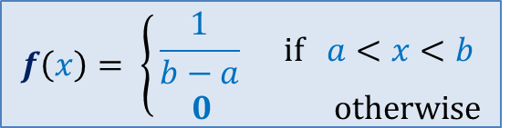
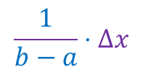



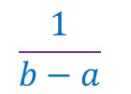


Uniform Probability Space
$$Δx$$
$$x$$
$$a$$
$$I$$
$$b$$
$$\frac{1}{b−a}⋅Δx$$
P[ the point is from $I ]$ =
$$f\left(x\right)= \left\{\begin{aligned}\frac{1}{b−a} if a<x<b \\ 0 otherwise\end{aligned}\right.$$
Let us plot $f\left(x\right)$
Probability density
$$Δx$$
$$\frac{1}{b−a}$$
$$a$$
$$I$$
$$b$$
P[ the point is from $I ]$
= Area of the rectangle

Slide 10



Uniform Probability Space
In the case of uniform probability distribution,
Probability density is the same at each point.
But it may vary with $x$.
How can we extend/generalize uniform probability distribution ?
Let us consider any continuous function $f(x)$.
$$\frac{1}{b−a}$$
$$a$$
$$b$$
$$I$$
P[ the point is from $I ]$
= Area of the rectangle

Slide 11











Uniform Probability Space
Continuous
Conditions on $f(x)$
Defined for all real numbers
Non-negative
Total area under the curve $f(x)$
$= 1$
$$\lim_{|I|→0}{}$$
P[ the point is from $I ]$
=Area under the curve
for interval $I$
$$f(x)$$
= $f(x)$
|$I$|
$$x$$
$$I$$

Slide 12



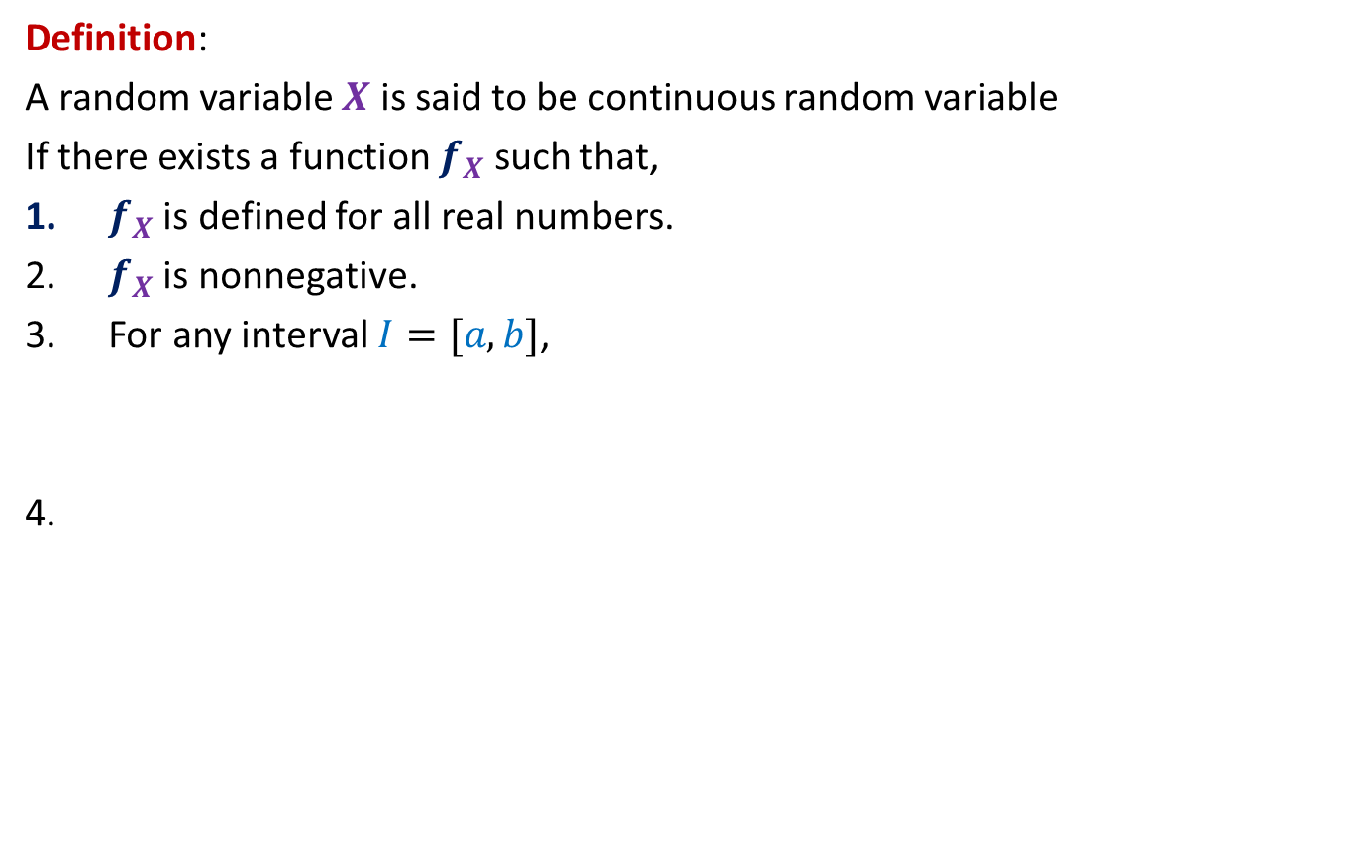

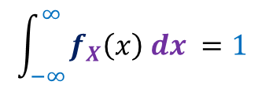
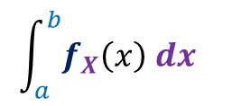
Continuous random variable
Definition:
A random variable $X$ is said to be continuous random variable
If there exists a function $f_{X}$ such that,
$f_{X}$is defined for all real numbers.
$f_{X}$is nonnegative.
For any interval $I=[a,b]$,
$$\int_{a}^{b}{f_{X}\left(x\right) dx }$$
P[$X∈I$] =
Area under $f_{X}$
for interval $I$
$$\int_{−∞ }^{∞}{f_{X}\left(x\right) dx }=1$$
Since integral exists for each continuous function.
$f_{X}$ is called probability density function of $X$

Slide 13
Examples

Slide 14
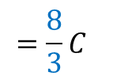
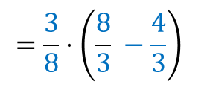


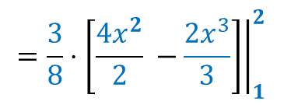

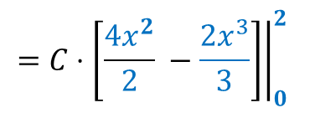
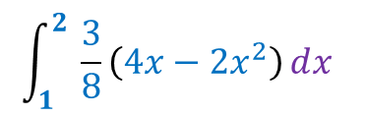



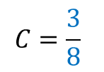
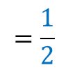
Example 1
$X$ is a continuous random variable with probability density function $f_{X}\left(x\right)$
given by
(a) What is value of $C$?
(b) Find P[$X>1$]
$$f_{X}\left(x\right)= \left\{\begin{aligned}C\left(4x−2x^{2}\right) if 0<x<2 \\ 0 otherwise\end{aligned}\right.$$
$$\int_{0}^{2}{C\left(4x−2x^{2}\right)ⅆx}$$
$$={\left.C⋅\left[\frac{{4x}^{2}}{2} −\frac{2x^{3}}{3}\right]\right|}_{0}^{2}$$
(a)
$$1=$$
$$=C⋅\left[8−\frac{16}{3}\right]$$
$$=\frac{8}{3}C$$
$$C=\frac{3}{8}$$
➔
$$\int_{1}^{2}{ \frac{3}{8}\left(4x−2x^{2}\right)ⅆx}$$
$$={\left.\frac{3}{8}⋅\left[\frac{{4x}^{2}}{2} −\frac{2x^{3}}{3}\right]\right|}_{1}^{2}$$
$$=\frac{3}{8}⋅\left(\frac{8}{3} −\frac{4}{3}\right)$$
$$=\frac{1}{2}$$
(b)
P[$X>1$] =

Slide 15
Expected value of a continuous random variable

Slide 16



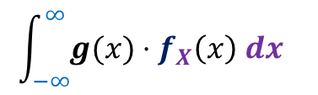

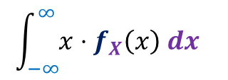
Expected value of a continuous random variable
$X$ is a continuous random variable with probability density function $f\left(x\right)$
Suppose $g$ is any real valued function defined on all real numbers.
$$\int_{−∞}^{∞}{x⋅f_{X}\left(x\right) dx }$$
E[$X$] =
$Y$ = $g(X)$
$$\int_{−∞}^{∞}{g(x)⋅f_{X}\left(x\right) dx }$$
E[$Y$] =

Slide 17
Probability Distribution Function of continuous random variable

Slide 18

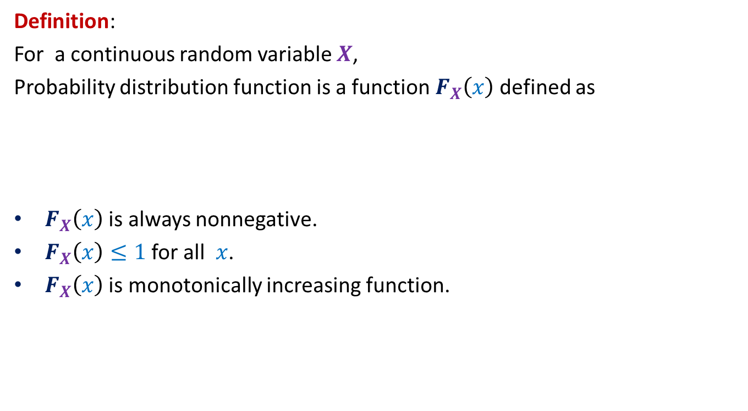

Probability Distribution Function
Definition:
For a continuous random variable $X$,
Probability distribution function is a function $F_{X}\left(x\right)$ defined as
$F_{X}\left(x\right)$ is always nonnegative.
$F_{X}\left(x\right)≤1$ for all $x$.
$F_{X}\left(x\right)$ is monotonically increasing function.
$F_{X}\left(x\right)$ =
P[$X<x$]

Slide 19
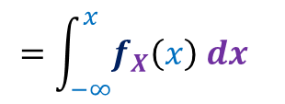

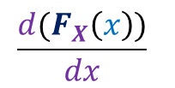





Relationship between $F_{X}\left(x\right)$ and $f_{X}\left(x\right)$
Given $F_{X}\left(x\right)$, how to calculate $f_{X}\left(x\right)$?
Given $f_{X}\left(x\right)$, how to calculate $F_{X}\left(x\right)$?
$$\frac{d(F_{X}\left(x\right))}{dx}$$
P[$X<x$]
$f_{X}\left(x\right)$ =
$F_{X}\left(x\right)$ =
$$=\int_{−∞}^{x}{f_{X}\left(x\right) dx }$$

Slide 20










Example 2
$X$ is a continuous random variable with probability distribution function $F_{X}\left(x\right)$.
$Y$ is a continuous random variable with probability distribution function $F_{Y}\left(x\right)$.
$X$and $Y$are independent.
$Z$= max($X,Y$)
What is probability distribution function of $Z$ ?
$F_{Z}\left(x\right)$ =
P[$Z<x$]
= P[max$(X,Y)<x$]
= P[$X<x$ and $Y<x$]
= P[$X<x$ ] $⋅$P[$Y<x$]
= $F_{X}\left(x\right)⋅ F_{Y}\left(x\right)$
$f_{Z}\left(x\right)$ =
$$F_{X}\left(x\right)⋅ f_{Y}\left(x\right)$$
+
$$f_{X}\left(x\right)⋅ F_{Y}\left(x\right)$$

Slide 21


Problem 2
$$(1,1)$$
2 points are picked from a unit square.
What is the expected square of distance between the two points ?
$$(0,0)$$

Slide 22


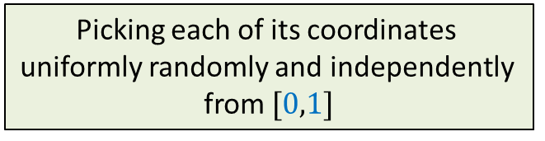
Problem 2
Idea:
What if only 2nd point is picked randomly uniformly.
$$(1,1)$$
$$(x_{1},y_{1})$$
$$(0,0)$$
What does picking a uniformly random point from unit square mean ?
Picking each of its coordinates
uniformly randomly and independently
from $[0,1]$

Slide 23


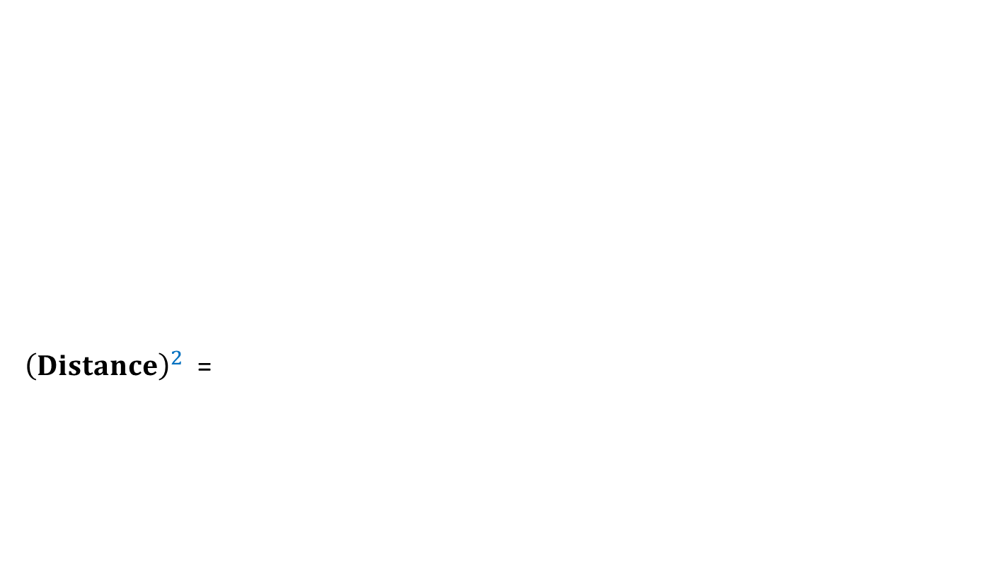


Problem 2
Idea:
What if only 2nd point is picked randomly uniformly
$$(1,1)$$
${\left(Distance\right)}^{2}$ =
$$(x_{1},y_{1})$$
$$(0,0)$$
E[ ]
E[ ]
E[ ]
$${\left(Difference in x−coordinates\right)}^{2}$$
$${+ \left(Difference in y−coordinates\right)}^{2}$$
$$D_{x}(x_{1},y_{1})$$
$$D_{y}(x_{1},y_{1})$$

Slide 24








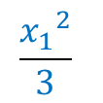






Problem 2
Idea:
What if only 2nd point is picked randomly
$$x_{1}$$
0
1
P[ the point is picked from left of $x_{1} ]$ =
$$\frac{x_{1}}{1}$$
$${=x}_{1}$$
$Z$ :
Distance of the point from $x_{1}$.
$$D_{x}(x_{1},y_{1})$$
= E[$Z^{2}$]
E[$Z^{2}$] =
E[$Z^{2}$|point is picked from left of $x_{1}$]
+
$${⋅x}_{1}$$
E[$Z^{2}$|point is picked from right of $x_{1}$]
$${⋅(1−x}_{1})$$
$$\frac{{x_{1}}^{2}}{3}$$
$$\frac{{(1−x_{1})}^{2}}{3}$$

Slide 25

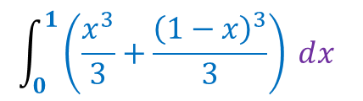




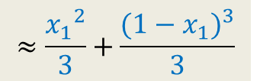


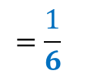
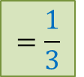

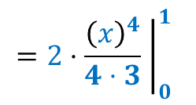




Uniform Probability Space
$$Δx$$
$$x$$
$$0$$
$$I$$
$$1$$
P[ the first point is from $I ]$ =
$$Δx$$
E[$X^{2}$|the point is from $I]$ =
$$≈\frac{{x_{1}}^{2}}{3}+\frac{{(1−x_{1})}^{3}}{3}$$
$Y$ :
Difference in y-coordinate of 2 points.
$X$ :
Difference in x-coordinate of 2 points.
$$\int_{0}^{1}{\left(\frac{x^{3}}{3}+\frac{{\left(1−x\right)}^{3}}{3}\right) ⅆx}$$
$$={ \left.\frac{{\left(x\right)}^{4}}{4⋅3} −\frac{{\left(1−x\right)}^{4}}{4⋅3}\right|}_{0}^{1}$$
E[$X^{2}$] =
$$={\left.2⋅\frac{{\left(x\right)}^{4}}{4⋅3} \right|}_{0}^{1}$$
$$=\frac{1}{6}$$
$$\frac{1}{6}$$
$$=\frac{1}{6}+\frac{1}{6}$$
$$=\frac{1}{3}$$
E[$Y^{2}$] =
Expected square of distance between 2 points

