Slide 1
Mathematic for Computer Science - III CS203B
Lecture 17
Continuous Probability Space
III

Slide 2

Discrete Probability space
Continuous probability space
Time or 1-D space
2-D space

Slide 3




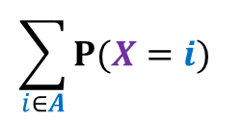





Discrete Probability space
Continuous probability space
$$i$$
$$I$$
Probability mass function
$$P(X=i)$$
Probability density function
$$f_{X}(x)$$
$A$ : a discrete set
$I$ = ($a,b$)
$$\sum_{i∈A}{P(X=i)}$$
$$\int_{a}^{b}{f_{X}\left(x\right) dx }$$
P[$X∈A$] =
P[$X∈I$] =

Slide 4

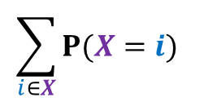

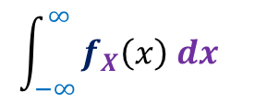

Discrete Probability space
Continuous probability space
$$i$$
$$I$$
Probability mass function
$$P(X=i)$$
Probability density function
$$f_{X}(x)$$
$$\sum_{i∈X}{P(X=i)}$$
$$\int_{−∞ }^{∞}{f_{X}\left(x\right) dx }$$
$$=1$$
$$=1$$

Slide 5

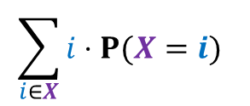
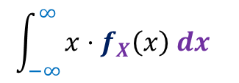


Expected value
Discrete Probability space
Continuous probability space
$$i$$
$$I$$
Probability mass function
$$P(X=i)$$
Probability density function
$$f_{X}(x)$$
$$\sum_{ω∈Ω}{X(ω)⋅P(ω)}$$
$$\int_{−∞ }^{∞}{{x⋅f}_{X}\left(x\right) dx }$$
$$E\left[X\right]=$$
$$E\left[X\right]=$$
$$\sum_{i∈X}{i⋅P(X=i)}$$
$$E\left[X\right]=$$

Slide 6




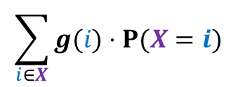




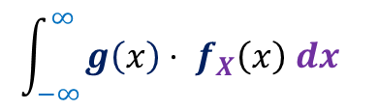






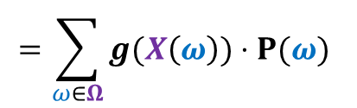
Functions of random variables
Discrete Probability space
Continuous probability space
$$i$$
$$I$$
Probability mass function
$$P(X=i)$$
Probability density function
$$f_{X}(x)$$
$g$ :
any real valued function of $x$
$g$ :
any real valued continuous function of $x$
Domain of $g$
$$⊇$$
Range of $X$
Domain of $g$
$$⊇$$
Range of $X$
$Y$ = $g(X)$
$Y$ = $g(X)$
$$\sum_{i∈X}{g(i)⋅P(X=i)}$$
$$\int_{−∞ }^{∞}{{g\left(x\right)⋅ f}_{X}\left(x\right) dx }$$
$$E\left[Y\right]=$$
$$E\left[Y\right]=$$
$$=\sum_{ω∈Ω}{g(X\left(ω\right))⋅P(ω)}$$

Slide 7




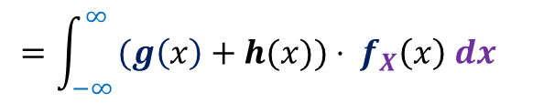
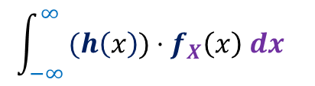
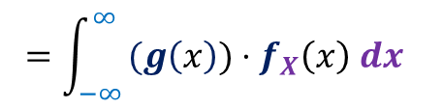


Linearity of Expectation
Discrete Probability space
Continuous probability space
$$i$$
$$I$$
Probability mass function
$$P(X=i)$$
Probability density function
$$f_{X}(x)$$
$Y$ = $g(X)$
$Z$ = $h(X)$
$$E\left[Y+Z\right]$$
$$= E\left[Y]+E[Z\right]$$
$$=\int_{−∞ }^{∞}{{(g\left(x\right)+h(x))⋅ f}_{X}\left(x\right) dx }$$
$$=\int_{−∞ }^{∞}{{(g\left(x\right))⋅f}_{X}\left(x\right) dx }$$
+
$$\int_{−∞ }^{∞}{{(h\left(x\right))⋅f}_{X}\left(x\right) dx }$$
$$E\left[Y\right]$$
$$E\left[Z\right]$$

Slide 8






Variance
Discrete Probability space
Continuous probability space
$$i$$
$$I$$
Probability mass function
$$P(X=i)$$
Probability density function
$$f_{X}(x)$$
$$Var\left(a\right)=$$
$$0$$
$$Var\left(aX\right)=$$
$$a^{2}Var\left(X\right)$$
Same
$$Var\left(X\right)=$$
$$E\left[X^{2}\right]−{\left(E\left[X\right]\right)}^{2}$$

Slide 9
Distributions

Slide 10
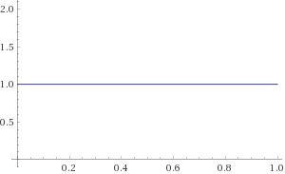

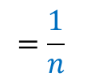




Uniform Distribution
Discrete Probability space
Continuous probability space
$$f_{X}\left(x\right)$$
$$i$$
$$=\frac{1}{n}$$
$$P(X=i)$$
$$f_{X}(x)$$
$$=1$$
for $x∈$[$0,1$]

Slide 11










Geometric Distribution
Discrete Probability space
Continuous probability space
$$P(X=i)$$
$$={\left(1−p\right)}^{i−1}p$$
$$x$$
$$f_{X}(x)$$
$$= e^{−λx}$$
for $x∈$[$0,∞$]
$$c$$
$$\int_{0 }^{∞}{f_{X}\left(x\right) dx=1 }$$
$${\left.\frac{−c}{λ} e^{−λx}\right|}_{0}^{∞}=1$$
$$\frac{c}{λ}=1$$

Slide 12
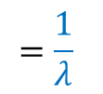

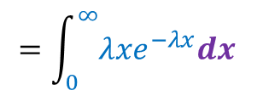
Exponential random variable
Definition:
A continuous random variable is said to be an exponential random variable
with parameter $λ$ if
$f_{X}(x)$ = ${λe}^{−λx}$ for $x∈$[$0,∞$]
$f_{X}(x)$ = $0$ for $x∈$[$−∞,0)$
Expected value of $X$ :
$$=\int_{0 }^{∞}{{λxe}^{−λx}dx }$$
$$=\frac{1}{λ}$$

Slide 13
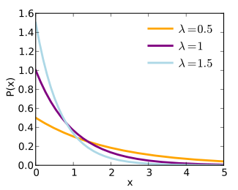


Exponential random variable
$$f_{X}(x)$$
$$x$$

Slide 14

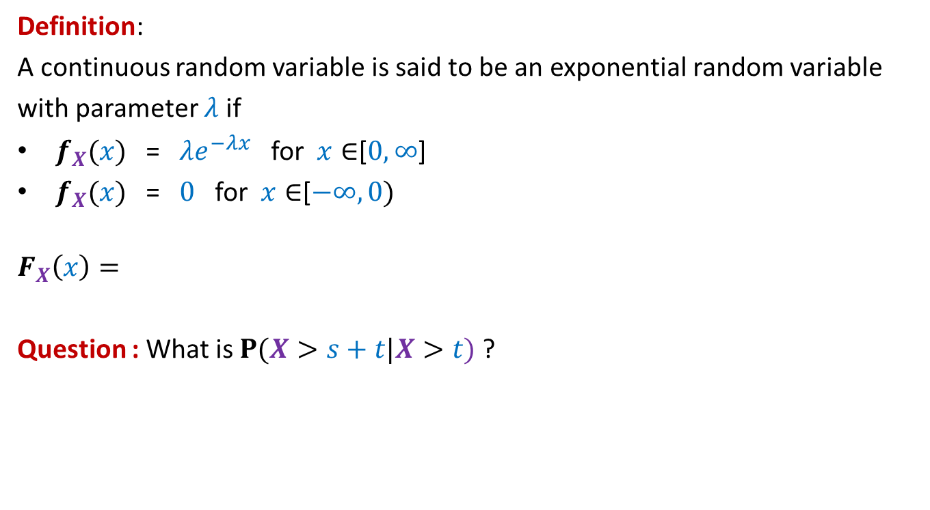


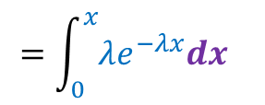
Exponential random variable
Definition:
A continuous random variable is said to be an exponential random variable
with parameter $λ$ if
$f_{X}(x)$ = ${λe}^{−λx}$ for $x∈$[$0,∞$]
$f_{X}(x)$ = $0$ for $x∈$[$−∞,0)$
$$F_{X}\left(x\right)=$$
Question : What is $P(X>s+t|X>t)$ ?
$$=\int_{0 }^{x}{{λe}^{−λx}dx }$$
$$=1−e^{−λx}$$
$P(X≤x)$
$=P(X>s)$
Memoryless property

Slide 15
Functions of continuous random variables

Slide 16

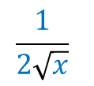









Example 1
$X$ is a continuous random variable with probability density function $f_{X}$
$g\left(x\right)=x^{2}$
$Y$ = $g(X)$.
Question: What is probability density function of $Y$ ?
Answer:
$$F_{Y}\left(x\right)=P[Y≤x]$$
$$\frac{1}{2\sqrt{x}}$$
$f_{Y}\left(x\right)$ =
$$\left[f_{X}\left(\sqrt{x}\right)+f_{X}\left(−\sqrt{x}\right)\right]$$
= P[$g(X)≤x$]
= P[$X^{2}≤x$]
= P[$−\sqrt{x}≤X≤\sqrt{x}$]
= P$\left[X≤\sqrt{x}\right]$
$−$ P$\left[X≤−\sqrt{x}\right]$
= $F_{X}\left(\sqrt{x}\right)$
${− F}_{X}\left(−\sqrt{x}\right)$

Slide 17
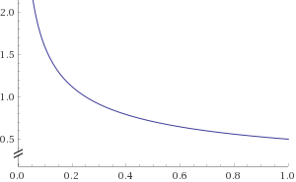








$X$ : Uniform in [$0,1$]
$$Y=X^{2}$$
$$\frac{1}{2\sqrt{x}}$$
$$1$$
$f_{Y}\left(x\right)$ =
$$\left[f_{X}\left(\sqrt{x}\right)+f_{X}\left(−\sqrt{x}\right)\right]$$
$$f_{X}\left(x\right)$$
$$f_{Y}\left(x\right)$$

Slide 18









Example 2
$X$ is a continuous random variable distributed randomly uniformly in [$0,1$]
$$g\left(x\right)=−\log_{e}{x}$$
$Y$ = $g(X)$.
Question: What is probability distribution function of $Y$ ?
Answer:
$$F_{y}\left(x\right)=P[Y≤x]$$
$f_{Y}\left(x\right)$ =
$e^{−x}$
= P[$g(X)≤x$]
$Y$ :
Exponential random variable with mean 1
= P[$−\log_{e}{X}≤x$]
= P[$e^{−\log_{e}{X}}≤e^{x}$]
= P$\left[\frac{1}{X}≤e^{x}\right]$
= P$\left[X≥e^{−x}\right]$
= $1$ $−$ P$\left[X≤e^{−x}\right]$
= $1$ $−$ $e^{−x}$

Slide 19
Example 2
Application
Various libraries of C and C++ provide random number generators that generate random numbers uniformly from [0,1].
Suppose you need random numbers following some other probability distribution (e.g. Exponential distribution),
Example 2 shows that we can still use the library functions of C intelligently and generate random numbers with exponential distribution with mean 1.
Think over it. Isn’t it nice ?

