Slide 1
Mathematic for Computer Science - III CS203B
Lecture 18
Inspirational solutions for problems
in Continuous Probability Space

Slide 2






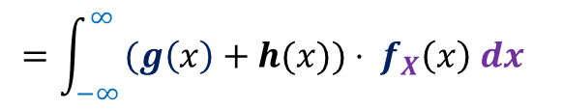
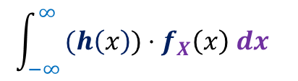

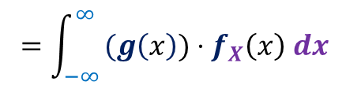



Linearity of Expectation
Discrete Probability space
Continuous probability space
$$i$$
$$I$$
Probability mass function
$$P(X=i)$$
Probability density function
$$f_{X}(x)$$
$Y$ = $g(X)$
$Z$ = $h(X)$
$$E\left[Y+Z\right]$$
$$= E\left[Y]+E[Z\right]$$
$$=\int_{−∞ }^{∞}{{(g\left(x\right)+h(x))⋅ f}_{X}\left(x\right) dx }$$
$$=\int_{−∞ }^{∞}{{(g\left(x\right))⋅f}_{X}\left(x\right) dx }$$
+
$$\int_{−∞ }^{∞}{{(h\left(x\right))⋅f}_{X}\left(x\right) dx }$$
$$E\left[Y\right]$$
$$E\left[Z\right]$$

Slide 3
Problem 1
Buffon’s needle problem

Slide 4







needle
$L$ cm
$1$cm
$Z$ : Number of intersections of the needle with the horizontal lines
Aim: To calculate E[$Z$].
Range of $Z$ :
$$5$$
$$3$$
$$0$$
Suppose we have a floor with parallel lines drawn on it.
Each pair of consecutive lines have width= 1cm.
We have a needle.
$$0≤Z≤⌈L⌉$$
?
The needle is dropped randomly on the floor.

Slide 5



needle
$L$ cm
$1$cm
$$x$$
$Z$ : Number of intersections of the needle with the horizontal lines
Aim: To calculate E[$Z$].
$$θ$$
There is a solution requiring integration
and a lot of careful calculations. But we
shall solve it using a novel method.
Pick any arbitrary point on the needle.
2. Place it at a uniformly random point in between two consecutive lines.
3. Pick an angle with the line uniformly randomly from [$0,π$].

Slide 6








$$Z_{1}$$
$$Z_{2}$$
needle
$d$ cm
$d$ cm
$1$cm
$Z$ : Number of intersections of the needle with the horizontal lines
Aim: To calculate E[$Z$].
$$Z_{1}$$
$$Z_{2}$$
Does probability distribution of the number of intersections of an interval of needle depend upon the location of the interval ?
No
E[$Z_{1}$]
?
E[$Z_{2}$]

Slide 7






$$Z_{1}$$
$$Z_{2}$$
needle
$L/2$ cm
$L/2$ cm
$1$cm
$Z$ : Number of intersections of the needle with the horizontal lines
Aim: To calculate E[$Z$].
$Z$ = $Z_{1}+Z_{2}$
E[$Z$]
= $2$E[$Z_{1}$]

Slide 8







$$Z′$$
: Number of intersections
of needle of length $1$ cm
$1$cm
needle
$1$cm
$Z$ : Number of intersections of the needle with the horizontal lines
Aim: To calculate E[$Z$].
Let $c=$ E[$Z′$].
How to find the value of $c$ ?
E[$Z$] = ?
$$cL$$

Slide 9
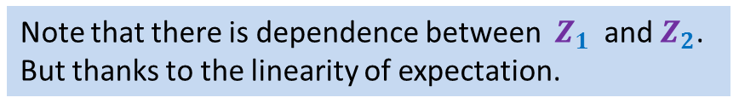

$$Z_{1}$$
$$Z_{2}$$
needle
$1$cm
Any arbitrary point.
$Z$ : Number of intersections of the needle with the horizontal lines
Aim: To calculate E[$Z$].
Bend it at the point
Will the expected no. of intersections of the bent needle be different from the straight needle ?
$Z$ = $Z_{1}+Z_{2}$
No
Note that there is dependence between $Z_{1}$ and $Z_{2}$.
But thanks to the linearity of expectation.
E[$Z$] = E[$Z_{1}$] + E[$Z_{2}$]
This is the power of linearity of expectation ☺

Slide 10
needle
$1$cm
$Z$ : Number of intersections of the needle with the horizontal lines
Aim: To calculate E[$Z$].
We can transform the needle into any shape.
Each shape will have the same expected no. of intersections

Slide 11

needle
$1$cm
$Z$ : Number of intersections of the needle with the horizontal lines
Aim: To calculate E[$Z$].
Triangle is symmetric but the number of intersections still depend upon its orientation ☹.
Let us try some shape that can help us find $c$ easily ?

Slide 12
needle
$1$cm
$Z$ : Number of intersections of the needle with the horizontal lines
Aim: To calculate E[$Z$].
Square is symmetric but the number of intersections still depend upon its orientation ☹.
Is there some shape whose intersections are independent of its orientation ?.

Slide 13


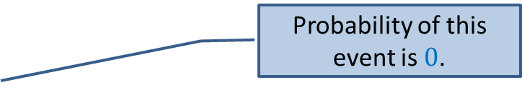






needle
$1$cm
Circumference = $π$
$Z$ : Number of intersections of the needle with the horizontal lines
Aim: To calculate E[$Z$].
Can we form a circle whose expected no. of intersections does not depend upon even distance from its center to nearest line ?
Probability of this event is $0$.
The number of intersections depend only upon the distance of the center of the circle from its nearest line . ☺
Expected no. of intersections
of a circle of diameter $1$cm
is $2$
Expected no. of intersections
of a needle of length $π$cm
is $2$
E[$Z$] = ?
$$=\frac{2}{π}L$$
$$cL$$

Slide 14

Problem 2
Sampling $n$ points from an interval

Slide 15

Practice sheet 6
Ambulance problem
What is the expected distance travelled by the ambulance ?
$$vehicle$$
ambulance
0
L
You used integration and probability concepts to solve this problem.
But there is a way to solve this problem and its generalization without any calculations ☺.

Slide 16

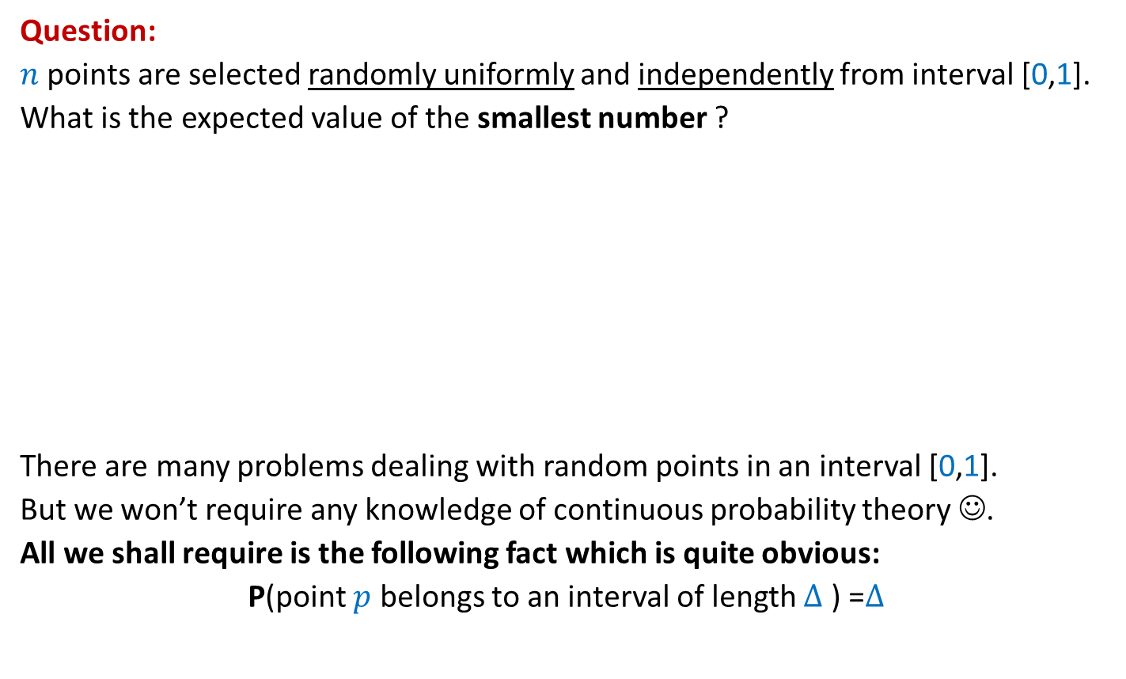


Question:
$n$ points are selected randomly uniformly and independently from interval [0,1].
What is the expected value of the smallest number ?
There are many problems dealing with random points in an interval [0,1].
But we won’t require any knowledge of continuous probability theory ☺.
All we shall require is the following fact which is quite obvious:
P(point $p$ belongs to an interval of length $∆$ ) =$∆$
$$p$$
$$p$$
$$p$$
0
1
$$∆$$

Slide 17






Sampling points on a line segment
Question: What is E[$X_{i}]$ ?
Answer: It appears to depend upon $i$.
1
0
1
0
$$X_{n}$$
$$X_{n+1}$$
$$X_{1}$$
$$X_{2}$$
$$X_{3}$$
$$X_{4}$$

Slide 18











Sampling points on a Circle (of circumference 1)
$$X_{n}$$
Question: What is E[$X_{i}]$ ?
➔ E[$X_{1}$]=E[$X_{2}$]= … = E[$X_{n}$]
E[$X_{1}$+$X_{2}+…X_{n}$]= ??
➔ E[$X_{1}$]= ??
$$X_{1}$$
$$X_{n−1}$$
$$X_{2}$$
$$X_{3}$$
$$X_{4}$$
Prob. distribution of $X_{i}$
Prob. distribution of $X_{j}$
$$1$$
$$1/n$$

Slide 19


Alice
Bob
Bob is color-blind
(can’t distinguish between red and green color)

Slide 20
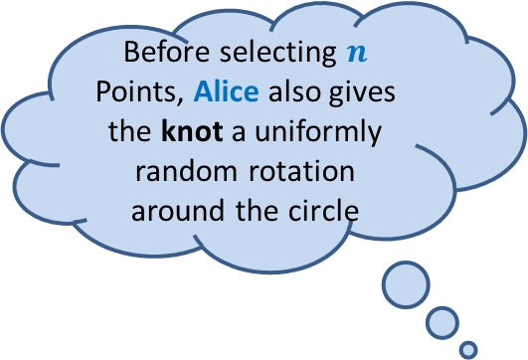
Transforming a line segment to a circle
Alice joins the ends of the line segment to form a knot so that it looks like circle.
Alice
Before selecting $n$
Points, Alice also gives the knot a uniformly random rotation around the circle

Slide 21



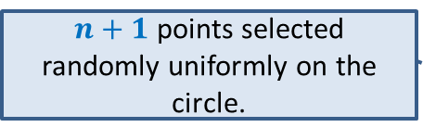
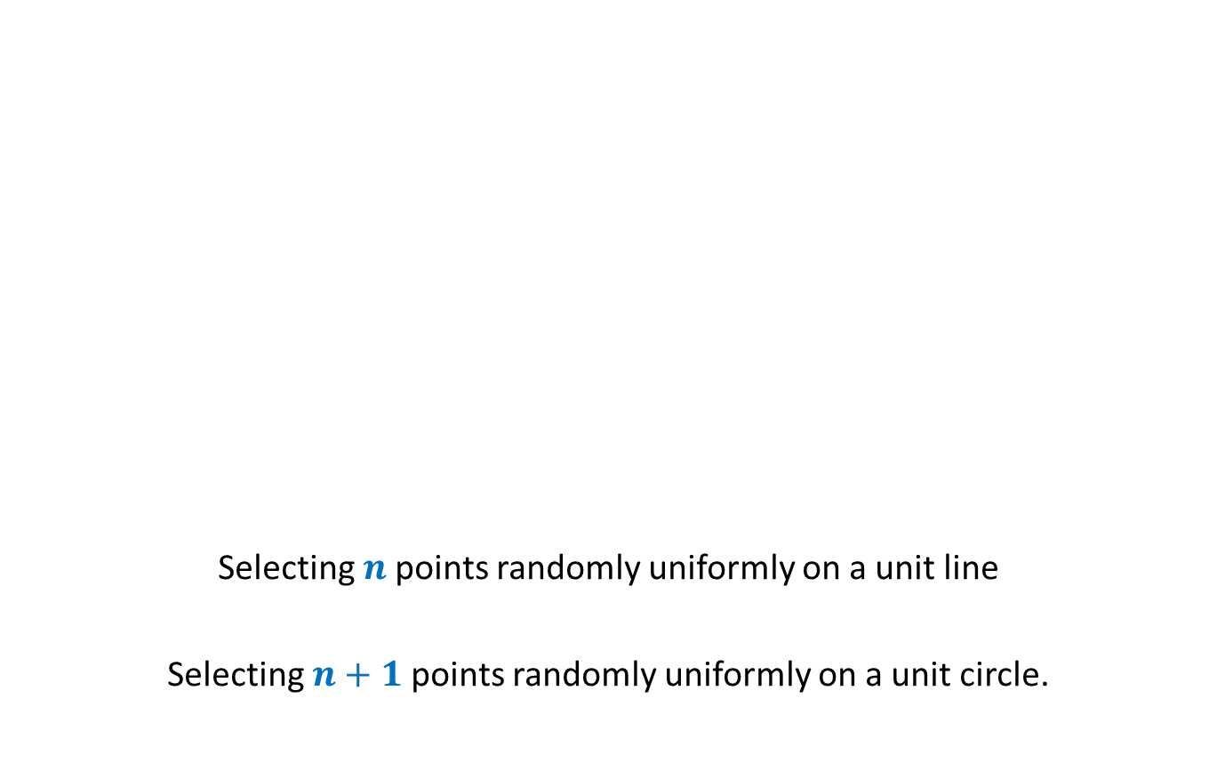



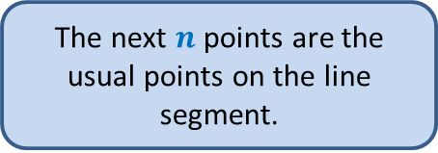
Transforming a line segment to a circle
Now Bob arrives
Alice
Selecting $n$points randomly uniformly on a unit line
Selecting $n+1$points randomly uniformly on a unit circle.
$$X_{n+1}$$
$$X_{n}$$
$$X_{1}$$
$$X_{2}$$
$$X_{3}$$
How will Bob perceive the entire experiment ?
$$X_{4}$$
First uniformly random point is the knot.
$n+1$ points selected randomly uniformly on the circle.
The next $n$ points are the usual points on the line segment.

Slide 22
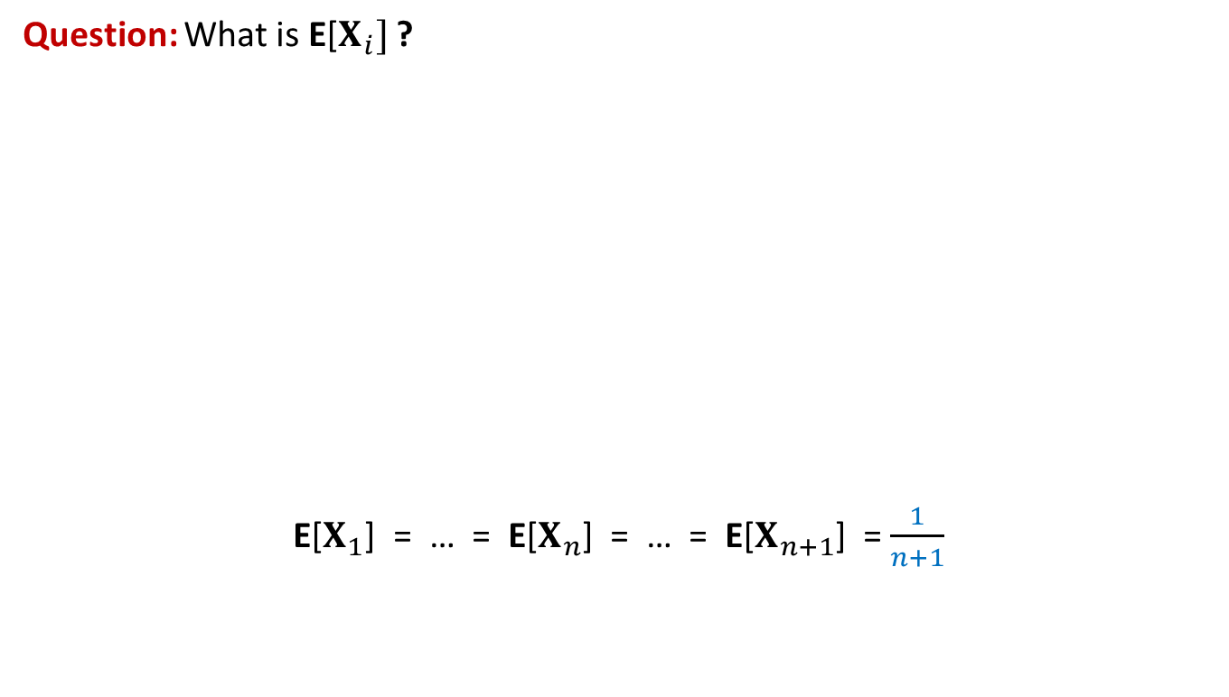
We have got the answer of the problem (without any knowledge of continuous probability theory)
Question: What is E[$X_{i}]$ ?
E[$X_{1}$] = … = E[$X_{n}$] = … = E[$X_{n+1}$] = $\frac{1}{n+1}$
0
1
1
0
$$X_{n}$$
$$X_{n+1}$$
$$X_{1}$$
$$X_{2}$$
$$X_{3}$$
$$X_{4}$$

