Slide 1
Mathematic for Computer Science - III CS203B
Lecture 19
Probabilistic Method

Slide 2

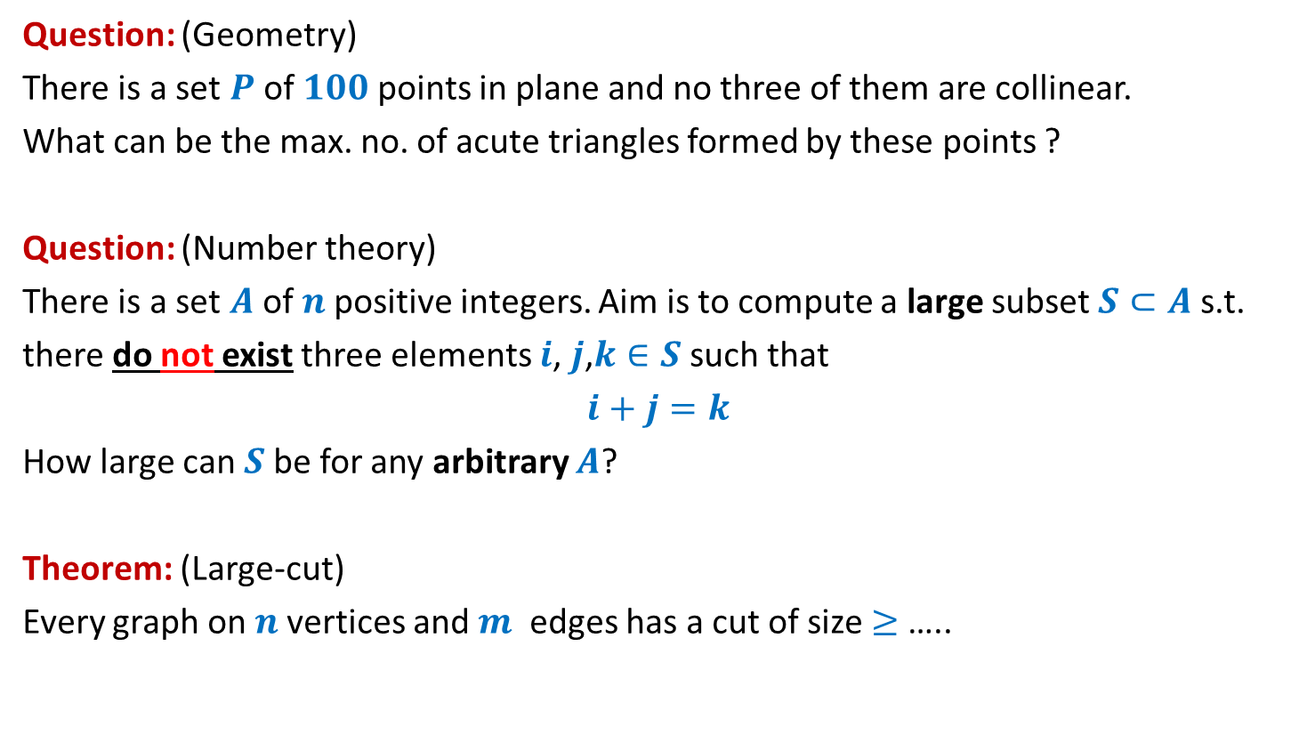


Questions from Discrete Mathematics
At most $70\%$
Question: (Geometry)
There is a set $P$of $100$points in plane and no three of them are collinear.
What can be the max. no. of acute triangles formed by these points ?
Question: (Number theory)
There is a set $A$of $n$positive integers. Aim is to compute a large subset $S⊂A$s.t.
there do not exist three elements $i$, $j$,$k∈S$ such that
$i+j=k$
How large can $S$be for any arbitrary $A$?
Theorem: (Large-cut)
Every graph on $n$vertices and $m$ edges has a cut of size $≥$ …..
At least $n/3$
$$m/2$$

Slide 3
Probabilistic methods

Slide 4
Probabilistic methods
Methods that use
Probability theory
Randomized algorithm
to prove deterministic combinatorial results

Slide 5
problem 1 How many Acute Triangles ?

Slide 6
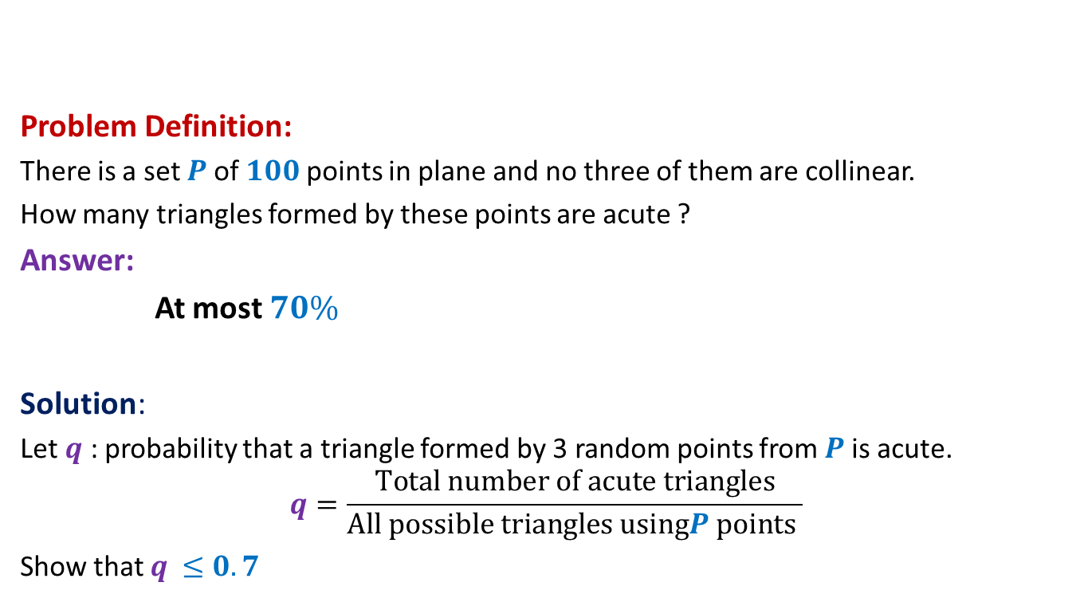
How many acute triangles
Problem Definition:
There is a set $P$of $100$points in plane and no three of them are collinear.
How many triangles formed by these points are acute ?
Answer:
At most $70\%$
Solution:
Let $q$ : probability that a triangle formed by 3 random points from $P$is acute.
$$q=\frac{Total number of acute triangles}{All possible triangles usingP points }$$
Show that $q$ $≤0.7$

Slide 7
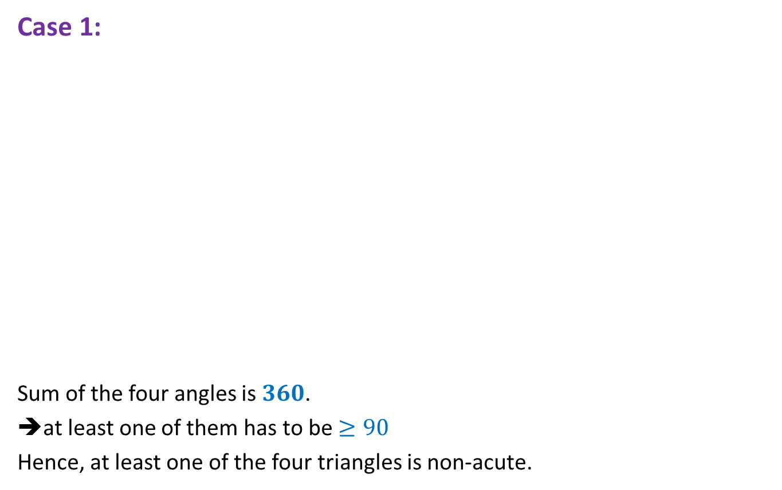

$4$ points
Case 1:
Sum of the four angles is $360$.
➔at least one of them has to be $≥90$
Hence, at least one of the four triangles is non-acute.

Slide 8
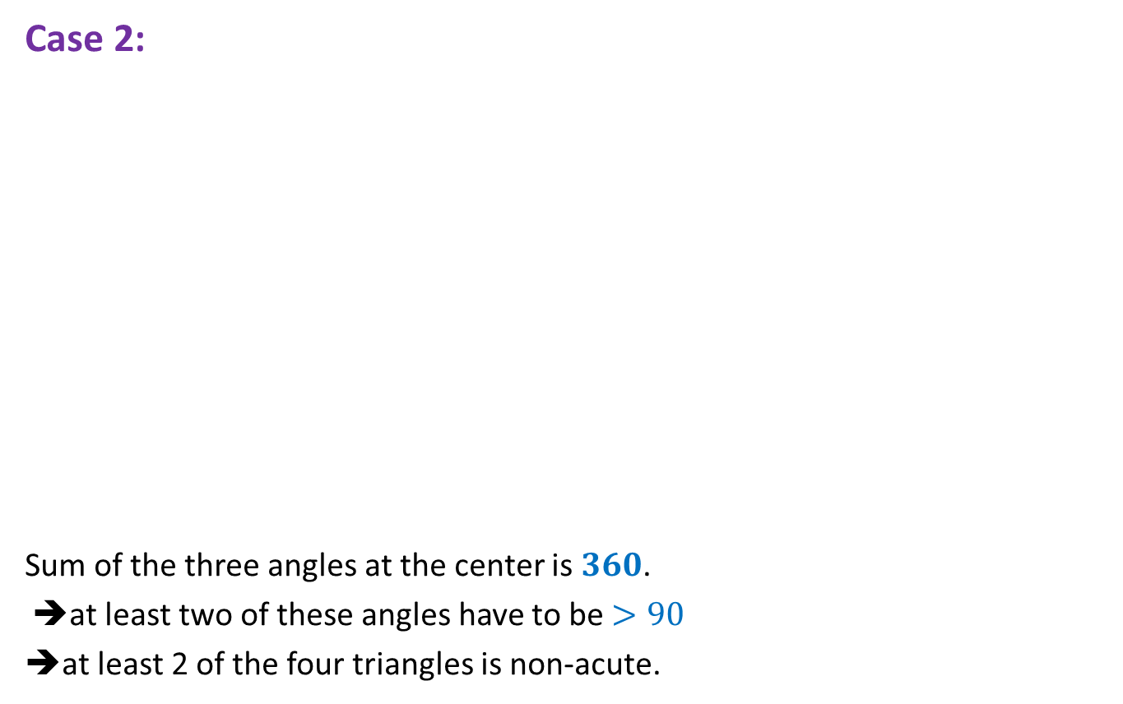
$4$ points
Case 2:
Sum of the three angles at the center is $360$.
➔at least two of these angles have to be $>90$
➔at least 2 of the four triangles is non-acute.

Slide 9
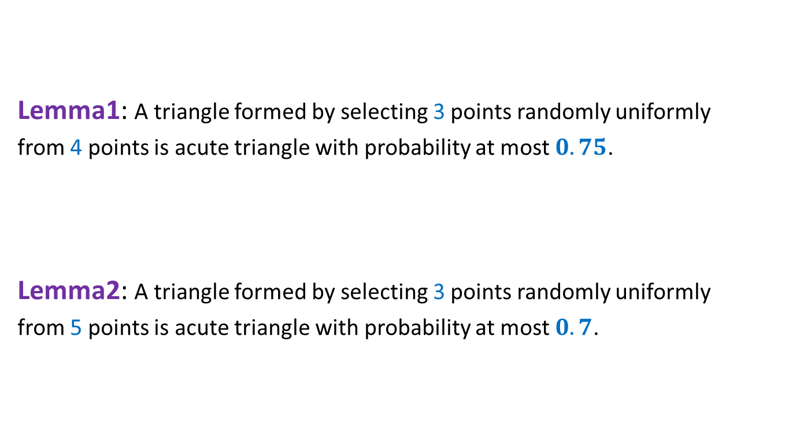

$4$ points ➔ $5$ points
Lemma1: A triangle formed by selecting 3 points randomly uniformly
from 4 points is acute triangle with probability at most $0.75$.
Lemma2: A triangle formed by selecting 3 points randomly uniformly
from 5 points is acute triangle with probability at most $0.7$.
Extension to 100 points ?
☹

Slide 10

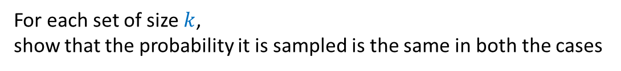










Two stage sampling
$$j≤k≤n$$
$$R_{2}$$
$$j$$
?
Same probability distribution
$$R_{1}$$
$$k$$
$$R$$
$$j$$
$$S$$
$$n$$
$$S$$
$$n$$
How to show this formally:
For each set of size $k$,
show that the probability it is sampled is the same in both the cases

Slide 11
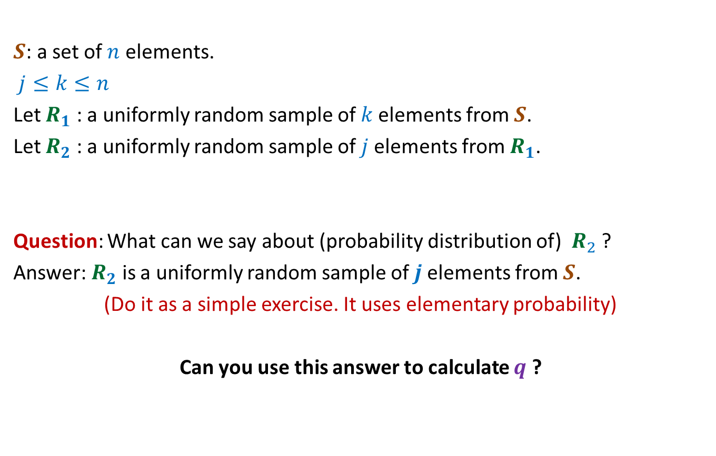
Two stage sampling
$S$: a set of $n$ elements.
$j≤k≤n$
Let $R_{1}$ : a uniformly random sample of $k$elements from $S$.
Let $R_{2}$ : a uniformly random sample of $j$elements from $R_{1}$.
Question: What can we say about (probability distribution of) $R_{2}$ ?
Answer: $R_{2}$ is a uniformly random sample of $j$elements from $S$.
(Do it as a simple exercise. It uses elementary probability)
Can you use this answer to calculate $q$ ?

Slide 12

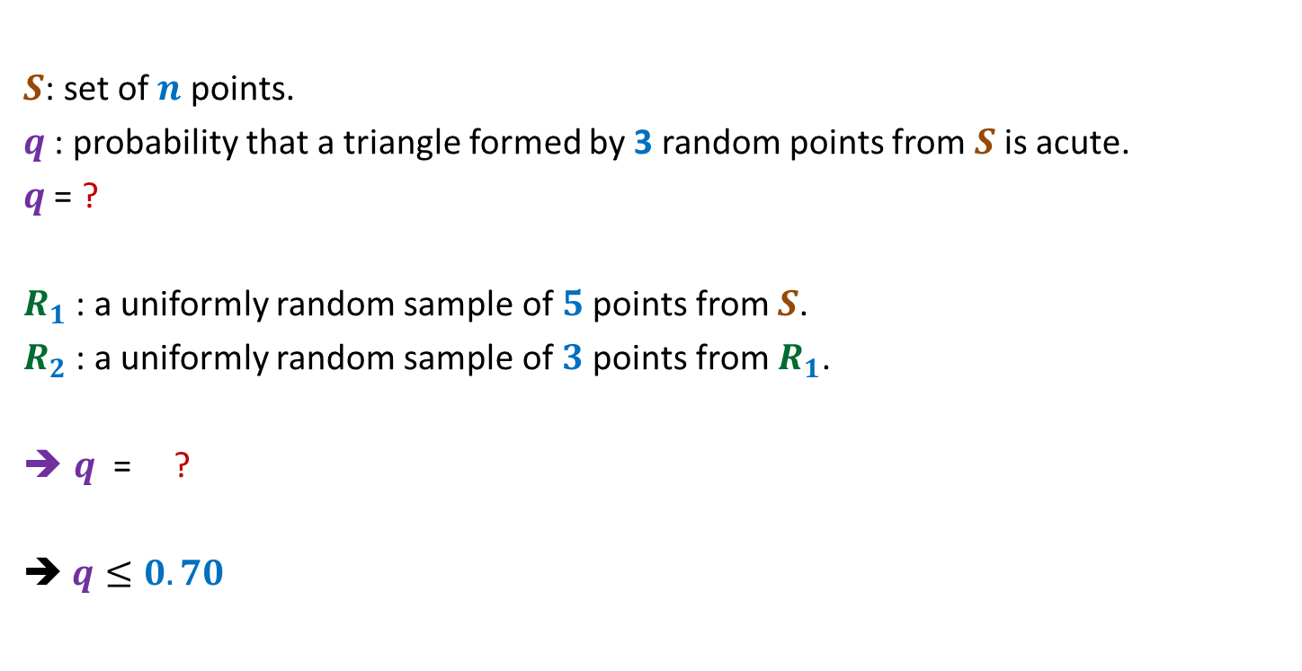
Number of acute triangles
$S$: set of $n$ points.
$q$ : probability that a triangle formed by 3 random points from $S$is acute.
$q$ = ?
$R_{1}$ : a uniformly random sample of $5$points from $S$.
$R_{2}$ : a uniformly random sample of $3$points from $R_{1}$.
$q$ = ?
➔ $q≤0.70$
P(a random triangle from $S$ is acute)

Slide 13
problem 2 Large CUT in a graph

Slide 14

A simple fact
Let $X$ is a random variable defined over a probability space $(Ω,P)$.
If $E\left[X\right]=α$, then there exists an elementary event $ω∈Ω$, such that
$$X\left(ω\right)≥α.$$

Slide 15
Undirected graph

Slide 16

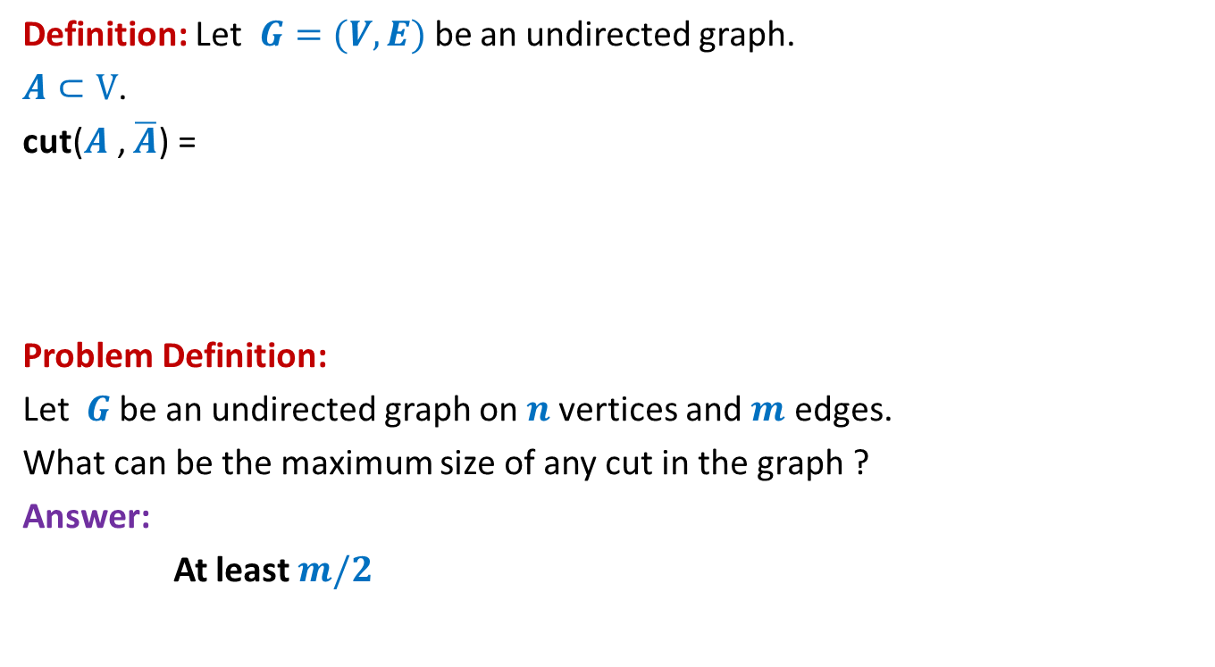
Large cut in a graph
Definition: Let $G=(V,E)$be an undirected graph.
$A⊂V$.
cut($A$, $\overline{A}$) =
Problem Definition:
Let $G$be an undirected graph on $n$vertices and $m$ edges.
What can be the maximum size of any cut in the graph ?
Answer:
At least $m/2$
{ $\left(u,v\right)∈E$) : $u∈A$, $v∈$ $\overline{A}$ or $u∈\overline{A}$, $v∈$ $A$}

Slide 17


Large cut in a graph
$$A$$
$$\overline{A}$$

Slide 18
Large cut in a graph
$$A$$
$$\overline{A}$$

Slide 19

Large cut in a graph
A randomized algorithm:
$A$←∅;
Add each vertex from $V$to $A$randomly independently with probability $\frac{1}{2}$.
Return the cut defined by $A$.

Slide 20

Large cut in a graph
$X$: size of cut ($A,\overline{A}$) returned by the randomized algorithm.
E[$X$] = ??
$$X_{e}:\left\{\begin{aligned}1 if e is present in the cut \\ 0 otherwise \end{aligned}\right.$$
$X=\sum_{e}{X_{e}}$
E[$X$] $=\sum_{e}{{E[X}_{e}]}$
$=\sum_{e}{{P(X}_{e}=1)}$

Slide 21









Large cut in a graph
$$A$$
$$\overline{A}$$
$$u$$
$$v$$
$$u$$
$$v$$
$$v$$
$$u$$
$$e$$
$$\frac{1}{4}$$
+
$$\frac{1}{4}$$

Slide 22

Large cut in a graph
$X$: size of cut ($A,\overline{A}$) returned by the randomized algorithm.
E[$X$] = ??
$$X_{e}:\left\{\begin{aligned}1 if e is present in the cut \\ 0 otherwise \end{aligned}\right.$$
$X=\sum_{e}{X_{e}}$
E[$X$] $=\sum_{e}{{E[X}_{e}]}$
$=\sum_{e}{{P(X}_{e}=1)}$
$=\sum_{e}{\frac{1}{2}}$
$=\frac{m}{2}$

Slide 23
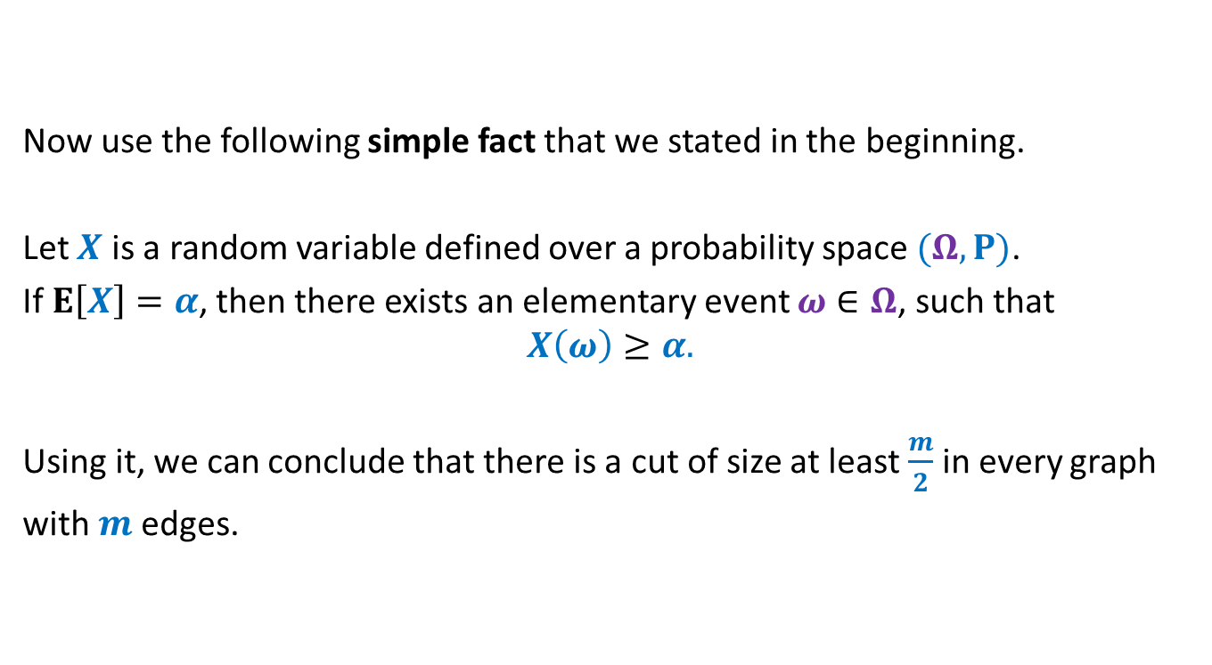
Large cut in a graph
Now use the following simple fact that we stated in the beginning.
Let $X$ is a random variable defined over a probability space $(Ω,P)$.
If $E\left[X\right]=α$, then there exists an elementary event $ω∈Ω$, such that
$$X\left(ω\right)≥α.$$
Using it, we can conclude that there is a cut of size at least $\frac{m}{2}$ in every graph
with $m$edges.

Slide 24

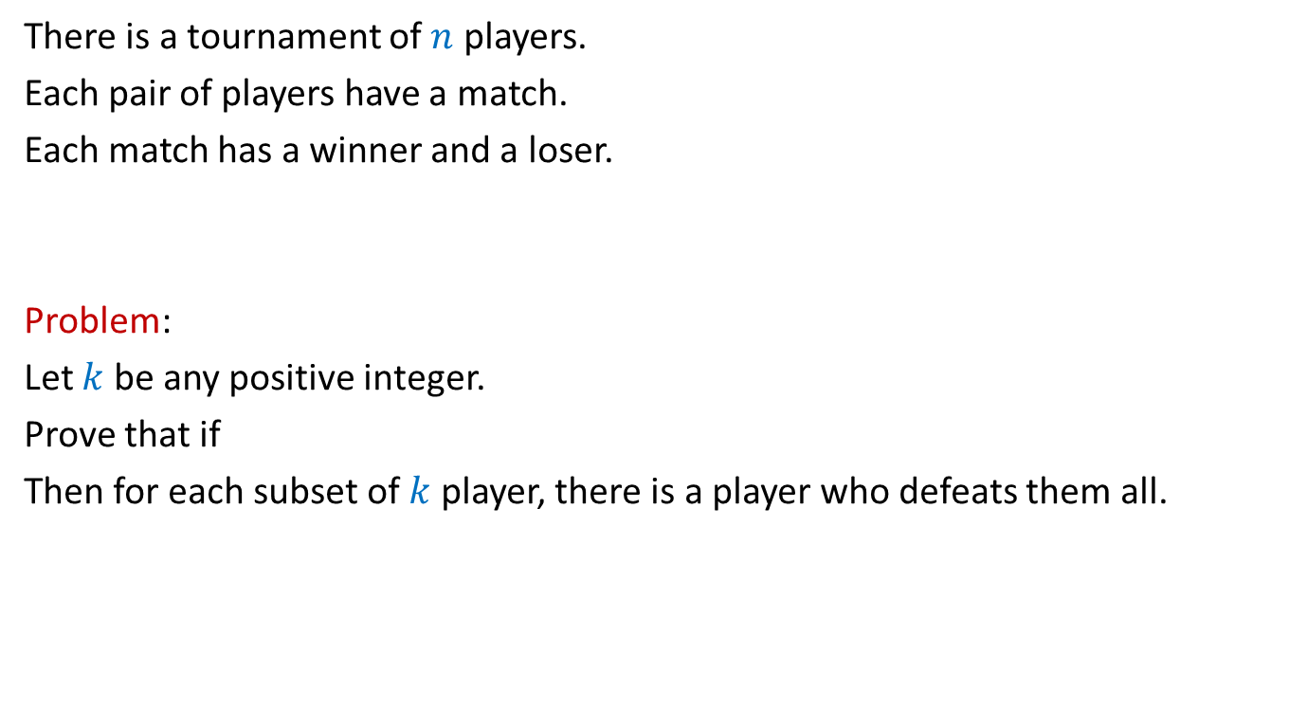
Problem 3
There is a tournament of $n$ players.
Each pair of players have a match.
Each match has a winner and a loser.
Problem:
Let $k$ be any positive integer.
Prove that if
Then for each subset of $k$ player, there is a player who defeats them all.
$$\left({n \atop k}\right){\left(1−2^{−k}\right)}^{n−k}<1$$
We shall solve it in the next class. Please make sincere attempt to solve it.
➔ Hint: Think of a random tournament.

Slide 25
problem 4 Sum free subset of large size

Slide 26
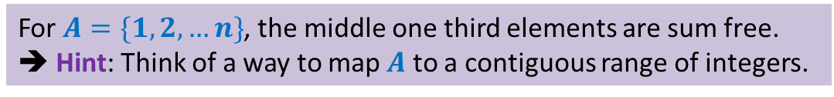
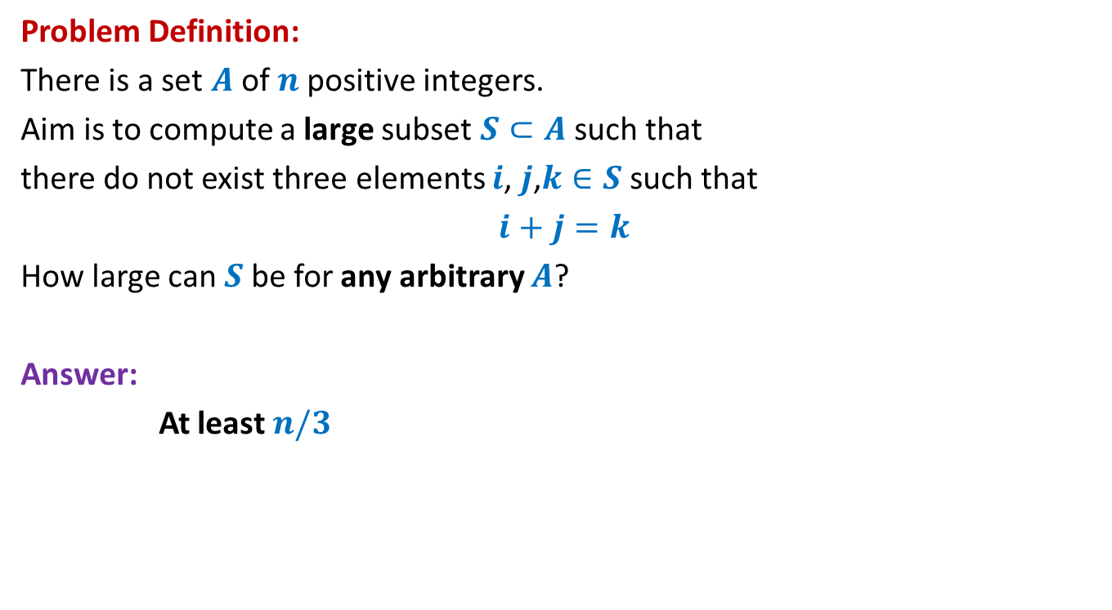
Large subset that is sum-free
Problem Definition:
There is a set $A$of $n$positive integers.
Aim is to compute a large subset $S⊂A$such that
there do not exist three elements $i$, $j$,$k∈S$ such that
$i+j=k$
How large can $S$be for any arbitrary $A$?
Answer:
At least $n/3$
We shall solve it in the next class. Please make sincere attempt to solve it.
For $A=\{1,2,…n\}$, the middle one third elements are sum free.
➔ Hint: Think of a way to map $A$ to a contiguous range of integers.

