Slide 1
Mathematic for Computer Science - III CS203B
Lecture 20
Probabilistic Methods
Answers to old questions
Some new questions to ponder over ☺

Slide 2
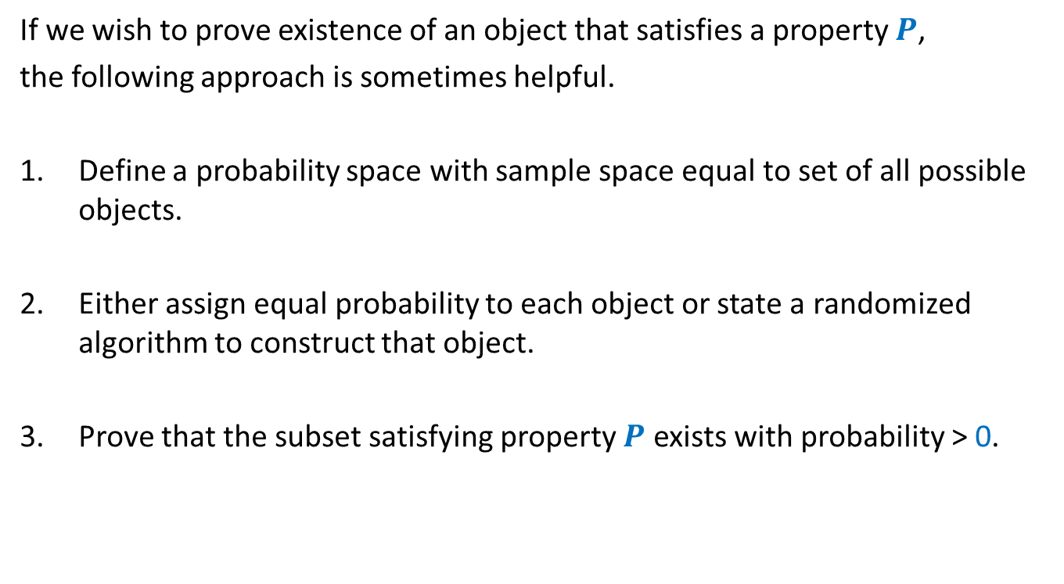
A common framework of using Probabilistic methods
If we wish to prove existence of an object that satisfies a property $P$,
the following approach is sometimes helpful.
Define a probability space with sample space equal to set of all possible objects.
Either assign equal probability to each object or state a randomized algorithm to construct that object.
Prove that the subset satisfying property $P$ exists with probability > 0.

Slide 3




Questions from Discrete Mathematics
Question: (Geometry)
There is a set $P$of $100$points in plane and no three of them are collinear.
What can be the max. no. of acute triangles formed by these points ?
Theorem: (Large-cut)
Every graph on $n$vertices and $m$ edges has a cut of size $≥$ …..
At most $70\%$
Property:
Triangle is acute angle.
Sample space =
Set of all possible triangles formed by points from $P$.
Each triangle is equally likely to be picked.
We showed that a randomly picked triangle is acute angle triangle with probability $≤$ 0.7
We shall now demonstrate the use of this framework with a new problem ☺.
$$m/2$$
Property:
Cut of size $≥m/2$.
Sample space =
Set of all cuts (including cut defined by all vertices)
We gave a randomized algorithm to pick a cut.
We showed that expected size of the cut will be $≥m/2$

Slide 4

Problem 3
Definition of Tournament of $n$ players:
In a tournament of $n$ players,
Each pair of players have a match.
Each match results in one player winning and the other losing it.
(That is, there are never ties).

Slide 5




Problem 4
Problem: Let $k$ be any positive integer.
Prove that if
for each subset of $k$ players, there is a player who defeats them all.
Let us use the framework described just now to solve this problem.
It suffices if we can show the following:
$$\left({n \atop k}\right){\left(1−2^{−k}\right)}^{n−k}<1$$
, then there exists a tournament of $n$players s.t.
Property $D_{k}$
Sample space =
Set of all possible tournaments
Size of the set = $2^{\left({n \atop 2}\right)}$
Each tournament is equally likely.
A randomly picked tournament is going to satisfy property $D_{k}$ with probability< $1$
We shall now establish this inequality systematically.

Slide 6
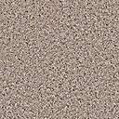









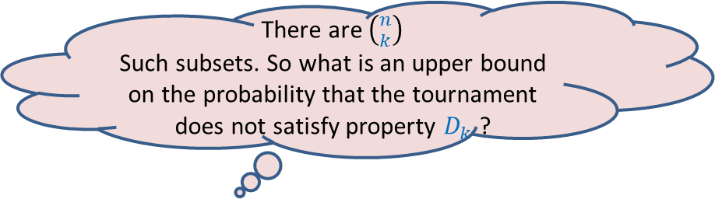
Problem 4
Problem: Let $k$ be any positive integer.
Prove that if
for each subset of $k$ players, there is a player who defeats them all.
Let us use the framework described just now to solve this problem.
$$\left({n \atop k}\right){\left(1−2^{−k}\right)}^{n−k}<1$$
, then there exists a tournament such that
Property $D_{k}$
Sample space =
Set of all possible tournaments
Size of the set = $2^{\left({n \atop 2}\right)}$
Each tournament is equally likely.
There are $\left({n \atop k}\right)$
Such subsets. So what is an upper bound on the probability that the tournament does not satisfy property $D_{k}$ ?
What is the probability that this player does not defeat all players of the set ?
What is the probability that this player defeats all players of the set ?
What is the probability that no player outside the set defeats all players of the set ?
Consider any player outside this set.
Consider any subset of $k$ players.
$$n−k$$
$$\left({n \atop k}\right)$$
$$2^{−k}$$
$$\left(1−2^{−k}\right)$$
$$<1$$
We are done ☺
$$k$$
Hint: Use Union theorem
$$n$$

Slide 7
problem 4 Sum free subset of large size
This is the most non-trivial application of probabilistic methods.
Fully internalize it.

Slide 8


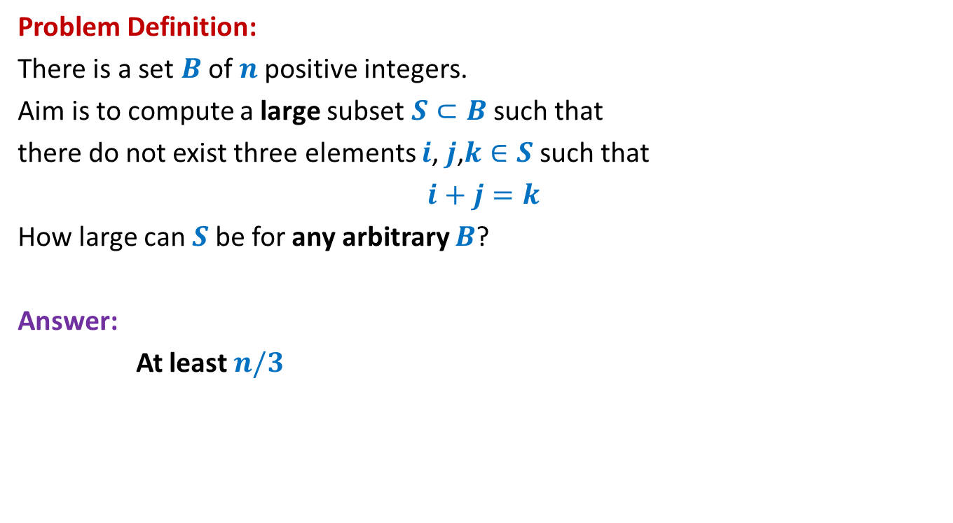



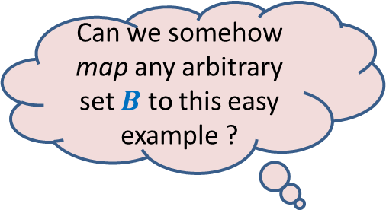
Large subset that is sum-free
Can we somehow map any arbitrary set $B$ to this easy example ?
Problem Definition:
There is a set $B$of $n$positive integers.
Aim is to compute a large subset $S⊂B$such that
there do not exist three elements $i$, $j$,$k∈S$ such that
$i+j=k$
How large can $S$be for any arbitrary $B$?
Answer:
At least $n/3$
Yes, by randomization
An easy example of $B$
Suppose $B=[1..n]$
$$n=3m$$
$m m+1$ … … $2m+1$
$1 2$ … … $3m$
$$S$$

Slide 9
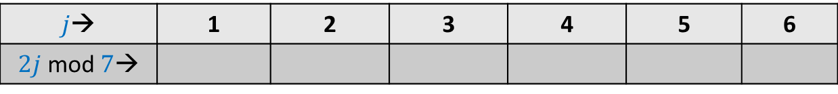

mod operation
$p$ : a prime number
$A$: {$1,2,…,p−1$}
Consider any $i∈A$.
Question: What can we say about set $A_{i}$ = { $ij mod p | j∈A$} ?
Example: $p=7$
$j$→ | 1 | 2 | 3 | 4 | 5 | 6
$2j$ mod $7$→
2
4
6
1
3
5

Slide 10
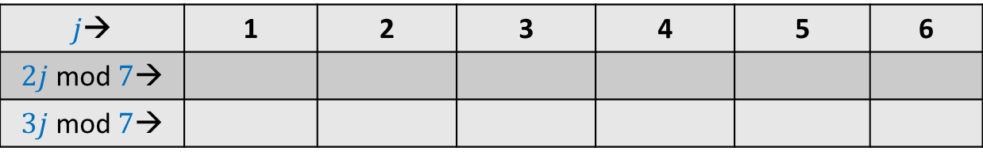
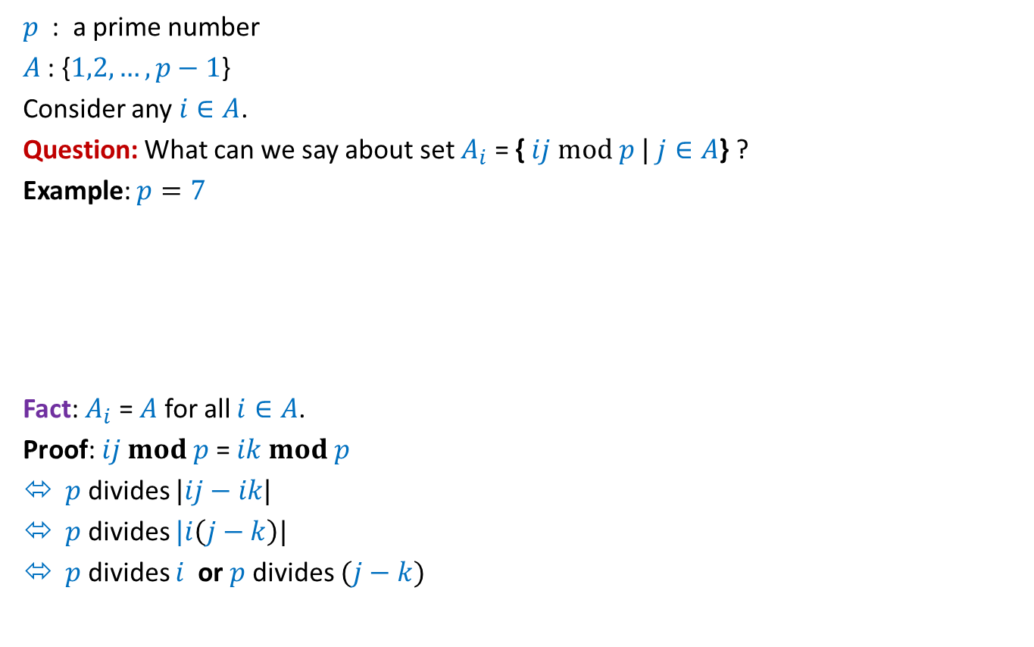
mod operation
$p$ : a prime number
$A$: {$1,2,…,p−1$}
Consider any $i∈A$.
Question: What can we say about set $A_{i}$ = { $ij mod p |$ $j∈A$} ?
Example: $p=7$
Fact: $A_{i}$ = $A$ for all $i∈A$.
Proof: $ij mod p$= $ik mod p$
$p$ divides $|ij−ik|$
$p$ divides $|i\left(j−k\right)|$
$p$ divides $i$ or $p$divides $(j−k)$
$j$→ | 1 | 2 | 3 | 4 | 5 | 6
$2j$ mod $7$→
$3j$ mod $7$→
2
4
6
1
3
5
3 6 2 5 1 4
Not possible

Slide 11


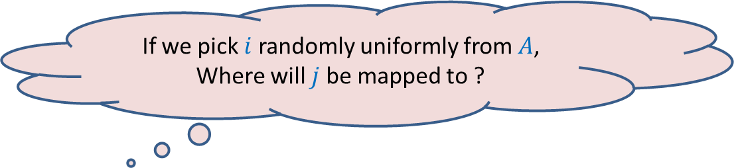
mod operation
$p$ : a prime number
$A$: {$1,2,…,p−1$}
Consider any $i∈A$.
Question: What can we say about set $A_{i}$ = { $ij mod p |$ $j∈A$} ?
Example: $p=7$
$j$→ | 1 | 2 | 3 | 4 | 5 | 6
$2j$ mod $7$→
$3j$ mod $7$→
2
4
6
1
3
5
3 6 2 5 1 4
If we pick $i$ randomly uniformly from $A$,
Where will $j$ be mapped to ?
Uniformly over whole of $A$.

Slide 12
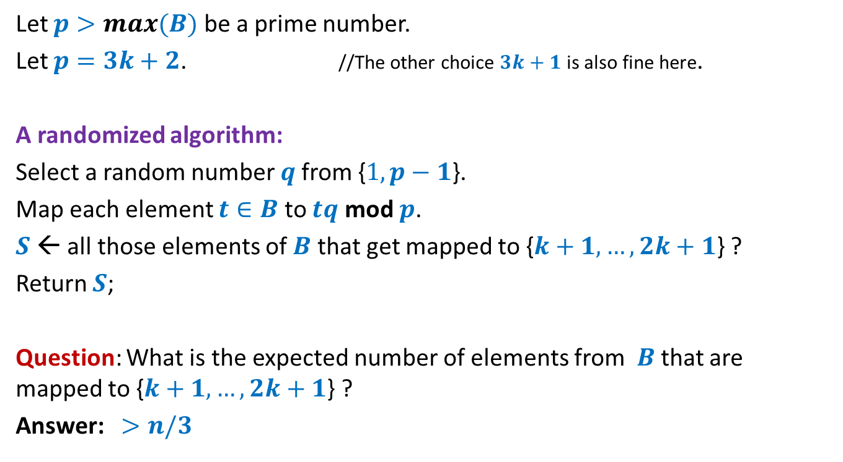
Large subset that is sum-free
Let $p>max(B)$ be a prime number.
Let $p=3k+2$. //The other choice $3k+1$ is also fine here.
A randomized algorithm:
Select a random number $q$from {$1,p−1$}.
Map each element $t∈B$ to $tq$ mod $p$.
$S$← all those elements of $B$ that get mapped to {$k+1,…,2k+1$} ?
Return $S$;
Question: What is the expected number of elements from $B$that are mapped to {$k+1,…,2k+1$} ?
Answer: $>n/3$
To prove it, use
the fact that mapping is 1-1 and uniform.
and Linearity of expectation.

Slide 13

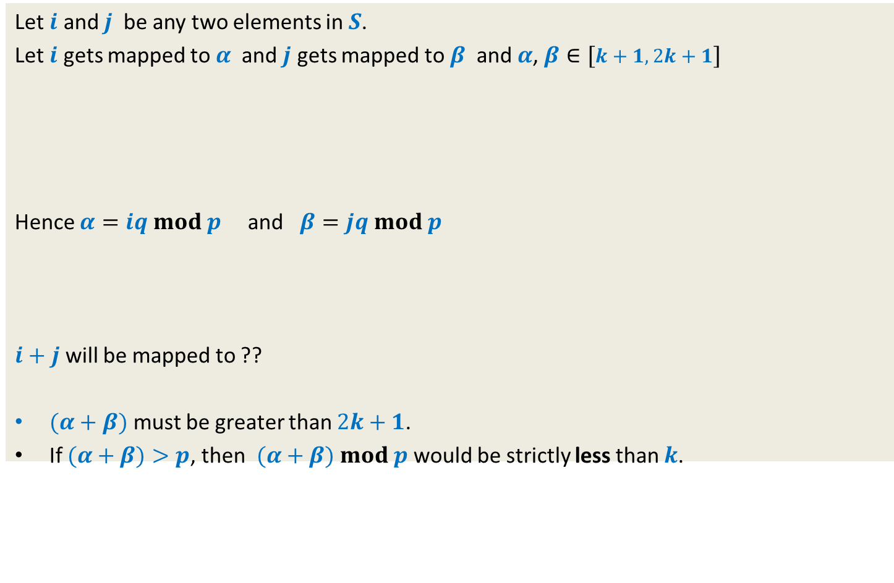


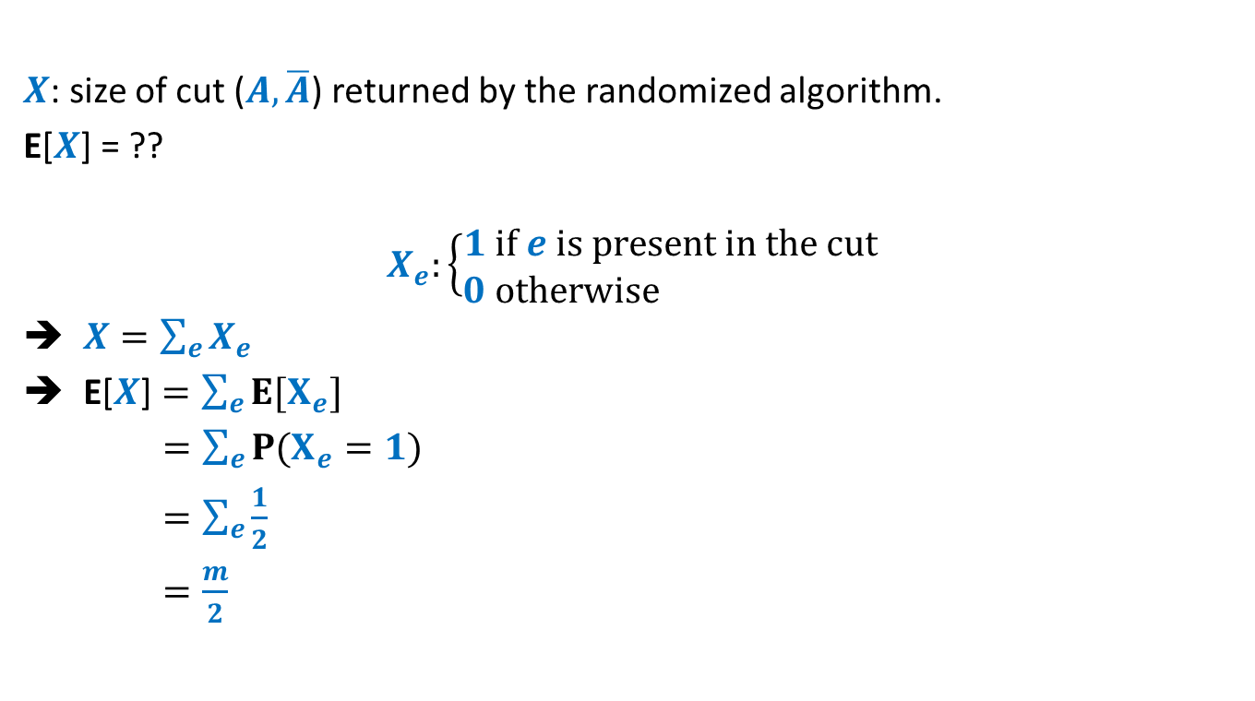





Showing that $S$is sum-free.
Let $i$ and $j$ be any two elements in $S$.
Let $i$ gets mapped to $α$ and $j$ gets mapped to $β$ and $α$, $β∈[k+1,2k+1]$
Hence $α=iq mod p$ and $β=jq mod p$
$i+j$ will be mapped to ??
$(α+β)$ must be greater than $2k+1$.
If $(α+β)>p$, then $(α+β)$ $mod p$ would be strictly less than $k$.
1 2 … $k$ $k+1$ … … … $2k+1$ … $3k+1$
$$α$$
$$β$$
$\left(i+j\right)q$ $mod p$
$\left(iq+jq\right)$ $mod p$
$$\left(iqmod p+jqmod p\right)$$
$(α+β)$ $mod p$
$mod p$
Because even for the largest two elements - $2k$ , $2k+1$ in the middle half,
their sum mod $p$ is $k−1$

Slide 14
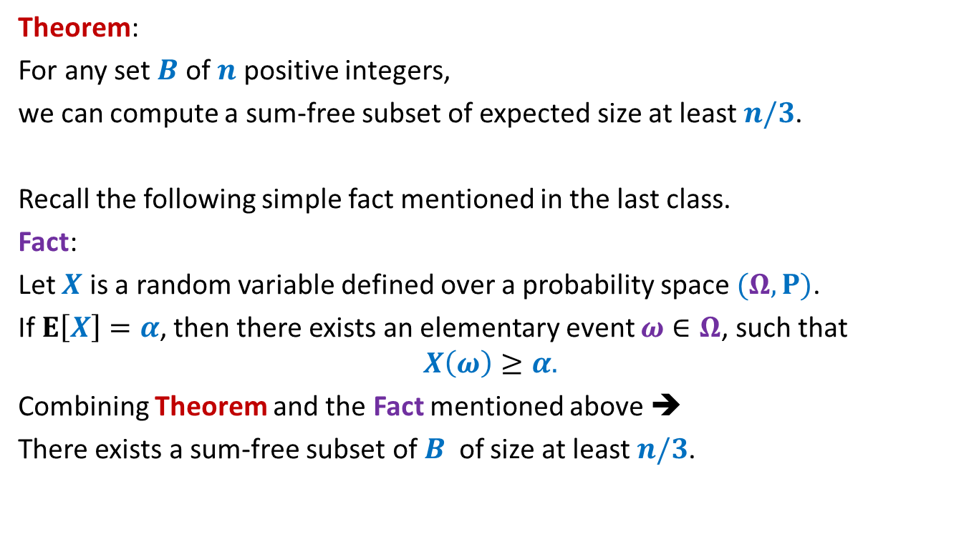
Large subset that is sum-free
Theorem:
For any set $B$ of $n$ positive integers,
we can compute a sum-free subset of expected size at least $n/3$.
Recall the following simple fact mentioned in the last class.
Fact:
Let $X$ is a random variable defined over a probability space $(Ω,P)$.
If $E\left[X\right]=α$, then there exists an elementary event $ω∈Ω$, such that
$$X\left(ω\right)≥α.$$
Combining Theorem and the Fact mentioned above ➔
There exists a sum-free subset of $B$ of size at least $n/3$.

Slide 15

Try to ponder over the entire solution given for the Large sum-free subset problem.
Try to realize the importance of each part of the solution
primality of $p$,
the choice of middle third,
…

Slide 16
A paradox
Chord and an equilateral triangle

Slide 17
Chord and an equilateral triangle
C
A chord is picked randomly.
What is the probability that its length is more than the length of AB in the triangle?
A
B

Slide 18
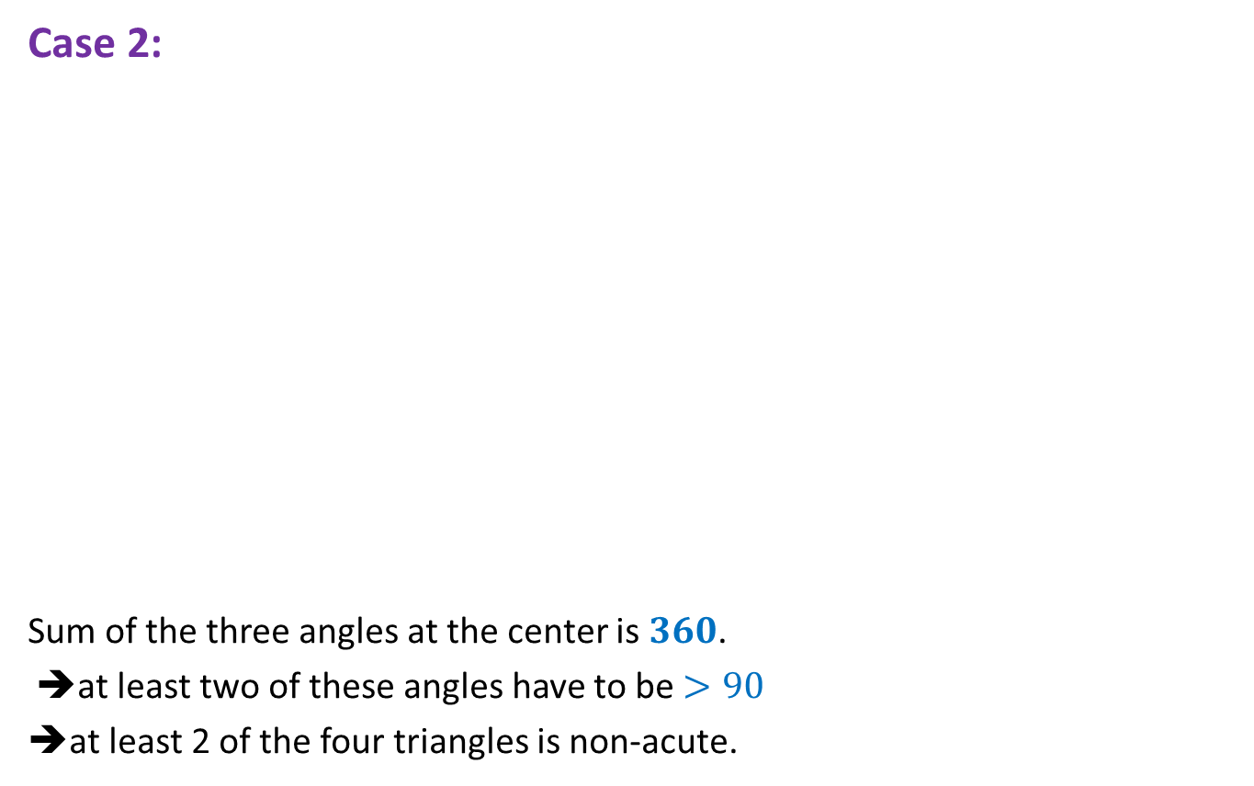
Answer 1
= $\frac{1}{3}$
C
A
A
B
Fact 1:
Length of a chord is uniquely defined by its two endpoints.
Pick the endpoints of the chord randomly

Slide 19
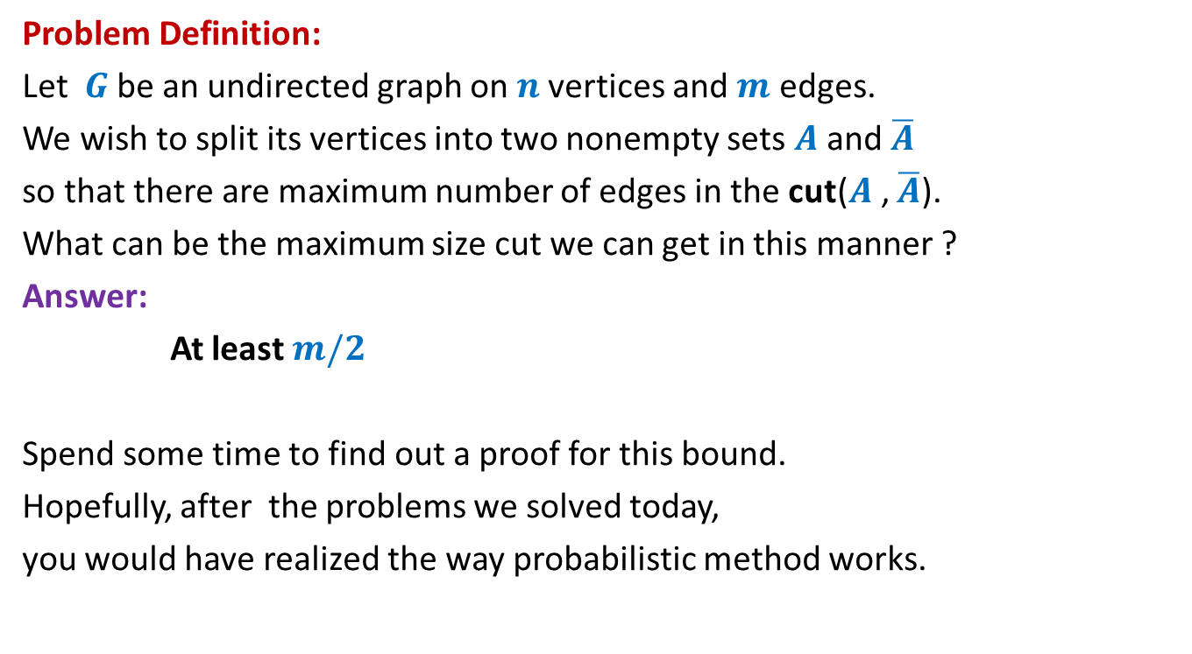
Answer 2
= $\frac{1}{4}$
C
A
A
B
Fact 2:
Length of a chord is uniquely defined if we know the center of the chord.
Pick the center of the chord randomly.

Slide 20

Answer 3
= $\frac{1}{2}$
C
Which answer is correct ?
A
A
B
Fact 3:
Length of a chord is uniquely defined if we know its distance from the center of circle.
Pick the distance of the chord from center randomly

Slide 21






So all solutions are correct for their respective probability space
C
Same sample space.
But different probability mapping.
A
A
B
$$P$$
Pick the center of the chord randomly.
($Ω,$ )
($Ω,$ )
Pick the endpoints of the chord randomly uniformly
$$P′$$
Pick the distance of the chord from center randomly
($Ω,$ )
$$P′′$$

Slide 22
Another paradox only for fun
Birthdays

Slide 23
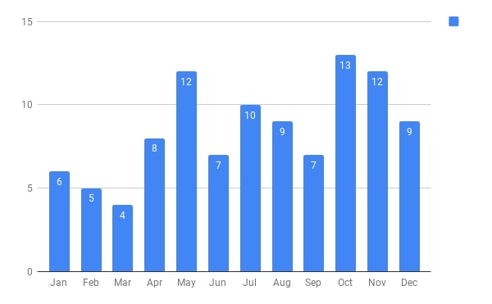
Birthdays of students who were present in the 1st class of CS203B
There are 102 students and 365 days.
What might be the chances of two students sharing a birthday ?

Slide 24



















































First 25 students
First 50 students
First 75 students
All 102 students
$$2$$
$$7$$
$$11$$
$$31$$
$$≈28$$
$$2$$
$9$^{th} January
$$3$$
$5$^{th} May
$$2$$
$27$^{th} July
$$2$$
$9$^{th} January
$$2$$
$9$^{th} January
$$2$$
$3$^{rd} June
$$3$$
$27$^{th} July
$$3$$
$27$^{th} July
$$2$$
$7$^{th} July
$$3$$
$27$^{th} July
$$2$$
$7$^{th} October
$$2$$
$2$^{th} October
$$2$$
$2$^{th} October
Ponder over these surprising results.
Only for fun…
$$2$$
$7$^{th} October
$$2$$
$22$^{th} October
$$2$$
$8$^{th} December
$$3$$
$7$^{th} October
$$2$$
$26$^{th} October
$$2$$
$1$^{st} November
$$2$$
$4$^{th} November
$$2$$
$14$^{st} November
$$2$$
$10$^{th} December
Prob.>$0.5$
Prob.>$0.97$
Prob.>$0.9997$
Prob.>$0.9999997$

Slide 25
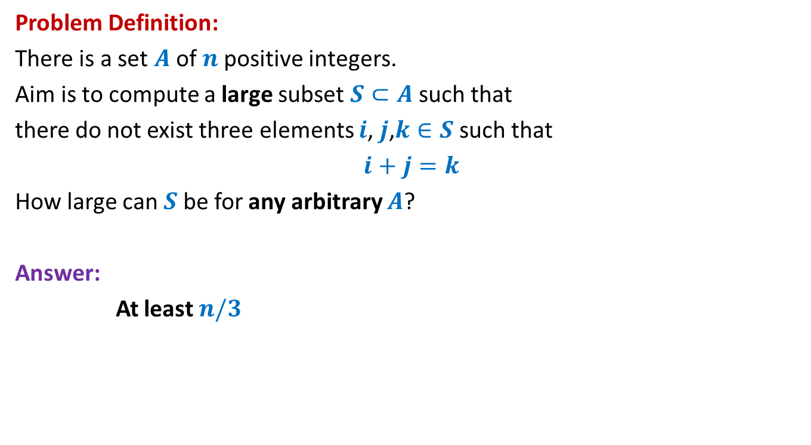


A convex body
Definition:
A 3-D body is said to be convex if for each pair of points on the body,
all the points lying on the line joining them also lie inside the body.
Does it hold true for any convex body as well ?
Sphere surface area : $4πr^{2}$
Ratio = $1/4$
yes
Shadow surface area : $πr^{2}$

Slide 26




Practice sheet 6
A square frame is placed with only one of its sides touching the ground.
The frame subtends an angle with the ground which is uniformly distributed in the interval [0, π].
What is the expected area of the shadow of the frame ?
$$A$$
Sphere surface area : $4πr^{2}$
Ratio = $1/π$
Ratio = $1/4$
Shadow surface area : $\frac{A}{π}$
?
Shadow surface area : $πr^{2}$
What went wrong ?

Slide 27
There is a calculation free proof
Ponder over this proof.
Only for fun…
The vector perpendicular to the “small area” is picked uniformly over the sphere.
The End of CS203B

