Slide 1
Linear Models III
CS771: Introduction to Machine Learning
Purushottam Kar

Slide 2
Announcements
Quiz 1 marks released on Gradescope
Please submit any and all regrading requests by 25th August, 2019
Will close regrading requests for quiz 1 after that
Regrading requests entertained only if rubrics were applied incorrectly or else if the rubrics missed a way of completely correctly solving the problem
No more “partial” mark rubric will be added now
Assignment 1 released
Two part submission: Gradescope (.pdf) + website (.py)
Deadline: 01 September, 11:59PM IST
Gradescope will stop accepting submissions after this deadline
Google form will also close down after this deadline
We will run a script to download code files after this deadline – make sure your file is present at the location you submitted in the Google form

Slide 3
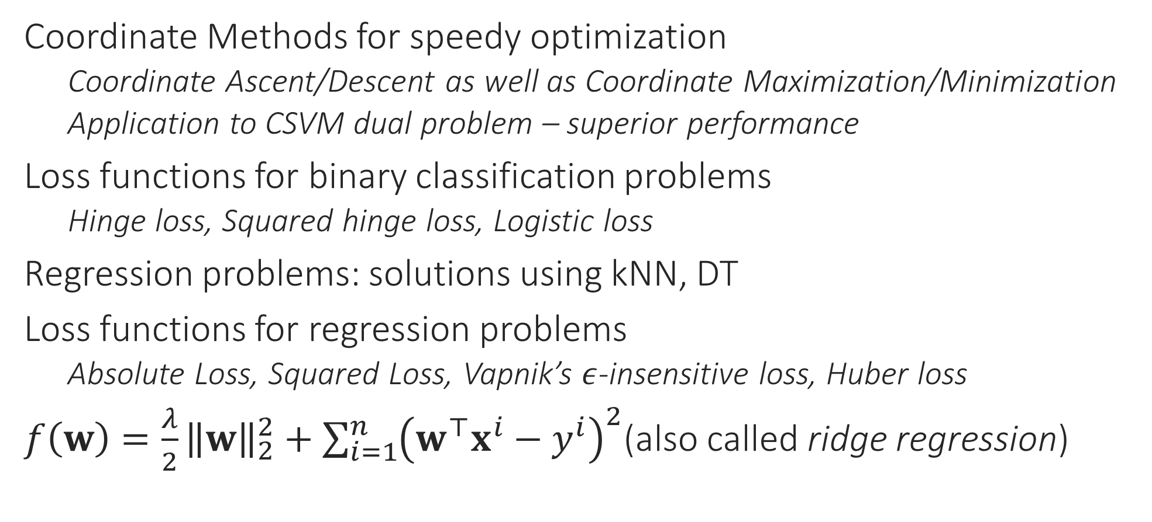
Recap of Last Lecture
Coordinate Methods for speedy optimization
Coordinate Ascent/Descent as well as Coordinate Maximization/Minimization
Application to CSVM dual problem – superior performance
Loss functions for binary classification problems
Hinge loss, Squared hinge loss, Logistic loss
Regression problems: solutions using kNN, DT
Loss functions for regression problems
Absolute Loss, Squared Loss, Vapnik’s $ε$-insensitive loss, Huber loss
$f\left(w\right)=\frac{λ}{2}{\left\|w\right\|}_{2}^{2}+\sum_{i=1}^{n}{{\left(w^{⊤}x^{i}−y^{i}\right)}^{2}}$(also called ridge regression)

Slide 4

Regularization
Makes sense since regularization is supposed to protect us from data issues
An umbrella term used in ML to describe a whole family of steps taken to prevent ML algos from suffering from problems in data
These help ML algos offer stable behaviour even if data misbehaves
In an ideal world where data is perfectly clean and there is plenty of data available, there would be no need for any regularization!
How to do regularization is often decided without looking at data
However, regularization usually involves its own hyperparameters that need to be tuned using data itself (using validation techniques)
In general, regularization techniques prevent the model from just blindly doing well on data (since data cannot be trusted)
So regularization can be somewhat data dependent

Slide 5




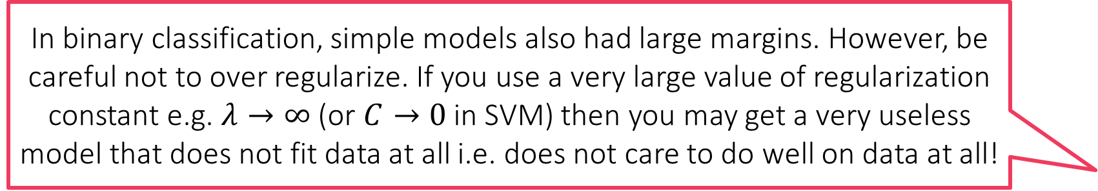
Regularization by adding a regularizer
A regularizer essentially tells the optimizer to not just blindly return a model that does well on data (according to the loss function), but rather return a model that does well and is simple. The L2 regularizer defines simplicity using the L2 norm (or Euclidean length). A model is simple if it has small L2 norm
$f\left(w\right)=\frac{1}{2}{\left\|w\right\|}_{2}^{2}+C⋅{\sum_{i=1}^{n}{\left[1−y^{i}⋅w^{⊤}x^{i}\right]}}_{+}$
$f\left(w\right)=\frac{λ}{2}{\left\|w\right\|}_{2}^{2}+\sum_{i=1}^{n}{{\left(w^{⊤}x^{i}−y^{i}\right)}^{2}}$
The ${\left\|w\right\|}_{2}^{2}$ term above is called the L2 regularizer (or the squared L2 regularizer if we want to be very specific)
In binary classification settings, we saw that this regularizer encourages a large margin
In regression settings it ensures uniqueness of solution
Recall that the closed form solution is $w={\left(2X^{⊤}X+λ⋅I\right)}^{−1}\left(2X^{⊤}y\right)$
If $X^{⊤}X$ is non-invertible then we have infinitely many solutions if $λ=0$
Having $λ>0$ ensures unique solution no matter what the data
In binary classification, simple models also had large margins. However, be careful not to over regularize. If you use a very large value of regularization constant e.g. $λ→∞$ (or $C→0$ in SVM) then you may get a very useless model that does not fit data at all i.e. does not care to do well on data at all!
The key is moderation. Usually regularization constants are chosen using validation. Other important considerations include: how noisy do we expect data to be and how much data do we have. Rule of thumb: as you have more and more data, you can safely afford to regularize less and less

Slide 6

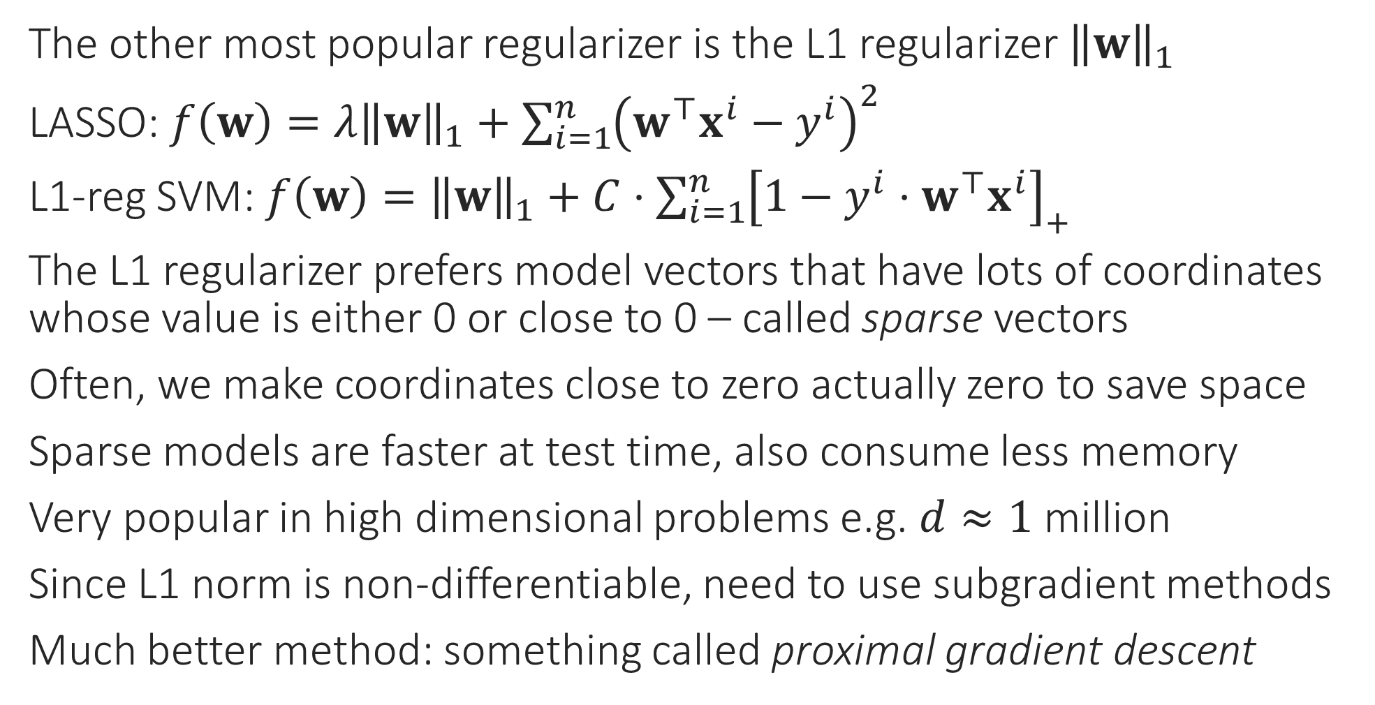
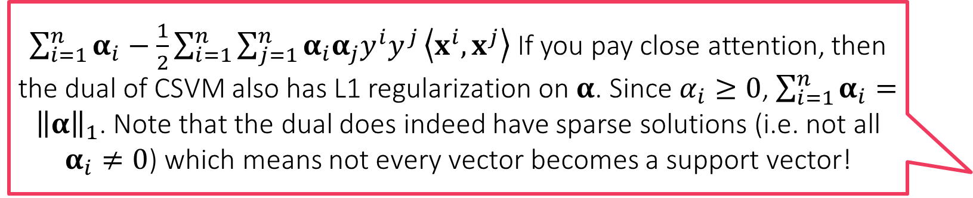
Other popular regularizers
$\sum_{i=1}^{n}{α_{i}}−\frac{1}{2}\sum_{i=1}^{n}{\sum_{j=1}^{n}{α_{i}α_{j}y^{i}y^{j}}\left\langle x^{i},x^{j}\right\rangle }$ If you pay close attention, then the dual of CSVM also has L1 regularization on $α$. Since $α_{i}≥0$, $\sum_{i=1}^{n}{α_{i}}={\left\|α\right\|}_{1}$. Note that the dual does indeed have sparse solutions (i.e. not all $α_{i}≠0$) which means not every vector becomes a support vector!
The other most popular regularizer is the L1 regularizer ${\left\|w\right\|}_{1}$
LASSO: $f\left(w\right)=λ{\left\|w\right\|}_{1}+\sum_{i=1}^{n}{{\left(w^{⊤}x^{i}−y^{i}\right)}^{2}}$
L1-reg SVM: $f\left(w\right)={\left\|w\right\|}_{1}+C⋅{\sum_{i=1}^{n}{\left[1−y^{i}⋅w^{⊤}x^{i}\right]}}_{+}$
The L1 regularizer prefers model vectors that have lots of coordinates whose value is either 0 or close to 0 – called sparse vectors
Often, we make coordinates close to zero actually zero to save space
Sparse models are faster at test time, also consume less memory
Very popular in high dimensional problems e.g. $d≈1$ million
Since L1 norm is non-differentiable, need to use subgradient methods
Much better method: something called proximal gradient descent

Slide 7
Regularization by Early Stopping
Sometimes, ML practitioners stop an optimizer well before it has solved the optimization problem fully – sometimes due to timeout but sometimes deliberately
Note that this automatically prevents the model from fitting the data too closely (this is good if the data was noisy or had outliers)
This often happens implicitly with complex optimization problems e.g. training deep networks where the person training the network gets tired and gives up training – gets some regularization for free ☺
Be careful not to misuse this – if you stop too early, you may just get an overregularized model that does not fit data at all i.e. does not do well on data at all!

Slide 8
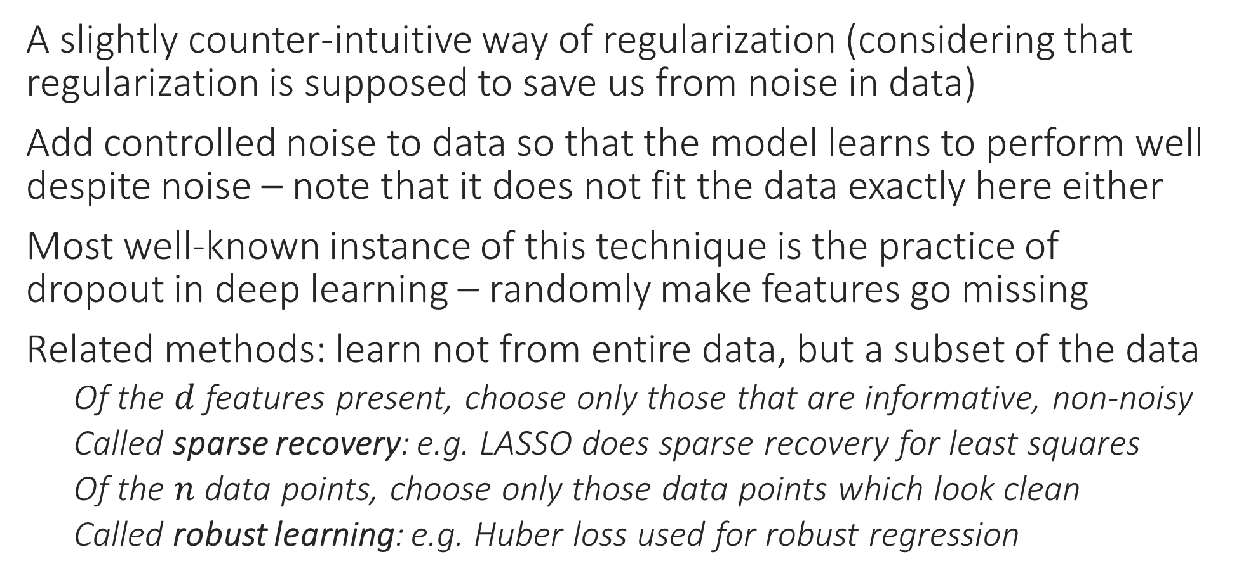
Regularization by adding noise
A slightly counter-intuitive way of regularization (considering that regularization is supposed to save us from noise in data)
Add controlled noise to data so that the model learns to perform well despite noise – note that it does not fit the data exactly here either
Most well-known instance of this technique is the practice of dropout in deep learning – randomly make features go missing
Related methods: learn not from entire data, but a subset of the data
Of the $d$ features present, choose only those that are informative, non-noisy
Called sparse recovery: e.g. LASSO does sparse recovery for least squares
Of the $n$ data points, choose only those data points which look clean
Called robust learning: e.g. Huber loss used for robust regression

Slide 9

Multiclass Classification
Sometimes aka multiclassification – have seen kNN and DTs solve it
Can be solved using linear models too!
Trick is to reduce to binary classification
If there are $C$ classes, then train $C$ linear models, each trained to identify one class
E.g. $C=3$ {dog, horse, fish}. Train model1 to say yes to dog images but no to horse and no to fish images, similarly model2, 3
Called the OVA method (one-vs-all)
At test time, just ask all three models and hope that only one of them says yes ☺

Slide 10
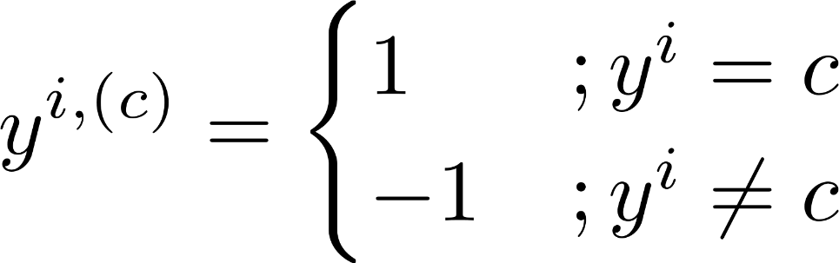
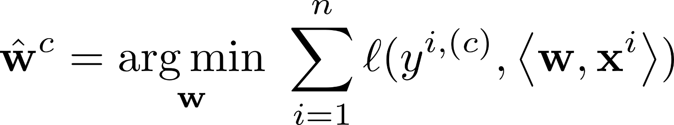
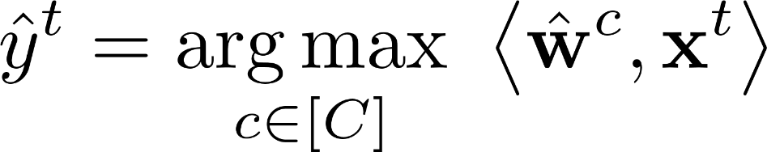
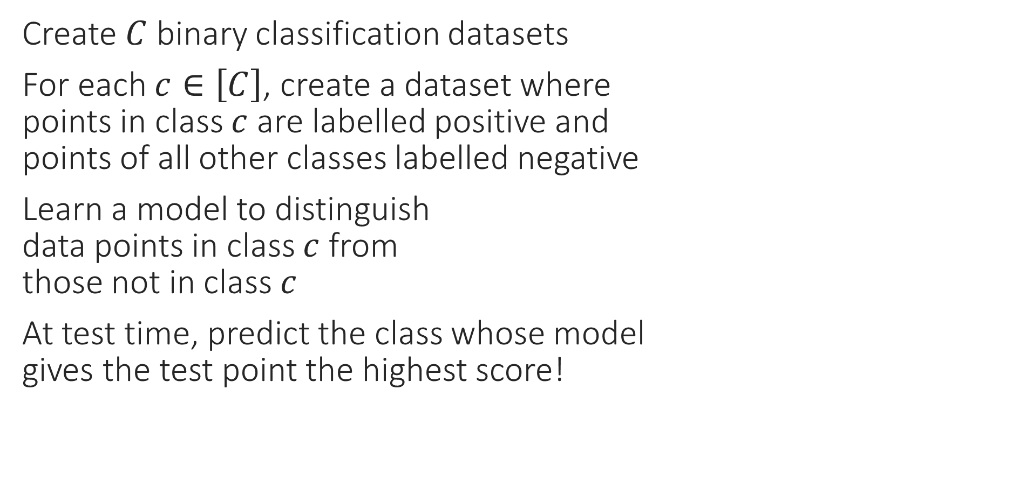

OVA – Reduce to $C$ binary problems
Create $C$ binary classification datasets
For each $c∈\left[C\right]$, create a dataset where points in class $c$ are labelled positive and points of all other classes labelled negative
Learn a model to distinguish data points in class $c$ from those not in class $c$
At test time, predict the class whose model gives the test point the highest score!

Slide 11
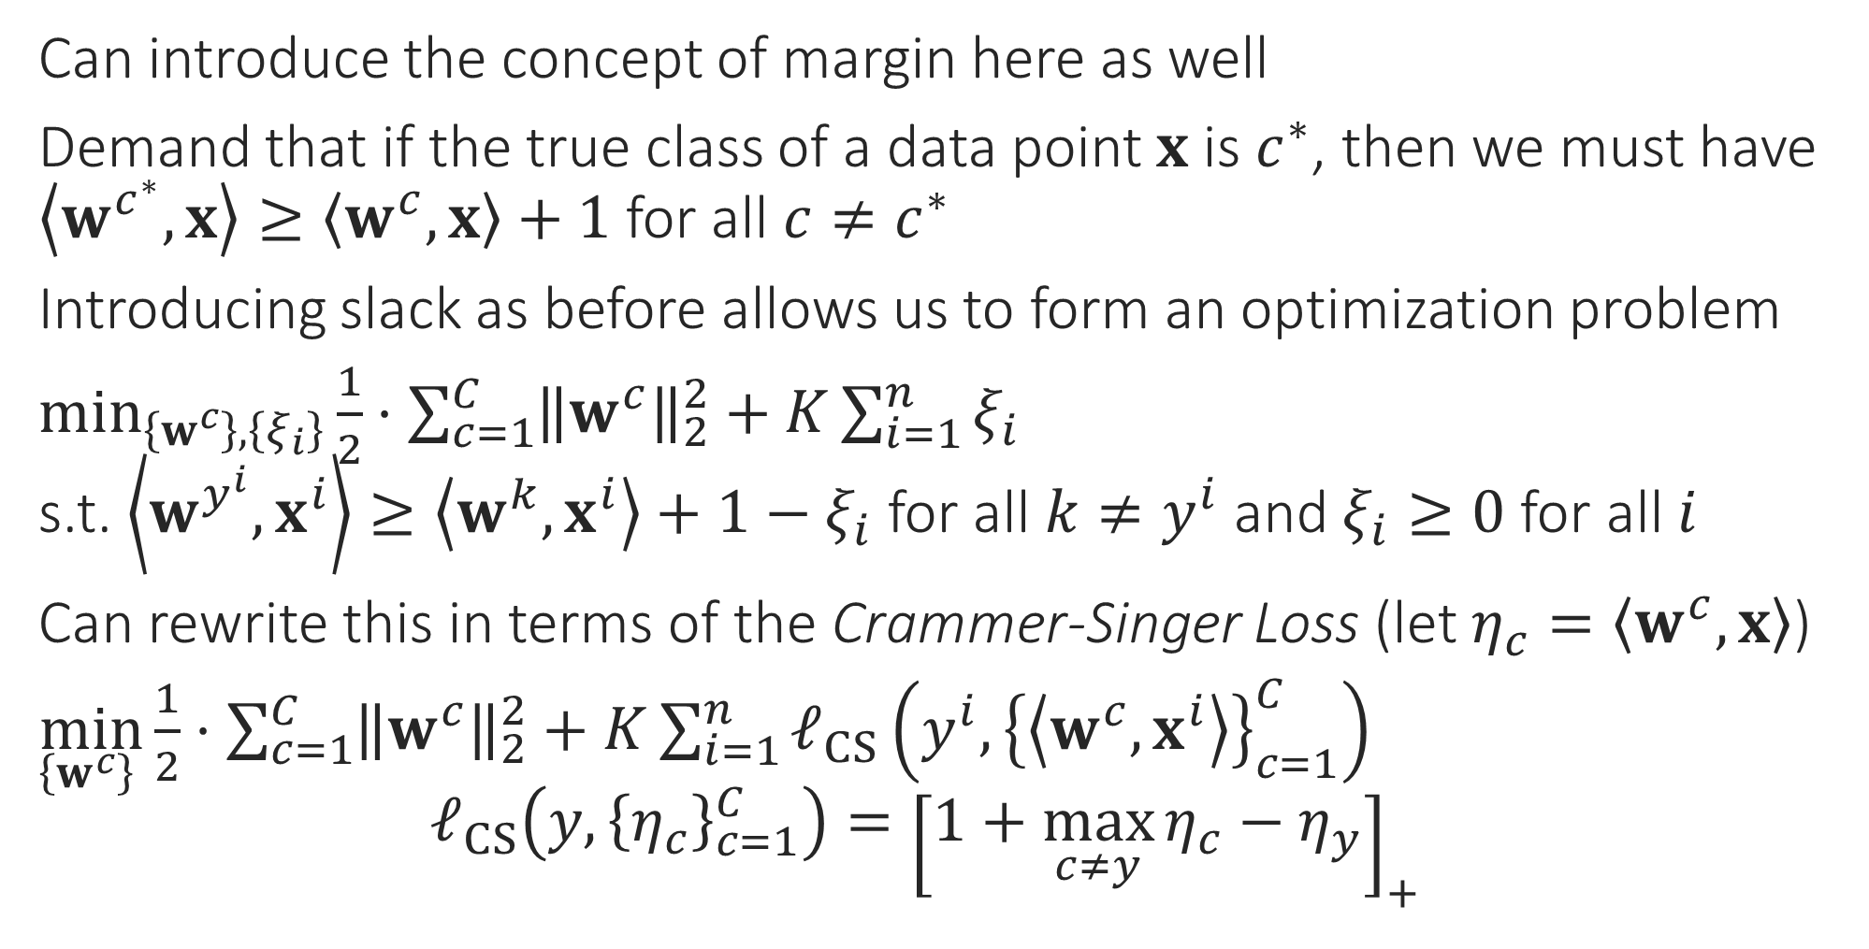

OVA – Learn the $C$ models together
Can introduce the concept of margin here as well
Demand that if the true class of a data point $x$ is $c^{∗}$, then we must have $\left\langle w^{c^{∗}},x\right\rangle ≥\left\langle w^{c},x\right\rangle +1$ for all $c≠c^{∗}$
Introducing slack as before allows us to form an optimization problem
$\min_{\left\{w^{c}\right\},\left\{ξ_{i}\right\}}{\frac{1}{2}⋅\sum_{c=1}^{C}{{\left\|w^{c}\right\|}_{2}^{2}}}+K\sum_{i=1}^{n}{ξ_{i}}$ s.t. $\left\langle w^{y^{i}},x^{i}\right\rangle ≥\left\langle w^{k},x^{i}\right\rangle +1−ξ_{i} \text{for} \text{all} k≠y^{i}$ and $ξ_{i}≥0$ for all $i$
Can rewrite this in terms of the Crammer-Singer Loss (let $η_{c}=\left\langle w^{c},x\right\rangle$)
$\min_{\left\{w^{c}\right\} }{\frac{1}{2}⋅\sum_{c=1}^{C}{{\left\|w^{c}\right\|}_{2}^{2}}}+K\sum_{i=1}^{n}{ℓ_{CS}\left(y^{i},{\left\{\left\langle w^{c},x^{i}\right\rangle \right\}}_{c=1}^{C}\right)}$ $ℓ_{CS}\left(y,{\left\{η_{c}\right\}}_{c=1}^{C}\right)={\left[1+\max_{c≠y}{η_{c}}−η_{y}\right]}_{+}$

Slide 12
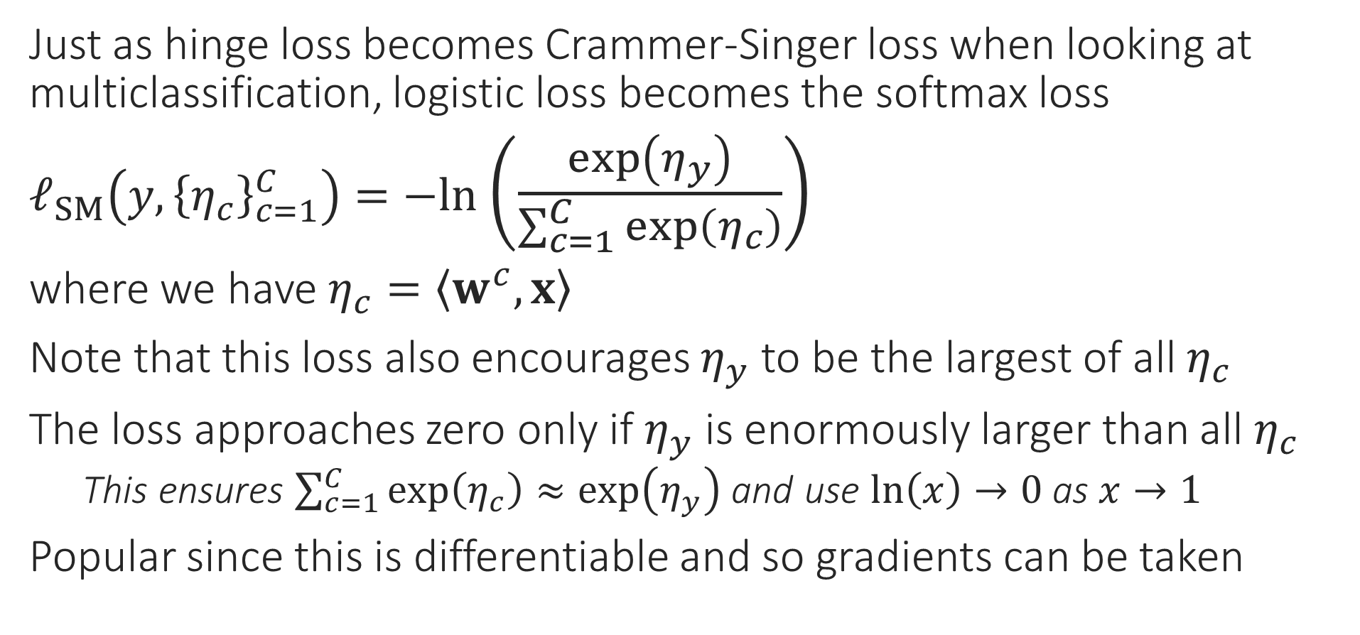
OVA via Softmax
Just as hinge loss becomes Crammer-Singer loss when looking at multiclassification, logistic loss becomes the softmax loss
$ℓ_{SM}\left(y,{\left\{η_{c}\right\}}_{c=1}^{C}\right)=−ln$ $\left(\frac{\exp\left(η_{y}\right)}{\sum_{c=1}^{C}{\exp\left(η_{c}\right)}}\right)$
where we have $η_{c}=\left\langle w^{c},x\right\rangle$
Note that this loss also encourages $η_{y}$ to be the largest of all $η_{c}$
The loss approaches zero only if $η_{y}$ is enormously larger than all $η_{c}$
This ensures $\sum_{c=1}^{C}{\exp\left(η_{c}\right)}≈\exp\left(η_{y}\right)$ and use $\ln\left(x\right)→0$ as $x→1$
Popular since this is differentiable and so gradients can be taken

Slide 13
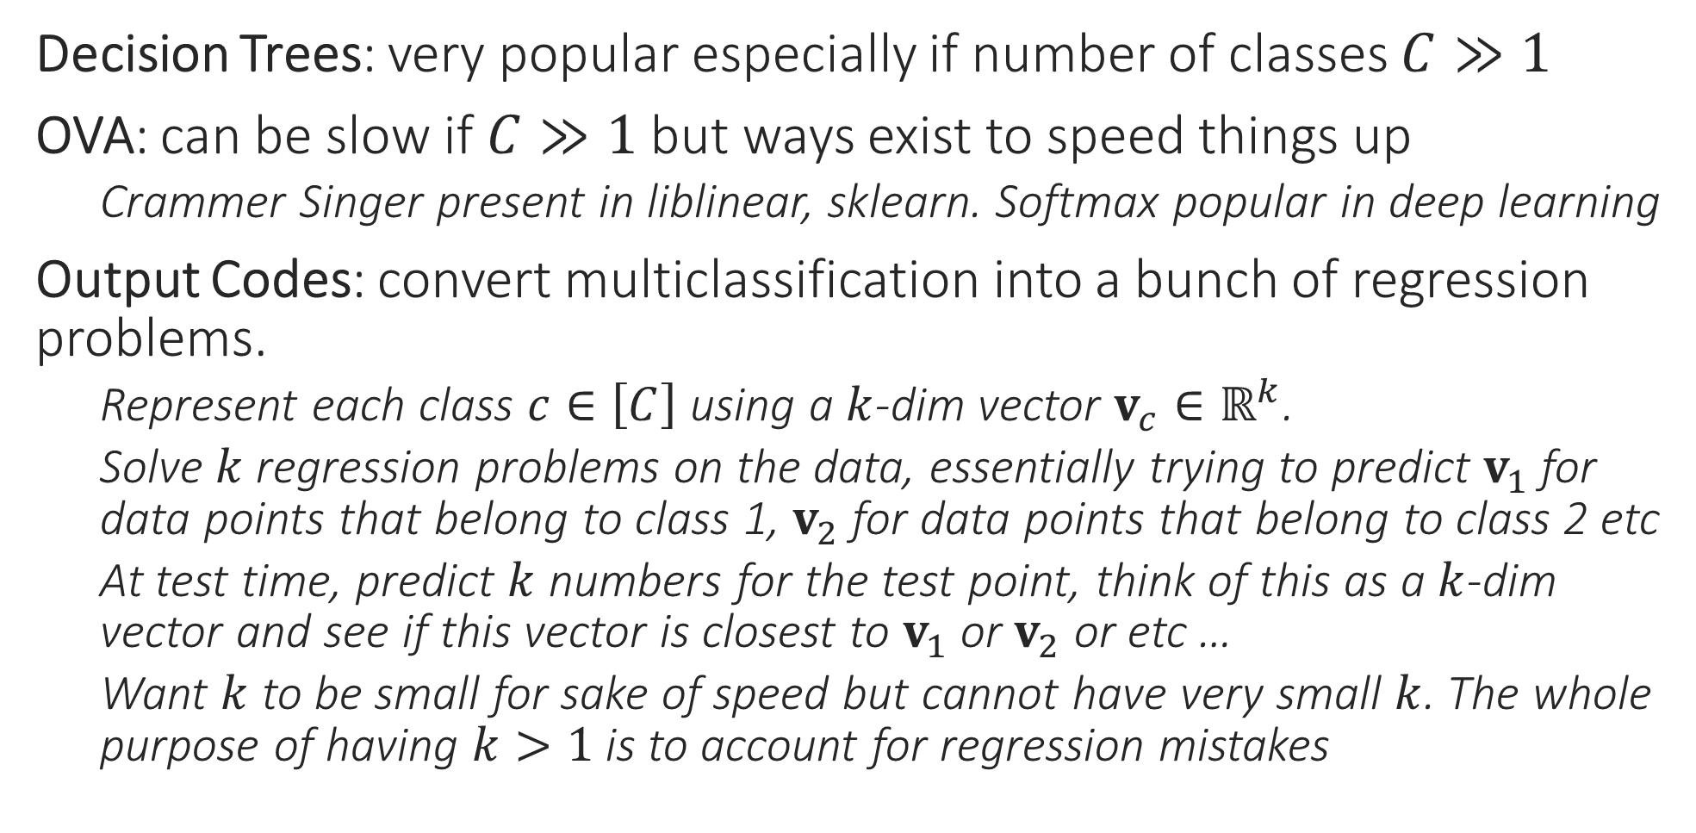
Multiclassification – popular techniques
Decision Trees: very popular especially if number of classes $C≫1$
OVA: can be slow if $C≫1$ but ways exist to speed things up
Crammer Singer present in liblinear, sklearn. Softmax popular in deep learning
Output Codes: convert multiclassification into a bunch of regression problems.
Represent each class $c∈\left[C\right]$ using a $k$-dim vector $v_{c}∈ℝ^{k}$.
Solve $k$ regression problems on the data, essentially trying to predict $v_{1}$ for data points that belong to class 1, $v_{2}$ for data points that belong to class 2 etc
At test time, predict $k$ numbers for the test point, think of this as a $k$-dim vector and see if this vector is closest to $v_{1}$ or $v_{2}$ or etc …
Want $k$ to be small for sake of speed but cannot have very small $k$. The whole purpose of having $k>1$ is to account for regression mistakes

Slide 14
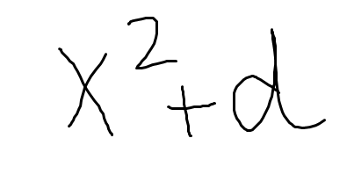
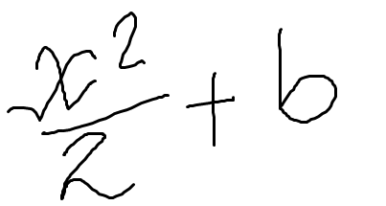
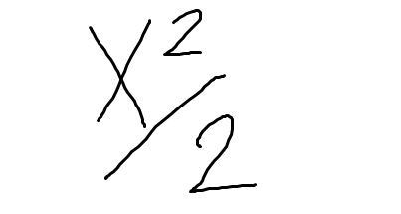
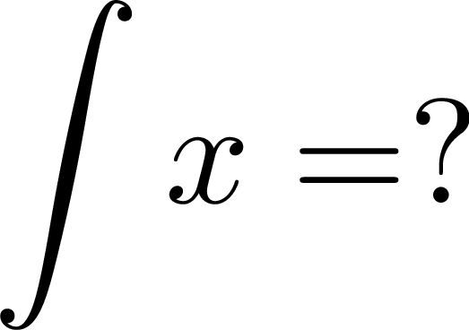
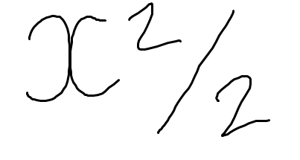
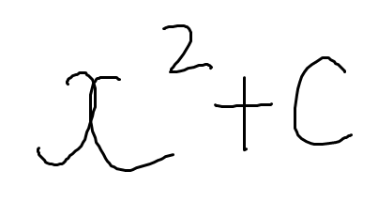
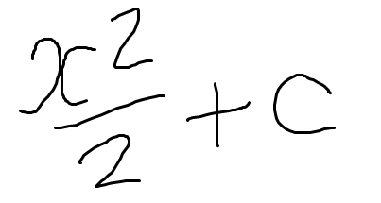
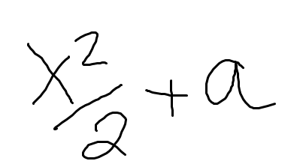

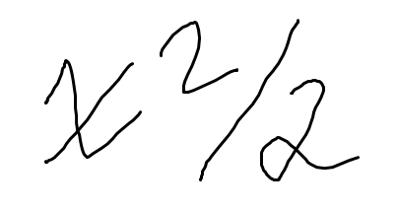
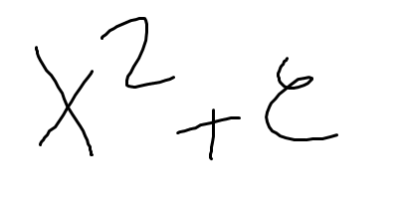
How to grade an exam
Grouping similar objects together is the task of clustering
4/5
gradescope
Q1.
5/5
5 marks
2/5
No labels here – that is why clustering is often called an unsupervised learning problem

Slide 15
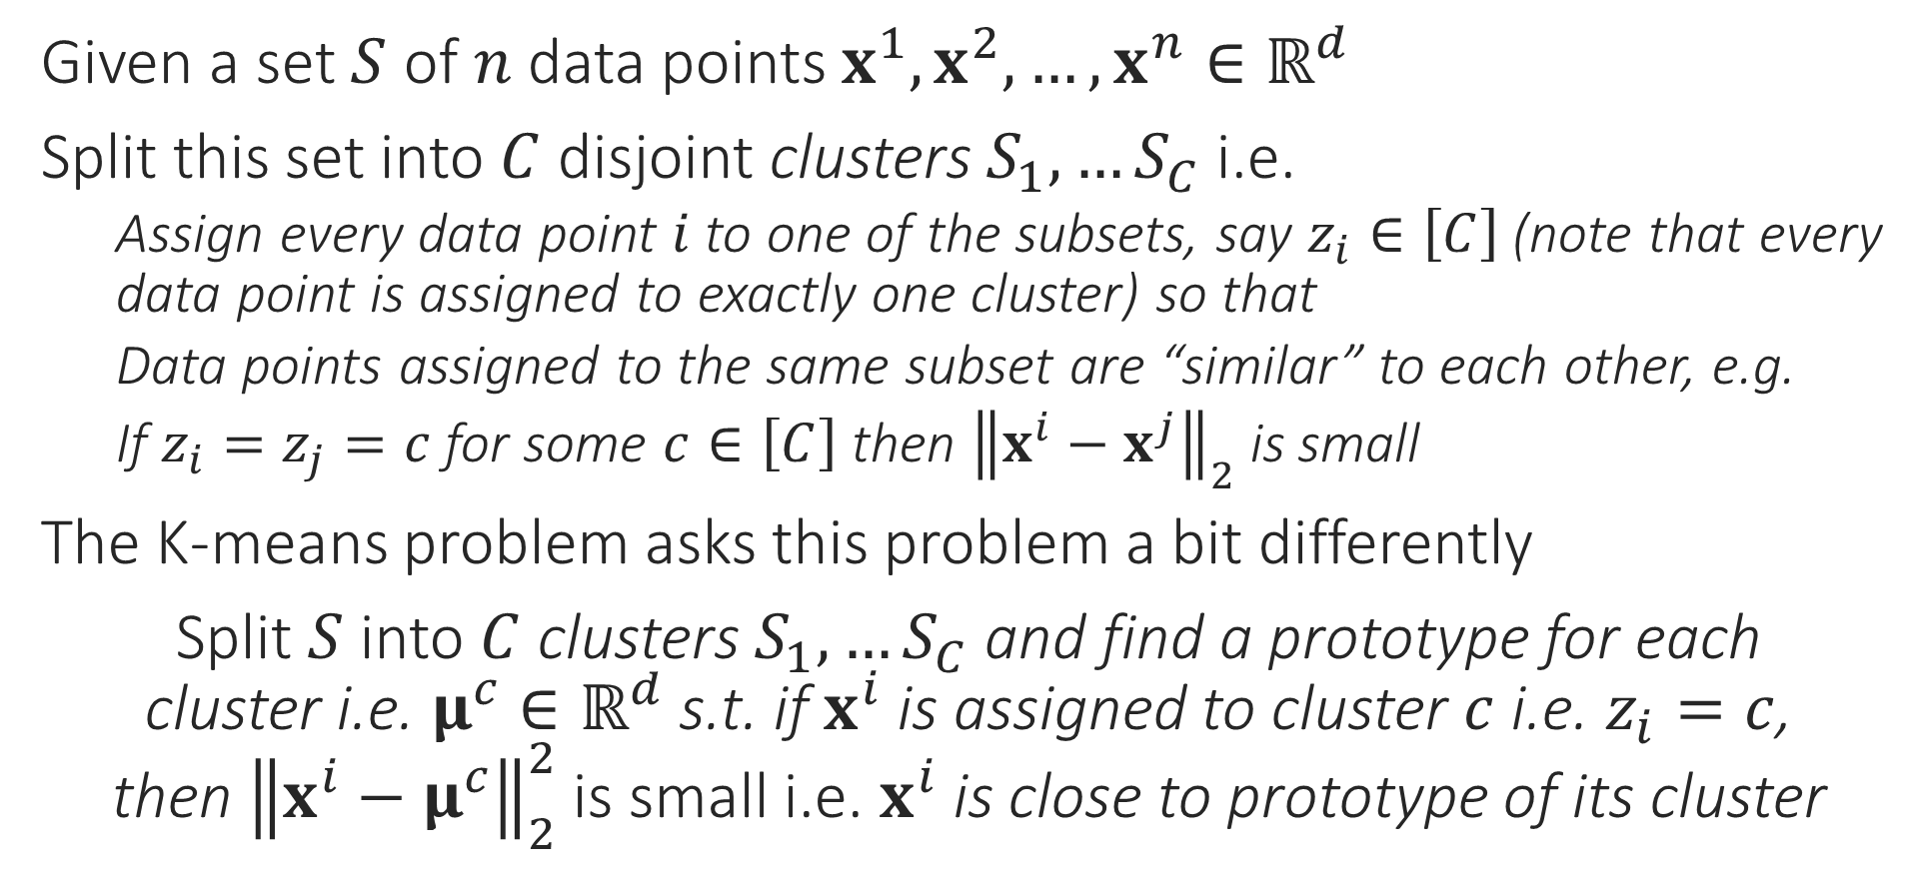
Clustering
Given a set $S$ of $n$ data points $x^{1},x^{2},…,x^{n}∈ℝ^{d}$
Split this set into $C$ disjoint clusters $S_{1},…S_{C}$ i.e.
Assign every data point $i$ to one of the subsets, say $z_{i}∈\left[C\right]$(note that every data point is assigned to exactly one cluster) so that
Data points assigned to the same subset are “similar” to each other, e.g.
If $z_{i}=z_{j}=c$ for some $c∈\left[C\right]$ then ${\left\|x^{i}−x^{j}\right\|}_{2}$ is small
The K-means problem asks this problem a bit differently
Split $S$ into $C$ clusters $S_{1},…S_{C}$ and find a prototype for each cluster i.e. $μ^{c}∈ℝ^{d}$ s.t. if $x^{i}$ is assigned to cluster $c$ i.e. $z_{i}=c$, then ${\left\|x^{i}−μ^{c}\right\|}_{2}^{2}$ is small i.e. $x^{i}$ is close to prototype of its cluster

Slide 16


K-means clustering
Looks a bit like coordinate minimization where we fix all but one coordinate and update that one coordinate to its optimal value
$\min_{\left\{μ^{c}∈ℝ^{d}\right\},\left\{z_{i}∈\left[C\right]\right\}}{\sum_{c=1}^{C}{\sum_{i:z_{i}=c}{{\left\|x^{i}−μ^{c}\right\|}_{2}^{2}}}}$
This optimization problem is NP hard to solve ☹
Popular heuristic: Lloyd’s algorithm (often called k-means algorithm)
Uses a technique called alternating minimization
Observation 1: if we fix all $μ^{c}$, obtaining optimal assignments $z_{i}$ is very simple
Assign each data point to the cluster whose prototype is closest!
Observation 2: if we fix all assignments $z_{i}$, obtaining optimal prototypes simple
$\min_{\left\{μ^{c}∈ℝ^{d}\right\}}{\sum_{c=1}^{C}{\sum_{i:z_{i}=c}{{\left\|x^{i}−μ^{c}\right\|}_{2}^{2}}}}$ -- all that is needed is $\min_{μ^{c}}{\sum_{i:z_{i}=c}{{\left\|x^{i}−μ^{c}\right\|}_{2}^{2}}}$
Apply first order optimality to deduce that optimal value of $μ^{c}$ is simply the average of all data points assigned to the cluster $c$ – repeat for all $c∈\left[C\right]$
Keep repeating these two steps again and again
K-MEANS/LLOYD’S ALGORITHM
Initialize means ${\left\{μ^{c}\right\}}_{c=1…C}$
For $i∈\left[n\right]$, update $z_{i}$ using $\left\{μ^{c}\right\}$
Let $z_{i}=\arg{\min_{c}{ {\left\|x^{i}−μ^{c}\right\|}_{2}^{2}}}$
Let $n_{c}=$ # points assigned to $c$
Update $μ^{c}=\frac{1}{n_{c}}\sum_{i:z_{i}=c}{x^{i}}$
Repeat until convergence
True, coordinate minimization can be thought of as a special case of alternating optimization ☺

