Slide 1
Clustering
CS771: Introduction to Machine Learning
Purushottam Kar

Slide 2
Recap of Last Lecture
Regularization and various techniques to perform regularization
Adding a regularizer (L1/L2), early stopping, adding noise
Multiclassification
Using kNN, DTs, output codes
By converting to several binary classification problems – OVA
Crammer-Singer loss, softmax loss

Slide 3

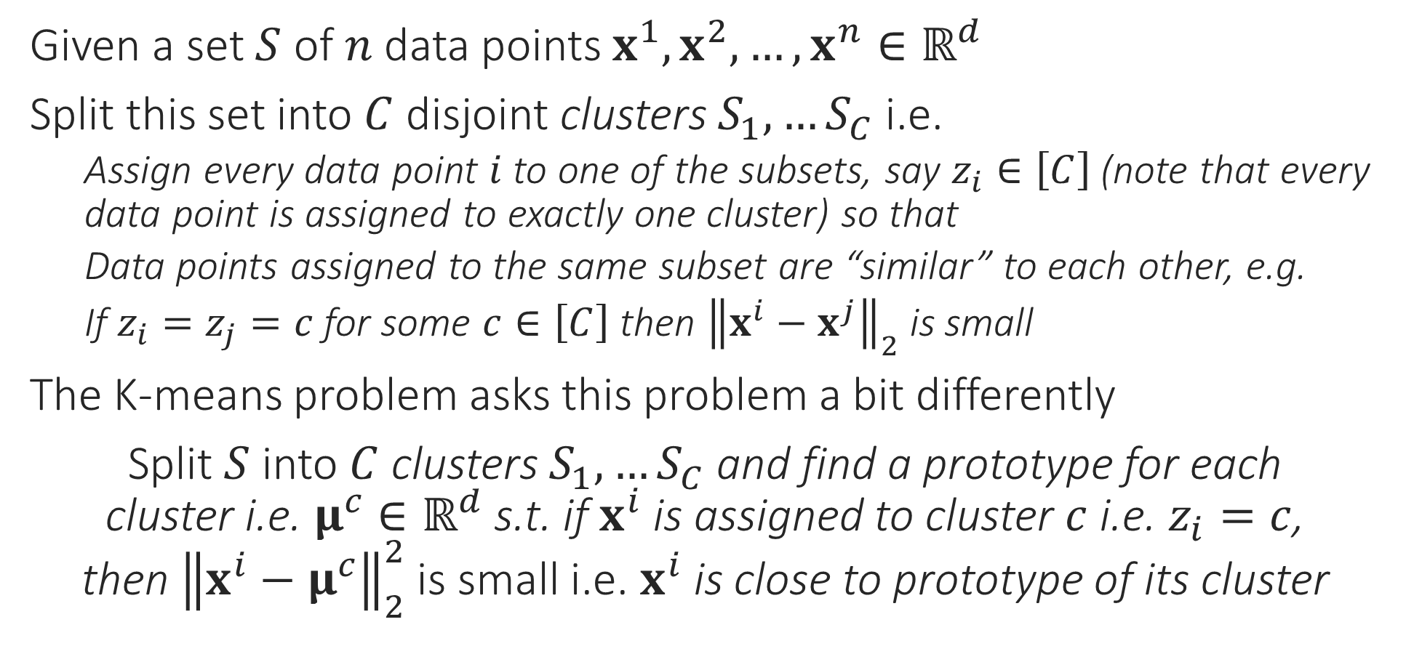
Clustering
The technical term used in books/papers is centroid
Given a set $S$ of $n$ data points $x^{1},x^{2},…,x^{n}∈ℝ^{d}$
Split this set into $C$ disjoint clusters $S_{1},…S_{C}$ i.e.
Assign every data point $i$ to one of the subsets, say $z_{i}∈\left[C\right]$(note that every data point is assigned to exactly one cluster) so that
Data points assigned to the same subset are “similar” to each other, e.g.
If $z_{i}=z_{j}=c$ for some $c∈\left[C\right]$ then ${\left\|x^{i}−x^{j}\right\|}_{2}$ is small
The K-means problem asks this problem a bit differently
Split $S$ into $C$ clusters $S_{1},…S_{C}$ and find a prototype for each cluster i.e. $μ^{c}∈ℝ^{d}$ s.t. if $x^{i}$ is assigned to cluster $c$ i.e. $z_{i}=c$, then ${\left\|x^{i}−μ^{c}\right\|}_{2}^{2}$ is small i.e. $x^{i}$ is close to prototype of its cluster
centroid
centroid

Slide 4



K-means clustering
Looks a bit like coordinate minimization where we fix all but one coordinate and update that one coordinate to its optimal value
$\min_{\left\{μ^{c}∈ℝ^{d}\right\},\left\{z_{i}∈\left[C\right]\right\}}{\sum_{c=1}^{C}{\sum_{i:z_{i}=c}{{\left\|x^{i}−μ^{c}\right\|}_{2}^{2}}}}$
This optimization problem is NP hard to solve ☹
Popular heuristic: Lloyd’s algorithm (often called k-means algorithm)
Uses a technique called alternating minimization
Observation 1: if we fix all $μ^{c}$, obtaining optimal assignments $z_{i}$ is very simple
Assign each data point to the cluster whose centroid is closest!
Observation 2: if we fix all assignments $z_{i}$, obtaining optimal centroid simple
$\min_{\left\{μ^{c}∈ℝ^{d}\right\}}{\sum_{c=1}^{C}{\sum_{i:z_{i}=c}{{\left\|x^{i}−μ^{c}\right\|}_{2}^{2}}}}$ -- all that is needed is $\min_{μ^{c}}{\sum_{i:z_{i}=c}{{\left\|x^{i}−μ^{c}\right\|}_{2}^{2}}}$
Apply first order optimality to deduce that optimal value of $μ^{c}$ is simply the average of all data points assigned to the cluster $c$ – repeat for all $c∈\left[C\right]$
Keep repeating these two steps again and again
K-MEANS/LLOYD’S ALGORITHM
Initialize means ${\left\{μ^{c}\right\}}_{c=1…C}$
For $i∈\left[n\right]$, update $z_{i}$ using $\left\{μ^{c}\right\}$
Let $z_{i}=\arg{\min_{c}{ {\left\|x^{i}−μ^{c}\right\|}_{2}^{2}}}$
Let $n_{c}=$ # points assigned to $c$
Update $μ^{c}=\frac{1}{n_{c}}\sum_{i:z_{i}=c}{x^{i}}$
Repeat until convergence
True, coordinate minimization can be thought of as a special case of alternating optimization ☺

Slide 5



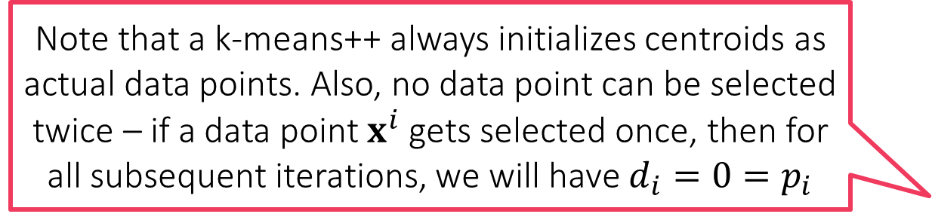
K-means++ Initializer
Note that a k-means++ always initializes centroids as actual data points. Also, no data point can be selected twice – if a data point $x^{i}$ gets selected once, then for all subsequent iterations, we will have $d_{i}=0=p_{i}$
Initializes k-means with centroids that are well spread out
Provable guarantees: Arthur and Vassilvitskii, SODA 2007
Widely used in practice: especially beneficial if $k$ is large
K-MEANS++ INITIALIZER
Select first prototype randomly $μ^{1}=x^{i}$, where $i∼UNIF\left(\left[n\right]\right)$
For $j=2,…,k$
For all $i∈\left[n\right]$, calculate $d_{i}=\min_{l∈1,…,j−1}{{\left\|x^{i}−μ^{l}\right\|}_{2}}$
Set $μ^{j}=x^{i}$ where $i$ is chosen with probability $p_{i}=\frac{d_{i}^{2}}{\sum_{s=1}^{n}{d_{s}^{2}}}$

Slide 6
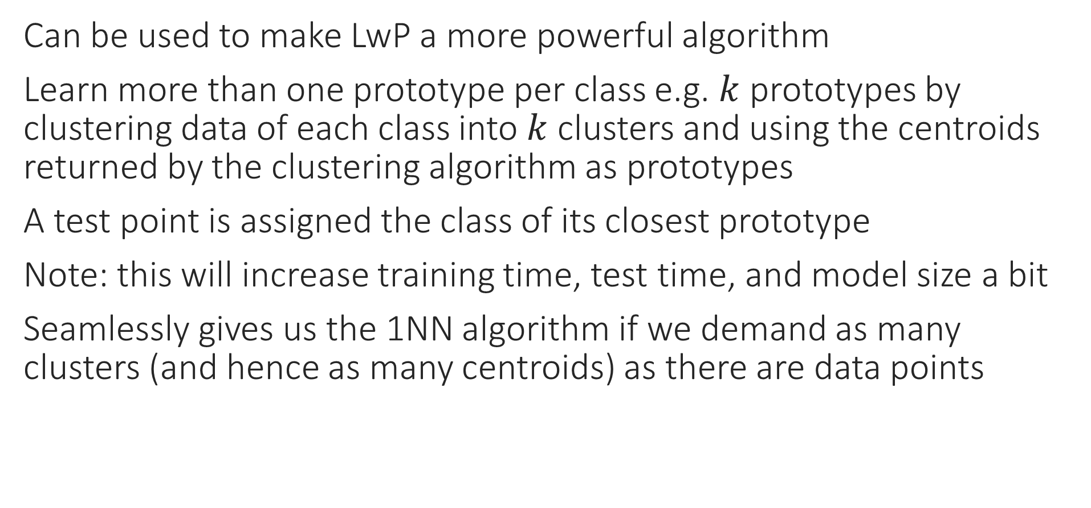
Some applications of clustering
Can be used to make LwP a more powerful algorithm
Learn more than one prototype per class e.g. $k$ prototypes by clustering data of each class into $k$ clusters and using the centroids returned by the clustering algorithm as prototypes
A test point is assigned the class of its closest prototype
Note: this will increase training time, test time, and model size a bit
Seamlessly gives us the 1NN algorithm if we demand as many clusters (and hence as many centroids) as there are data points

Slide 7
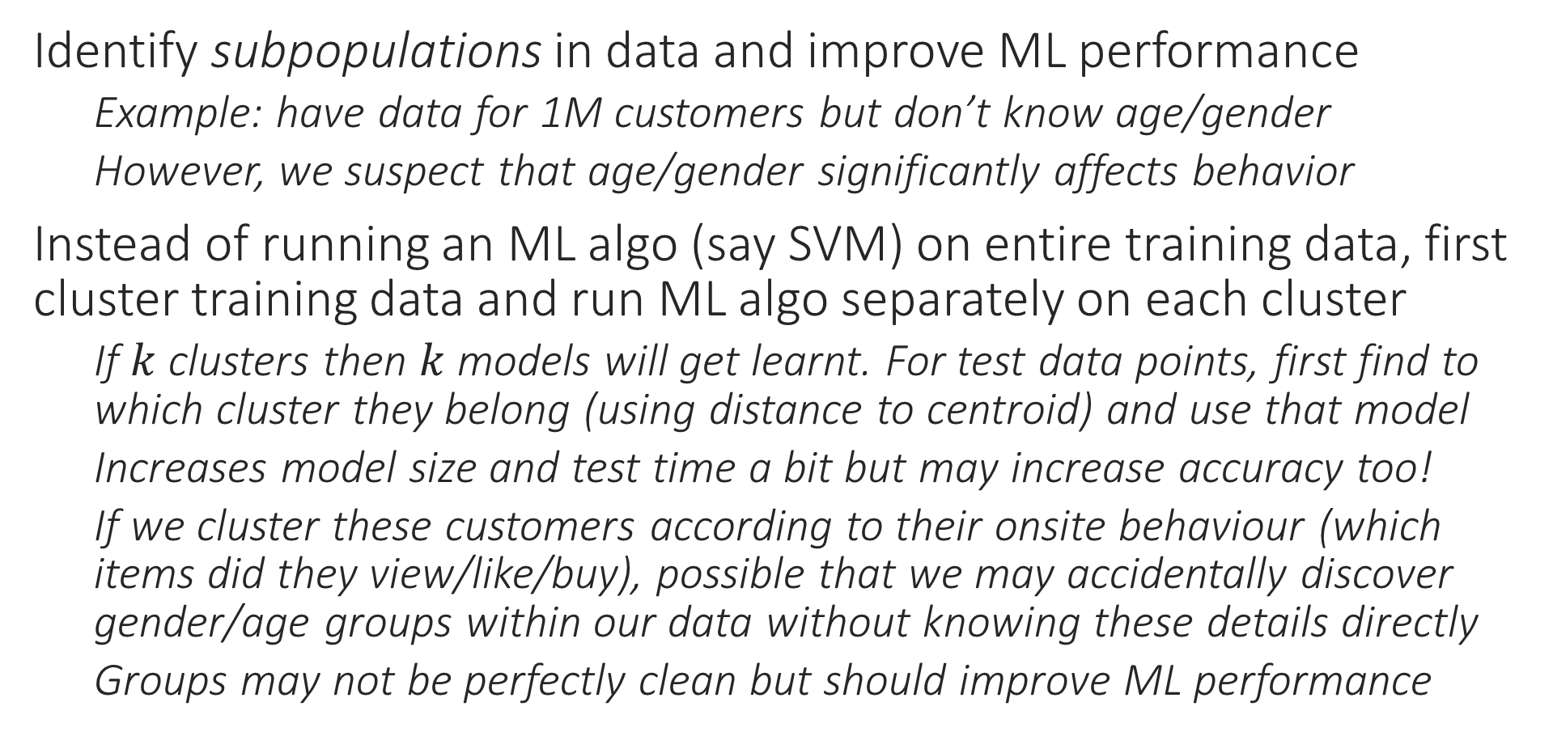
Some applications of clustering
Identify subpopulations in data and improve ML performance
Example: have data for 1M customers but don’t know age/gender
However, we suspect that age/gender significantly affects behavior
Instead of running an ML algo (say SVM) on entire training data, first cluster training data and run ML algo separately on each cluster
If $k$ clusters then $k$ models will get learnt. For test data points, first find to which cluster they belong (using distance to centroid) and use that model
Increases model size and test time a bit but may increase accuracy too!
If we cluster these customers according to their onsite behaviour (which items did they view/like/buy), possible that we may accidentally discover gender/age groups within our data without knowing these details directly
Groups may not be perfectly clean but should improve ML performance

Slide 8



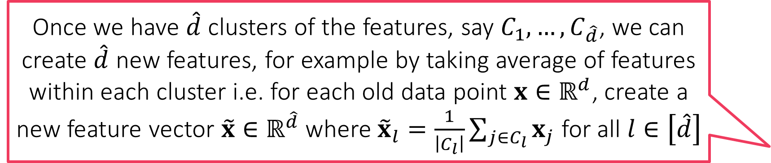
Some applications of clustering
Features for features!!
Reduce number of features (also called dimensionality reduction)
Example: have 1M features i.e. $x^{i}∈ℝ^{d}$ for $d=$ 1M but we suspect many of these features are redundant or encode similar information
Example: synonyms in bag of words (“buy” vs “purchase”)
Can cluster features together into $\hat{d}≪d$ clusters
To do this, we first need a way to represent features themselves
Method 1: represent feature $j$ using values it takes on the $n$ train data points
$z^{j}=\left[x_{j}^{1},x_{j}^{2},…,x_{j}^{n}\right]∈ℝ^{n}$ for all $j∈\left[d\right]$
Method 2: represent feature $j$ using avg value it takes on points of each class
Let $n_{c}$ denote number of train data points that belong to class $c∈\left[C\right]$
$z^{j}=\left[\frac{1}{n_{1}}\sum_{i:y^{i}=1}{x_{j}^{i}},\frac{1}{n_{2}}\sum_{i:y^{i}=2}{x_{j}^{i}},…,\frac{1}{n_{C}}\sum_{i:y^{i}=C}{x_{j}^{i}}\right]∈ℝ^{C}$ for all $j∈\left[d\right]$
Once we have $\hat{d}$ clusters of the features, say $C_{1},…,C_{\hat{d}}$, we can create $\hat{d}$ new features, for example by taking average of features within each cluster i.e. for each old data point $x∈ℝ^{d}$, create a new feature vector $\tilde{x}∈ℝ^{\hat{d}}$ where ${\tilde{x}}_{l}=\frac{1}{\left|C_{l}\right|}\sum_{j∈C_{l}}{x_{j}}$ for all $l∈\left[\hat{d}\right]$
This trick is often called feature clustering or feature agglomeration and is a form of dimensionality reduction. Will see other dimensionality reduction techniques later

Slide 9
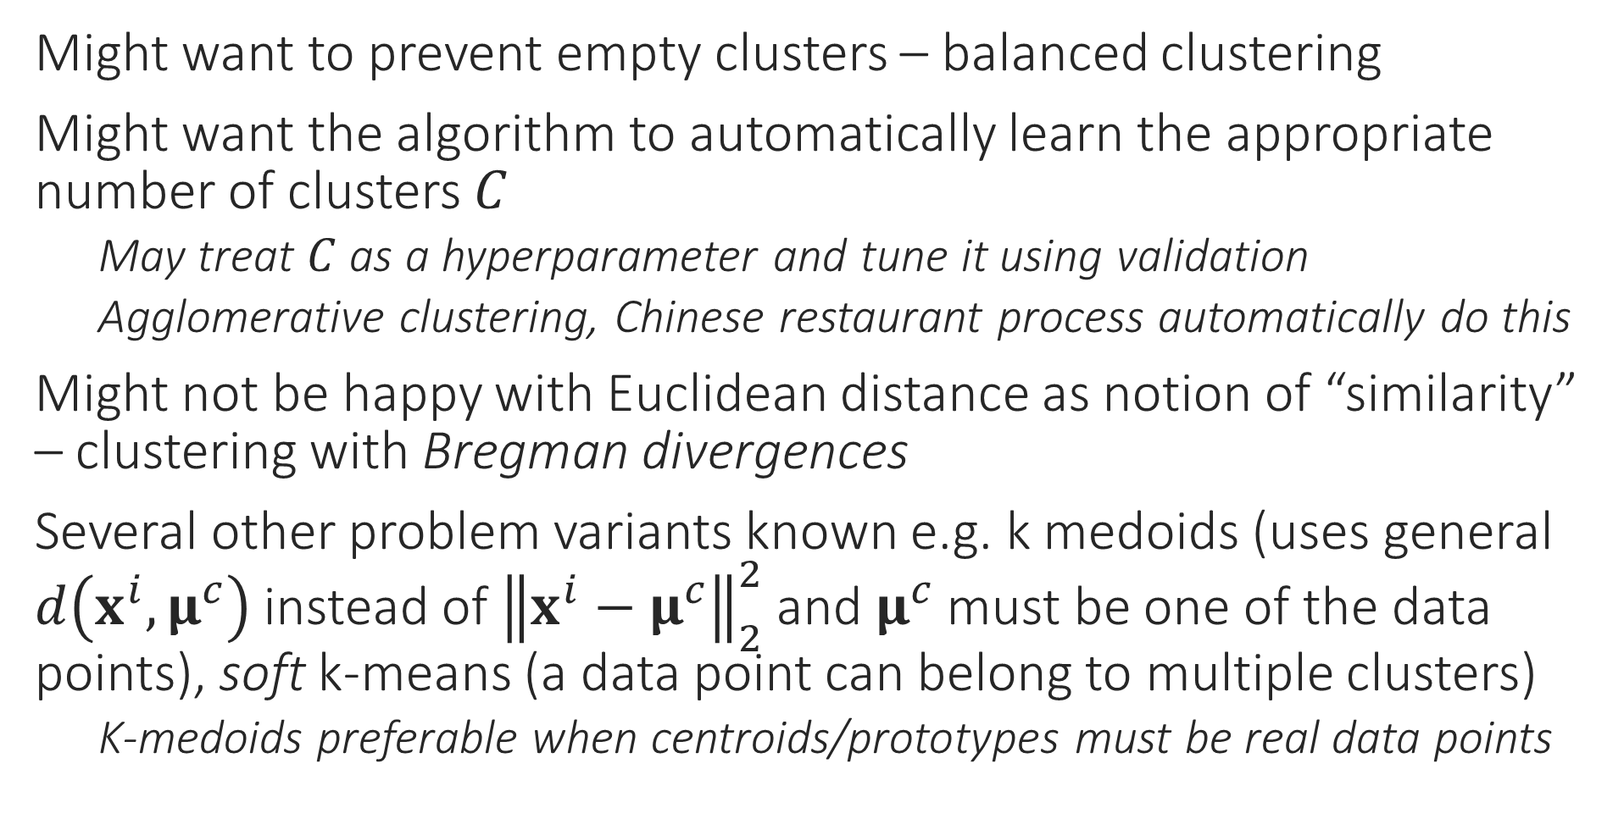
Variations in clustering
Might want to prevent empty clusters – balanced clustering
Might want the algorithm to automatically learn the appropriate number of clusters $C$
May treat $C$ as a hyperparameter and tune it using validation
Agglomerative clustering, Chinese restaurant process automatically do this
Might not be happy with Euclidean distance as notion of “similarity” – clustering with Bregman divergences
Several other problem variants known e.g. k medoids (uses general $d\left(x^{i},μ^{c}\right)$ instead of ${\left\|x^{i}−μ^{c}\right\|}_{2}^{2}$ and $μ^{c}$ must be one of the data points), soft k-means (a data point can belong to multiple clusters)
K-medoids preferable when centroids/prototypes must be real data points

Slide 10
Probability Theory

Slide 11
What is Probability
Depends on whom we ask this question
A statistician will claim probability is a way of measuring how frequently does something happen
“If I recommend an iPhone to 1000 female customers aged 25-30 years, roughly 600 of them will make a purchase”
A logician will claim that probability is a way of measuring the amount of uncertainty in a certain statement
“If John makes a credit card transaction worth more than ₹10,000, then there is a 70% chance it is fraudulent since he never spends so much”
A measure theoretician will claim probability is a way of assigning positive scores in a way so that two scores can be easily compared
“This customer is more likely to be in the 20-30 age group than the 50+ group”
Machine Learning subscribes to all these views in one way or another

Slide 12
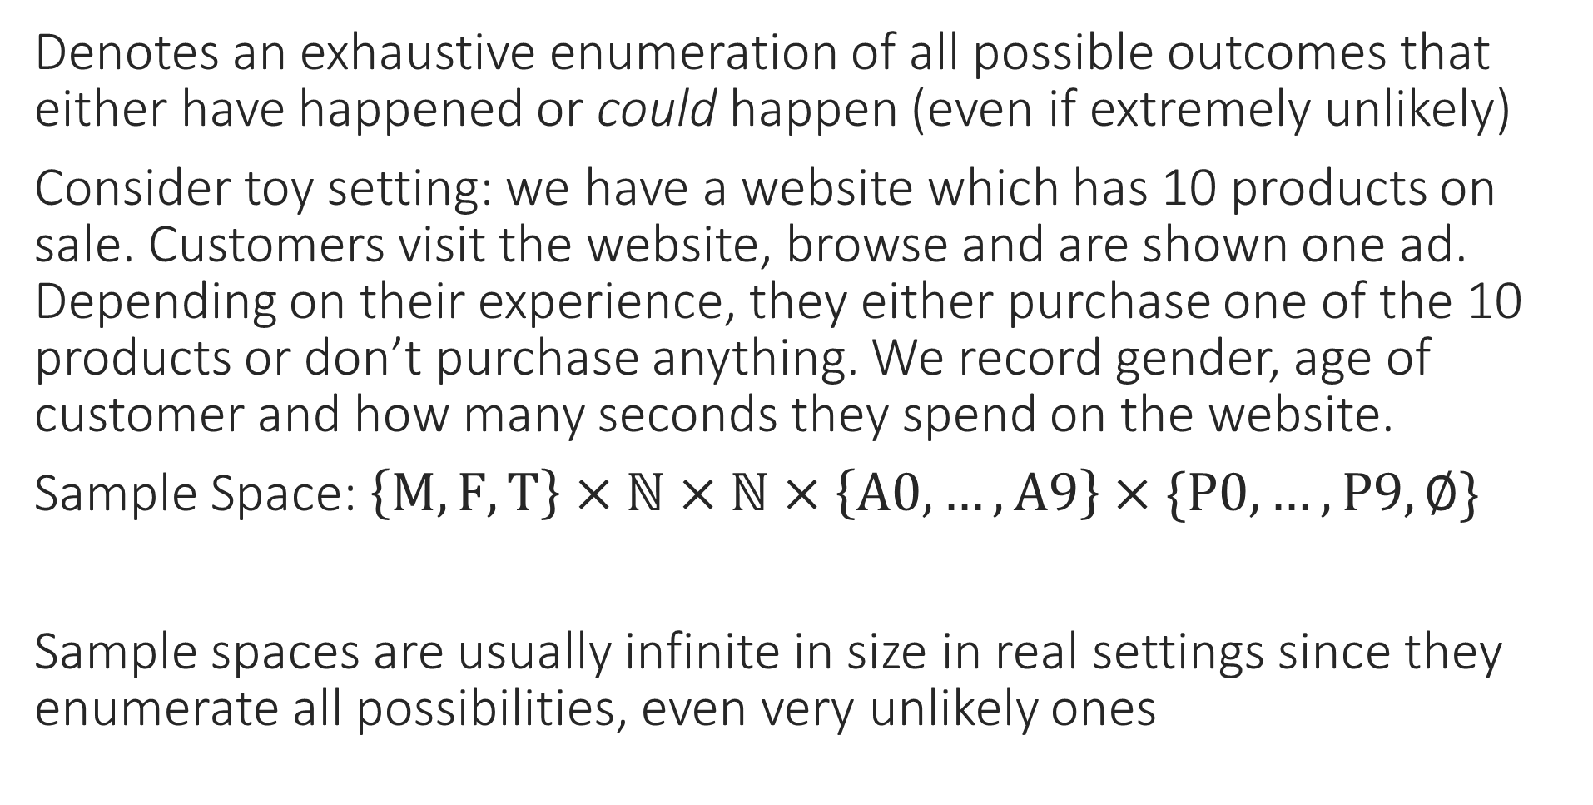
Sample Space
Denotes an exhaustive enumeration of all possible outcomes that either have happened or could happen (even if extremely unlikely)
Consider toy setting: we have a website which has 10 products on sale. Customers visit the website, browse and are shown one ad. Depending on their experience, they either purchase one of the 10 products or don’t purchase anything. We record gender, age of customer and how many seconds they spend on the website.
Sample Space: $\left\{M,F,T\right\}×ℕ×ℕ×\left\{A0,…,A9\right\}×\{P0,…,P9,∅\}$
Sample spaces are usually infinite in size in real settings since they enumerate all possibilities, even very unlikely ones
Gender
Age
Time Spent
Ad Shown
Purchase

Slide 13
Events
An event is simply a description of useful facts about an outcome
A male customer in age group 20-30 years visiting our website is an event
A female customer being shown an ad for a P2 (a laptop) is an event
A customer purchasing something that was shown as an ad is an event
A customer purchasing something that was not shown as an ad is an event
A customer spending more than 20 minutes on the website is an event
ML can be used to do several useful things
Tell us how frequently does an event occur/if one event more likely than other
What fraction of male customers aged 35-40 purchase P6 (a phone) if shown an ad?
What fraction of female customers purchase P2 (a laptop) whether ad shown or not?
Is it more likely that a purchase will be made if I show a mobile ad or a laptop ad?
Is it more likely that a 20-25 year old will purchase if I show a mobile vs laptop ad?
Tell us how confident is the ML algorithm while giving the above replies

Slide 14

Random Variables
I could have also defined a random variable such that S = 1 if purchase made (whether or not on ad shown) and S = 0 otherwise. What I define as a random variable (or even an event) is totally up to my creativity.
Random variables are simply a way to express useful facts about events as numbers so that we can do math with them
Random variables can be categorical or numerical
Categorical: X = 1 if female, X = 2 if male, X = 3 if transgender
Numerical (Discrete): Y = age of person in years
Numerical (Continuous): Z = number of seconds spent on the website
Indicator: W = 1 if purchase made on ad shown, W = 0 otherwise
Example Outcome: A male customer aged 25 years spent 18 minutes on our website but did not purchase the product whose ad was shown
X = 2, Y = 25, Z = 1080, W = 0
Can arrange several random variables as vectors too – [2, 25, 1080, 0]

Slide 15
Probability Distribution
For starters, a 120 year old human being is almost certainly a woman not a man
For the purpose of ML, a probability distribution serves two purposes
Given an event it can tell us how likely is that event
This also allows us to ask given two events, which one is more likely
Note that random variables can be used to define events too e.g. W = 1 is an event (that a purchase was made on the product whose ad was shown)
Generate a sample outcome
It is expected that outcomes that are more likely are generated more often than extremely rare outcomes e.g. “a 120 year old man who is shown an ad for P8, spent 1000 seconds but did not purchasing anything” is not very likely
We can also ask for a sample outcome with certain restrictions to be generated e.g. “a female customer who is shown an ad for P6”. In this case, we are requesting outcomes that satisfy the above but are more likely, to be generated more often.
In this case, we are interesting in getting samples of female customers who are shown an ad for P6. For example, if such customers are more likely to buy P6 then we would like W = 1 more frequently for these samples too!

Slide 16
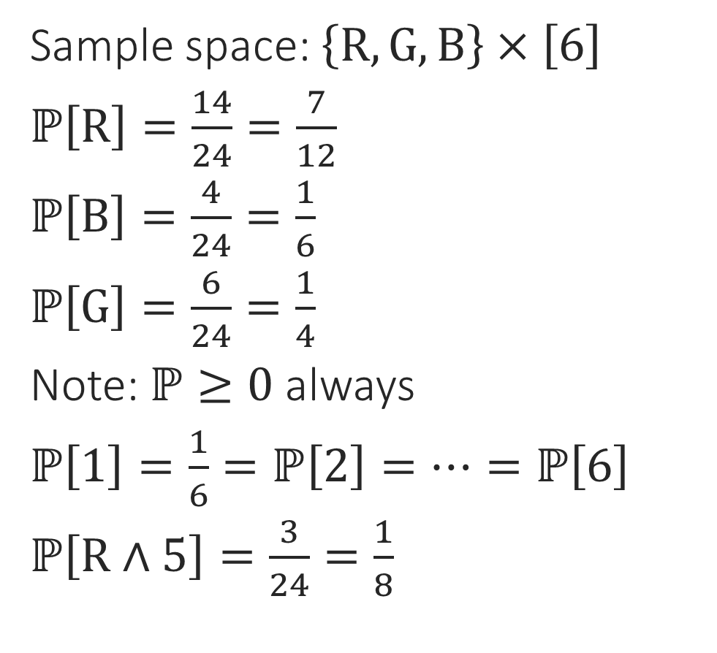
Getting Started
Sample space: $\left\{R,G,B\right\}×\left[6\right]$
$ℙ\left[R\right]=\frac{14}{24}=\frac{7}{12}$
$ℙ\left[B\right]=\frac{4}{24}=\frac{1}{6}$
$ℙ\left[G\right]=\frac{6}{24}=\frac{1}{4}$
Note: $ℙ≥0$ always
$ℙ\left[1\right]=\frac{1}{6}=ℙ\left[2\right]=…=ℙ\left[6\right]$
$ℙ\left[R∧5\right]=\frac{3}{24}=\frac{1}{8}$
1
2
3
4
5
6
1
2
3
4
5
6
1
2
3
4
5
6
1
2
3
4
5
6
Initially, to get used to things, it is good to think of probability in terms of proportions or frequency

