Slide 1
Probability Theory II
CS771: Introduction to Machine Learning
Purushottam Kar

Slide 2
Announcements
Assignment 1 deadline extended: Sat 07 Sept 2019, 9:59 PM IST
Applies to both PDF and code submission
Quiz: August 30 (Friday), 6PM, L20 – same as quiz 1
Assigned seating – don’t be late (will waste time finding your seat)
Syllabus is till whatever we cover today i.e. Aug 28 (Wed)
Bring your institute ID card with you – will lose time if you forget
Bring a pencil, pen, eraser, sharpener with you – we wont provide!
Answers to be written on question paper itself. If you write with pen and make a mistake, no extra paper. Final answer must be in pen
Auditors cannot appear for quiz – please come to L20 at ~ 6:40PM
Doubt clearing session: Aug 29 (Thu), 6PM KD101 (venue changed!)

Slide 3
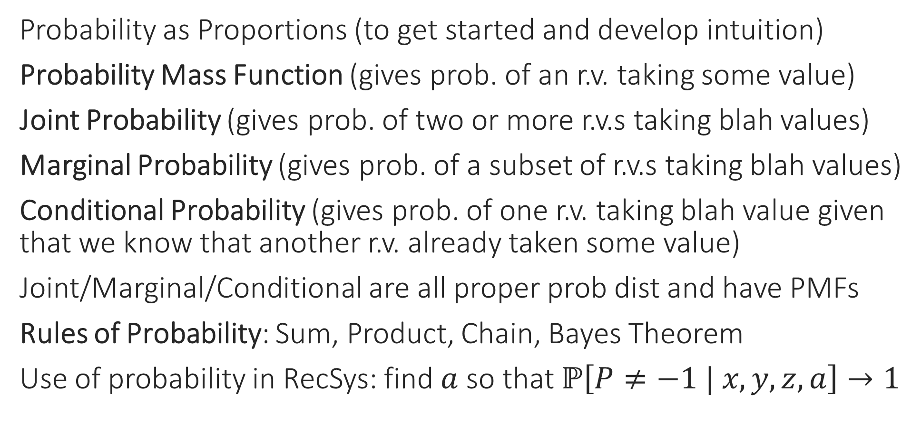
Recap of Last Lecture
Probability as Proportions (to get started and develop intuition)
Probability Mass Function (gives prob. of an r.v. taking some value)
Joint Probability (gives prob. of two or more r.v.s taking blah values)
Marginal Probability (gives prob. of a subset of r.v.s taking blah values)
Conditional Probability (gives prob. of one r.v. taking blah value given that we know that another r.v. already taken some value)
Joint/Marginal/Conditional are all proper prob dist and have PMFs
Rules of Probability: Sum, Product, Chain, Bayes Theorem
Use of probability in RecSys: find $a$ so that $ℙ\left[P≠−1 | x, y, z,a\right]→1$

Slide 4

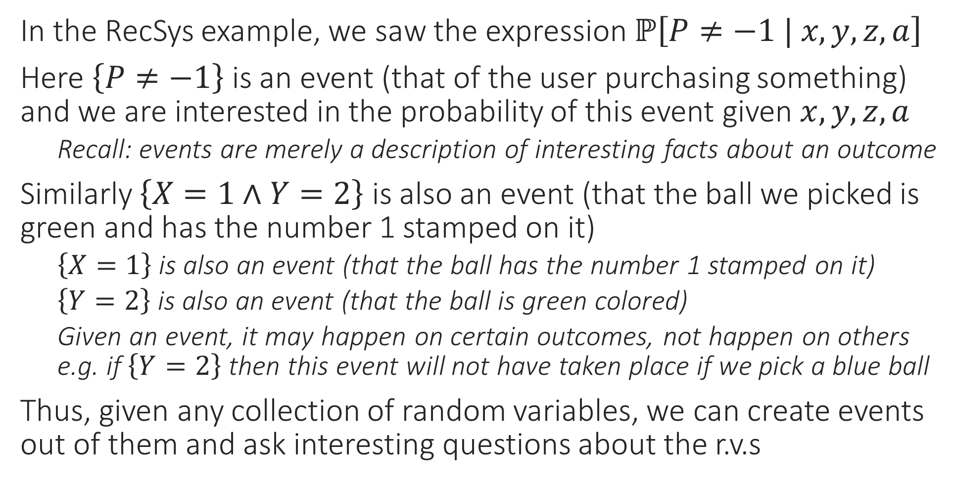
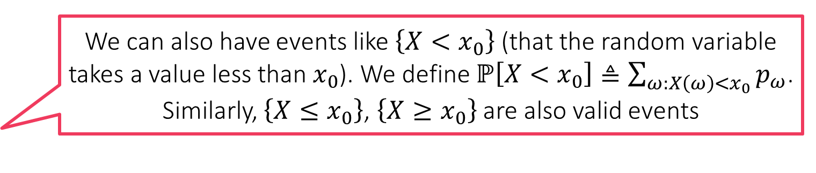
Creating Events from Random Variables??
We can also have events like $\left\{X<x_{0}\right\}$ (that the random variable takes a value less than $x_{0}$). We define $ℙ\left[X<x_{0}\right]≜\sum_{ω:X\left(ω\right)<x_{0}}{p_{ω}}$. Similarly, $\left\{X≤x_{0}\right\}$, $\left\{X≥x_{0}\right\}$ are also valid events
In the RecSys example, we saw the expression $ℙ\left[P≠−1 | x, y, z,a\right]$
Here $\left\{P≠−1\right\}$ is an event (that of the user purchasing something) and we are interested in the probability of this event given $x,y,z,a$
Recall: events are merely a description of interesting facts about an outcome
Similarly $\left\{X=1∧Y=2\right\}$ is also an event (that the ball we picked is green and has the number 1 stamped on it)
$\left\{X=1\right\}$ is also an event (that the ball has the number 1 stamped on it)
$\left\{Y=2\right\}$ is also an event (that the ball is green colored)
Given an event, it may happen on certain outcomes, not happen on others e.g. if $\left\{Y=2\right\}$ then this event will not have taken place if we pick a blue ball
Thus, given any collection of random variables, we can create events out of them and ask interesting questions about the r.v.s

Slide 5


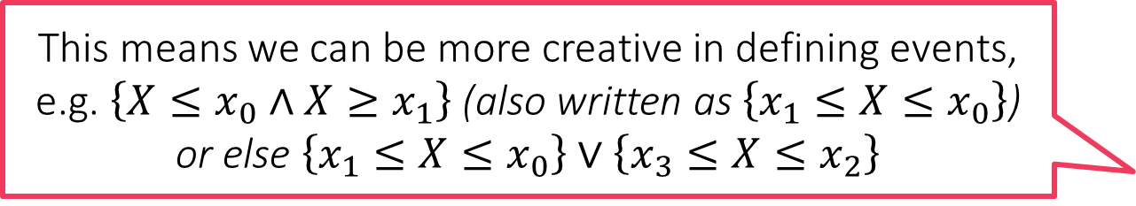



Event Calculus
The term calculus in general, means a system of rules – no differentiation or integration going on here ☺
Let $A,B$ be events (possibly defined using same/different r.v.s etc)
$¬A$ is also an event
Called the negation or complement of $A$ ($A$ did not happen)
$A∪B$ is also an event
Called the union of the two events (either $A$ happened or $B$ happened or both happened)
$A∩B$ is also an event
Called the intersection of the two events (both $A$ and $B$ happened)
De Morgan’s Laws: for any two events $A,B$, we must have
$¬\left(A∪B\right)=¬A∩¬B$ as well as $¬\left(A∩B\right)=¬A∪¬B$
$¬\left(A∪B\right)=¬A∩¬B$ tell us that saying
“It is not the case that either A happened or B happened or both happened”
is just a funny way of saying
“A did not happen and B did not happen i.e. neither happened”
$¬\left(A∩B\right)=¬A∪¬B$ tell us that saying
“It is not the case that both A and B happened”
is just another way of saying
“Either A did not happen or B did not happen or both did not happen”
This means we can be more creative in defining events, e.g. $\left\{X≤x_{0}∧X≥x_{1}\right\}$ (also written as $\left\{x_{1}≤X≤x_{0}\right\}$) or else $\left\{x_{1}≤X≤x_{0}\right\}∨\left\{x_{3}≤X≤x_{2}\right\}$

Slide 6
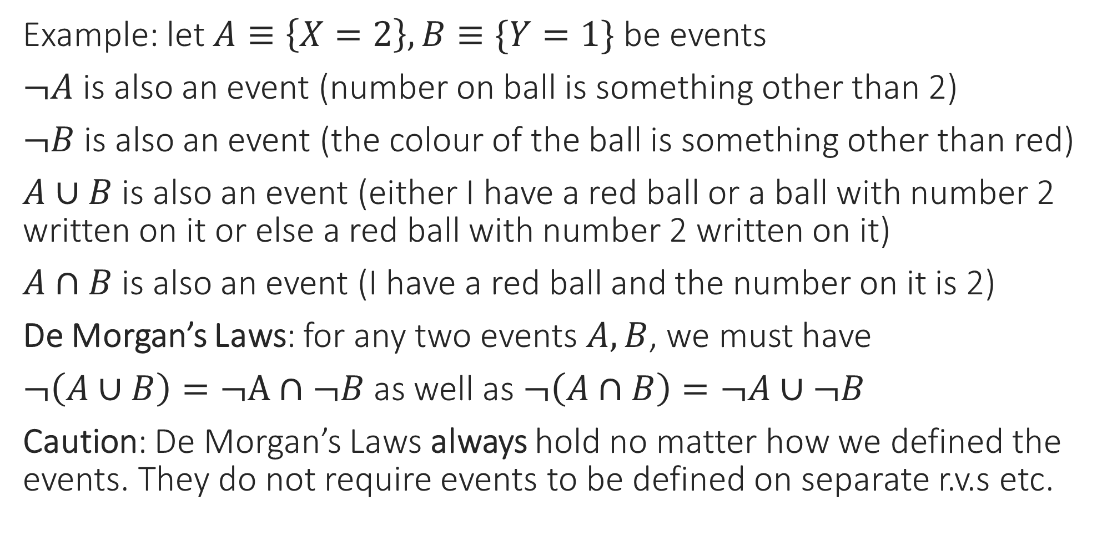
Event Calculus
Example: let $A≡\left\{X=2\right\},B≡\{Y=1\}$ be events
$¬A$ is also an event (number on ball is something other than 2)
$¬B$ is also an event (the colour of the ball is something other than red)
$A∪B$ is also an event (either I have a red ball or a ball with number 2 written on it or else a red ball with number 2 written on it)
$A∩B$ is also an event (I have a red ball and the number on it is 2)
De Morgan’s Laws: for any two events $A,B$, we must have
$¬\left(A∪B\right)=¬A∩¬B$ as well as $¬\left(A∩B\right)=¬A∪¬B$
Caution: De Morgan’s Laws always hold no matter how we defined the events. They do not require events to be defined on separate r.v.s etc.

Slide 7
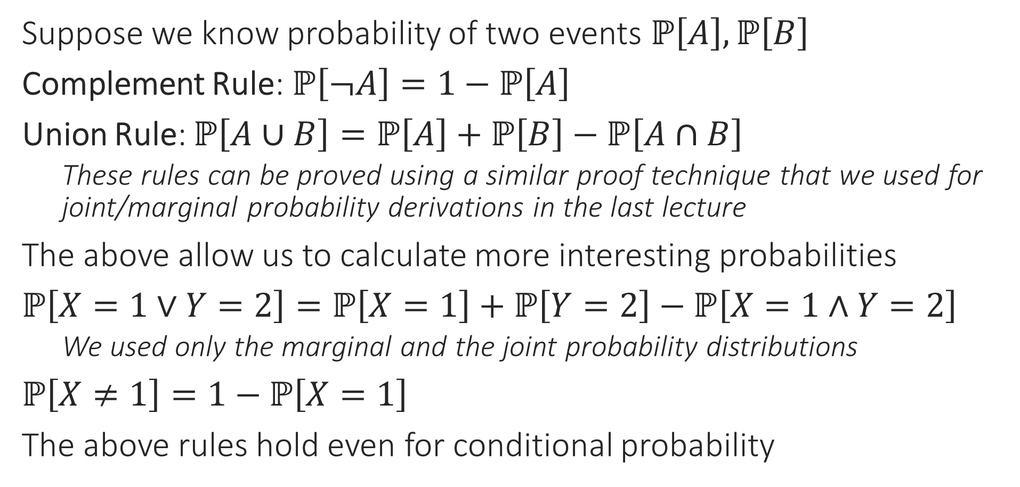
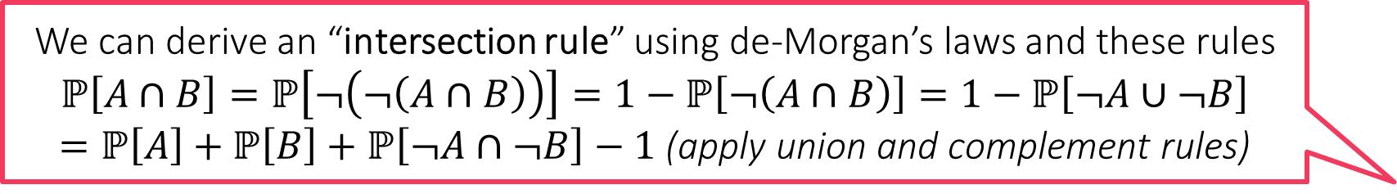
Rules of Probability for Complex Events
We can derive an “intersection rule” using de-Morgan’s laws and these rules
$$ℙ\left[A∩B\right]=ℙ\left[¬\left(¬\left(A∩B\right)\right)\right]=1−ℙ\left[¬\left(A∩B\right)\right]=1−ℙ\left[¬A∪¬B\right]$$
$=ℙ\left[A\right]+ℙ\left[B\right]+ℙ\left[¬A∩¬B\right]−1$ (apply union and complement rules)
Suppose we know probability of two events $ℙ\left[A\right],ℙ\left[B\right]$
Complement Rule: $ℙ\left[¬A\right]=1−ℙ\left[A\right]$
Union Rule: $ℙ\left[A∪B\right]=ℙ\left[A\right]+ℙ\left[B\right]−ℙ\left[A∩B\right]$
These rules can be proved using a similar proof technique that we used for joint/marginal probability derivations in the last lecture
The above allow us to calculate more interesting probabilities
$ℙ\left[X=1∨Y=2\right]=ℙ\left[X=1\right]+ℙ\left[Y=2\right]−ℙ\left[X=1∧Y=2\right]$
We used only the marginal and the joint probability distributions
$ℙ\left[X≠1\right]=1−ℙ\left[X=1\right]$
The above rules hold even for conditional probability

Slide 8


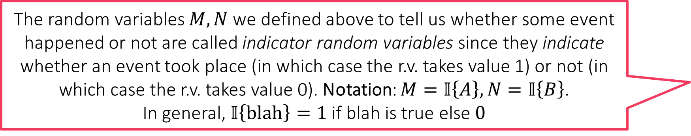
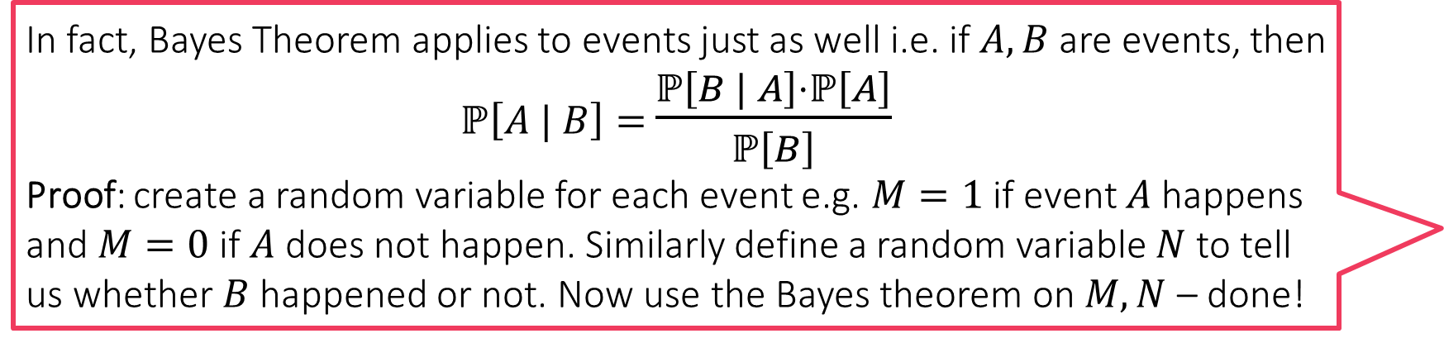
Rules of Conditional Probability
In fact, Bayes Theorem applies to events just as well i.e. if $A,B$ are events, then $ℙ\left[A | B\right]=$ $\frac{ℙ\left[B | A\right]⋅ℙ\left[A\right]}{ℙ\left[B\right]}$
Proof: create a random variable for each event e.g. $M=1$ if event $A$ happens and $M=0$ if $A$ does not happen. Similarly define a random variable $N$ to tell us whether $B$ happened or not. Now use the Bayes theorem on $M,N$ – done!
Let $C$ denote an event
For example $C≡\left\{X=x_{0}∧Y=y_{0}∧Z=z_{0}∧A=a_{0}\right\}$
A user with gender $x_{0}$, age $y_{0}$ spent $z_{0}$ sec on website and was shown ad $a_{0}$
Let $A,B$ denote two events
$A, B$ may be related/unrelated to $C$ – does not matter – the rules always hold
Conditional Complement Rule: $ℙ\left[¬A | C\right]=1−ℙ\left[A | C\right]$
Conditional Union Rule: $ℙ\left[A∪B|C\right]=ℙ\left[A|C\right]+ℙ\left[B|C\right]−ℙ\left[A∩B|C\right]$
Conditional Implication Rule: If $C⇒A$, then $ℙ\left[A | C\right]=1$. On the other hand, if $C⇒¬B$, then $ℙ\left[B | C\right]=0$
Example: $C$ defined as above and $A≡\left\{X=x_{0}\right\}$ and $B≡\left\{Z=z^{′}\right\},z^{′}≠z_{0}$
In the above cases, we will indeed have $ℙ\left[A | C\right]=1$ and $ℙ\left[B | C\right]=0$
The random variables $M,N$ we defined above to tell us whether some event happened or not are called indicator random variables since they indicate whether an event took place (in which case the r.v. takes value 1) or not (in which case the r.v. takes value 0). Notation: $M=𝕀\left\{A\right\}, N=𝕀\left\{B\right\}$.
In general, $𝕀\left\{blah\right\}=1$ if blah is true else $0$
Caution: not a standard rule you would find in textbooks

Slide 9




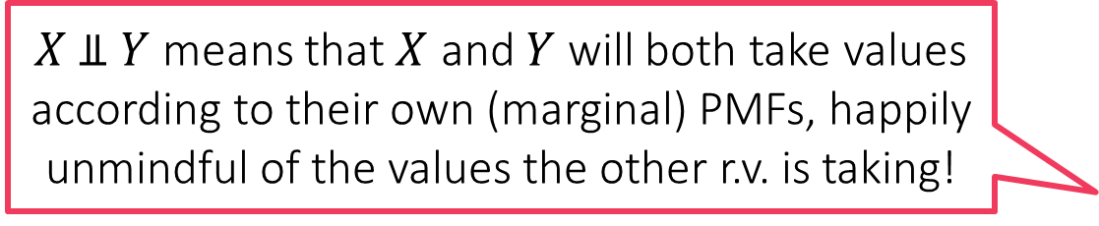
Independence of Random Variables
$X \text{⫫} Y$ means that $X$ and $Y$ will both take values according to their own (marginal) PMFs, happily unmindful of the values the other r.v. is taking!
Two r.v.s $X,Y$ are said to be independent if, for all $x∈S_{X}$ and $y∈S_{Y}$, we have $ℙ\left[X=x,Y=y\right]=ℙ\left[X=x\right]⋅ℙ\left[Y=y\right]$
We can show that if two r.v.s are independent, then this means that the value one r.v. takes does not influence the other r.v. to take some value more preferentially than others in any way
Proof: $ℙ\left[X=x | Y=y\right]=\frac{ℙ\left[X=x | Y=y\right]}{ℙ\left[Y=y\right]}=\frac{ℙ\left[X=x\right]⋅ℙ\left[Y=y\right]}{ℙ\left[Y=y\right]}=ℙ\left[X=x\right]$
Similarly, we also get $ℙ\left[Y=y |X=x\right]=ℙ\left[Y=y\right]$
Independence of r.v.s makes life extremely simple in ML algorithms but is very precious – not always available
Notation: If $X,Y$ are independent, then we often write $X\text{⫫}Y$
Can you show that if $X \text{⫫} Y$ (i.e. $ℙ_{Y|X=x_{0}}=ℙ_{Y}$ for all $x_{0}∈S_{X}$) then we must always have $Y \text{⫫} X$ (i.e. $ℙ_{X|Y=y_{0}}=ℙ_{X}$ for all $y_{0}∈S_{X}$) as well?
Hint: use the definition of independence
We have $ℙ_{Y}=\left[\frac{1}{2},\frac{1}{4},\frac{1}{4}\right]$
We can verify that we have
$ℙ_{Y|X=x_{0}}=\left[\frac{1}{2},\frac{1}{4},\frac{1}{4}\right]=ℙ_{Y}$ for
all $x_{0}∈{\left[6\right]=S}_{X}$ i.e. $X \text{⫫} Y$
Similarly, we can verify that $ℙ_{X|Y=y_{0}}=\left[\frac{1}{6},\frac{1}{6},…,\frac{1}{6}\right]=ℙ_{X}$ for
all $y_{0}∈{\left[3\right]=S}_{Y}$ i.e. $Y \text{⫫} X$
We have $ℙ_{Y}=\left[\frac{7}{12},\frac{3}{12},\frac{2}{12}\right]$
However, if we condition on
$X=1$, then we have
$ℙ_{Y|X=1}=\left[\frac{2}{4},\frac{1}{4},\frac{1}{4}\right]$ i.e. $X \text{⫫} Y$
For independence, we should
have had $ℙ_{Y|X=x_{0}}=ℙ_{Y}$ for all
$$x_{0}∈S_{X}$$
1
2
3
4
5
6
1
2
3
4
5
6
1
2
3
4
5
6
1
2
3
4
5
6
1
2
3
4
5
6
1
2
3
4
5
6
1
2
3
4
5
6
1
2
3
4
5
6

Slide 10




Conditional Independence
If $X,Y,Z$ are three r.v.s such that for all $x∈S_{X},y∈S_{Y},z∈S_{Z}$ we have
$ℙ\left[X=x,Y=y | Z=z\right]=ℙ\left[X=x | Z=z\right]⋅ℙ\left[Y=y | Z=z\right]$
then we say that $X$ and $Y$ are conditionally independent given $Z$
Notation: $X \text{⫫} Y | Z$
If $X,Y$ are independent, then it is not necessary that they continue to be independent even if conditioned on a third random variable
This is the earlier example where
we verified that $X \text{⫫} Y$ and $Y \text{⫫} X$
However it is easy to see that we
do not have $X \text{⫫} Y | Z$ since
$ℙ\left[X=2,Y=2 | Z=1\right]=0≠$
$ℙ\left[X=2 | Z=1\right]⋅ℙ\left[Y=2 | Z=1\right]$
1
2
3
4
5
6
$$Z=1$$
1
2
3
4
5
6
1
2
3
4
5
6
$$Z=2$$
1
2
3
4
5
6

Slide 11










Conditional Independence
If $X,Y,Z$ are three r.v.s such that for all $x∈S_{X},y∈S_{Y},z∈S_{Z}$ we have
$ℙ\left[X=x,Y=y | Z=z\right]=ℙ\left[X=x | Z=z\right]⋅ℙ\left[Y=y | Z=z\right]$
then we say that $X$ and $Y$ are conditionally independent given $Z$
Notation: $X \text{⫫} Y | Z$
If $X,Y$ are independent, then it is not necessary that they continue to be independent even if conditioned on a third random variable
Even if $X,Y$ are not independent, it is still possible that there may exist a third random variable $Z$ such that makes $X,Y$ conditionally independent i.e. $X \text{⫫} Y | Z$
The r.v.s number $X$ and colour $Y$ are not independent here. To see this, note that$ℙ\left[Y=3 | X=1\right]=0.4$
$≠0.25=ℙ\left[Y=3\right]$. However, if we condition on a new random variable $Z$ that distinguishes the first two rows from the last two rows, then $X$ and $Y$ become independent r.v.s i.e. $X \text{⫫} Y$ but we do have $X \text{⫫} Y | Z$
1
2
3
4
5
6
$$\frac{1}{96}$$
$$\frac{1}{96}$$
$$\frac{2}{96}$$
$$\frac{2}{96}$$
$$\frac{9}{96}$$
$$\frac{9}{96}$$
$$Z=1$$
1
2
3
4
5
6
$$\frac{1}{96}$$
$$\frac{1}{96}$$
$$\frac{2}{96}$$
$$\frac{2}{96}$$
$$\frac{9}{96}$$
$$\frac{9}{96}$$
1
2
3
4
5
6
$$\frac{1}{24}$$
$$\frac{1}{24}$$
$$\frac{1}{24}$$
$$\frac{1}{24}$$
$$\frac{1}{24}$$
$$\frac{1}{24}$$
$$Z=2$$
1
2
3
4
5
6
$$\frac{1}{24}$$
$$\frac{1}{24}$$
$$\frac{1}{24}$$
$$\frac{1}{24}$$
$$\frac{1}{24}$$
$$\frac{1}{24}$$

Slide 12
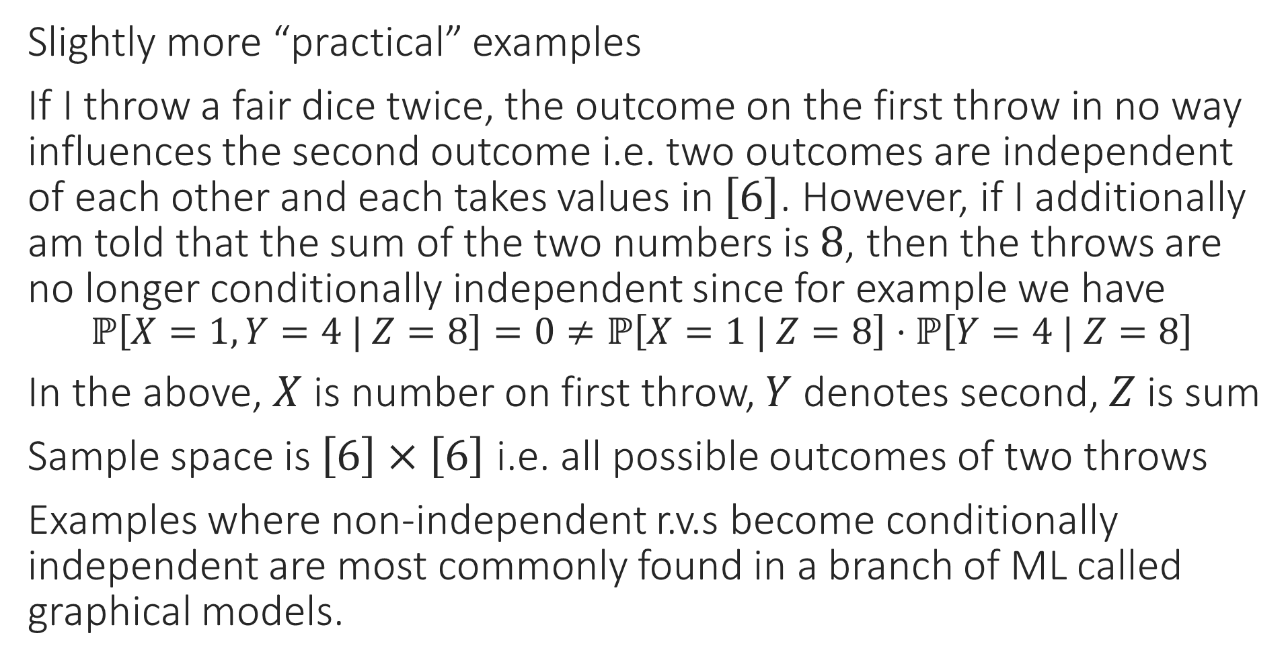
Conditional Independence
Slightly more “practical” examples
If I throw a fair dice twice, the outcome on the first throw in no way influences the second outcome i.e. two outcomes are independent of each other and each takes values in $\left[6\right]$. However, if I additionally am told that the sum of the two numbers is $8$, then the throws are no longer conditionally independent since for example we have $ℙ\left[X=1,Y=4 | Z=8\right]=0≠ℙ\left[X=1 | Z=8\right]⋅ℙ\left[Y=4 | Z=8\right]$
In the above, $X$ is number on first throw, $Y$ denotes second, $Z$ is sum
Sample space is $\left[6\right]×\left[6\right]$ i.e. all possible outcomes of two throws
Examples where non-independent r.v.s become conditionally independent are most commonly found in a branch of ML called graphical models.

Slide 13
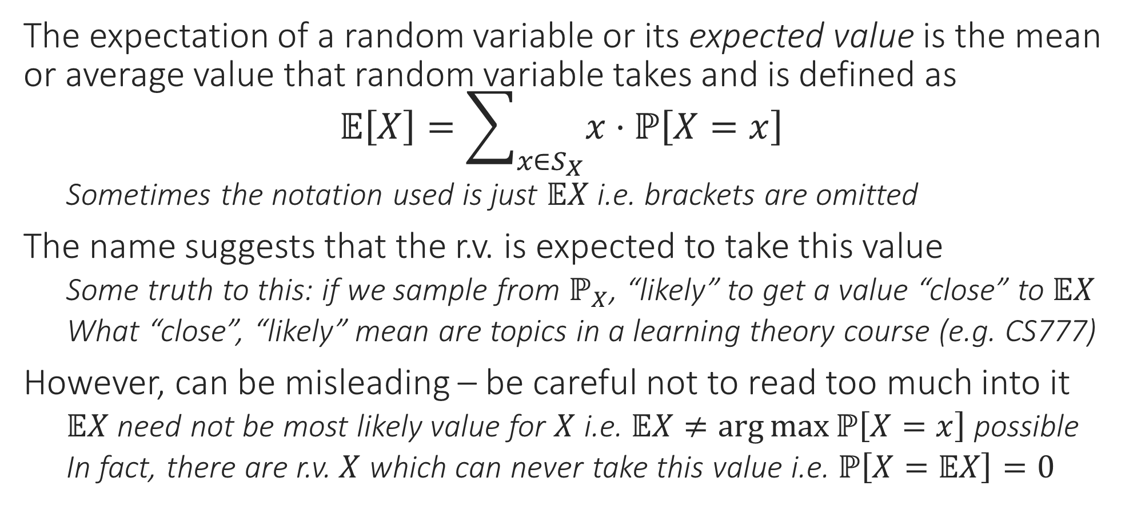
Expectation of a Random Variable
The expectation of a random variable or its expected value is the mean or average value that random variable takes and is defined as $𝔼\left[X\right]=\sum_{x∈S_{X}}{x⋅ℙ\left[X=x\right]}$
Sometimes the notation used is just $𝔼X$ i.e. brackets are omitted
The name suggests that the r.v. is expected to take this value
Some truth to this: if we sample from $ℙ_{X}$, “likely” to get a value “close” to $𝔼X$
What “close”, “likely” mean are topics in a learning theory course (e.g. CS777)
However, can be misleading – be careful not to read too much into it
$𝔼X$ need not be most likely value for $X$ i.e. $𝔼X≠\arg{\max{ℙ\left[X=x\right]}}$ possible
In fact, there are r.v. $X$ which can never take this value i.e. $ℙ\left[X=𝔼X\right]=0$

Slide 14
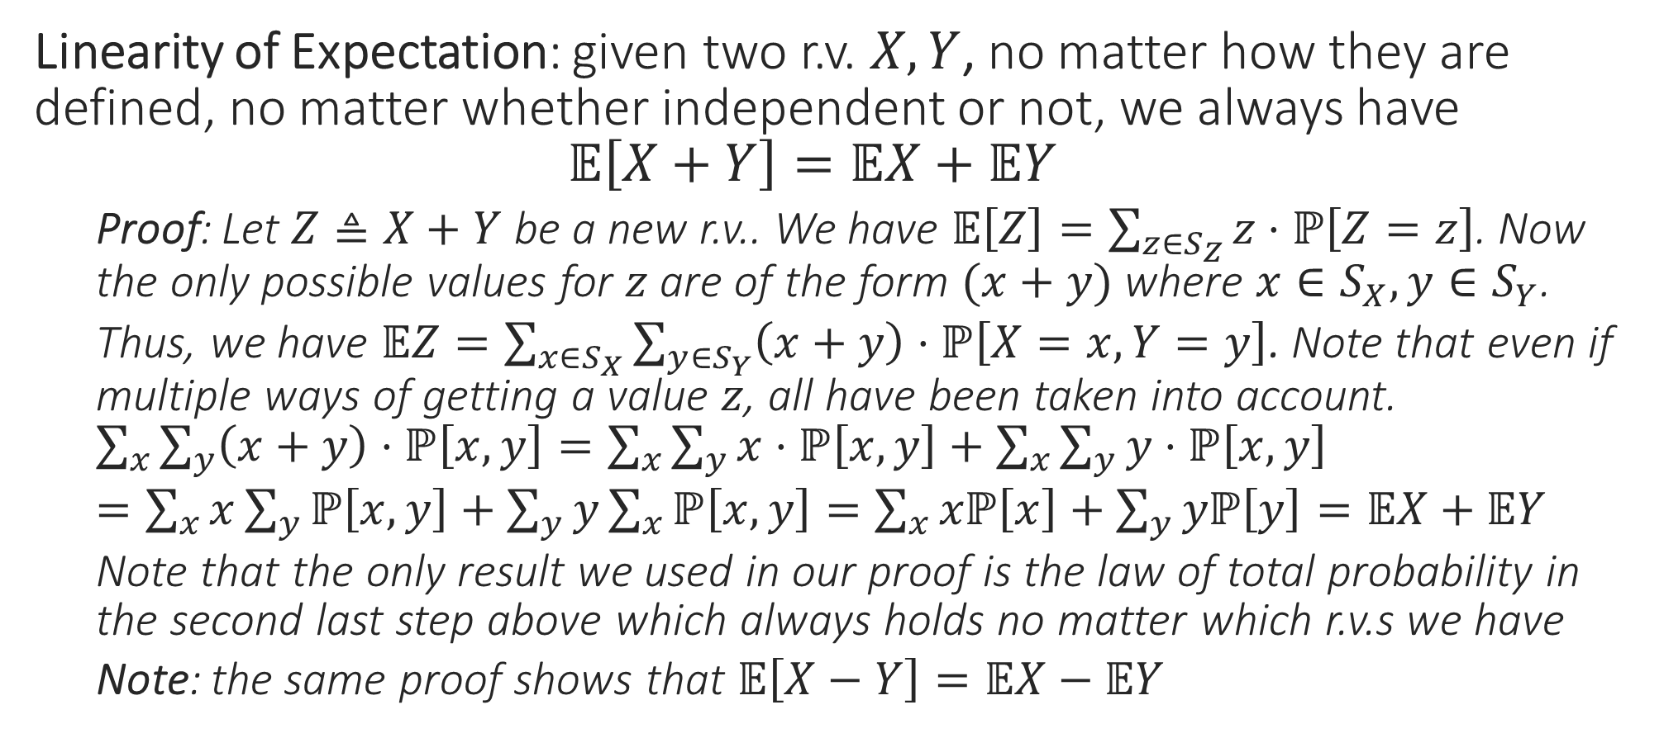
Rules of Expectation: Sum Rule
Linearity of Expectation: given two r.v. $X,Y$, no matter how they are defined, no matter whether independent or not, we always have $𝔼\left[X+Y\right]=𝔼X+𝔼Y$
Proof: Let $Z≜X+Y$ be a new r.v.. We have $𝔼\left[Z\right]=\sum_{z∈S_{Z}}{z⋅ℙ\left[Z=z\right]}$. Now the only possible values for $z$ are of the form $(x+y)$ where $x∈S_{X},y∈S_{Y}$.
Thus, we have $𝔼Z=\sum_{x∈S_{X}}{\sum_{y∈S_{Y}}{\left(x+y\right)⋅ℙ\left[X=x,Y=y\right]}}$. Note that even if multiple ways of getting a value $z$, all have been taken into account. $\sum_{x}{\sum_{y}{\left(x+y\right)⋅ℙ\left[x,y\right]}}=\sum_{x}{\sum_{y}{x⋅ℙ\left[x,y\right]}}+\sum_{x}{\sum_{y}{y⋅ℙ\left[x,y\right]}}$
$=\sum_{x}{x\sum_{y}{ℙ\left[x,y\right]}}+\sum_{y}{y\sum_{x}{ℙ\left[x,y\right]}}=\sum_{x}{xℙ\left[x\right]}+\sum_{y}{yℙ\left[y\right]}=𝔼X+𝔼Y$
Note that the only result we used in our proof is the law of total probability in the second last step above which always holds no matter which r.v.s we have
Note: the same proof shows that $𝔼\left[X−Y\right]=𝔼X−𝔼Y$

Slide 15
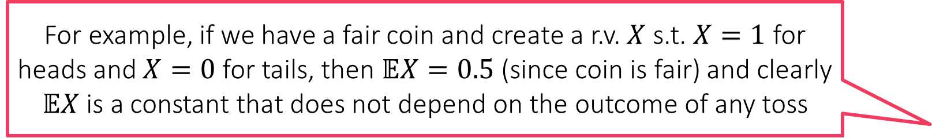
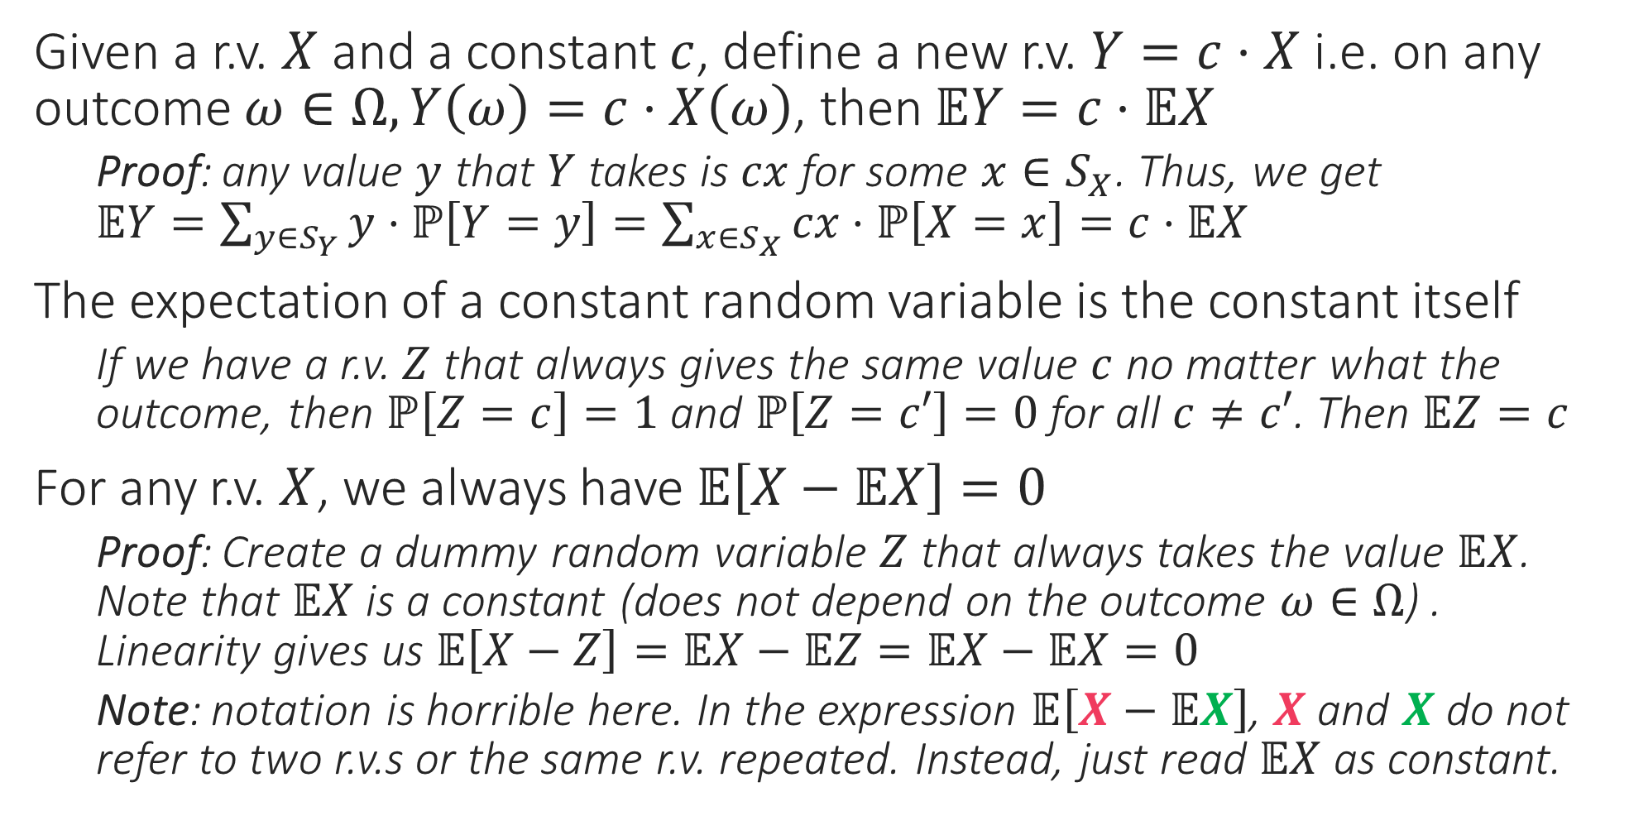
Rules of Expectation: Scaling Rule
Given a r.v. $X$ and a constant $c$, define a new r.v. $Y=c⋅X$ i.e. on any outcome $ω∈Ω,Y\left(ω\right)=c⋅X\left(ω\right)$, then $𝔼Y=c⋅𝔼X$
Proof: any value $y$ that $Y$ takes is $cx$ for some $x∈S_{X}$. Thus, we get $𝔼Y=\sum_{y∈S_{Y}}{y⋅ℙ\left[Y=y\right]}=\sum_{x∈S_{X}}{cx⋅ℙ\left[X=x\right]}=c⋅𝔼X$
The expectation of a constant random variable is the constant itself
If we have a r.v. $Z$ that always gives the same value $c$ no matter what the outcome, then $ℙ\left[Z=c\right]=1$ and $ℙ\left[Z=c′\right]=0$ for all $c≠c′$. Then $𝔼Z=c$
For any r.v. $X$, we always have $𝔼\left[X−𝔼X\right]=0$
Proof: Create a dummy random variable $Z$ that always takes the value $𝔼X$. Note that $𝔼X$ is a constant (does not depend on the outcome $ω∈Ω$) . Linearity gives us $𝔼\left[X−Z\right]=𝔼X−𝔼Z=𝔼X−𝔼X=0$
Note: notation is horrible here. In the expression $𝔼\left[X−𝔼X\right]$, $X$ and $X$ do not refer to two r.v.s or the same r.v. repeated. Instead, just read $𝔼X$ as constant.
For example, if we have a fair coin and create a r.v. $X$ s.t. $X=1$ for heads and $X=0$ for tails, then $𝔼X=0.5$ (since coin is fair) and clearly $𝔼X$ is a constant that does not depend on the outcome of any toss

Slide 16
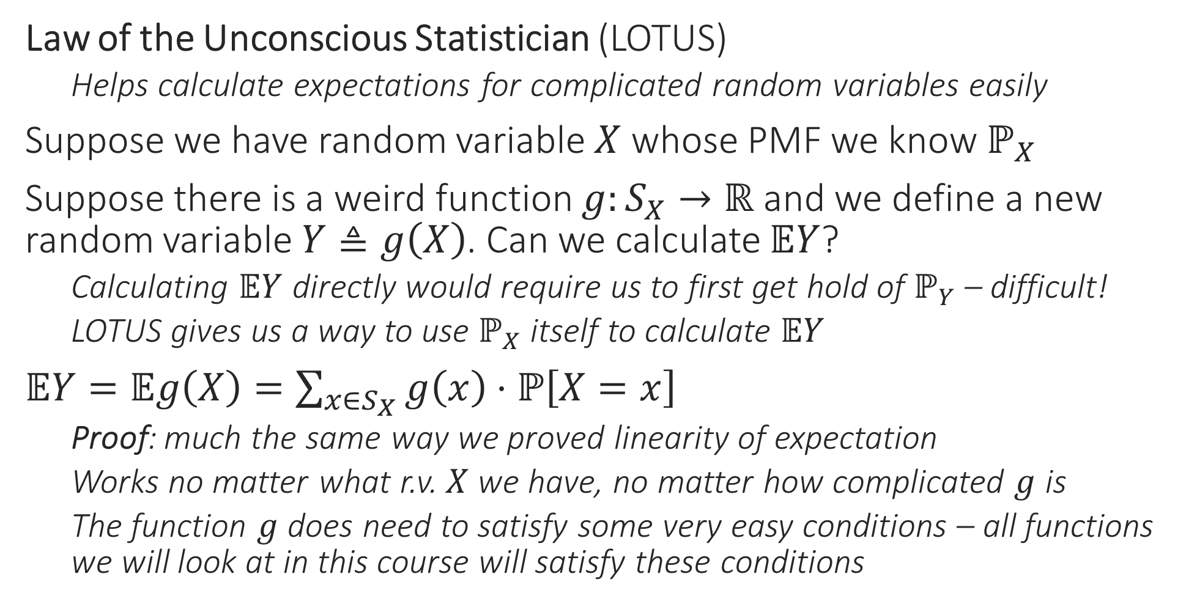
Rules of Expectation
Law of the Unconscious Statistician (LOTUS)
Helps calculate expectations for complicated random variables easily
Suppose we have random variable $X$ whose PMF we know $ℙ_{X}$
Suppose there is a weird function $g:S_{X}→ℝ$ and we define a new random variable $Y≜g\left(X\right)$. Can we calculate $𝔼Y$?
Calculating $𝔼Y$ directly would require us to first get hold of $ℙ_{Y}$ – difficult!
LOTUS gives us a way to use $ℙ_{X}$ itself to calculate $𝔼Y$
$𝔼Y=𝔼g\left(X\right)=\sum_{x∈S_{X}}{g\left(x\right)⋅ℙ\left[X=x\right]}$
Proof: much the same way we proved linearity of expectation
Works no matter what r.v. $X$ we have, no matter how complicated $g$ is
The function $g$ does need to satisfy some very easy conditions – all functions we will look at in this course will satisfy these conditions

Slide 17
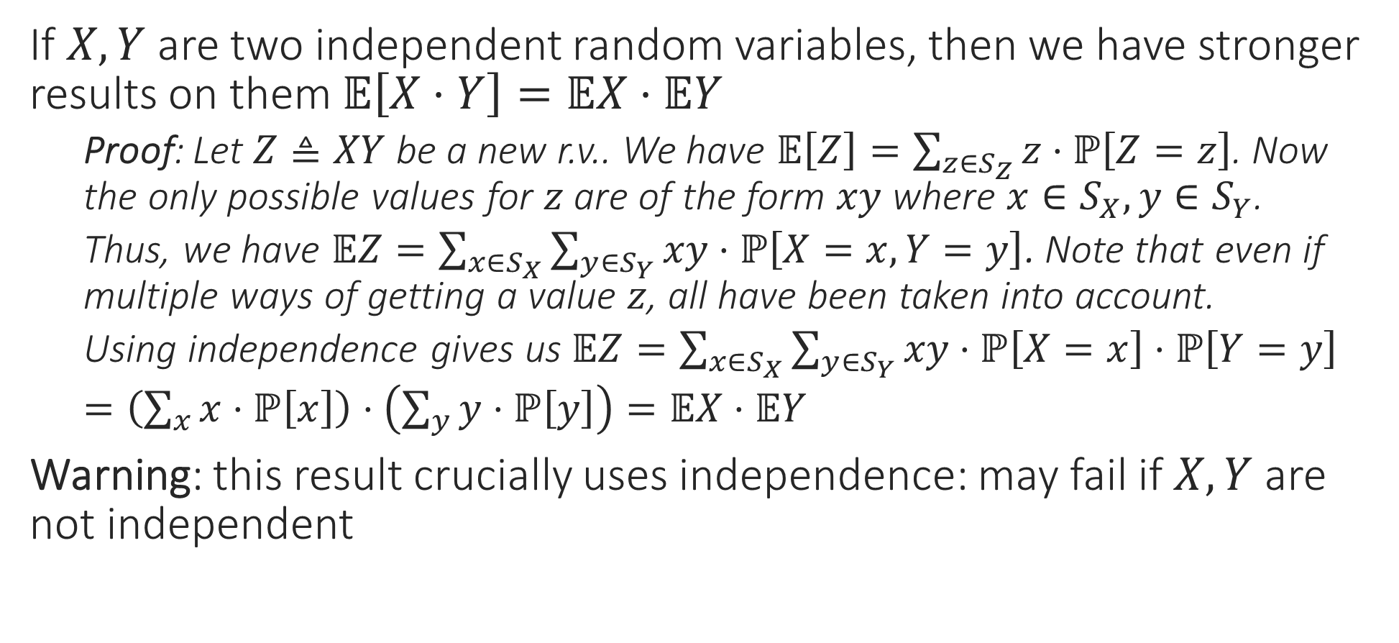
Rules of Expectation: Product Rule
If $X,Y$ are two independent random variables, then we have stronger results on them $𝔼\left[X⋅Y\right]=𝔼X⋅𝔼Y$
Proof: Let $Z≜XY$ be a new r.v.. We have $𝔼\left[Z\right]=\sum_{z∈S_{Z}}{z⋅ℙ\left[Z=z\right]}$. Now the only possible values for $z$ are of the form $xy$ where $x∈S_{X},y∈S_{Y}$.
Thus, we have $𝔼Z=\sum_{x∈S_{X}}{\sum_{y∈S_{Y}}{xy⋅ℙ\left[X=x,Y=y\right]}}$. Note that even if multiple ways of getting a value $z$, all have been taken into account.
Using independence gives us $𝔼Z=\sum_{x∈S_{X}}{\sum_{y∈S_{Y}}{xy⋅ℙ\left[X=x\right]⋅ℙ\left[Y=y\right]}}$
$=\left(\sum_{x}{x⋅ℙ\left[x\right]}\right)⋅\left(\sum_{y}{y⋅ℙ\left[y\right]}\right)=𝔼X⋅𝔼Y$
Warning: this result crucially uses independence: may fail if $X,Y$ are not independent

Slide 18



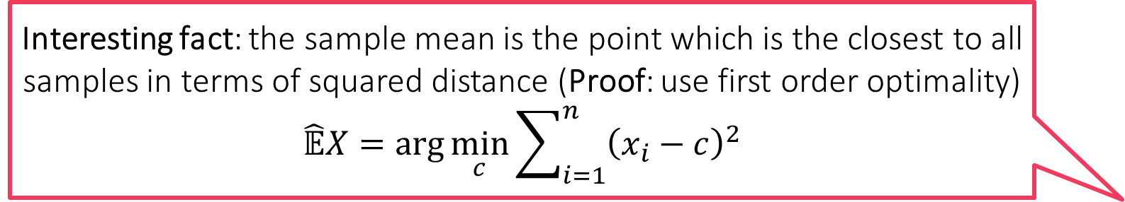
Sample Mean
Indeed! If we ask 1000 random Indians, how many children they have, the sample mean might come out to be 2.35. However, no Indian can have 2.35 children since number of children has to be an integer!
Suppose we have a r.v. $X$ and we sample it again and again, say $n$ times
E.g. we have a dice/coin and we throw/toss it again and again
Make sure that samples are independent of each other
For example in the coin case, do toss the coin fairly $n$ times – do not just toss it once and then blindly repeat the value of the first toss $n$times
Using the values obtained in these repeated samples, say $x_{1},x_{2},…,x_{n}$, we can get a very good estimate $𝔼X$ if $n$ is sufficiently large
Called sample mean, or sample expectation, or empirical mean
$\hat{𝔼}X=\overline{X}=\frac{1}{n}\sum_{i=1}^{n}{x_{i}}$
Note: sample mean can give answers that need patient analysis
Yes, that is why we warned not to take expectation/sample mean literally. All that your experiment tells you is that most Indians have around 2.35 children. Some may have much more (e.g. 7) or much less (e.g. 0) but they are usually rarer
Interesting fact: the sample mean is the point which is the closest to all samples in terms of squared distance (Proof: use first order optimality) $$\hat{𝔼}X=\arg{\min_{c}{\sum_{i=1}^{n}{{\left(x_{i}−c\right)}^{2}}}}$$
Interesting fact: even the mean itself satisfies the nice property $$𝔼X=\arg{\min_{c}{𝔼\left[{\left(X−c\right)}^{2}\right]}}$$

Slide 19
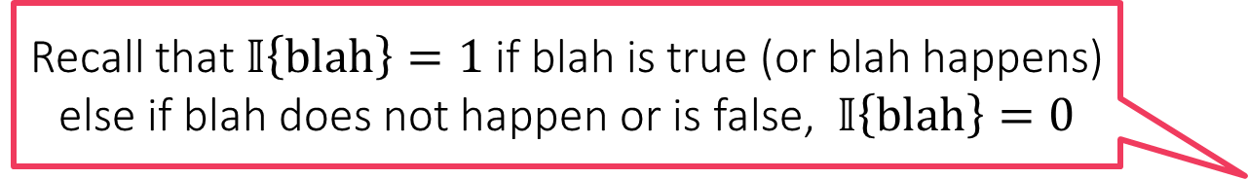
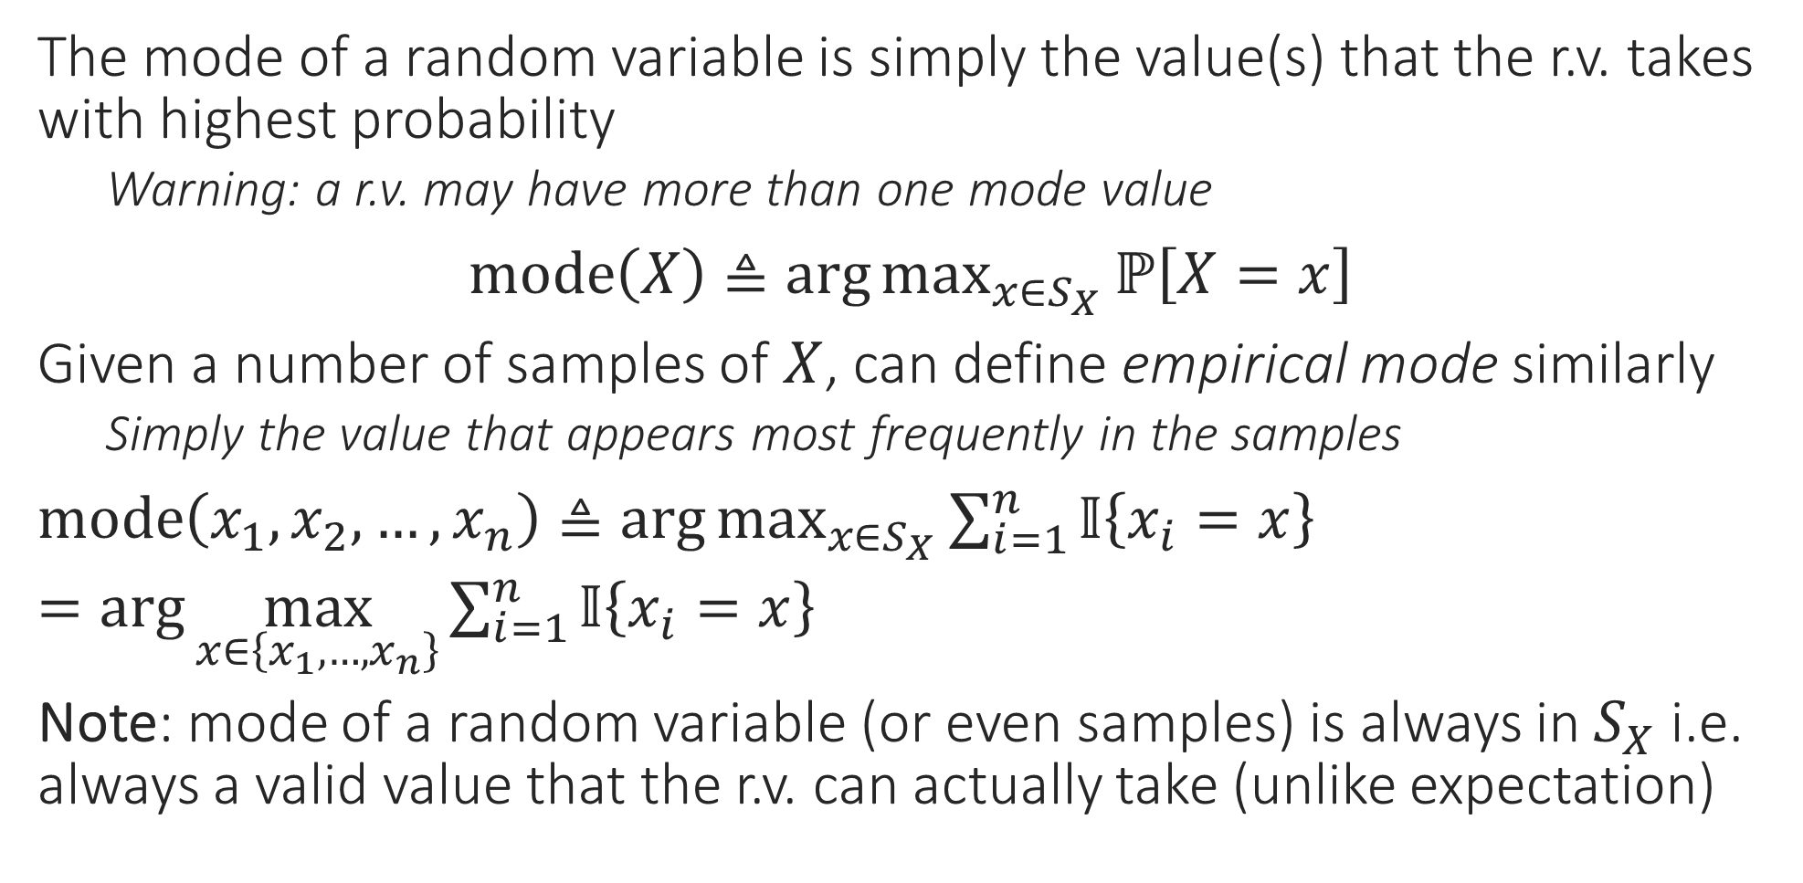
Mode of a Random Variable
The mode of a random variable is simply the value(s) that the r.v. takes with highest probability
Warning: a r.v. may have more than one mode value
$mode\left(X\right)≜\arg{\max_{x∈S_{X}}{ℙ\left[X=x\right]}}$
Given a number of samples of $X$, can define empirical mode similarly
Simply the value that appears most frequently in the samples
$mode\left(x_{1},x_{2},…,x_{n}\right)≜\arg{\max_{x∈S_{X}}{\sum_{i=1}^{n}{𝕀\left\{x_{i}=x\right\}}}}$
$=\arg{\max_{x∈\left\{x_{1},…,x_{n}\right\}}{\sum_{i=1}^{n}{𝕀\left\{x_{i}=x\right\}}}}$
Note: mode of a random variable (or even samples) is always in $S_{X}$ i.e. always a valid value that the r.v. can actually take (unlike expectation)
Recall that $𝕀\left\{blah\right\}=1$ if blah is true (or blah happens) else if blah does not happen or is false, $𝕀\left\{blah\right\}=0$

Slide 20
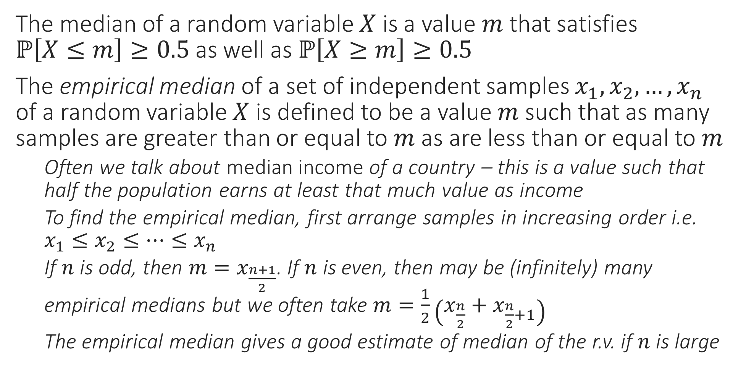
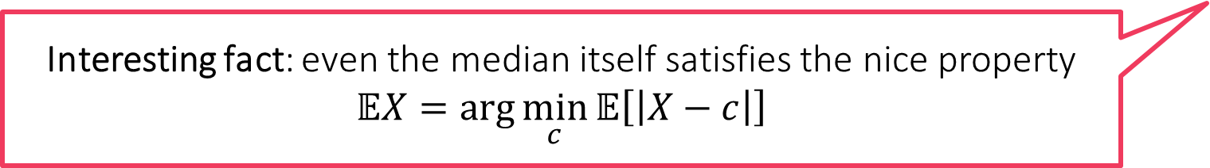

Median of a Random Variable
Interesting Fact: The empirical median is the point which is the closest to all samples in terms of absolute distance (Proof: in notes) $$\hat{𝔼}X=\arg{\min_{c}{\sum_{i=1}^{n}{\left|x_{i}−c\right|}}}$$
The median of a random variable $X$ is a value $m$ that satisfies $ℙ\left[X≤m\right]≥0.5$ as well as $ℙ\left[X≥m\right]≥0.5$
The empirical median of a set of independent samples $x_{1},x_{2},…,x_{n}$ of a random variable $X$ is defined to be a value $m$ such that as many samples are greater than or equal to $m$ as are less than or equal to $m$
Often we talk about median income of a country – this is a value such that half the population earns at least that much value as income
To find the empirical median, first arrange samples in increasing order i.e. $x_{1}≤x_{2}≤…≤x_{n}$
If $n$ is odd, then $m=x_{\frac{n+1}{2}}$. If $n$ is even, then may be (infinitely) many empirical medians but we often take $m=\frac{1}{2}\left(x_{\frac{n}{2}}+x_{\frac{n}{2}+1}\right)$
The empirical median gives a good estimate of median of the r.v. if $n$ is large
Interesting fact: even the median itself satisfies the nice property $$𝔼X=\arg{\min_{c}{𝔼\left[\left|X−c\right|\right]}}$$

Slide 21
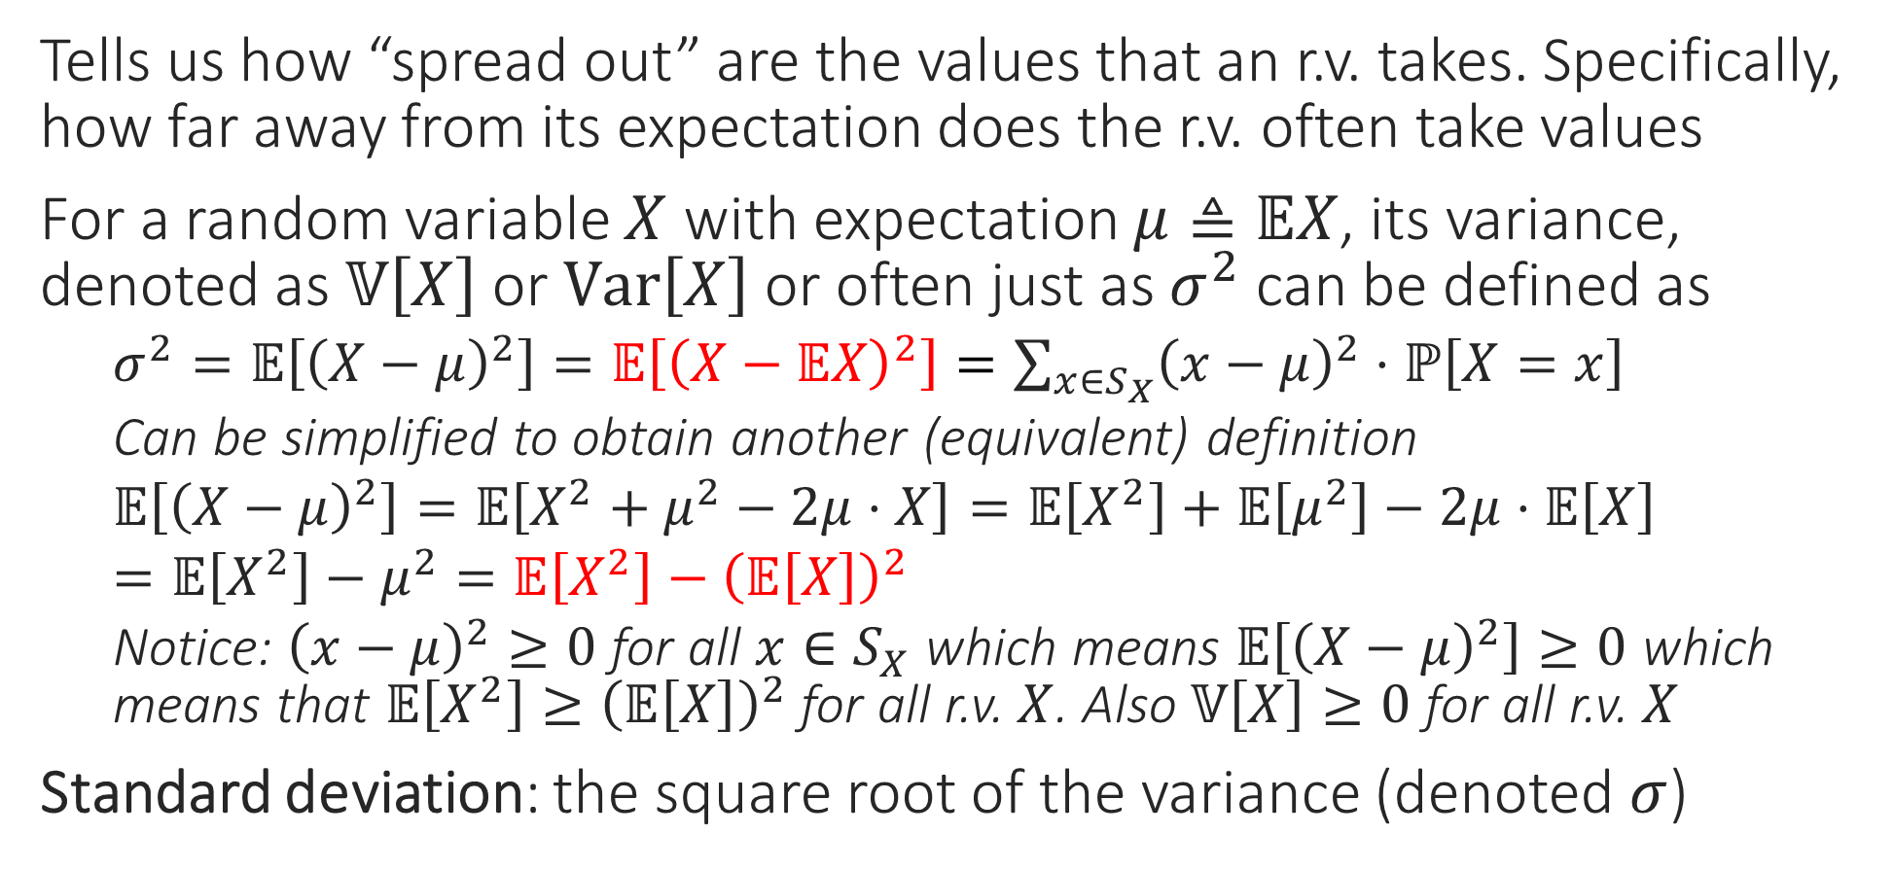
Variance
Tells us how “spread out” are the values that an r.v. takes. Specifically, how far away from its expectation does the r.v. often take values
For a random variable $X$ with expectation $μ≜𝔼X$, its variance, denoted as $𝕍\left[X\right]$ or $Var\left[X\right]$ or often just as $σ^{2}$ can be defined as
$σ^{2}=𝔼\left[{\left(X−μ\right)}^{2}\right]=𝔼\left[{\left(X−𝔼X\right)}^{2}\right]=\sum_{x∈S_{X}}{{\left(x−μ\right)}^{2}⋅ℙ\left[X=x\right]}$
Can be simplified to obtain another (equivalent) definition
$𝔼\left[{\left(X−μ\right)}^{2}\right]=𝔼\left[X^{2}+μ^{2}−2μ⋅X\right]=𝔼\left[X^{2}\right]+𝔼\left[μ^{2}\right]−2μ⋅𝔼\left[X\right]$
$=𝔼\left[X^{2}\right]−μ^{2}=𝔼\left[X^{2}\right]−{\left(𝔼\left[X\right]\right)}^{2}$
Notice: ${\left(x−μ\right)}^{2}≥0$ for all $x∈S_{X}$ which means $𝔼\left[{\left(X−μ\right)}^{2}\right]≥0$ which means that $𝔼\left[X^{2}\right]≥{\left(𝔼\left[X\right]\right)}^{2}$ for all r.v. $X$. Also $𝕍\left[X\right]≥0$ for all r.v. $X$
Standard deviation: the square root of the variance (denoted $σ$)

Slide 22




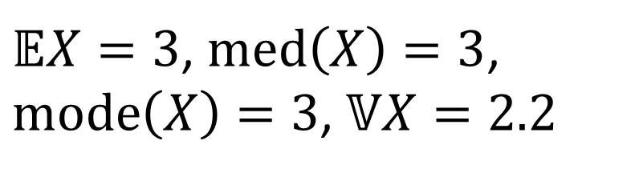
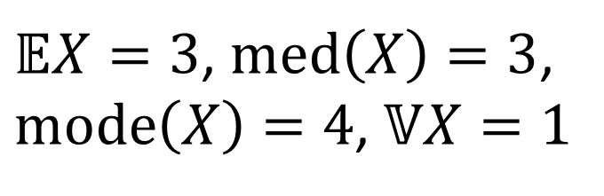
Example
$$ℙ\left[X\right]$$
$$ℙ\left[X\right]$$
0 0.1 0.2 0.3 0.4
0 0.1 0.2 0.3 0.4
0 1 2 3 4 5 6
$$X$$
0 1 2 3 4 5 6
$$X$$
$𝔼X=3$, $med\left(X\right)=3$, $mode\left(X\right)=4$, $𝕍X=1$
$𝔼X=3$, $med\left(X\right)=3$, $mode\left(X\right)=3$, $𝕍X=2.2$
This distribution has the same mean and median as the first one but is more “spread out” hence larger variance

Slide 23
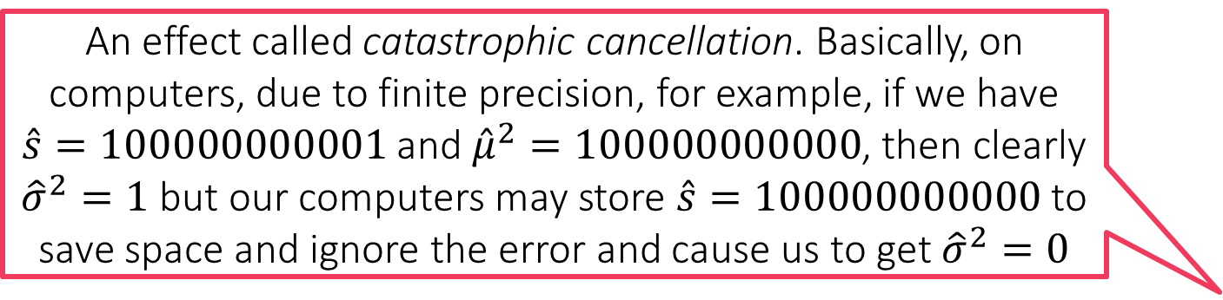
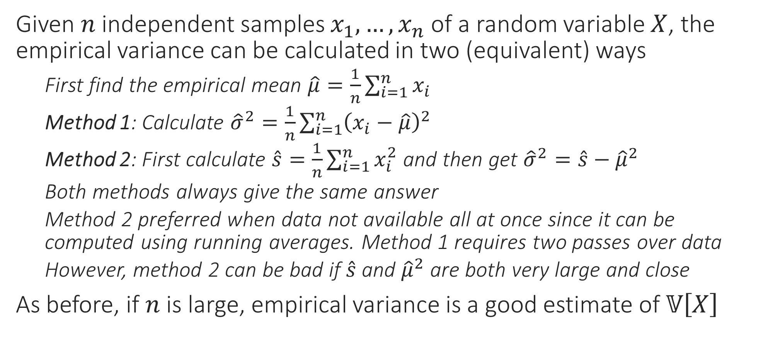
Sample Variance
Given $n$ independent samples $x_{1},…,x_{n}$ of a random variable $X$, the empirical variance can be calculated in two (equivalent) ways
First find the empirical mean $\hat{μ}=\frac{1}{n}\sum_{i=1}^{n}{x_{i}}$
Method 1: Calculate ${\hat{σ}}^{2}=\frac{1}{n}\sum_{i=1}^{n}{{\left(x_{i}−\hat{μ}\right)}^{2}}$
Method 2: First calculate $\hat{s}=\frac{1}{n}\sum_{i=1}^{n}{x_{i}^{2}}$ and then get ${\hat{σ}}^{2}=\hat{s}−{\hat{μ}}^{2}$
Both methods always give the same answer
Method 2 preferred when data not available all at once since it can be computed using running averages. Method 1 requires two passes over data
However, method 2 can be bad if $\hat{s}$ and ${\hat{μ}}^{2}$ are both very large and close
As before, if $n$ is large, empirical variance is a good estimate of $𝕍\left[X\right]$
An effect called catastrophic cancellation. Basically, on computers, due to finite precision, for example, if we have $\hat{s}=100000000001$ and ${\hat{μ}}^{2}=100000000000$, then clearly ${\hat{σ}}^{2}=1$ but our computers may store $\hat{s}=100000000000$ to save space and ignore the error and cause us to get ${\hat{σ}}^{2}=0$

Slide 24

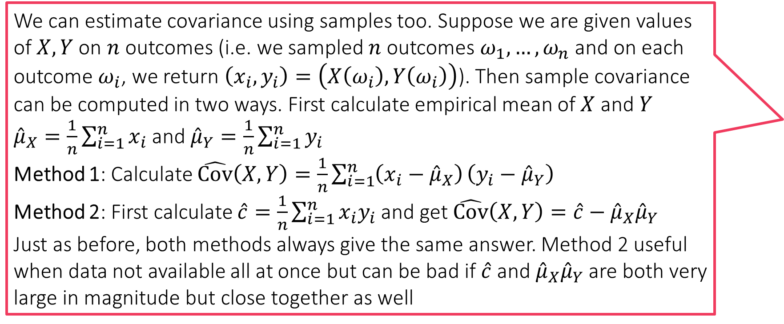
Covariance
We can estimate covariance using samples too. Suppose we are given values of $X,Y$ on $n$ outcomes (i.e. we sampled $n$ outcomes $ω_{1},…,ω_{n}$ and on each outcome $ω_{i}$, we return $\left(x_{i},y_{i}\right)=\left(X\left(ω_{i}\right),Y\left(ω_{i}\right)\right)$). Then sample covariance can be computed in two ways. First calculate empirical mean of $X$ and $Y$
${\hat{μ}}_{X}=\frac{1}{n}\sum_{i=1}^{n}{x_{i}}$ and ${\hat{μ}}_{Y}=\frac{1}{n}\sum_{i=1}^{n}{y_{i}}$
Method 1: Calculate $\hat{Cov}\left(X,Y\right)=\frac{1}{n}\sum_{i=1}^{n}{\left(x_{i}−{\hat{μ}}_{X}\right)}\left(y_{i}−{\hat{μ}}_{Y}\right)$
Method 2: First calculate $\hat{c}=\frac{1}{n}\sum_{i=1}^{n}{x_{i}y_{i}}$ and get $\hat{Cov}\left(X,Y\right)=\hat{c}−{\hat{μ}}_{X}{\hat{μ}}_{Y}$
Just as before, both methods always give the same answer. Method 2 useful when data not available all at once but can be bad if $\hat{c}$ and ${\hat{μ}}_{X}{\hat{μ}}_{Y}$ are both very large in magnitude but close together as well
If we have two r.v.s $X,Y$ then the covariance of these two r.v.s tell us how they behave in tandem
Example 1: let education level and income be two random variables defined on the sample space of all Indians – it is expected that if education of a person is higher than mean education level of all Indians, then their income should also be higher than mean income level of all Indians
Example 2: let age and sleeping hours be two different r.v.s – it is expected that if age of a person is higher than mean age of all Indians, then the person would sleep fewer than the average number of hours (since children typically sleep more and old people tend to sleep less)
$Cov\left(X,Y\right)≜𝔼\left[\left(X−𝔼X\right)⋅\left(Y−𝔼Y\right)\right]=𝔼\left[XY\right]−𝔼X⋅𝔼Y$
$=\sum_{ω∈Ω}{\left(X\left(ω\right)−𝔼X\right)⋅\left(Y\left(ω\right)−𝔼Y\right)⋅p_{ω}}$
Note that $Cov\left(X,X\right)=𝕍\left[X\right]$
Note that $Cov\left(X,Y\right)$ may be positive, negative or zero

Slide 25
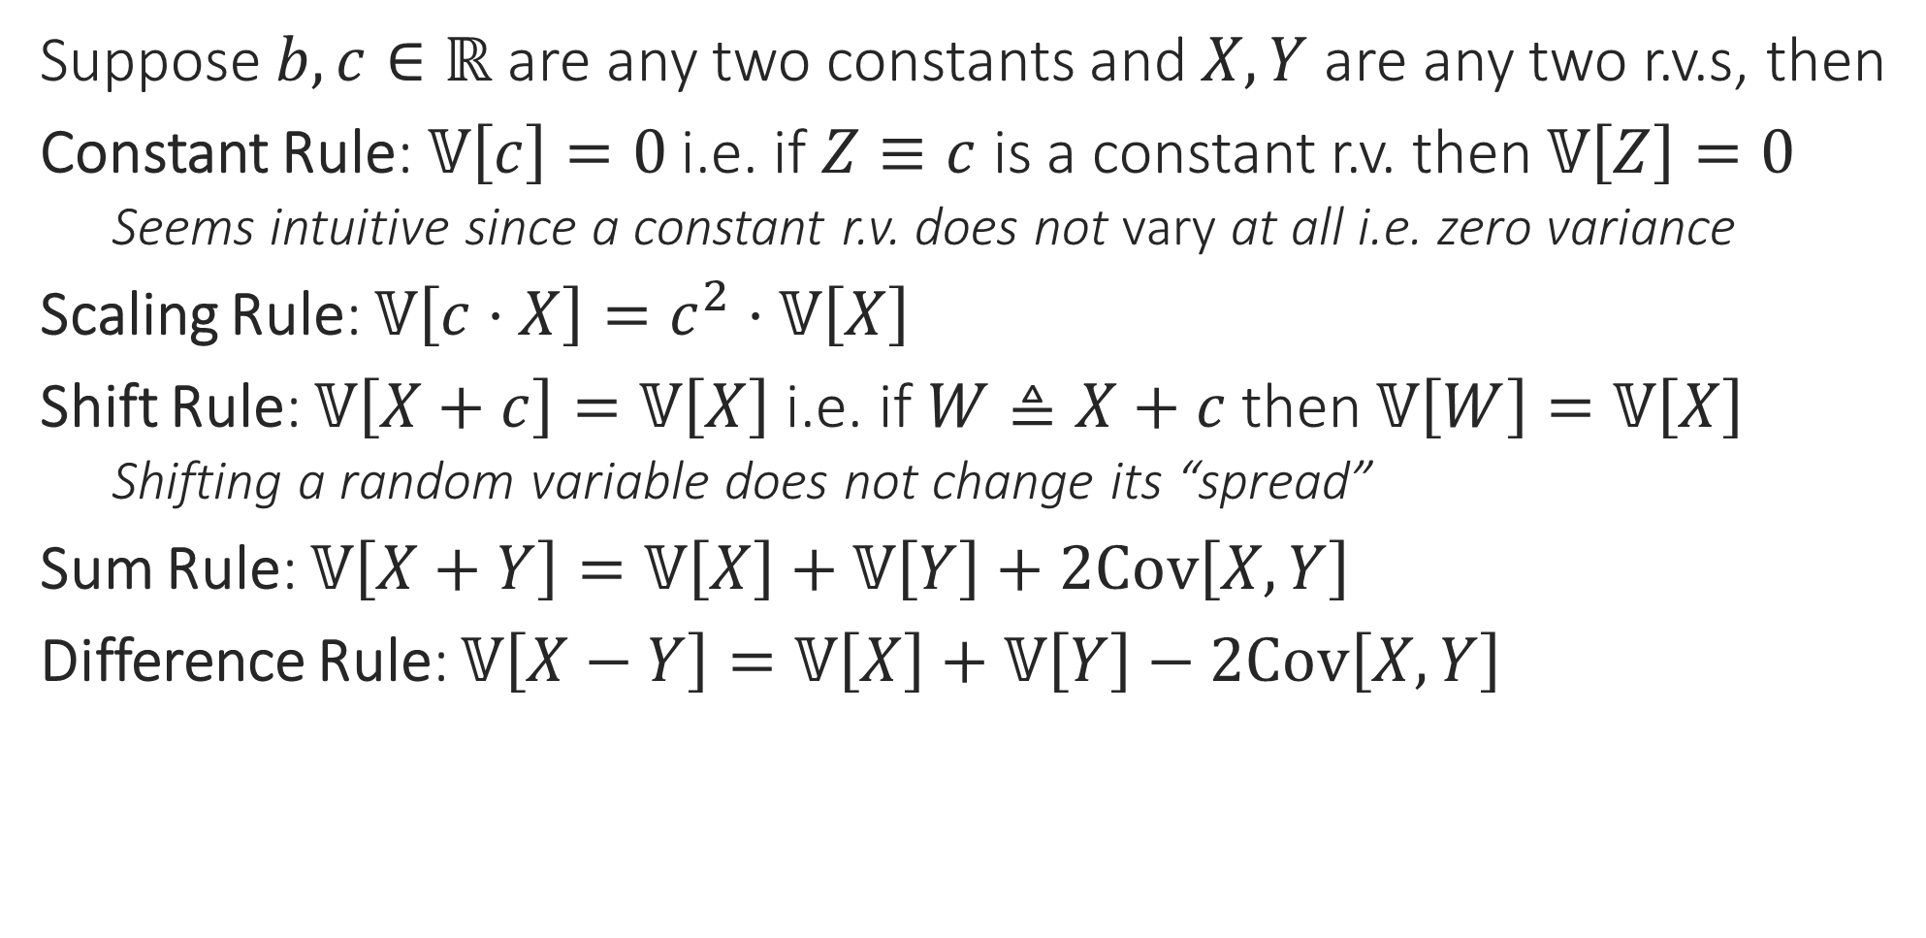
Rules of Variance
Suppose $b,c∈ℝ$ are any two constants and $X,Y$ are any two r.v.s, then
Constant Rule: $𝕍\left[c\right]=0$ i.e. if $Z≡c$ is a constant r.v. then $𝕍\left[Z\right]=0$
Seems intuitive since a constant r.v. does not vary at all i.e. zero variance
Scaling Rule: $𝕍\left[c⋅X\right]=c^{2}⋅𝕍\left[X\right]$
Shift Rule: $𝕍\left[X+c\right]=𝕍\left[X\right]$ i.e. if $W≜X+c$ then $𝕍\left[W\right]=𝕍\left[X\right]$
Shifting a random variable does not change its “spread”
Sum Rule: $𝕍\left[X+Y\right]=𝕍\left[X\right]+𝕍\left[Y\right]+2Cov\left[X,Y\right]$
Difference Rule: $𝕍\left[X−Y\right]=𝕍\left[X\right]+𝕍\left[Y\right]−2Cov\left[X,Y\right]$
Often used to deal with catastrophic cancellation by shifting the data to make it smaller in magnitude but leaving variance unchanged

Slide 26

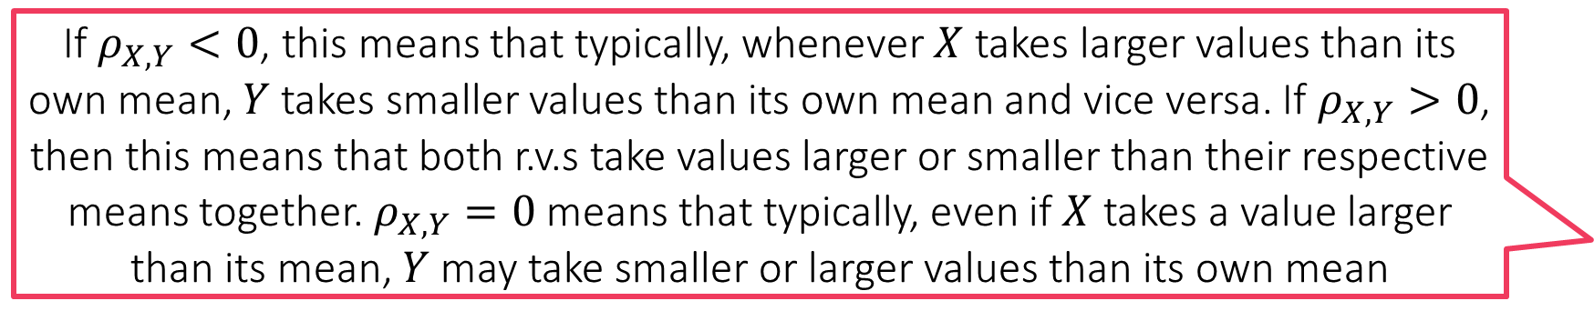
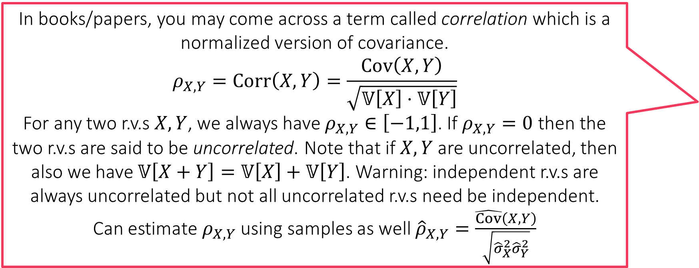
Rules of Covariance
In books/papers, you may come across a term called correlation which is a normalized version of covariance.
$$ρ_{X,Y}=Corr\left(X,Y\right)=\frac{Cov\left(X,Y\right)}{\sqrt{𝕍\left[X\right]⋅𝕍\left[Y\right]}}$$
For any two r.v.s $X,Y$, we always have $ρ_{X,Y}∈\left[−1,1\right]$. If $ρ_{X,Y}=0$ then the two r.v.s are said to be uncorrelated. Note that if $X,Y$ are uncorrelated, then also we have $𝕍\left[X+Y\right]=𝕍\left[X\right]+𝕍\left[Y\right]$. Warning: independent r.v.s are always uncorrelated but not all uncorrelated r.v.s need be independent.
Can estimate $ρ_{X,Y}$ using samples as well ${\hat{ρ}}_{X,Y}=\frac{\hat{Cov}\left(X,Y\right)}{\sqrt{{\hat{σ}}_{X}^{2}{\hat{σ}}_{Y}^{2}}}$
Suppose $b,c∈ℝ$ are any two constants and $X,Y$ are any two r.v.s, then
Constant Rule: $Cov\left[X,c\right]=0$
Symmetry Rule: $Cov\left[X,Y\right]=Cov\left[Y,X\right]$
Scaling Rule: $Cov\left[bX,cY\right]=bc⋅Cov\left[X,Y\right]$
Shift Rule: $Cov\left[X+b,Y+c\right]=Cov\left[X,Y\right]$
If $X,Y$ are independent then $Cov\left[X,Y\right]=0$
Proof: $Cov\left(X,Y\right)=𝔼\left[XY\right]−𝔼X⋅𝔼Y=𝔼X⋅𝔼Y−𝔼X⋅𝔼Y=0$
We applied the product rule for expectations above
Corollary: If $X,Y$ are independent r.v.s, then $𝕍\left[X+Y\right]=𝕍\left[X\right]+𝕍\left[Y\right]$
If $ρ_{X,Y}<0$, this means that typically, whenever $X$ takes larger values than its own mean, $Y$ takes smaller values than its own mean and vice versa. If $ρ_{X,Y}>0$, then this means that both r.v.s take values larger or smaller than their respective means together. $ρ_{X,Y}=0$ means that typically, even if $X$ takes a value larger than its mean, $Y$ may take smaller or larger values than its own mean

