Slide 1
Probabilistic ML II
CS771: Introduction to Machine Learning
Purushottam Kar

Slide 2
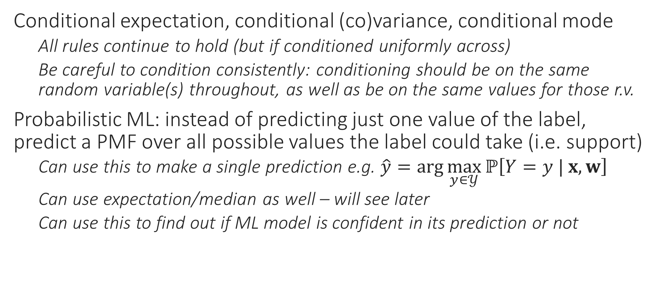
Recap of Last Lecture
Conditional expectation, conditional (co)variance, conditional mode
All rules continue to hold (but if conditioned uniformly across)
Be careful to condition consistently: conditioning should be on the same random variable(s) throughout, as well as be on the same values for those r.v.
Probabilistic ML: instead of predicting just one value of the label, predict a PMF over all possible values the label could take (i.e. support)
Can use this to make a single prediction e.g. $\hat{y}=\arg{\max_{y∈𝒴}{ℙ\left[Y=y | x, w\right]}}$
Can use expectation/median as well – will see later
Can use this to find out if ML model is confident in its prediction or not

Slide 3
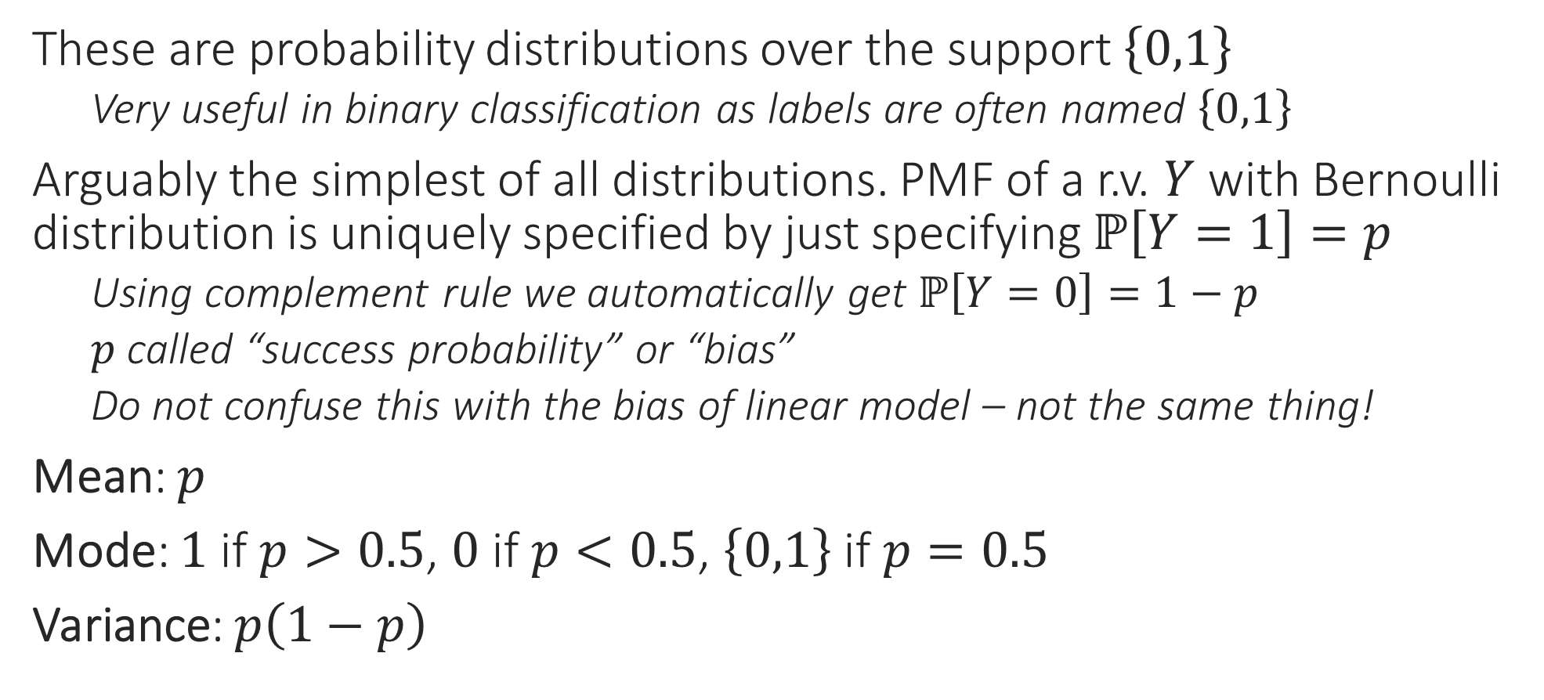
Bernoulli Distributions
These are probability distributions over the support $\left\{0,1\right\}$
Very useful in binary classification as labels are often named $\left\{0,1\right\}$
Arguably the simplest of all distributions. PMF of a r.v. $Y$ with Bernoulli distribution is uniquely specified by just specifying $ℙ\left[Y=1\right]=p$
Using complement rule we automatically get $ℙ\left[Y=0\right]=1−p$
$p$ called “success probability” or “bias”
Do not confuse this with the bias of linear model – not the same thing!
Mean: $p$
Mode: $1$ if $p>0.5$, $0$ if $p<0.5$, $\left\{0,1\right\}$ if $p=0.5$
Variance: $p\left(1−p\right)$

Slide 4
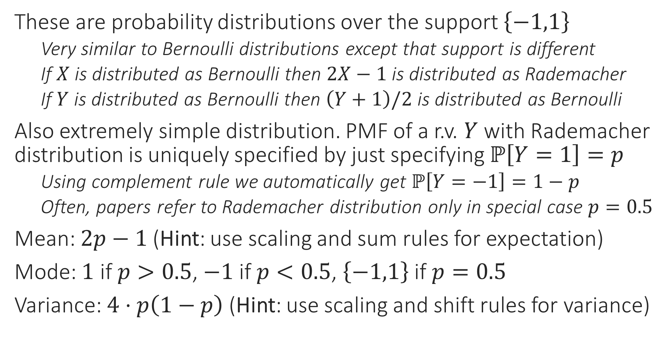
Rademacher Distributions
These are probability distributions over the support $\left\{−1,1\right\}$
Very similar to Bernoulli distributions except that support is different
If $X$ is distributed as Bernoulli then $2X−1$ is distributed as Rademacher
If $Y$ is distributed as Bernoulli then $\left(Y+1\right)/2$ is distributed as Bernoulli
Also extremely simple distribution. PMF of a r.v. $Y$ with Rademacher distribution is uniquely specified by just specifying $ℙ\left[Y=1\right]=p$
Using complement rule we automatically get $ℙ\left[Y=−1\right]=1−p$
Often, papers refer to Rademacher distribution only in special case $p=0.5$
Mean: $2p−1$ (Hint: use scaling and sum rules for expectation)
Mode: $1$ if $p>0.5$, $−1$ if $p<0.5$, $\left\{−1,1\right\}$ if $p=0.5$
Variance: $4⋅p\left(1−p\right)$ (Hint: use scaling and shift rules for variance)

Slide 5
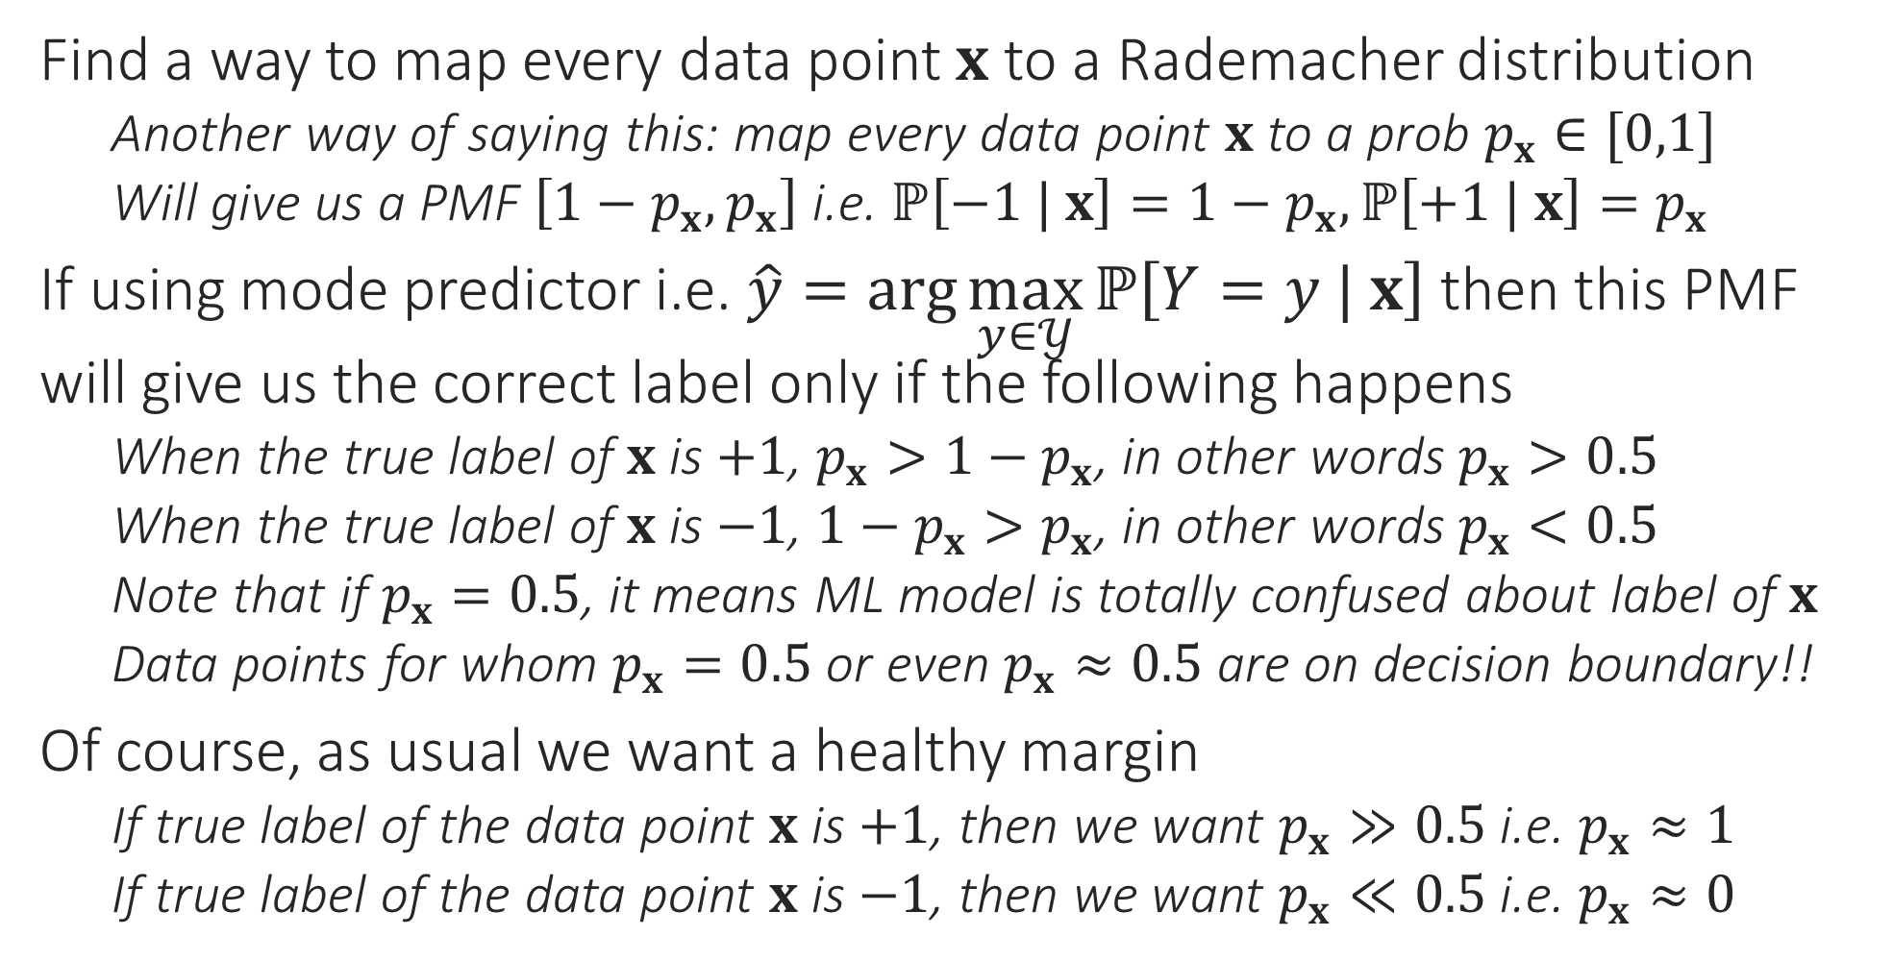
Probabilistic Binary Classification
Find a way to map every data point $x$ to a Rademacher distribution
Another way of saying this: map every data point $x$ to a prob $p_{x}∈[0,1]$
Will give us a PMF $\left[1−p_{x},p_{x}\right]$ i.e. $ℙ\left[−1 | x\right]=1−p_{x},ℙ\left[+1 | x\right]=p_{x}$
If using mode predictor i.e. $\hat{y}=\arg{\max_{y∈𝒴}{ℙ\left[Y=y | x\right]}}$ then this PMF will give us the correct label only if the following happens
When the true label of $x$ is $+1$, $p_{x}>1−p_{x}$, in other words $p_{x}>0.5$
When the true label of $x$ is $−1$, ${1−p}_{x}>p_{x}$, in other words $p_{x}<0.5$
Note that if $p_{x}=0.5$, it means ML model is totally confused about label of $x$
Data points for whom $p_{x}=0.5$ or even $p_{x}≈0.5$ are on decision boundary!!
Of course, as usual we want a healthy margin
If true label of the data point $x$ is $+1$, then we want $p_{x}≫0.5$ i.e. $p_{x}≈1$
If true label of the data point $x$ is $−1$, then we want $p_{x}≪0.5$ i.e. $p_{x}≈0$

Slide 6



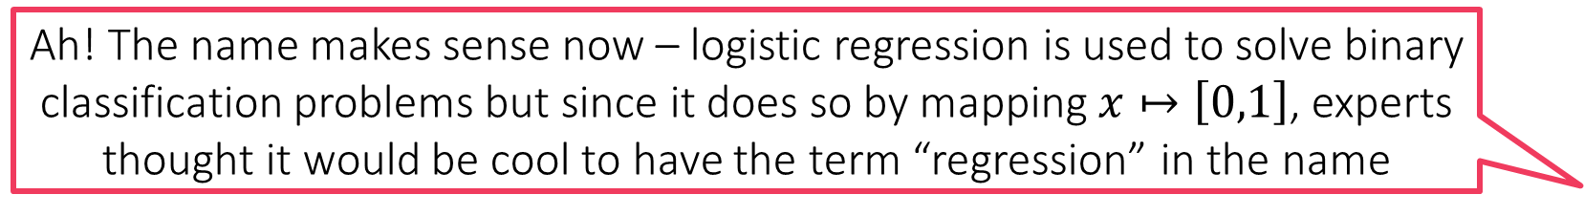
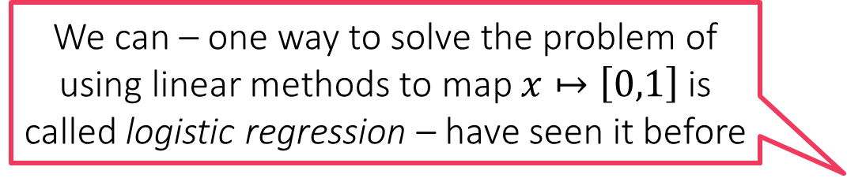
Probabilistic Binary Classification
So can we never use linear models to do probabilistic ML?
How to map feature vectors $x$ to probability values $p_{x}∈[0,1]$?
Could treat it as a regression problem since prob values $∈ℝ$ after all
Will need to modify the training set a bit to do this (basically change all $−1$ labels to $0$ since we want $p_{x}=0$ if the label is $−1$
Could use kNN, DT etc to solve this regression problem
Using linear models to do this presents a challenge
If we learn a linear model $w$ using ridge regression it may happen that for some data point $x$, we have $w^{⊤}x<0$ or else $w^{⊤}x>1$
$p_{x}$ wont make sense in this case – not a valid PMF!!
kNN, DT don’t suffer from this problem since they always predict a $p_{x}∈[0,1]$
kNN, DT use averages of a bunch of train labels to obtain test prediction – the average of a bunch of 0s and 1s is always a value in the range $\left[0,1\right]$
We can – one way to solve the problem of using linear methods to map $x↦\left[0,1\right]$ is called logistic regression – have seen it before
Yes, but there is a trick involved. Let us take a look at it
Ah! The name makes sense now – logistic regression is used to solve binary classification problems but since it does so by mapping $x↦\left[0,1\right]$, experts thought it would be cool to have the term “regression” in the name

Slide 7

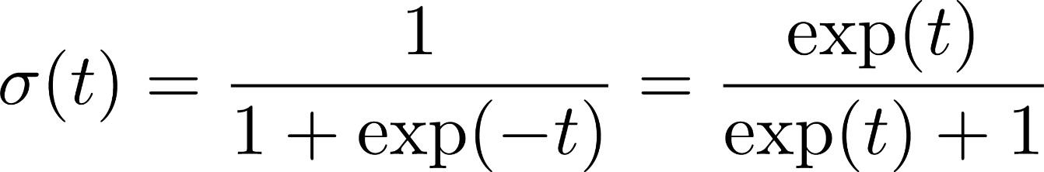
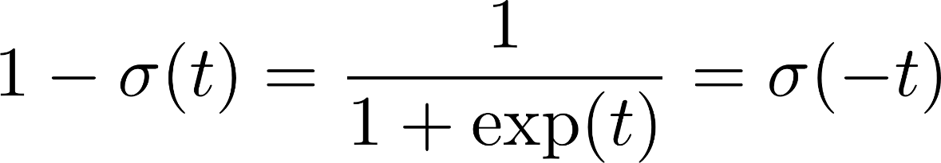
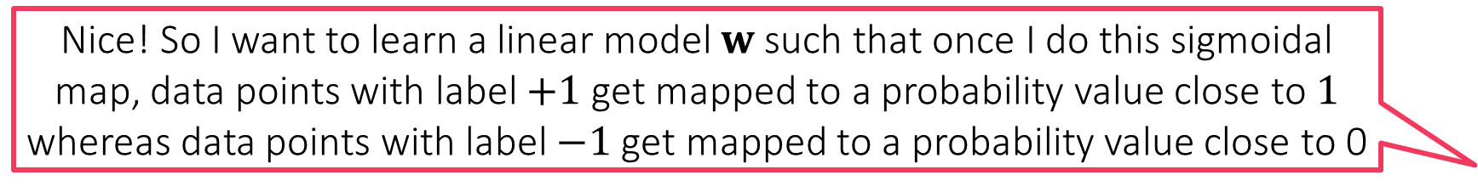

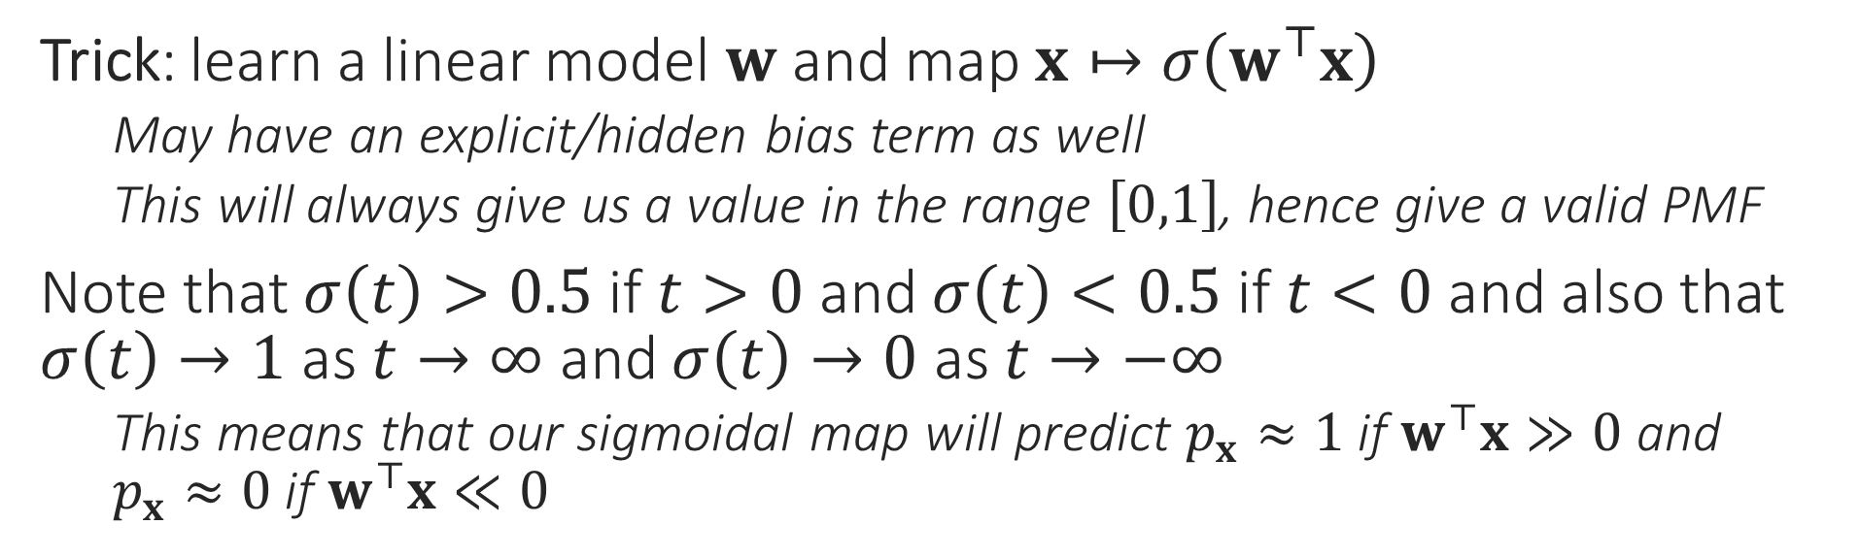
Sigmoid Function
Nice! So I want to learn a linear model $w$ such that once I do this sigmoidal map, data points with label $+1$ get mapped to a probability value close to $1$ whereas data points with label $−1$ get mapped to a probability value close to 0
1
0.5
There are several other such wrapper/quashing/link/activation functions which do similar jobs e.g. tanh, ramp, ReLU
0
Trick: learn a linear model $w$ and map $x↦σ\left(w^{⊤}x\right)$
May have an explicit/hidden bias term as well
This will always give us a value in the range $\left[0,1\right]$, hence give a valid PMF
Note that $σ\left(t\right)>0.5$ if $t>0$ and $σ\left(t\right)<0.5$ if $t<0$ and also that $σ\left(t\right)→1$ as $t→∞$ and $σ\left(t\right)→0$ as $t→−∞$
This means that our sigmoidal map will predict $p_{x}≈1$ if $w^{⊤}x≫0$ and $p_{x}≈0$ if $w^{⊤}x≪0$
How do I learn such a model $w$?

Slide 8
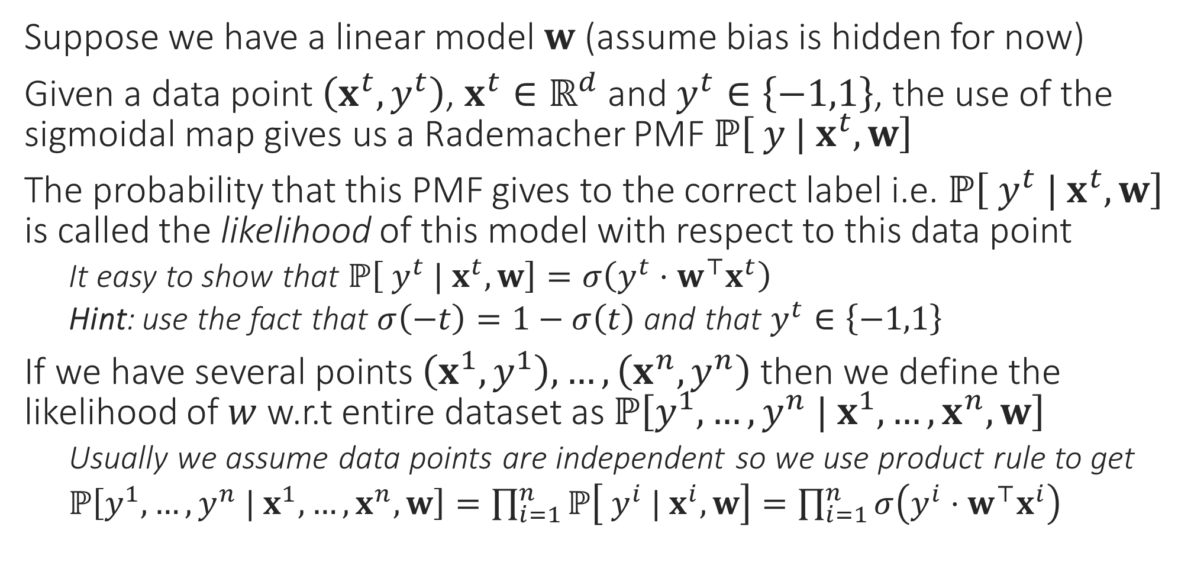
Likelihood
Data might not actually be independent e.g. my visiting a website may not be independent from my friend visiting the same website if I have found an offer on that website and posted about it on social website. However, often we nevertheless assume independence to make life simple
Suppose we have a linear model $w$ (assume bias is hidden for now)
Given a data point $\left(x^{t},y^{t}\right)$, $x^{t}∈ℝ^{d}$ and $y^{t}∈\left\{−1,1\right\}$, the use of the sigmoidal map gives us a Rademacher PMF $ℙ\left[ y | x^{t},w\right]$
The probability that this PMF gives to the correct label i.e. $ℙ\left[ y^{t} | x^{t},w\right]$ is called the likelihood of this model with respect to this data point
It easy to show that $ℙ\left[ y^{t} | x^{t},w\right]=σ\left(y^{t}⋅w^{⊤}x^{t}\right)$
Hint: use the fact that $σ\left(−t\right)=1−σ\left(t\right)$ and that $y^{t}∈\left\{−1,1\right\}$
If we have several points $\left(x^{1},y^{1}\right),…,\left(x^{n},y^{n}\right)$ then we define the likelihood of $w$ w.r.t entire dataset as $ℙ\left[y^{1},…,y^{n} | x^{1},…,x^{n},w\right]$
Usually we assume data points are independent so we use product rule to get
$ℙ\left[y^{1},…,y^{n} | x^{1},…,x^{n},w\right]=\prod_{i=1}^{n}{ℙ\left[ y^{i} | x^{i},w\right]}=\prod_{i=1}^{n}{σ\left(y^{i}⋅w^{⊤}x^{i}\right)}$

Slide 9
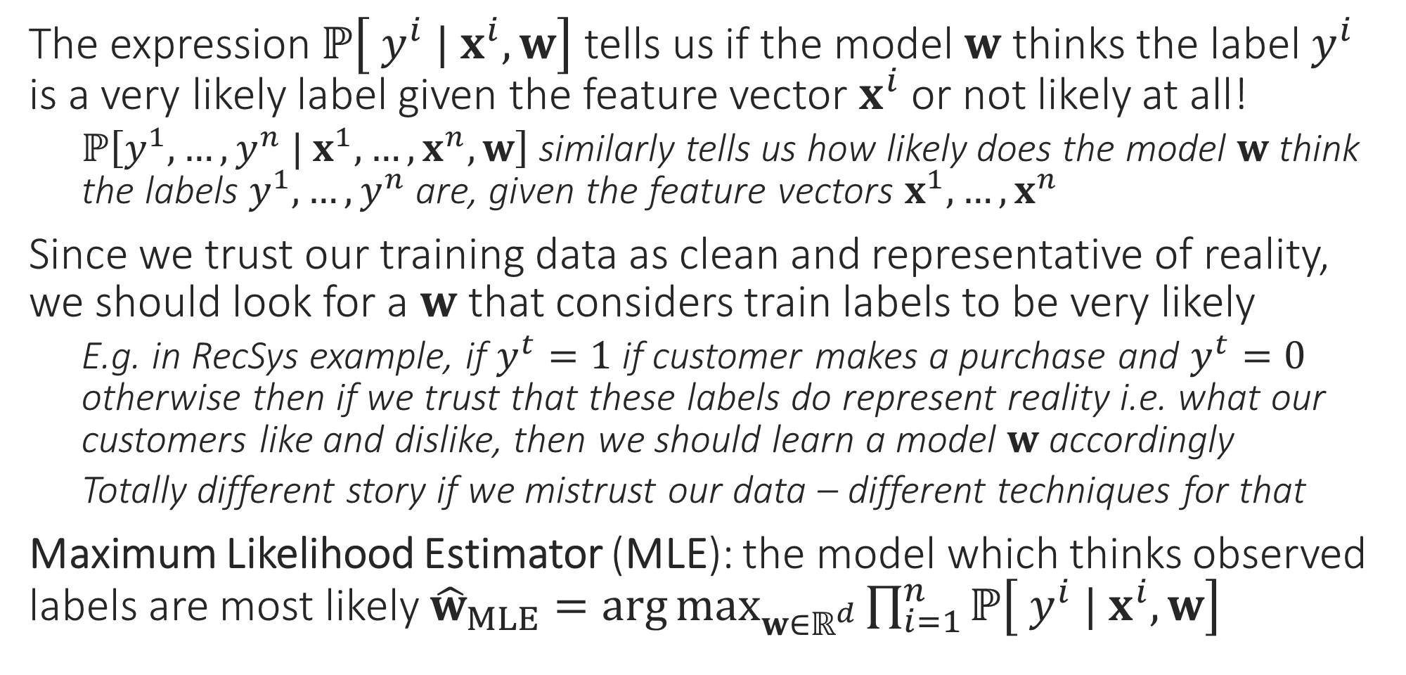
Maximum Likelihood
The expression $ℙ\left[ y^{i} | x^{i},w\right]$ tells us if the model $w$ thinks the label $y^{i}$ is a very likely label given the feature vector $x^{i}$ or not likely at all!
$ℙ\left[y^{1},…,y^{n} | x^{1},…,x^{n},w\right]$ similarly tells us how likely does the model $w$ think the labels $y^{1},…,y^{n}$ are, given the feature vectors $x^{1},…,x^{n}$
Since we trust our training data as clean and representative of reality, we should look for a $w$ that considers train labels to be very likely
E.g. in RecSys example, if $y^{t}=1$ if customer makes a purchase and $y^{t}=0$ otherwise then if we trust that these labels do represent reality i.e. what our customers like and dislike, then we should learn a model $w$ accordingly
Totally different story if we mistrust our data – different techniques for that
Maximum Likelihood Estimator (MLE): the model which thinks observed labels are most likely ${\hat{w}}_{MLE}=\arg{\max_{w∈ℝ^{d}}{\prod_{i=1}^{n}{ℙ\left[ y^{i} | x^{i},w\right]}}}$

Slide 10
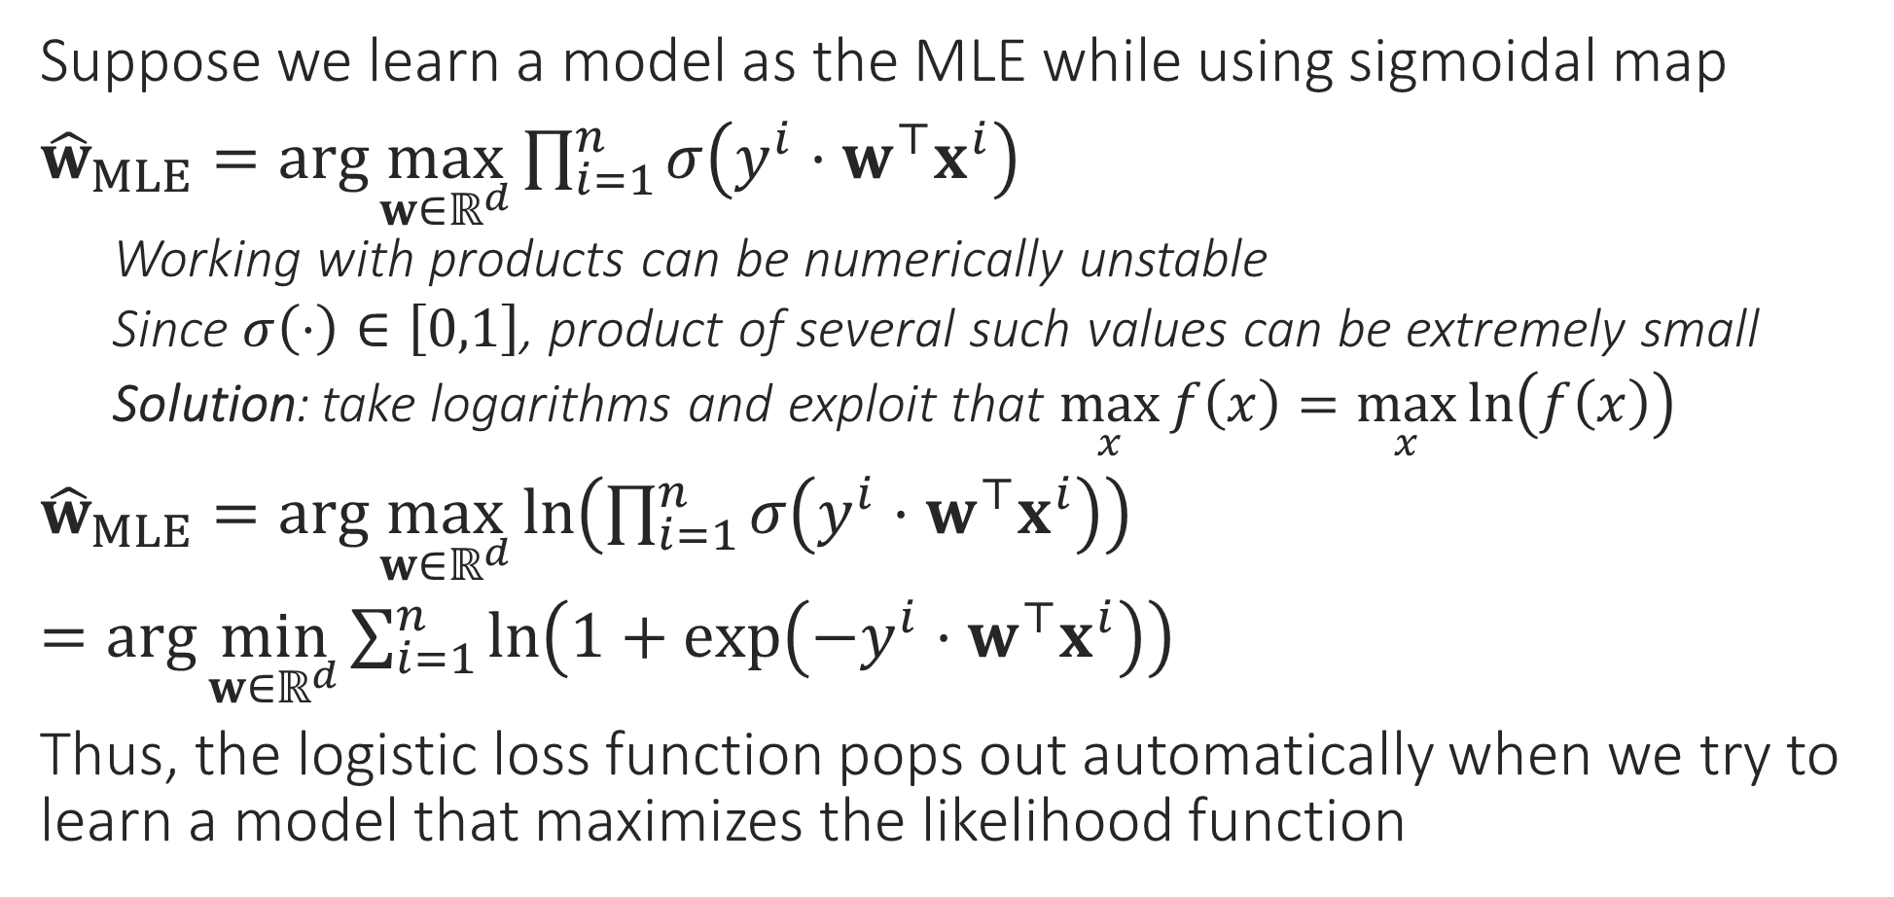
Logistic Regression
Suppose we learn a model as the MLE while using sigmoidal map
${\hat{w}}_{MLE}=\arg{\max_{w∈ℝ^{d}}{\prod_{i=1}^{n}{σ\left(y^{i}⋅w^{⊤}x^{i}\right)}}}$
Working with products can be numerically unstable
Since $σ\left(⋅\right)∈\left[0,1\right]$, product of several such values can be extremely small
Solution: take logarithms and exploit that $\max_{x}{f\left(x\right)}=\max_{x}{\ln\left(f\left(x\right)\right)}$
${\hat{w}}_{MLE}=\arg{\max_{w∈ℝ^{d}}{\ln\left(\prod_{i=1}^{n}{σ\left(y^{i}⋅w^{⊤}x^{i}\right)}\right)}}$
$=\arg{\min_{w∈ℝ^{d}}{\sum_{i=1}^{n}{\ln\left(1+\exp\left(−y^{i}⋅w^{⊤}x^{i}\right)\right)}}}$
Thus, the logistic loss function pops out automatically when we try to learn a model that maximizes the likelihood function
Also called negative log-likelihood

Slide 11


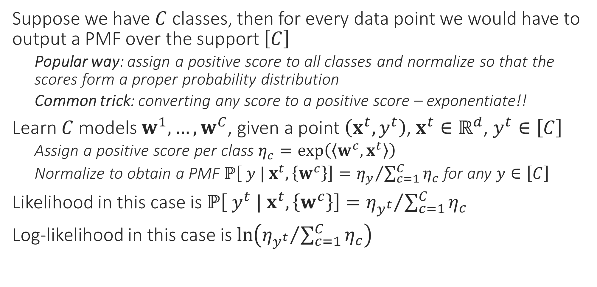
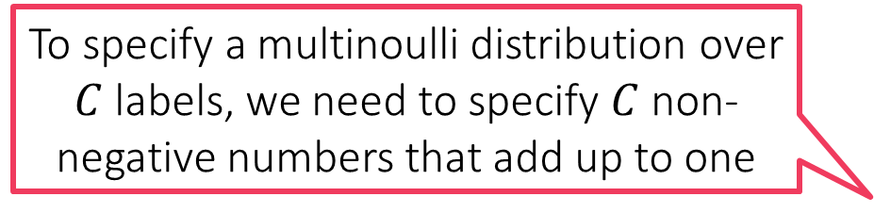
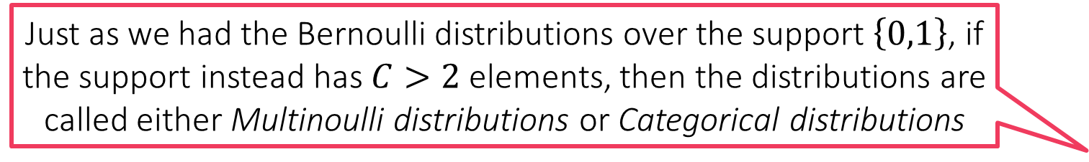
Probabilistic Multiclassification
Just as we had the Bernoulli distributions over the support $\left\{0,1\right\}$, if the support instead has $C>2$ elements, then the distributions are called either Multinoulli distributions or Categorical distributions
Suppose we have $C$ classes, then for every data point we would have to output a PMF over the support $\left[C\right]$
Popular way: assign a positive score to all classes and normalize so that the scores form a proper probability distribution
Common trick: converting any score to a positive score – exponentiate!!
Learn $C$ models $w^{1},…,w^{C}$, given a point $\left(x^{t},y^{t}\right)$, $x^{t}∈ℝ^{d}$, $y^{t}∈\left[C\right]$
Assign a positive score per class $η_{c}=\exp\left(\left\langle w^{c},x^{t}\right\rangle \right)$
Normalize to obtain a PMF $ℙ\left[ y | x^{t},\left\{w^{c}\right\}\right]={η_{y}}/{\sum_{c=1}^{C}{η_{c}}}$ for any $y∈\left[C\right]$
Likelihood in this case is $ℙ\left[ y^{t} | x^{t},\left\{w^{c}\right\}\right]={η_{y^{t}}}/{\sum_{c=1}^{C}{η_{c}}}$
Log-likelihood in this case is $\ln\left({η_{y^{t}}}/{\sum_{c=1}^{C}{η_{c}}}\right)$
To specify a multinoulli distribution over $C$ labels, we need to specify $C$ non-negative numbers that add up to one

Slide 12



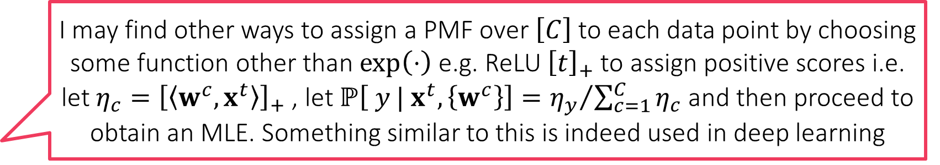
Softmax Regression
I may find other ways to assign a PMF over $\left[C\right]$ to each data point by choosing some function other than $\exp\left(⋅\right)$ e.g. ReLU ${\left[t\right]}_{+}$ to assign positive scores i.e. let $η_{c}={\left[\left\langle w^{c},x^{t}\right\rangle \right]}_{+}$ , let $ℙ\left[ y | x^{t},\left\{w^{c}\right\}\right]={η_{y}}/{\sum_{c=1}^{C}{η_{c}}}$ and then proceed to obtain an MLE. Something similar to this is indeed used in deep learning
If we now want to learn the MLE, we would have to find
$\left\{{\hat{w}}_{MLE}^{1},…,{\hat{w}}_{MLE}^{C}\right\}=\arg{\max_{w^{1},…,w^{C}∈ℝ^{d}}{\prod_{i=1}^{n}{ℙ\left[ y^{i} | x^{i},w\right]}}}$
$=\arg{\max_{w^{1},…,w^{C}∈ℝ^{d}}{\prod_{i=1}^{n}{{η_{y^{t}}^{i}}/{\sum_{c=1}^{C}{η_{c}^{i}}}}}}$ where $η_{c}^{i}=\exp\left(\left\langle w^{c},x^{i}\right\rangle \right)$
Using the negative log-likelihood for numerical stability
$=\arg{\min_{w^{1},…,w^{C}∈ℝ^{d}}{\sum_{i=1}^{n}{−\ln\left({η_{y^{t}}^{i}}/{\sum_{c=1}^{C}{η_{c}^{i}}}\right)}}}$
Note: this is nothing but the softmax loss function we saw earlier, also known as the cross entropy loss function
Reason for the name: it corresponds to something known as the cross entropy between the PMF given by the model and the true label of the data point
It should be noted that this is not the only way to do probabilistic multiclassification. It is just that this way is simple to understand, implement and hence popular
However, be warned that generating a PMF using DT/kNN need not necessarily be an MLE since we have not explicitly maximized any likelihood function here
I could do also kNN or DT and invoke the “probability as proportions” interpretation to assign a test data point to a PMF that simply gives the proportion of each label in the neighbourhood/leaf of that data point!!

Slide 13
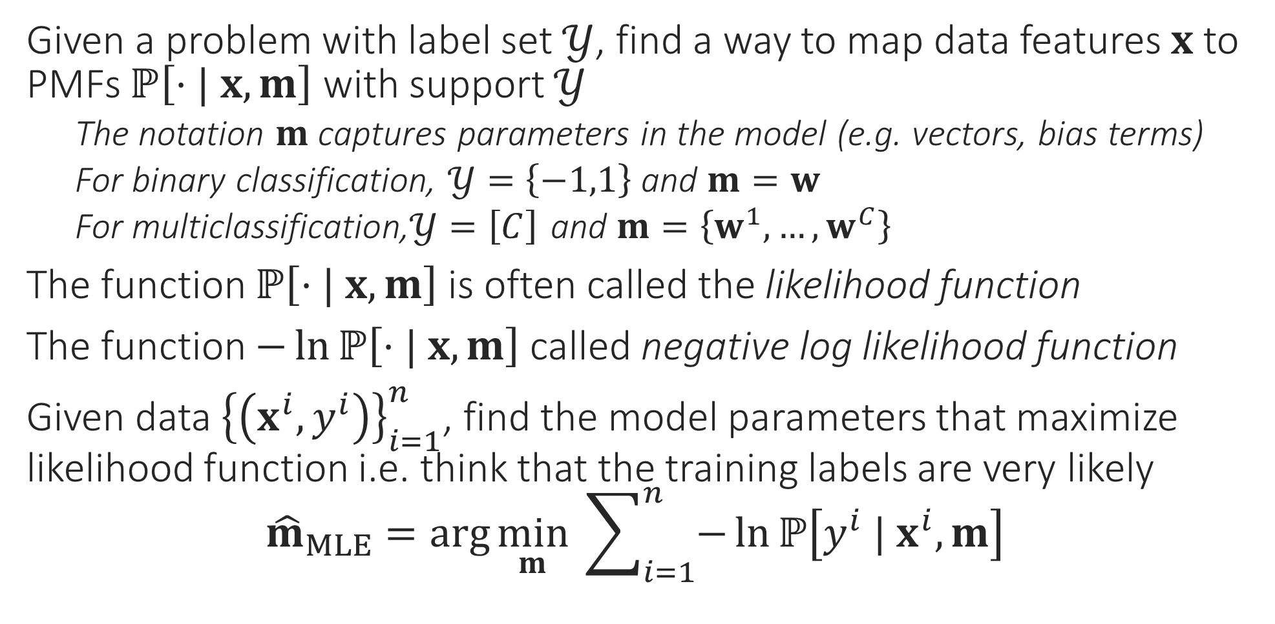
General Recipe for MLE Algorithms
Given a problem with label set $𝒴$, find a way to map data features $x$ to PMFs $ℙ\left[⋅| x, m\right]$ with support $𝒴$
The notation $m$ captures parameters in the model (e.g. vectors, bias terms)
For binary classification, $𝒴=\left\{−1,1\right\}$ and $m=w$
For multiclassification,$𝒴=\left[C\right]$ and $m=\left\{w^{1},…,w^{C}\right\}$
The function $ℙ\left[⋅| x, m\right]$ is often called the likelihood function
The function $−\ln{ℙ\left[⋅| x, m\right]}$ called negative log likelihood function
Given data ${\left\{\left(x^{i},y^{i}\right)\right\}}_{i=1}^{n}$, find the model parameters that maximize likelihood function i.e. think that the training labels are very likely ${\hat{m}}_{MLE}=\arg{\min_{m}{ \sum_{i=1}^{n}{−\ln{ℙ\left[y^{i} | x^{i}, m\right]}}}}$

Slide 14

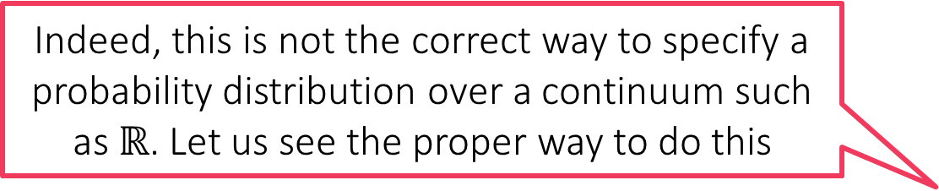
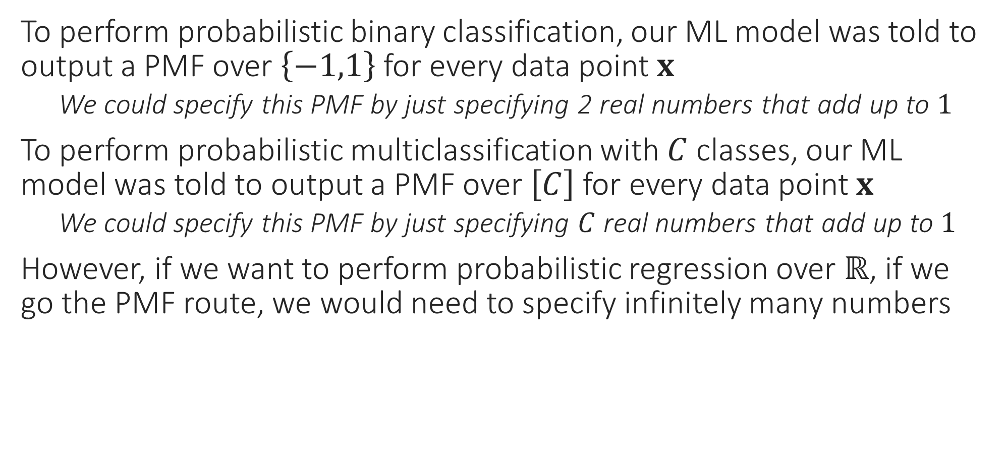
Probabilistic Regression??
To perform probabilistic binary classification, our ML model was told to output a PMF over $\left\{−1,1\right\}$ for every data point $x$
We could specify this PMF by just specifying 2 real numbers that add up to $1$
To perform probabilistic multiclassification with $C$ classes, our ML model was told to output a PMF over $\left[C\right]$ for every data point $x$
We could specify this PMF by just specifying $C$ real numbers that add up to $1$
However, if we want to perform probabilistic regression over $ℝ$, if we go the PMF route, we would need to specify infinitely many numbers
Indeed, this is not the correct way to specify a probability distribution over a continuum such as $ℝ$. Let us see the proper way to do this
We can’t do that. Is there a way out?

Slide 15


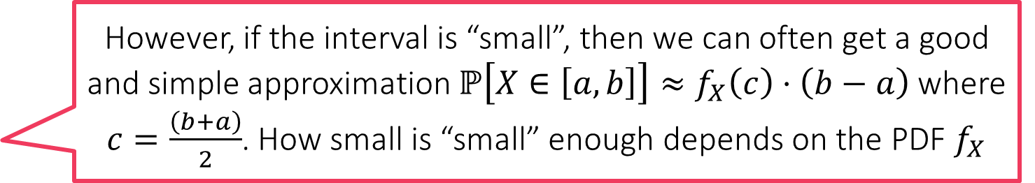

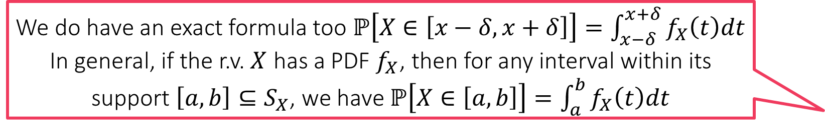
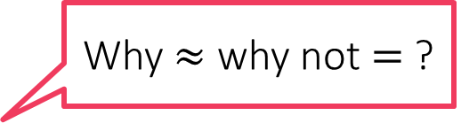
Continuous Random Variables
These are r.v. that can take infinitely many possibly values that are not discrete but continuous i.e. support is $ℝ$ or some subset of $ℝ$
The notion of PMF which tells us with what probability does the r.v. take this value or that value does not make sense when support is continuous
Instead of PMF, we use a PDF (probability density function) in such cases
Consider a r.v. $X$ which takes value in the interval $\left[−2,2\right]$
Warning: $\left[−2,2\right]$ is very different from $\left\{−2,2\right\}$
To specify the probability distribution of $X$ we use a PDF $f_{X}:S_{X}→ℝ_{+}$
The PDF takes a value in support of r.v. and spits out a non-negative number
Note: $f_{X}$ can take values greater than $1$ as well but they must not be negative
Interpretation: For any $x∈S_{X}$, the value $f_{X}\left(x\right)$ tells us how likely is $X$ to take a value around $x$ i.e. for some teeny $δ>0$, we have $ℙ\left[X∈\left[x−δ,x+δ\right]\right]≈f_{X}\left(x\right)⋅2δ$
Why $≈$ why not $=$ ?
We do have an exact formula too $ℙ\left[X∈\left[x−δ,x+δ\right]\right]=\int_{x−δ}^{x+δ}{f_{X}\left(t\right)dt}$
In general, if the r.v. $X$ has a PDF $f_{X}$, then for any interval within its support $\left[a,b\right]⊆S_{X}$, we have $ℙ\left[X∈\left[a,b\right]\right]=\int_{a}^{b}{f_{X}\left(t\right)dt}$
However, if the interval is “small”, then we can often get a good and simple approximation $ℙ\left[X∈\left[a,b\right]\right]≈f_{X}\left(c\right)⋅\left(b−a\right)$ where $c=\frac{\left(b+a\right)}{2}$. How small is “small” enough depends on the PDF $f_{X}$

Slide 16
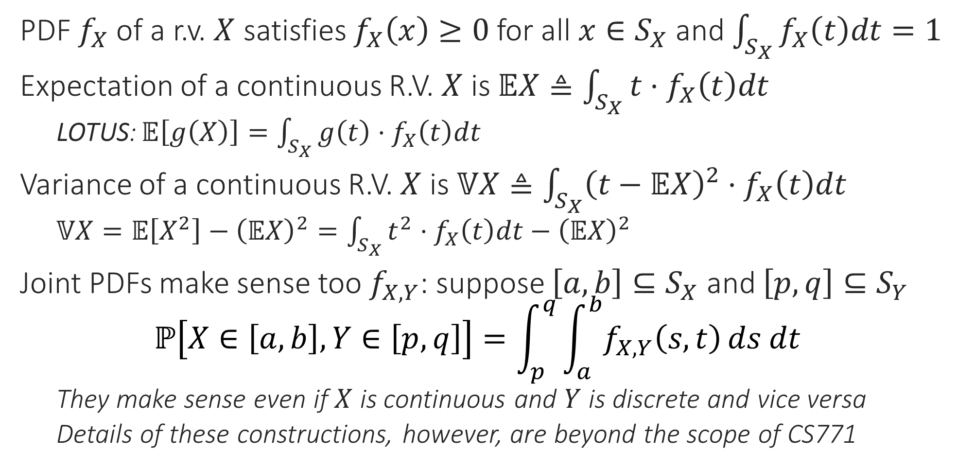
Continuous R.V.s– the Rules Revisited
PDF $f_{X}$ of a r.v. $X$ satisfies $f_{X}\left(x\right)≥0$ for all $x∈S_{X}$ and $\int_{S_{X}}{f_{X}\left(t\right)dt}=1$
Expectation of a continuous R.V. $X$ is $𝔼X≜\int_{S_{X}}{t⋅f_{X}\left(t\right)dt}$
LOTUS: $𝔼\left[g\left(X\right)\right]=\int_{S_{X}}{g\left(t\right)⋅f_{X}\left(t\right)dt}$
Variance of a continuous R.V. $X$ is $𝕍X≜\int_{S_{X}}{{\left(t−𝔼X\right)}^{2}⋅f_{X}\left(t\right)dt}$
$𝕍X=𝔼\left[X^{2}\right]−{\left(𝔼X\right)}^{2}=\int_{S_{X}}{t^{2}⋅f_{X}\left(t\right)dt}−{\left(𝔼X\right)}^{2}$
Joint PDFs make sense too $f_{X,Y}$: suppose $\left[a,b\right]⊆S_{X}$ and $\left[p,q\right]⊆S_{Y}$ $ℙ\left[X∈\left[a,b\right],Y∈\left[p,q\right]\right]=\int_{p}^{q}{\int_{a}^{b}{f_{X,Y}\left(s,t\right)}ds dt}$
They make sense even if $X$ is continuous and $Y$ is discrete and vice versa
Details of these constructions, however, are beyond the scope of CS771

Slide 17
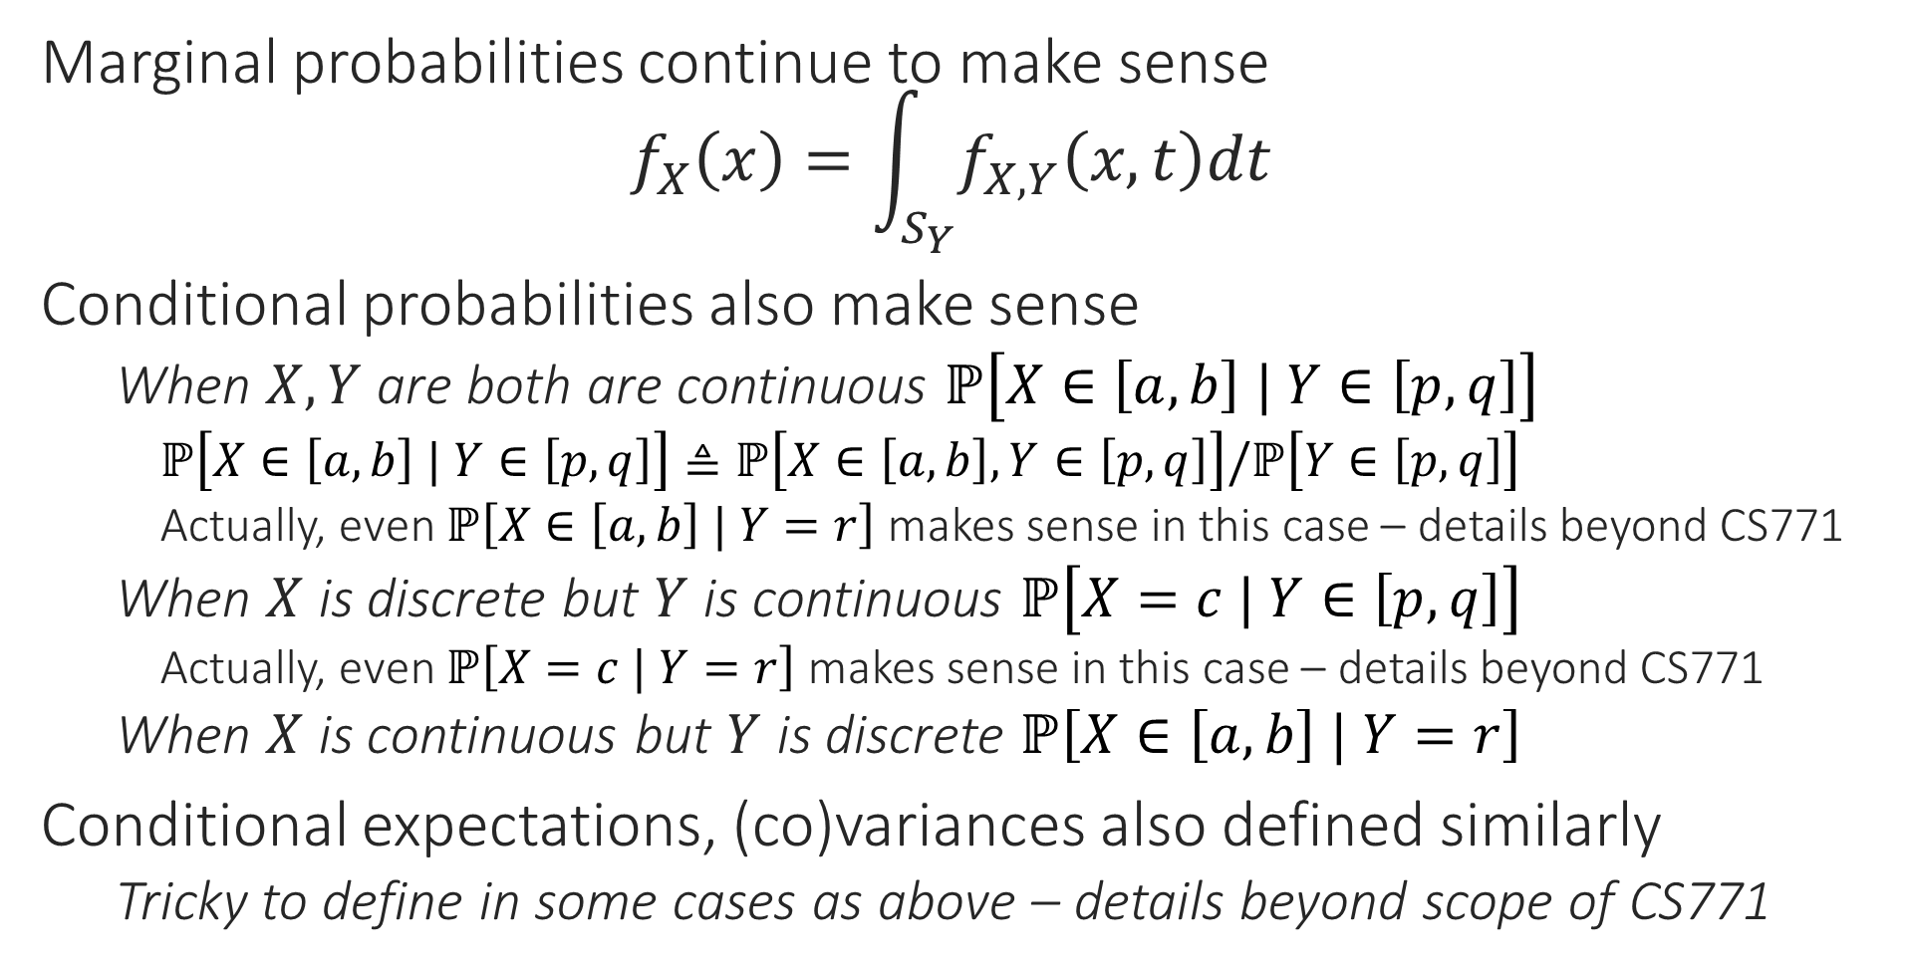
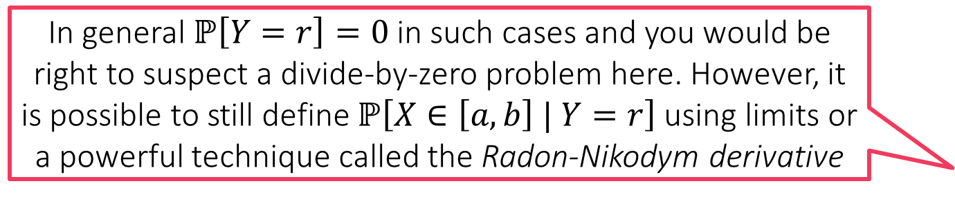
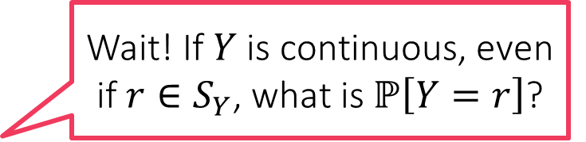
Continuous R.V.s– the Rules Revisited
Wait! If $Y$ is continuous, even if $r∈S_{Y}$, what is $ℙ\left[Y=r\right]$?
Marginal probabilities continue to make sense $f_{X}\left(x\right)=\int_{S_{Y}}{f_{X,Y}\left(x,t\right)dt}$
Conditional probabilities also make sense
When $X,Y$ are both are continuous $ℙ\left[X∈\left[a,b\right] | Y∈\left[p,q\right]\right]$
$ℙ\left[X∈\left[a,b\right] | Y∈\left[p,q\right]\right]≜ℙ\left[X∈\left[a,b\right],Y∈\left[p,q\right]\right]/ℙ\left[Y∈\left[p,q\right]\right]$
Actually, even $ℙ\left[X∈\left[a,b\right] | Y=r\right]$ makes sense in this case – details beyond CS771
When $X$ is discrete but $Y$ is continuous $ℙ\left[X=c | Y∈\left[p,q\right]\right]$
Actually, even $ℙ\left[X=c | Y=r\right]$ makes sense in this case – details beyond CS771
When $X$ is continuous but $Y$ is discrete $ℙ\left[X∈\left[a,b\right] | Y=r\right]$
Conditional expectations, (co)variances also defined similarly
Tricky to define in some cases as above – details beyond scope of CS771
In general $ℙ\left[Y=r\right]=0$ in such cases and you would be right to suspect a divide-by-zero problem here. However, it is possible to still define $ℙ\left[X∈\left[a,b\right] | Y=r\right]$ using limits or a powerful technique called the Radon-Nikodym derivative

Slide 18
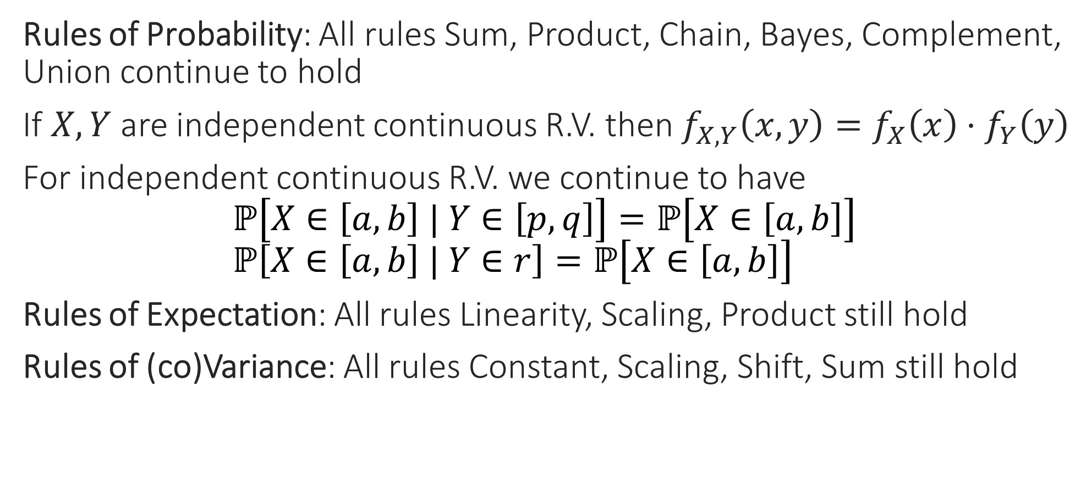
Continuous R.V.s– the Rules Revisited
Rules of Probability: All rules Sum, Product, Chain, Bayes, Complement, Union continue to hold
If $X,Y$ are independent continuous R.V. then $f_{X,Y}\left(x,y\right)=f_{X}\left(x\right)⋅f_{Y}\left(y\right)$
For independent continuous R.V. we continue to have $ℙ\left[X∈\left[a,b\right] | Y∈\left[p,q\right]\right]=ℙ\left[X∈\left[a,b\right]\right]$ $ℙ\left[X∈\left[a,b\right] | Y∈r\right]=ℙ\left[X∈\left[a,b\right]\right]$
Rules of Expectation: All rules Linearity, Scaling, Product still hold
Rules of (co)Variance: All rules Constant, Scaling, Shift, Sum still hold

