Slide 1
Probabilistic ML III
CS771: Introduction to Machine Learning
Purushottam Kar

Slide 2
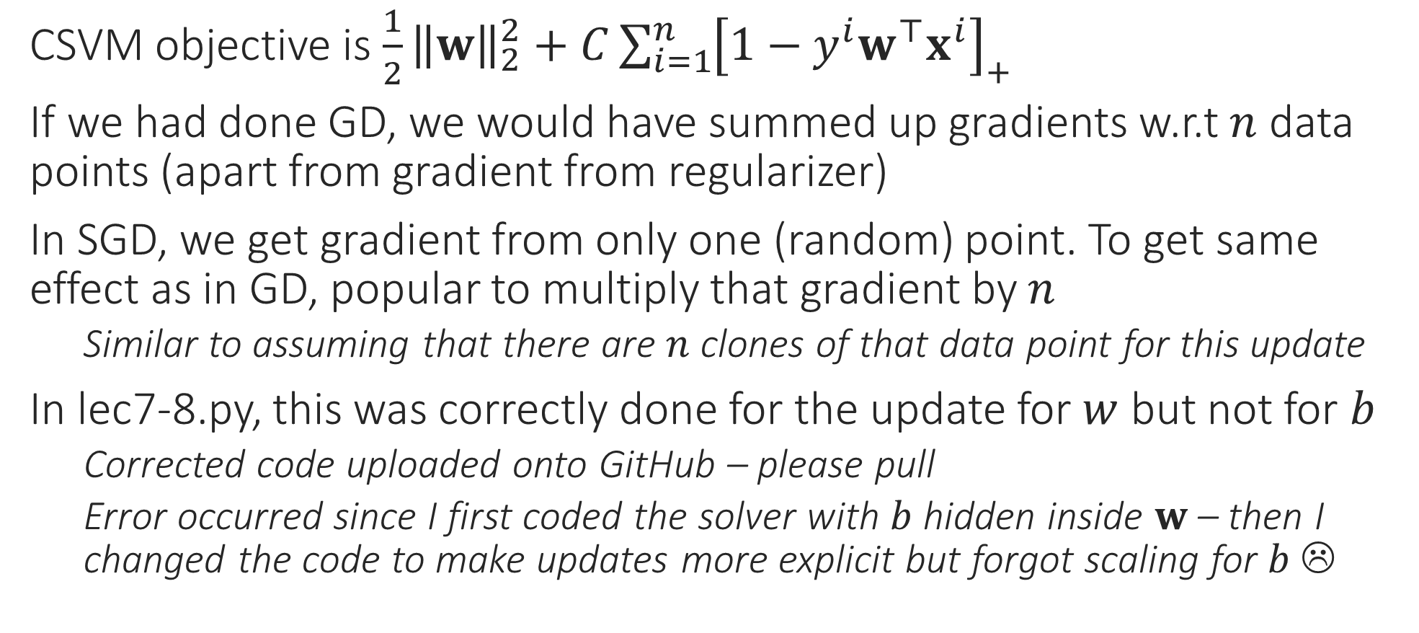
Scaling in SGD
CSVM objective is $\frac{1}{2}{\left\|w\right\|}_{2}^{2}+C{\sum_{i=1}^{n}{\left[1−y^{i}w^{⊤}x^{i}\right]}}_{+}$
If we had done GD, we would have summed up gradients w.r.t $n$ data points (apart from gradient from regularizer)
In SGD, we get gradient from only one (random) point. To get same effect as in GD, popular to multiply that gradient by $n$
Similar to assuming that there are $n$ clones of that data point for this update
In lec7-8.py, this was correctly done for the update for $w$ but not for $b$
Corrected code uploaded onto GitHub – please pull
Error occurred since I first coded the solver with $b$ hidden inside $w$ – then I changed the code to make updates more explicit but forgot scaling for $b$ ☹

Slide 3
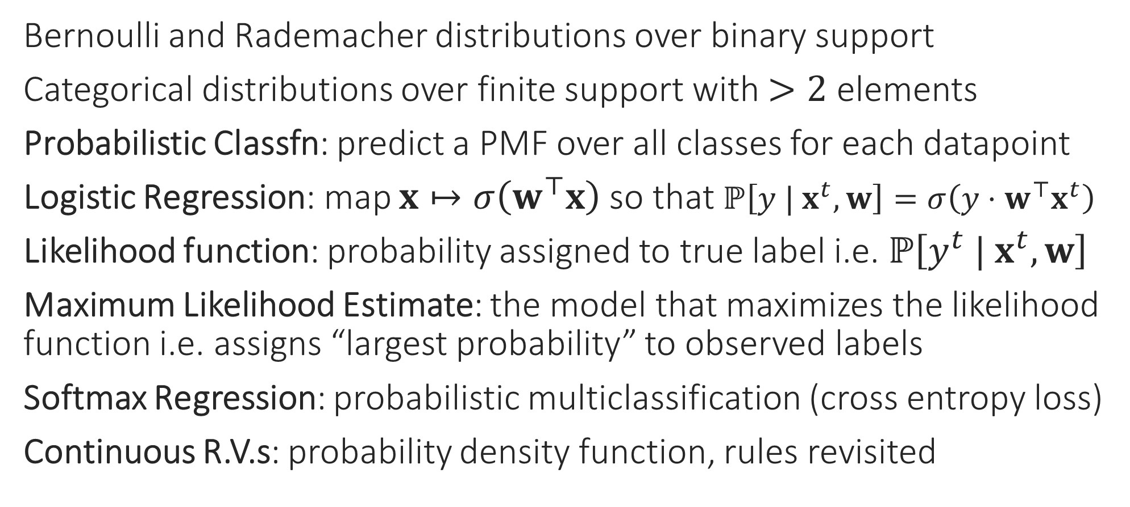
Recap of Last Lecture
Bernoulli and Rademacher distributions over binary support
Categorical distributions over finite support with $>2$ elements
Probabilistic Classfn: predict a PMF over all classes for each datapoint
Logistic Regression: map $x↦σ\left(w^{⊤}x\right)$ so that $ℙ\left[y | x^{t},w\right]=σ\left(y⋅w^{⊤}x^{t}\right)$
Likelihood function: probability assigned to true label i.e. $ℙ\left[y^{t} | x^{t},w\right]$
Maximum Likelihood Estimate: the model that maximizes the likelihood function i.e. assigns “largest probability” to observed labels
Softmax Regression: probabilistic multiclassification (cross entropy loss)
Continuous R.V.s: probability density function, rules revisited

Slide 4




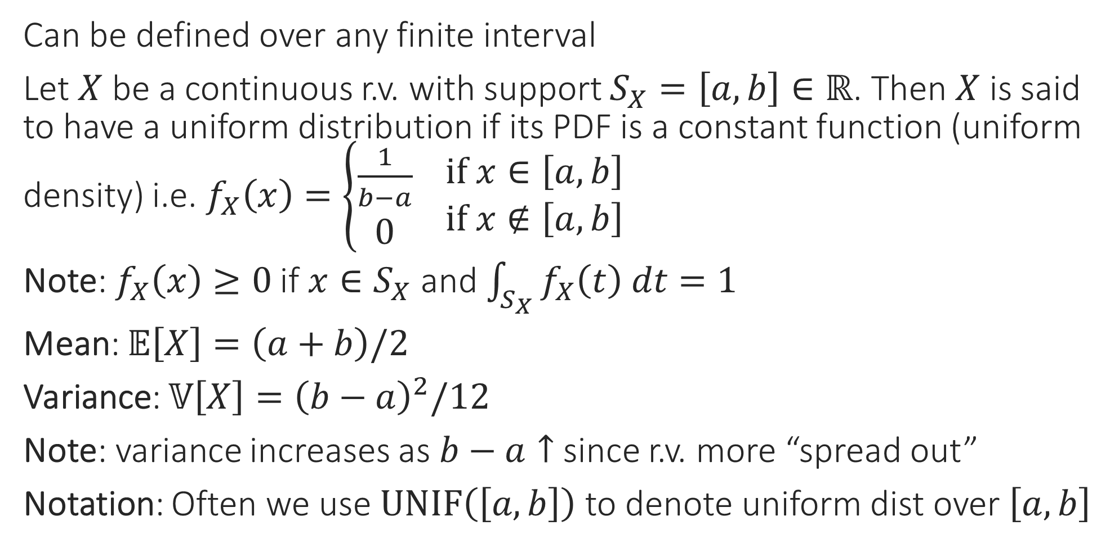


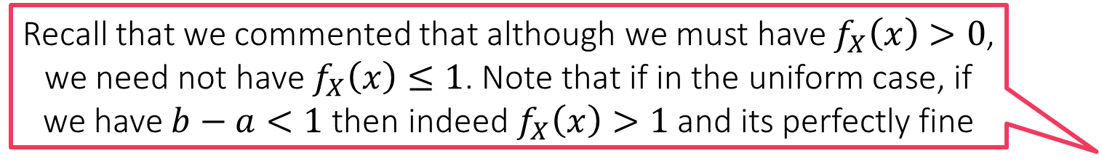

Uniform Distribution
Recall that we commented that although we must have $f_{X}\left(x\right)>0$, we need not have $f_{X}\left(x\right)≤1$. Note that if in the uniform case, if we have $b−a<1$ then indeed $f_{X}\left(x\right)>1$ and its perfectly fine
Can be defined over any finite interval
Let $X$ be a continuous r.v. with support $S_{X}=\left[a,b\right]∈ℝ$. Then $X$ is said to have a uniform distribution if its PDF is a constant function (uniform density) i.e. $f_{X}\left(x\right)=\left\{\begin{aligned}\frac{1}{b−a} \\ 0\end{aligned} \begin{matrix}if x∈\left[a,b\right] \\ if x∉\left[a,b\right]\end{matrix}\right.$
Note: $f_{X}\left(x\right)≥0$ if $x∈S_{X}$ and $\int_{S_{X}}{f_{X}\left(t\right) dt}=1$
Mean: $𝔼\left[X\right]=\left(a+b\right)/2$
Variance: $𝕍\left[X\right]={\left(b−a\right)}^{2}/12$
Note: variance increases as $b−a↑$ since r.v. more “spread out”
Notation: Often we use $UNIF\left(\left[a,b\right]\right)$ to denote uniform dist over $\left[a,b\right]$
$$f_{X}\left(x\right)$$
$$\frac{1}{b−a}$$
$$a$$
$$\frac{a+b}{2}$$
$$b$$
$$x$$

Slide 5
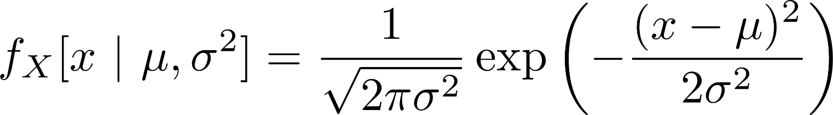



Gaussian (aka Normal) Distributions
Arguably one of the most popular of all probability distributions
Models our intuitive assumption that in real life, data often takes values around its mean value and it gets unlikely to witness extreme values
A fundamental result in probability theory – the law of large numbers –shows that some form of this is indeed true

Slide 6
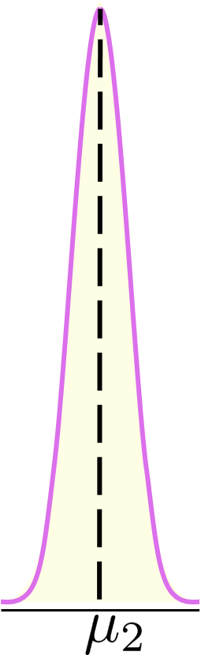

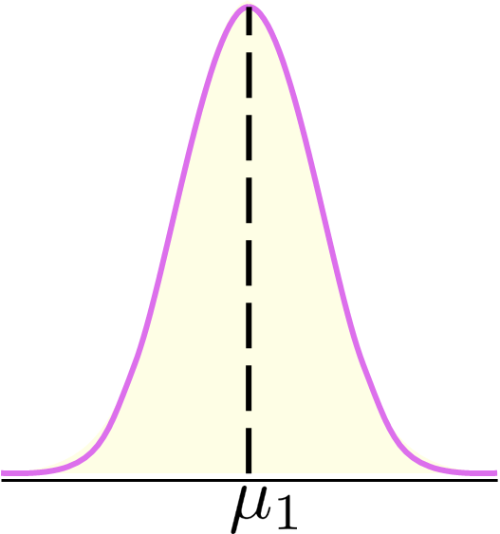
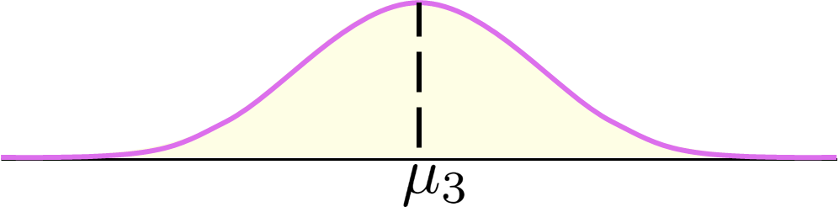

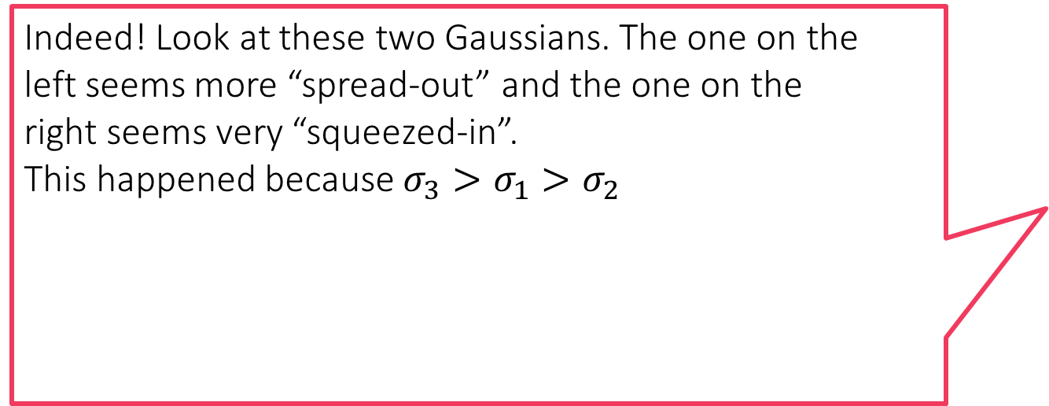
Gaussian Distributions
Indeed! Look at these two Gaussians. The one on the left seems more “spread-out” and the one on the right seems very “squeezed-in”. This happened because $σ_{3}>σ_{1}>σ_{2}$
Specifying a Bernoulli/Rademacher distribution took two numbers,
Specifying a categorical distribution over $C$ elements takes $C$ numbers
Specifying a Gaussian distribution over $ℝ$ requires two numbers
$μ$: must be a real number (may be negative or positive or even zero)
$σ^{2}$: must be a non-negative real number
Notation: PDF for a Gaussian r.v. $X$ i.e. $f_{X}\left[X | μ,σ^{2}\right]$ is often written as $𝒩_{X}\left(x;μ,σ^{2}\right)$ or simply as $𝒩\left(x;μ,σ^{2}\right)$
Notice that even here we condition on constants (either using $|$ or $;$ symbol)
The notation is no accident – if the PDF of a r.v. $X$ is $𝒩_{X}\left(x;μ,σ^{2}\right)$, then
$𝔼\left[X\right]=μ$ = Mode = Median, as well as $𝕍\left[X\right]=σ^{2}$
Requires a bit of integration to prove these results ☺

Slide 7

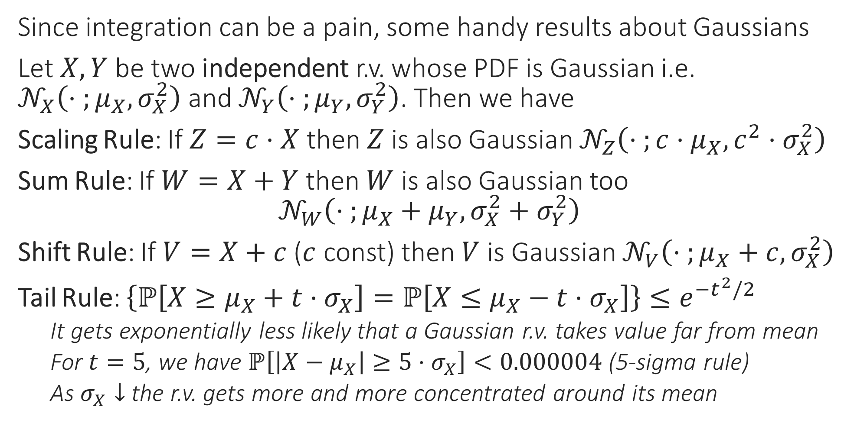
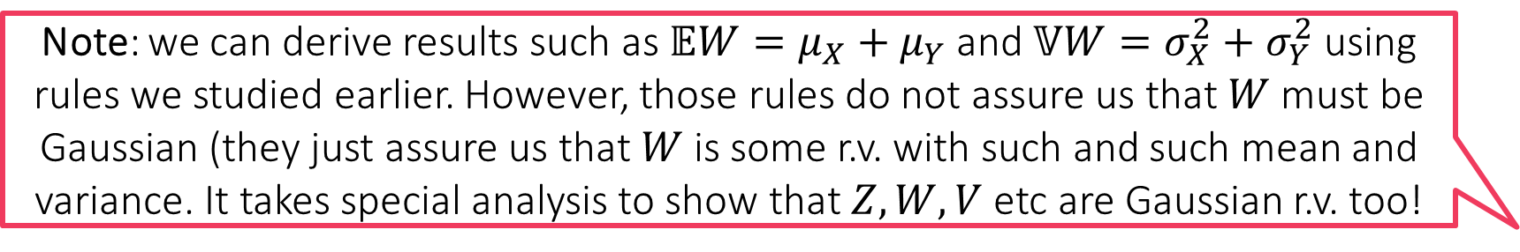
Operations with Gaussians
Note: we can derive results such as $𝔼W=μ_{X}+μ_{Y}$ and $𝕍W=σ_{X}^{2}+σ_{Y}^{2}$ using rules we studied earlier. However, those rules do not assure us that $W$ must be Gaussian (they just assure us that $W$ is some r.v. with such and such mean and variance. It takes special analysis to show that $Z,W,V$ etc are Gaussian r.v. too!
Since integration can be a pain, some handy results about Gaussians
Let $X,Y$ be two independent r.v. whose PDF is Gaussian i.e. $𝒩_{X}\left(⋅ ;μ_{X},σ_{X}^{2}\right)$ and $𝒩_{Y}\left(⋅ ;μ_{Y},σ_{Y}^{2}\right)$. Then we have
Scaling Rule: If $Z=c⋅X$ then $Z$ is also Gaussian $𝒩_{Z}\left(⋅ ;c⋅μ_{X},c^{2}⋅σ_{X}^{2}\right)$
Sum Rule: If $W=X+Y$ then $W$ is also Gaussian too $𝒩_{W}\left(⋅ ;μ_{X}+μ_{Y},σ_{X}^{2}+σ_{Y}^{2}\right)$
Shift Rule: If $V=X+c$ ($c$ const) then $V$ is Gaussian $𝒩_{V}\left(⋅ ;μ_{X}+c,σ_{X}^{2}\right)$
Tail Rule: $\left\{ℙ\left[X≥μ_{X}+t⋅σ_{X}\right]=ℙ\left[X≤μ_{X}−t⋅σ_{X}\right]\right\}≤e^{−t^{2}/2}$
It gets exponentially less likely that a Gaussian r.v. takes value far from mean
For $t=5$, we have $ℙ\left[\left|X−μ_{X}\right|≥5⋅σ_{X}\right]<0.000004$ (5-sigma rule)
As $σ_{X}↓$ the r.v. gets more and more concentrated around its mean

Slide 8

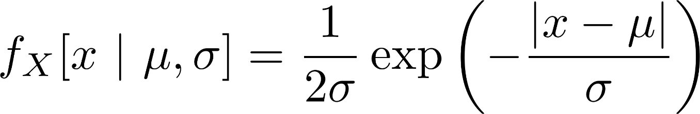
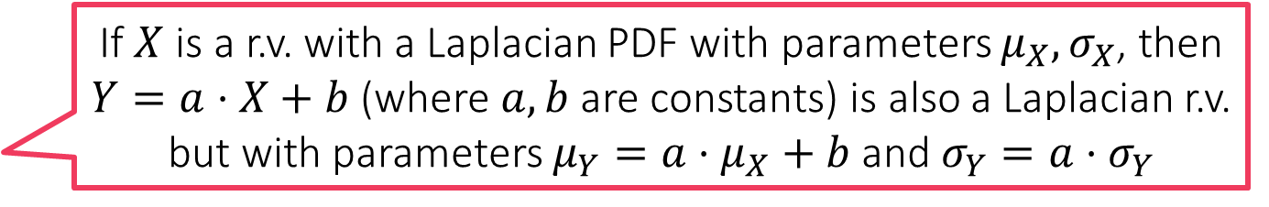

Laplacian Distribution
If $X$ is a r.v. with a Laplacian PDF with parameters $μ_{X},σ_{X}$, then $Y=a⋅X+b$ (where $a,b$ are constants) is also a Laplacian r.v. but with parameters $μ_{Y}=a⋅μ_{X}+b$ and $σ_{Y}=a⋅σ_{Y}$
Close cousins of Gaussian distributions except that a Laplacian r.v. concentrates much more strongly around its mean than a Gaussian r.v.
Also require two parameters to be specified $μ∈ℝ,σ≥0$
Mean = Mode = Median: $μ$, Variance: $2σ^{2}$

Slide 9



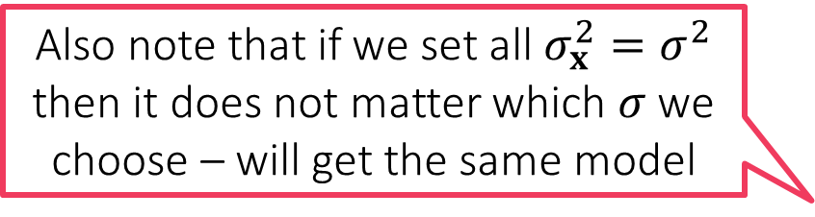
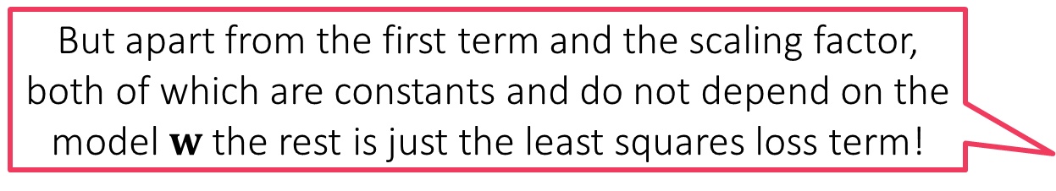
Probabilistic Regression
But apart from the first term and the scaling factor, both of which are constants and do not depend on the model $w$ the rest is just the least squares loss term!
In order to perform probabilistic regression I have to assign a label distribution over all $ℝ$ for every data point $x$
Suppose I decide to do that using a Gaussian distribution – need to decide on a mean $μ_{x}$ and a variance $σ_{x}^{2}>0$
Popular choice: Let $μ_{x}=w^{⊤}x$ and $σ_{x}^{2}=σ^{2}$ i.e. $𝒩\left(⋅| w^{⊤}x,σ^{2}\right)$
We can also choose a different $σ$ for every data point – more complicated
Likelihood function w.r.t a data point $\left(x^{i},y^{i}\right)$ then becomes $𝒩\left(y^{i} | w^{⊤}x^{i},σ^{2}\right)=\frac{1}{\sqrt{2πσ^{2}}}\exp\left(−{\left(y^{i}−w^{⊤}x^{i}\right)}^{2}/{2σ}^{2}\right)$
Negative log likelihood w.r.t a set of data points ${\left\{\left(x^{i},y^{i}\right)\right\}}_{i=1}^{n}$ $\frac{n}{2}ln\left(2πσ^{2}\right)+\frac{1}{2σ^{2}}\sum_{i=1}^{n}{{\left(y^{i}−w^{⊤}x^{i}\right)}^{2}}$
The MLE with respect to the Gaussian likelihood indeed the minimizes least squares loss
Also note that if we set all $σ_{x}^{2}=σ^{2}$ then it does not matter which $σ$ we choose – will get the same model
$$\min_{w∈ℝ^{d}}{}$$

Slide 10


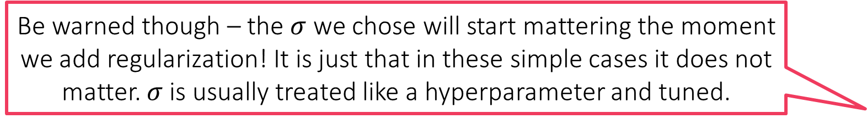

Probabilistic Regression
Be warned though – the $σ$ we chose will start mattering the moment we add regularization! It is just that in these simple cases it does not matter. $σ$ is usually treated like a hyperparameter and tuned.
Suppose I decide to use a Laplacian distribution instead and choose $μ_{x}=w^{⊤}x$ and $σ_{x}=σ$ i.e. $Lap\left(⋅| w^{⊤}x,σ^{2}\right)$
Likelihood function w.r.t a data point $\left(x^{i},y^{i}\right)$ then becomes $Lap\left(y^{i} | w^{⊤}x^{i},σ^{2}\right)=\frac{1}{2σ}\exp\left(−\left|y^{i}−w^{⊤}x\right|/σ\right)$
Negative log likelihood w.r.t a set of data points ${\left\{\left(x^{i},y^{i}\right)\right\}}_{i=1}^{n}$ $\min_{w∈ℝ^{d}}{ n⋅ln\left(σ\right)+\frac{1}{σ}\sum_{i=1}^{n}{\left|y^{i}−w^{⊤}x^{i}\right|}}=\min_{w∈ℝ^{d}}{ \sum_{i=1}^{n}{\left|y^{i}−w^{⊤}x^{i}\right|}}$
Thus, if we change the likelihood function to use the Laplacian distribution instead, the MLE ends up minimizing absolute loss!
As before, does not matter which $σ$ we choose
So I am a bit confused. All MLEs (classification/regression) demand a model that places maximum probability on the true label. Why don’t we just ask the model to predict the true label itself?
That is like asking the PMF/PDF to place probability 1 on the true label and 0 everywhere else – why can’t we do just that?
For the same reason we needed slack variables in CSVM – to allow for the fact that in realistic situations, no linear model may be able to do what we would ideally like. In probabilistic ML, allowing the model to place a less than 1 probability on the true label is much like a slack – allows us to learn good models even if not perfect ones

Slide 11
Probabilistic Regularization??
We have seen that MLE often reduces to loss minimization e.g. logistic regression/least squares regression but without regularization terms ☹
Even probabilistic methods can do regularization by way of priors
Recall: regularization basically tells us which kinds of models we prefer
L2 regularization means we prefer models with small L2 norm
L1 regularization means we prefer models with small L1 norm/sparse models
In the language of probability, the most direct way of specifying such a preference is by specifying a probability distribution itself
Prior: a probability distribution over all possible models
Just like we usually decide regularization before seeing any data, prior distribution also does not consider/condition on, any data
But our models are vectors right? Can we have probability distribution over vectors as well?
Of course we can. But first, let us see the basic operations in a toy 1D setting before getting into the complications of vector-valued r.v.s

Slide 12

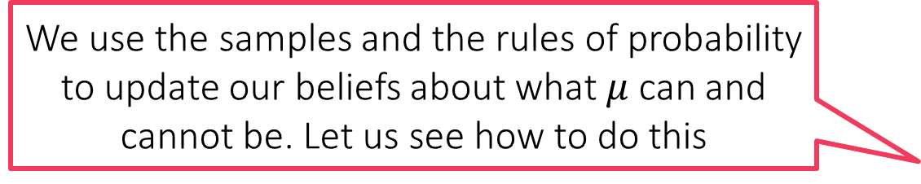
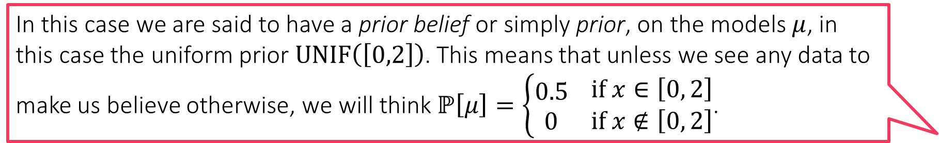
Can you Guess the Mean?
In this case we are said to have a prior belief or simply prior, on the models $μ$, in this case the uniform prior $UNIF\left(\left[0,2\right]\right)$. This means that unless we see any data to make us believe otherwise, we will think $ℙ\left[μ\right]=\left\{\begin{aligned}0.5 \\ 0\end{aligned} \begin{matrix}if x∈\left[0, 2\right] \\ if x∉\left[0, 2\right]\end{matrix}\right.$.
There is a Gaussian with unknown mean but known variance (for sake of simplicity) from which we receive $n$ independent samples $x_{1},x_{2},…,x_{n}∼𝒩\left(μ^{∗},1\right)$
Can we estimate the “model” $μ^{∗}$ from these samples?
Likelihood function: for a candidate model $μ$ and sample $x_{i}$ $ℙ\left[x_{i} | μ,1\right]=\frac{1}{\sqrt{2π}}\exp\left(−{\left(x_{i}−μ\right)}^{2}/2\right)$
MLE: $\arg{\max_{μ∈ℝ}{\prod_{i=1}^{n}{ℙ\left[x_{i} | μ,1\right]}}}=\arg{\min_{μ∈ℝ}{\sum_{i=1}^{n}{{\left(x_{i}−μ\right)}^{2}}}}$
Suppose we believe (e.g. someone tells us) even before the samples have been presented that $μ^{∗}$ definitely lies in the interval $\left[0,2\right]$ (but could otherwise be any value within that interval)
What happens we do see some data, namely the actual samples from the distribution?
We use the samples and the rules of probability to update our beliefs about what $μ$ can and cannot be. Let us see how to do this

Slide 13
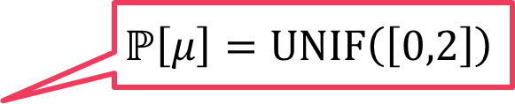
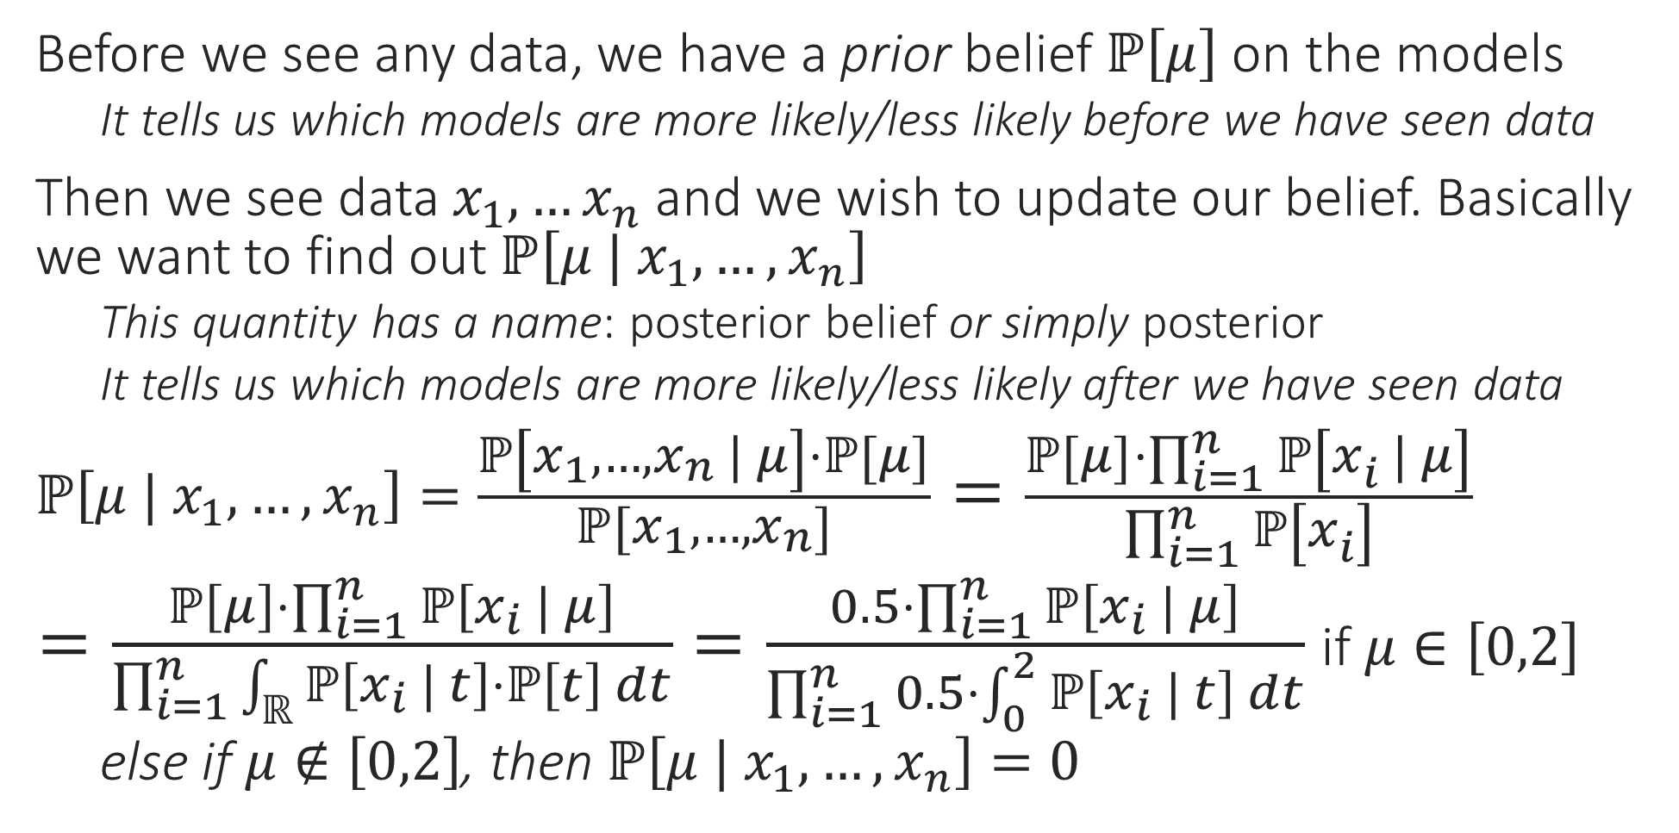
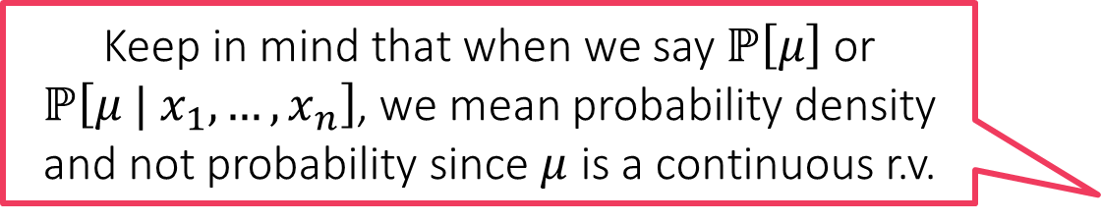
Posterior
Before we see any data, we have a prior belief $ℙ\left[μ\right]$ on the models
It tells us which models are more likely/less likely before we have seen data
Then we see data $x_{1},…x_{n}$ and we wish to update our belief. Basically we want to find out $ℙ\left[μ | x_{1},…,x_{n}\right]$
This quantity has a name: posterior belief or simply posterior
It tells us which models are more likely/less likely after we have seen data
$ℙ\left[μ | x_{1},…,x_{n}\right]=\frac{ℙ\left[x_{1},…,x_{n} | μ\right]⋅ℙ\left[μ\right]}{ℙ\left[x_{1},…,x_{n}\right]}=\frac{ℙ\left[μ\right]⋅\prod_{i=1}^{n}{ℙ\left[x_{i} | μ\right]}}{\prod_{i=1}^{n}{ℙ\left[x_{i}\right]}}$
$=\frac{ℙ\left[μ\right]⋅\prod_{i=1}^{n}{ℙ\left[x_{i} | μ\right]}}{\prod_{i=1}^{n}{\int_{ℝ}{ℙ\left[x_{i} | t\right]⋅ℙ\left[t\right] dt}}}=\frac{0.5⋅\prod_{i=1}^{n}{ℙ\left[x_{i} | μ\right]}}{\prod_{i=1}^{n}{0.5⋅\int_{0}^{2}{ℙ\left[x_{i} | t\right] dt}}}$ if $μ∈\left[0,2\right]$
else if $μ∉\left[0,2\right]$, then $ℙ\left[μ | x_{1},…,x_{n}\right]=0$
Keep in mind that when we say $ℙ\left[μ\right]$ or $ℙ\left[μ | x_{1},…,x_{n}\right]$, we mean probability density and not probability since $μ$ is a continuous r.v.
Bayes Rule
Samples are independent
Law of total probability
$$ℙ\left[μ\right]=UNIF\left(\left[0,2\right]\right)$$

Slide 14


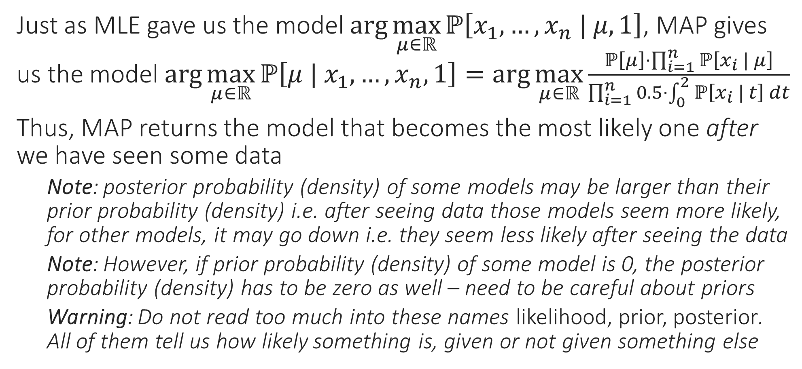
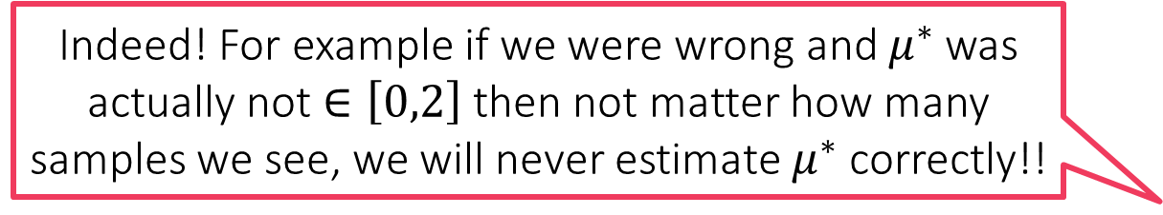
Maximum a Posteriori (MAP) Estimate
It is better to choose priors that do not completely exclude some models by giving them 0 probability (as we did)
Just as MLE gave us the model $\arg{\max_{μ∈ℝ}{ℙ\left[x_{1},…,x_{n} | μ,1\right]}}$, MAP gives us the model $\arg{\max_{μ∈ℝ}{ℙ\left[μ | x_{1},…,x_{n},1\right]}}=\arg{\max_{μ∈ℝ}}\frac{ℙ\left[μ\right]⋅\prod_{i=1}^{n}{ℙ\left[x_{i} | μ\right]}}{\prod_{i=1}^{n}{0.5⋅\int_{0}^{2}{ℙ\left[x_{i} | t\right] dt}}}$
Thus, MAP returns the model that becomes the most likely one after we have seen some data
Note: posterior probability (density) of some models may be larger than their prior probability (density) i.e. after seeing data those models seem more likely, for other models, it may go down i.e. they seem less likely after seeing the data
Note: However, if prior probability (density) of some model is 0, the posterior probability (density) has to be zero as well – need to be careful about priors
Warning: Do not read too much into these names likelihood, prior, posterior. All of them tell us how likely something is, given or not given something else
True! Even in general, if your priors are bad, or too strong, then you may end up getting funny models as a result of doing MAP estimation
Indeed! For example if we were wrong and $μ^{∗}$ was actually not $∈\left[0,2\right]$ then not matter how many samples we see, we will never estimate $μ^{∗}$ correctly!!

Slide 15
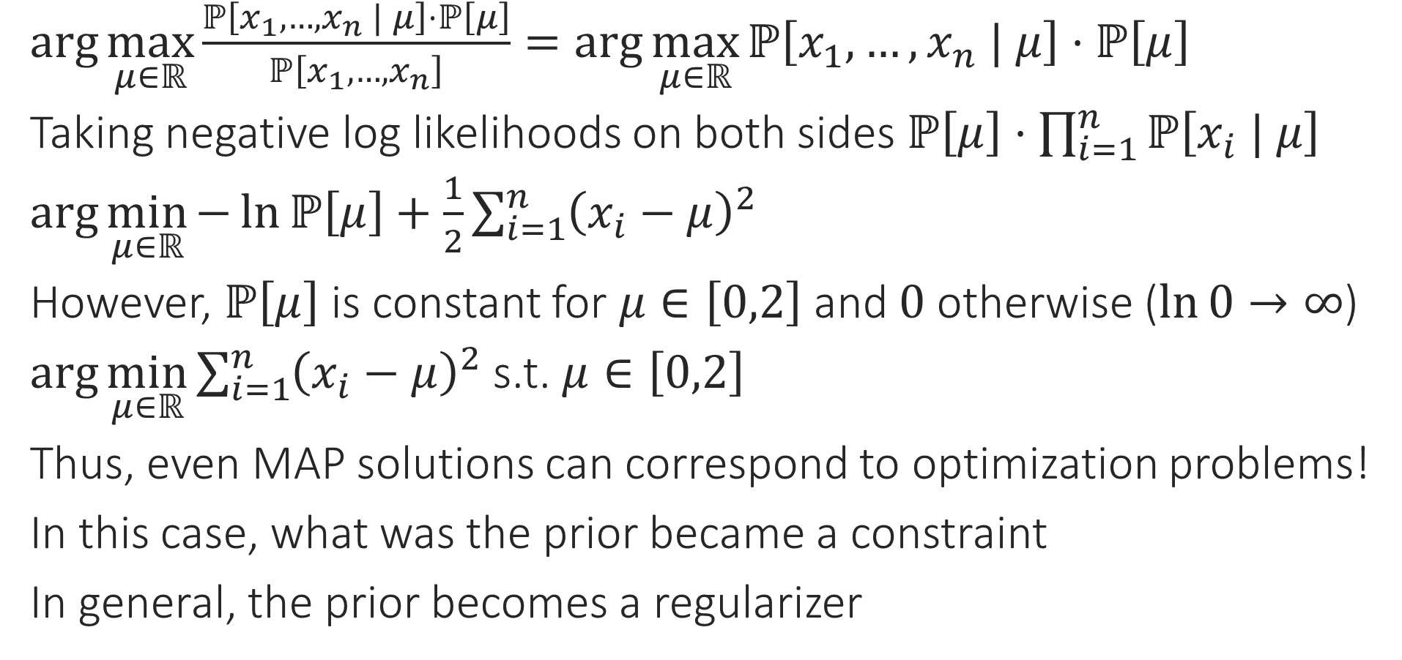
MAP vs Regularization
$\arg{\max_{μ∈ℝ}{\frac{ℙ\left[x_{1},…,x_{n} | μ\right]⋅ℙ\left[μ\right]}{ℙ\left[x_{1},…,x_{n}\right]}}}=\arg{\max_{μ∈ℝ}{ℙ\left[x_{1},…,x_{n} | μ\right]⋅ℙ\left[μ\right]}}$
Taking negative log likelihoods on both sides $ℙ\left[μ\right]⋅\prod_{i=1}^{n}{ℙ\left[x_{i} | μ\right]}$
$\arg{\min_{μ∈ℝ}{−\ln{ℙ\left[μ\right]}+\frac{1}{2}\sum_{i=1}^{n}{{\left(x_{i}−μ\right)}^{2}}}}$
However, $ℙ\left[μ\right]$ is constant for $μ∈\left[0,2\right]$ and $0$ otherwise ($\ln{0}→∞$)
$\arg{\min_{μ∈ℝ}{\sum_{i=1}^{n}{{\left(x_{i}−μ\right)}^{2}}}}$ s.t. $μ∈\left[0,2\right]$
Thus, even MAP solutions can correspond to optimization problems!
In this case, what was the prior became a constraint
In general, the prior becomes a regularizer

Slide 16

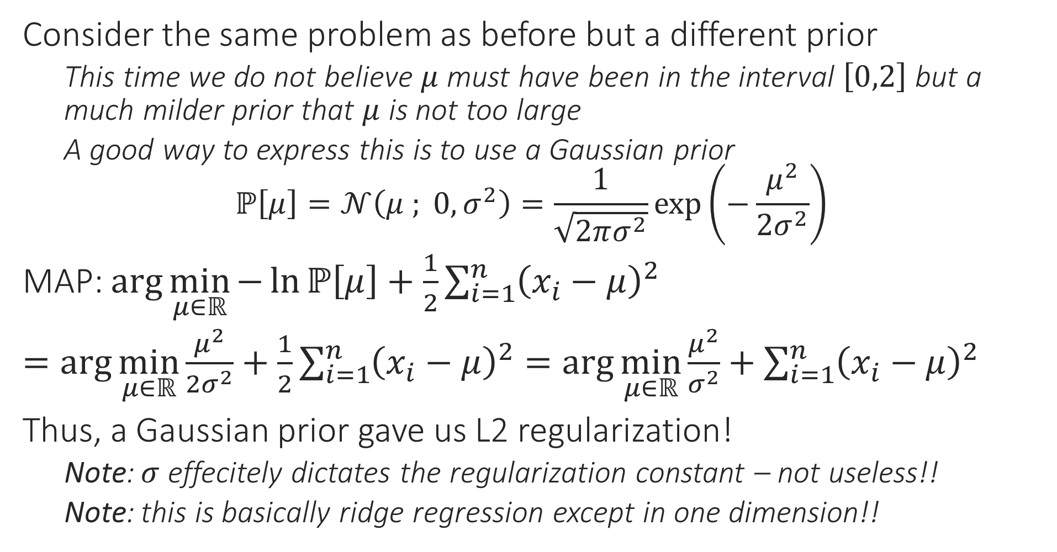
MAP vs Regularization
Similarly, had we used a Laplacian prior, we would have obtained L1 regularization instead
Consider the same problem as before but a different prior
This time we do not believe $μ$ must have been in the interval $\left[0,2\right]$ but a much milder prior that $μ$ is not too large
A good way to express this is to use a Gaussian prior $ℙ\left[μ\right]=𝒩\left(μ ; 0,σ^{2}\right)=\frac{1}{\sqrt{2πσ^{2}}}\exp\left(−\frac{μ^{2}}{2σ^{2}}\right)$
MAP: $\arg{\min_{μ∈ℝ}{−\ln{ℙ\left[μ\right]}+\frac{1}{2}\sum_{i=1}^{n}{{\left(x_{i}−μ\right)}^{2}}}}$
$=\arg{\min_{μ∈ℝ}{\frac{μ^{2}}{{2σ}^{2}}+\frac{1}{2}\sum_{i=1}^{n}{{\left(x_{i}−μ\right)}^{2}}}}=\arg{\min_{μ∈ℝ}{\frac{μ^{2}}{σ^{2}}+\sum_{i=1}^{n}{{\left(x_{i}−μ\right)}^{2}}}}$
Thus, a Gaussian prior gave us L2 regularization!
Note: $σ$ effecitely dictates the regularization constant – not useless!!
Note: this is basically ridge regression except in one dimension!!

