Slide 1
Probabilistic ML IV
CS771: Introduction to Machine Learning
Purushottam Kar

Slide 2
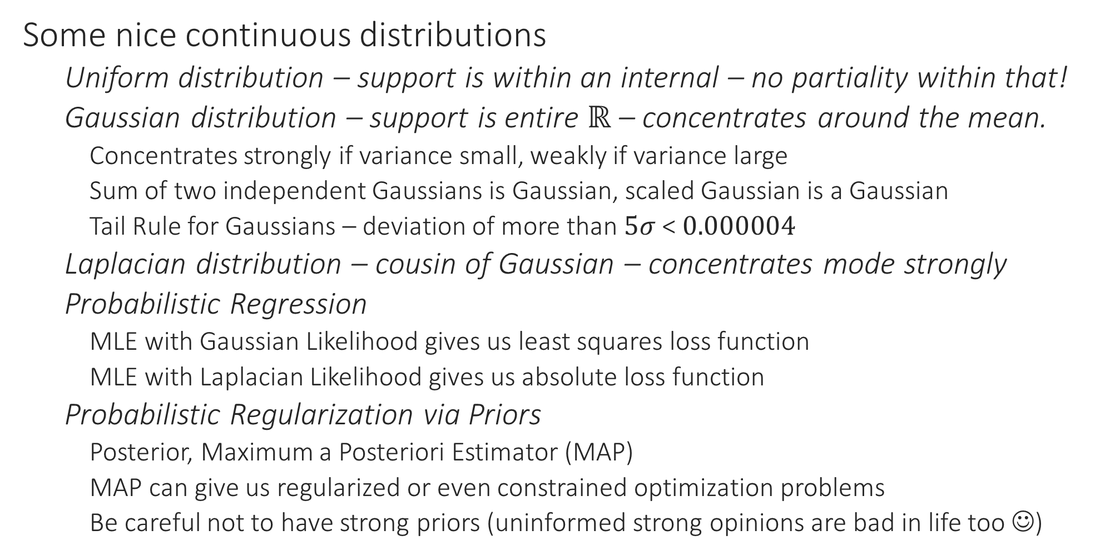
Recap of Last Lecture
Some nice continuous distributions
Uniform distribution – support is within an internal – no partiality within that!
Gaussian distribution – support is entire $ℝ$ – concentrates around the mean.
Concentrates strongly if variance small, weakly if variance large
Sum of two independent Gaussians is Gaussian, scaled Gaussian is a Gaussian
Tail Rule for Gaussians – deviation of more than $5σ$ < $0.000004$
Laplacian distribution – cousin of Gaussian – concentrates mode strongly
Probabilistic Regression
MLE with Gaussian Likelihood gives us least squares loss function
MLE with Laplacian Likelihood gives us absolute loss function
Probabilistic Regularization via Priors
Posterior, Maximum a Posteriori Estimator (MAP)
MAP can give us regularized or even constrained optimization problems
Be careful not to have strong priors (uninformed strong opinions are bad in life too ☺)

Slide 3
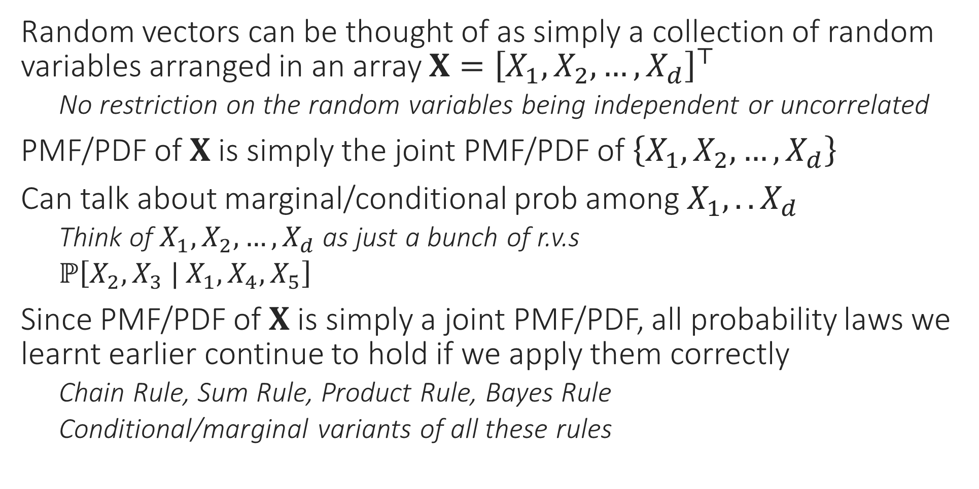
Random Vectors
Random vectors can be thought of as simply a collection of random variables arranged in an array $X={\left[X_{1},X_{2},…,X_{d}\right]}^{⊤}$
No restriction on the random variables being independent or uncorrelated
PMF/PDF of $X$ is simply the joint PMF/PDF of $\left\{X_{1},X_{2},…,X_{d}\right\}$
Can talk about marginal/conditional prob among $X_{1},.. X_{d}$
Think of $X_{1},X_{2},…,X_{d}$ as just a bunch of r.v.s
$ℙ\left[X_{2},X_{3} | X_{1},X_{4},X_{5}\right]$
Since PMF/PDF of $X$ is simply a joint PMF/PDF, all probability laws we learnt earlier continue to hold if we apply them correctly
Chain Rule, Sum Rule, Product Rule, Bayes Rule
Conditional/marginal variants of all these rules

Slide 4
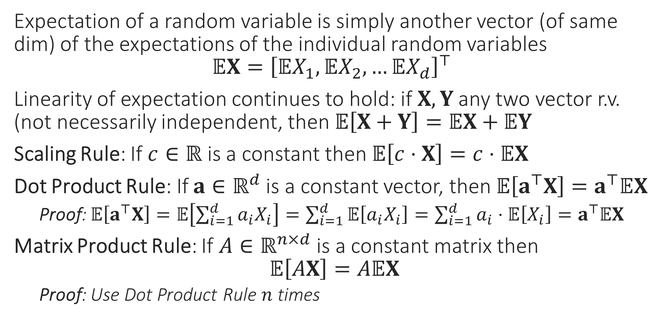
Random Vectors
Expectation of a random variable is simply another vector (of same dim) of the expectations of the individual random variables $𝔼X={\left[𝔼X_{1},𝔼X_{2},…𝔼X_{d}\right]}^{⊤}$
Linearity of expectation continues to hold: if $X,Y$ any two vector r.v. (not necessarily independent, then $𝔼\left[X+Y\right]=𝔼X+𝔼Y$
Scaling Rule: If $c∈ℝ$ is a constant then $𝔼\left[c⋅X\right]=c⋅𝔼X$
Dot Product Rule: If $a∈ℝ^{d}$ is a constant vector, then $𝔼\left[a^{⊤}X\right]=a^{⊤}𝔼X$
Proof: $𝔼\left[a^{⊤}X\right]=𝔼\left[\sum_{i=1}^{d}{a_{i}X_{i}}\right]=\sum_{i=1}^{d}{𝔼\left[a_{i}X_{i}\right]}=\sum_{i=1}^{d}{a_{i}⋅𝔼\left[X_{i}\right]}=a^{⊤}𝔼X$
Matrix Product Rule: If $A∈ℝ^{n×d}$ is a constant matrix then $𝔼\left[AX\right]=A𝔼X$
Proof: Use Dot Product Rule $n$ times

Slide 5
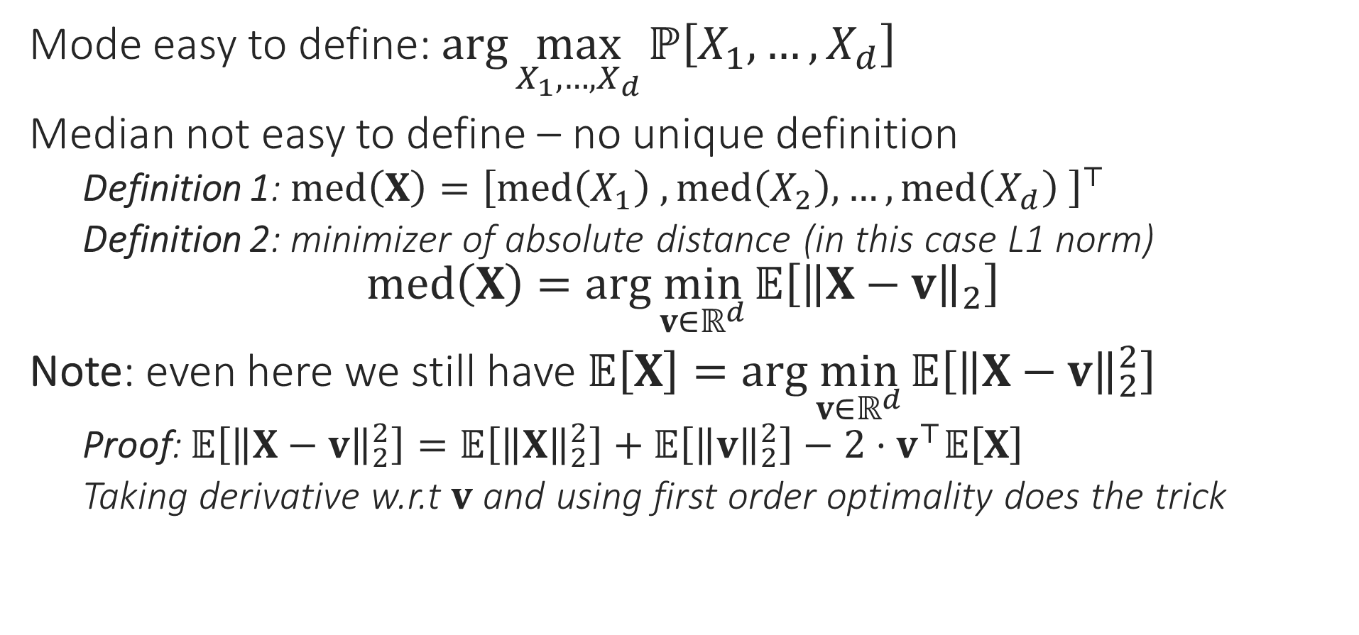
Random Vectors
Mode easy to define: $\arg{\max_{X_{1},…,X_{d}}{ℙ\left[X_{1},…,X_{d}\right]}}$
Median not easy to define – no unique definition
Definition 1: $med\left(X\right)={\left[med\left(X_{1}\right) ,med\left(X_{2}\right),…,med\left(X_{d}\right) \right]}^{⊤}$
Definition 2: minimizer of absolute distance (in this case L1 norm) $med\left(X\right)=\arg{\min_{v∈ℝ^{d}}{𝔼\left[{\left\|X−v\right\|}_{2}\right]}}$
Note: even here we still have $𝔼\left[X\right]=\arg{\min_{v∈ℝ^{d}}{𝔼\left[{\left\|X−v\right\|}_{2}^{2}\right]}}$
Proof: $𝔼\left[{\left\|X−v\right\|}_{2}^{2}\right]=𝔼\left[{\left\|X\right\|}_{2}^{2}\right]+𝔼\left[{\left\|v\right\|}_{2}^{2}\right]−2⋅v^{⊤}𝔼\left[X\right]$
Taking derivative w.r.t $v$ and using first order optimality does the trick

Slide 6



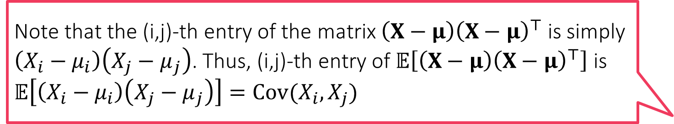
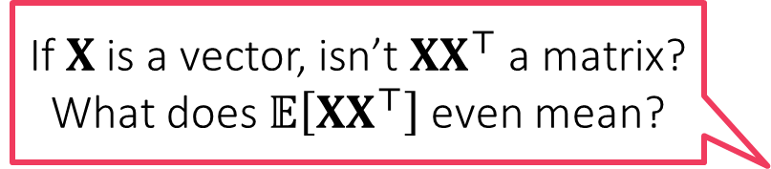
Random Vectors
If $X$ is a vector, isn’t $XX^{⊤}$ a matrix? What does $𝔼\left[XX^{⊤}\right]$ even mean?
Since random vectors are a bunch of real valued r.v.s, to specify the variance of this collection, need to have all pairwise covariances
Covariance
$Cov\left(X\right)=\left[\begin{aligned}\begin{matrix}𝕍X_{1} & Cov\left(X_{1},X_{2}\right) & … \\ Cov\left(X_{2},X_{1}\right) & 𝕍X_{1} & … \\ ⋮ & ⋮ & ⋱\end{matrix} \\ \begin{matrix}Cov\left(X_{d},X_{1}\right) & Cov\left(X_{d},X_{2}\right) & …\end{matrix}\end{aligned} \begin{matrix}Cov\left(X_{1},X_{d}\right) \\ Cov\left(X_{2},X_{d}\right) \\ \begin{aligned}⋮ \\ 𝕍X_{d}\end{aligned}\end{matrix}\right]$
Another cute formula
$Cov\left(X\right)=𝔼\left[\left(X−μ\right){\left(X−μ\right)}^{⊤}\right]=𝔼\left[XX^{⊤}\right]−μμ^{⊤}$, where $μ=𝔼X$
$Cov\left(c⋅X\right)=c^{2}⋅Cov\left(X\right)$
Just as a random vector is a collection of random variables arranged as a 1D array, a random matrix is a collection of r.v.s arranged as a 2D array!
Note that the (i,j)-th entry of the matrix $\left(X−μ\right){\left(X−μ\right)}^{⊤}$ is simply $\left(X_{i}−μ_{i}\right)\left(X_{j}−μ_{j}\right)$. Thus, (i,j)-th entry of $𝔼\left[\left(X−μ\right){\left(X−μ\right)}^{⊤}\right]$ is $𝔼\left[\left(X_{i}−μ_{i}\right)\left(X_{j}−μ_{j}\right)\right]=Cov(X_{i},X_{j})$

Slide 7
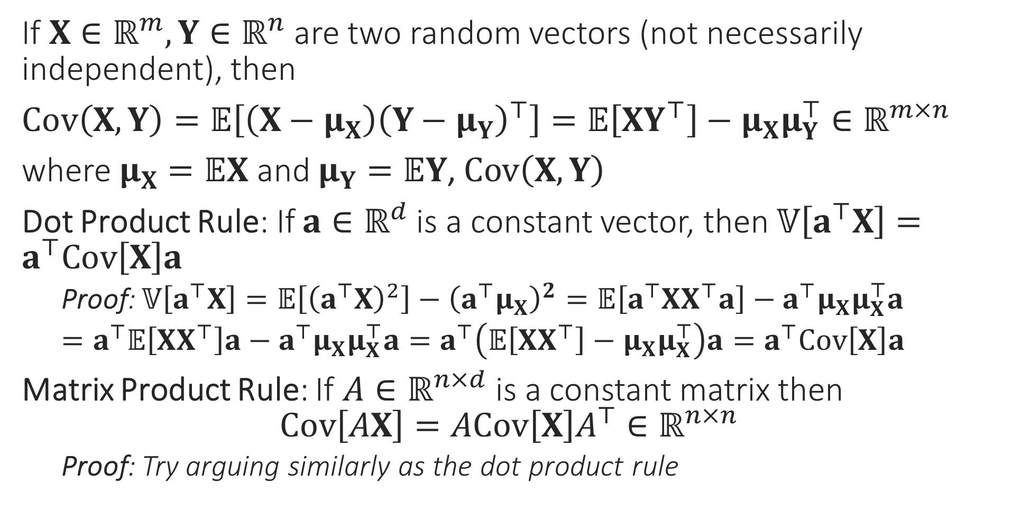
Useful Operations on Vector R.V.
Can you prove that the covariance matrix of any random vector is always a PSD matrix?
If $X∈ℝ^{m},Y∈ℝ^{n}$ are two random vectors (not necessarily independent), then
$Cov\left(X,Y\right)=𝔼\left[\left(X−μ_{X}\right){\left(Y−μ_{Y}\right)}^{⊤}\right]=𝔼\left[XY^{⊤}\right]−μ_{X}μ_{Y}^{⊤}∈ℝ^{m×n}$
where $μ_{X}=𝔼X$ and $μ_{Y}=𝔼Y$, $Cov\left(X,Y\right)$
Dot Product Rule: If $a∈ℝ^{d}$ is a constant vector, then $𝕍\left[a^{⊤}X\right]=a^{⊤}Cov\left[X\right]a$
Proof: $𝕍\left[a^{⊤}X\right]=𝔼\left[{\left(a^{⊤}X\right)}^{2}\right]−{\left(a^{⊤}μ_{X}\right)}^{2}=𝔼\left[a^{⊤}XX^{⊤}a\right]−a^{⊤}μ_{X}μ_{X}^{⊤}a$
$=a^{⊤}𝔼\left[XX^{⊤}\right]a−a^{⊤}μ_{X}μ_{X}^{⊤}a=a^{⊤}\left(𝔼\left[XX^{⊤}\right]−μ_{X}μ_{X}^{⊤}\right)a=a^{⊤}Cov\left[X\right]a$
Matrix Product Rule: If $A∈ℝ^{n×d}$ is a constant matrix then $Cov\left[AX\right]=ACov\left[X\right]A^{⊤}∈ℝ^{n×n}$
Proof: Try arguing similarly as the dot product rule

Slide 8
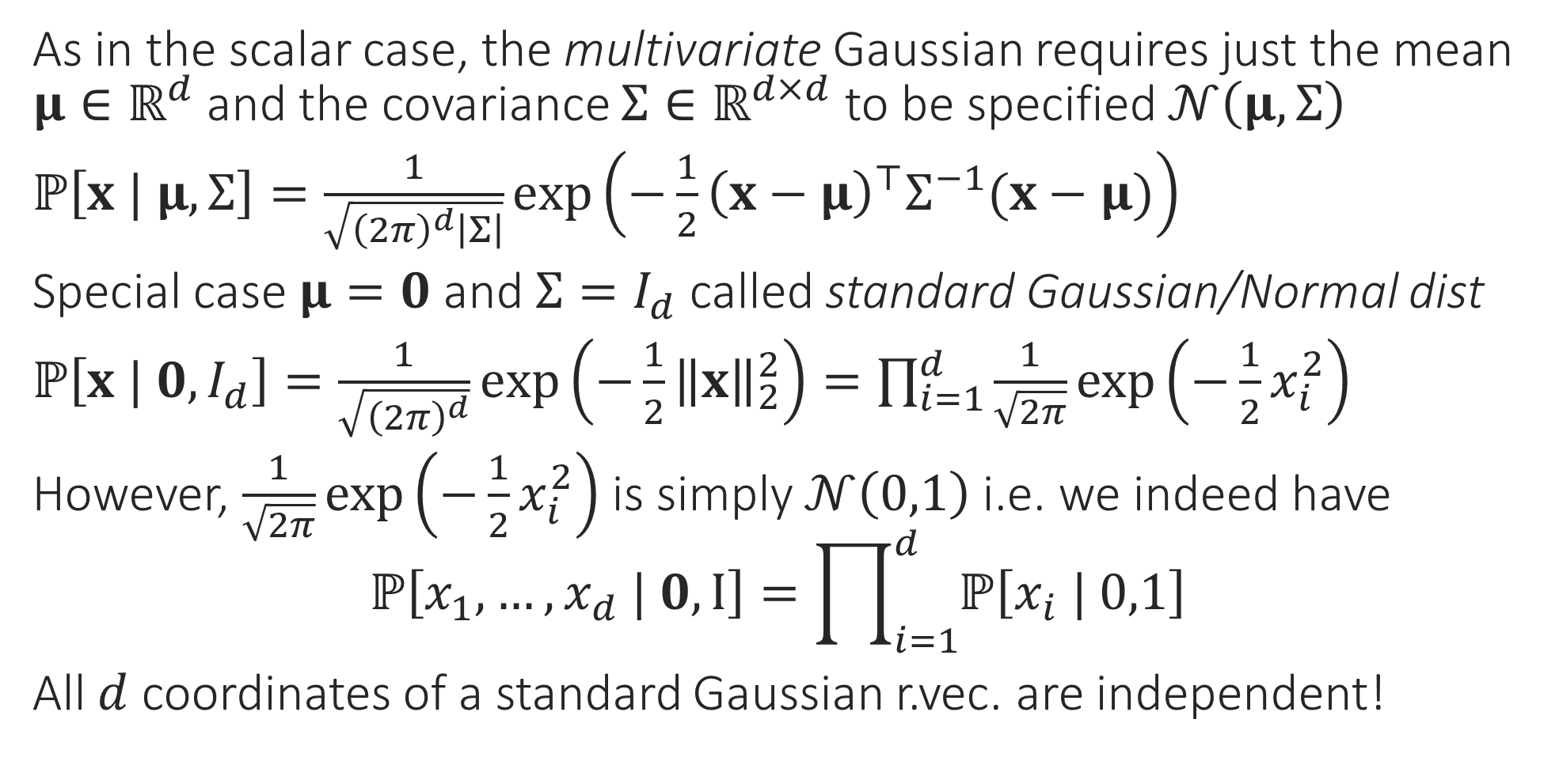
Gaussian Random Vector
As in the scalar case, the multivariate Gaussian requires just the mean $μ∈ℝ^{d}$ and the covariance $Σ∈ℝ^{d×d}$ to be specified $𝒩\left(μ,Σ\right)$
$ℙ\left[x | μ,Σ\right]=\frac{1}{\sqrt{{\left(2π\right)}^{d}\left|Σ\right|}}\exp\left(−\frac{1}{2}{\left(x−μ\right)}^{⊤}Σ^{−1}(x−μ)\right)$
Special case $μ=0$ and $Σ=I_{d}$ called standard Gaussian/Normal dist
$ℙ\left[x | 0,I_{d}\right]=\frac{1}{\sqrt{{\left(2π\right)}^{d}}}\exp\left(−\frac{1}{2}{\left\|x\right\|}_{2}^{2}\right)=\prod_{i=1}^{d}{\frac{1}{\sqrt{2π}}\exp\left(−\frac{1}{2}x_{i}^{2}\right)}$
However, $\frac{1}{\sqrt{2π}}\exp\left(−\frac{1}{2}x_{i}^{2}\right)$ is simply $𝒩\left(0,1\right)$ i.e. we indeed have $ℙ\left[x_{1},…,x_{d} | 0,I\right]=\prod_{i=1}^{d}{ℙ\left[x_{i} | 0,1\right]}$
All $d$ coordinates of a standard Gaussian r.vec. are independent!

