Slide 1
Bayesian ML
CS771: Introduction to Machine Learning
Purushottam Kar

Slide 2
Announcement
Some groups submitted code using homepages of non-group members
These submissions will be examined “more closely”
From next time onwards – please use homepage of a group member only
From next time, will also introduce use of password-protected archives
Code submissions were downloaded from the links ~11:10PM, Sep 07
Any changes you made after that wont be graded since we won’t have it!
Second assignment coming up in a day or two
Will have no restrictions on library/external code usage so long as you cite/acknowledge the usage
Will essentially ask you to create a recommendation system

Slide 3
Recap of Last Lecture
Notion of random vectors
Defined simply as an ordered array of random variables
However, beautiful and powerful results emerge from this ordering
Notions of mean, mode, median
No unique notion of median for random vectors
Notion of random matrices
Defined simply as a bunch of random variables ordered as a matrix
Covariance matrix of a random vector
Covariance matrix between two random vectors
Useful operations involving random vectors/covariance matrices

Slide 4
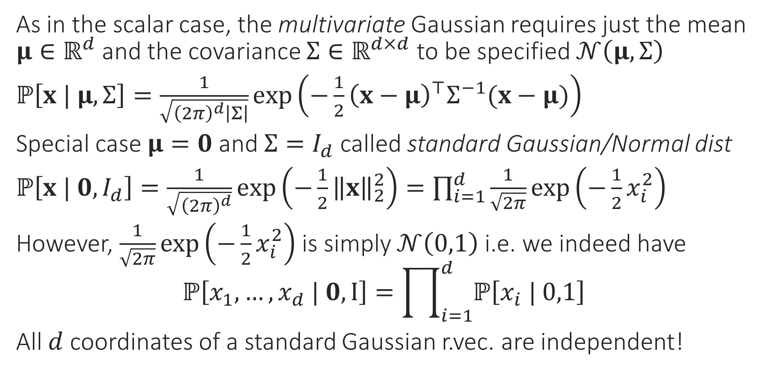
Gaussian Random Vector
As in the scalar case, the multivariate Gaussian requires just the mean $μ∈ℝ^{d}$ and the covariance $Σ∈ℝ^{d×d}$ to be specified $𝒩\left(μ,Σ\right)$
$ℙ\left[x | μ,Σ\right]=\frac{1}{\sqrt{{\left(2π\right)}^{d}\left|Σ\right|}}\exp\left(−\frac{1}{2}{\left(x−μ\right)}^{⊤}Σ^{−1}(x−μ)\right)$
Special case $μ=0$ and $Σ=I_{d}$ called standard Gaussian/Normal dist
$ℙ\left[x | 0,I_{d}\right]=\frac{1}{\sqrt{{\left(2π\right)}^{d}}}\exp\left(−\frac{1}{2}{\left\|x\right\|}_{2}^{2}\right)=\prod_{i=1}^{d}{\frac{1}{\sqrt{2π}}\exp\left(−\frac{1}{2}x_{i}^{2}\right)}$
However, $\frac{1}{\sqrt{2π}}\exp\left(−\frac{1}{2}x_{i}^{2}\right)$ is simply $𝒩\left(0,1\right)$ i.e. we indeed have $ℙ\left[x_{1},…,x_{d} | 0,I\right]=\prod_{i=1}^{d}{ℙ\left[x_{i} | 0,1\right]}$
All $d$ coordinates of a standard Gaussian r.vec. are independent!

Slide 5

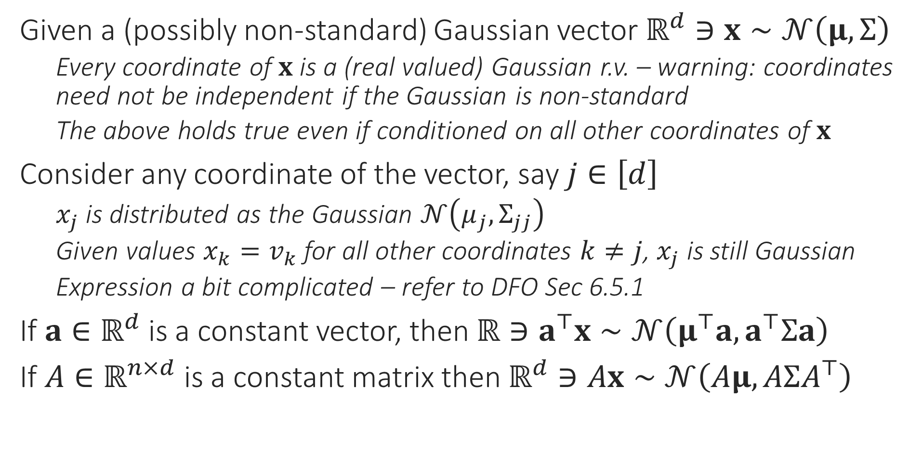
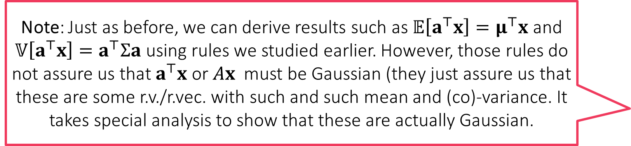
Gaussian Random Vector
Note: Just as before, we can derive results such as $𝔼\left[a^{⊤}x\right]=μ^{⊤}x$ and $𝕍\left[a^{⊤}x\right]=a^{⊤}Σa$ using rules we studied earlier. However, those rules do not assure us that $a^{⊤}x$ or $Ax$ must be Gaussian (they just assure us that these are some r.v./r.vec. with such and such mean and (co)-variance. It takes special analysis to show that these are actually Gaussian.
Given a (possibly non-standard) Gaussian vector $ℝ^{d}∋x∼𝒩\left(μ,Σ\right)$
Every coordinate of $x$ is a (real valued) Gaussian r.v. – warning: coordinates need not be independent if the Gaussian is non-standard
The above holds true even if conditioned on all other coordinates of $x$
Consider any coordinate of the vector, say $j∈\left[d\right]$
$x_{j}$ is distributed as the Gaussian $𝒩\left(μ_{j},Σ_{jj}\right)$
Given values ${x_{k}=v}_{k}$ for all other coordinates $k≠j$, $x_{j}$ is still Gaussian
Expression a bit complicated – refer to DFO Sec 6.5.1
If $a∈ℝ^{d}$ is a constant vector, then $ℝ∋a^{⊤}x∼𝒩\left(μ^{⊤}a,a^{⊤}Σa\right)$
If $A∈ℝ^{n×d}$ is a constant matrix then $ℝ^{d}∋Ax∼𝒩\left(Aμ,AΣA^{⊤}\right)$

Slide 6
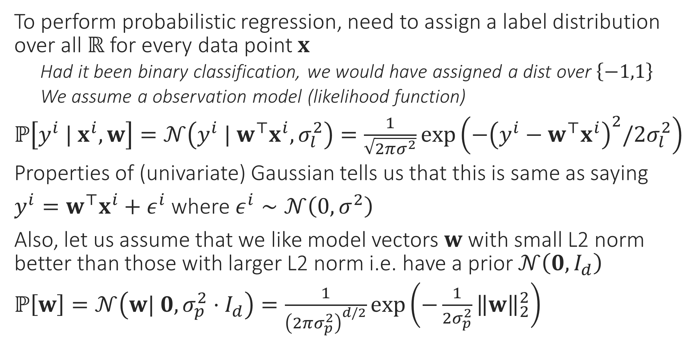
Probabilistic Regression Revisited
To perform probabilistic regression, need to assign a label distribution over all $ℝ$ for every data point $x$
Had it been binary classification, we would have assigned a dist over $\left\{−1,1\right\}$
We assume a observation model (likelihood function)
$ℙ\left[y^{i} | x^{i},w\right]=𝒩\left(y^{i} | w^{⊤}x^{i},σ_{l}^{2}\right)=\frac{1}{\sqrt{2πσ^{2}}}\exp\left(−{\left(y^{i}−w^{⊤}x^{i}\right)}^{2}/{2σ}_{l}^{2}\right)$
Properties of (univariate) Gaussian tells us that this is same as saying
$y^{i}=w^{⊤}x^{i}+ε^{i}$ where $ε^{i}∼𝒩\left(0,σ^{2}\right)$
Also, let us assume that we like model vectors $w$ with small L2 norm better than those with larger L2 norm i.e. have a prior $𝒩\left(0,I_{d}\right)$
$ℙ\left[w\right]=𝒩\left(w| 0,σ_{p}^{2}⋅I_{d}\right)=\frac{1}{{\left(2πσ_{p}^{2}\right)}^{d/2}}\exp\left(−\frac{1}{2σ_{p}^{2}}{\left\|w\right\|}_{2}^{2}\right)$

Slide 7


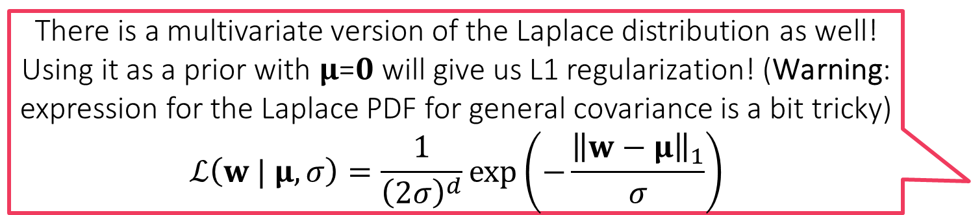


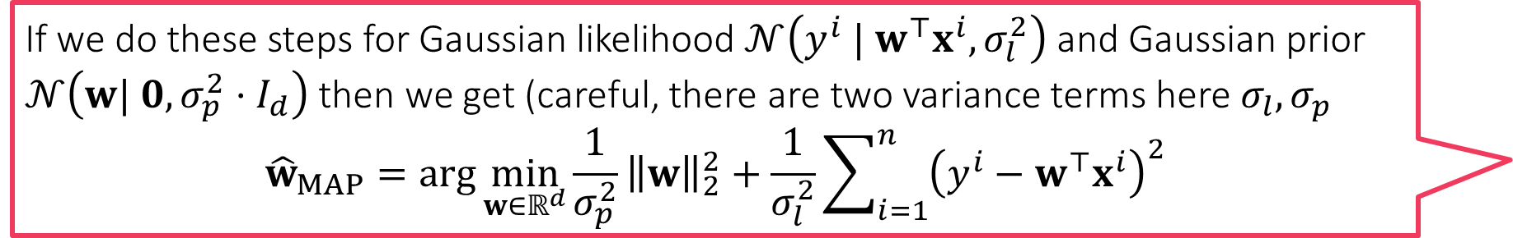
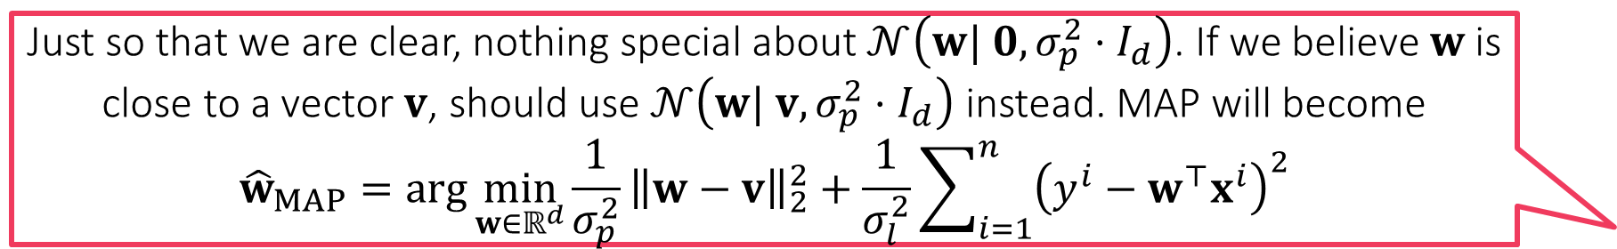
Probabilistic Regression Revisited
If we do these steps for Gaussian likelihood $𝒩\left(y^{i} | w^{⊤}x^{i},σ_{l}^{2}\right)$ and Gaussian prior $𝒩\left(w| 0,σ_{p}^{2}⋅I_{d}\right)$ then we get (careful, there are two variance terms here $σ_{l},σ_{p}$
$${\hat{w}}_{MAP}=\arg{\min_{w∈ℝ^{d}}{\frac{1}{σ_{p}^{2}}}{\left\|w\right\|}_{2}^{2}+\frac{1}{σ_{l}^{2}}\sum_{i=1}^{n}{{\left(y^{i}−w^{⊤}x^{i}\right)}^{2}}}$$
Recall that the prior encodes our beliefs before we have seen data
Posterior encodes our beliefs after we have seen data – Bayes Rule
$ℙ\left[w | y^{1}…y^{n},x^{1}…x^{n}\right]=$ $\frac{ℙ\left[y^{1}…y^{n},x^{1}…x^{n} | w\right]⋅ℙ\left[w\right]}{ℙ\left[y^{1}…y^{n},x^{1}…x^{n}\right]}$
Using independence gives us $=\frac{ℙ\left[w\right]⋅\prod_{i=1}^{n}{ℙ\left[y^{i}, x^{i} | w\right]}}{\prod_{i=1}^{n}{ℙ\left[y^{i}, x^{i}\right]}}$
Ignoring terms that don’t involve $w$, taking logs gives us MAP estimate
${\hat{w}}_{MAP}=\arg{\min_{w∈ℝ^{d}}{−\ln{ℙ\left[w\right]}−\sum_{i=1}^{n}{\ln{ℙ\left[y^{i}, x^{i} | w\right]}}}}$
Note: Likelihood is a distribution over labels i.e. over $ℝ$ but the prior and posterior are distributions over models i.e. over $ℝ^{d}$
This is the same as $\arg{\min_{w∈ℝ^{d}}{{\left(\frac{σ_{l}}{σ_{p}}\right)}^{2}⋅}{\left\|w\right\|}_{2}^{2}+\sum_{i=1}^{n}{{\left(y^{i}−w^{⊤}x^{i}\right)}^{2}}}$. This means that $σ_{l},σ_{p}$ together decide the regularization constant!
There is a multivariate version of the Laplace distribution as well! Using it as a prior with 𝛍=𝟎 will give us L1 regularization! (Warning: expression for the Laplace PDF for general covariance is a bit tricky) $$ℒ\left(w | μ,σ\right)=\frac{1}{{\left(2σ\right)}^{d}}\exp\left(−\frac{{\left\|w−μ\right\|}_{1}}{σ}\right)$$
Just so that we are clear, nothing special about $𝒩\left(w| 0,σ_{p}^{2}⋅I_{d}\right)$. If we believe $w$ is close to a vector $v$, should use $𝒩\left(w| v,σ_{p}^{2}⋅I_{d}\right)$ instead. MAP will become
$${\hat{w}}_{MAP}=\arg{\min_{w∈ℝ^{d}}{\frac{1}{σ_{p}^{2}}}{\left\|w−v\right\|}_{2}^{2}+\frac{1}{σ_{l}^{2}}\sum_{i=1}^{n}{{\left(y^{i}−w^{⊤}x^{i}\right)}^{2}}}$$

Slide 8
Bayesian Learning
Before we started doing probabilistic ML, we output a single label. With PML we started giving a distribution over labels instead
However, we still do so using a single model
In MLE we use the model with highest likelihood function value to do so
In MAP we use the mode of the posterior distribution to do so
In Bayesian learning, we take this philosophy further – instead of trusting a single model, place partial trust, possibly over all models
Models with high posterior probability (density) value get high trust
Models with low posterior probability (density) value get low trust
We use Bayes rule yet again to perform these calculations

Slide 9
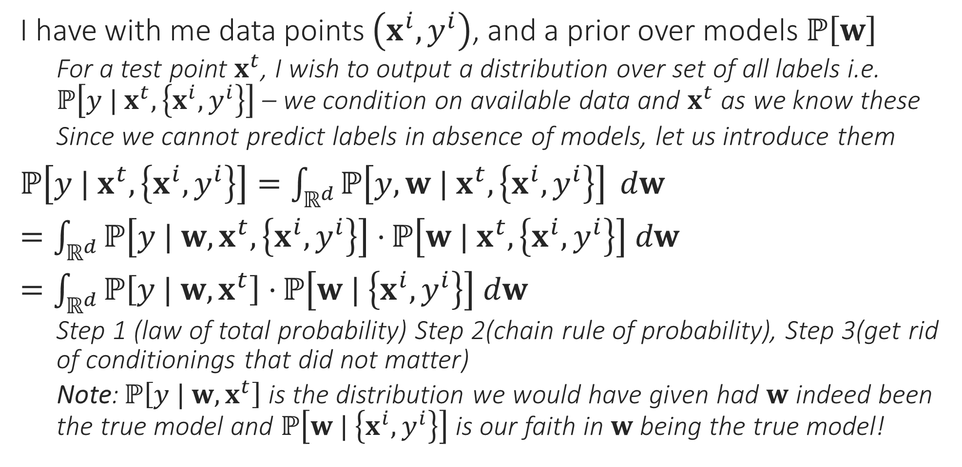
From PML to BML
I have with me data points $\left(x^{i},y^{i}\right)$, and a prior over models $ℙ\left[w\right]$
For a test point $x^{t}$, I wish to output a distribution over set of all labels i.e. $ℙ\left[y | x^{t},\left\{x^{i},y^{i}\right\}\right]$ – we condition on available data and $x^{t}$ as we know these
Since we cannot predict labels in absence of models, let us introduce them
$ℙ\left[y | x^{t},\left\{x^{i},y^{i}\right\}\right]=\int_{ℝ^{d}}{ℙ\left[y,w | x^{t},\left\{x^{i},y^{i}\right\}\right]} dw$
$=\int_{ℝ^{d}}{ℙ\left[y | w, x^{t},\left\{x^{i},y^{i}\right\}\right]⋅}ℙ\left[w | x^{t},\left\{x^{i},y^{i}\right\}\right] dw$
$=\int_{ℝ^{d}}{ℙ\left[y | w, x^{t}\right]⋅}ℙ\left[w | \left\{x^{i},y^{i}\right\}\right] dw$
Step 1 (law of total probability) Step 2(chain rule of probability), Step 3(get rid of conditionings that did not matter)
Note: $ℙ\left[y | w, x^{t}\right]$ is the distribution we would have given had $w$ indeed been the true model and $ℙ\left[w | \left\{x^{i},y^{i}\right\}\right]$ is our faith in $w$ being the true model!

Slide 10
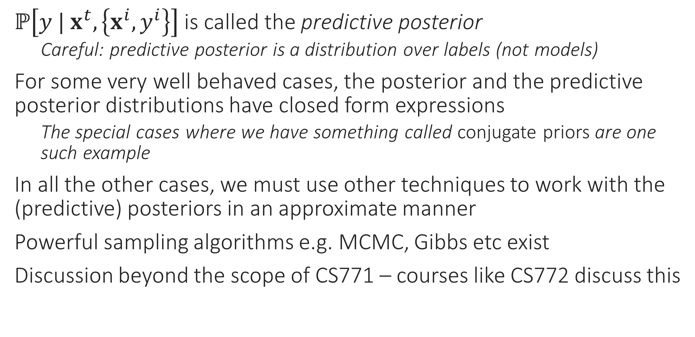
BML Trivia
$ℙ\left[y | x^{t},\left\{x^{i},y^{i}\right\}\right]$ is called the predictive posterior
Careful: predictive posterior is a distribution over labels (not models)
For some very well behaved cases, the posterior and the predictive posterior distributions have closed form expressions
The special cases where we have something called conjugate priors are one such example
In all the other cases, we must use other techniques to work with the (predictive) posteriors in an approximate manner
Powerful sampling algorithms e.g. MCMC, Gibbs etc exist
Discussion beyond the scope of CS771 – courses like CS772 discuss this

Slide 11
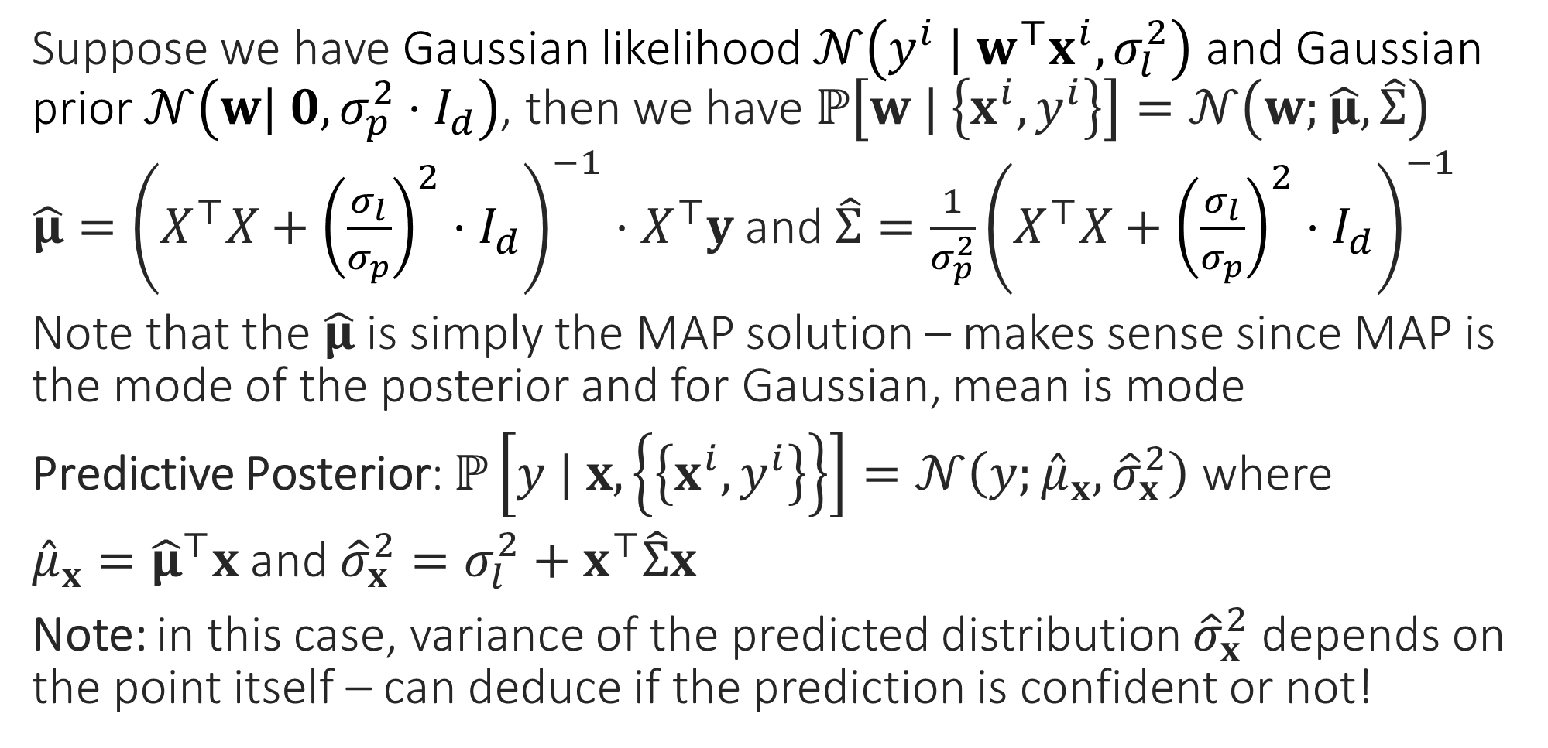
Bayesian Regression
Suppose we have Gaussian likelihood $𝒩\left(y^{i} | w^{⊤}x^{i},σ_{l}^{2}\right)$ and Gaussian prior $𝒩\left(w| 0,σ_{p}^{2}⋅I_{d}\right)$, then we have $ℙ\left[w | \left\{x^{i},y^{i}\right\}\right]=𝒩\left(w;\hat{μ},\hat{Σ}\right)$
$\hat{μ}={\left(X^{⊤}X+{\left(\frac{σ_{l}}{σ_{p}}\right)}^{2}⋅I_{d}\right)}^{−1}⋅X^{⊤}y$ and $\hat{Σ}=\frac{1}{σ_{p}^{2}}{\left(X^{⊤}X+{\left(\frac{σ_{l}}{σ_{p}}\right)}^{2}⋅I_{d}\right)}^{−1}$
Note that the $\hat{μ}$ is simply the MAP solution – makes sense since MAP is the mode of the posterior and for Gaussian, mean is mode
Predictive Posterior: $ℙ\left[y | x,\left\{\left\{x^{i},y^{i}\right\}\right\}\right]=𝒩\left(y;{\hat{μ}}_{x},{\hat{σ}}_{x}^{2}\right)$ where
${\hat{μ}}_{x}={\hat{μ}}^{⊤}x$ and ${\hat{σ}}_{x}^{2}=σ_{l}^{2}+x^{⊤}\hat{Σ}x$
Note: in this case, variance of the predicted distribution ${\hat{σ}}_{x}^{2}$ depends on the point itself – can deduce if the prediction is confident or not!

Slide 12
Conjugate Priors
Bayesian Logistic Regression or Softmax Regression is not nearly as pretty – no closed form solutions for posterior or predictive posterior
However, some likelihood-prior pairs are special
Always yield a posterior that is of the same family as the prior
Such pairs of distributions are called conjugate pairs
The prior in such cases is said to be conjugate to the likelihood
Gaussian-Gaussian is one example – warning: one Gaussian is a likelihood over reals, the other Gaussian is a prior over models (i.e. vectors)
Other conjugate pairs exist too
Discussion beyond the scope of CS771 – courses like CS772 discuss this

Slide 13
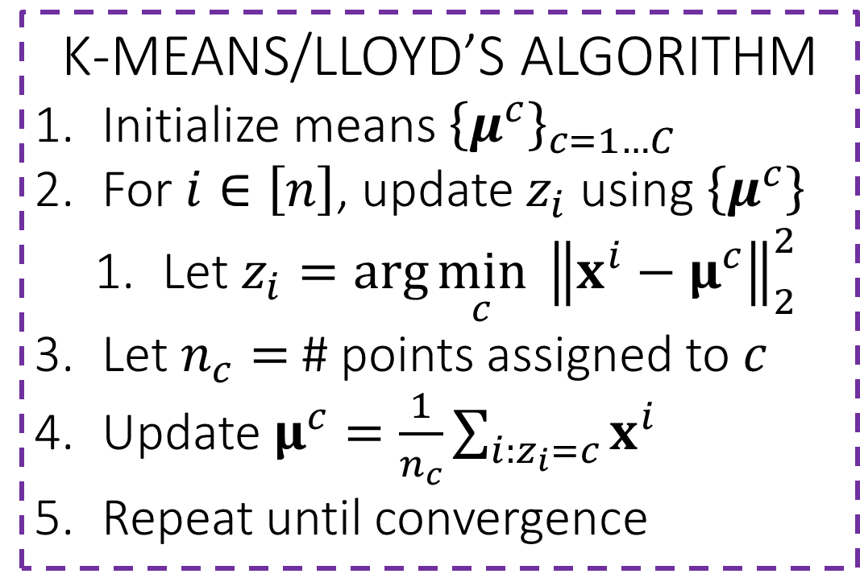
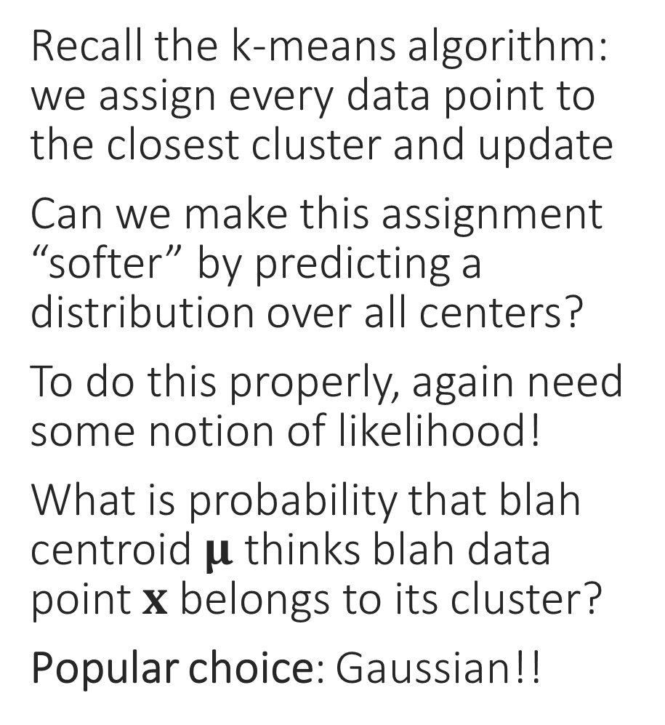
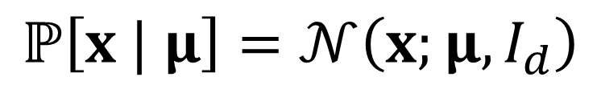
Probabilistic Clustering??
Recall the k-means algorithm: we assign every data point to the closest cluster and update
Can we make this assignment “softer” by predicting a distribution over all centers?
To do this properly, again need some notion of likelihood!
What is probability that blah centroid $μ$ thinks blah data point $x$ belongs to its cluster?
Popular choice: Gaussian!!
K-MEANS/LLOYD’S ALGORITHM
Initialize means ${\left\{μ^{c}\right\}}_{c=1…C}$
For $i∈\left[n\right]$, update $z_{i}$ using $\left\{μ^{c}\right\}$
Let $z_{i}=\arg{\min_{c}{ {\left\|x^{i}−μ^{c}\right\|}_{2}^{2}}}$
Let $n_{c}=$ # points assigned to $c$
Update $μ^{c}=\frac{1}{n_{c}}\sum_{i:z_{i}=c}{x^{i}}$
Repeat until convergence
$$ℙ\left[x | μ\right]=𝒩\left(x;μ,I_{d}\right)$$

Slide 14

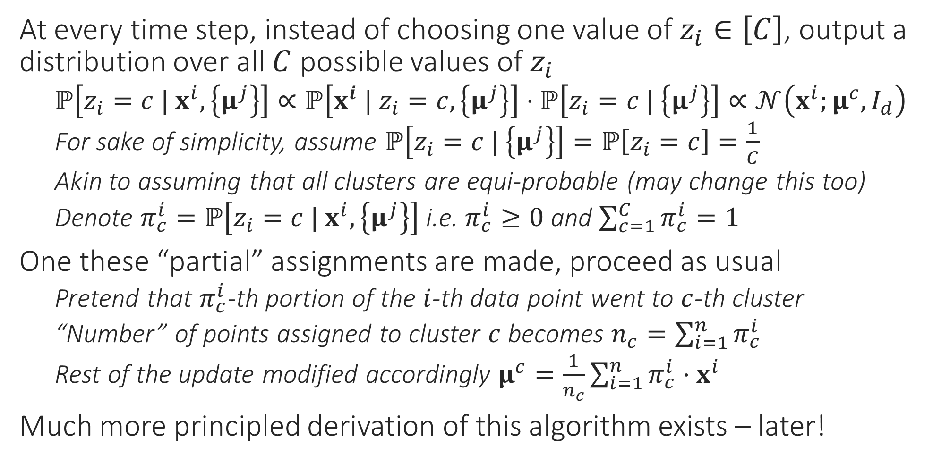
Soft k-means
At every time step, instead of choosing one value of $z_{i}∈\left[C\right]$, output a distribution over all $C$ possible values of $z_{i}$
$ℙ\left[z_{i}=c | x^{i},\left\{μ^{j}\right\}\right]∝ℙ\left[x^{i} | z_{i}=c,\left\{μ^{j}\right\}\right]⋅ℙ\left[z_{i}=c | \left\{μ^{j}\right\}\right]∝𝒩\left(x^{i};μ^{c},I_{d}\right)$
For sake of simplicity, assume $ℙ\left[z_{i}=c | \left\{μ^{j}\right\}\right]=ℙ\left[z_{i}=c\right]=\frac{1}{C}$
Akin to assuming that all clusters are equi-probable (may change this too)
Denote $π_{c}^{i}=ℙ\left[z_{i}=c | x^{i},\left\{μ^{j}\right\}\right]$ i.e. $π_{c}^{i}≥0$ and $\sum_{c=1}^{C}{π_{c}^{i}}=1$
One these “partial” assignments are made, proceed as usual
Pretend that $π_{c}^{i}$-th portion of the $i$-th data point went to $c$-th cluster
“Number” of points assigned to cluster $c$ becomes $n_{c}=\sum_{i=1}^{n}{π_{c}^{i}}$
Rest of the update modified accordingly $μ^{c}=\frac{1}{n_{c}}\sum_{i=1}^{n}{π_{c}^{i}⋅x^{i}}$
Much more principled derivation of this algorithm exists – later!
SOFT K-MEANS ALGORITHM
Initialize means ${\left\{μ^{c}\right\}}_{c=1…C}$
For $i∈\left[n\right]$, update $π_{c}^{i}$ using $\left\{μ^{c}\right\}$
Let $p_{c}^{i}=\exp\left(−\frac{{\left\|x^{i}−μ^{c}\right\|}_{2}^{2}}{2}\right)$
Let $π_{c}^{i}=\frac{p_{c}^{i}}{\sum_{c=1}^{C}{p_{c}^{i}}}$ (normalize)
Let $n_{c}=\sum_{i=1}^{n}{π_{c}^{i}}$
Update $μ^{c}=\frac{1}{n_{c}}\sum_{i=1}^{n}{π_{c}^{i}⋅x^{i}}$
Repeat until convergence

Slide 15
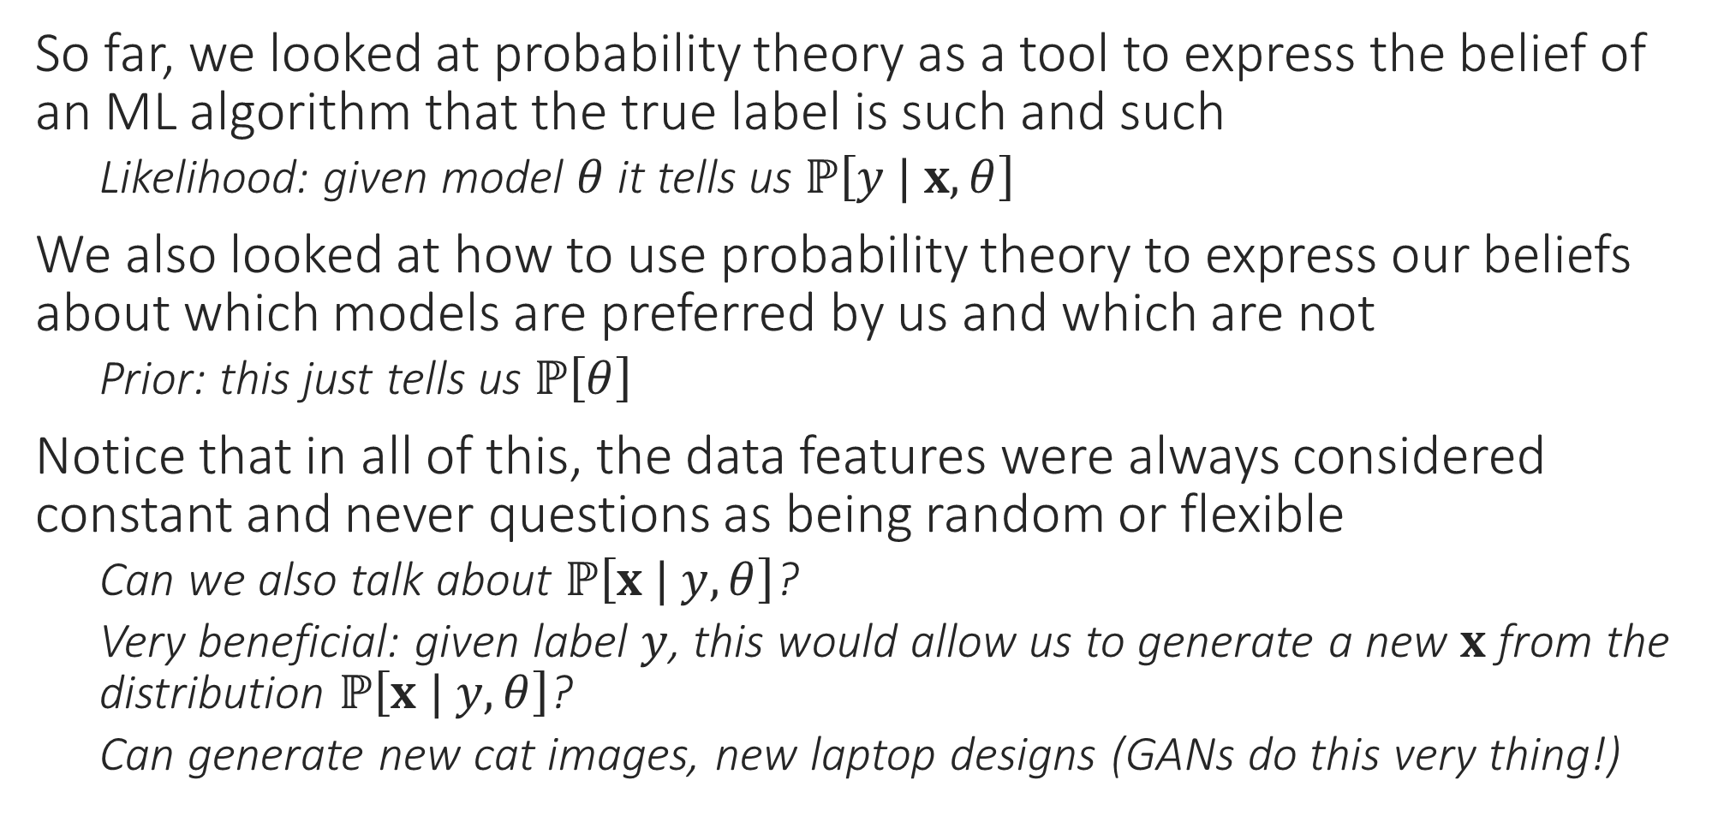
Generative Models
So far, we looked at probability theory as a tool to express the belief of an ML algorithm that the true label is such and such
Likelihood: given model $θ$ it tells us $ℙ\left[y | x,θ\right]$
We also looked at how to use probability theory to express our beliefs about which models are preferred by us and which are not
Prior: this just tells us $ℙ\left[θ\right]$
Notice that in all of this, the data features were always considered constant and never questions as being random or flexible
Can we also talk about $ℙ\left[x | y, θ\right]$?
Very beneficial: given label $y$, this would allow us to generate a new $x$ from the distribution $ℙ\left[x | y, θ\right]$?
Can generate new cat images, new laptop designs (GANs do this very thing!)

