Slide 1
Generative ML
CS771: Introduction to Machine Learning
Purushottam Kar

Slide 2
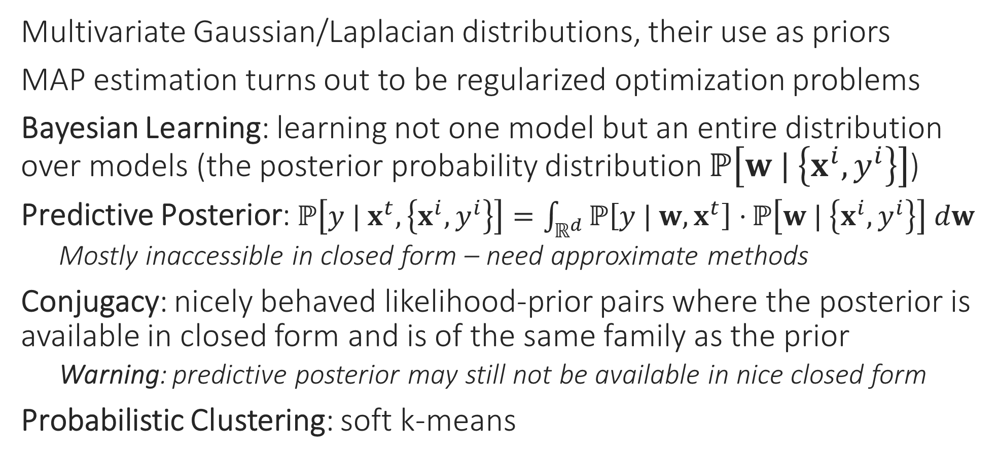
Recap of Last Lecture
Multivariate Gaussian/Laplacian distributions, their use as priors
MAP estimation turns out to be regularized optimization problems
Bayesian Learning: learning not one model but an entire distribution over models (the posterior probability distribution $ℙ\left[w | \left\{x^{i},y^{i}\right\}\right]$)
Predictive Posterior: $ℙ\left[y | x^{t},\left\{x^{i},y^{i}\right\}\right]=\int_{ℝ^{d}}{ℙ\left[y | w, x^{t}\right]⋅}ℙ\left[w | \left\{x^{i},y^{i}\right\}\right] dw$
Mostly inaccessible in closed form – need approximate methods
Conjugacy: nicely behaved likelihood-prior pairs where the posterior is available in closed form and is of the same family as the prior
Warning: predictive posterior may still not be available in nice closed form
Probabilistic Clustering: soft k-means

Slide 3
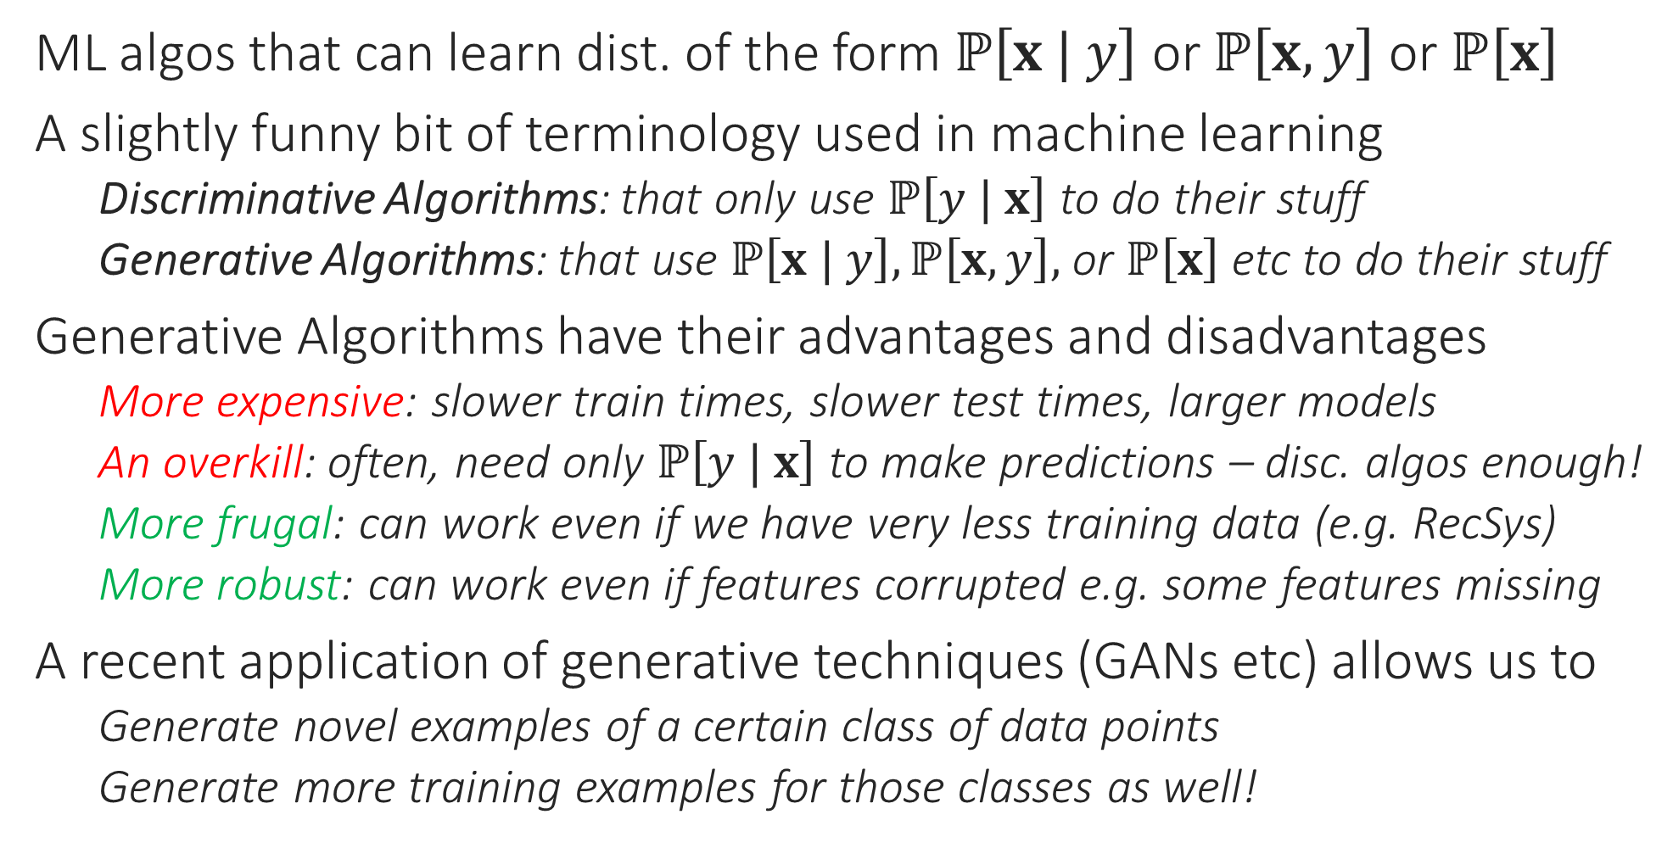
Generative Algorithms
ML algos that can learn dist. of the form $ℙ\left[x | y\right]$ or $ℙ\left[x,y\right]$ or $ℙ\left[x\right]$
A slightly funny bit of terminology used in machine learning
Discriminative Algorithms: that only use $ℙ\left[y | x\right]$ to do their stuff
Generative Algorithms: that use $ℙ\left[x | y\right],ℙ\left[x,y\right],$ or $ℙ\left[x\right]$ etc to do their stuff
Generative Algorithms have their advantages and disadvantages
More expensive: slower train times, slower test times, larger models
An overkill: often, need only $ℙ\left[y | x\right]$ to make predictions – disc. algos enough!
More frugal: can work even if we have very less training data (e.g. RecSys)
More robust: can work even if features corrupted e.g. some features missing
A recent application of generative techniques (GANs etc) allows us to
Generate novel examples of a certain class of data points
Generate more training examples for those classes as well!

Slide 4
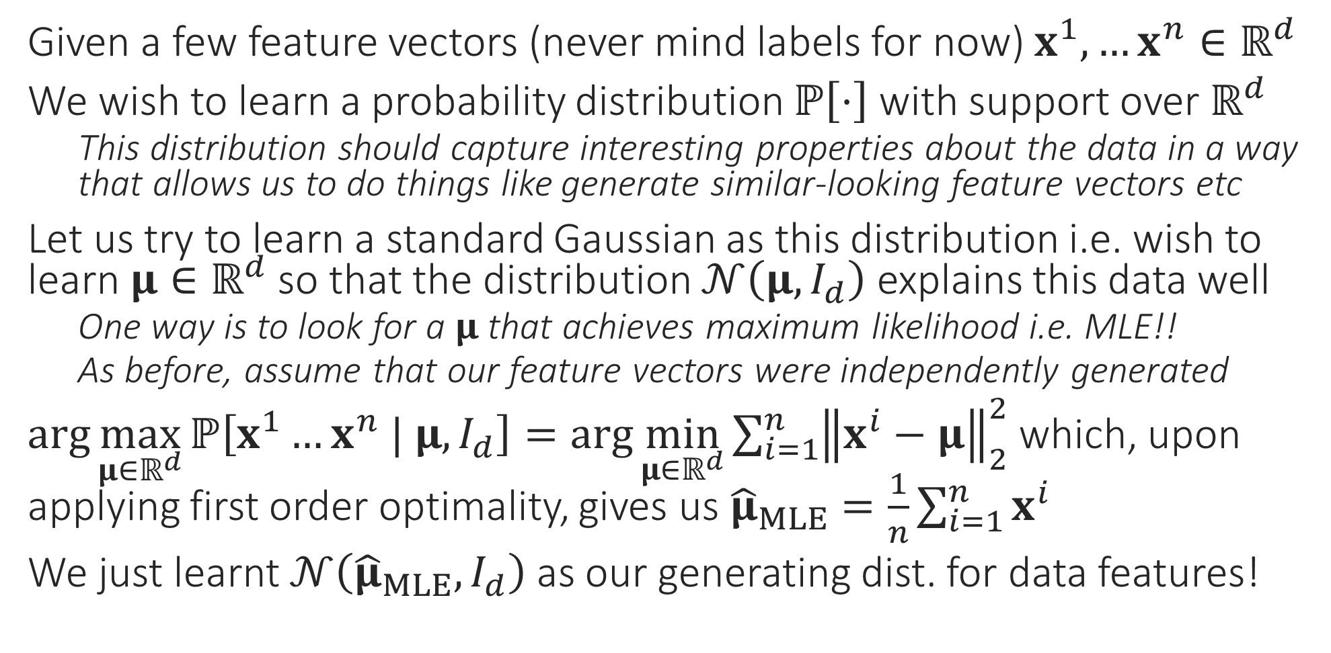
A very simple generative model
Given a few feature vectors (never mind labels for now) $x^{1},…x^{n}∈ℝ^{d}$
We wish to learn a probability distribution $ℙ\left[⋅\right]$ with support over $ℝ^{d}$
This distribution should capture interesting properties about the data in a way that allows us to do things like generate similar-looking feature vectors etc
Let us try to learn a standard Gaussian as this distribution i.e. wish to learn $μ∈ℝ^{d}$ so that the distribution $𝒩\left(μ,I_{d}\right)$ explains this data well
One way is to look for a $μ$ that achieves maximum likelihood i.e. MLE!!
As before, assume that our feature vectors were independently generated
$\arg{\max_{μ∈ℝ^{d}}{ℙ\left[x^{1}…x^{n} | μ,I_{d}\right]}}=\arg{\min_{μ∈ℝ^{d}}{\sum_{i=1}^{n}{{\left\|x^{i}−μ\right\|}_{2}^{2}}}}$ which, upon applying first order optimality, gives us ${\hat{μ}}_{MLE}=\frac{1}{n}\sum_{i=1}^{n}{x^{i}}$
We just learnt $𝒩\left({\hat{μ}}_{MLE},I_{d}\right)$ as our generating dist. for data features!

Slide 5
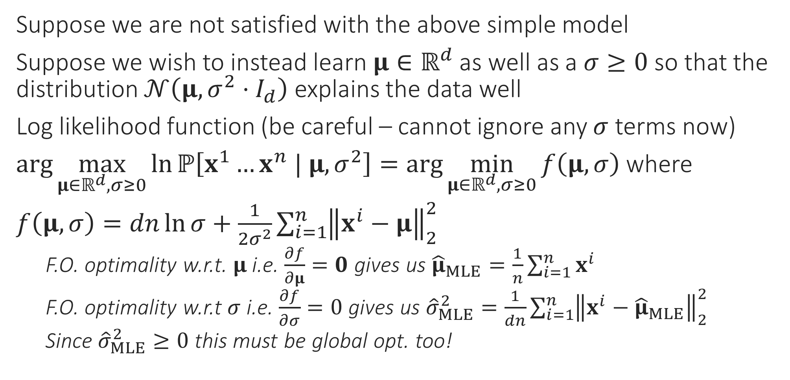
A more powerful generative model
Suppose we are not satisfied with the above simple model
Suppose we wish to instead learn $μ∈ℝ^{d}$ as well as a $σ≥0$ so that the distribution $𝒩\left(μ,{σ^{2}⋅I}_{d}\right)$ explains the data well
Log likelihood function (be careful – cannot ignore any $σ$ terms now)
$\arg{\max_{μ∈ℝ^{d},σ≥0}{\ln{ℙ\left[x^{1}…x^{n} | μ,σ^{2}\right]}}}=\arg{\min_{μ∈ℝ^{d},σ≥0}{f\left(μ,σ\right)}}$ where
$f\left(μ,σ\right)=dn\ln{σ}+\frac{1}{2σ^{2}}\sum_{i=1}^{n}{{\left\|x^{i}−μ\right\|}_{2}^{2}}$
F.O. optimality w.r.t. $μ$ i.e. $\frac{∂f}{∂μ}=0$ gives us ${\hat{μ}}_{MLE}=\frac{1}{n}\sum_{i=1}^{n}{x^{i}}$
F.O. optimality w.r.t $σ$ i.e. $\frac{∂f}{∂σ}=0$ gives us ${\hat{σ}}_{MLE}^{2}=\frac{1}{dn}\sum_{i=1}^{n}{{\left\|x^{i}−{\hat{μ}}_{MLE}\right\|}_{2}^{2}}$
Since ${\hat{σ}}_{MLE}^{2}≥0$ this must be global opt. too!

Slide 6
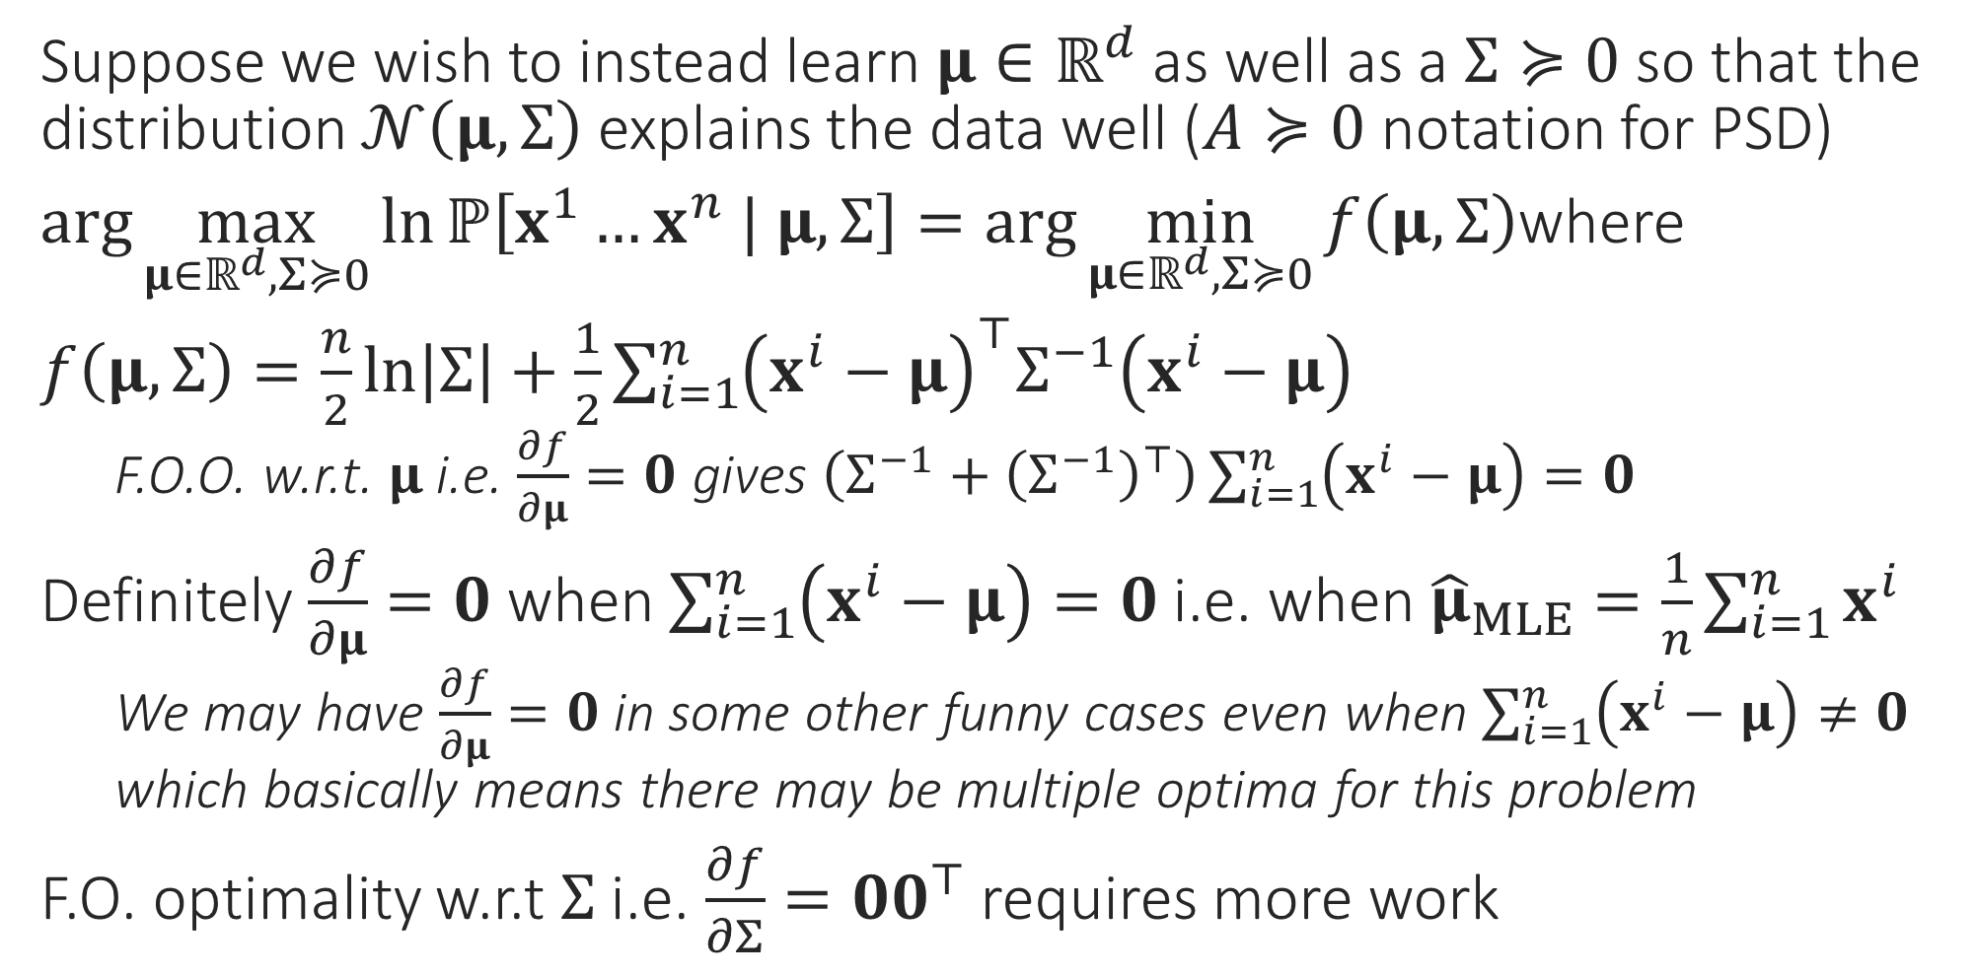
A still more powerful generative model
Suppose we wish to instead learn $μ∈ℝ^{d}$ as well as a $Σ≽0$ so that the distribution $𝒩\left(μ,Σ\right)$ explains the data well ($A≽0$ notation for PSD)
$\arg{\max_{μ∈ℝ^{d},Σ≽0}{\ln{ℙ\left[x^{1}…x^{n} | μ,Σ\right]}}}=\arg{\min_{μ∈ℝ^{d},Σ≽0}{f\left(μ,Σ\right)}}$where
$f\left(μ,Σ\right)=\frac{n}{2}\ln\left|Σ\right|+\frac{1}{2}\sum_{i=1}^{n}{{\left(x^{i}−μ\right)}^{⊤}Σ^{−1}\left(x^{i}−μ\right)}$
F.O.O. w.r.t. $μ$ i.e. $\frac{∂f}{∂μ}=0$ gives $\left(Σ^{−1}+{\left(Σ^{−1}\right)}^{⊤}\right)\sum_{i=1}^{n}{\left(x^{i}−μ\right)}=0$
Definitely $\frac{∂f}{∂μ}=0$ when $\sum_{i=1}^{n}{\left(x^{i}−μ\right)}=0$ i.e. when ${\hat{μ}}_{MLE}=\frac{1}{n}\sum_{i=1}^{n}{x^{i}}$
We may have $\frac{∂f}{∂μ}=0$ in some other funny cases even when $\sum_{i=1}^{n}{\left(x^{i}−μ\right)}≠0$ which basically means there may be multiple optima for this problem
F.O. optimality w.r.t $Σ$ i.e. $\frac{∂f}{∂Σ}={00}^{⊤}$ requires more work

Slide 7
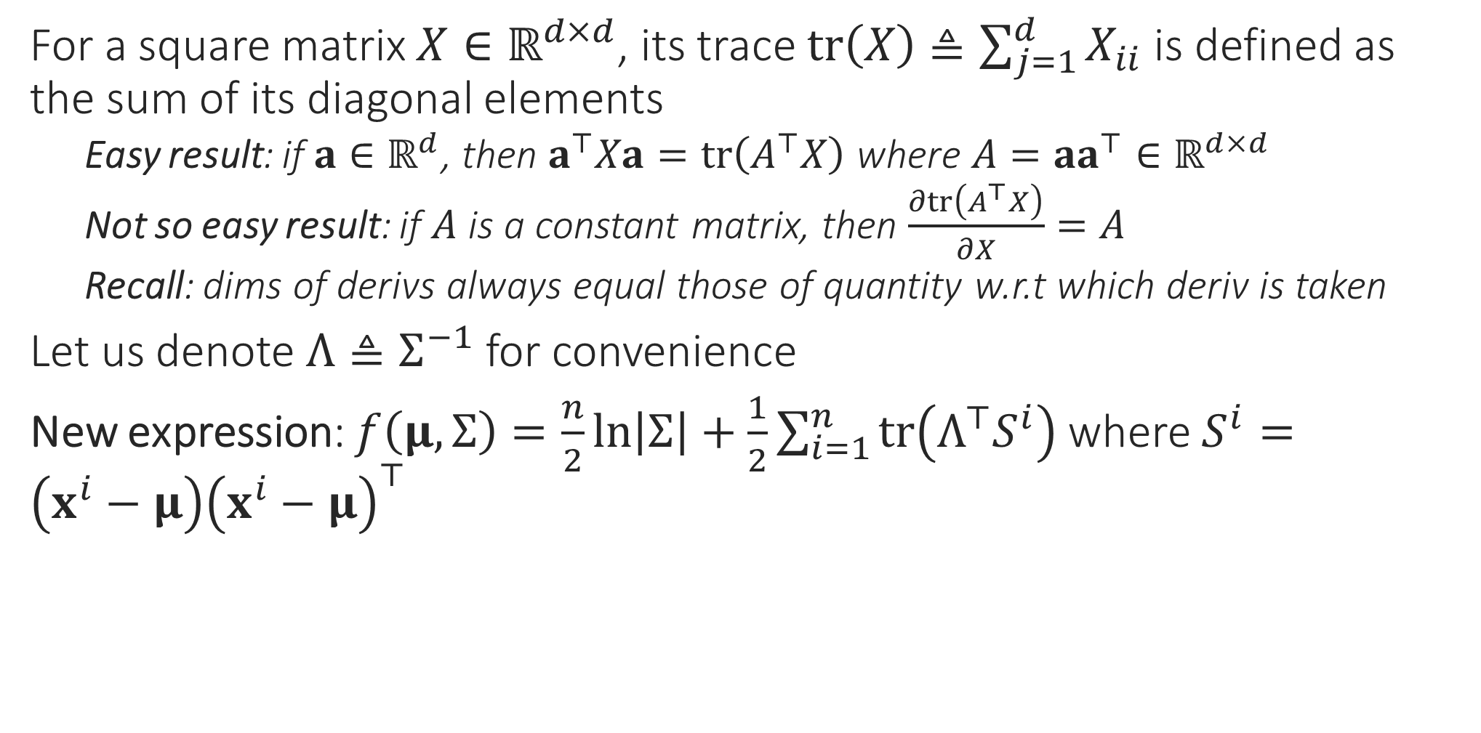
A still more powerful generative model
For a square matrix $X∈ℝ^{d×d}$, its trace $tr\left(X\right)≜\sum_{j=1}^{d}{X_{ii}}$ is defined as the sum of its diagonal elements
Easy result: if $a∈ℝ^{d}$, then $a^{⊤}Xa=tr\left(A^{⊤}X\right)$ where $A=aa^{⊤}∈ℝ^{d×d}$
Not so easy result: if $A$ is a constant matrix, then $\frac{∂tr\left(A^{⊤}X\right)}{∂X}=A$
Recall: dims of derivs always equal those of quantity w.r.t which deriv is taken
Let us denote $Λ≜Σ^{−1}$ for convenience
New expression: $f\left(μ,Σ\right)=\frac{n}{2}\ln\left|Σ\right|+\frac{1}{2}\sum_{i=1}^{n}{tr\left(Λ^{⊤}S^{i}\right)}$ where $S^{i}=\left(x^{i}−μ\right){\left(x^{i}−μ\right)}^{⊤}$

Slide 8
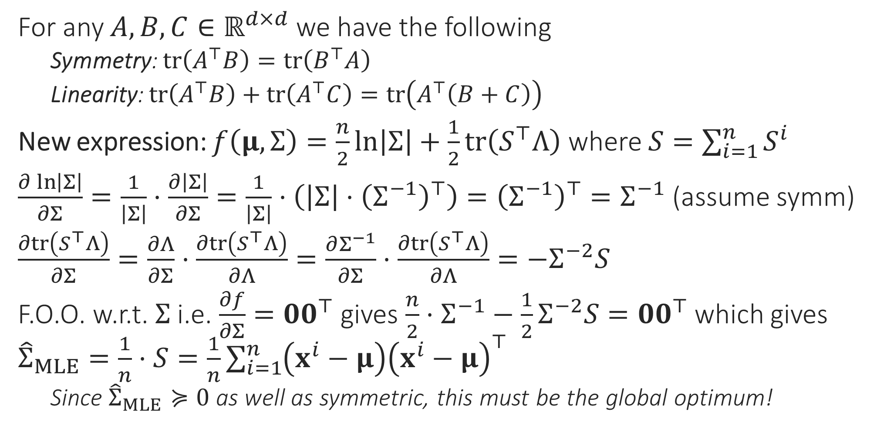
A still more powerful generative model
See “The Matrix Cookbook” (reference section on course webpage) for these results
For any $A,B,C∈ℝ^{d×d}$ we have the following
Symmetry: $tr\left(A^{⊤}B\right)=tr\left(B^{⊤}A\right)$
Linearity: $tr\left(A^{⊤}B\right)+tr\left(A^{⊤}C\right)=tr\left(A^{⊤}\left(B+C\right)\right)$
New expression: $f\left(μ,Σ\right)=\frac{n}{2}\ln\left|Σ\right|+\frac{1}{2}tr\left(S^{⊤}Λ\right)$ where $S=\sum_{i=1}^{n}{S^{i}}$
$\frac{∂\ln\left|Σ\right|}{∂Σ}=\frac{1}{\left|Σ\right|}⋅\frac{∂\left|Σ\right|}{∂Σ}=\frac{1}{\left|Σ\right|}⋅\left(\left|Σ\right|⋅{\left(Σ^{−1}\right)}^{⊤}\right)={\left(Σ^{−1}\right)}^{⊤}=Σ^{−1}$ (assume symm)
$\frac{∂tr\left(S^{⊤}Λ\right)}{∂Σ}=\frac{∂Λ}{∂Σ}⋅\frac{∂tr\left(S^{⊤}Λ\right)}{∂Λ}=\frac{∂Σ^{−1}}{∂Σ}⋅\frac{∂tr\left(S^{⊤}Λ\right)}{∂Λ}=−Σ^{−2}S$
F.O.O. w.r.t. $Σ$ i.e. $\frac{∂f}{∂Σ}=00^{⊤}$ gives $\frac{n}{2}⋅Σ^{−1}−\frac{1}{2}Σ^{−2}S={00}^{⊤}$ which gives ${\hat{Σ}}_{MLE}=\frac{1}{n}⋅S=\frac{1}{n}\sum_{i=1}^{n}{\left(x^{i}−μ\right){\left(x^{i}−μ\right)}^{⊤}}$
Since ${\hat{Σ}}_{MLE}≽0$ as well as symmetric, this must be the global optimum!

Slide 9
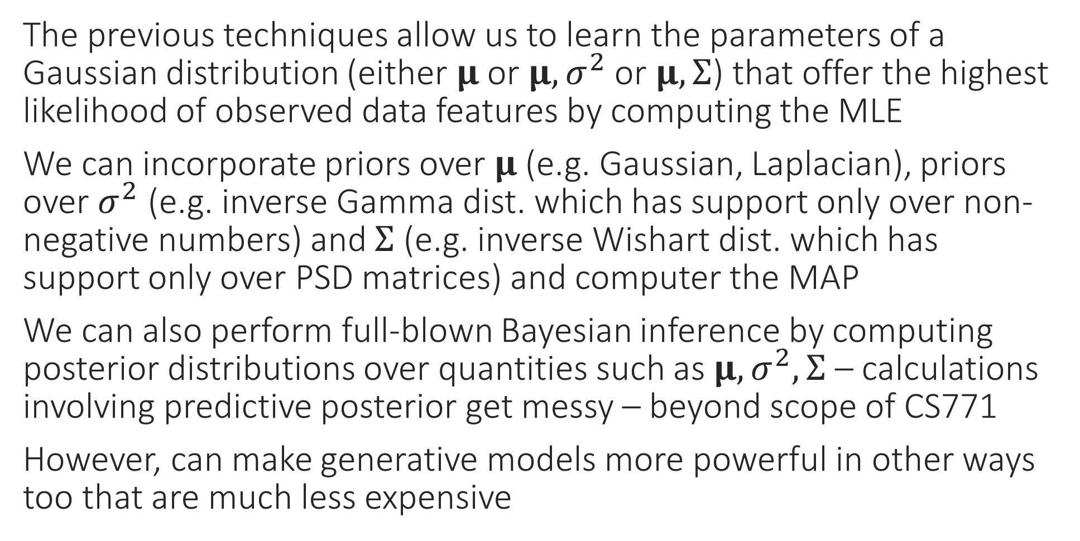
MAP, Bayesian Generative Models?
The previous techniques allow us to learn the parameters of a Gaussian distribution (either $μ$ or $μ,σ^{2}$ or $μ,Σ$) that offer the highest likelihood of observed data features by computing the MLE
We can incorporate priors over $μ$ (e.g. Gaussian, Laplacian), priors over $σ^{2}$ (e.g. inverse Gamma dist. which has support only over non-negative numbers) and $Σ$ (e.g. inverse Wishart dist. which has support only over PSD matrices) and computer the MAP
We can also perform full-blown Bayesian inference by computing posterior distributions over quantities such as $μ,σ^{2},Σ$ – calculations involving predictive posterior get messy – beyond scope of CS771
However, can make generative models more powerful in other ways too that are much less expensive

Slide 10
Still more powerful generative model?
Suppose we are concerned that a single Gaussian cannot capture all the variations in our data
Just as in LwP when we realized sometimes, a single prototype not enough
Can we learn 2 (or more) Gaussians to represent our data instead?
Such a generative model is often called a mixture of Gaussians
The Expectation Maximization (EM) algorithm is a very powerful technique for performing this and several other tasks
Soft clustering, learning Gaussian mixture models (GMM)
Robust learning, Mixed Regression
Also underlies more powerful variational algorithms such as VAE

Slide 11

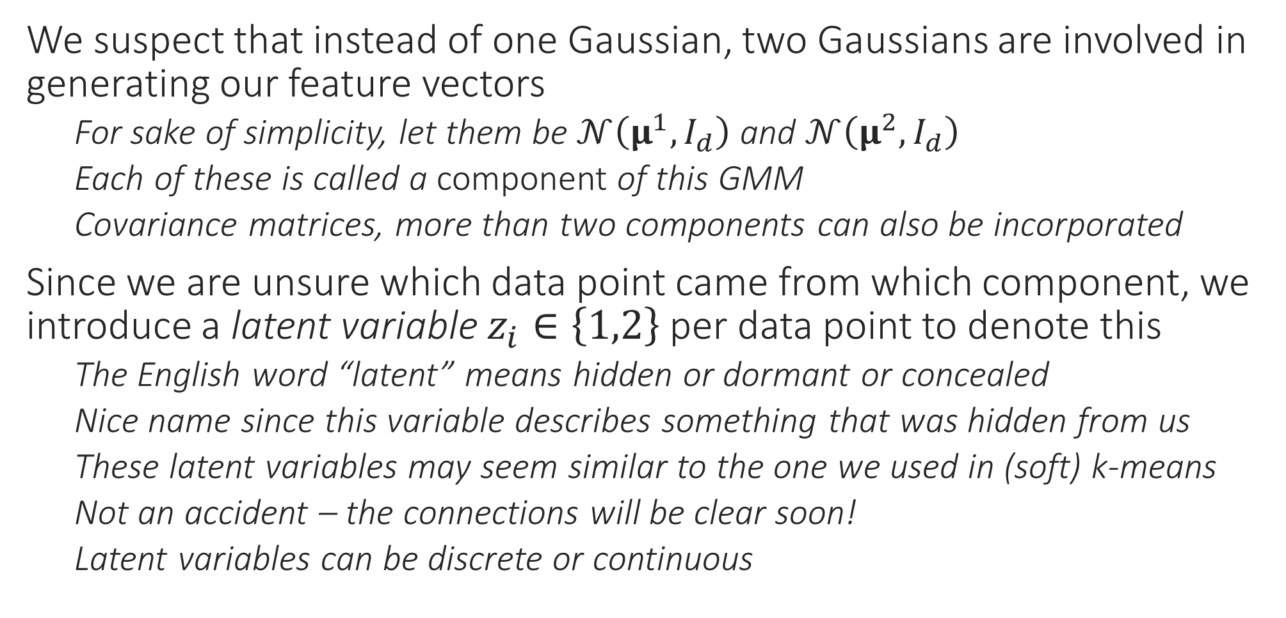
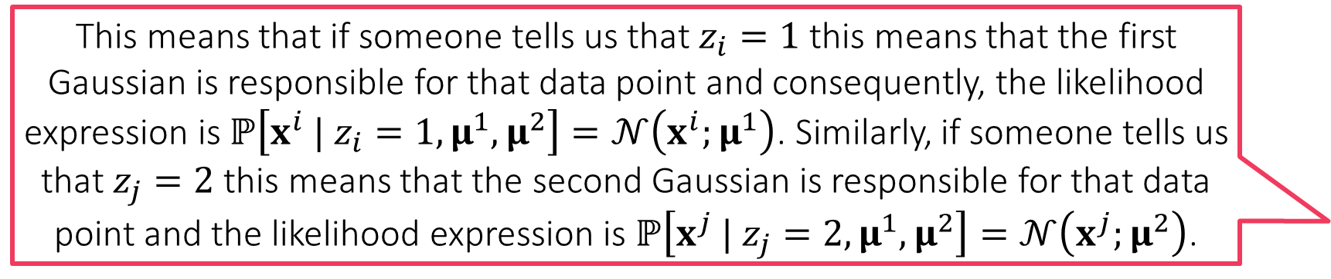
Learning a Mixture of Two Gaussians
This means that if someone tells us that $z_{i}=1$ this means that the first Gaussian is responsible for that data point and consequently, the likelihood expression is $ℙ\left[x^{i} | z_{i}=1,μ^{1},μ^{2}\right]=𝒩\left(x^{i};μ^{1}\right)$. Similarly, if someone tells us that $z_{j}=2$ this means that the second Gaussian is responsible for that data point and the likelihood expression is $ℙ\left[x^{j} | z_{j}=2,μ^{1},μ^{2}\right]=𝒩\left(x^{j};μ^{2}\right)$.
We suspect that instead of one Gaussian, two Gaussians are involved in generating our feature vectors
For sake of simplicity, let them be $𝒩\left(μ^{1},I_{d}\right)$ and $𝒩\left(μ^{2},I_{d}\right)$
Each of these is called a component of this GMM
Covariance matrices, more than two components can also be incorporated
Since we are unsure which data point came from which component, we introduce a latent variable $z_{i}∈\left\{1,2\right\}$ per data point to denote this
The English word “latent” means hidden or dormant or concealed
Nice name since this variable describes something that was hidden from us
These latent variables may seem similar to the one we used in (soft) k-means
Not an accident – the connections will be clear soon!
Latent variables can be discrete or continuous

Slide 12
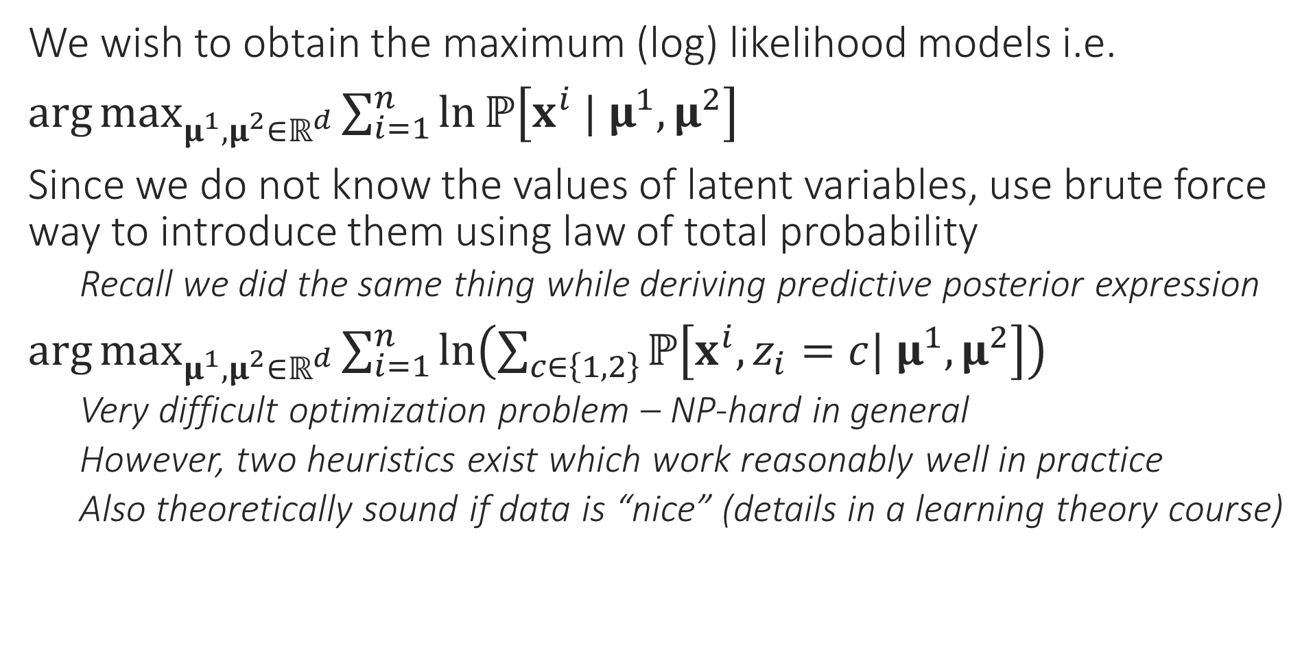
MLE with Latent Variables
We wish to obtain the maximum (log) likelihood models i.e.
$\arg{\max_{μ^{1},μ^{2}∈ℝ^{d}}{\sum_{i=1}^{n}{\ln{ℙ\left[x^{i} | μ^{1},μ^{2}\right]}}}}$
Since we do not know the values of latent variables, use brute force way to introduce them using law of total probability
Recall we did the same thing while deriving predictive posterior expression
$\arg{\max_{μ^{1},μ^{2}∈ℝ^{d}}{\sum_{i=1}^{n}{\ln\left(\sum_{c∈\left\{1,2\right\}}{ℙ\left[x^{i},z_{i}=c| μ^{1},μ^{2}\right]}\right)}}}$
Very difficult optimization problem – NP-hard in general
However, two heuristics exist which work reasonably well in practice
Also theoretically sound if data is “nice” (details in a learning theory course)

Slide 13

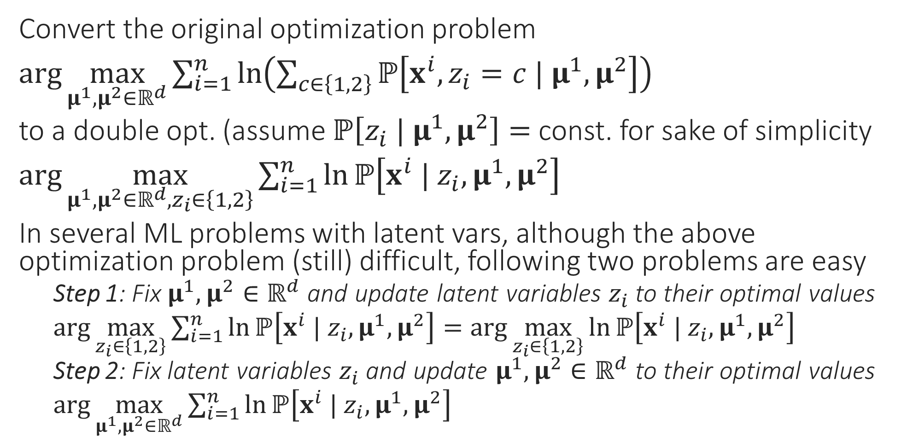
Heuristic 1: Alternating Optimization
Keep alternating between step 1 and step 2 till you are tired or till the process has converged!
Convert the original optimization problem
$\arg{\max_{μ^{1},μ^{2}∈ℝ^{d}}{\sum_{i=1}^{n}{\ln\left(\sum_{c∈\left\{1,2\right\}}{ℙ\left[x^{i},z_{i}=c | μ^{1},μ^{2}\right]}\right)}}}$
to a double opt. (assume $ℙ\left[z_{i} | μ^{1},μ^{2}\right]=$ const. for sake of simplicity
$\arg{\max_{μ^{1},μ^{2}∈ℝ^{d},z_{i}∈\left\{1,2\right\}}{\sum_{i=1}^{n}{\ln{ℙ\left[x^{i} | z_{i},μ^{1},μ^{2}\right]}}}}$
In several ML problems with latent vars, although the above optimization problem (still) difficult, following two problems are easy
Step 1: Fix $μ^{1},μ^{2}∈ℝ^{d}$ and update latent variables $z_{i}$ to their optimal values
$\arg{\max_{z_{i}∈\left\{1,2\right\}}{\sum_{i=1}^{n}{\ln{ℙ\left[x^{i} | z_{i},μ^{1},μ^{2}\right]}}}}=\arg{\max_{z_{i}∈\left\{1,2\right\}}{\ln{ℙ\left[x^{i} | z_{i},μ^{1},μ^{2}\right]}}}$
Step 2: Fix latent variables $z_{i}$ and update $μ^{1},μ^{2}∈ℝ^{d}$ to their optimal values
$\arg{\max_{μ^{1},μ^{2}∈ℝ^{d}}{\sum_{i=1}^{n}{\ln{ℙ\left[x^{i} | z_{i},μ^{1},μ^{2}\right]}}}}$
The most important difference between the original and the new problem is that original has a sum of log of sum which is very difficult to optimize whereas the new problem gets rid of this and looks simply like a MLE problem. We know how to solve MLE problems very easily!

Slide 14


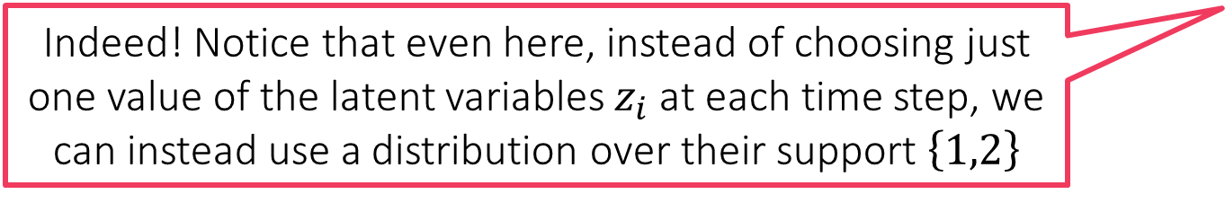
Heuristic 1 at Work
Isn’t this like the k-means algorithm?
As discussed before, we assume a mixture of two Gaussians
$ℙ\left[x^{i} | z_{i}=1,μ^{1},μ^{2}\right]=𝒩\left(x^{i};μ^{1}\right)$ and $ℙ\left[x^{j} | z_{j}=2,μ^{1},μ^{2}\right]=𝒩\left(x^{j};μ^{2}\right)$
Step 1 becomes
$\arg{\max_{z_{i}∈\left\{1,2\right\}}{\ln{ℙ\left[x^{i} | z_{i},μ^{1},μ^{2}\right]}}}={\arg{\min_{z_{i}∈\left\{1,2\right\}}\left\|x^{i}−μ^{z_{i}}\right\|}}_{2}^{2}$
Step 2 becomes
$\arg{\max_{μ^{1},μ^{2}∈ℝ^{d}}{\sum_{i=1}^{n}{\ln{ℙ\left[x^{i} | z_{i},μ^{1},μ^{2}\right]}}}}$
$=\arg{\min_{μ^{1} ∈ℝ^{d}}{\sum_{i:z_{i}=1}{{\left\|x^{i}−μ^{1}\right\|}_{2}^{2}}}}+\arg{\min_{μ^{2}∈ℝ^{d}}{\sum_{i:z_{i}=2}{{\left\|x^{i}−μ^{2}\right\|}_{2}^{2}}}}$
Thus, $μ^{1}=\frac{1}{n_{1}}\sum_{i:z_{i}=1}{x^{i}}$ and $μ^{2}=\frac{1}{n_{2}}\sum_{i:z_{i}=2}{x^{i}}$ where $n_{c}$ is the number of data points for which we have $z_{i}=c$
Repeat!
Not just “like” – this is the k-means algorithm! This means that the k-means algorithm is one heuristic way to compute an MLE which is difficult to compute directly!
Indeed! Notice that even here, instead of choosing just one value of the latent variables $z_{i}$ at each time step, we can instead use a distribution over their support $\left\{1,2\right\}$
I have a feeling that the second heuristic will also give us something we have already studied!

Slide 15
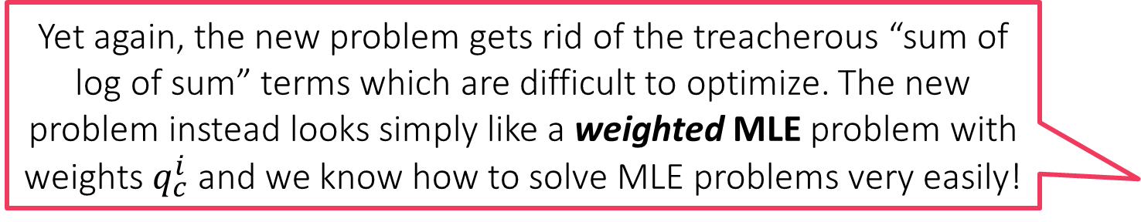

Heuristic 2: Expectation Maximization
Original Prob: $\arg{\max_{μ^{1},μ^{2}∈ℝ^{d}}{\sum_{i=1}^{n}{\ln\left(\sum_{c∈\left\{1,2\right\}}{ℙ\left[x^{i},z_{i}=c | μ^{1},μ^{2}\right]}\right)}}}$
Step 1 (E Step) Consists of two sub-steps
Step 1.1 Assume our current model estimates are $μ^{1}=p,μ^{2}=q$
Use the current models to ascertain how likely are different values of $z_{i}$ for the $i$-th data point i.e. compute $q_{c}^{i}=ℙ\left[z_{i}=c | x^{i},p,q\right]$ for both $c∈\left\{1,2\right\}$
Step 1.2 Use weights $q_{c}^{i}$ to set up a new objective function
As before, assume $ℙ\left[z_{i} | μ^{1},μ^{2}\right]=$ constant for sake of simplicity
$\sum_{i=1}^{n}{\sum_{c∈\left\{1,2\right\}}{q_{c}^{i}⋅\ln{ℙ\left[x^{i}, | z_{i}=c,μ^{1},μ^{2}\right]}}}$
Step 2 (M Step) Maximize the new obj. fn. to get new models
$\arg{\max_{μ^{1},μ^{2}∈ℝ^{d}}{\sum_{i=1}^{n}{\sum_{c∈\left\{1,2\right\}}{q_{c}^{i}⋅\ln{ℙ\left[x^{i}, | z_{i}=c,μ^{1},μ^{2}\right]}}}}}$
Repeat!
Yet again, the new problem gets rid of the treacherous “sum of log of sum” terms which are difficult to optimize. The new problem instead looks simply like a weighted MLE problem with weights $q_{c}^{i}$ and we know how to solve MLE problems very easily!

Slide 16
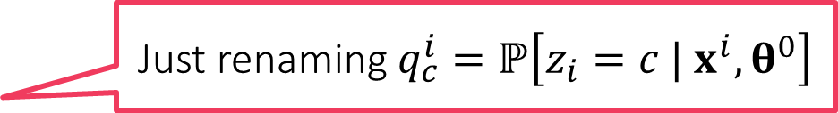
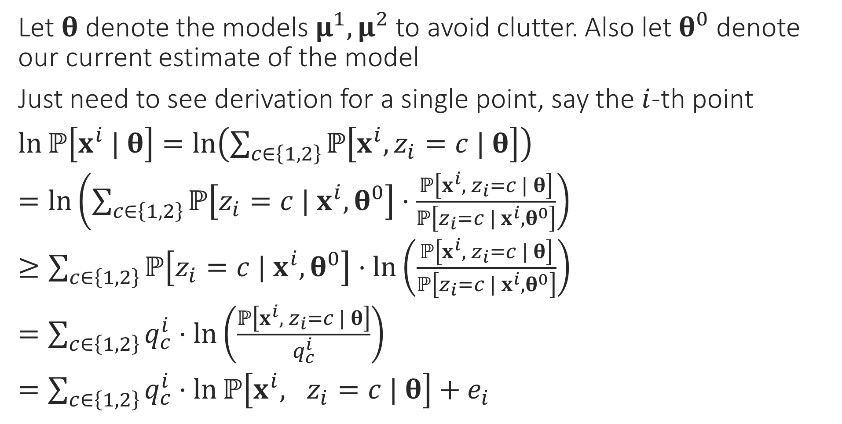

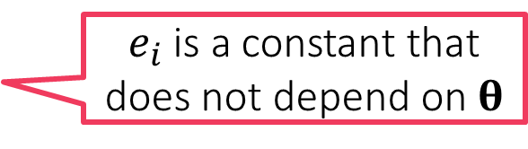
Derivation of the E Step
Jensen’s inequality tells us that $f\left(𝔼X\right)≤𝔼\left[f\left(X\right)\right]$ for any convex function. We used the fact that $\ln\left(⋅\right)$ is a concave function and so the inequality reverses since every concave function is the negative of a convex function
Let $θ$ denote the models $μ^{1},μ^{2}$ to avoid clutter. Also let $θ^{0}$ denote our current estimate of the model
Just need to see derivation for a single point, say the $i$-th point
$\ln{ℙ\left[x^{i} | θ\right]}=\ln\left(\sum_{c∈\left\{1,2\right\}}{ℙ\left[x^{i},z_{i}=c | θ\right]}\right)$
$=\ln\left(\sum_{c∈\left\{1,2\right\}}{ℙ\left[z_{i}=c | x^{i},θ^{0}\right]}⋅\frac{ℙ\left[x^{i}, z_{i}=c | θ\right]}{ℙ\left[z_{i}=c | x^{i},θ^{0}\right]}\right)$
$≥\sum_{c∈\left\{1,2\right\}}{ℙ\left[z_{i}=c | x^{i},θ^{0}\right]}⋅\ln\left(\frac{ℙ\left[x^{i}, z_{i}=c | θ\right]}{ℙ\left[z_{i}=c | x^{i},θ^{0}\right]}\right)$
$=\sum_{c∈\left\{1,2\right\}}{q_{c}^{i}}⋅\ln\left(\frac{ℙ\left[x^{i}, z_{i}=c | θ\right]}{q_{c}^{i}}\right)$
$=\sum_{c∈\left\{1,2\right\}}{q_{c}^{i}}⋅\ln{ℙ\left[x^{i}, z_{i}=c | θ\right]}+e_{i}$
Law of total probability
Simply multiply and divide by the same term
Jensen’s inequality
Just renaming $q_{c}^{i}=ℙ\left[z_{i}=c | x^{i},θ^{0}\right]$
$e_{i}$ is a constant that does not depend on $θ$

Slide 17



The EM Algorithm
Note: assumptions such as $ℙ\left[z_{i} | μ^{1},μ^{2}\right]=$ const are made for sake of simplicity only. Can execute EM perfectly well without making these assumptions a well. However, updates get more involved – be careful not to make mistakes
If we instantiate the EM algorithm with the GMM likelihoods, we will recover the soft k-means algorithm
Thus, the soft k-means algorithm is yet another heuristic way (the k-means algo is the other) to compute an MLE which is difficult to compute directly!
The EM algorithm has pros and cons over alternating optimization
Con: EM is usually more expensive to execute than alternating optimization
Pro: EM will ensures that objective value of the original problem i.e.
$\arg{\max_{μ^{1},μ^{2}∈ℝ^{d}}{\sum_{i=1}^{n}{\ln\left(\sum_{c∈\left\{1,2\right\}}{ℙ\left[x^{i},z_{i}=c | μ^{1},μ^{2}\right]}\right)}}}$
… always keeps going up at every iteration – monotonic progress!!
May include details in the course notes (not very difficult)
However, no guarantee that we will ever reach the global maximum
May converge to, and get stuck at, a local maximum instead
EM for GMM
Initialize means ${\left\{μ^{c}\right\}}_{c=1…C}$
For $i∈\left[n\right]$, update $π_{c}^{i}$ using $\left\{μ^{c}\right\}$
Let $p_{c}^{i}=\exp\left(−\frac{{\left\|x^{i}−μ^{c}\right\|}_{2}^{2}}{2}\right)$
Let $q_{c}^{i}=\frac{p_{c}^{i}}{\sum_{c=1}^{C}{p_{c}^{i}}}$ (normalize)
Let $n_{c}=\sum_{i=1}^{n}{q_{c}^{i}}$
Update $μ^{c}=\frac{1}{n_{c}}\sum_{i=1}^{n}{q_{c}^{i}⋅x^{i}}$
Repeat until convergence

Slide 18
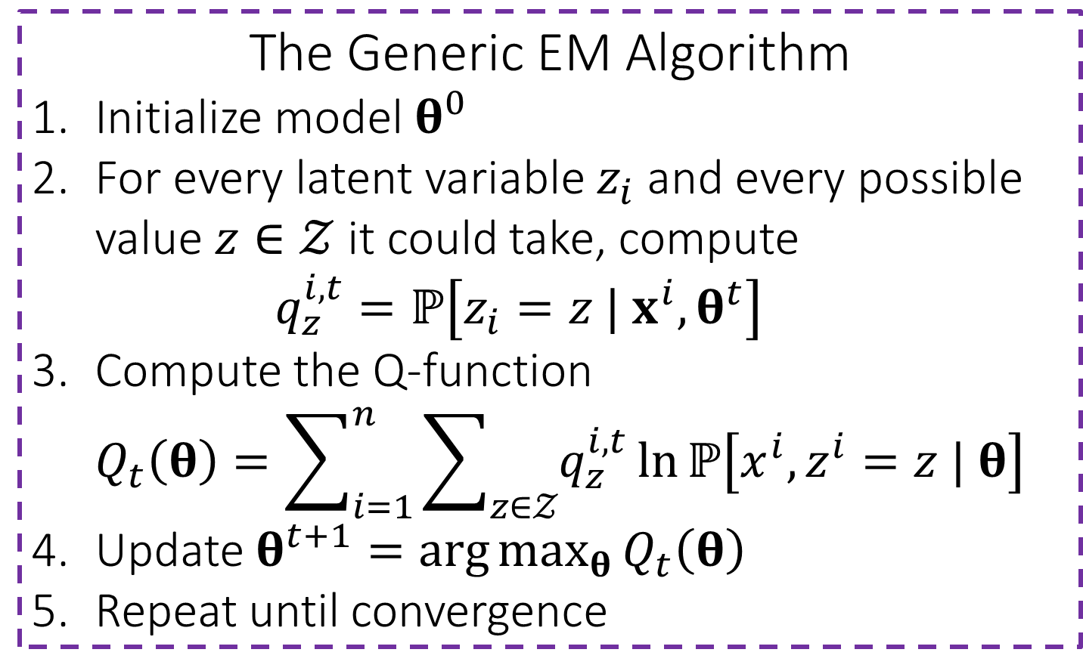

The Q Function
The Generic EM Algorithm
Initialize model $θ^{0}$
For every latent variable $z_{i}$ and every possible value $z∈𝒵$ it could take, compute $q_{z}^{i,t}=ℙ\left[z_{i}=z | x^{i},θ^{t}\right]$
Compute the Q-function $Q_{t}\left(θ\right)=\sum_{i=1}^{n}{\sum_{z∈𝒵}{q_{z}^{i,t}\ln{ℙ\left[x^{i},z^{i}=z | θ\right]}}}$
Update $θ^{t+1}=\arg{\max_{θ}{Q_{t}\left(θ\right)}}$
Repeat until convergence
Let $Q_{t}\left(θ\right)=\sum_{i=1}^{n}{\sum_{c∈\left\{1,2\right\}}{q_{c}^{i}}⋅\ln{ℙ\left[x^{i}, z_{i}=c | θ\right]}+e_{i}}$ be the new objective function constructed at time step $t$
The EM algorithm constructs a new $Q_{t}$ function at each time during the E-step and maximizes it during the M-step
$θ^{t+1}=\arg{\max{Q_{t}\left(θ\right)}}$
We have already seen that $Q\left(θ\right)≥\sum_{i=1}^{n}{\ln{ℙ\left[x^{i} | θ\right]}}$ for all $θ$
Can also show that $Q\left(θ^{t}\right)=\sum_{i=1}^{n}{\ln{ℙ\left[x^{i} | θ^{t}\right]}}$ (see course notes)
Some indication as to why EM increases likelihood at each iteration
Alt. Opt. instead can be thought of as using a $Q$ function of the form $Q_{t}\left(θ\right)=\sum_{i=1}^{n}{\ln{ℙ\left[x^{i}, {\tilde{z}}_{i}| θ\right]}}$ where ${\tilde{z}}_{i}=\arg{\max_{z_{i}∈\left\{1,2\right\}}{\ln{ℙ\left[x^{i} | z_{i},θ^{t}\right]}}}$

Slide 19










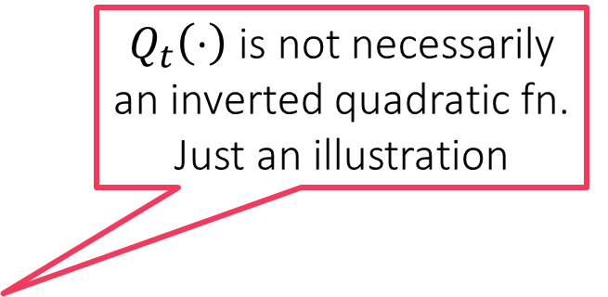
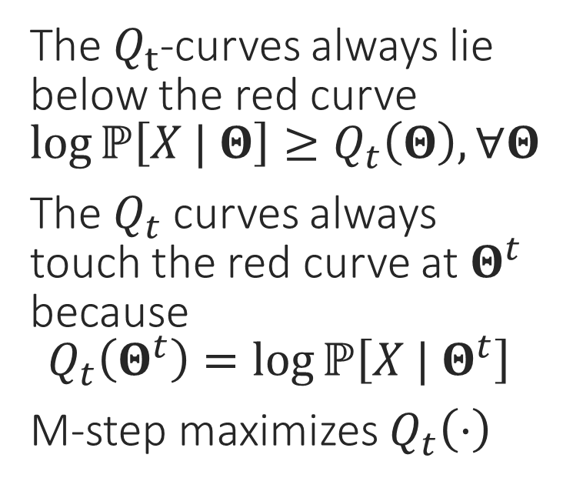
A pictorial depiction of the EM
$Q_{t}\left(⋅\right)$ is not necessarily an inverted quadratic fn. Just an illustration
The $Q_{t}$-curves always lie below the red curve $\log{ℙ\left[X | Θ\right]}≥Q_{t}\left(Θ\right), ∀Θ$
The $Q_{t}$ curves always touch the red curve at $Θ^{t}$ because $Q_{t}\left(Θ^{t}\right)=\log{ℙ\left[X | Θ^{t}\right]}$
M-step maximizes $Q_{t}\left(⋅\right)$
Stuck!!

