Slide 1
Principal Component Analysis II
CS771: Introduction to Machine Learning
Purushottam Kar

Slide 2
Announcements
No class on Wednesday October 02 due to institute holiday
Several group mergers, migrations have taken place in the last week
Nice that almost all assignment groups have at least 4 members
A few assignment groups dissolved since all members joined other groups
Will still allow mergers/migrations in case there is a pressing need, for example if a group member drops the course altogether
Group sizes should not exceed 6 members in any such mergers/migrations
Please focus on assignment 2 now (deadline October 26, 9:59PM IST)

Slide 3
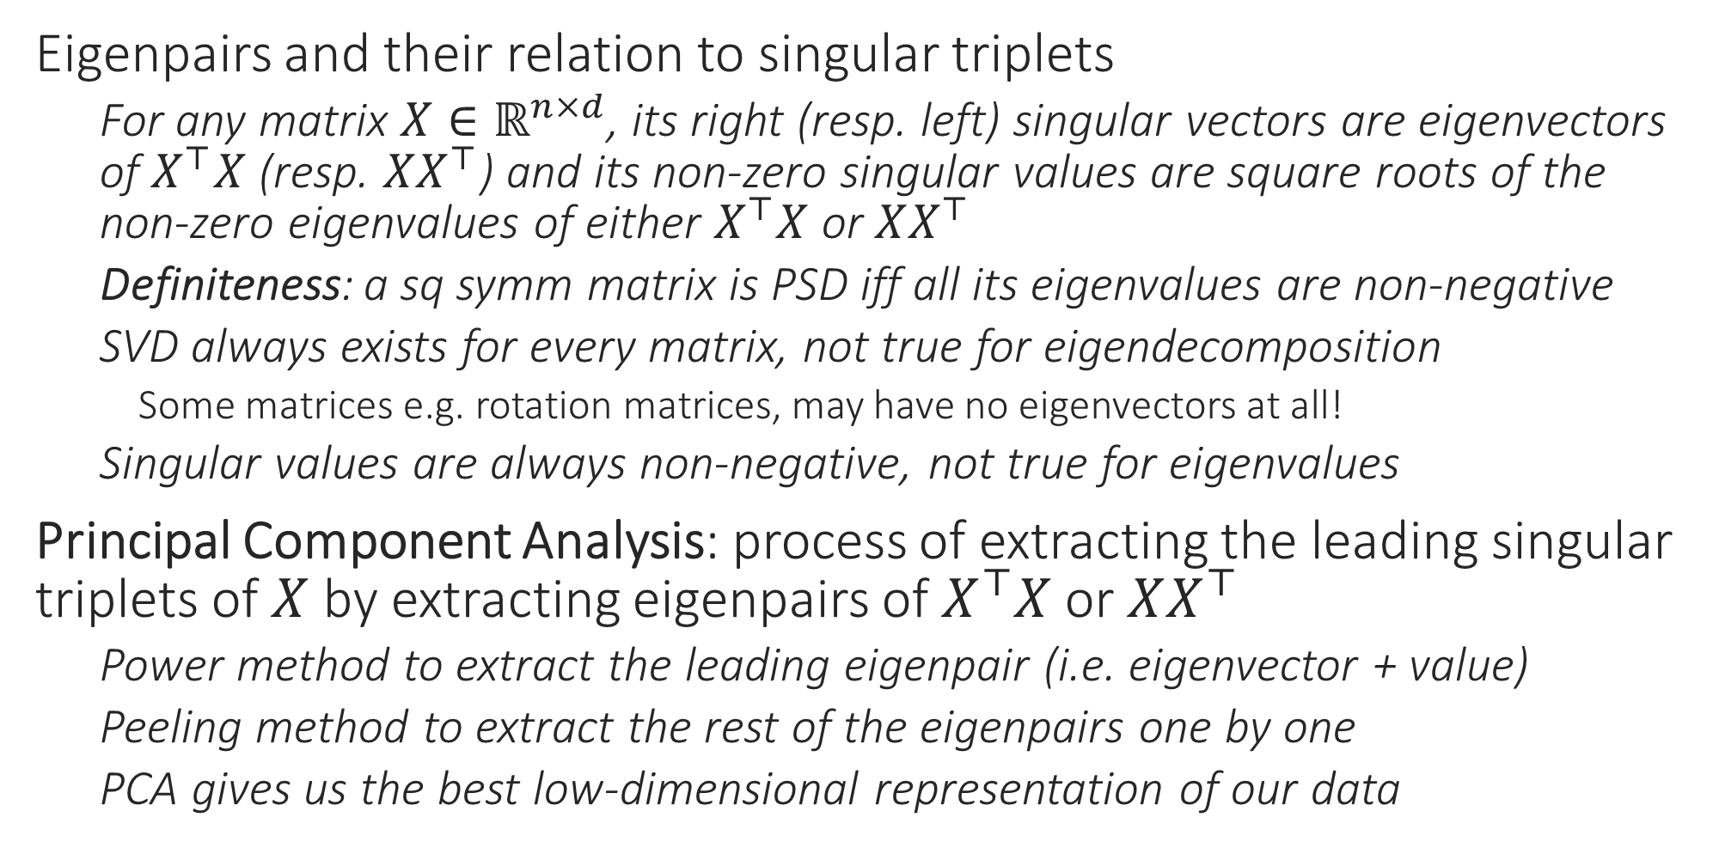
Recap of Last Lecture
Eigenpairs and their relation to singular triplets
For any matrix $X∈ℝ^{n×d}$, its right (resp. left) singular vectors are eigenvectors of $X^{⊤}X$ (resp. $XX^{⊤}$) and its non-zero singular values are square roots of the non-zero eigenvalues of either $X^{⊤}X$ or $XX^{⊤}$
Definiteness: a sq symm matrix is PSD iff all its eigenvalues are non-negative
SVD always exists for every matrix, not true for eigendecomposition
Some matrices e.g. rotation matrices, may have no eigenvectors at all!
Singular values are always non-negative, not true for eigenvalues
Principal Component Analysis: process of extracting the leading singular triplets of $X$ by extracting eigenpairs of $X^{⊤}X$ or $XX^{⊤}$
Power method to extract the leading eigenpair (i.e. eigenvector + value)
Peeling method to extract the rest of the eigenpairs one by one
PCA gives us the best low-dimensional representation of our data

Slide 4

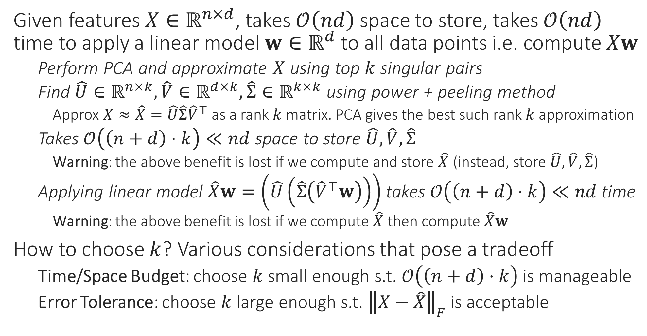

Applications of PCA – Space Savings
Is there are quick way to find whether ${\left\|X−\hat{X}\right\|}_{F}$ is small or not?
Given features $X∈ℝ^{n×d}$, takes $𝒪\left(nd\right)$ space to store, takes $𝒪\left(nd\right)$ time to apply a linear model $w∈ℝ^{d}$ to all data points i.e. compute $Xw$
Perform PCA and approximate $X$ using top $k$ singular pairs
Find $\hat{U}∈ℝ^{n×k},\hat{V}∈ℝ^{d×k},\hat{Σ}∈ℝ^{k×k}$ using power + peeling method
Approx $X≈\hat{X}=\hat{U}\hat{Σ}{\hat{V}}^{⊤}$ as a rank $k$ matrix. PCA gives the best such rank $k$ approximation
Takes $𝒪\left(\left(n+d\right)⋅k\right)≪nd$ space to store $\hat{U},\hat{V},\hat{Σ}$
Warning: the above benefit is lost if we compute and store $\hat{X}$ (instead, store $\hat{U},\hat{V},\hat{Σ}$)
Applying linear model $\hat{X}w=\left(\hat{U}\left(\hat{Σ}\left({\hat{V}}^{⊤}w\right)\right)\right)$ takes $𝒪\left(\left(n+d\right)⋅k\right)≪nd$ time
Warning: the above benefit is lost if we compute $\hat{X}$ then compute $\hat{X}w$
How to choose $k$? Various considerations that pose a tradeoff
Time/Space Budget: choose $k$ small enough s.t. $𝒪\left(\left(n+d\right)⋅k\right)$ is manageable
Error Tolerance: choose $k$ large enough s.t. ${\left\|X−\hat{X}\right\|}_{F}$ is acceptable

Slide 5



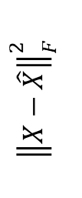

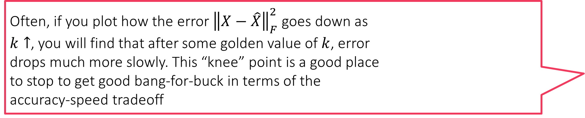
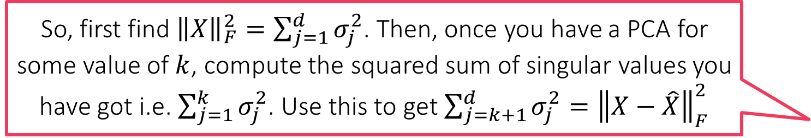
Finding the right value of $k$
So, first find ${\left\|X\right\|}_{F}^{2}=\sum_{j=1}^{d}{σ_{j}^{2}}$. Then, once you have a PCA for some value of $k$, compute the squared sum of singular values you have got i.e. $\sum_{j=1}^{k}{σ_{j}^{2}}$. Use this to get $\sum_{j=k+1}^{d}{σ_{j}^{2}}={\left\|X−\hat{X}\right\|}_{F}^{2}$
For $d<n$, we have $X=\sum_{j=1}^{d}{σ_{j}u^{j}{\left(v^{j}\right)}^{⊤}}$ and $\hat{X}=\sum_{j=1}^{k}{σ_{j}u^{j}{\left(v^{j}\right)}^{⊤}}$
Thus, ignoring peeling errors, we get $X−\hat{X}=\sum_{j=k+1}^{d}{σ_{j}u^{j}{\left(v^{j}\right)}^{⊤}}$
Fact: ${\left\|A\right\|}_{F}^{2}=tr\left(A^{⊤}A\right)=tr\left(AA^{⊤}\right)$ where $tr$ is the trace (sum of diagonal)
${\left\|X−\hat{X}\right\|}_{F}^{2}=tr\left(\sum_{j=k+1}^{d}{σ_{j}^{2}v^{j}{\left(u^{j}\right)}^{⊤}u^{j}{\left(v^{j}\right)}^{⊤}}+\sum_{j≠l}{σ_{j}σ_{l}v^{j}{\left(u^{j}\right)}^{⊤}u^{l}{\left(v^{l}\right)}^{⊤}}\right)$
Now $u^{j}$ are orthonormal and so are $v^{j}$ i.e. ${\left(u^{j}\right)}^{⊤}u^{l}=0$ and ${\left(u^{j}\right)}^{⊤}u^{j}=1$
${\left\|X−\hat{X}\right\|}_{F}^{2}=tr\left(\sum_{j=k+1}^{d}{σ_{j}^{2}v^{j}{\left(v^{j}\right)}^{⊤}}\right)=\sum_{j=k+1}^{d}{σ_{j}^{2}tr\left(v^{j}{\left(v^{j}\right)}^{⊤}\right)}=\sum_{j=k+1}^{d}{σ_{j}^{2}}$
Used linearity of trace and $tr\left(v^{j}{\left(v^{j}\right)}^{⊤}\right)=tr\left({{\left(v^{j}\right)}^{⊤}v}^{j}\right)=1$ to show this
Similarly, can show that ${\left\|X\right\|}_{F}^{2}=\sum_{j=1}^{d}{σ_{j}^{2}}$
A prominent knee point, if one exists, gives us a good idea of the true intrinsic dimensionality of the data
Often, if you plot how the error ${\left\|X−\hat{X}\right\|}_{F}^{2}$ goes down as $k↑$, you will find that after some golden value of $k$, error drops much more slowly. This “knee” point is a good place to stop to get good bang-for-buck in terms of the accuracy-speed tradeoff
“knee” point
$${\left\|X−\hat{X}\right\|}_{F}^{2}$$
$$k$$

Slide 6
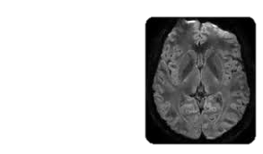
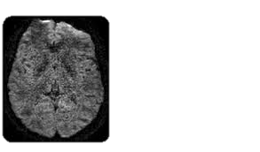
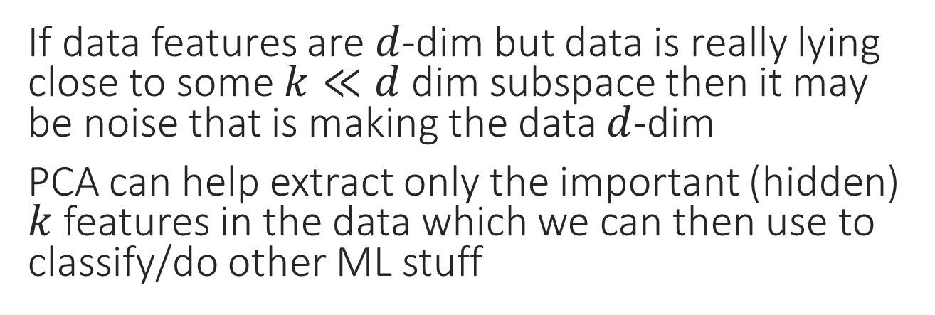
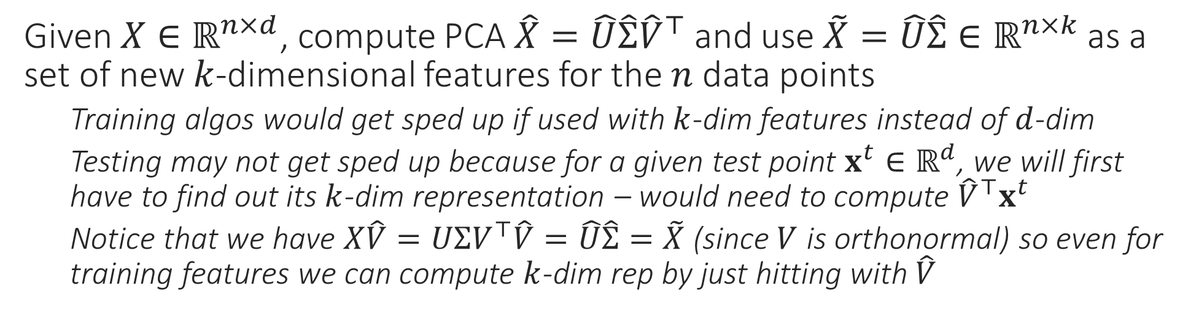
Applications of PCA – Noise Removal
Treat images as matrix and “smoothen” the image by taking a low-rank approximation
If data features are $d$-dim but data is really lying close to some $k≪d$ dim subspace then it may be noise that is making the data $d$-dim
PCA can help extract only the important (hidden) $k$ features in the data which we can then use to classify/do other ML stuff
Given $X∈ℝ^{n×d}$, compute PCA $\hat{X}=\hat{U}\hat{Σ}{\hat{V}}^{⊤}$ and use $\tilde{X}=\hat{U}\hat{Σ}∈ℝ^{n×k}$ as a set of new $k$-dimensional features for the $n$ data points
Training algos would get sped up if used with $k$-dim features instead of $d$-dim
Testing may not get sped up because for a given test point $x^{t}∈ℝ^{d}$, we will first have to find out its $k$-dim representation – would need to compute ${\hat{V}}^{⊤}x^{t}$
Notice that we have $X\hat{V}=UΣV^{⊤}\hat{V}=\hat{U}\hat{Σ}=\tilde{X}$ (since $V$ is orthonormal) so even for training features we can compute $k$-dim rep by just hitting with $\hat{V}$

Slide 7


Foreground Background Separation
$$=$$
$$+$$
7

Slide 8
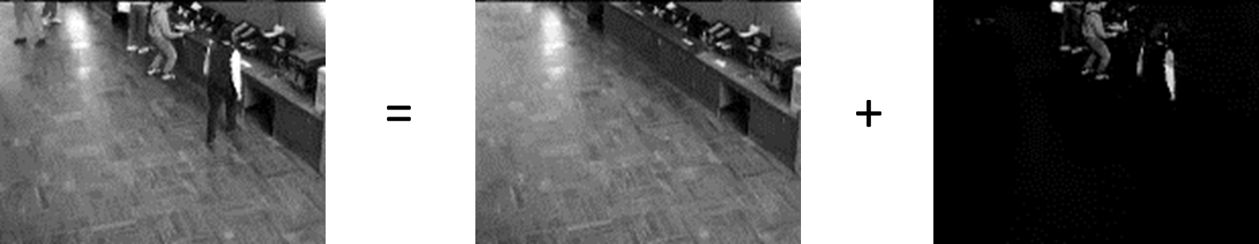
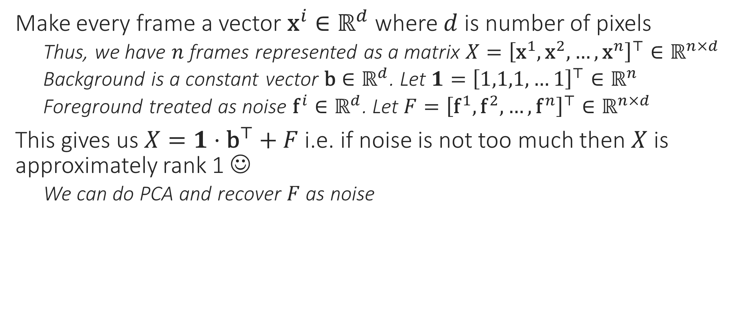
Denoising, Foreground Extraction
Note: here we are treating images as vectors and a group of images (say a video) is treated as a matrix – this is different from the noise removal example where every image was treated as a matrix itself
Make every frame a vector ${\text{x}}^{i}∈ℝ^{d}$ where $d$ is number of pixels
Thus, we have $n$ frames represented as a matrix $X={\left[{\text{x}}^{1},{\text{x}}^{2},…,{\text{x}}^{n}\right]}^{⊤}∈ℝ^{n×d}$
Background is a constant vector $\text{b}∈ℝ^{d}$. Let $1={\left[1,1,1,…1\right]}^{⊤}∈ℝ^{n}$
Foreground treated as noise ${\text{f}}^{i}∈ℝ^{d}$. Let $F={\left[{\text{f}}^{1},{\text{f}}^{2},…,{\text{f}}^{n}\right]}^{⊤}∈ℝ^{n×d}$
This gives us $X=1⋅{\text{b}}^{⊤}+F$ i.e. if noise is not too much then $X$ is approximately rank 1 ☺
We can do PCA and recover $F$ as noise

Slide 9
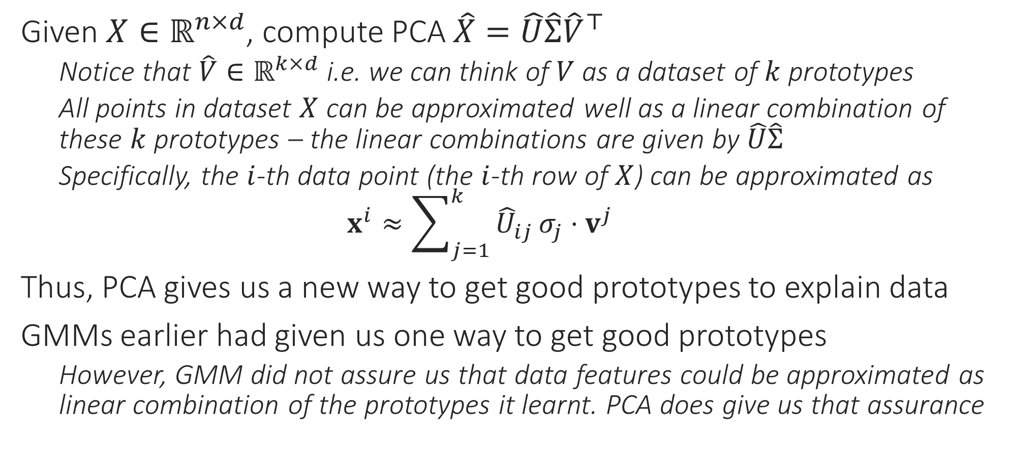
Applications of PCA – Learning Prototypes
Given $X∈ℝ^{n×d}$, compute PCA $\hat{X}=\hat{U}\hat{Σ}{\hat{V}}^{⊤}$
Notice that $\hat{V}∈ℝ^{k×d}$ i.e. we can think of $V$ as a dataset of $k$ prototypes
All points in dataset $X$ can be approximated well as a linear combination of these $k$ prototypes – the linear combinations are given by $\hat{U}\hat{Σ}$
Specifically, the $i$-th data point (the $i$-th row of $X$) can be approximated as $x^{i}≈\sum_{j=1}^{k}{{\hat{U}}_{ij}}σ_{j}⋅v^{j}$
Thus, PCA gives us a new way to get good prototypes to explain data
GMMs earlier had given us one way to get good prototypes
However, GMM did not assure us that data features could be approximated as linear combination of the prototypes it learnt. PCA does give us that assurance

Slide 10
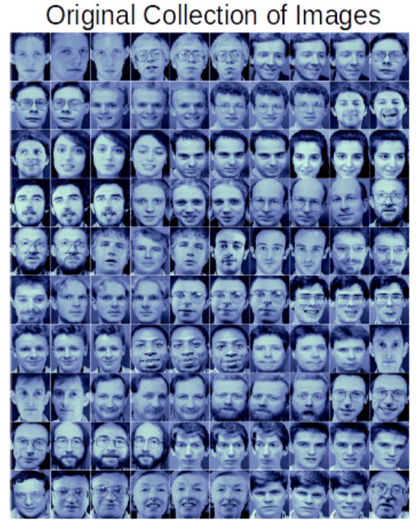
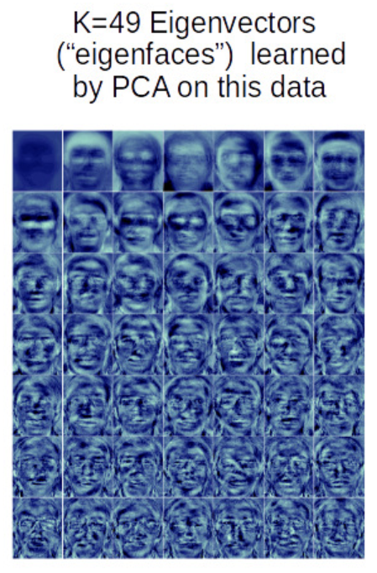
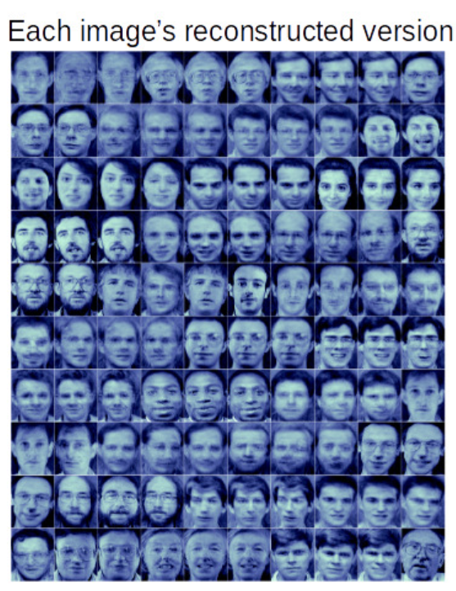
Eigenfaces [Sirovich and Kirby, Turk and Pentland]
Note: here again, we are treating images as vectors and a group of images is treated as a matrix
An iconic application of PCA – given face images, the prototypes given by the leading few right singular vectors are called “eigenfaces”
Images are treated as vectors for this (and many other) application

Slide 11



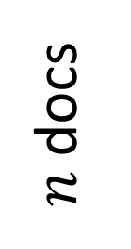


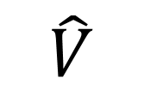

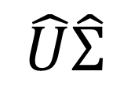

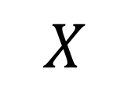


Latent Semantic Analysis (LSA/LSI)
Each topic here is represented by a prototypical document for that topic. All documents are linear representations of the topics. The amount of weight a document places on a certain topic in its representation tells us a lot about what is that document talking about e.g. if $\left|U_{ij}\right|≫1$ then the $j$-th topic is really core to the $i$-th document
Used to be a very popular course project topic ☺
Given $n$ documents, each as bag-of-words representation with dictionary size $d$ as very large $d≈{10}^{6}$, discover $k≪d$ “topics” about which the documents are talking
Topics could be sports, education, politics, science, entertainment
Word of caution: PCA itself will not tell you whether blah prototype is about sports or bleh prototype is about politics. You have to take a look at the prototype vector, also look at documents that place lots of weight on that prototype and make these deductions separately
$d$ words
$k$ topics
$d$ words
$k$ topics
$$≈$$
$n$ docs
$$n$$
$$X$$
$$\hat{U}\hat{Σ}$$
$$\hat{V}$$

Slide 12
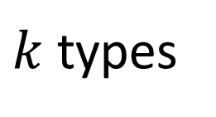
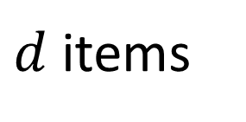

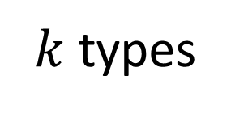
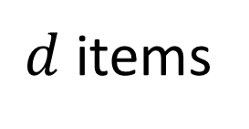

Recommendation Systems
Word of caution: This is a very different problem setting than the one in assignment 2. Assignment 2, where users have features, is called content-based filtering. In the setting in this slide, users have no features. A drawback of collaborative filtering is that it gets more difficult to add new users to the system
A popular technique is RecSys is Collaborative Filtering
Have data for $n$ users and their interactions with $d$ items
For these $n$ users, predict other items that they would also like
Done by discovering $k$ “user types” and representing each user as a combination of these user types
$d$ items
$k$ types
$d$ items
$k$ types
$$≈$$
$n$ users
$$n$$

Slide 13
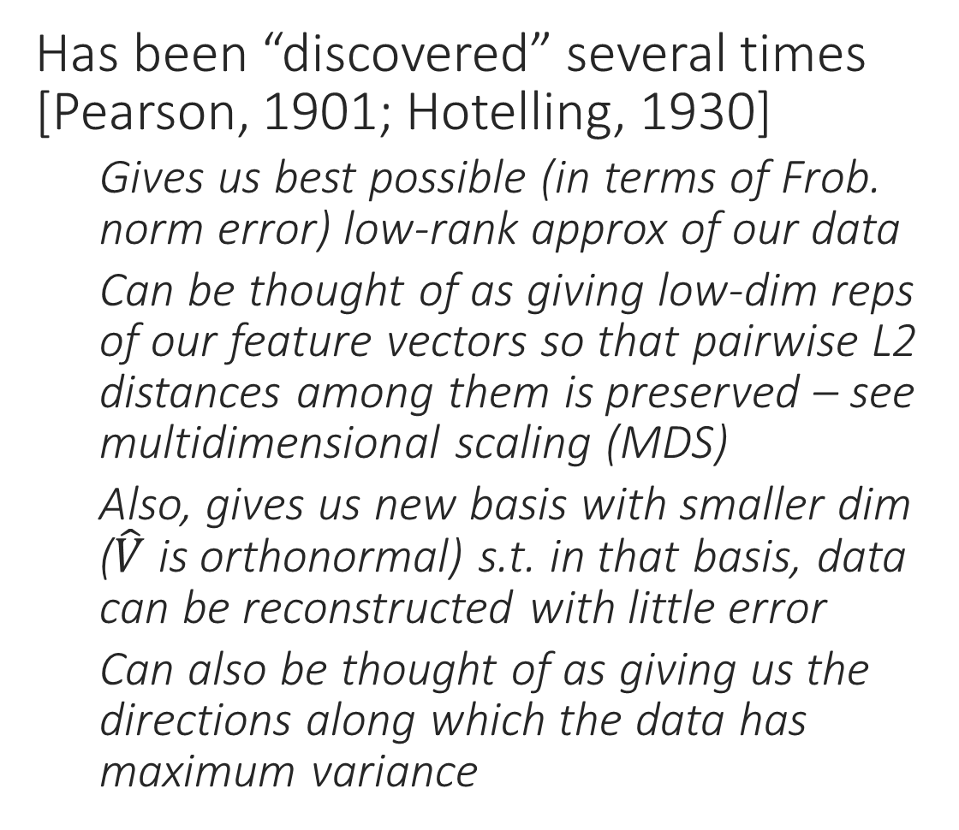
The Many Faces of PCA
Has been “discovered” several times [Pearson, 1901; Hotelling, 1930]
Gives us best possible (in terms of Frob. norm error) low-rank approx of our data
Can be thought of as giving low-dim reps of our feature vectors so that pairwise L2 distances among them is preserved – see multidimensional scaling (MDS)
Also, gives us new basis with smaller dim ($\hat{V}$ is orthonormal) s.t. in that basis, data can be reconstructed with little error
Can also be thought of as giving us the directions along which the data has maximum variance
This line captures most of the information in the data Why not get rid of the other information? Save space, reduce noise!

Slide 14
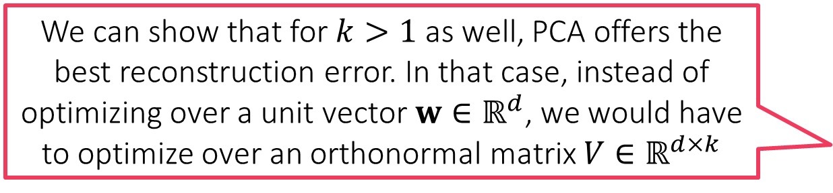
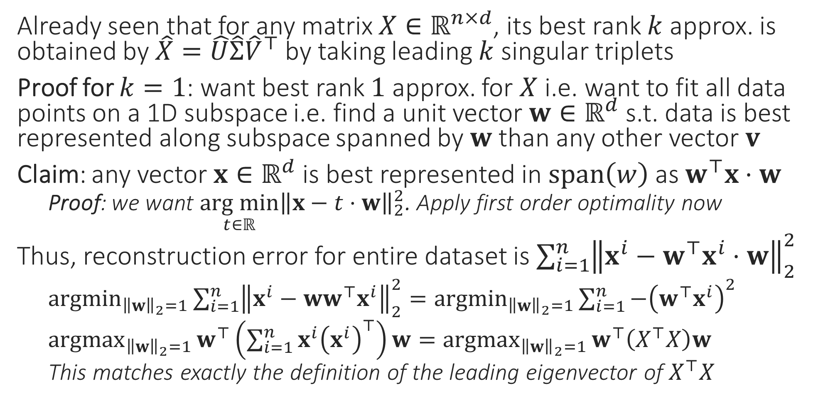
PCA Minimizes Reconstruction Error
We can show that for $k>1$ as well, PCA offers the best reconstruction error. In that case, instead of optimizing over a unit vector $w∈ℝ^{d}$, we would have to optimize over an orthonormal matrix $V∈ℝ^{d×k}$
Already seen that for any matrix $X∈ℝ^{n×d}$, its best rank $k$ approx. is obtained by $\hat{X}=\hat{U}\hat{Σ}{\hat{V}}^{⊤}$ by taking leading $k$ singular triplets
Proof for $k=1$: want best rank $1$ approx. for $X$ i.e. want to fit all data points on a 1D subspace i.e. find a unit vector $w∈ℝ^{d}$ s.t. data is best represented along subspace spanned by $w$ than any other vector $v$
Claim: any vector $x∈ℝ^{d}$ is best represented in $span\left(w\right)$ as $w^{⊤}x⋅w$
Proof: we want $\underset{t∈ℝ}{arg min}{{\left\|x−t⋅w\right\|}_{2}^{2}}$. Apply first order optimality now
Thus, reconstruction error for entire dataset is $\sum_{i=1}^{n}{{\left\|x^{i}−w^{⊤}x^{i}⋅w\right\|}_{2}^{2}}$
${argmin}_{{\left\|w\right\|}_{2}=1}{\sum_{i=1}^{n}{{\left\|x^{i}−{ww}^{⊤}x^{i}\right\|}_{2}^{2}}}={argmin}_{{\left\|w\right\|}_{2}=1}{\sum_{i=1}^{n}{−{\left(w^{⊤}x^{i}\right)}^{2}}}$
${argmax}_{{\left\|w\right\|}_{2}=1}{w^{⊤}\left(\sum_{i=1}^{n}{{x^{i}\left(x^{i}\right)}^{⊤}}\right)w}={argmax}_{{\left\|w\right\|}_{2}=1}{w^{⊤}\left(X^{⊤}X\right)w}$
This matches exactly the definition of the leading eigenvector of $X^{⊤}X$

Slide 15
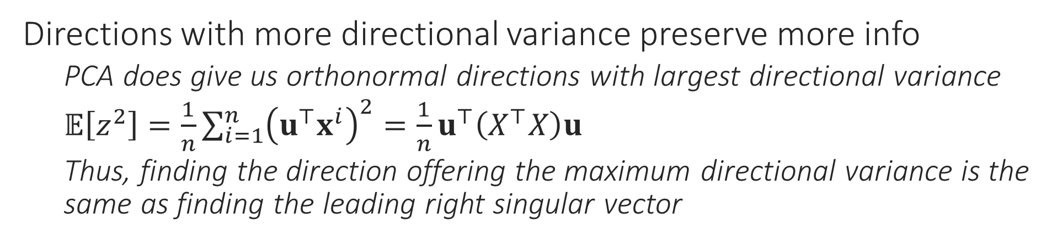
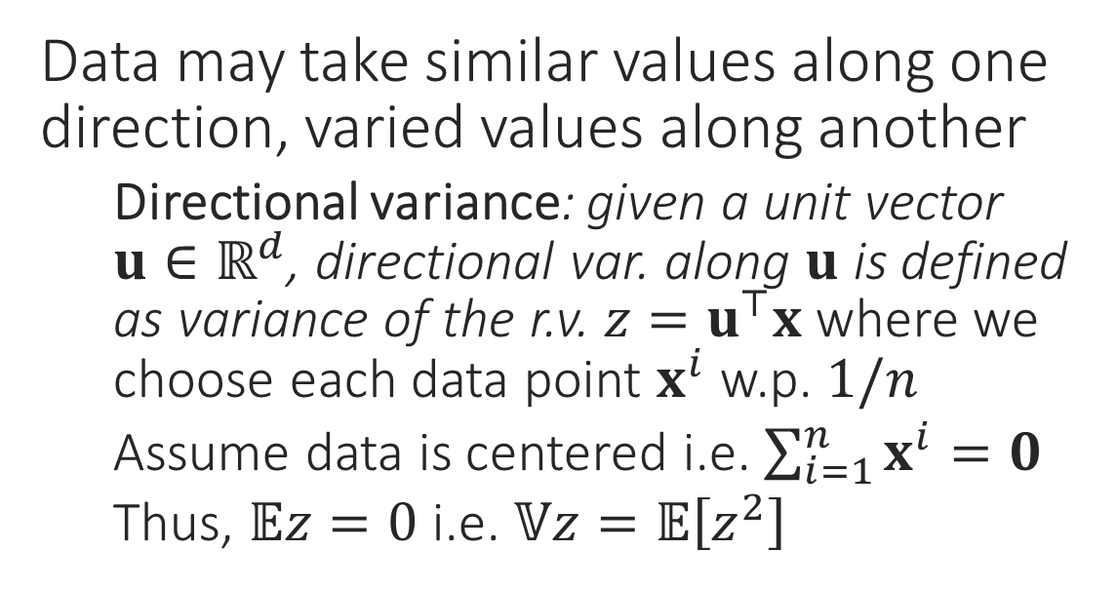
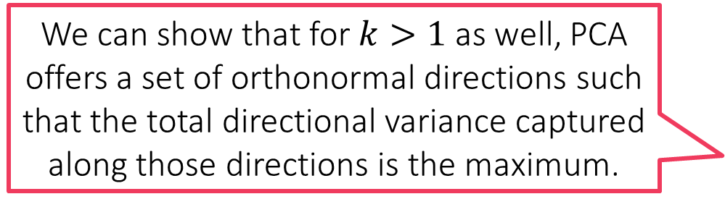
PCA Preserves Maximum Data Variance
Data may take similar values along one direction, varied values along another
Directional variance: given a unit vector $u∈ℝ^{d}$, directional var. along $u$ is defined as variance of the r.v. $z=u^{⊤}x$ where we choose each data point $x^{i}$ w.p. $1/n$
Assume data is centered i.e. $\sum_{i=1}^{n}{x^{i}}=0$
Thus, $𝔼z=0$ i.e. $𝕍z=𝔼\left[z^{2}\right]$
Projecting onto this line throws away a lot of information about the data ☹
Directions with more directional variance preserve more info
PCA does give us orthonormal directions with largest directional variance
$𝔼\left[z^{2}\right]=\frac{1}{n}\sum_{i=1}^{n}{{\left(u^{⊤}x^{i}\right)}^{2}}=\frac{1}{n}u^{⊤}\left(X^{⊤}X\right)u$
Thus, finding the direction offering the maximum directional variance is the same as finding the leading right singular vector
We can show that for $k>1$ as well, PCA offers a set of orthonormal directions such that the total directional variance captured along those directions is the maximum.

