Slide 1
Principal Component Analysis III
CS771: Introduction to Machine Learning
Purushottam Kar

Slide 2
Announcements
No classes next week on account of mid-semester recess
Classes resume on Monday, October 14
Quiz 3 to be held on October 16

Slide 3
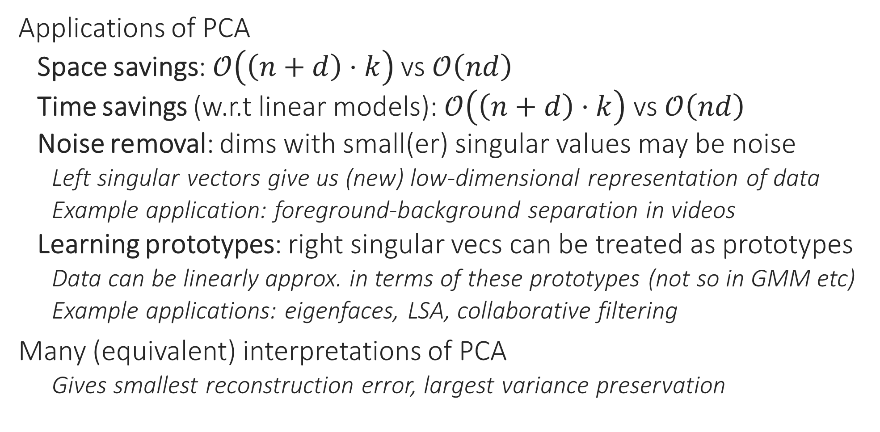
Recap of Last Lecture
Applications of PCA
Space savings: $𝒪\left(\left(n+d\right)⋅k\right)$ vs $𝒪\left(nd\right)$
Time savings (w.r.t linear models): $𝒪\left(\left(n+d\right)⋅k\right)$ vs $𝒪\left(nd\right)$
Noise removal: dims with small(er) singular values may be noise
Left singular vectors give us (new) low-dimensional representation of data
Example application: foreground-background separation in videos
Learning prototypes: right singular vecs can be treated as prototypes
Data can be linearly approx. in terms of these prototypes (not so in GMM etc)
Example applications: eigenfaces, LSA, collaborative filtering
Many (equivalent) interpretations of PCA
Gives smallest reconstruction error, largest variance preservation

Slide 4







Probabilistic PCA
The real data was actually sampled from a $k$-dim standard Gaussian, but got linearly mapped to a $d$-dim space and some noise got added
Given $x^{1},…,x^{n}$, can we recover $W,{\text{z}}^{1},…{\text{z}}^{n}?$ In other words, given $X∈ℝ^{n×d}$ , recover $W∈ℝ^{d×k}$ and $Z∈ℝ^{n×k}$ such that $X≈ZW^{⊤}$
$$x^{i}$$
$$W$$
$$z^{i}$$
=
Dictionary/Factor Loading matrix

Slide 5
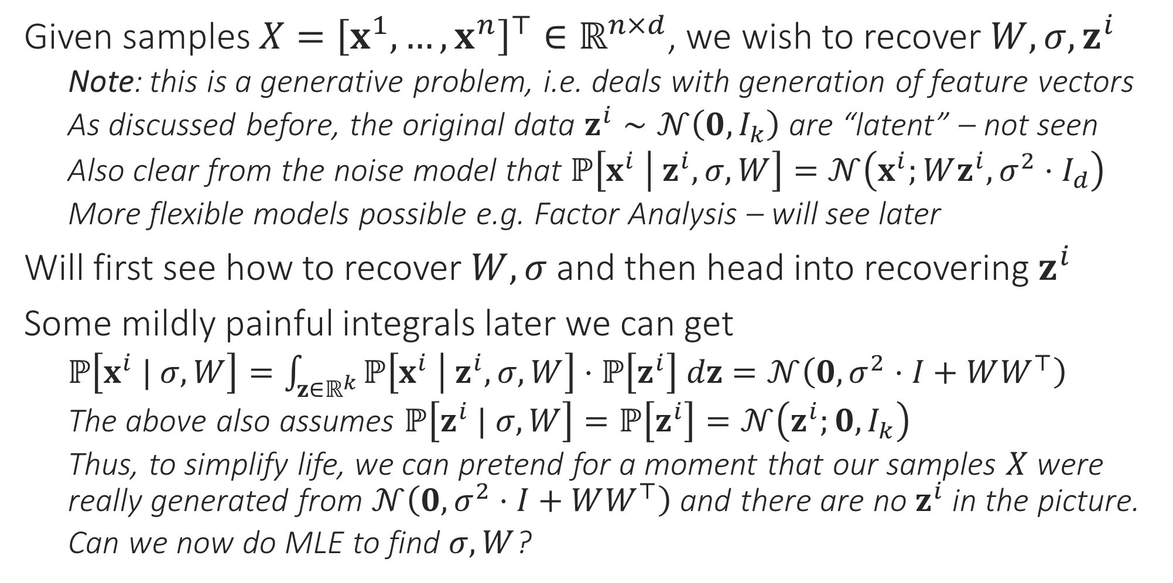
Probabilistic PCA [Tipping and Bishop, 1999]
It is very unusual for latent variables to simply integrate out like this leaving behind a nice Gaussian density. We got very lucky here ☺. Usually latent variables mean AltOpt/EM
Given samples $X={\left[x^{1},…,x^{n}\right]}^{⊤}∈ℝ^{n×d}$, we wish to recover $W,σ,z^{i}$
Note: this is a generative problem, i.e. deals with generation of feature vectors
As discussed before, the original data $z^{i}∼𝒩\left(0,I_{k}\right)$ are “latent” – not seen
Also clear from the noise model that $ℙ\left[x^{i} | z^{i},σ,W\right]=𝒩\left(x^{i};Wz^{i},σ^{2}⋅I_{d}\right)$
More flexible models possible e.g. Factor Analysis – will see later
Will first see how to recover $W,σ$ and then head into recovering $z^{i}$
Some mildly painful integrals later we can get
$ℙ\left[x^{i} | σ,W\right]=\int_{z∈ℝ^{k}}{ℙ\left[x^{i} | z^{i},σ,W\right]⋅ℙ\left[z^{i}\right] dz}=𝒩\left(0,σ^{2}⋅I+WW^{⊤}\right)$
The above also assumes $ℙ\left[z^{i} | σ,W\right]=ℙ\left[z^{i}\right]=𝒩\left(z^{i};0,I_{k}\right)$
Thus, to simplify life, we can pretend for a moment that our samples $X$ were really generated from $𝒩\left(0,σ^{2}⋅I+WW^{⊤}\right)$ and there are no $z^{i}$ in the picture.
Can we now do MLE to find $σ,W$?

Slide 6
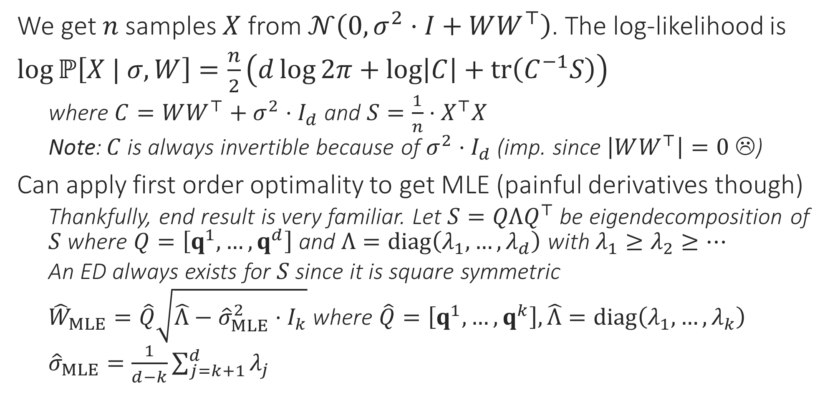

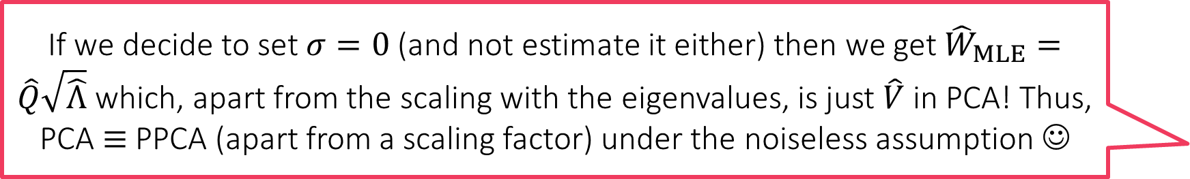
An MLE For $W,σ$ in PPCA
If we decide to set $σ=0$ (and not estimate it either) then we get ${\hat{W}}_{MLE}=\hat{Q}\sqrt{\hat{Λ}}$ which, apart from the scaling with the eigenvalues, is just $\hat{V}$ in PCA! Thus, PCA $≡$ PPCA (apart from a scaling factor) under the noiseless assumption ☺
We get $n$ samples $X$ from $𝒩\left(0,σ^{2}⋅I+WW^{⊤}\right)$. The log-likelihood is
$\log{ℙ\left[X | σ,W\right]}=\frac{n}{2}\left(d\log{2π}+\log\left|C\right|+tr\left(C^{−1}S\right)\right)$
where $C=WW^{⊤}+σ^{2}⋅I_{d}$ and $S=\frac{1}{n}⋅X^{⊤}X$
Note: $C$ is always invertible because of $σ^{2}⋅I_{d}$ (imp. since $\left|WW^{⊤}\right|=0$ ☹)
Can apply first order optimality to get MLE (painful derivatives though)
Thankfully, end result is very familiar. Let $S=QΛQ^{⊤}$ be eigendecomposition of $S$ where $Q=\left[q^{1},…,q^{d}\right]$ and $Λ=diag\left(λ_{1},…,λ_{d}\right)$ with $λ_{1}≥λ_{2}≥…$
An ED always exists for $S$ since it is square symmetric
${\hat{W}}_{MLE}=\hat{Q}\sqrt{\hat{Λ}−{\hat{σ}}_{MLE}^{2}⋅I_{k}}$ where $\hat{Q}=\left[q^{1},…,q^{k}\right],\hat{Λ}=diag\left(λ_{1},…,λ_{k}\right)$
${\hat{σ}}_{MLE}=\frac{1}{d−k}\sum_{j=k+1}^{d}{λ_{j}}$

Slide 7
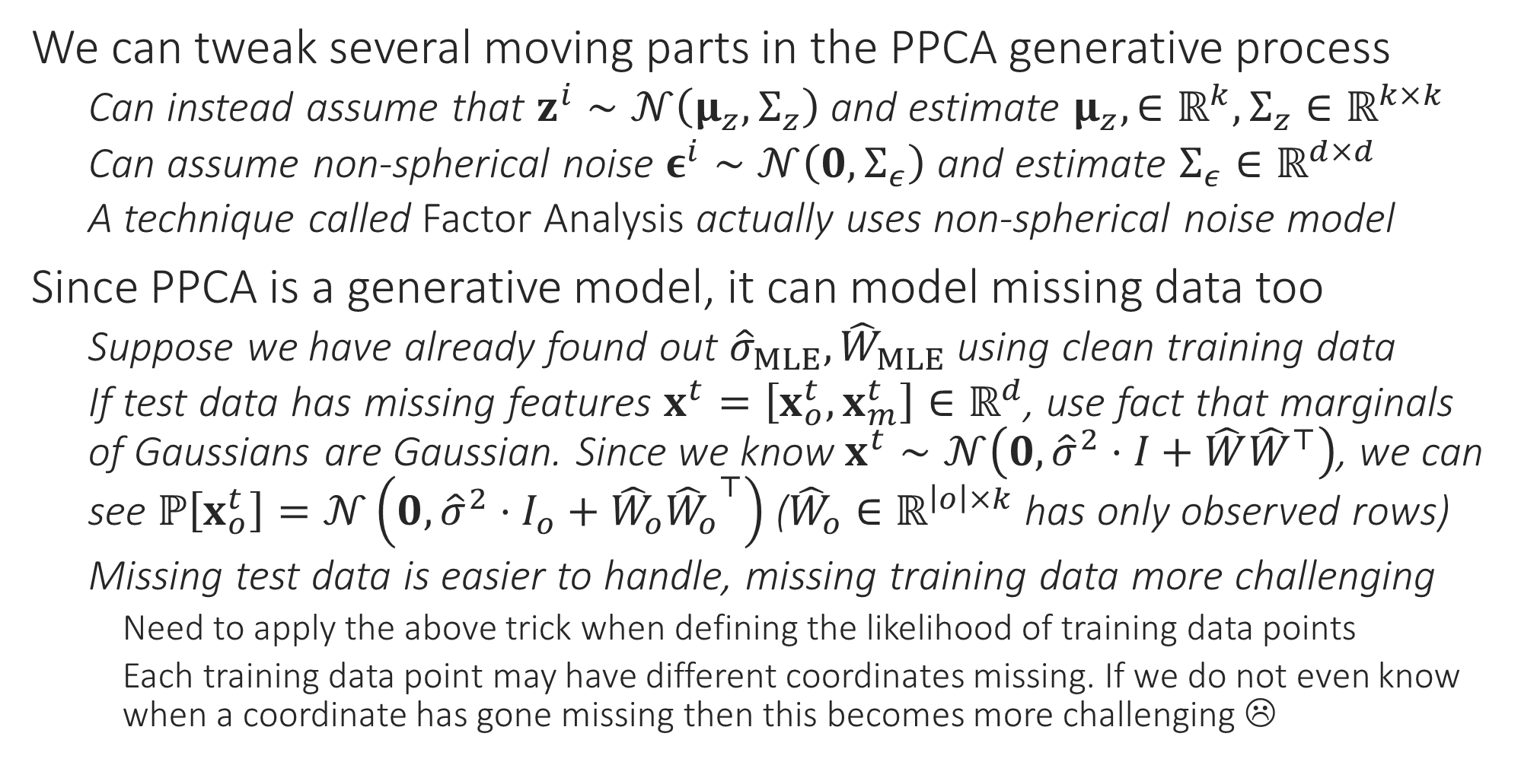
PPCA Variants
We can tweak several moving parts in the PPCA generative process
Can instead assume that $z^{i}∼𝒩\left(μ_{z},Σ_{z}\right)$ and estimate $μ_{z},∈ℝ^{k},Σ_{z}∈ℝ^{k×k}$
Can assume non-spherical noise $ε^{i}∼𝒩\left(0,Σ_{ε}\right)$ and estimate $Σ_{ε}∈ℝ^{d×d}$
A technique called Factor Analysis actually uses non-spherical noise model
Since PPCA is a generative model, it can model missing data too
Suppose we have already found out ${\hat{σ}}_{MLE},{\hat{W}}_{MLE}$ using clean training data
If test data has missing features $x^{t}=\left[x_{o}^{t},x_{m}^{t}\right]∈ℝ^{d}$, use fact that marginals of Gaussians are Gaussian. Since we know $x^{t}∼𝒩\left(0,{\hat{σ}}^{2}⋅I+\hat{W}{\hat{W}}^{⊤}\right)$, we can see $ℙ\left[x_{o}^{t}\right]=𝒩\left(0,{\hat{σ}}^{2}⋅I_{o}+{\hat{W}}_{o}{{\hat{W}}_{o}}^{⊤}\right)$ (${\hat{W}}_{o}∈ℝ^{\left|o\right|×k}$ has only observed rows)
Missing test data is easier to handle, missing training data more challenging
Need to apply the above trick when defining the likelihood of training data points
Each training data point may have different coordinates missing. If we do not even know when a coordinate has gone missing then this becomes more challenging ☹

Slide 8
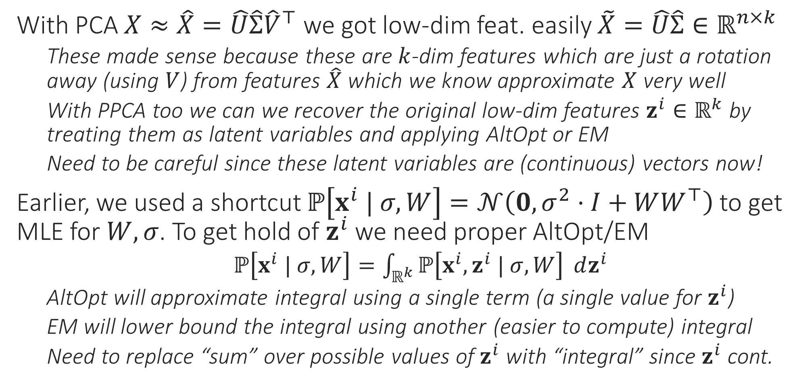
Dimensionality Reduction using PPCA
With PCA $X≈\hat{X}=\hat{U}\hat{Σ}{\hat{V}}^{⊤}$ we got low-dim feat. easily $\tilde{X}=\hat{U}\hat{Σ}∈ℝ^{n×k}$
These made sense because these are $k$-dim features which are just a rotation away (using $V$) from features $\hat{X}$ which we know approximate $X$ very well
With PPCA too we can we recover the original low-dim features $z^{i}∈ℝ^{k}$ by treating them as latent variables and applying AltOpt or EM
Need to be careful since these latent variables are (continuous) vectors now!
Earlier, we used a shortcut $ℙ\left[x^{i} | σ,W\right]=𝒩\left(0,σ^{2}⋅I+WW^{⊤}\right)$ to get MLE for $W,σ$. To get hold of $z^{i}$ we need proper AltOpt/EM
$ℙ\left[x^{i} | σ,W\right]=\int_{ℝ^{k}}{ℙ\left[x^{i},z^{i} | σ,W\right]} dz^{i}$
AltOpt will approximate integral using a single term (a single value for $z^{i}$)
EM will lower bound the integral using another (easier to compute) integral
Need to replace “sum” over possible values of $z^{i}$ with “integral” since $z^{i}$ cont.

Slide 9




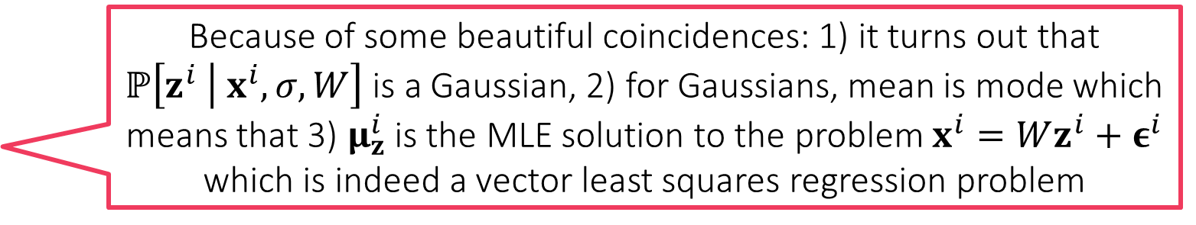

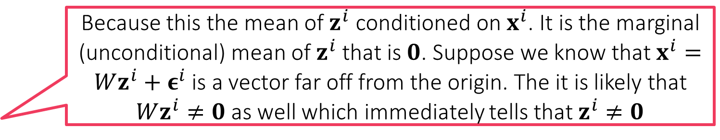
PPCA – Alternating Optimization
These derivations are routine but tedious. You can check [BIS] Chapter 12 for details. Warning: equation 12.42 in that book has an error. The correct expression is given in this slide
We wish to get $\arg{\max_{W,σ}{\sum_{i=1}^{n}{\ln\left(\int_{ℝ^{k}}{ℙ\left[x^{i},z^{i} | σ,W\right]} dz^{i}\right)}}}$
Same old pesky sum-log-sum (actually sum-log-integral) form – difficult ☹
Approximate integral by its most dominant term $\int_{ℝ^{k}}{ℙ\left[x^{i},z^{i} | σ,W\right]}{dz}^{i}≈$
$ℙ\left[x^{i},{\tilde{z}}^{i}|σ,W\right]$ with ${\tilde{z}}^{i}=\arg{\max_{z}{ℙ\left[x^{i},z | σ,W\right]}}=\arg{\max_{z}{ℙ\left[z |{ x}^{i},σ,W\right]}}$
Approx. integral by a single term may not be bad if the dist. $ℙ\left[z |{ x}^{i},σ,W\right]$ has small variance – advantage of being cheaper than EM in computation time
Thus, we wish to solve $\arg{\max_{W,σ,z^{i}}{\sum_{i=1}^{n}{\ln{ℙ\left[x^{i},z^{i} | σ,W\right]}}}}$
$ℙ\left[z^{i} | x^{i},σ,W\right]=𝒩\left(z^{i};μ_{z}^{i},Σ_{z}\right)$ where $μ_{z}^{i}={\left(W^{⊤}W+σ^{2}⋅I_{k}\right)}^{−1}W^{⊤}x^{i}∈ℝ^{k}$ and $Σ_{z}=σ^{2}⋅{\left(W^{⊤}W+σ^{2}⋅I_{k}\right)}^{−1}∈ℝ^{k×k}$
Since for Gaussians, mode is mean, we have $\arg{\max_{z}{ℙ\left[z |{ x}^{i},σ,W\right]}}=μ_{z}^{i}$
This gives us one of the alternating updates, lets derive the other
Because this the mean of $z^{i}$ conditioned on $x^{i}$. It is the marginal (unconditional) mean of $z^{i}$ that is $0$. Suppose we know that $x^{i}=Wz^{i}+ε^{i}$ is a vector far off from the origin. The it is likely that $Wz^{i}≠0$ as well which immediately tells that $z^{i}≠0$
We know that $z^{i}∼𝒩\left(z^{i};0,I_{k}\right)$. Then how come $μ_{z}^{i}≠0$?
Because of some beautiful coincidences: 1) it turns out that $ℙ\left[z^{i} | x^{i},σ,W\right]$ is a Gaussian, 2) for Gaussians, mean is mode which means that 3) $μ_{z}^{i}$ is the MLE solution to the problem $x^{i}=Wz^{i}+ε^{i}$ which is indeed a vector least squares regression problem
Why does the expression $μ_{z}^{i}={\left(W^{⊤}W+σ^{2}⋅I_{k}\right)}^{−1}W^{⊤}x^{i}$ look like least squares?

Slide 10
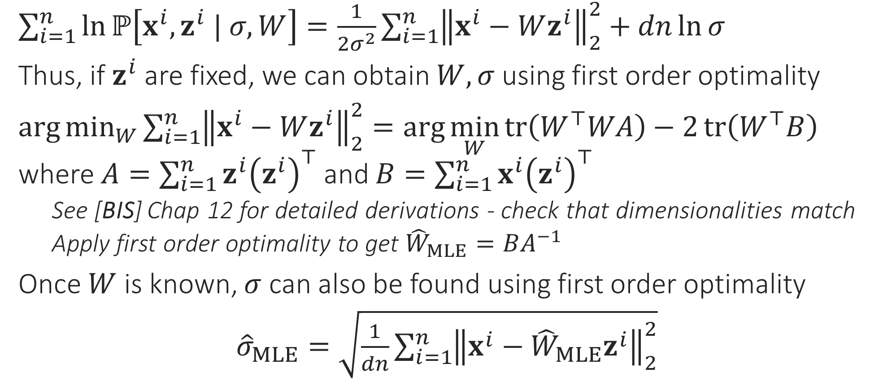
PPCA – Alternating Optimization
$\sum_{i=1}^{n}{\ln{ℙ\left[x^{i},z^{i} | σ,W\right]}}=\frac{1}{2σ^{2}}{\sum_{i=1}^{n}{\left\|x^{i}−Wz^{i}\right\|}}_{2}^{2}+dn\ln{σ}$
Thus, if $z^{i}$ are fixed, we can obtain $W,σ$ using first order optimality
$\arg{\min_{W}{{\sum_{i=1}^{n}{\left\|x^{i}−Wz^{i}\right\|}}_{2}^{2}}}=\arg{\min_{W}{tr\left(W^{⊤}WA\right)−2}}tr\left(W^{⊤}B\right)$ where $A=\sum_{i=1}^{n}{z^{i}{\left(z^{i}\right)}^{⊤}}$ and $B=\sum_{i=1}^{n}{x^{i}{\left(z^{i}\right)}^{⊤}}$
See [BIS] Chap 12 for detailed derivations - check that dimensionalities match
Apply first order optimality to get ${\hat{W}}_{MLE}=BA^{−1}$
Once $W$ is known, $σ$ can also be found using first order optimality
${\hat{σ}}_{MLE}=\sqrt{\frac{1}{dn}{\sum_{i=1}^{n}{\left\|x^{i}−{\hat{W}}_{MLE}z^{i}\right\|}}_{2}^{2}}$

Slide 11
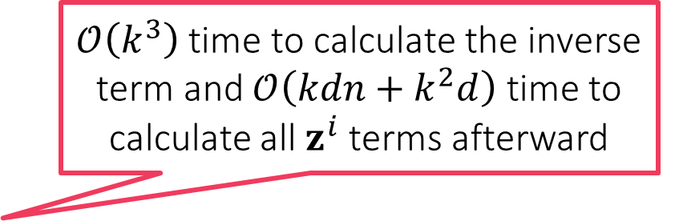


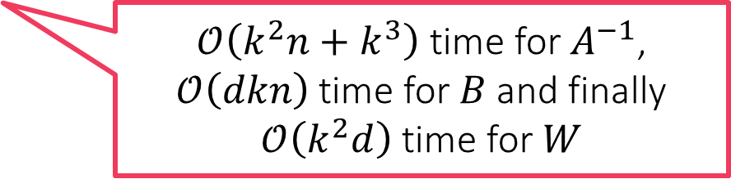
PPCA – Alternating Optimization
Total of $𝒪\left(k^{2}\left(d+n\right)+kdn\right)$ time taken per iteration. In contrast, PCA using power + peeling method takes only $𝒪\left(kdn\right)$ time if we do power updates as $Av=X^{⊤}\left(Xv\right)$ which takes $𝒪\left(dn\right)$ time per power step
ALTERNATING OPTIMIZATION
Initialize $W$
For $t=0, 1, 2,…$
Update $z^{i}$ fixing $W,σ$
Let $z^{i}={\left(W^{⊤}W+{σ^{2}⋅I}_{k}\right)}^{−1}W^{⊤}x^{i}$, for $i∈\left[n\right]$
Update $W,σ$ fixing $z^{i}$
Calculate $A=\sum_{i=1}^{n}{z^{i}{\left(z^{i}\right)}^{⊤}}$ and $B=\sum_{i=1}^{n}{x^{i}{\left(z^{i}\right)}^{⊤}}$
Update $W=BA^{−1}$
Calculate $V={\sum_{i=1}^{n}{\left\|x^{i}−Wz^{i}\right\|}}_{2}^{2}$
Update $σ=\sqrt{V/dn}$
$𝒪\left(k^{3}\right)$ time to calculate the inverse term and $𝒪\left(kdn+k^{2}d\right)$ time to calculate all $z^{i}$ terms afterward
In practice, PCA is usually faster than AltOpt PPCA – no inverses required to solve PCA, just simple mat-vec multiplication steps ☺
$𝒪\left(k^{2}n+k^{3}\right)$ time for $A^{−1}$, $𝒪\left(dkn\right)$ time for $B$ and finally $𝒪\left(k^{2}d\right)$ time for $W$

Slide 12
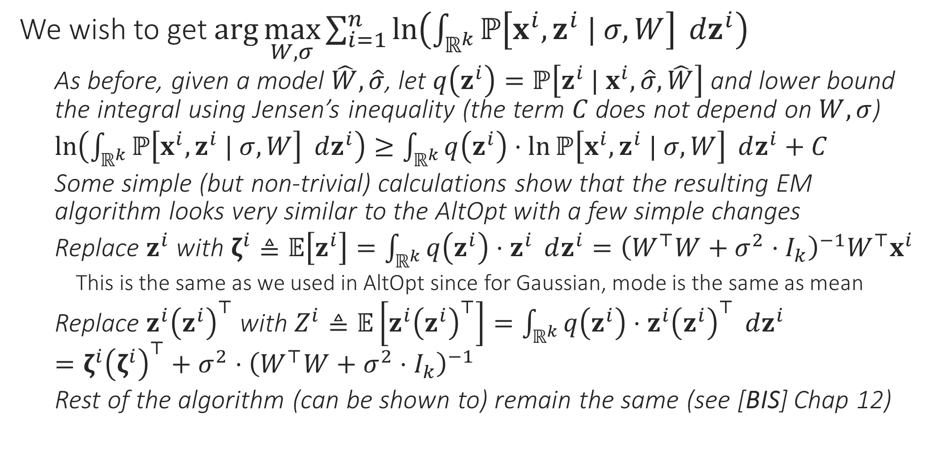
PPCA – Expectation Maximization
We wish to get $\arg{\max_{W,σ}{\sum_{i=1}^{n}{\ln\left(\int_{ℝ^{k}}{ℙ\left[x^{i},z^{i} | σ,W\right]} dz^{i}\right)}}}$
As before, given a model $\hat{W},\hat{σ}$, let $q\left(z^{i}\right)=ℙ\left[z^{i} | x^{i},\hat{σ},\hat{W}\right]$ and lower bound the integral using Jensen’s inequality (the term $C$ does not depend on $W,σ$)
$\ln\left(\int_{ℝ^{k}}{ℙ\left[x^{i},z^{i} | σ,W\right]} dz^{i}\right)≥\int_{ℝ^{k}}{q\left(z^{i}\right)⋅\ln{ℙ\left[x^{i},z^{i} | σ,W\right]}} dz^{i}+C$
Some simple (but non-trivial) calculations show that the resulting EM algorithm looks very similar to the AltOpt with a few simple changes
Replace $z^{i}$ with $ζ^{i}≜𝔼\left[z^{i}\right]=\int_{ℝ^{k}}{q\left(z^{i}\right)⋅z^{i}} dz^{i}={\left(W^{⊤}W+{σ^{2}⋅I}_{k}\right)}^{−1}W^{⊤}x^{i}$
This is the same as we used in AltOpt since for Gaussian, mode is the same as mean
Replace $z^{i}{\left(z^{i}\right)}^{⊤}$ with $Z^{i}≜𝔼\left[z^{i}{\left(z^{i}\right)}^{⊤}\right]=\int_{ℝ^{k}}{q\left(z^{i}\right)⋅z^{i}{\left(z^{i}\right)}^{⊤}} dz^{i}$ $=ζ^{i}{\left(ζ^{i}\right)}^{⊤}+σ^{2}⋅{\left(W^{⊤}W+{σ^{2}⋅I}_{k}\right)}^{−1}$
Rest of the algorithm (can be shown to) remain the same (see [BIS] Chap 12)

Slide 13
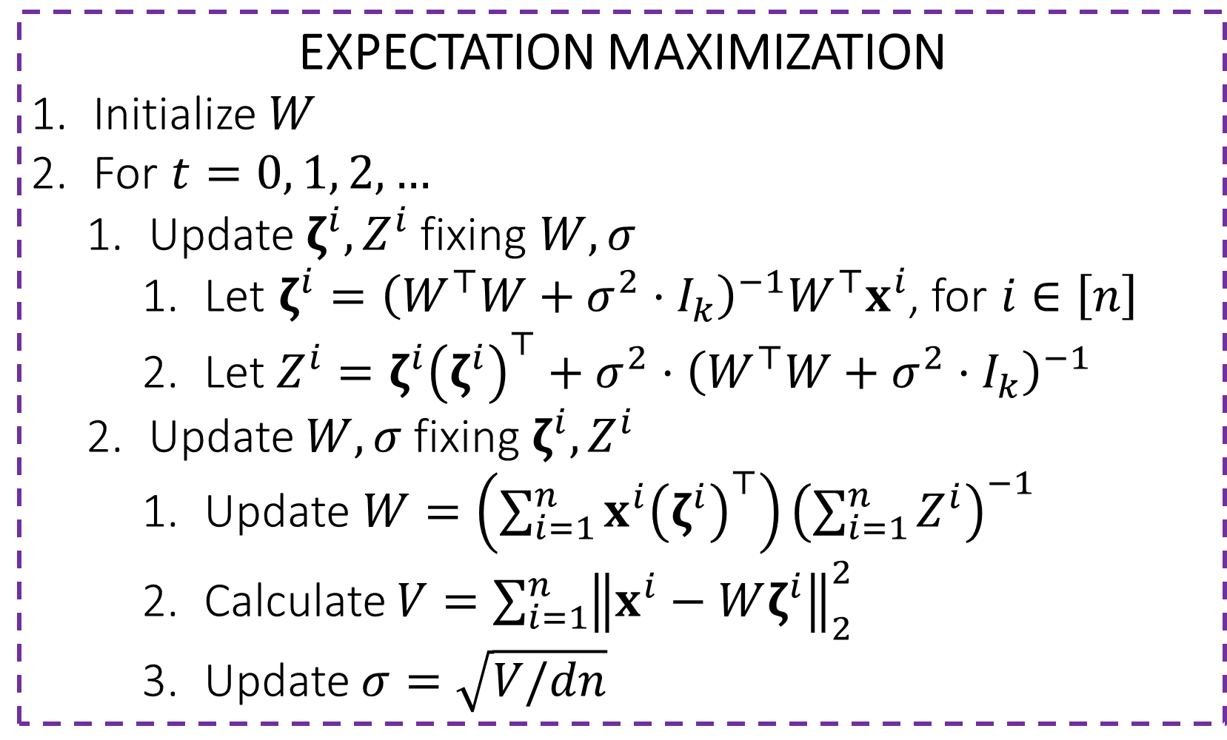
PPCA – Expectation Maximization
Time complexity of PPCA using EM roughly same as that of PPCA using AltOpt.
EXPECTATION MAXIMIZATION
Initialize $W$
For $t=0, 1, 2,…$
Update $ζ^{i},Z^{i}$ fixing $W,σ$
Let $ζ^{i}={\left(W^{⊤}W+{σ^{2}⋅I}_{k}\right)}^{−1}W^{⊤}x^{i}$, for $i∈\left[n\right]$
Let $Z^{i}=ζ^{i}{\left(ζ^{i}\right)}^{⊤}+σ^{2}⋅{\left(W^{⊤}W+{σ^{2}⋅I}_{k}\right)}^{−1}$
Update $W,σ$ fixing $ζ^{i},Z^{i}$
Update $W=\left(\sum_{i=1}^{n}{x^{i}{\left(ζ^{i}\right)}^{⊤}}\right){\left(\sum_{i=1}^{n}{Z^{i}}\right)}^{−1}$
Calculate $V={\sum_{i=1}^{n}{\left\|x^{i}−Wζ^{i}\right\|}}_{2}^{2}$
Update $σ=\sqrt{V/dn}$

Slide 14
Wrapping Up Linear Models
Have studied how linear models can be used to do classification (binary/multi), regression, clustering, dimensionality reduction
We looked at several techniques to do so
Function Approximation Method: define a loss function over the output (and optionally a regularizer over model parameters) and minimize (regularized) loss to learn a good model
Probabilistic Method: define a likelihood over the output (and optionally a prior over model parameters) and use MLE/MAP to learn a good model
Bayesian Method: use likelihood and prior to learn a posterior distribution over all (possibly infinite) models. At test time, aggregate responses from each one of these models, weighted by their posterior prob. to make final prediction
Probabilistic and Bayesian methods usually come with a “generative story” specified by likelihood+prior dists. of how we assume data was generated

Slide 15
Non Linear Models
Agenda for the next few weeks (after mid-sem recess)
Kernel Learning
Deep Learning
Let us take half-a-step towards learning non-linear models today

Slide 16
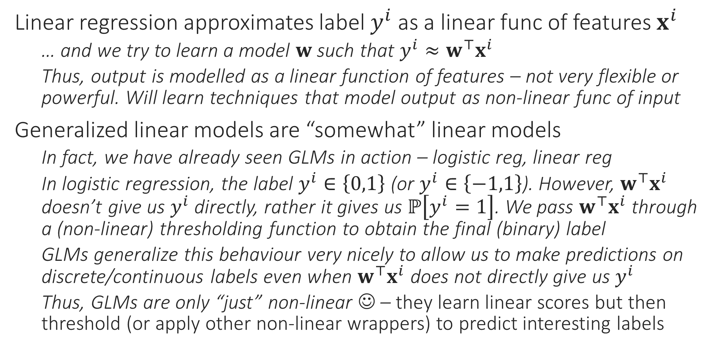
Generalized Linear Models (GLM/GLiM)
Linear regression approximates label $y^{i}$ as a linear func of features $x^{i}$
… and we try to learn a model $w$ such that $y^{i}≈w^{⊤}x^{i}$
Thus, output is modelled as a linear function of features – not very flexible or powerful. Will learn techniques that model output as non-linear func of input
Generalized linear models are “somewhat” linear models
In fact, we have already seen GLMs in action – logistic reg, linear reg
In logistic regression, the label $y^{i}∈\left\{0,1\right\}$ (or $y^{i}∈\left\{−1,1\right\}$). However, $w^{⊤}x^{i}$ doesn’t give us $y^{i}$ directly, rather it gives us $ℙ\left[y^{i}=1\right]$. We pass $w^{⊤}x^{i}$ through a (non-linear) thresholding function to obtain the final (binary) label
GLMs generalize this behaviour very nicely to allow us to make predictions on discrete/continuous labels even when $w^{⊤}x^{i}$ does not directly give us $y^{i}$
Thus, GLMs are only “just” non-linear ☺ – they learn linear scores but then threshold (or apply other non-linear wrappers) to predict interesting labels

Slide 17
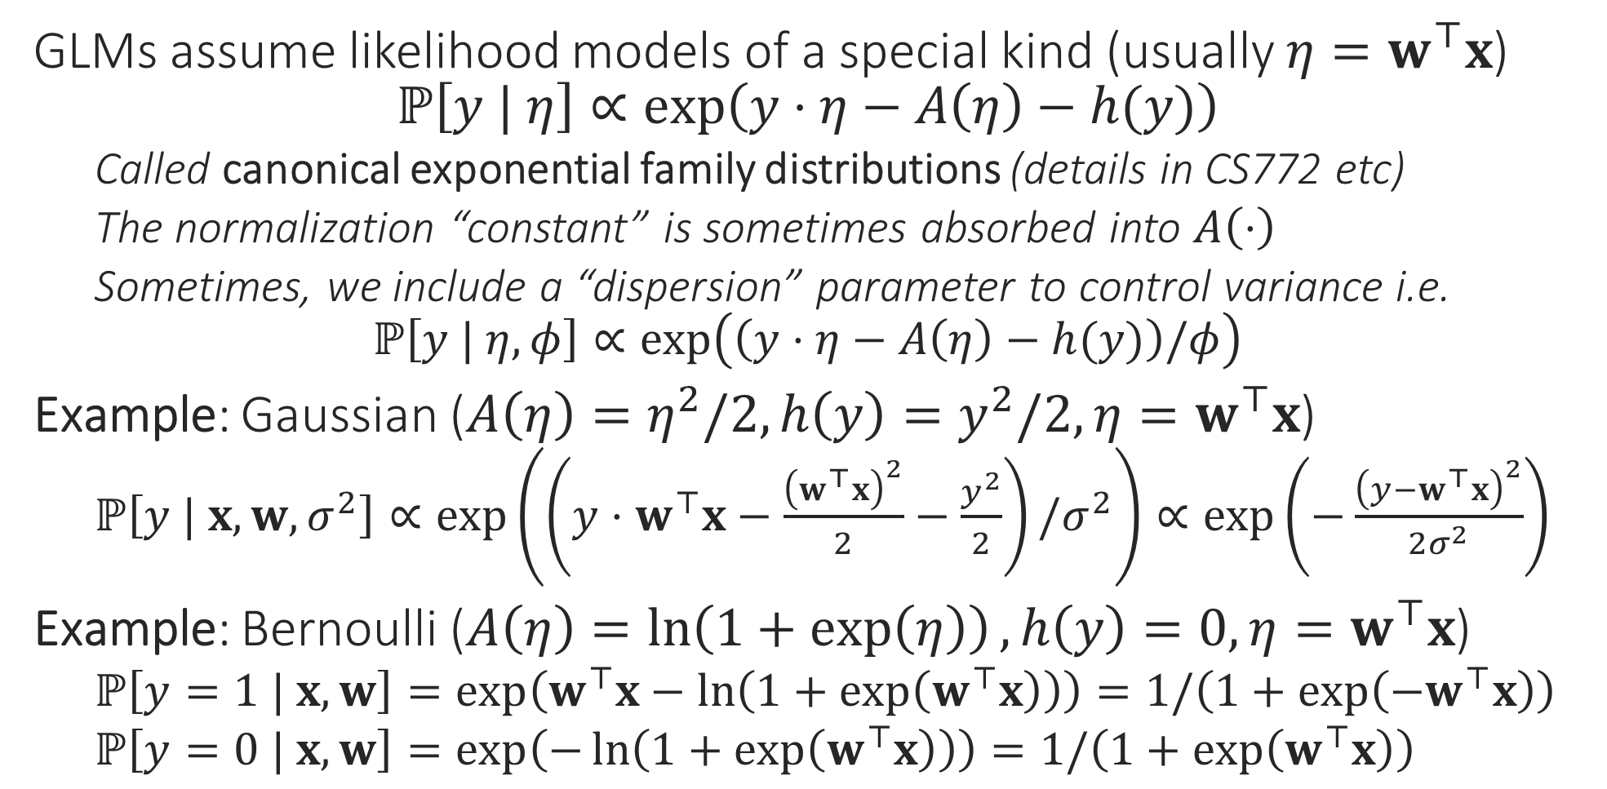
Generalized Linear Models
GLMs assume likelihood models of a special kind (usually $η=w^{⊤}x$) $ℙ\left[y | η\right]∝\exp\left(y⋅η−A\left(η\right)−h(y)\right)$
Called canonical exponential family distributions (details in CS772 etc)
The normalization “constant” is sometimes absorbed into $A\left(⋅\right)$
Sometimes, we include a “dispersion” parameter to control variance i.e. $ℙ\left[y | η,φ\right]∝\exp\left(\left(y⋅η−A\left(η\right)−h(y)\right)/φ\right)$
Example: Gaussian ($A\left(η\right)=η^{2}/2,h\left(y\right)=y^{2}/2,η=w^{⊤}x$)
$ℙ\left[y | x,w,σ^{2}\right]∝\exp\left(\left(y⋅w^{⊤}x−\frac{{\left(w^{⊤}x\right)}^{2}}{2}−\frac{y^{2}}{2}\right)/σ^{2}\right)∝\exp\left(−\frac{{\left(y−w^{⊤}x\right)}^{2}}{2σ^{2}}\right)$
Example: Bernoulli ($A\left(η\right)=\ln\left(1+\exp\left(η\right)\right),h\left(y\right)=0,η=w^{⊤}x$)
$ℙ\left[y=1 | x,w\right]=\exp\left(w^{⊤}x−\ln\left(1+\exp\left(w^{⊤}x\right)\right)\right)=1/\left(1+\exp\left(−w^{⊤}x\right)\right)$
$ℙ\left[y=0 | x,w\right]=\exp\left(−\ln\left(1+\exp\left(w^{⊤}x\right)\right)\right)=1/\left(1+\exp\left(w^{⊤}x\right)\right)$

Slide 18
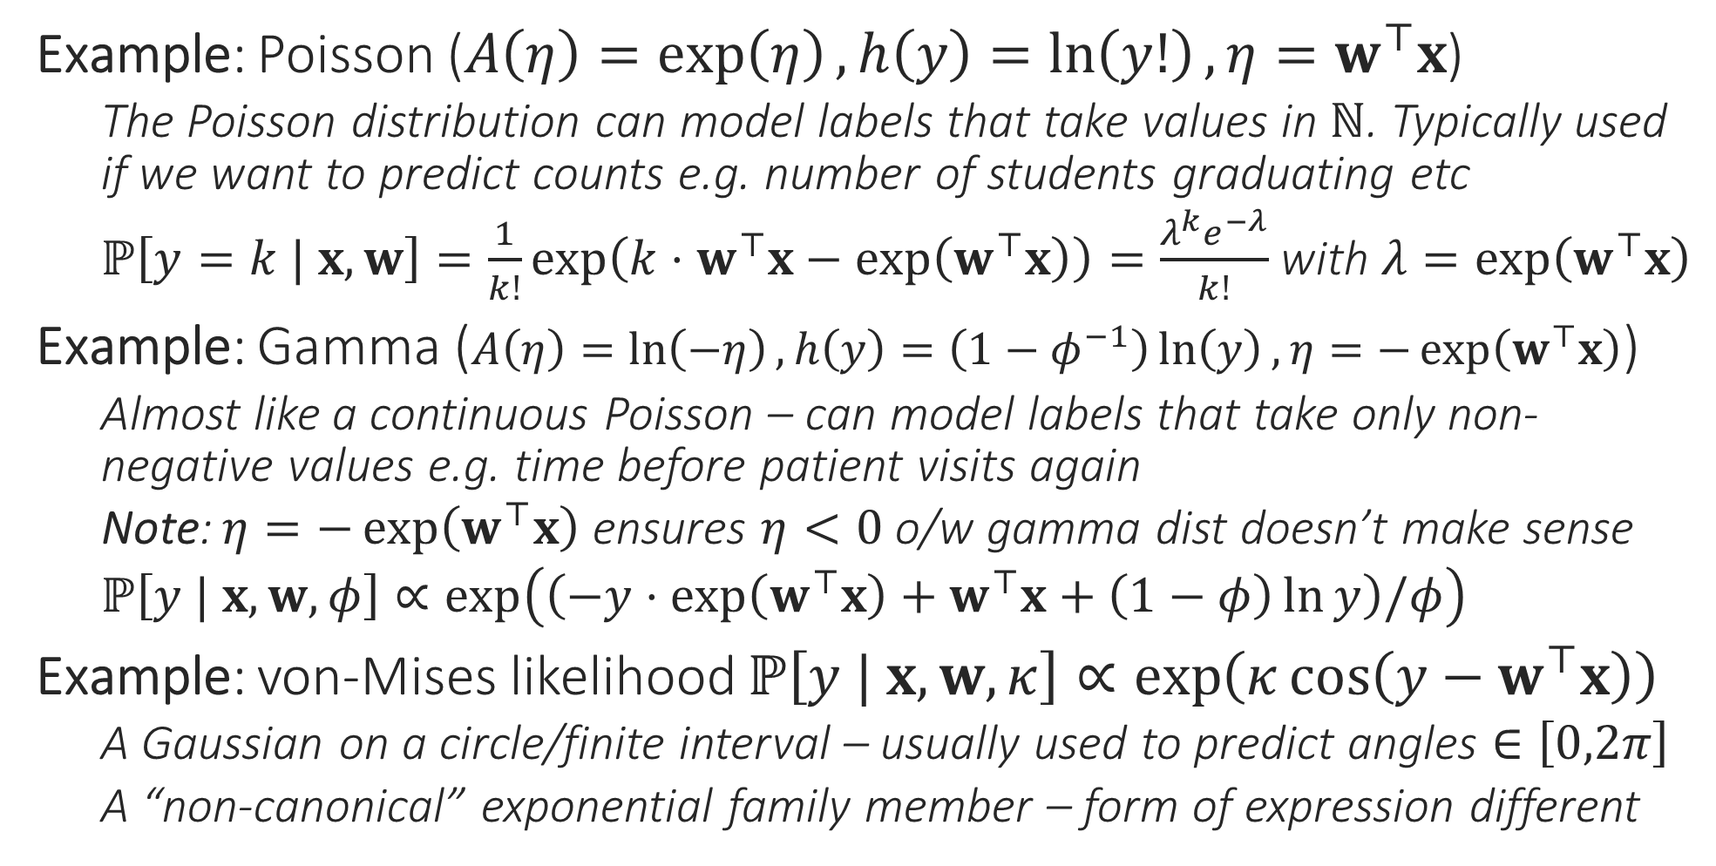
Generalized Linear Models
Example: Poisson ($A\left(η\right)=\exp\left(η\right),h\left(y\right)=\ln\left(y!\right),η=w^{⊤}x$)
The Poisson distribution can model labels that take values in $ℕ$. Typically used if we want to predict counts e.g. number of students graduating etc
$ℙ\left[y=k | x,w\right]=\frac{1}{k!}\exp\left(k⋅w^{⊤}x−\exp\left(w^{⊤}x\right)\right)=\frac{λ^{k}e^{−λ}}{k!}$ with $λ=\exp\left(w^{⊤}x\right)$
Example: Gamma ($A\left(η\right)=\ln\left(−η\right),h\left(y\right)=\left(1−φ^{−1}\right)\ln\left(y\right),η=−\exp\left(w^{⊤}x\right)$)
Almost like a continuous Poisson – can model labels that take only non-negative values e.g. time before patient visits again
Note: $η=−\exp\left(w^{⊤}x\right)$ ensures $η<0$ o/w gamma dist doesn’t make sense
$ℙ\left[y | x,w,φ\right]∝\exp\left(\left(−y⋅\exp\left(w^{⊤}x\right)+w^{⊤}x+\left(1−φ\right)\ln{y}\right)/φ\right)$
Example: von-Mises likelihood $ℙ\left[y | x,w,κ\right]∝\exp\left(κ\cos\left(y−w^{⊤}x\right)\right)$
A Gaussian on a circle/finite interval – usually used to predict angles $∈\left[0,2π\right]$
A “non-canonical” exponential family member – form of expression different

Slide 19
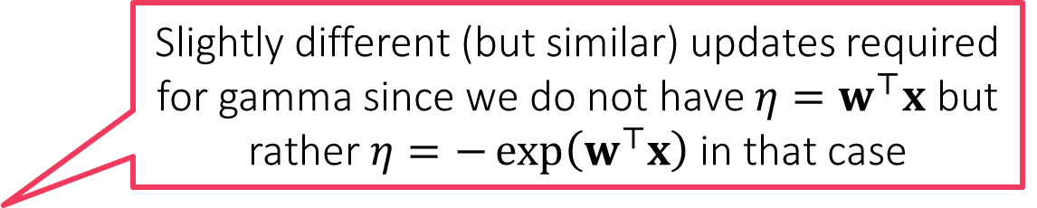
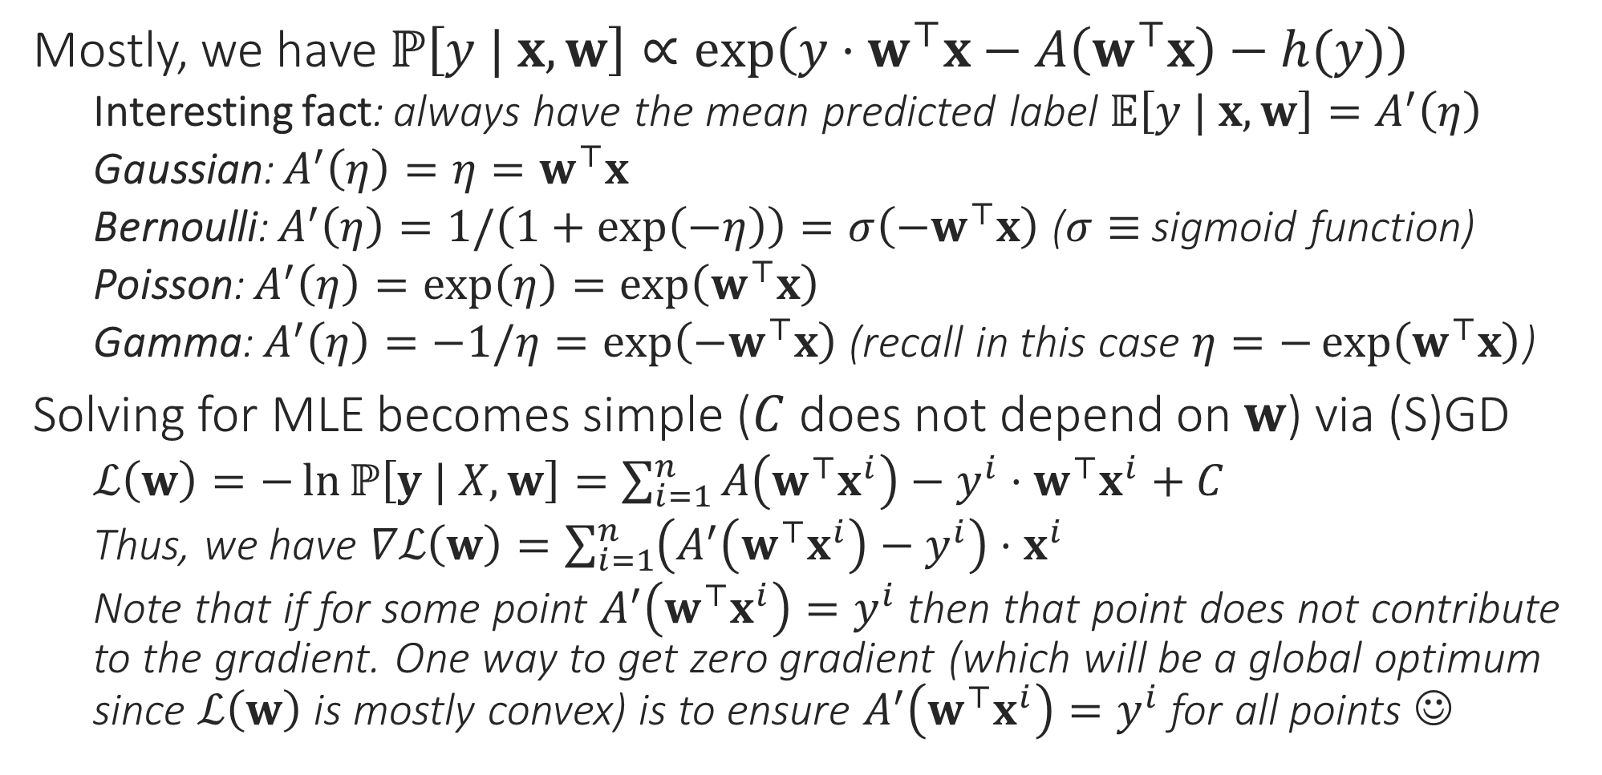
MLE with GLMs
Mostly, we have $ℙ\left[y | x,w\right]∝\exp\left(y⋅w^{⊤}x−A\left(w^{⊤}x\right)−h(y)\right)$
Interesting fact: always have the mean predicted label $𝔼\left[y | x,w\right]=A^{′}\left(η\right)$
Gaussian: $A^{′}\left(η\right)=η=w^{⊤}x$
Bernoulli: $A^{′}\left(η\right)=1/\left(1+\exp\left(−η\right)\right)=σ\left(−w^{⊤}x\right)$ ($σ≡$ sigmoid function)
Poisson: $A^{′}\left(η\right)=\exp\left(η\right)=\exp\left(w^{⊤}x\right)$
Gamma: $A^{′}\left(η\right)=−1/η=\exp\left(−w^{⊤}x\right)$ (recall in this case $η=−\exp\left(w^{⊤}x\right)$)
Solving for MLE becomes simple ($C$ does not depend on $w$) via (S)GD
$ℒ\left(w\right)=−\ln{ℙ\left[y | X,w\right]}=\sum_{i=1}^{n}{A\left(w^{⊤}x^{i}\right)−y^{i}⋅w^{⊤}x^{i}}+C$
Thus, we have $∇ℒ\left(w\right)=\sum_{i=1}^{n}{\left(A^{′}\left(w^{⊤}x^{i}\right)−y^{i}\right)⋅x^{i}}$
Note that if for some point $A^{′}\left(w^{⊤}x^{i}\right)=y^{i}$ then that point does not contribute to the gradient. One way to get zero gradient (which will be a global optimum since $ℒ\left(w\right)$ is mostly convex) is to ensure $A^{′}\left(w^{⊤}x^{i}\right)=y^{i}$ for all points ☺
Slightly different (but similar) updates required for gamma since we do not have $η=w^{⊤}x$ but rather $η=−\exp\left(w^{⊤}x\right)$ in that case

