Slide 1
Learning with Kernels III
CS771: Introduction to Machine Learning
Purushottam Kar

Slide 2
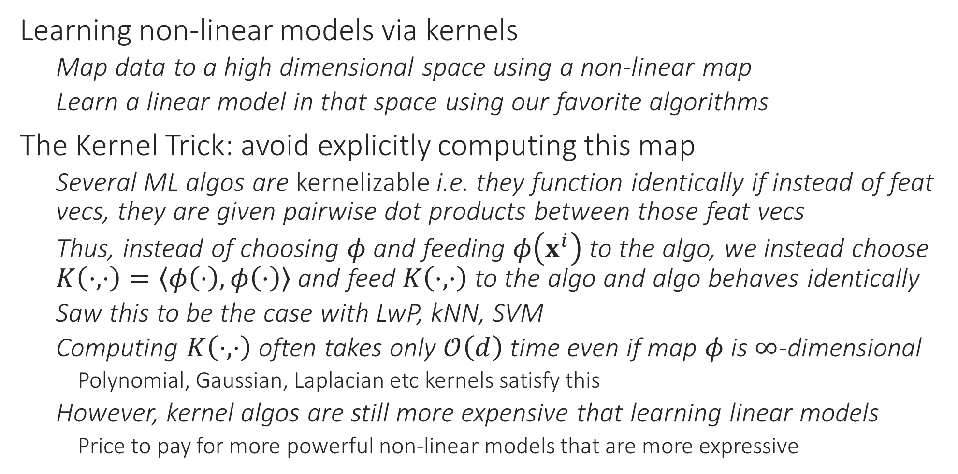
Recap of Last Lecture
Learning non-linear models via kernels
Map data to a high dimensional space using a non-linear map
Learn a linear model in that space using our favorite algorithms
The Kernel Trick: avoid explicitly computing this map
Several ML algos are kernelizable i.e. they function identically if instead of feat vecs, they are given pairwise dot products between those feat vecs
Thus, instead of choosing $φ$ and feeding $φ\left(x^{i}\right)$ to the algo, we instead choose $K\left(⋅,⋅\right)=\left\langle φ\left(⋅\right),φ\left(⋅\right)\right\rangle$ and feed $K\left(⋅,⋅\right)$ to the algo and algo behaves identically
Saw this to be the case with LwP, kNN, SVM
Computing $K\left(⋅,⋅\right)$ often takes only $𝒪\left(d\right)$ time even if map $φ$ is $∞$-dimensional
Polynomial, Gaussian, Laplacian etc kernels satisfy this
However, kernel algos are still more expensive that learning linear models
Price to pay for more powerful non-linear models that are more expressive

Slide 3
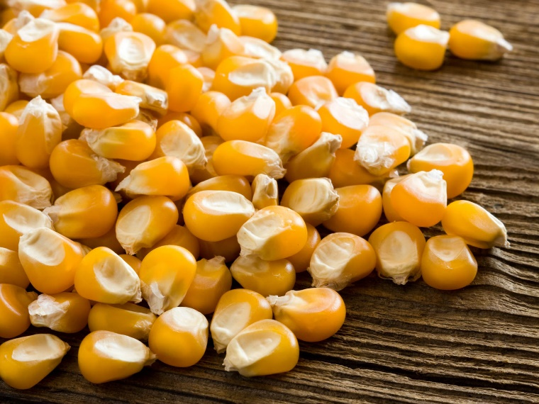





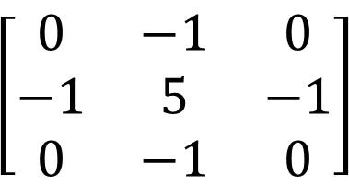
Kernels and Kernels
Kernel of linear transformation
✓
Kernels of corn
$$\left[\begin{matrix}0 & −1 & 0 \\ −1 & 5 & −1 \\ 0 & −1 & 0\end{matrix}\right]$$
Convolution kernels (masks)
OS Kernel

Slide 4
Kernel kNN
Step 1: choose a kernel $K$ with map $φ$
Gaussian kernel is popular but domain specific kernels may do better
Step 2: training
Receive training points $\left(x^{i},y^{i}\right),i∈\left[n\right],x^{i}∈ℝ^{d}$
Store them
Step 3: prediction
Receive a test point $x^{t}∈ℝ^{d}$
Find the nearest neighbour using $i^{t}=\arg{\min_{i∈\left[n\right]}{{\left\|φ\left(x^{t}\right)−φ\left(x^{i}\right)\right\|}_{ℋ}^{2}}}$
Too expensive so instead use $i^{t}=arg{\min_{i∈\left[n\right]}{K\left(x^{i},x^{i}\right)−2K\left(x^{i},x^{t}\right)}}$
Predict $y^{i^{t}}$

Slide 5
Kernel LwP
Step 1: choose a kernel $K$ with map $φ$
Gaussian kernel is popular but domain specific kernels may do better
Step 2: training
Receive training points $\left(x^{i},y^{i}\right),i∈\left[n\right],x^{i}∈ℝ^{d},y^{i}∈\left\{−1,1\right\}$
Store them (cannot compute prototypes explicitly as $φ$ may be $∞$ dim ☹)
Step 3: prediction
Receive a test point $x^{t}∈ℝ^{d}$
Find distance to +ve prototype ${\left\|φ\left(x^{t}\right)−{\tilde{p}}^{+}\right\|}_{2}^{2}$ where ${\tilde{p}}^{+}=\frac{1}{n_{+}}⋅\sum_{y^{i}=1}{φ\left(x^{i}\right)}$
Too expensive so instead use the formula ${\left\|φ\left(x^{t}\right)−{\tilde{p}}^{+}\right\|}_{2}^{2}=K\left(x^{t},x^{t}\right)−\frac{2}{n_{+}}⋅\sum_{y^{i}=1}{K\left(x^{t},x^{i}\right)}+\frac{1}{n_{+}^{2}}⋅\sum_{y^{i}=1}{\sum_{y^{j}=1}{K\left(x^{i},x^{j}\right)}}$
Predict $sign\left({\left\|φ\left(x^{t}\right)−{\tilde{p}}^{−}\right\|}_{2}^{2}−{\left\|φ\left(x^{t}\right)−{\tilde{p}}^{+}\right\|}_{2}^{2}\right)$

Slide 6
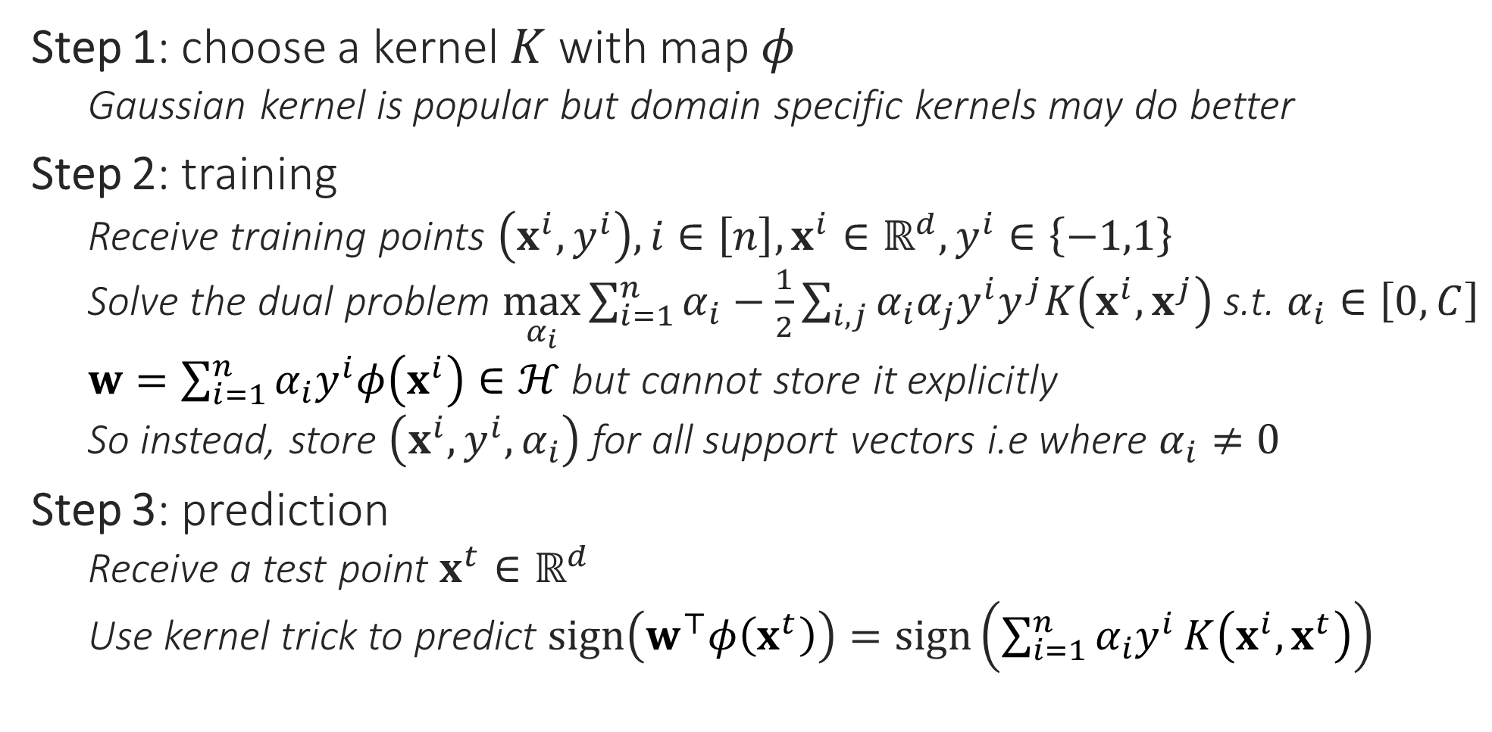
Kernel SVM
Step 1: choose a kernel $K$ with map $φ$
Gaussian kernel is popular but domain specific kernels may do better
Step 2: training
Receive training points $\left(x^{i},y^{i}\right),i∈\left[n\right],x^{i}∈ℝ^{d},y^{i}∈\left\{−1,1\right\}$
Solve the dual problem $\max_{α_{i}}{\sum_{i=1}^{n}{α_{i}}−\frac{1}{2}\sum_{i,j}{α_{i}α_{j}y^{i}y^{j}K\left(x^{i},x^{j}\right)}}$ s.t. $α_{i}∈\left[0,C\right]$
$w=\sum_{i=1}^{n}{α_{i}y^{i}φ\left(x^{i}\right)}∈ℋ$ but cannot store it explicitly
So instead, store $\left(x^{i},y^{i},α_{i}\right)$ for all support vectors i.e where $α_{i}≠0$
Step 3: prediction
Receive a test point $x^{t}∈ℝ^{d}$
Use kernel trick to predict $sign\left(w^{⊤}φ\left(x^{t}\right)\right)=sign\left(\sum_{i=1}^{n}{α_{i}y^{i}}K\left(x^{i},x^{t}\right)\right)$

Slide 7

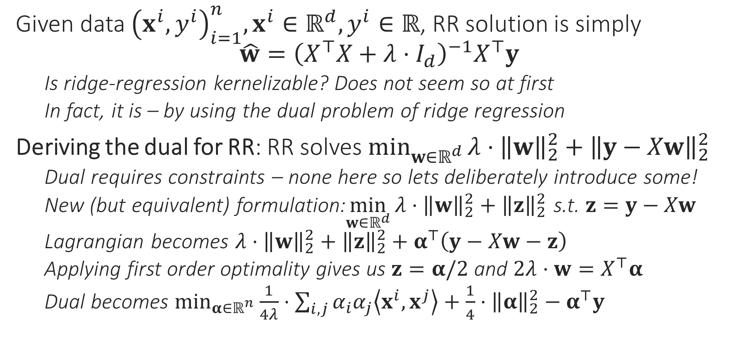
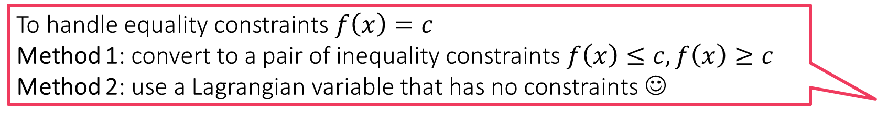
Kernel Ridge Regression
Given data ${\left(x^{i},y^{i}\right)}_{i=1}^{n},x^{i}∈ℝ^{d},y^{i}∈ℝ$, RR solution is simply $\hat{w}={\left(X^{⊤}X+λ⋅I_{d}\right)}^{−1}X^{⊤}y$
Is ridge-regression kernelizable? Does not seem so at first
In fact, it is – by using the dual problem of ridge regression
Deriving the dual for RR: RR solves $\min_{w∈ℝ^{d}}{λ⋅{\left\|w\right\|}_{2}^{2}+{\left\|y−Xw\right\|}_{2}^{2}}$
Dual requires constraints – none here so lets deliberately introduce some!
New (but equivalent) formulation:$\min_{w∈ℝ^{d}}{{λ⋅{\left\|w\right\|}_{2}^{2}+\left\|z\right\|}_{2}^{2}}$ s.t. $z=y−Xw$
Lagrangian becomes ${λ⋅{\left\|w\right\|}_{2}^{2}+\left\|z\right\|}_{2}^{2}+α^{⊤}\left(y−Xw−z\right)$
Applying first order optimality gives us $z=α/2$ and $2λ⋅w=X^{⊤}α$
Dual becomes $\min_{α∈ℝ^{n}}{\frac{1}{4λ}⋅\sum_{i,j}{α_{i}α_{j}\left\langle x^{i},x^{j}\right\rangle }+\frac{1}{4}⋅{\left\|α\right\|}_{2}^{2}−α^{⊤}y}$
To handle equality constraints $f\left(x\right)=c$
Method 1: convert to a pair of inequality constraints $f\left(x\right)≤c,f\left(x\right)≥c$
Method 2: use a Lagrangian variable that has no constraints ☺

Slide 8

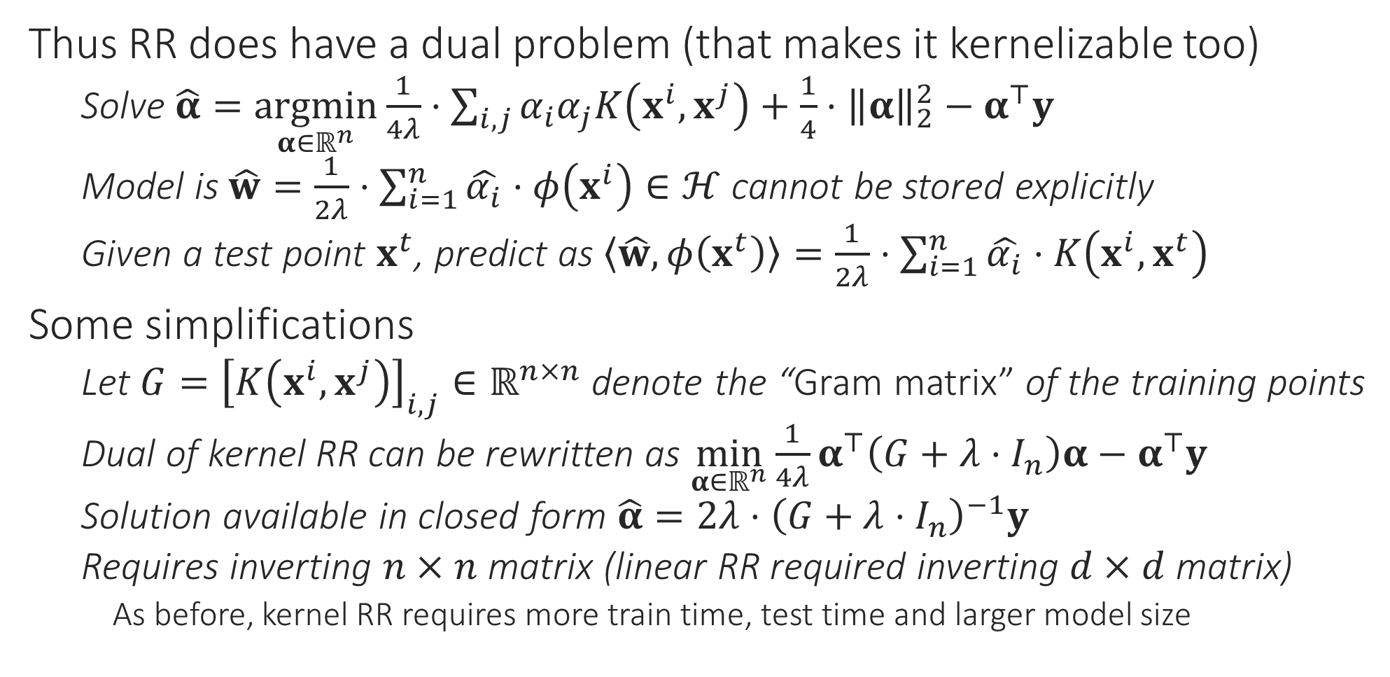
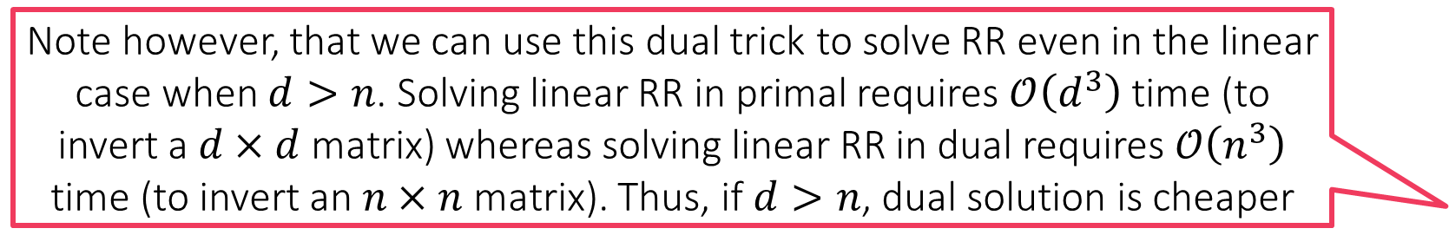
Kernel Ridge Regression
Note however, that we can use this dual trick to solve RR even in the linear case when $d>n$. Solving linear RR in primal requires $𝒪\left(d^{3}\right)$ time (to invert a $d×d$ matrix) whereas solving linear RR in dual requires $𝒪\left(n^{3}\right)$ time (to invert an $n×n$ matrix). Thus, if $d>n$, dual solution is cheaper
Thus RR does have a dual problem (that makes it kernelizable too)
Solve $\hat{α}=\underset{α∈ℝ^{n}}{argmin}{\frac{1}{4λ}⋅\sum_{i,j}{α_{i}α_{j}K\left(x^{i},x^{j}\right)}+\frac{1}{4}⋅{\left\|α\right\|}_{2}^{2}−α^{⊤}y}$
Model is $\hat{w}=\frac{1}{2λ}⋅\sum_{i=1}^{n}{\hat{α_{i}}⋅φ\left(x^{i}\right)}∈ℋ$ cannot be stored explicitly
Given a test point $x^{t}$, predict as $\left\langle \hat{w},φ\left(x^{t}\right)\right\rangle =\frac{1}{2λ}⋅\sum_{i=1}^{n}{\hat{α_{i}}⋅K\left(x^{i},x^{t}\right)}$
Some simplifications
Let $G={\left[K\left(x^{i},x^{j}\right)\right]}_{i,j}∈ℝ^{n×n}$ denote the “Gram matrix” of the training points
Dual of kernel RR can be rewritten as $\min_{α∈ℝ^{n}}{\frac{1}{4λ}α^{⊤}\left(G+λ⋅I_{n}\right)α−α^{⊤}y}$
Solution available in closed form $\hat{α}=2λ⋅{\left(G+λ⋅I_{n}\right)}^{−1}y$
Requires inverting $n×n$ matrix (linear RR required inverting $d×d$ matrix)
As before, kernel RR requires more train time, test time and larger model size

Slide 9


Kernel Clustering
Should be relatively simple given our experience with kernel LwP, kNN
All we need to do is kernelize the distance computations and keep track of the cluster centers implicitly since now $μ^{k}∈ℋ$
K-MEANS/LLOYD’S ALGORITHM
Initialize centroids ${\left\{μ^{k}\right\}}_{k=1,…K}∈ℝ^{d}$
For $i∈\left[n\right]$, do cluster assignment, update $z^{i}∈\left[K\right]$ using $μ^{k}$
Let $z^{i}=\arg{\min_{k}{{\left\|x^{i}−μ^{k}\right\|}_{2}^{2}}}$
Update $μ^{k}=\frac{1}{n_{k}}\sum_{i:z^{i}=k}{x^{i}},where n_{k}=\left|\left\{i:z^{i}=k\right\}\right|$
Repeat until convergence

Slide 10


Kernel K-means
Note that cluster centers in k-means are always the average of data points that were assigned to that cluster - $z^{i}$ maintains this info
Need to maintain this information a bit differently for easy processing
Let $α_{i}^{k}=1$ if $z^{i}=k$ and $α_{i}^{k}=0$ if $z^{i}≠k$ i.e. $n_{k}=\sum_{i=1}^{n}{α_{i}^{k}}=1^{⊤}α^{k}$
This lets us write $μ^{k}={\left(\sum_{i=1}^{n}{α_{i}^{k}}\right)}^{−1}⋅\sum_{i=1}^{n}{α_{i}^{k}⋅φ\left(x^{i}\right)}∈ℋ$
Let $G={\left[K\left(x^{i},x^{j}\right)\right]}_{i,j}∈ℝ^{n×n}$ denote the Gram matrix of training points
Using this, we can rewrite distance computations as ${\left\|φ\left(x^{j}\right)−μ^{k}\right\|}_{ℋ}^{2}=K\left(x^{j},x^{j}\right)−2\left\langle μ^{k},φ\left(x^{j}\right)\right\rangle +\left\langle μ^{k},μ^{k}\right\rangle$
where $\left\langle μ^{k},φ\left(x^{j}\right)\right\rangle ={\left(\sum_{i=1}^{n}{α_{i}^{k}}\right)}^{−1}⋅\sum_{i=1}^{n}{α_{i}^{k}⋅K\left(x^{i},x^{j}\right)}={\left(1^{⊤}α^{k}\right)}^{−1}G_{j}^{⊤}α^{k}$ ($G_{j}$ is j-th column of $G$) and $\left\langle μ^{k},μ^{k}\right\rangle ={\left(\sum_{i=1}^{n}{α_{k}^{i}}\right)}^{−2}⋅\sum_{i,j=1}^{n}{α_{i}^{k}α_{j}^{k}K\left(x^{i},x^{j}\right)}$ which is nothing but ${\left(1^{⊤}α^{k}\right)}^{−2}{\left(α^{k}\right)}^{⊤}Gα^{k}$
KERNEL K-MEANS
Initialize ${\left\{α^{k}\right\}}_{k=1,…K}∈{\left\{0,1\right\}}^{n}$ randomly
For $i∈\left[n\right]$, do cluster assignment
Let $n_{k}=1^{⊤}α^{k}$
Let $z^{i}=\arg{\min_{k}{ n_{k}^{−2}⋅{\left(α^{k}\right)}^{⊤}Gα^{k}−2}}n_{k}^{−1}⋅G_{i}^{⊤}α^{k}$
For $k∈\left[K\right]$ update $α^{k}$
For $i∈\left[n\right]$, set $α_{i}^{z^{i}}=1$ and $α_{i}^{l}=0$ for all $l≠z^{i}$
Repeat until convergence

Slide 11


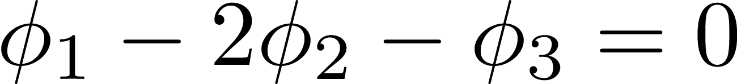

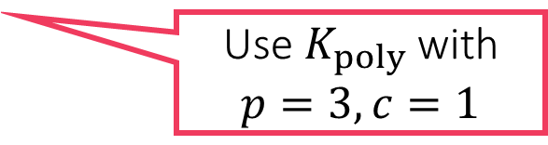
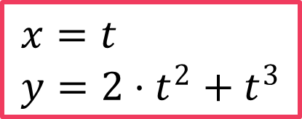
Kernel PCA
Non-linear principal component – much better fit!
Principal component given by PCA/PPCA
$$x=t \\ y=2⋅t^{2}+t^{3}$$
Use $K_{poly}$ with $p=3,c=1$
This data can actually be explained using a single variable! Even though the data looks 2D, it is inherently 1D in a nonlinear way. Kernel PCA can recover this hidden structure

Slide 12
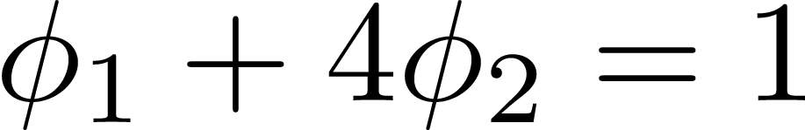

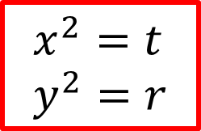
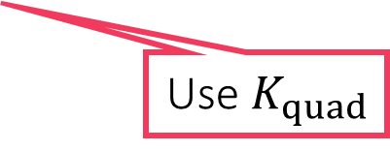
Kernel PCA
Non-linear principal component – much better fit!
Did not do dim-redn but explained data much better!
Principal component given by PCA/PPCA
$$x^{2}+4y^{2}=1$$
$$x^{2}=t \\ y^{2}=r$$
Even this data can actually be explained using a single variable! Even though the data looks 2D, it is inherently 1D in a nonlinear way. Kernel PCA can recover this hidden structure
Use $K_{quad}$

Slide 13
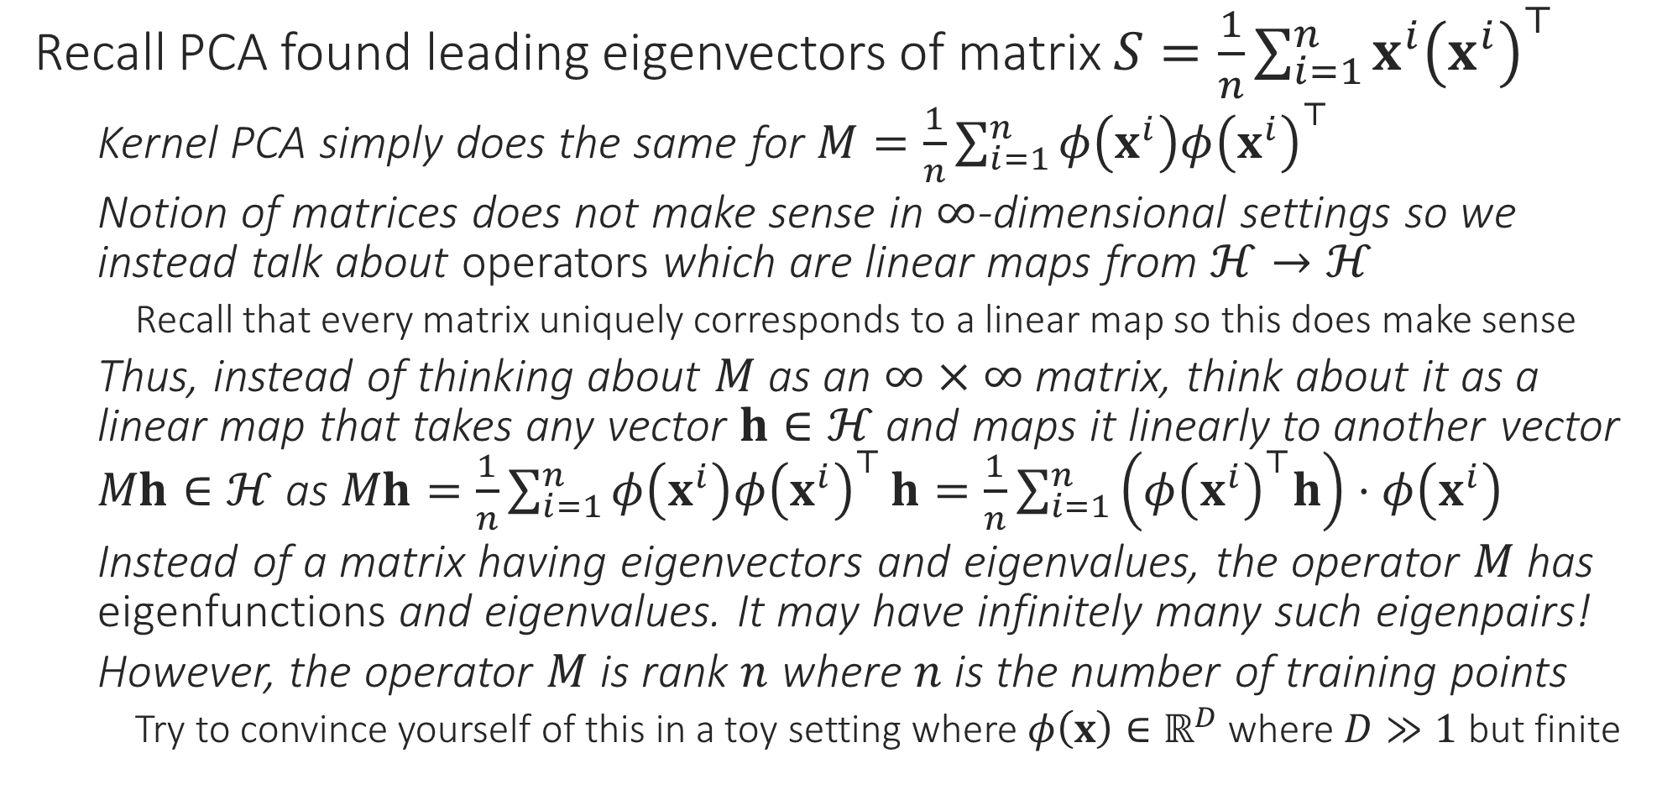
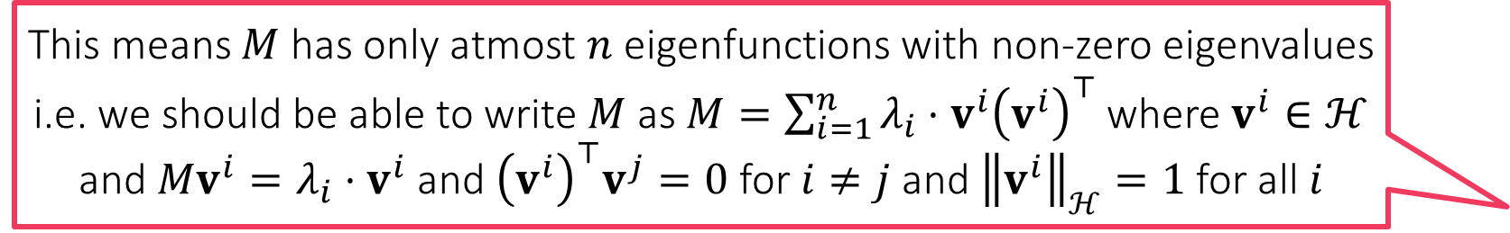
Kernel PCA
This means $M$ has only atmost $n$ eigenfunctions with non-zero eigenvalues i.e. we should be able to write $M$ as $M=\sum_{i=1}^{n}{λ_{i}⋅v^{i}{\left(v^{i}\right)}^{⊤}}$ where $v^{i}∈ℋ$ and $Mv^{i}=λ_{i}⋅v^{i}$ and ${\left(v^{i}\right)}^{⊤}v^{j}=0$ for $i≠j$ and ${\left\|v^{i}\right\|}_{ℋ}=1$ for all $i$
Recall PCA found leading eigenvectors of matrix $S=\frac{1}{n}\sum_{i=1}^{n}{x^{i}{\left(x^{i}\right)}^{⊤}}$
Kernel PCA simply does the same for $M=\frac{1}{n}\sum_{i=1}^{n}{φ\left(x^{i}\right)φ{\left(x^{i}\right)}^{⊤}}$
Notion of matrices does not make sense in $∞$-dimensional settings so we instead talk about operators which are linear maps from $ℋ→ℋ$
Recall that every matrix uniquely corresponds to a linear map so this does make sense
Thus, instead of thinking about $M$ as an $∞×∞$ matrix, think about it as a linear map that takes any vector $h∈ℋ$ and maps it linearly to another vector $Mh∈ℋ$ as $Mh=\frac{1}{n}\sum_{i=1}^{n}{φ\left(x^{i}\right)φ{\left(x^{i}\right)}^{⊤}}h=\frac{1}{n}\sum_{i=1}^{n}{\left(φ{\left(x^{i}\right)}^{⊤}h\right)⋅φ\left(x^{i}\right)}$
Instead of a matrix having eigenvectors and eigenvalues, the operator $M$ has eigenfunctions and eigenvalues. It may have infinitely many such eigenpairs!
However, the operator $M$ is rank $n$ where $n$ is the number of training points
Try to convince yourself of this in a toy setting where $φ\left(x\right)∈ℝ^{D}$ where $D≫1$ but finite

Slide 14
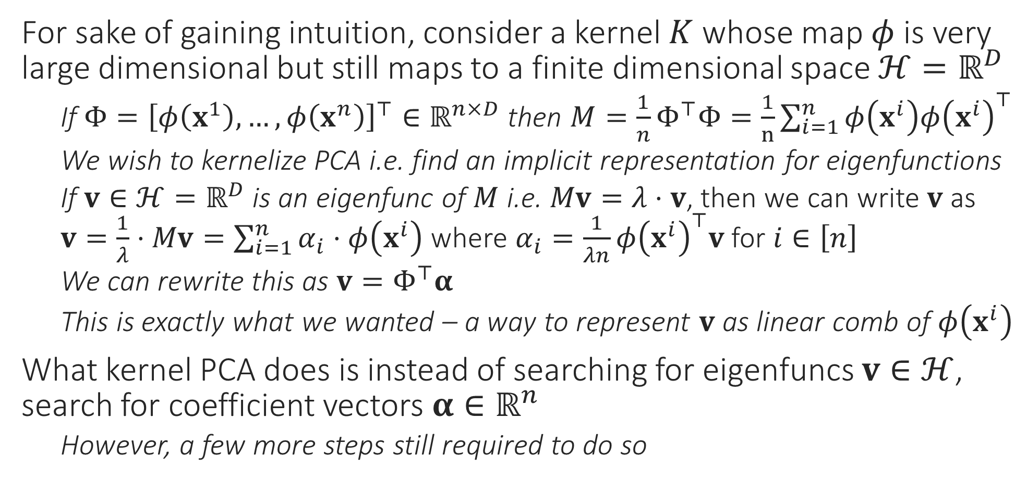

Executing PCA in an RKHS $ℋ$
For sake of gaining intuition, consider a kernel $K$ whose map $φ$ is very large dimensional but still maps to a finite dimensional space $ℋ=ℝ^{D}$
If $Φ={\left[φ\left(x^{1}\right),…,φ\left(x^{n}\right)\right]}^{⊤}∈ℝ^{n×D}$ then $M=\frac{1}{n}Φ^{⊤}Φ=\frac{1}{n}\sum_{i=1}^{n}{φ\left(x^{i}\right)φ{\left(x^{i}\right)}^{⊤}}$
We wish to kernelize PCA i.e. find an implicit representation for eigenfunctions
If $v∈{ℋ=ℝ}^{D}$ is an eigenfunc of $M$ i.e. $Mv=λ⋅v$, then we can write $v$ as $v=\frac{1}{λ}⋅Mv=\sum_{i=1}^{n}{α_{i}⋅φ\left(x^{i}\right)}$ where $α_{i}=\frac{1}{λn}φ{\left(x^{i}\right)}^{⊤}v$ for $i∈\left[n\right]$
We can rewrite this as $v=Φ^{⊤}α$
This is exactly what we wanted – a way to represent $v$ as linear comb of $φ\left(x^{i}\right)$
What kernel PCA does is instead of searching for eigenfuncs $v∈ℋ$, search for coefficient vectors $α∈ℝ^{n}$
However, a few more steps still required to do so

Slide 15
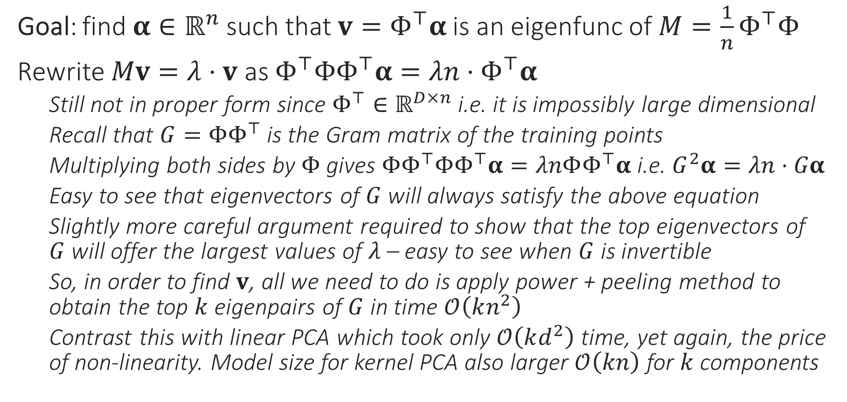
Executing PCA in an RKHS $ℋ$
Goal: find $α∈ℝ^{n}$ such that $v=Φ^{⊤}α$ is an eigenfunc of $M=\frac{1}{n}Φ^{⊤}Φ$
Rewrite $Mv=λ⋅v$ as $Φ^{⊤}ΦΦ^{⊤}α=λn⋅Φ^{⊤}α$
Still not in proper form since $Φ^{⊤}∈ℝ^{D×n}$ i.e. it is impossibly large dimensional
Recall that $G=ΦΦ^{⊤}$ is the Gram matrix of the training points
Multiplying both sides by $Φ$ gives $ΦΦ^{⊤}ΦΦ^{⊤}α=λnΦΦ^{⊤}α$ i.e. $G^{2}α=λn⋅Gα$
Easy to see that eigenvectors of $G$ will always satisfy the above equation
Slightly more careful argument required to show that the top eigenvectors of $G$ will offer the largest values of $λ$ – easy to see when $G$ is invertible
So, in order to find $v$, all we need to do is apply power + peeling method to obtain the top $k$ eigenpairs of $G$ in time $𝒪\left(kn^{2}\right)$
Contrast this with linear PCA which took only $𝒪\left(kd^{2}\right)$ time, yet again, the price of non-linearity. Model size for kernel PCA also larger $𝒪\left(kn\right)$ for $k$ components

Slide 16
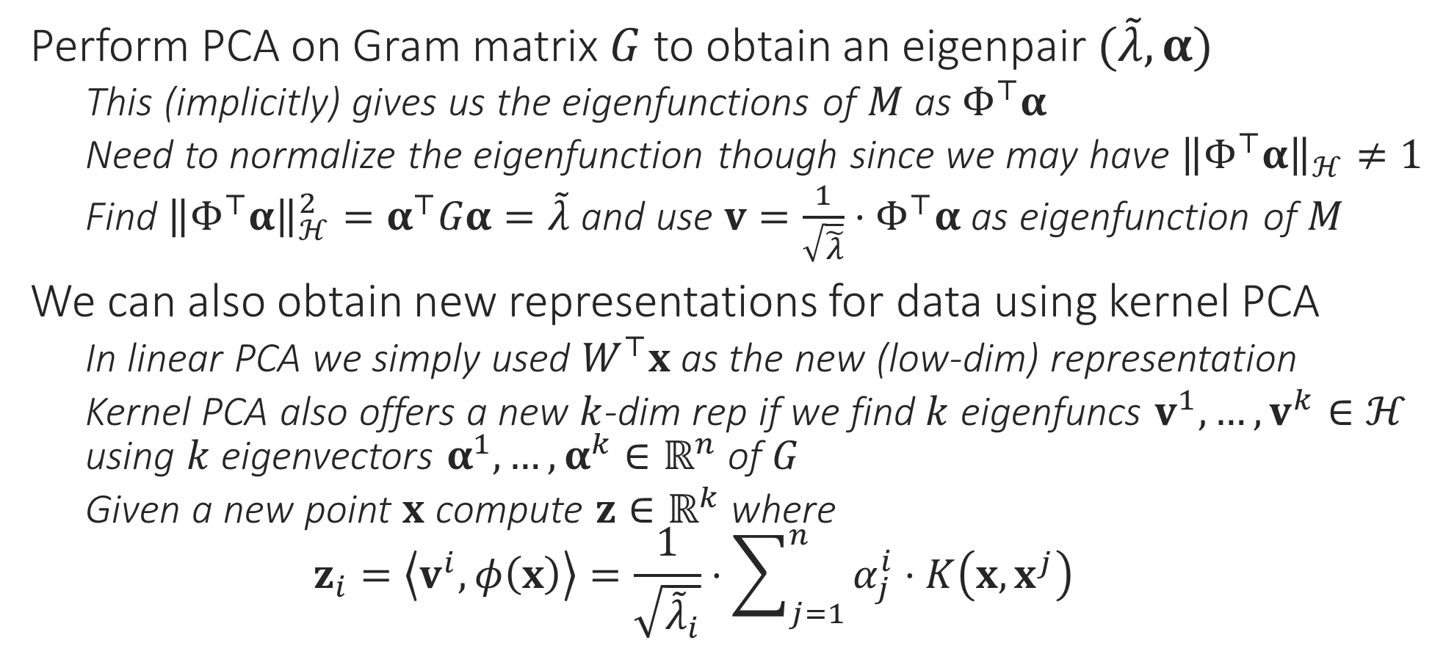
Executing PCA in an RKHS $ℋ$
Perform PCA on Gram matrix $G$ to obtain an eigenpair $(\tilde{λ},α)$
This (implicitly) gives us the eigenfunctions of $M$ as $Φ^{⊤}α$
Need to normalize the eigenfunction though since we may have ${\left\|Φ^{⊤}α\right\|}_{ℋ}≠1$
Find ${\left\|Φ^{⊤}α\right\|}_{ℋ}^{2}=α^{⊤}Gα=\tilde{λ}$ and use $v=\frac{1}{\sqrt{\tilde{λ}}}⋅Φ^{⊤}α$ as eigenfunction of $M$
We can also obtain new representations for data using kernel PCA
In linear PCA we simply used $W^{⊤}x$ as the new (low-dim) representation
Kernel PCA also offers a new $k$-dim rep if we find $k$ eigenfuncs $v^{1},…,v^{k}∈ℋ$ using $k$ eigenvectors $α^{1},…,α^{k}∈ℝ^{n}$ of $G$
Given a new point $x$ compute $z∈ℝ^{k}$ where $z_{i}=\left\langle v^{i},φ\left(x\right)\right\rangle =\frac{1}{\sqrt{{\tilde{λ}}_{i}}}⋅\sum_{j=1}^{n}{α_{j}^{i}⋅K\left(x,x^{j}\right)}$

Slide 17
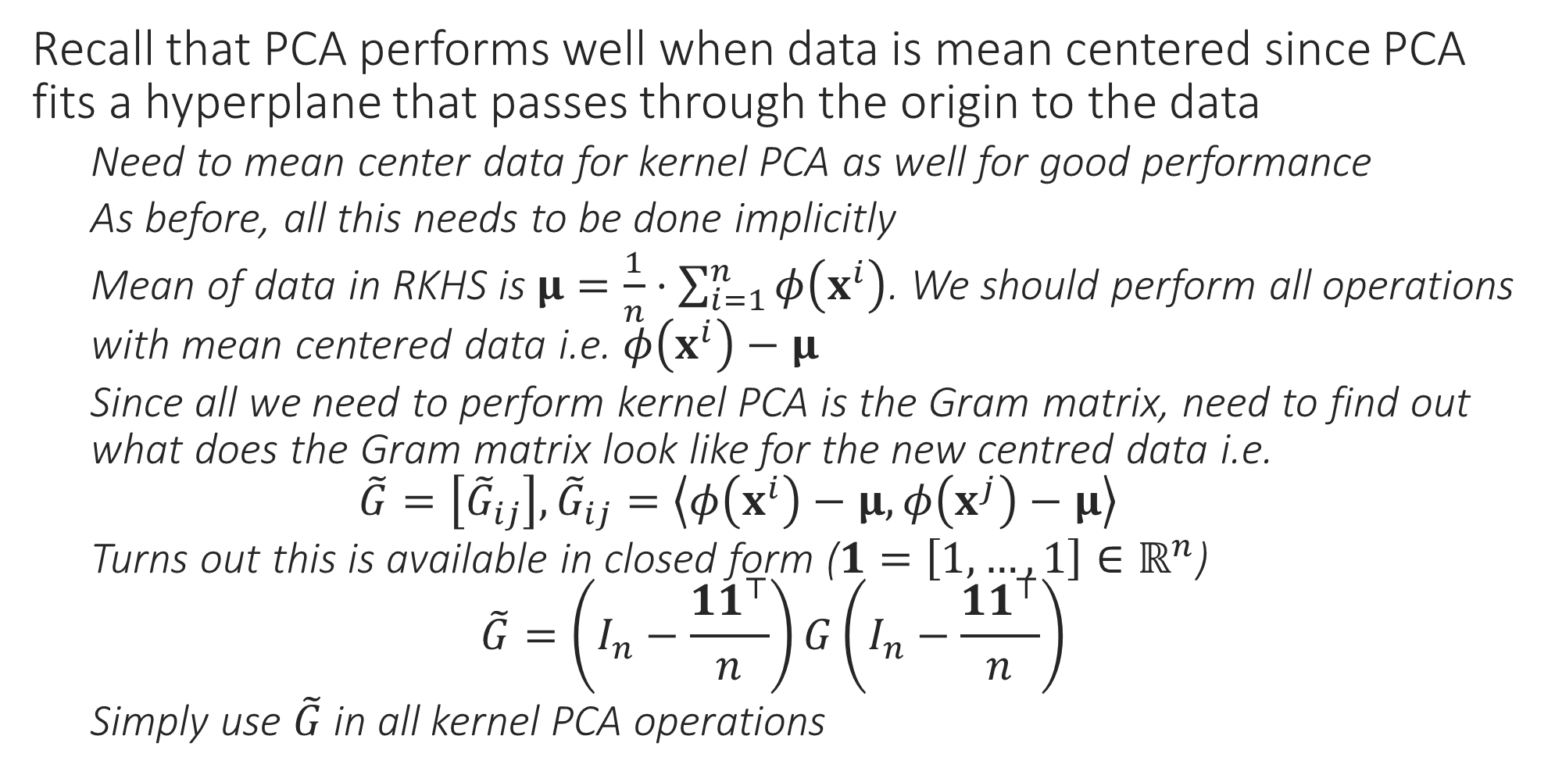
A note on data centering
Recall that PCA performs well when data is mean centered since PCA fits a hyperplane that passes through the origin to the data
Need to mean center data for kernel PCA as well for good performance
As before, all this needs to be done implicitly
Mean of data in RKHS is $μ=\frac{1}{n}⋅\sum_{i=1}^{n}{φ\left(x^{i}\right)}$. We should perform all operations with mean centered data i.e. $φ\left(x^{i}\right)−μ$
Since all we need to perform kernel PCA is the Gram matrix, need to find out what does the Gram matrix look like for the new centred data i.e. $\tilde{G}=\left[{\tilde{G}}_{ij}\right],{\tilde{G}}_{ij}=\left\langle φ\left(x^{i}\right)−μ,φ\left(x^{j}\right)−μ\right\rangle$
Turns out this is available in closed form ($1=\left[1,…,1\right]∈ℝ^{n}$) $\tilde{G}=\left(I_{n}−\frac{{11}^{⊤}}{n}\right)G\left(I_{n}−\frac{{11}^{⊤}}{n}\right)$
Simply use $\tilde{G}$ in all kernel PCA operations

Slide 18
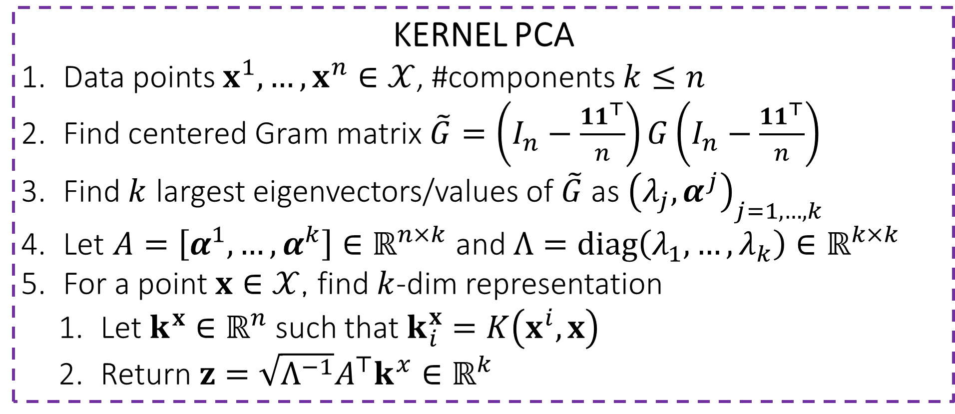

Kernel PCA
KERNEL PCA
Data points $x^{1},…,x^{n}∈𝒳$, #components $k≤n$
Find centered Gram matrix $\tilde{G}=\left(I_{n}−\frac{{11}^{⊤}}{n}\right)G\left(I_{n}−\frac{{11}^{⊤}}{n}\right)$
Find $k$ largest eigenvectors/values of $\tilde{G}$ as ${\left(λ_{j},α^{j}\right)}_{j=1,…,k}$
Let $A=\left[α^{1},…,α^{k}\right]∈ℝ^{n×k}$ and $Λ=diag\left(λ_{1},…,λ_{k}\right)∈ℝ^{k×k}$
For a point $x∈𝒳$, find $k$-dim representation
Let $k^{x}∈ℝ^{n}$ such that $k_{i}^{x}=K\left(x^{i},x\right)$
Return $z=\sqrt{Λ^{−1}}A^{⊤}k^{x}∈ℝ^{k}$
Whereas PCA could return only $k≤d$ components, KPCA can return upto $k≤n$ components – more data, more possible components!

