Slide 1
Kernel Learning IV
CS771: Introduction to Machine Learning
Purushottam Kar

Slide 2
Announcements
Assignment 2 deadline extended to 02 Nov (Saturday) 9:59PM IST
Applies to both PDF submission (Gradescope) and code submission (website)
No cascading extensions to other portions of the course
Assignment 3 will be released early next week as scheduled originally
Cannot delay this as we are nearing end of course as is
Quiz 4 will be held on 01 Nov as scheduled originally
Cannot delay this as we have our endsem exam scheduled by DoAA on 18 Nov

Slide 3
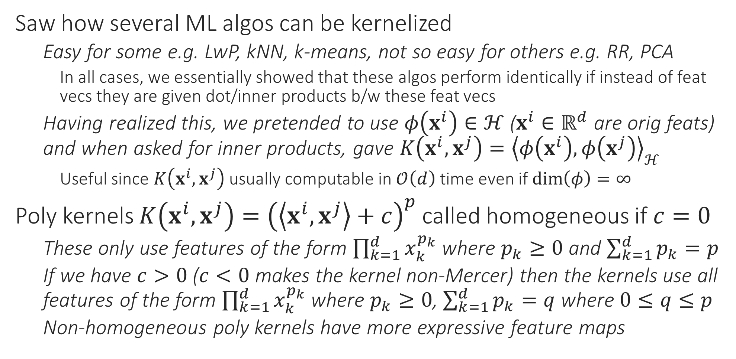
Recap of Last Lecture
Saw how several ML algos can be kernelized
Easy for some e.g. LwP, kNN, k-means, not so easy for others e.g. RR, PCA
In all cases, we essentially showed that these algos perform identically if instead of feat vecs they are given dot/inner products b/w these feat vecs
Having realized this, we pretended to use $φ\left(x^{i}\right)∈ℋ$ ($x^{i}∈ℝ^{d}$ are orig feats) and when asked for inner products, gave $K\left(x^{i},x^{j}\right)={\left\langle φ\left(x^{i}\right),φ\left(x^{j}\right)\right\rangle }_{ℋ}$
Useful since $K\left(x^{i},x^{j}\right)$ usually computable in $𝒪\left(d\right)$ time even if $\dim\left(φ\right)=∞$
Poly kernels $K\left(x^{i},x^{j}\right)={\left(\left\langle x^{i},x^{j}\right\rangle +c\right)}^{p}$ called homogeneous if $c=0$
These only use features of the form $\prod_{k=1}^{d}{x_{k}^{p_{k}}}$ where $p_{k}≥0$ and $\sum_{k=1}^{d}{p_{k}}=p$
If we have $c>0$ ($c<0$ makes the kernel non-Mercer) then the kernels use all features of the form $\prod_{k=1}^{d}{x_{k}^{p_{k}}}$ where $p_{k}≥0$, $\sum_{k=1}^{d}{p_{k}}=q$ where $0≤q≤p$
Non-homogeneous poly kernels have more expressive feature maps

Slide 4
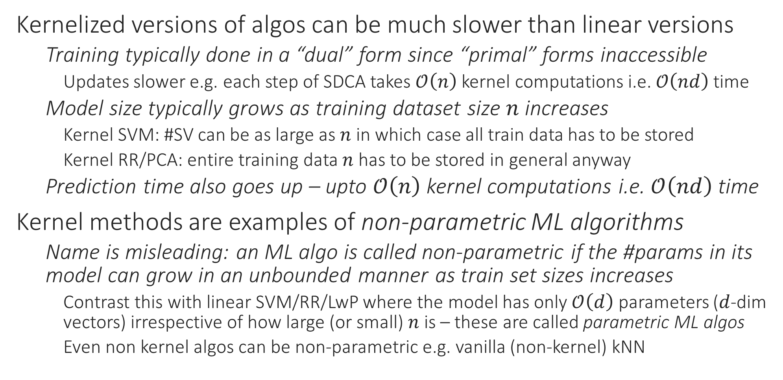
Accelerated Kernel Learning
Kernelized versions of algos can be much slower than linear versions
Training typically done in a “dual” form since “primal” forms inaccessible
Updates slower e.g. each step of SDCA takes $𝒪\left(n\right)$ kernel computations i.e. $𝒪\left(nd\right)$ time
Model size typically grows as training dataset size $n$ increases
Kernel SVM: #SV can be as large as $n$ in which case all train data has to be stored
Kernel RR/PCA: entire training data $n$ has to be stored in general anyway
Prediction time also goes up – upto $𝒪\left(n\right)$ kernel computations i.e. $𝒪\left(nd\right)$ time
Kernel methods are examples of non-parametric ML algorithms
Name is misleading: an ML algo is called non-parametric if the #params in its model can grow in an unbounded manner as train set sizes increases
Contrast this with linear SVM/RR/LwP where the model has only $𝒪\left(d\right)$ parameters ($d$-dim vectors) irrespective of how large (or small) $n$ is – these are called parametric ML algos
Even non kernel algos can be non-parametric e.g. vanilla (non-kernel) kNN

Slide 5
Accelerated Kernel Learning
Several techniques exist – can be grouped into three main families
Presented using kernel SVM as example – can be applied to kernel RR/PCA too
Post-processing: learn the kernel SVM model (will be a bit costly) but then compress the model to make storage/prediction cheaper
Approximate training: directly learn a kernel SVM model that is cheap to store and predict
Kernel approximation: use a kernel different than the one we originally wanted but choose this new kernel so that it
Provides approximately the same kernel values as the original one
Results in models that are cheap to store and predict

Slide 6
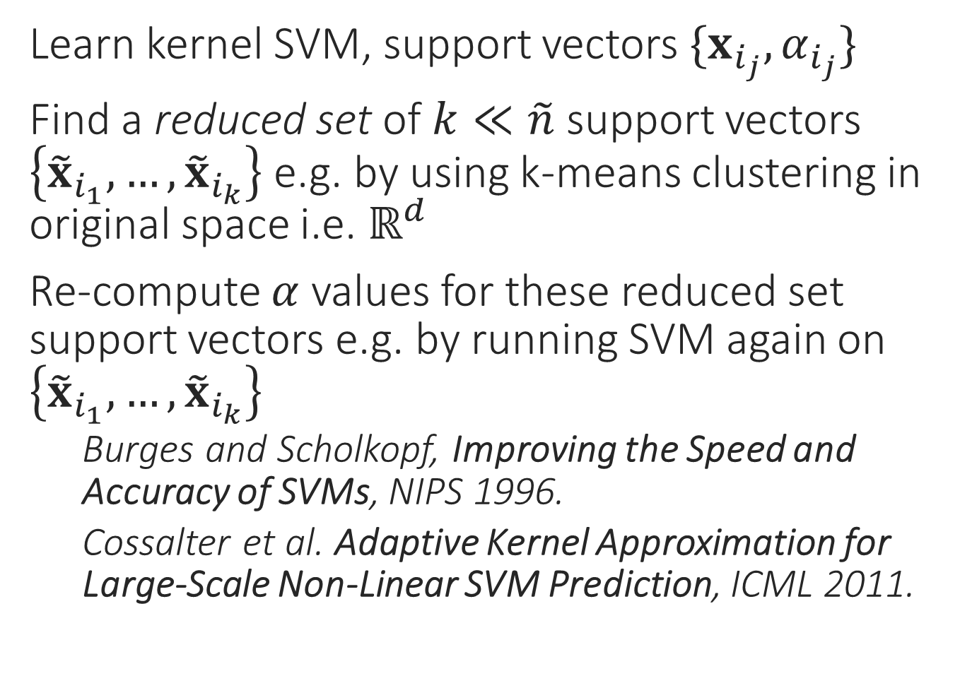
Post Processing
Learn kernel SVM, support vectors $\{x_{i_{j}},α_{i_{j}}\}$
Find a reduced set of $k≪\tilde{n}$ support vectors $\left\{{\tilde{x}}_{i_{1}},…,{\tilde{x}}_{i_{k}}\right\}$ e.g. by using k-means clustering in original space i.e. $ℝ^{d}$
Re-compute $α$ values for these reduced set support vectors e.g. by running SVM again on $\left\{{\tilde{x}}_{i_{1}},…,{\tilde{x}}_{i_{k}}\right\}$
Burges and Scholkopf, Improving the Speed and Accuracy of SVMs, NIPS 1996.
Cossalter et al. Adaptive Kernel Approximation for Large-Scale Non-Linear SVM Prediction, ICML 2011.

Slide 7
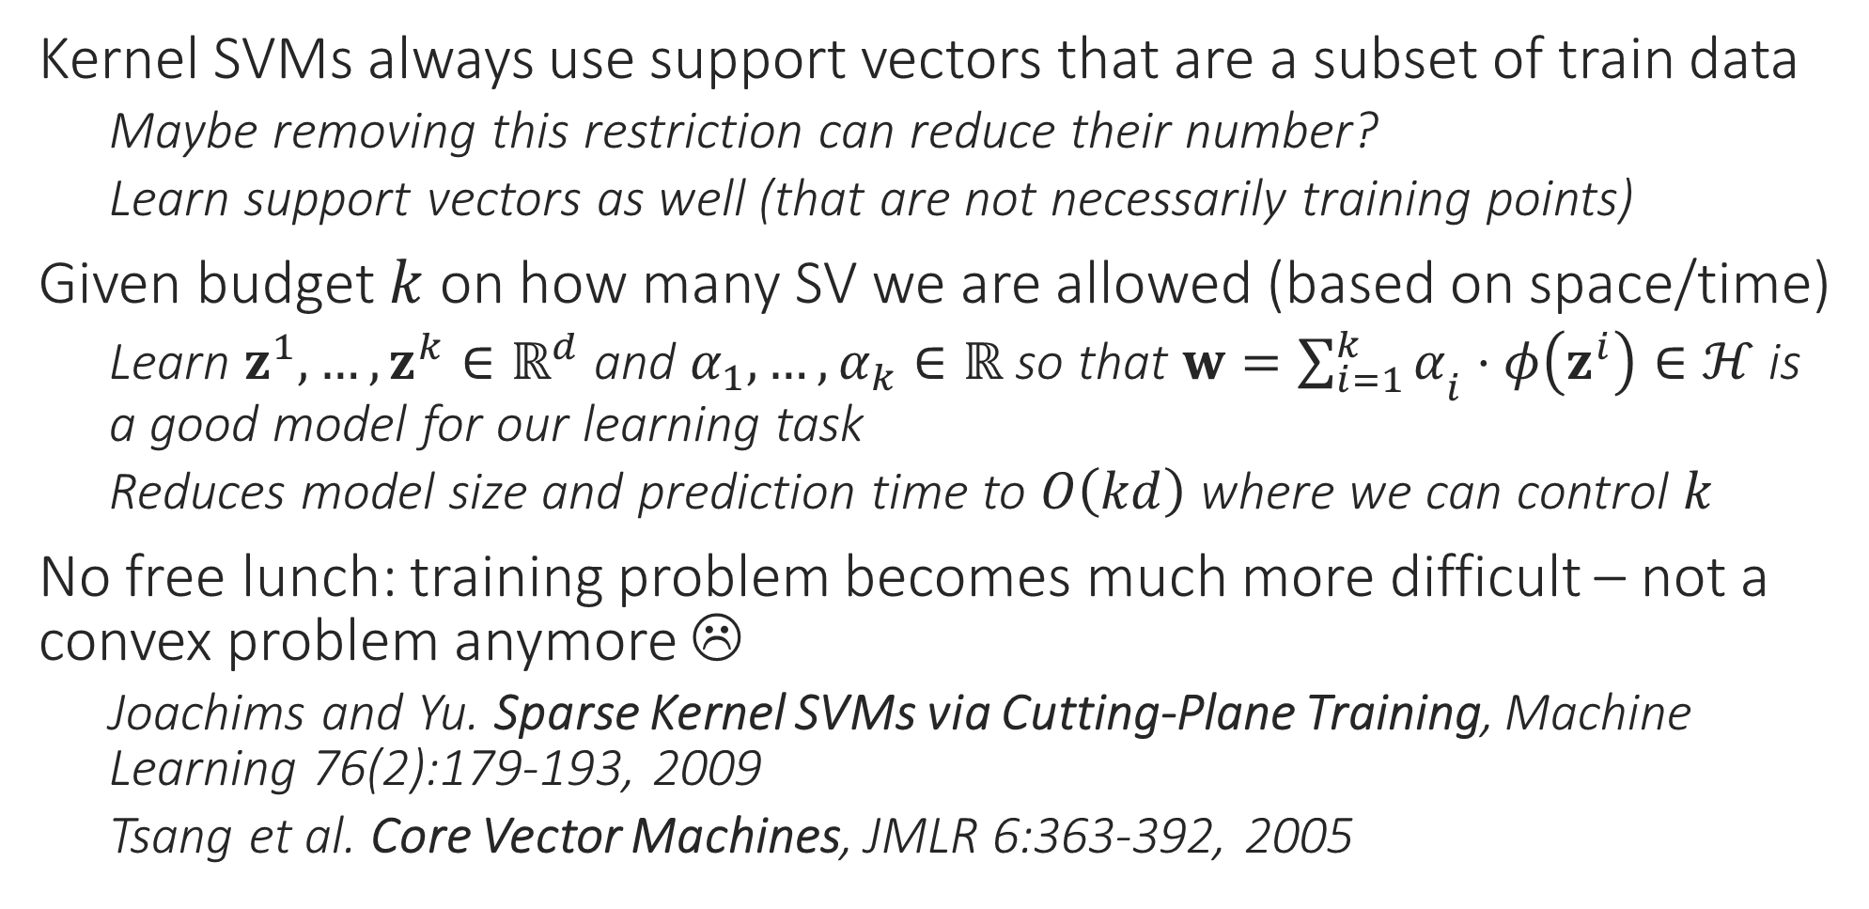
Approximate Training
Kernel SVMs always use support vectors that are a subset of train data
Maybe removing this restriction can reduce their number?
Learn support vectors as well (that are not necessarily training points)
Given budget $k$ on how many SV we are allowed (based on space/time)
Learn $z^{1},…,z^{k}∈ℝ^{d}$ and $α_{1},…,α_{k}∈ℝ$ so that $w={\sum_{i=1}^{k}{α}}_{i}⋅φ\left(z^{i}\right)∈ℋ$ is a good model for our learning task
Reduces model size and prediction time to $O\left(kd\right)$ where we can control $k$
No free lunch: training problem becomes much more difficult – not a convex problem anymore ☹
Joachims and Yu. Sparse Kernel SVMs via Cutting-Plane Training, Machine Learning 76(2):179-193, 2009
Tsang et al. Core Vector Machines, JMLR 6:363-392, 2005

Slide 8
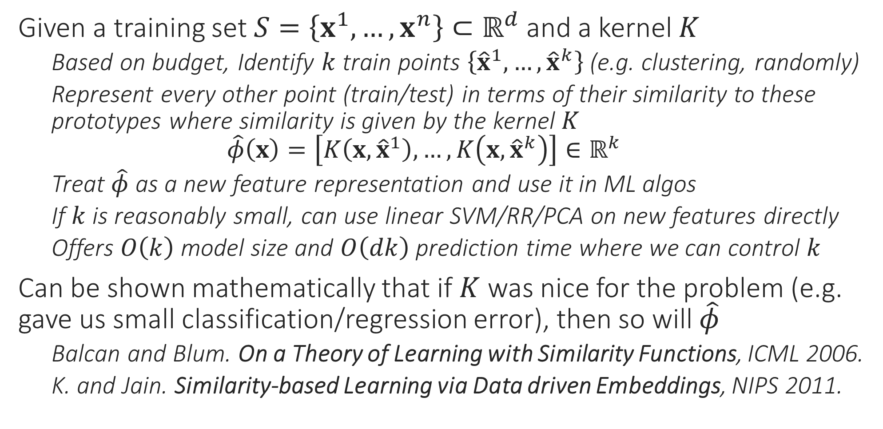
Kernel Approximation - Landmarking
Given a training set $S=\left\{x^{1},…,x^{n}\right\}⊂ℝ^{d}$ and a kernel $K$
Based on budget, Identify $k$ train points $\left\{{\hat{x}}^{1},…,{\hat{x}}^{k}\right\}$ (e.g. clustering, randomly)
Represent every other point (train/test) in terms of their similarity to these prototypes where similarity is given by the kernel $K$ $\hat{φ}\left(x\right)=\left[K\left(x,{\hat{x}}^{1}\right),…,K\left(x,{\hat{x}}^{k}\right)\right]∈ℝ^{k}$
Treat $\hat{φ}$ as a new feature representation and use it in ML algos
If $k$ is reasonably small, can use linear SVM/RR/PCA on new features directly
Offers $O\left(k\right)$ model size and $O\left(dk\right)$ prediction time where we can control $k$
Can be shown mathematically that if $K$ was nice for the problem (e.g. gave us small classification/regression error), then so will $\hat{φ}$
Balcan and Blum. On a Theory of Learning with Similarity Functions, ICML 2006.
K. and Jain. Similarity-based Learning via Data driven Embeddings, NIPS 2011.

Slide 9
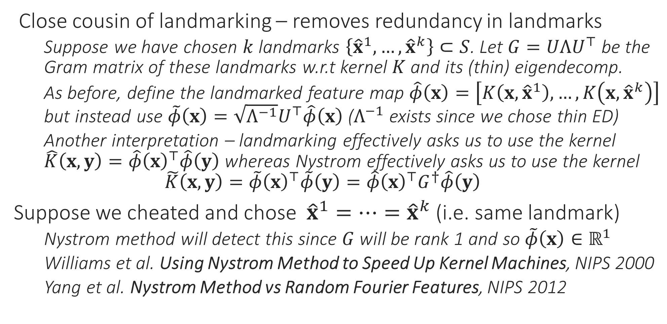
Kernel Approximation – Nystrom Method
Close cousin of landmarking – removes redundancy in landmarks
Suppose we have chosen $k$ landmarks $\left\{{\hat{x}}^{1},…,{\hat{x}}^{k}\right\}⊂S$. Let $G=UΛU^{⊤}$ be the Gram matrix of these landmarks w.r.t kernel $K$ and its (thin) eigendecomp.
As before, define the landmarked feature map $\hat{φ}\left(x\right)=\left[K\left(x,{\hat{x}}^{1}\right),…,K\left(x,{\hat{x}}^{k}\right)\right]$ but instead use $\tilde{φ}\left(x\right)=\sqrt{Λ^{−1}}U^{⊤}\hat{φ}\left(x\right)$ ($Λ^{−1}$ exists since we chose thin ED)
Another interpretation – landmarking effectively asks us to use the kernel $\hat{K}\left(x,y\right)=\hat{φ}{\left(x\right)}^{⊤}\hat{φ}\left(y\right)$ whereas Nystrom effectively asks us to use the kernel $\tilde{K}\left(x,y\right)=\tilde{φ}{\left(x\right)}^{⊤}\tilde{φ}\left(y\right)=\hat{φ}{\left(x\right)}^{⊤}G^{†}\hat{φ}\left(y\right)$
Suppose we cheated and chose ${\hat{x}}^{1}=…={\hat{x}}^{k}$ (i.e. same landmark)
Nystrom method will detect this since $G$ will be rank 1 and so $\tilde{φ}\left(x\right)∈ℝ^{1}$
Williams et al. Using Nystrom Method to Speed Up Kernel Machines, NIPS 2000
Yang et al. Nystrom Method vs Random Fourier Features, NIPS 2012

Slide 10
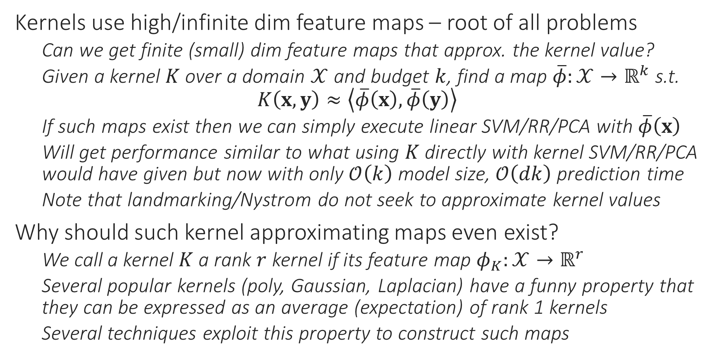
Kernel Approximation – Explicit Features
Kernels use high/infinite dim feature maps – root of all problems
Can we get finite (small) dim feature maps that approx. the kernel value?
Given a kernel $K$ over a domain $𝒳$ and budget $k$, find a map $\overline{φ}:𝒳→ℝ^{k}$ s.t. $K\left(x,y\right)≈\left\langle \overline{φ}\left(x\right),\overline{φ}\left(y\right)\right\rangle$
If such maps exist then we can simply execute linear SVM/RR/PCA with $\overline{φ}\left(x\right)$
Will get performance similar to what using $K$ directly with kernel SVM/RR/PCA would have given but now with only $𝒪\left(k\right)$ model size, $𝒪\left(dk\right)$ prediction time
Note that landmarking/Nystrom do not seek to approximate kernel values
Why should such kernel approximating maps even exist?
We call a kernel $K$ a rank $r$ kernel if its feature map $φ_{K}:𝒳→ℝ^{r}$
Several popular kernels (poly, Gaussian, Laplacian) have a funny property that they can be expressed as an average (expectation) of rank 1 kernels
Several techniques exploit this property to construct such maps

Slide 11
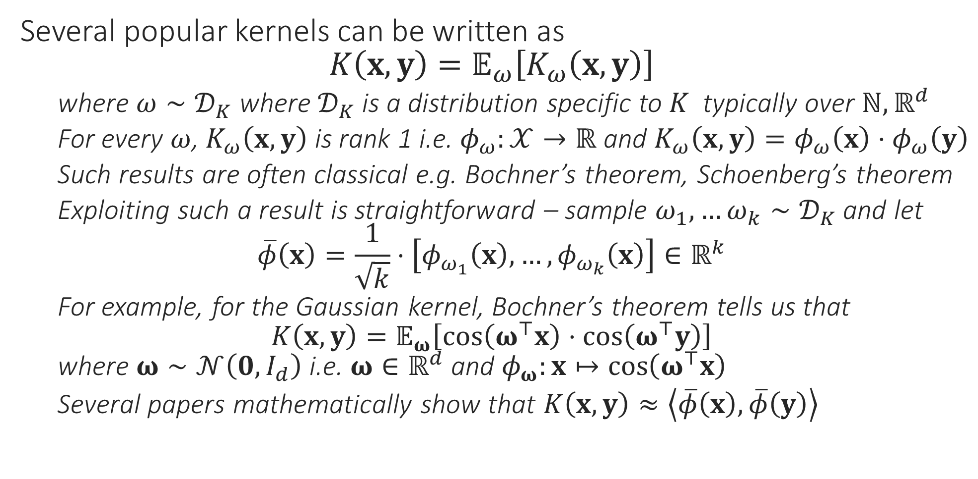
Kernel Approximation – Explicit Features
Several popular kernels can be written as $K\left(x,y\right)=𝔼_{ω}\left[K_{ω}\left(x,y\right)\right]$
where $ω∼𝒟_{K}$ where $𝒟_{K}$ is a distribution specific to $K$ typically over $ℕ,ℝ^{d}$
For every $ω$, $K_{ω}\left(x,y\right)$ is rank 1 i.e. $φ_{ω}:𝒳→ℝ$ and $K_{ω}\left(x,y\right)=φ_{ω}\left(x\right)⋅φ_{ω}\left(y\right)$
Such results are often classical e.g. Bochner’s theorem, Schoenberg’s theorem
Exploiting such a result is straightforward – sample $ω_{1},…ω_{k}∼𝒟_{K}$ and let $\overline{φ}\left(x\right)=\frac{1}{\sqrt{k}}⋅\left[φ_{ω_{1}}\left(x\right),…,φ_{ω_{k}}\left(x\right)\right]∈ℝ^{k}$
For example, for the Gaussian kernel, Bochner’s theorem tells us that $K\left(x,y\right)=𝔼_{ω}\left[\cos\left(ω^{⊤}x\right)⋅\cos\left(ω^{⊤}y\right)\right]$ where $ω∼𝒩\left(0,I_{d}\right)$ i.e. $ω∈ℝ^{d}$ and $φ_{ω}:x↦\cos\left(ω^{⊤}x\right)$
Several papers mathematically show that $K\left(x,y\right)≈\left\langle \overline{φ}\left(x\right),\overline{φ}\left(y\right)\right\rangle$

Slide 12
Kernel Approximation – Explicit Features
Feature constructions for Gaussian/Laplacian, intersection, poly kernels
Rahimi and Recht, Random Features for Large Scale Kernel Machines, NIPS ‘07
Maji and Berg, Max-margin Additive Classifiers for Detect, ICCV 2009
K. and Karnick. Random Feature Maps for Dot Product Kernels. AISTATS 2012
Other interesting approaches to kernel approximation exist too
Use decision trees to compute similarity between two points and use that as kernel – extremely fast prediction
Jose et al. Local Deep Kernel Learning, ICML 2013.
Learn these kernel approximations in a task-dependent manner
Perronnin et al. Large-scale Image Categorization with Explicit Data Embedding, CVPR 2010.

