Slide 1
Local Methods
CS771: Introduction to Machine Learning
Purushottam Kar

Slide 2
Announcements
Registered students would have received a Piazza invitation on their CC email IDs – please activate your account and join discussions
Please do not forget to form groups of 5 registered students – will be asked to submit group names next week itself
Code repository - https://tinyurl.com/ml19-20ac
Will contain lecture code as well as lecture notes
Tip: do not download individual file from repository – instead, do a git pull operation so that all updates (to old files as well) are received

Slide 3
Recap of Last Lecture
What are features – their types and how are they used in ML
Storing features as vectors – common ML operations on vectors
Learning with Prototypes (LwP) – an extremely simple method that gives lightweight models (just one prototype per class)
When LwP fails – when data points in class are very diverse, or else oddly distributed
One solution – make every training data point a prototype – 1NN

Slide 4




Learning with the 1-NN Classifier
In fact, if we were doing, active learning, we would have asked Mary to tell us the true class of not just points on the boundary but also of those close to it
Depends on the application – if you want to be careful, you can classify boundary points as normal to avoid causing Mary to lose a potentially important email
Decision boundary
What is the decision boundary of LwP classifier?
This is called the decision boundary. On one side of this boundary, I predict spam, on the other I predict non-spam
What if a point lies on the decision boundary? How will you classify that?

Slide 5



LwP – behind the scenes
Classifiers with linear decision boundaries are called linear classifiers. Thus, LwP is a linear classifier
Let $μ^{+},μ^{−}$ be the prototypes of the spam, non-spam classes resp.
Recall that we classify an email with feature vector $x$ as spam if
${\left\|x−μ^{+}\right\|}_{2}<{\left\|x−μ^{−}\right\|}_{2}$
$⇔{\left\|x−μ^{+}\right\|}_{2}^{2}<{\left\|x−μ^{−}\right\|}_{2}^{2}$
$⇔{\left\|x\right\|}_{2}^{2}+{\left\|μ^{+}\right\|}_{2}^{2}−2\left\langle x,μ^{+}\right\rangle <{\left\|x\right\|}_{2}^{2}+{\left\|μ^{−}\right\|}_{2}^{2}−2\left\langle x,μ^{−}\right\rangle$
$⇔{\left\|μ^{+}\right\|}_{2}^{2}−2\left\langle x,μ^{+}\right\rangle <{\left\|μ^{−}\right\|}_{2}^{2}−2\left\langle x,μ^{−}\right\rangle$
$⇔\left\langle x,2\left(μ^{+}−μ^{−}\right)\right\rangle +{\left\|μ^{−}\right\|}_{2}^{2}−{\left\|μ^{+}\right\|}_{2}^{2}>0$
$≡ \left\langle x,w\right\rangle +b>0$ with $w=2\left(μ^{+}−μ^{−}\right), b={\left\|μ^{−}\right\|}_{2}^{2}−{\left\|μ^{+}\right\|}_{2}^{2}$
What happens if there are 2 or more prototypes per class, or else if there are 3 classes?
Think about this on your own – will discuss later
Yes, this is known as a linear decision boundary.
So the decision boundary of the LwP classifier is always a line or a hyperplane if the distance function is Euclidean!!

Slide 6

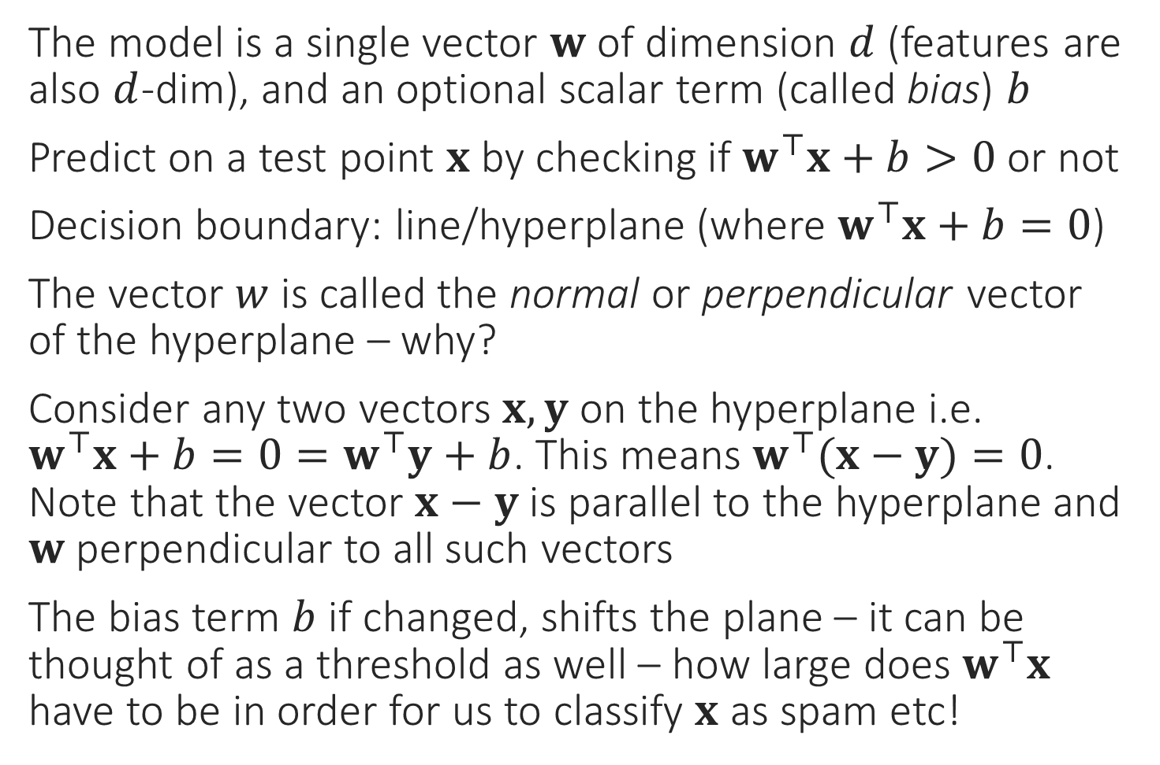
Linear/hyperplane Classifiers
The model is a single vector $w$ of dimension $d$ (features are also $d$-dim), and an optional scalar term (called bias) $b$
Predict on a test point $x$ by checking if $w^{⊤}x+b>0$ or not
Decision boundary: line/hyperplane (where $w^{⊤}x+b=0$)
The vector $w$ is called the normal or perpendicular vector of the hyperplane – why?
Consider any two vectors $x,y$ on the hyperplane i.e. $w^{⊤}x+b=0=w^{⊤}y+b$. This means $w^{⊤}(x−y)=0$. Note that the vector $x−y$ is parallel to the hyperplane and $w$ perpendicular to all such vectors
The bias term $b$ if changed, shifts the plane – it can be thought of as a threshold as well – how large does $w^{⊤}x$ have to be in order for us to classify $x$ as spam etc!
$$w$$

Slide 7
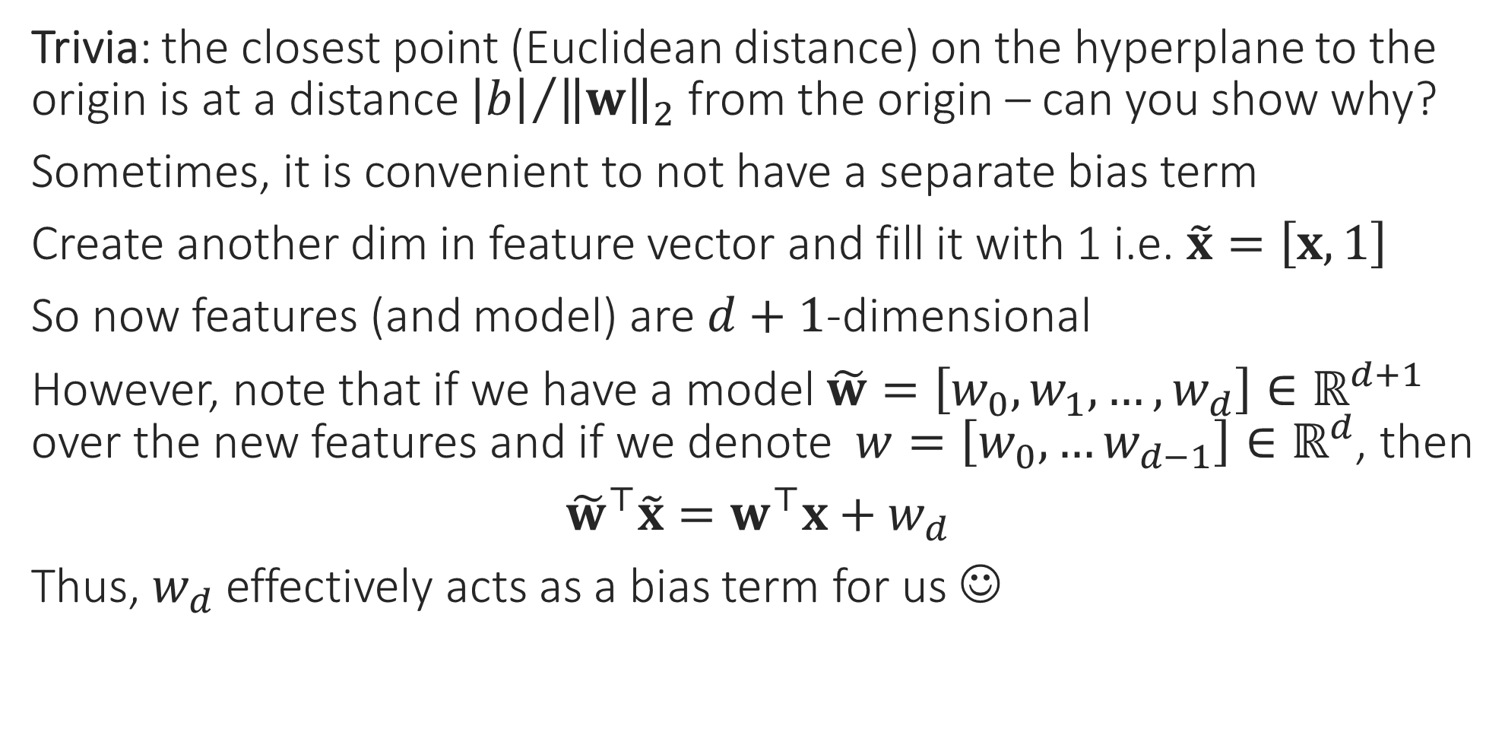

To $b$ or not to $b$ – that is the question!
Trivia: the closest point (Euclidean distance) on the hyperplane to the origin is at a distance ${\left|b\right|}/{{\left\|w\right\|}_{2}}$ from the origin – can you show why?
Sometimes, it is convenient to not have a separate bias term
Create another dim in feature vector and fill it with 1 i.e. $\tilde{x}=\left[x,1\right]$
So now features (and model) are $d+1$-dimensional
However, note that if we have a model $\tilde{w}=\left[w_{0},w_{1},…,w_{d}\right]∈ℝ^{d+1}$ over the new features and if we denote $w=\left[w_{0},…w_{d−1}\right]∈ℝ^{d}$, then
${\tilde{w}}^{⊤}\tilde{x}=w^{⊤}x+w_{d}$
Thus, $w_{d}$ effectively acts as a bias term for us ☺

Slide 8
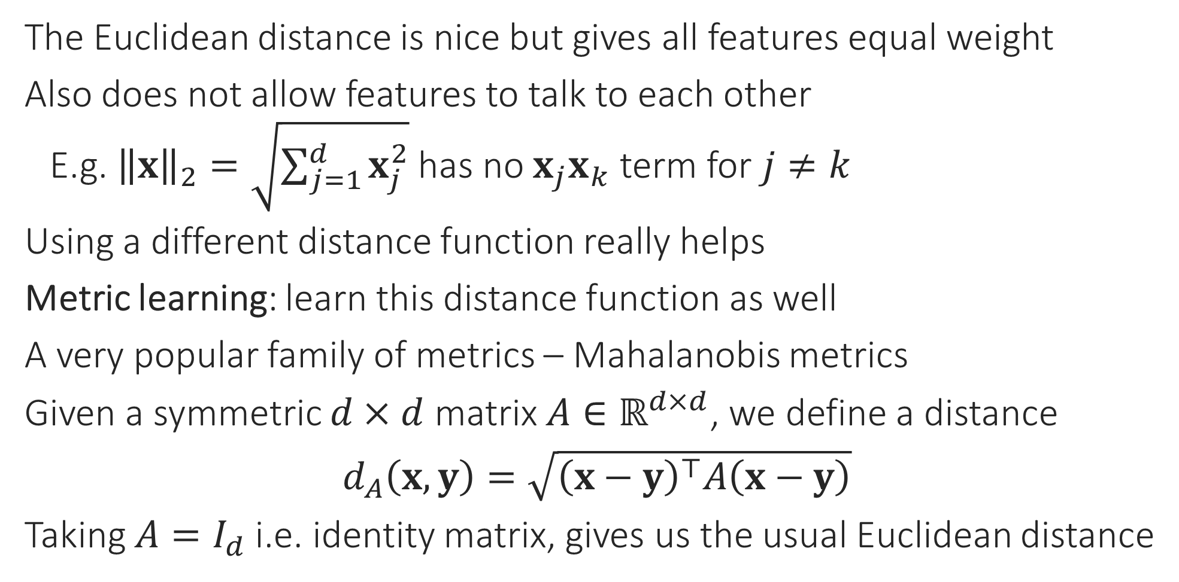
Making LwP more Powerful
The Euclidean distance is nice but gives all features equal weight
Also does not allow features to talk to each other
E.g. ${\left\|x\right\|}_{2}=\sqrt{\sum_{j=1}^{d}{x_{j}^{2}}}$ has no $x_{j}x_{k}$ term for $j≠k$
Using a different distance function really helps
Metric learning: learn this distance function as well
A very popular family of metrics – Mahalanobis metrics
Given a symmetric $d×d$ matrix $A∈ℝ^{d×d}$, we define a distance
$d_{A}\left(x,y\right)=\sqrt{{\left(x−y\right)}^{⊤}A\left(x−y\right)}$
Taking $A=I_{d}$ i.e. identity matrix, gives us the usual Euclidean distance
Euclidean distance does not change even if axes are rotated

Slide 9

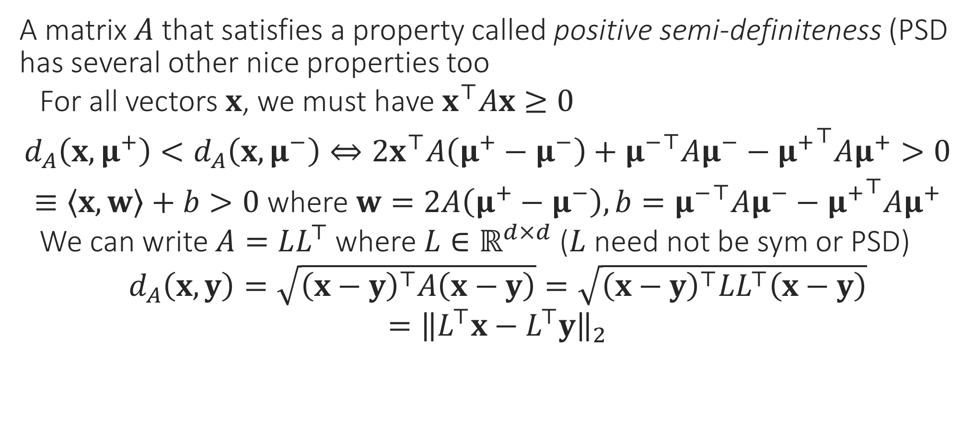
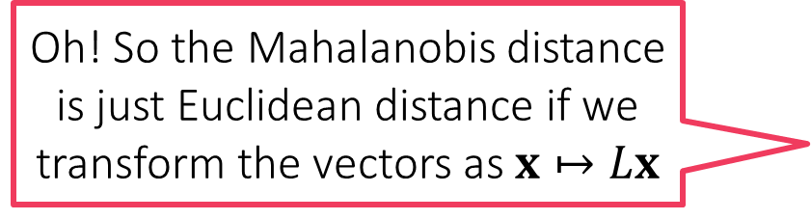
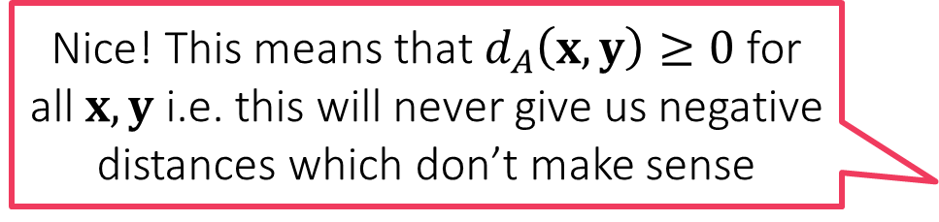
LwP with Mahalanobis metric still linear!!
A matrix $A$ that satisfies a property called positive semi-definiteness (PSD has several other nice properties too
For all vectors $x$, we must have $x^{⊤}Ax≥0$
$d_{A}\left(x,μ^{+}\right)<d_{A}\left(x,μ^{−}\right)⇔2x^{⊤}A\left(μ^{+}−μ^{−}\right)+{μ^{−}}^{⊤}Aμ^{−}−{μ^{+}}^{⊤}Aμ^{+}>0$
$≡\left\langle x,w\right\rangle +b>0$ where $w=2A\left(μ^{+}−μ^{−}\right), b={μ^{−}}^{⊤}Aμ^{−}−{μ^{+}}^{⊤}Aμ^{+}$
We can write $A=LL^{⊤}$ where $L∈ℝ^{d×d}$ ($L$ need not be sym or PSD)
$d_{A}\left(x,y\right)=\sqrt{{\left(x−y\right)}^{⊤}A\left(x−y\right)}=\sqrt{{\left(x−y\right)}^{⊤}LL^{⊤}\left(x−y\right)}$
$={\left\|L^{⊤}x−L^{⊤}y\right\|}_{2}$
Nice! This means that $d_{A}\left(x,y\right)≥0$ for all $x,y$ i.e. this will never give us negative distances which don’t make sense
Oh! So the Mahalanobis distance is just Euclidean distance if we transform the vectors as $x↦Lx$

Slide 10
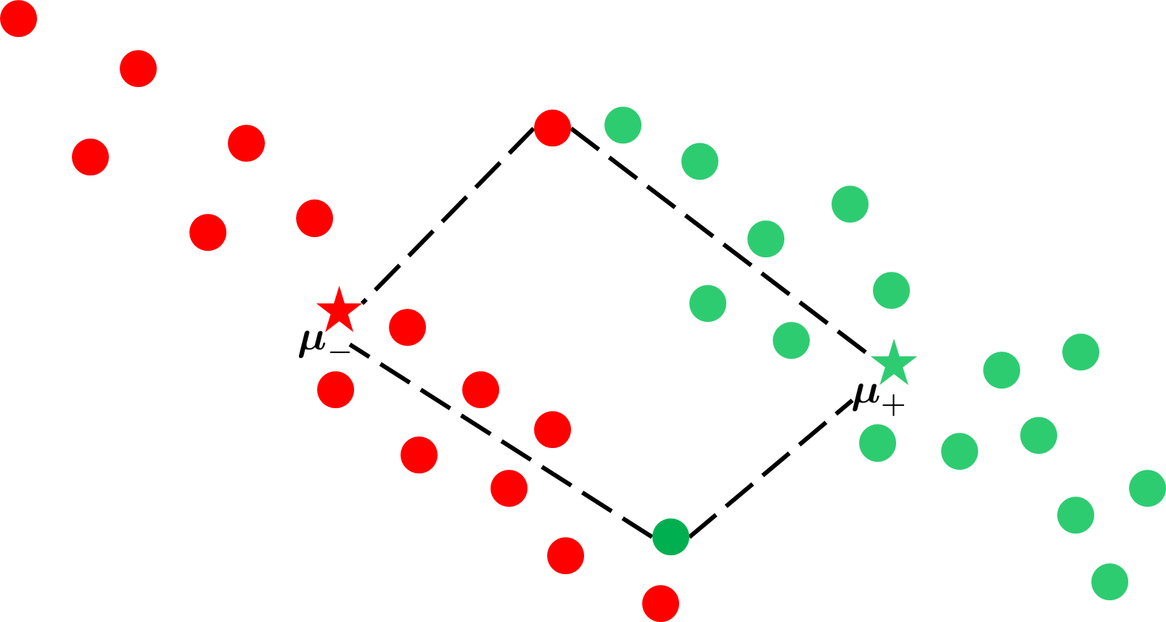
Why metric learning works

Slide 11

Why metric learning works

Slide 12

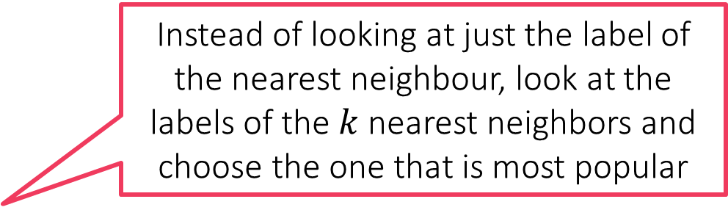
Back to Nearest Neighbors - kNN
Instead of looking at just the label of the nearest neighbour, look at the labels of the $k$ nearest neighbors and choose the one that is most popular

Slide 13

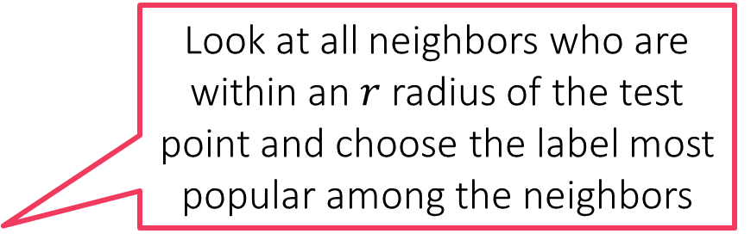
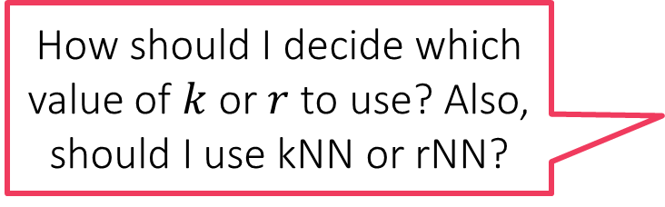
Back to Nearest Neighbors - rNN
Every classifier has a decision boundary even kNN, rNN have some decision boundary (which we hope are better than 1NN’s)
Look at all neighbors who are within an $r$ radius of the test point and choose the label most popular among the neighbors
How should I decide which value of $k$ or $r$ to use? Also, should I use kNN or rNN?

Slide 14

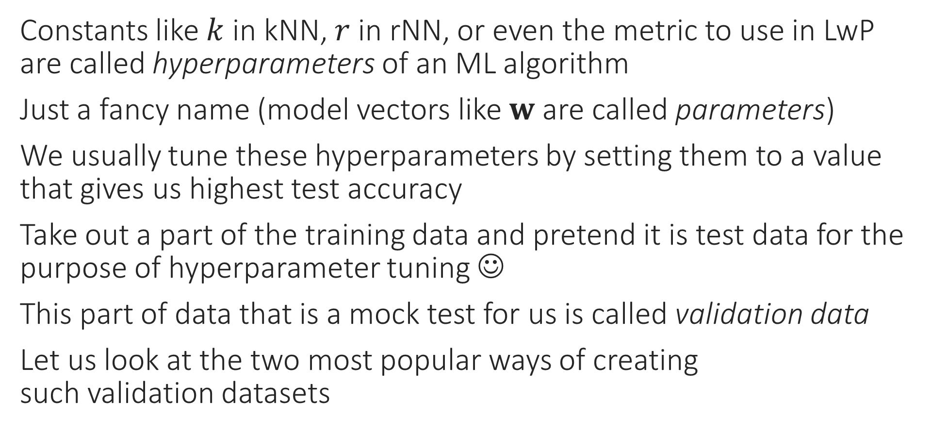
Hyperparameter Tuning in ML
Constants like $k$ in kNN, $r$ in rNN, or even the metric to use in LwP are called hyperparameters of an ML algorithm
Just a fancy name (model vectors like $w$ are called parameters)
We usually tune these hyperparameters by setting them to a value that gives us highest test accuracy
Take out a part of the training data and pretend it is test data for the purpose of hyperparameter tuning ☺
This part of data that is a mock test for us is called validation data
Let us look at the two most popular ways of creating such validation datasets
Looking at test data during training is an execution-worthy crime!

Slide 15
Held-out Validation
Non-spam
Spam
Train
Instead, pretend this is test
Train
Non-spam
Validation
Spam
Never touch this during training
Test
Test

Slide 16
Multi-fold Cross Validation
Split 1
Split 2
Split 3
Train
Train
Train
Validation
Validation
Validation

Slide 17


Learning with NN – Lessons
Compare this to LwP where model had 2 vectors no matter how many training points – such models are called parametric models
One of the oldest learning algorithms - Fix and Hodges (1951)
Very intuitive, in fact – theoretically, it is the best algorithm possible
In practice it performs well if there is lots and lots of training data
However, not used directly since it takes a lot of time to make a prediction on new test point (finding nearest neighbour expensive)
Instead, clever ways used to speed up calculation of nearest neighbor
Also notice, with NN, all training need to be stored. In LwP, I could throw away training points – lightweight!
Correct! NN requires huge storage too! Note that the model size goes up with the amount of training data ☹
Models whose size depends on the amount of training data are called non-parametric models
Makes sense. If there are 2M training points, each a 10K-dim vector, then naively finding nearest neighbor takes 20B operations i.e. ~20 seconds @ 2GHz
The entire training set is the model – NNs have huge models
Imagine if a bank website took 20 seconds to verify if a credit transaction is valid!
Wait! So what is the “model” for NN?

