Slide 1
Deep Learning
CS771: Introduction to Machine Learning
Purushottam Kar

Slide 2
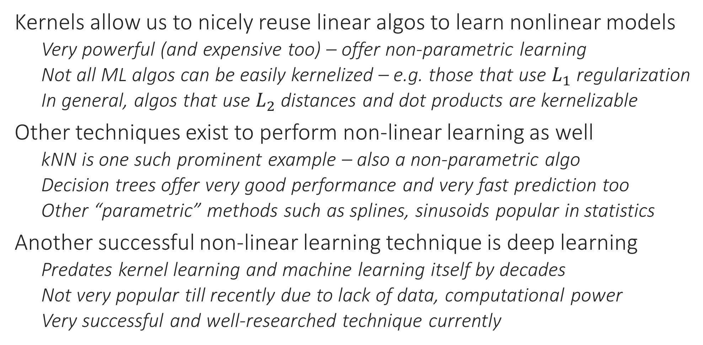
A New Perspective on Non-linear Learning
Kernels allow us to nicely reuse linear algos to learn nonlinear models
Very powerful (and expensive too) – offer non-parametric learning
Not all ML algos can be easily kernelized – e.g. those that use $L_{1}$ regularization
In general, algos that use $L_{2}$ distances and dot products are kernelizable
Other techniques exist to perform non-linear learning as well
kNN is one such prominent example – also a non-parametric algo
Decision trees offer very good performance and very fast prediction too
Other “parametric” methods such as splines, sinusoids popular in statistics
Another successful non-linear learning technique is deep learning
Predates kernel learning and machine learning itself by decades
Not very popular till recently due to lack of data, computational power
Very successful and well-researched technique currently

Slide 3
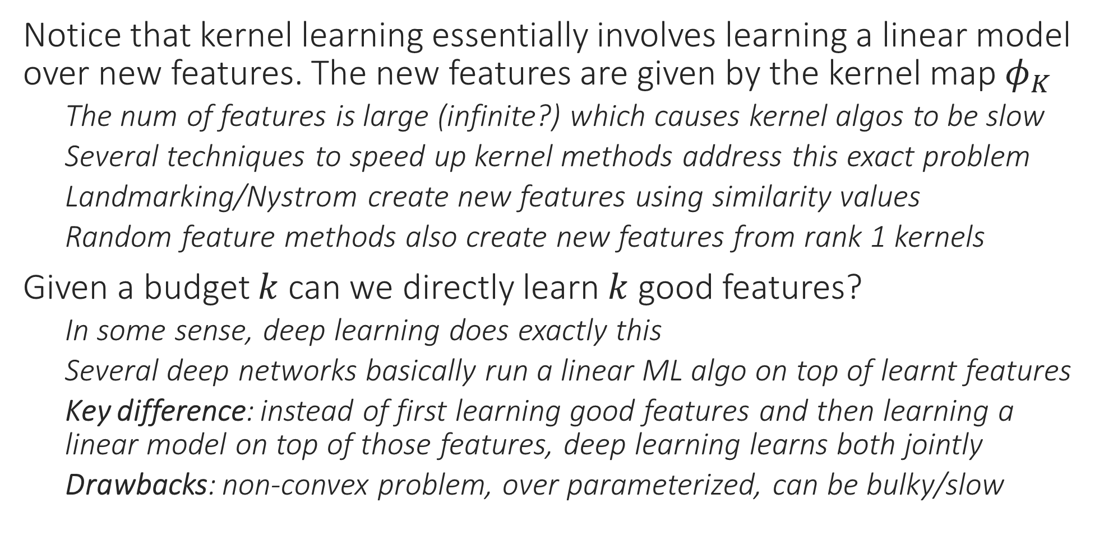
From Kernel Learning to Deep Learning
Notice that kernel learning essentially involves learning a linear model over new features. The new features are given by the kernel map $φ_{K}$
The num of features is large (infinite?) which causes kernel algos to be slow
Several techniques to speed up kernel methods address this exact problem
Landmarking/Nystrom create new features using similarity values
Random feature methods also create new features from rank 1 kernels
Given a budget $k$ can we directly learn $k$ good features?
In some sense, deep learning does exactly this
Several deep networks basically run a linear ML algo on top of learnt features
Key difference: instead of first learning good features and then learning a linear model on top of those features, deep learning learns both jointly
Drawbacks: non-convex problem, over parameterized, can be bulky/slow

Slide 4








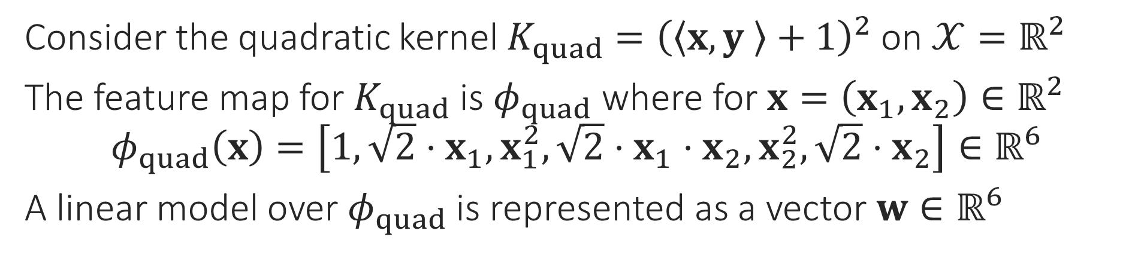












Kernel Learning viewed as Deep Learning
Consider the quadratic kernel $K_{quad}={\left(\left\langle x,y \right\rangle +1\right)}^{2}$ on $𝒳=ℝ^{2}$
The feature map for $K_{quad}$ is $φ_{quad}$ where for $x=\left(x_{1},x_{2}\right)∈ℝ^{2}$ $φ_{quad}\left(x\right)=\left[1, {\sqrt{2}⋅x}_{1}, x_{1}^{2},\sqrt{2}⋅x_{1}⋅x_{2}, x_{2}^{2},\sqrt{2}⋅x_{2}\right]∈ℝ^{6}$
A linear model over $φ_{quad}$ is represented as a vector $w∈ℝ^{6}$
A 3 layer network
Training kernel SVM/RR tunes these weights
$$\left\langle w,φ_{quad}\left(x\right)\right\rangle$$
I/O layers are called “visible”
$$+$$
Output layer
$$w_{1}$$
$$w_{6}$$
$$w_{2}$$
$$w_{3}$$
$$w_{4}$$
$$w_{5}$$
$$1$$
$$id$$
$$sq$$
$$×$$
$$sq$$
$$id$$
“Hidden” layer Usually many of these
$$\sqrt{2}$$
$$\sqrt[4]{2}$$
$$\sqrt[4]{2}$$
$$\sqrt{2}$$
$$x_{1}$$
$$x_{2}$$
Input layer

Slide 5









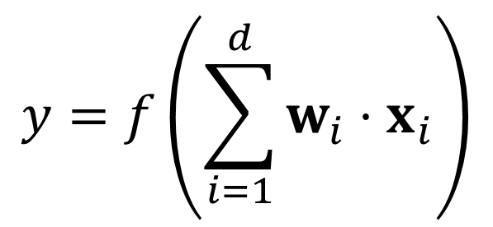


The “Neuron” in Deep/Neural Networks
Output
Output layer: final o/p Input/hidden layer: o/p to other neurons
If no hidden layer then the network is just a generalized linear model, also called a perceptron
Activation
Input layer: always id
Output layer: id/softmax/sign
Hidden layer: non-linear
$$y$$
$$y=f\left(\sum_{i=1}^{d}{w_{i}⋅x_{i}}\right)$$
$$f$$
Input
Input layer: no i/p
Hidden/output layer: i/p taken from other neurons
$$Σ$$
$$w_{1}$$
$$w_{d}$$
$$…$$
Some input items can be bias terms (constant) e.g. 1
$$w_{2}$$
$$x_{1}$$
$$x_{2}$$
$$…$$
$$x_{d}$$

Slide 6
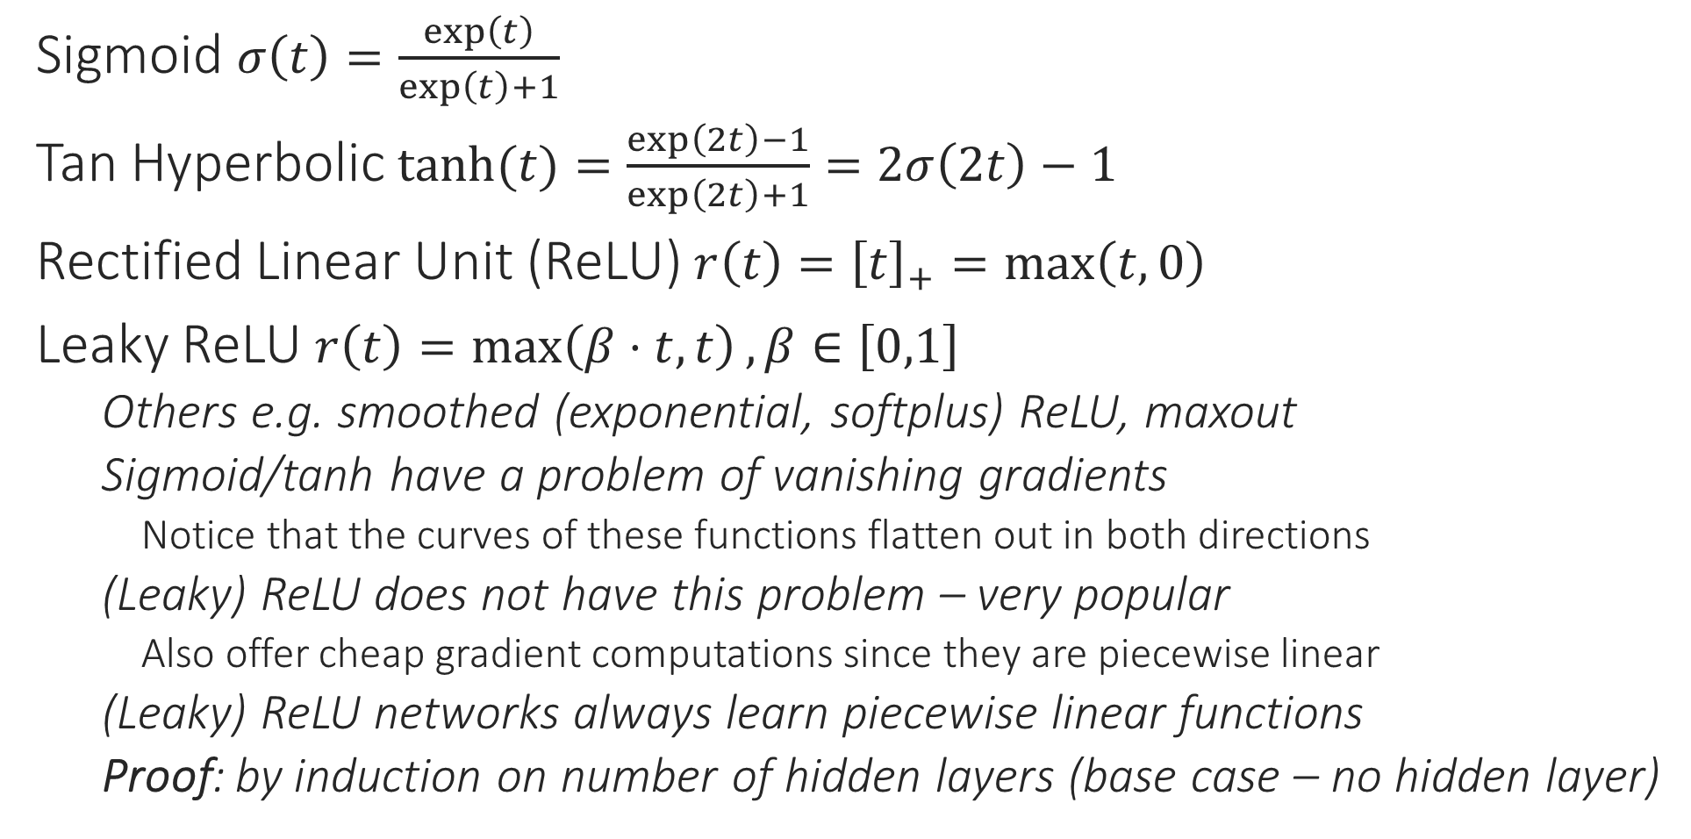
Common Activation Functions
1
1
0.5
Sigmoid $σ\left(t\right)=\frac{\exp\left(t\right)}{\exp\left(t\right)+1}$
Tan Hyperbolic $\tanh{(t)}=\frac{\exp\left(2t\right)−1}{\exp\left(2t\right)+1}=2σ\left(2t\right)−1$
Rectified Linear Unit (ReLU) $r\left(t\right)={\left[t\right]}_{+}=\max\left(t,0\right)$
Leaky ReLU $r\left(t\right)=\max\left(β⋅t,t\right),β∈\left[0,1\right]$
Others e.g. smoothed (exponential, softplus) ReLU, maxout
Sigmoid/tanh have a problem of vanishing gradients
Notice that the curves of these functions flatten out in both directions
(Leaky) ReLU does not have this problem – very popular
Also offer cheap gradient computations since they are piecewise linear
(Leaky) ReLU networks always learn piecewise linear functions
Proof: by induction on number of hidden layers (base case – no hidden layer)
0
0
1
-1
1
0
0
-1
Output layer neurons are usually given a task-specific activation e.g. identity for regression problems, sign for binary/multilabel classification problems, softmax for multiclassification problems

Slide 7
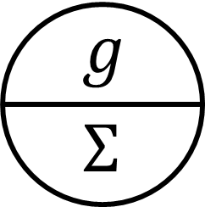
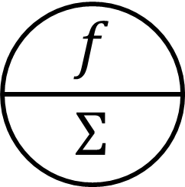



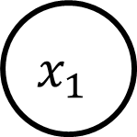


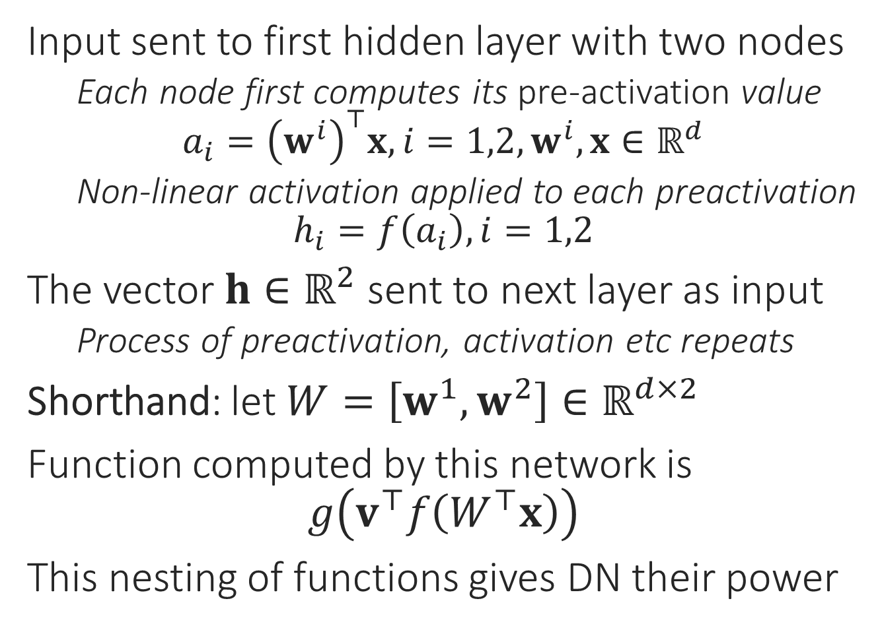


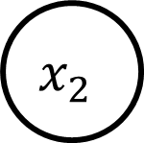



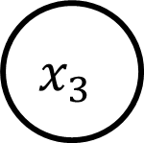


Toy Example
Input sent to first hidden layer with two nodes
Each node first computes its pre-activation value $a_{i}={\left(w^{i}\right)}^{⊤}x,i=1,2,w^{i},x∈ℝ^{d}$
Non-linear activation applied to each preactivation
$$h_{i}=f\left(a_{i}\right),i=1,2$$
The vector $h∈ℝ^{2}$ sent to next layer as input
Process of preactivation, activation etc repeats
Shorthand: let $W=\left[w^{1},w^{2}\right]∈ℝ^{d×2}$
Function computed by this network is $g\left(v^{⊤}f\left(W^{⊤}x\right)\right)$
This nesting of functions gives DN their power
$$v_{1}$$
$$v_{2}$$
$$h_{1}$$
$$h_{2}$$
$$a_{1}$$
$$a_{2}$$
$$w_{12}$$
$$w_{13}$$
$$w_{21}$$
$$w_{22}$$
$$w_{11}$$
$$w_{23}$$
$$x_{1}$$
$$x_{2}$$
$$x_{3}$$

Slide 8





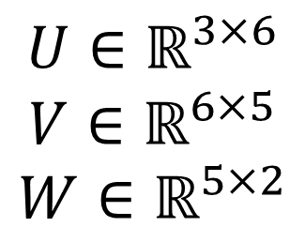

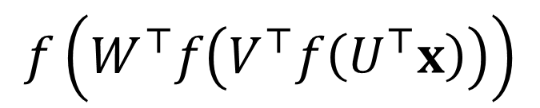
Feedforward Deep Networks
Some networks do allow “skip”, “feedback” connections, others allow activation fn $f$ to change from layer to layer
This architecture is often called a Multi-layered perceptron
$$f$$
$$f$$
One output node needed for binary classfn, regresn, more for multi-label/class
$$W$$
Cannot skip layers in classical FF networks
No “reverse” links allowed
$$V$$
Connections b/w layers usually “dense” – all pairs connected
$$U∈ℝ^{3×6}$$
$$V∈ℝ^{6×5}$$
$$W∈ℝ^{5×2}$$
$$U$$
All weights are learnt
$$f\left(W^{⊤}f\left(V^{⊤}f\left(U^{⊤}x\right)\right)\right)$$

Slide 9
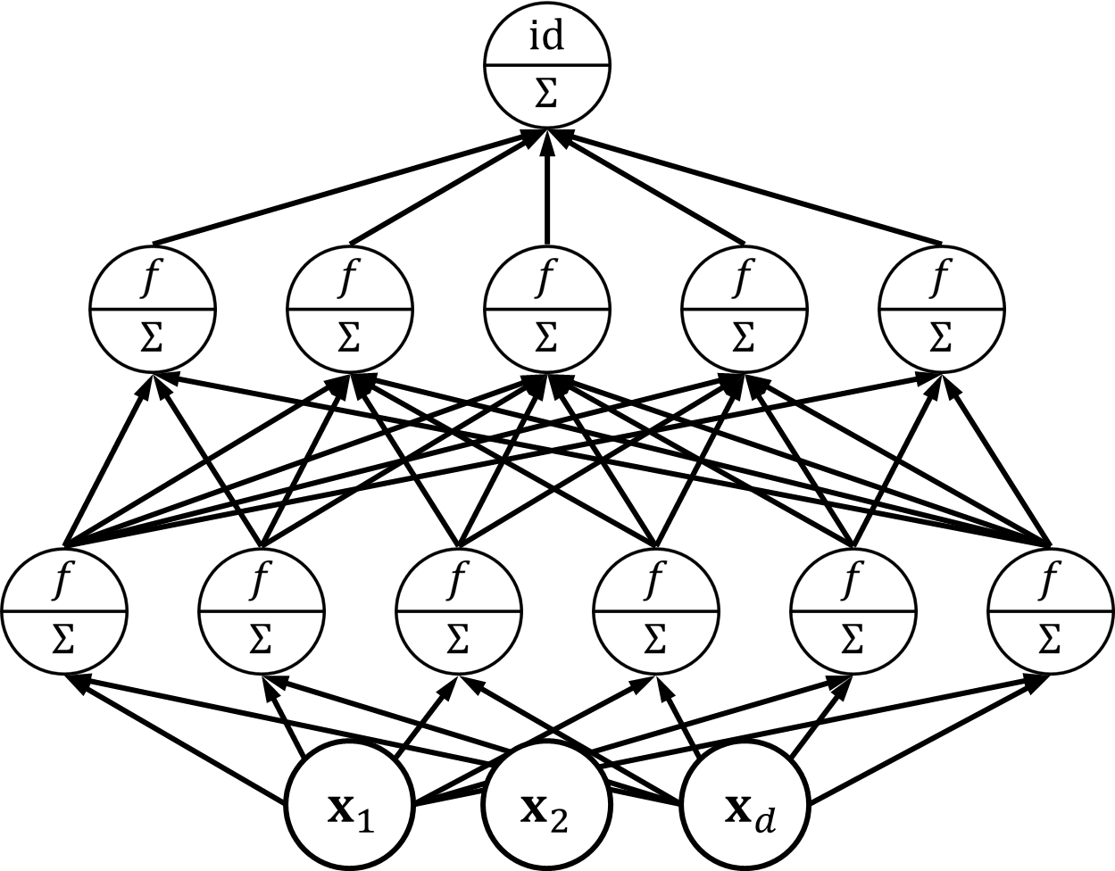

Deep Networks
Output layer
The layered architecture is what makes deep networks “deep”
Lower layers can be interpreted as computing useful features
Networks that learn polynomial etc features exist too – Sum Product Networks (SPN)
Last layer exploits all this hard work to learn a good linear model over them – can have any no. of layers, any no. of nodes in each layer
Kernels throw a large (often infinite) number of features at a problem, deep networks instead try to learn a small number of problem specific features
Easier said that done though ☺
A network having a linear activation function in hidden layers is useless since such a network can only learn a linear function in input
Can collapse, replace all hidden layers with a single connection from i/p to o/p
Even (leaky) ReLU are piecewise linear, not linear – non-linearity is essential
Hidden layer
$$φ\left(x\right)$$
Hidden layer
Input layer

