Slide 1
Deep Learning II
CS771: Introduction to Machine Learning
Purushottam Kar

Slide 2
Announcements
When submitting code for assignment 2 (and filling the Google form), please use the latest group numbers available at the following URL https://web.cse.iitk.ac.in/users/purushot/courses/ml/2019-20-a/material/assn_groups_16Oct2019.pdf
Your group number may have changed due to migrations/mergers
Please mention your group number, as well as names of group members, prominently on the top of the first page of the PDF file you submit to Gradescope.
This is to help us find out the group number when assigning coding question marks on Gradescope
For Assignment 1, graders had to perform a very tedious search by name. Please help them do their task more efficiently

Slide 3
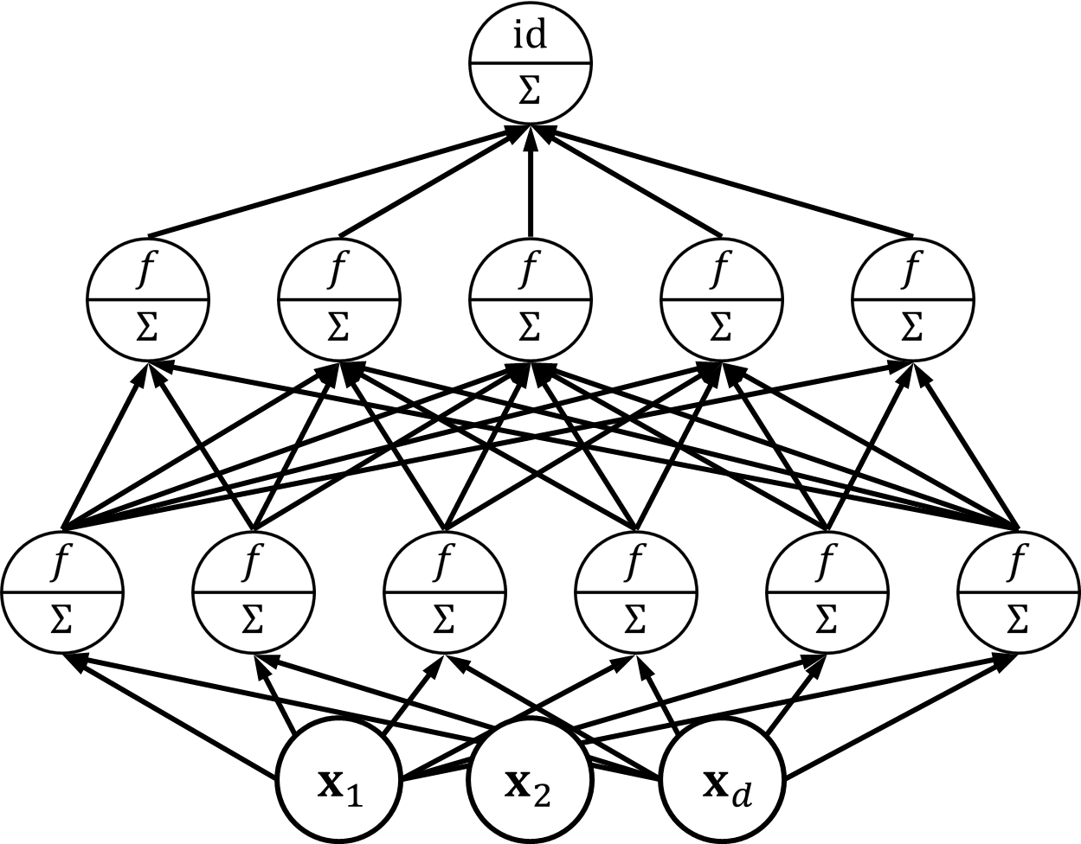

Recap of Last Lecture
Output layer
Neural networks offer a new way to learn non-linear models
Kernels implicitly create a large (infinite) number of features of which only few may be needed to solve problem whereas NN try to learn features themselves
At the top, both kernel methods and NN usually learn a linear model
Kernels do so over static features whereas NN learn model+features jointly
Strictly speaking, NN are parameterized models
However, they are frequently overparameterized – billions of parameters
Almost as good (bad) as non-parametric – bulky models, long train + test times
NN contain layers – I/O layer (1 each) and 0 or more hidden layers
This layering is what makes deep learning “deep”
Job of hidden layers is to learn good features, job of output layer is to learn a good linear model over those features, input layer simply supply input
Hidden layer
$$φ\left(x\right)$$
Hidden layer
Input layer

Slide 4
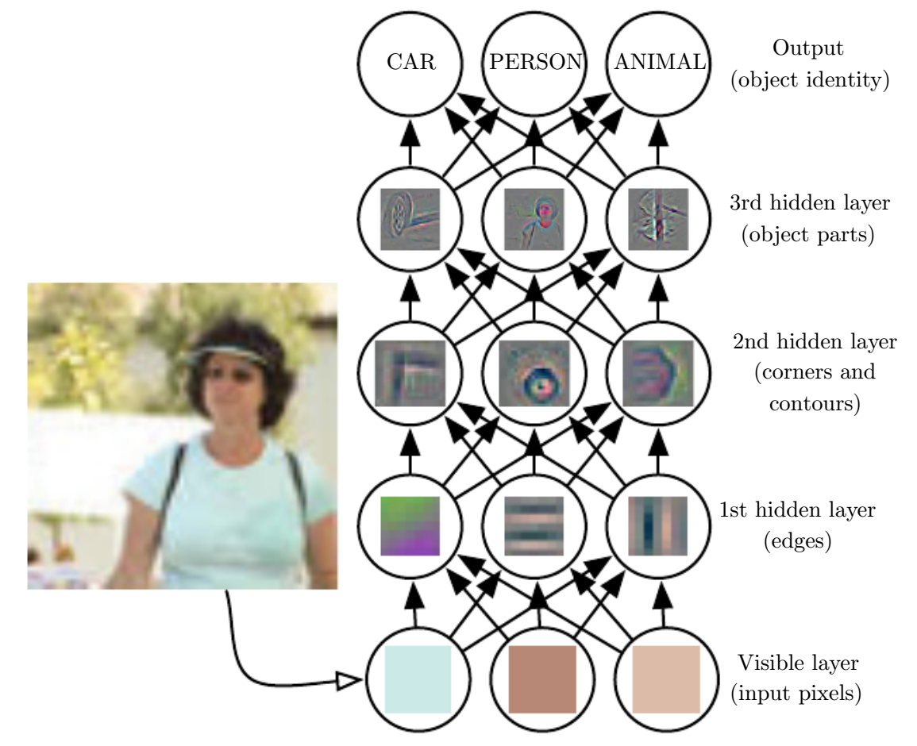
Deep Networks Learn Features
We know what are expected outputs of the o/p layer (they are the train labels). So we say that the o/p layer is “visible”
Hidden representations make it easier for a linear model to perform well
Hidden layers compute latent or “hidden” representations not supplied with train data
Input layer is fed with train features which are also “visible” in train data

Slide 5
Some General Comments
Deep networks are universal i.e. all powerful
Like universal kernels, a “big enough” network can learn any function
Big enough can mean large number of “narrow layers” (i.e. each with few hidden nodes)
Big enough can mean just one impossibly wide hidden layer (shallow and wide)
In practice, coming up with an appropriate architecture is challenging
A lot of current progress in deep learning is due to people coming up with innovative architectures that do very well for various problems
No universal/well accepted rule for architecture design. Once an architecture is successful in a domain e.g. vision, people often reuse that same design
Often, even weights for lower layers reused – only top (few) layers retrained ☺
Training deep networks not very straightforward either
Availability of GPUs speeds things up but several heuristics like dropout, batch normalization etc required to do very well on challenging problems

Slide 6
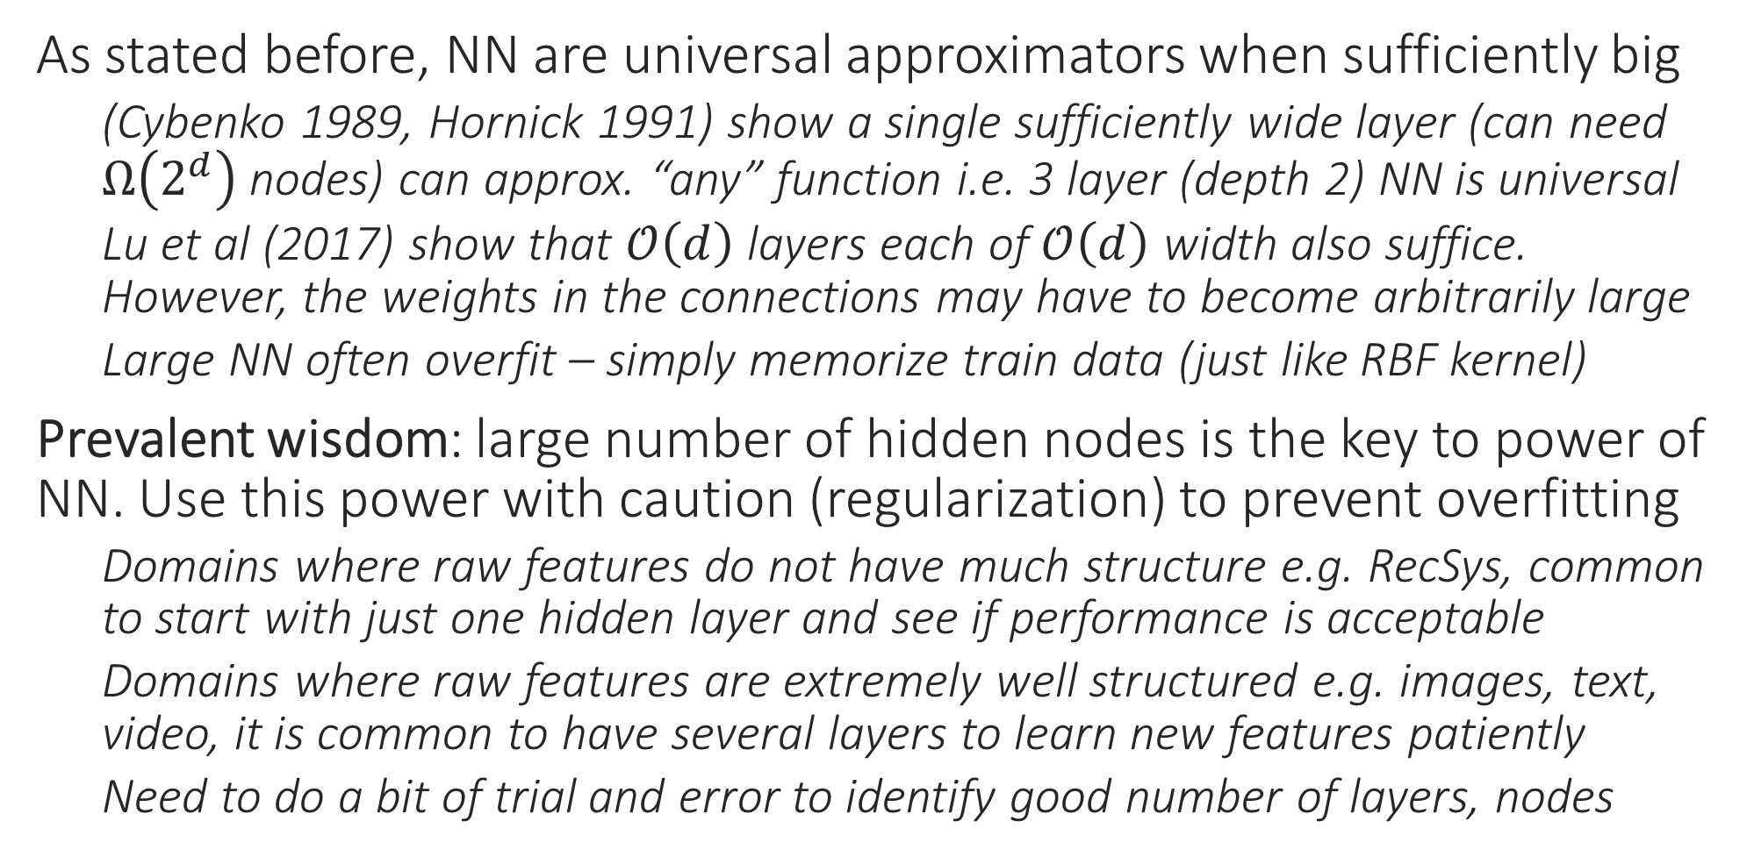
Deep Learning or Wide Learning?
As stated before, NN are universal approximators when sufficiently big
(Cybenko 1989, Hornick 1991) show a single sufficiently wide layer (can need $Ω\left(2^{d}\right)$ nodes) can approx. “any” function i.e. 3 layer (depth 2) NN is universal
Lu et al (2017) show that $𝒪\left(d\right)$ layers each of $𝒪\left(d\right)$ width also suffice. However, the weights in the connections may have to become arbitrarily large
Large NN often overfit – simply memorize train data (just like RBF kernel)
Prevalent wisdom: large number of hidden nodes is the key to power of NN. Use this power with caution (regularization) to prevent overfitting
Domains where raw features do not have much structure e.g. RecSys, common to start with just one hidden layer and see if performance is acceptable
Domains where raw features are extremely well structured e.g. images, text, video, it is common to have several layers to learn new features patiently
Need to do a bit of trial and error to identify good number of layers, nodes

Slide 7
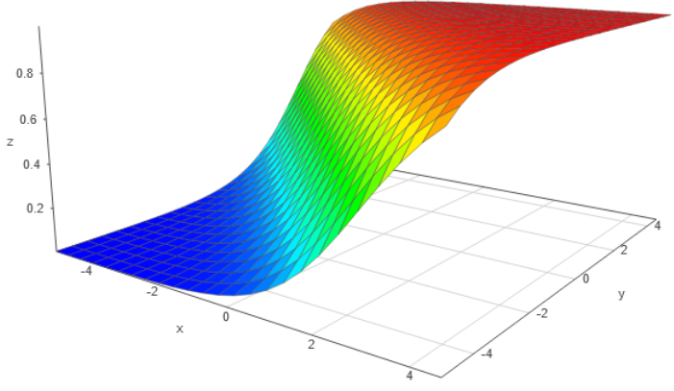
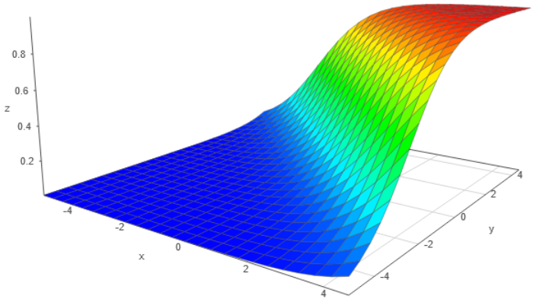
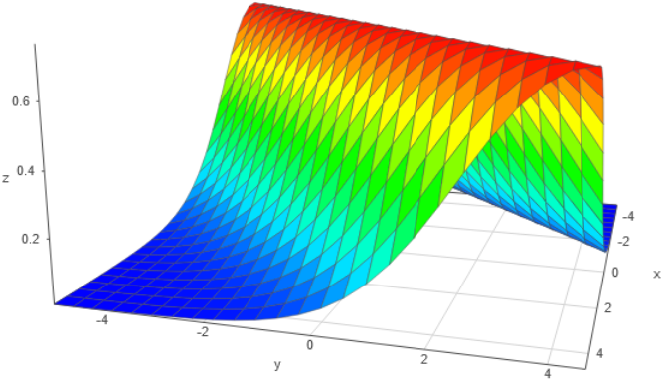
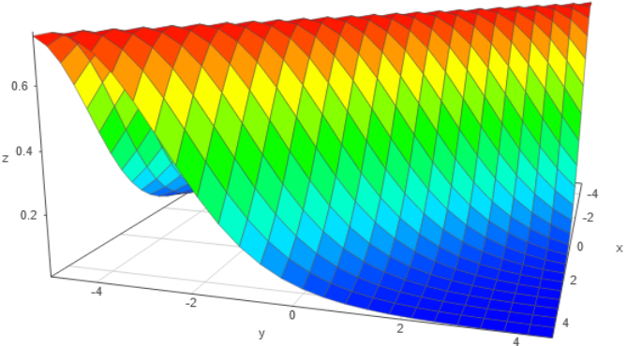
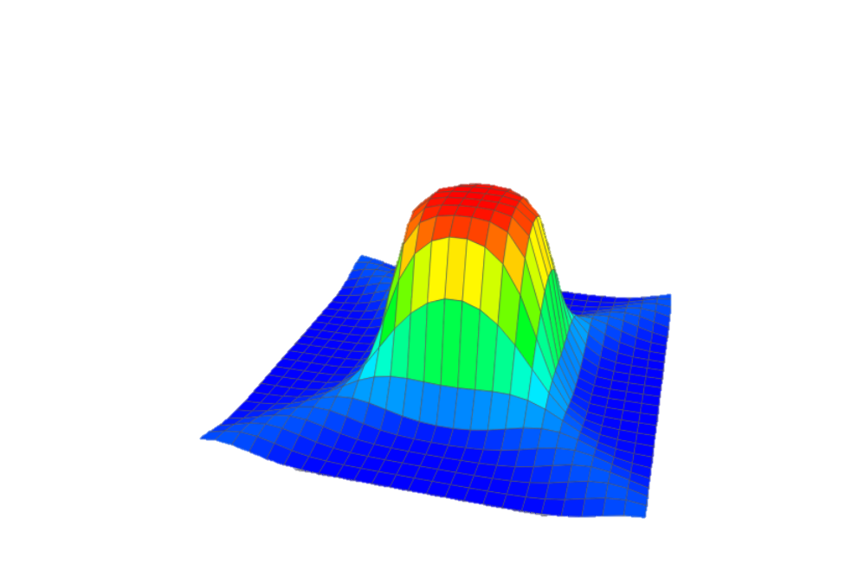
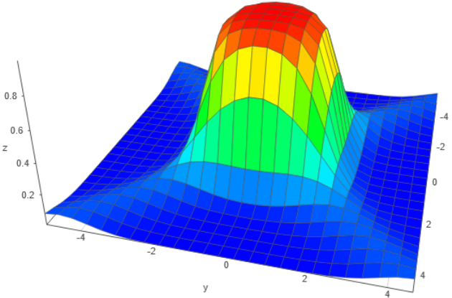

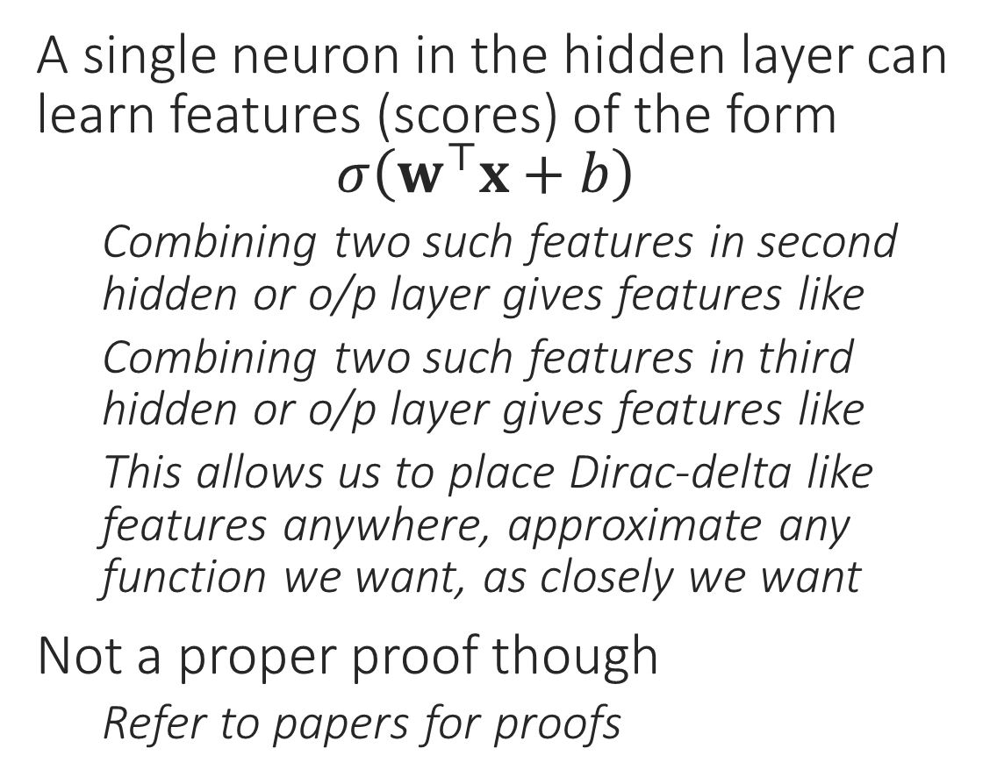

Toy “Proof” for Universality of Sigmoid NN
$$w={\left[1,1\right]}^{⊤}$$
$$b=2$$
$$w={\left[1,1\right]}^{⊤}$$
$$b=−2$$
A single neuron in the hidden layer can learn features (scores) of the form $σ\left(w^{⊤}x+b\right)$
Combining two such features in second hidden or o/p layer gives features like
Combining two such features in third hidden or o/p layer gives features like
This allows us to place Dirac-delta like features anywhere, approximate any function we want, as closely we want
Not a proper proof though
Refer to papers for proofs

Slide 8
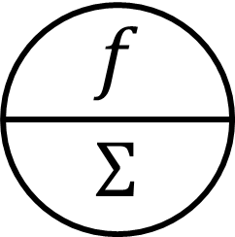

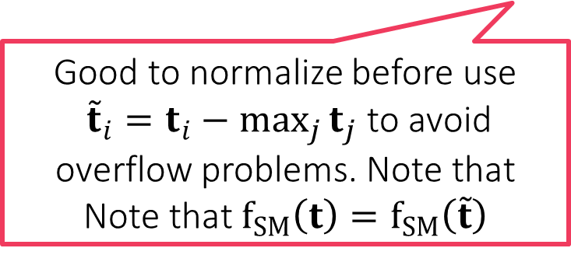
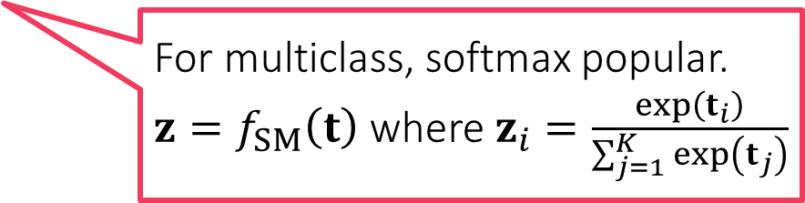
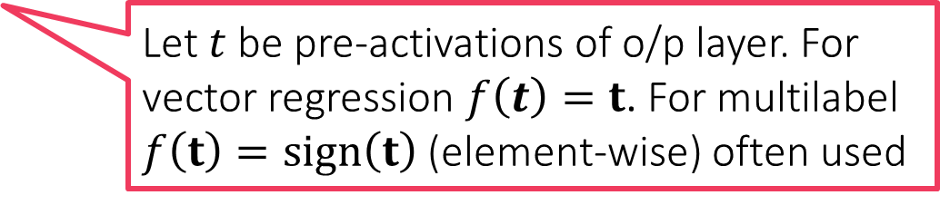
Multi-output Deep Networks
Useful for multi-class/label classfn, ranking, vector regression
Let $t$ be pre-activations of o/p layer. For vector regression $f\left(t\right)=t$. For multilabel $f\left(t\right)=sign\left(t\right)$ (element-wise) often used
For multiclass, softmax popular. $z=f_{SM}\left(t\right)$ where $z_{i}=\frac{\exp\left(t_{i}\right)}{\sum_{j=1}^{K}{\exp\left(t_{j}\right)}}$
Good to normalize before use ${\tilde{t}}_{i}=t_{i}−\max_{j}{t_{j}}$ to avoid overflow problems. Note that Note that $f_{SM}\left(t\right)=f_{SM}\left(\tilde{t}\right)$

Slide 9
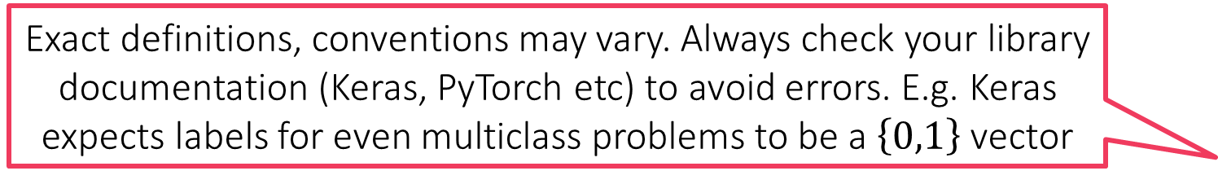
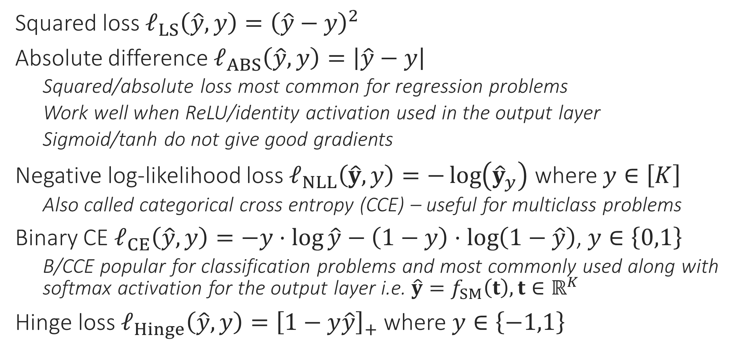
Loss Functions for Deep Learning
Exact definitions, conventions may vary. Always check your library documentation (Keras, PyTorch etc) to avoid errors. E.g. Keras expects labels for even multiclass problems to be a $\left\{0,1\right\}$ vector
Squared loss $ℓ_{LS}\left(\hat{y},y\right)={\left(\hat{y}−y\right)}^{2}$
Absolute difference $ℓ_{ABS}\left(\hat{y},y\right)=\left|\hat{y}−y\right|$
Squared/absolute loss most common for regression problems
Work well when ReLU/identity activation used in the output layer
Sigmoid/tanh do not give good gradients
Negative log-likelihood loss $ℓ_{NLL}\left(\hat{y},y\right)=−\log\left({\hat{y}}_{y}\right)$ where $y∈\left[K\right]$
Also called categorical cross entropy (CCE) – useful for multiclass problems
Binary CE $ℓ_{CE}\left(\hat{y},y\right)=−y⋅\log{\hat{y}}−\left(1−y\right)⋅\log\left(1−\hat{y}\right)$, $y∈\left\{0,1\right\}$
B/CCE popular for classification problems and most commonly used along with softmax activation for the output layer i.e. $\hat{y}=f_{SM}\left(t\right),t∈ℝ^{K}$
Hinge loss $ℓ_{Hinge}\left(\hat{y},y\right)={\left[1−y\hat{y}\right]}_{+}$ where $y∈\left\{−1,1\right\}$

Slide 10
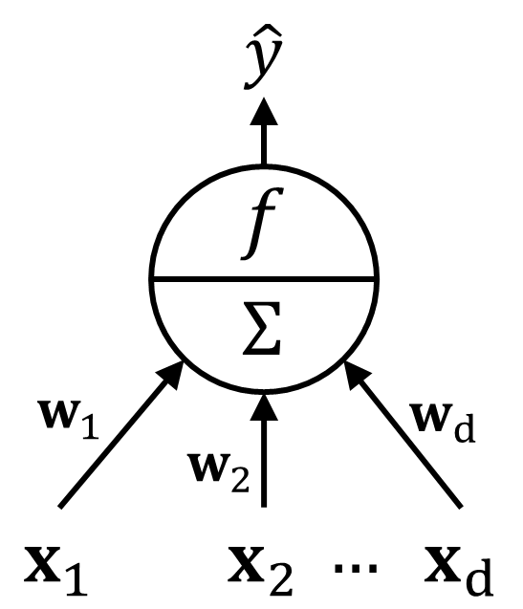



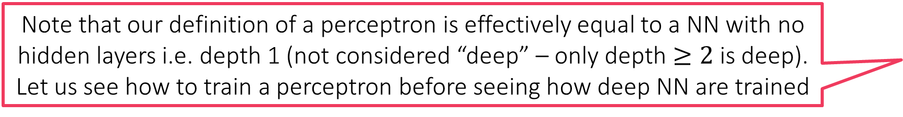
Training a Perceptron
Some texts may state that a perceptron is simply a linear model i.e. it cannot have a wrapper function around the linear model. We are using a broader definition of perceptron in our discussion
Recall that a perceptron is simply an activation function wrapped around a linear model i.e. $\hat{y}=f\left(\left\langle w,x\right\rangle \right)$ i.e. a gen-lin model
Given $\left(x^{1},y^{1}\right),…,\left(x^{n},y^{n}\right), x^{i}∈ℝ^{d}$ and loss fn $ℓ: ℝ×ℝ→ℝ_{+}$, we can train a perceptron by solving the following optimization problem $\arg{\min_{w∈ℝ^{d}}{\frac{1}{n}\sum_{i}^{n}{ℓ\left(f\left(\left\langle w,x^{i}\right\rangle \right),y^{i}\right)}}}=:\arg{\min_{w∈ℝ^{d}}{F\left(w\right)}}$
The training procedure is plain old gradient descent
However, this being a non-convex problem (due to $f$), requires more care
How to find a descent direction?
How to choose a step length?
How to detect convergence?
How to avoid overfitting?
GRADIENT DESCENT
Initialize ${\text{w}}^{0}$
For $t=1, 2,…$
Obtain a descent direction $g^{t}$
Update $w^{t+1}←w^{t}−η_{t}⋅g^{t}$
Repeat until convergence or until tired
Note that our definition of a perceptron is effectively equal to a NN with no hidden layers i.e. depth 1 (not considered “deep” – only depth $≥2$ is deep). Let us see how to train a perceptron before seeing how deep NN are trained

Slide 11
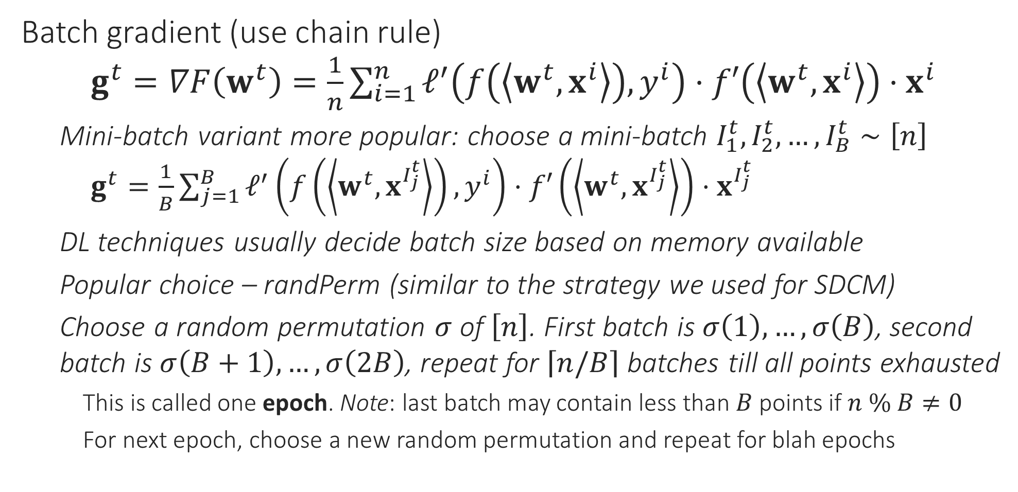
Choosing a Descent Direction
Batch gradient (use chain rule) $g^{t}=∇F\left(w^{t}\right)=\frac{1}{n}\sum_{i=1}^{n}{ℓ^{′}\left(f\left(\left\langle w^{t},x^{i}\right\rangle \right),y^{i}\right)⋅f′\left(\left\langle w^{t},x^{i}\right\rangle \right)}⋅x^{i}$
Mini-batch variant more popular: choose a mini-batch $I_{1}^{t},I_{2}^{t},…,I_{B}^{t}∼\left[n\right]$ $g^{t}=\frac{1}{B}\sum_{j=1}^{B}{ℓ^{′}\left(f\left(\left\langle w^{t},x^{I_{j}^{t}}\right\rangle \right),y^{i}\right)⋅f′\left(\left\langle w^{t},x^{I_{j}^{t}}\right\rangle \right)}⋅x^{I_{j}^{t}}$
DL techniques usually decide batch size based on memory available
Popular choice – randPerm (similar to the strategy we used for SDCM)
Choose a random permutation $σ$ of $\left[n\right]$. First batch is $σ\left(1\right),…,σ\left(B\right)$, second batch is $σ\left(B+1\right),…,σ\left(2B\right)$, repeat for $\left\lceil n/B\right\rceil$ batches till all points exhausted
This is called one epoch. Note: last batch may contain less than $B$ points if $n \% B≠0$
For next epoch, choose a new random permutation and repeat for blah epochs

Slide 12
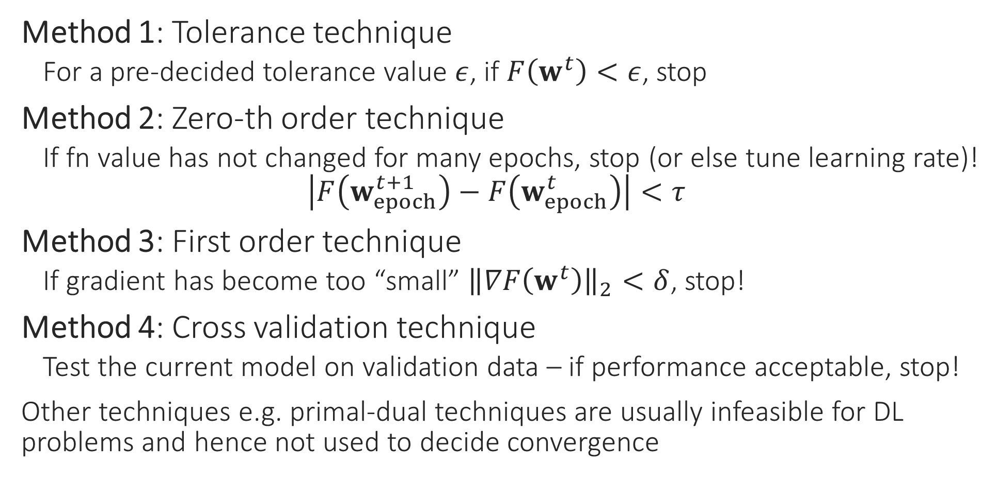
How to detect convergence
Method 1: Tolerance technique
For a pre-decided tolerance value $ε$, if $F\left(w^{t}\right)<ε$, stop
Method 2: Zero-th order technique
If fn value has not changed for many epochs, stop (or else tune learning rate)! $\left|F\left(w_{epoch}^{t+1}\right)−F\left(w_{epoch}^{t}\right)\right|<τ$
Method 3: First order technique
If gradient has become too “small” ${\left\|∇F\left(w^{t}\right)\right\|}_{2}<δ$, stop!
Method 4: Cross validation technique
Test the current model on validation data – if performance acceptable, stop!
Other techniques e.g. primal-dual techniques are usually infeasible for DL problems and hence not used to decide convergence

Slide 13
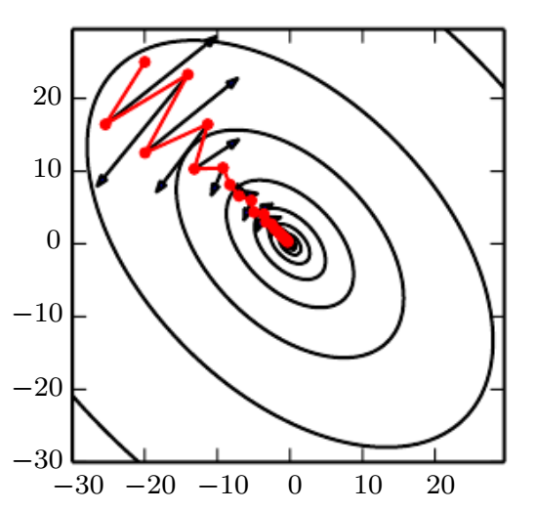
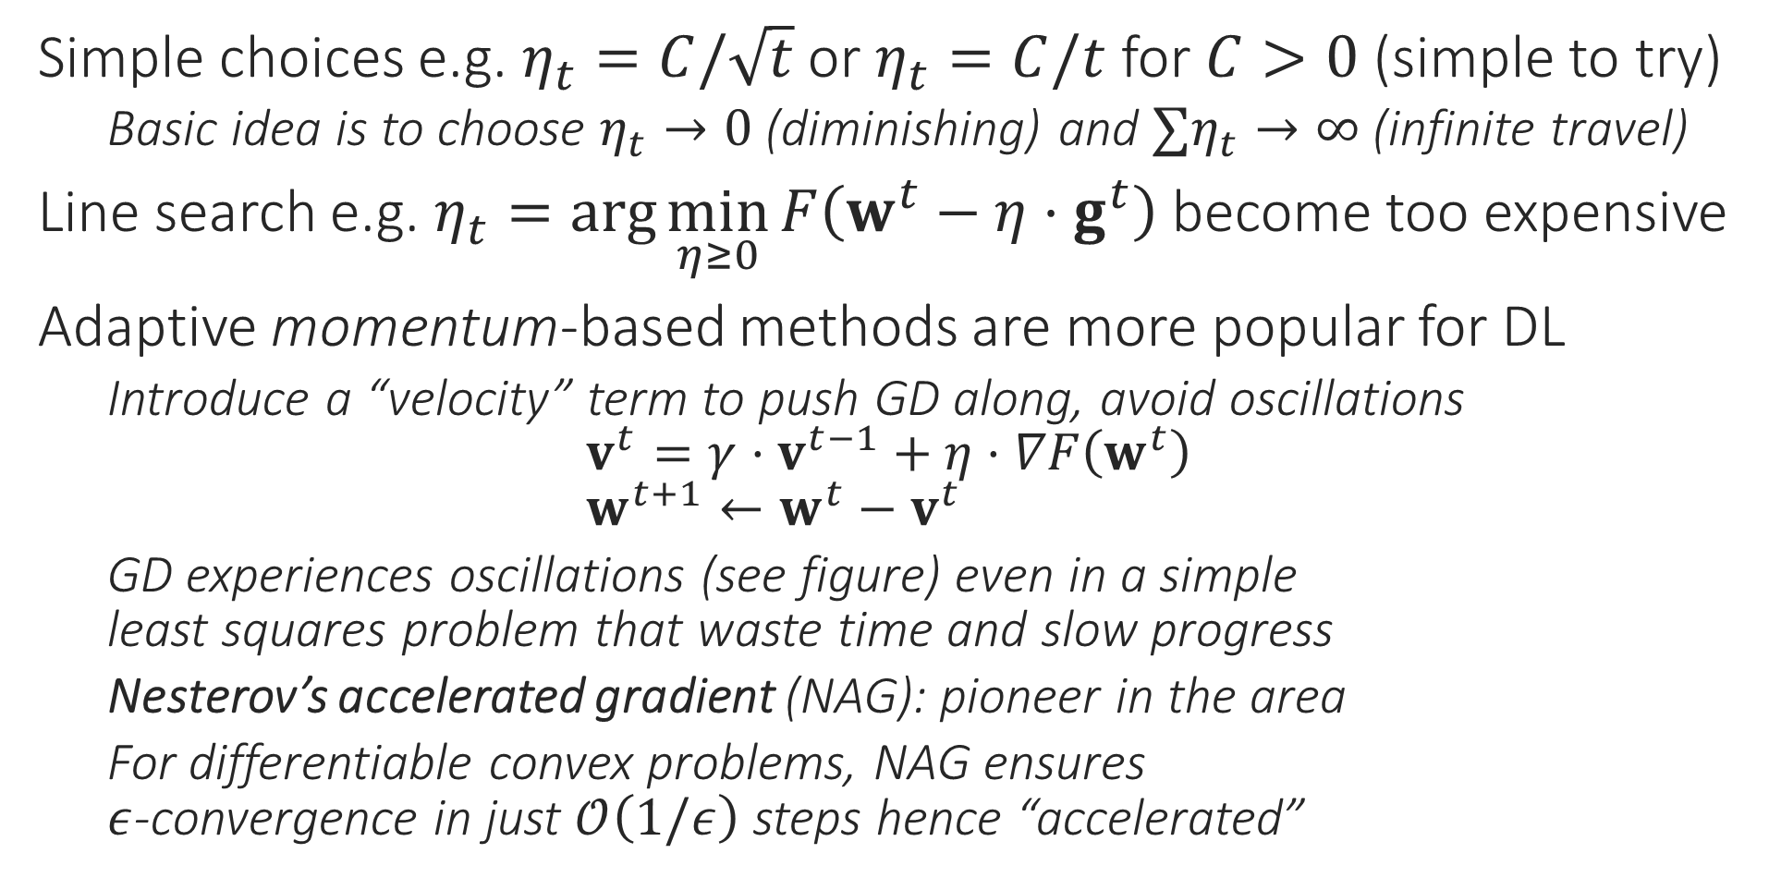
How to decide step length?
Simple choices e.g. $η_{t}=C/\sqrt{t}$ or $η_{t}=C/t$ for $C>0$ (simple to try)
Basic idea is to choose $η_{t}→0$ (diminishing) and $∑η_{t}→∞$ (infinite travel)
Line search e.g. $η_{t}=\arg{\min_{η≥0}{F\left(w^{t}−η⋅g^{t}\right)}}$ become too expensive
Adaptive momentum-based methods are more popular for DL
Introduce a “velocity” term to push GD along, avoid oscillations $v^{t}={γ⋅v}^{t−1}+η⋅∇F\left(w^{t}\right)$ $w^{t+1}←w^{t}−v^{t}$
GD experiences oscillations (see figure) even in a simple least squares problem that waste time and slow progress
Nesterov’s accelerated gradient (NAG): pioneer in the area
For differentiable convex problems, NAG ensures $ε$-convergence in just $𝒪\left(1/ε\right)$ steps hence “accelerated”

Slide 14
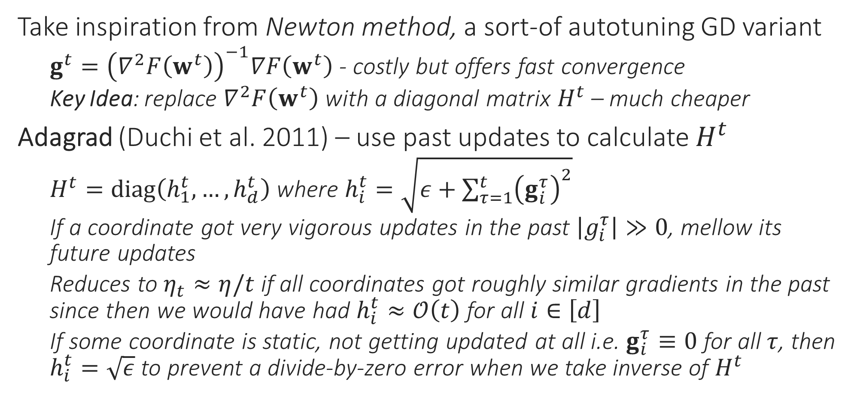
Adaptive Learning Rates
Take inspiration from Newton method, a sort-of autotuning GD variant
$g^{t}={\left(∇^{2}F\left(w^{t}\right)\right)}^{−1}∇F\left(w^{t}\right)$ - costly but offers fast convergence
Key Idea: replace $∇^{2}F\left(w^{t}\right)$ with a diagonal matrix $H^{t}$ – much cheaper
Adagrad (Duchi et al. 2011) – use past updates to calculate $H^{t}$
$H^{t}=diag\left(h_{1}^{t}, …,h_{d}^{t}\right)$ where $h_{i}^{t}=\sqrt{ε+\sum_{τ=1}^{t}{{\left(g_{i}^{τ}\right)}^{2}}}$
If a coordinate got very vigorous updates in the past $\left|g_{i}^{τ}\right|≫0$, mellow its future updates
Reduces to $η_{t}≈η/t$ if all coordinates got roughly similar gradients in the past since then we would have had $h_{i}^{t}≈𝒪\left(t\right)$ for all $i∈\left[d\right]$
If some coordinate is static, not getting updated at all i.e. $g_{i}^{τ}≡0$ for all $τ$, then $h_{i}^{t}=\sqrt{ε}$ to prevent a divide-by-zero error when we take inverse of $H^{t}$

Slide 15
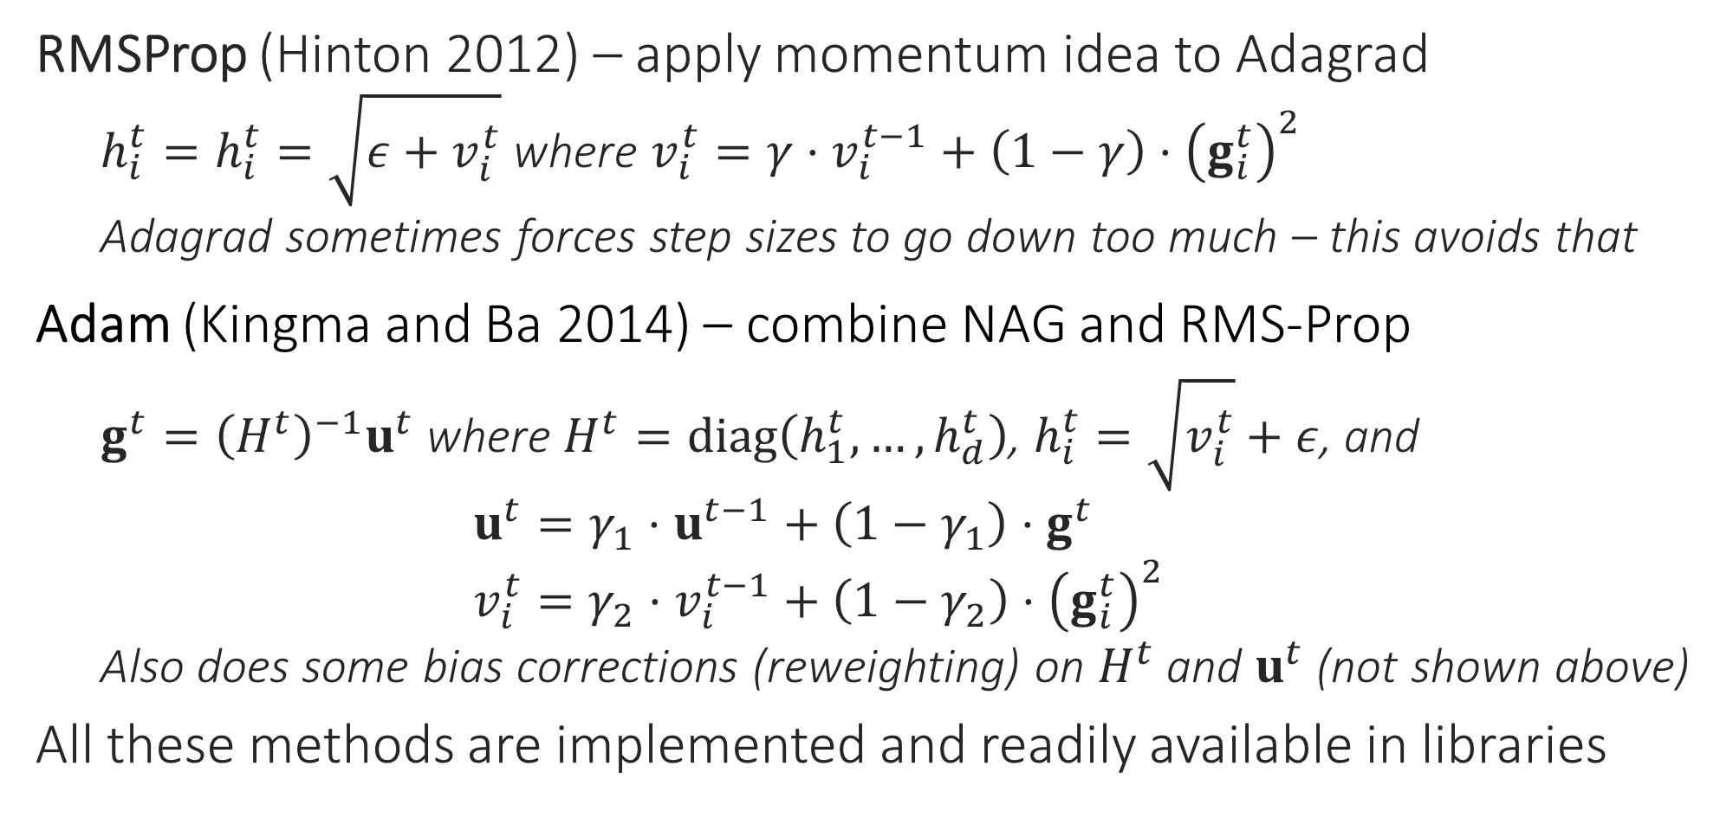
Adaptive Learning Rates
RMSProp (Hinton 2012) – apply momentum idea to Adagrad
$h_{i}^{t}=h_{i}^{t}=\sqrt{{ε+v}_{i}^{t}}$ where $v_{i}^{t}=γ⋅v_{i}^{t−1}+\left(1−γ\right)⋅{\left(g_{i}^{t}\right)}^{2}$
Adagrad sometimes forces step sizes to go down too much – this avoids that
Adam (Kingma and Ba 2014) – combine NAG and RMS-Prop
$g^{t}={\left(H^{t}\right)}^{−1}u^{t}$ where $H^{t}=diag\left(h_{1}^{t},…,h_{d}^{t}\right)$, $h_{i}^{t}=\sqrt{v_{i}^{t}}+ε$, and $u^{t}=γ_{1}⋅u^{t−1}+\left(1−γ_{1}\right)⋅g^{t}$ $v_{i}^{t}=γ_{2}⋅v_{i}^{t−1}+\left(1−γ_{2}\right)⋅{\left(g_{i}^{t}\right)}^{2}$
Also does some bias corrections (reweighting) on $H^{t}$ and $u^{t}$ (not shown above)
All these methods are implemented and readily available in libraries

Slide 16
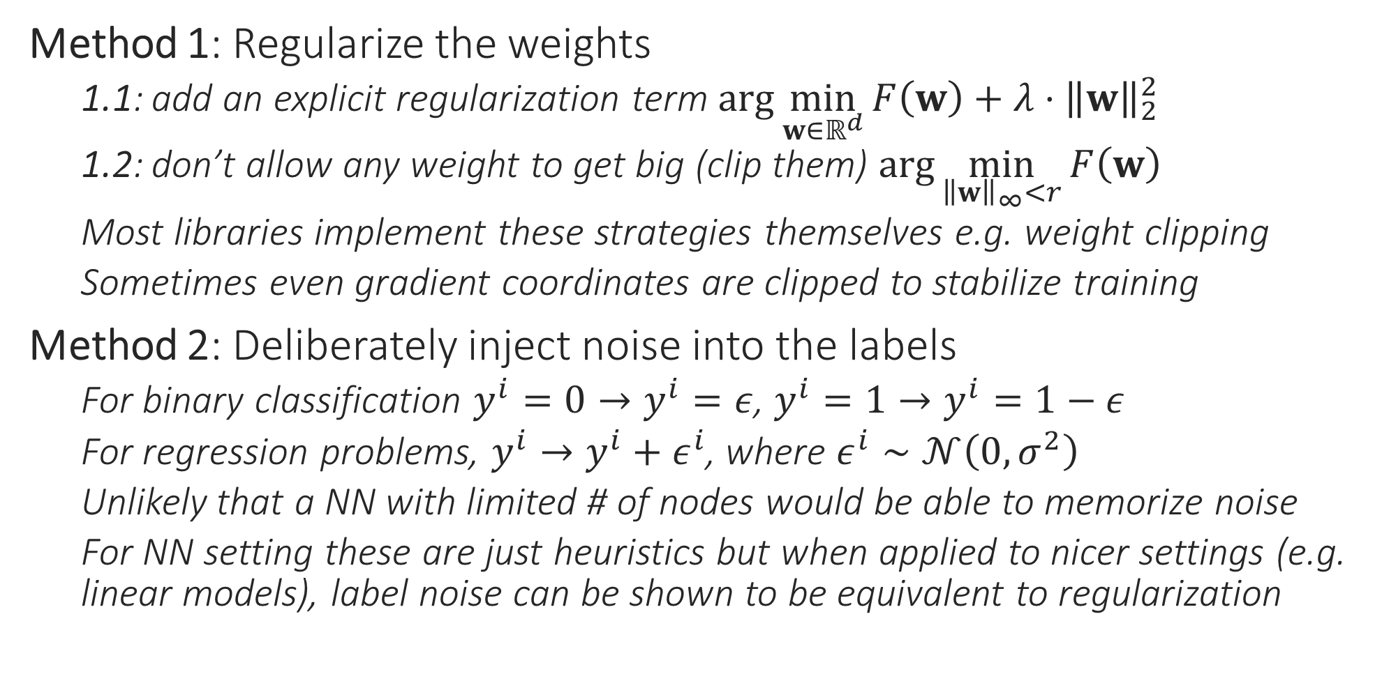
How to prevent overfitting?
Method 1: Regularize the weights
1.1: add an explicit regularization term $\arg{\min_{w∈ℝ^{d}}{F\left(w\right)}}+λ⋅{\left\|w\right\|}_{2}^{2}$
1.2: don’t allow any weight to get big (clip them) $\arg{\min_{{\left\|w\right\|}_{∞}<r}{F\left(w\right)}}$
Most libraries implement these strategies themselves e.g. weight clipping
Sometimes even gradient coordinates are clipped to stabilize training
Method 2: Deliberately inject noise into the labels
For binary classification $y^{i}=0→y^{i}=ε$, $y^{i}=1→y^{i}=1−ε$
For regression problems, $y^{i}→y^{i}+ε^{i}$, where $ε^{i}∼𝒩\left(0,σ^{2}\right)$
Unlikely that a NN with limited # of nodes would be able to memorize noise
For NN setting these are just heuristics but when applied to nicer settings (e.g. linear models), label noise can be shown to be equivalent to regularization

Slide 17
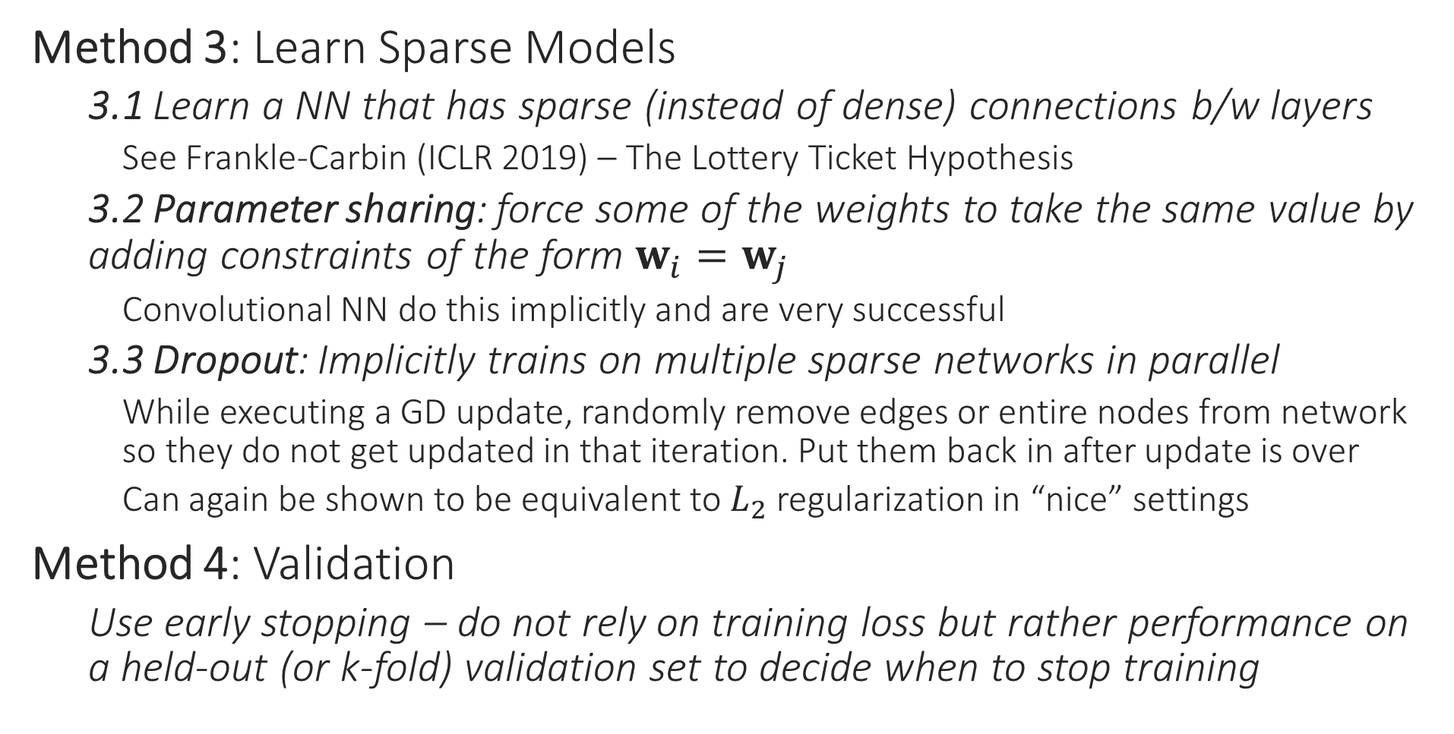
How to prevent overfitting?
Method 3: Learn Sparse Models
3.1 Learn a NN that has sparse (instead of dense) connections b/w layers
See Frankle-Carbin (ICLR 2019) – The Lottery Ticket Hypothesis
3.2 Parameter sharing: force some of the weights to take the same value by adding constraints of the form $w_{i}=w_{j}$
Convolutional NN do this implicitly and are very successful
3.3 Dropout: Implicitly trains on multiple sparse networks in parallel
While executing a GD update, randomly remove edges or entire nodes from network so they do not get updated in that iteration. Put them back in after update is over
Can again be shown to be equivalent to $L_{2}$ regularization in “nice” settings
Method 4: Validation
Use early stopping – do not rely on training loss but rather performance on a held-out (or k-fold) validation set to decide when to stop training

Slide 18
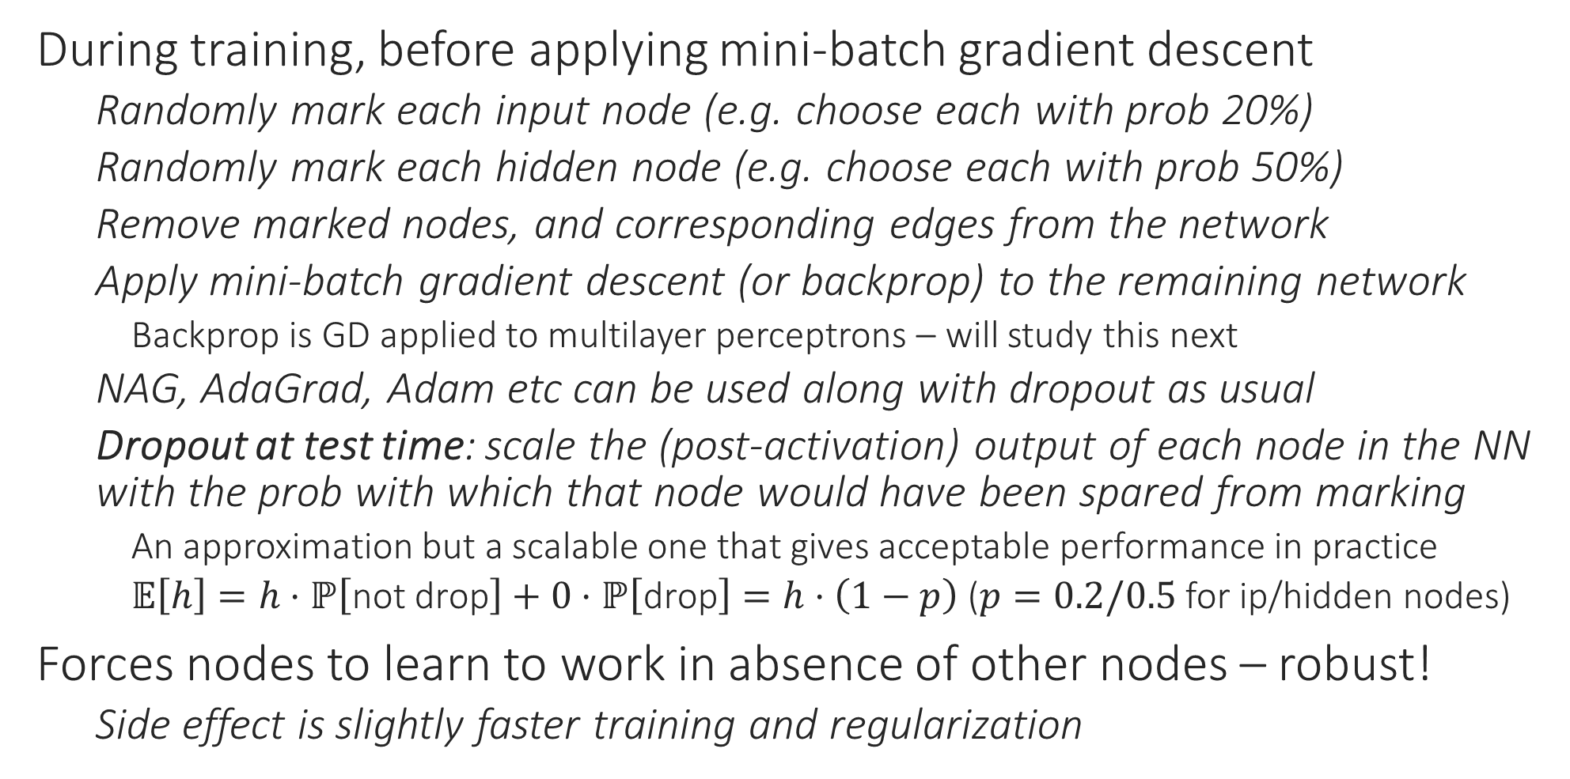
Dropout
During training, before applying mini-batch gradient descent
Randomly mark each input node (e.g. choose each with prob 20%)
Randomly mark each hidden node (e.g. choose each with prob 50%)
Remove marked nodes, and corresponding edges from the network
Apply mini-batch gradient descent (or backprop) to the remaining network
Backprop is GD applied to multilayer perceptrons – will study this next
NAG, AdaGrad, Adam etc can be used along with dropout as usual
Dropout at test time: scale the (post-activation) output of each node in the NN with the prob with which that node would have been spared from marking
An approximation but a scalable one that gives acceptable performance in practice
$𝔼\left[h\right]=h⋅ℙ\left[\text{not} \text{drop}\right]+0⋅ℙ\left[\text{drop}\right]=h⋅\left(1−p\right)$ ($p=0.2/0.5$ for ip/hidden nodes)
Forces nodes to learn to work in absence of other nodes – robust!
Side effect is slightly faster training and regularization

Slide 19



















Dropout at Work
$$id$$
$$id$$
$$id$$
$$id$$
$$id$$
16%
4%
4%
16%
16%
$$id$$
$$x_{1}$$
$$x_{2}$$
$$x_{2}$$
$$x_{1}$$
$$x_{1}$$
$$x_{2}$$
$$x_{1}$$
$$x_{2}$$
$$id$$
$$id$$
$$id$$
$$id$$
$$id$$
4%
4%
4%
4%
28%
$$x_{1}$$
$$x_{2}$$
$$x_{1}$$
$$x_{2}$$
$$x_{1}$$
$$x_{2}$$
In this toy example, 28% NN have no i/p nodes or no path connecting at least one i/p node to the o/p node i.e. cannot apply GD to them. For large networks, it is unlikely that sampling will result in such a disconnected network. In practice a large fraction of nodes do get retained

